Slide 1
NLP is AI-hard (AI-Complete)
Let’s do it!

Slide 2
Text segmentation
dividing written text into meaningful units, such as words, sentences, or topics

Slide 3
Word Segmentation: Tokenization
Whitespace (default, natural word delimiter)
Exceptions
New York
rock ’n’ roll
Contractions: I’m
Japanese | Chinese | Thai don’t have spaces between words
Emoticons: :)
Hashtags: #nlproc.
Notes:
Lattice-Based Recurrent Neural Network Encoders for Neural Machine Translation

Slide 4
Word Boundaries: Tokenization: Space
Split()
Regular Expressions (RE): Finite State Automata
Alphabetical: [a-zA-Z]*
Alpha-numerical: [a-zA-Z0-9]*
Punctuations: Ph.D., AT&T, cap’n
Special Chars
Currency $45.55
Dates (01/02/06)
URLs http://www.stanford.edu
Twitter hashtags #nlproc
Email hfani@uwindsor.ca
Notes:
https://en.wikipedia.org/wiki/Speech_disfluency

Slide 5
What should be considered as word?
Disfluencies in utterances
Fragments: broken-off repeated words: miss- misspelled, you- yourself
Fillers: non-lexical: huh, uh, erm, um, well, so, like, hmm
Punctuations , . : ; ? !
part-of-speech tagging
parsing
speech synthesis
Morphemes:
smallest meaning-bearing unit of a language
‘unlikeliest’ : morphemes [un-], [likely], [-est]
Notes:
https://en.wikipedia.org/wiki/Speech_disfluency
https://www.nltk.org/api/nltk.tokenize.html

Slide 6
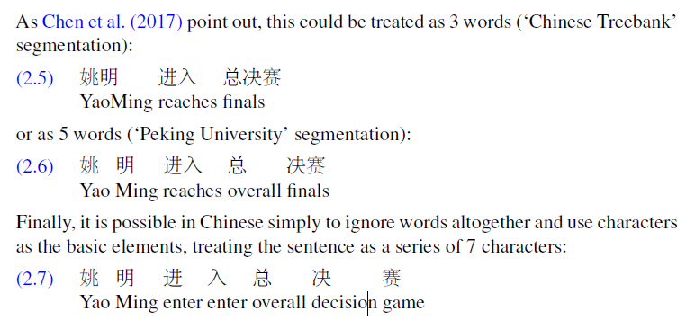
What should be considered as word?
Chinese
Chen, X., Shi, Z., Qiu, X., and Huang, X. (2017). Adversarial multi-criteria learning for Chinese word segmentation. In ACL 2017, 1193–1203.
Notes:
https://en.wikipedia.org/wiki/Speech_disfluency
https://www.nltk.org/api/nltk.tokenize.html

Slide 7
What should be considered as word?
Chinese
characters are at a reasonable semantic level for most applications
most word standards result in a huge vocabulary with large numbers of very rare words
Take characters as words
Notes:
https://en.wikipedia.org/wiki/Speech_disfluency
https://www.nltk.org/api/nltk.tokenize.html

Slide 8
Learn to tokenize

Slide 9
Word→ Subword → Word
Byte-Pair Encoding (BPE)
Sennrich, et al., (2016). Neural machine translation of rare words with subword units. In ACL 2016.
Wordpiece
Wu et al. (2016) Google's neural machine translation system: Bridging the gap between human and machine translation." arXiv.
MaxMatch in BERT
Devlin et al. (2019). BERT: Pretraining of deep bidirectional transformers for language understanding. In NAACL HLT.
SentencePiece
Kudo, T. and Richardson, J. (2018). SentencePiece: A simple and language independent subword tokenizer and detokenizer for neural text processing. In EMNLP.
Notes:
https://en.wikipedia.org/wiki/Speech_disfluency
https://www.nltk.org/api/nltk.tokenize.html

Slide 10
Word→ Subword → Word
Byte-Pair Encoding (BPE)
Sennrich, et al., (2016). Neural machine translation of rare words with subword units. In ACL 2016.
1. Rare words into subword units is sufficient for translation
2. Help to generalize to translate and produce unseen words
100 rare tokens in German training data and they are translatable from English via smaller units!
https://github.com/rsennrich/subword-nmt

Slide 11
Word→ Subword → Word
Byte-Pair Encoding (BPE)
Sennrich, et al., (2016). Neural machine translation of rare words with subword units. In ACL 2016.
Data Compression (Gage, P. (1994). A new algorithm for data compression. The C Users Journal, 12(2), 23–38.)
aaabdaaabac → pair ‘aa’ occurs most often → replace it with a char (byte) that is not used ‘Z’
aaabdaaabac → ZabdZabac; Z=aa
aaabdaaabac → ZabdZabac → pair ‘ab’ occurs most often → replace it with ‘Y’
aaabdaaabac → ZabdZabac → ZYdZYac; Y=ab, Z=aa
aaabdaaabac → ZabdZabac → ZYdZYac → byte pair ‘ZY’ with ‘X’
aaabdaaabac → ZabdZabac → ZYdZYac → XdXac; X=ZY, Y=ab, Z=aa
This data cannot be compressed further by byte pair encoding because there are no pairs of bytes that occur more than 1.

Slide 12
Word→ Subword → Word
Byte-Pair Encoding (BPE)
Sennrich, et al., (2016). Neural machine translation of rare words with subword units. In ACL 2016.
1- Initialization a Dictionary: Tokenize Text or Input an Available One
2- Initialize a Vocabulary: {unique characters} U {end-of-word symbol=</w>}
Loop:
3- get_stats((x, y) ∈ Vocabulary)
4- (A, B) = most frequent pair
4- Vocabulary U {Add most frequent pair=‘AB‘}
5- Dictionary.replace(‘A B’, ‘AB’)

Slide 13
Word→ Subword → Word
Byte-Pair Encoding (BPE)
Dictionary⁽⁰⁾
5: 'l o w </w>'
2: 'l o w e r </w>'
6: 'n e w e s t </w>'
3: 'w i d e s t </w>'
Vocabulary⁽⁰⁾
l, o, w, e, r, t, n, s, d, </w>
get_stats()
0: (l, I)
7: (l, o)
0: (l, w)
….
0: (o, I)
0: (o, o)
…
9: (e, s)
0: (o, </w>)
….
(e, s) = most frequent pair

Slide 14
Word→ Subword → Word
Byte-Pair Encoding (BPE)
Dictionary⁽¹⁾
5: ‘l o w </w>'
2: ‘l o w e r </w>'
6: 'n e w es t </w>'
3: 'w i d es t </w>'
Vocabulary⁽¹⁾
l, o, w, e, r, t, n, s, d, </w>,
es,
get_stats()
0: (l, I)
7: (l, o)
0: (l, w)
….
0: (o, I)
0: (o, o)
…
0: (e, s)
9: (es, t)
….
(es, t) = most frequent pair

Slide 15
Word→ Subword → Word
Byte-Pair Encoding (BPE)
Dictionary⁽²⁾
5: ‘l o w </w>'
2: ‘l o w e r </w>'
6: 'n e w est </w>'
3: 'w i d est </w>'
Vocabulary⁽²⁾
l, o, w, e, r, t, n, s, d, </w>,
es, est,
get_stats()
0: (l, I)
7: (l, o)
0: (l, w)
….
0: (o, I)
0: (o, o)
…
0: (e, s)
0: (es, t)
….
9: (est, </w>)
9: (est, </w>) = most frequent pair

Slide 16
Word→ Subword → Word
Byte-Pair Encoding (BPE)
Dictionary⁽³⁾
5: ‘l o w </w>'
2: ‘l o w e r </w>'
6: 'n e w est</w>'
3: 'w i d est</w>'
Vocabulary⁽³⁾
l, o, w, e, r, t, n, s, d, </w>,
es, est, est</w>
get_stats()
0: (l, I)
7: (l, o)
0: (l, w)
….
0: (o, I)
0: (o, o)
…
0: (e, s)
0: (es, t)
….
0: (est, </w>)
9: (est, </w>) = most frequent pair

Slide 17
Word→ Subword → Word
Byte-Pair Encoding (BPE)
Dictionary^{(n)}
5: ‘l o w </w>'
2: ‘l o w e r </w>'
6: 'n e w est</w>'
3: 'w i d est</w>'
Vocabulary^{(n)}
l, o, w, e, r, t, n, s, d, </w>,
es, est, est</w>, ….
newer
wider
lowest

Slide 18
Word→ Subword → Word
Wordpiece
Wu et al. (2016) Google's neural machine translation system: Bridging the gap between human and machine translation." arXiv.
Same as BPE but:
</w> appears at the beginning of words
merging the pairs that minimizes the language model likelihood of the training data.
Notes:
https://en.wikipedia.org/wiki/Speech_disfluency
https://www.nltk.org/api/nltk.tokenize.html

Slide 19
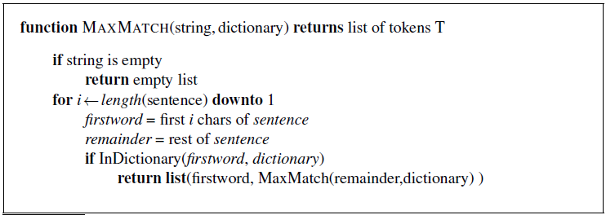
Word→ Subword → Word
MaxMatch in BERT
Devlin et al. (2019). BERT: Pretraining of deep bidirectional transformers for language understanding. In NAACL HLT.
Notes:
https://en.wikipedia.org/wiki/Speech_disfluency
https://www.nltk.org/api/nltk.tokenize.html

Slide 20
Word→ Subword → Word
MaxMatch in BERT
Devlin et al. (2019). BERT: Pretraining of deep bidirectional transformers for language understanding. In NAACL HLT.
unaffable
[u][naffable]
[un][affable]
[una][ffable]
[unaf][fable]
[unaff][able]
[unaffa][ble]
[unaffab][le]
[unaffabl][e]
[unaffable]

Slide 21
Word→ Subword → Word
MaxMatch in BERT
Devlin et al. (2019). BERT: Pretraining of deep bidirectional transformers for language understanding. In NAACL HLT.
unaffable
[u][naffable]
return
[un][affable]
[una][ffable]
[unaf][fable]
[unaff][able]
[unaffa][ble]
[unaffab][le]
[unaffabl][e]
[unaffable]

Slide 22
Word→ Subword → Word
MaxMatch in BERT
Devlin et al. (2019). BERT: Pretraining of deep bidirectional transformers for language understanding. In NAACL HLT.
unaffable
[u][naffable]
[un][affable]
{‘un’} U [affable]
[a][ffable]
[af][fable]
[aff][able]
…
[una][ffable]
[unaf][fable]
[unaff][able]
[unaffa][ble]
[unaffab][le]
[unaffabl][e]
[unaffable]

Slide 23
Word→ Subword → Word
MaxMatch in BERT
Devlin et al. (2019). BERT: Pretraining of deep bidirectional transformers for language understanding. In NAACL HLT.
unaffable → [un, ##aff, ##able]
intention → [intent, ##ion]
unwanted running → [un, ##want, ##ed, runn, ##ing]
## → marking as internal subwords that do not start words

Slide 24
Word→ Subword → Word
SentencePiece
Kudo, T. and Richardson, J. (2018). SentencePiece: A simple and language independent subword tokenizer and detokenizer for neural text processing. In EMNLP.
Whitespace is a character
For languages that space is not a delimiter
Notes:
https://en.wikipedia.org/wiki/Speech_disfluency
https://www.nltk.org/api/nltk.tokenize.html

Slide 25
Sentence Segmentation
Boundary markers
Exclamation (!)
Question (?)
Period (.)
Abbreviation: Mr. or Inc.
Both
The conference was in ABS Inc.
Notes:
Lattice-Based Recurrent Neural Network Encoders for Neural Machine Translation

Slide 26
Sentence Segmentation
Rule-based: Regular Expression
Stanford’s CoreNLP
Combined by word segmentation (Tokenizer)
Learn to Segment
Learn to label (.) as sentence marker or abbreviation marker or both
Notes:
Lattice-Based Recurrent Neural Network Encoders for Neural Machine Translation

Slide 27
Text normalization
Case Folding
mapping everything to lower (upper) case
Lemmatization
converts the word to its meaningful base form, which is called Lemma. The same word may have multiple different Lemmas
Stemming
removes or stems the last few characters of a word, often leading to incorrect meanings and spelling
Autocorrection

Slide 28
Case Folding
Positive Impact: ‘USA’ vs. ‘usa’
+ Information Retrieval
+ Speech Recognition
Negative Impact: ‘US’ the country vs. ‘us’ the pronoun
- Sentiment Analysis
- Text Classification
- Information Extraction
- Machine Translation
Notes:
https://en.wikipedia.org/wiki/Speech_disfluency
https://www.nltk.org/api/nltk.tokenize.html

Slide 29
Lemmatization
Polysemy
the association of one word with two or more distinct meanings
a polyseme is a word or phrase with multiple meanings
A polyseme may have multiple different Lemmas → Disambiguation
Saw as noun vs. Saw → See

Slide 30
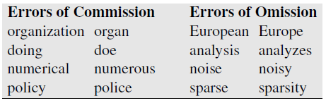
Stemming: simple but crude lemmatization
Mainly consists of chopping off word-final stemming affixes.
Porter, M. F. (1980). An algorithm for suffix stripping. Program, 14(3), 130–137.
A commission error is an error made due to using an item in the wrong context.

Slide 31
Spelling Correction via Minimum Edit Distance
Word Similarity (Distance)
In surface ‘Minimum’ ‘Maximum’
In semantic ‘Attention’ ‘Focus’
In relatedness ‘Company’ ‘Employee’
Levenshtein (1966)
Distance between two sequences is the total cost of changing one to reach the other one
Word Distance:
Insertion (cost = 1)
Deletion (cost = 1)
Substitution (Insertion + Deletion = 2)
Levenshtein, V. I. (1966). Binary codes capable of correcting deletions, insertions, and reversals. Cybernetics and Control Theory (1965).
Notes:
https://phiresky.github.io/levenshtein-demo/

Slide 32
Spelling Correction via Minimum Edit Distance
- Recursive Programing
Two words are similar if they are similar up until the last chars!
natura vs. nature
The distance of two words is the distance of their subwords till the last chars!
D(x[0:n], y[0:n]) = D(x[0:i-1], y[0:i-1]) + the cost of x[i:n] ↔ y[i:n]
i = n
Notes:
https://phiresky.github.io/levenshtein-demo/

Slide 33
Spelling Correction via Minimum Edit Distance
- Recursive Programing
D(x[0:n], y[0:n]) = D(x[0:i-1], y[0:i-1]) + the cost of x[i:n] ↔ y[i:n]
i = n
D([natura], D[nature])
D([natur], D[natur]) + [a] ↔ y[e]
Notes:
https://phiresky.github.io/levenshtein-demo/

Slide 34
Spelling Correction via Minimum Edit Distance
- Recursive Programing
D(x[0:n], y[0:n]) = D(x[0:i-1], y[0:i-1]) + the cost of x[i:n] ↔ y[i:n]
i = n
D([natura], D[nature])
D([natur], D[natur]) + [a] ↔ y[e]
D([natu], D[natu]) + [r] ↔ y[r]
Notes:
https://phiresky.github.io/levenshtein-demo/

Slide 35
Spelling Correction via Minimum Edit Distance
- Recursive Programing
D(x[0:n], y[0:n]) = D(x[0:i-1], y[0:i-1]) + the cost of x[i:n] ↔ y[i:n]
i = n
D([natura], D[nature])
D([natur], D[natur]) + [a] ↔ y[e]
D([natu], D[natu]) + [r] ↔ y[r]
D([nat], D[nat]) + [u] ↔ y[u]
D([na], D[na]) + [t] ↔ y[t]
D([n], D[n]) + [a] ↔ y[a]
D([], D[]) + [n] ↔ y[n]
D([], D[]) = 0
Notes:
https://phiresky.github.io/levenshtein-demo/

Slide 36
Spelling Correction via Minimum Edit Distance
- Recursive Programing
D(x[0:n], y[0:n]) = D(x[0:i-1], y[0:i-1]) + the cost of x[i:n] ↔ y[i:n]
i = n
D([natura], D[nature])
D([natur], D[natur]) + [a] ↔ y[e]
D([natu], D[natu]) + [r] ↔ y[r]
D([nat], D[nat]) + [u] ↔ y[u]
D([na], D[na]) + [t] ↔ y[t]
D([n], D[n]) + [a] ↔ y[a]
D([], D[]) + [n] ↔ y[n]
D([], D[]) = 0
Notes:
https://phiresky.github.io/levenshtein-demo/

Slide 37
Spelling Correction via Minimum Edit Distance
- Recursive Programing
D(x[0:n], y[0:n]) = D(x[0:i-1], y[0:i-1]) + the cost of x[i:n] ↔ y[i:n]
i = n
D([natura], D[nature])
D([natur], D[natur]) + [a] ↔ y[e]
D([natu], D[natu]) + [r] ↔ y[r]
D([nat], D[nat]) + [u] ↔ y[u]
D([na], D[na]) + [t] ↔ y[t]
D([n], D[n]) + [a] ↔ y[a]
0 + [n] ↔ y[n]
D([], D[]) = 0
Notes:
https://phiresky.github.io/levenshtein-demo/

Slide 38
Spelling Correction via Minimum Edit Distance
- Recursive Programing
D(x[0:n], y[0:n]) = D(x[0:i-1], y[0:i-1]) + the cost of x[i:n] ↔ y[i:n]
i = n
D([natura], D[nature])
D([natur], D[natur]) + [a] ↔ y[e]
D([natu], D[natu]) + [r] ↔ y[r]
D([nat], D[nat]) + [u] ↔ y[u]
D([na], D[na]) + [t] ↔ y[t]
D([n], D[n]) + [a] ↔ y[a]
0 + 0
D([], D[]) = 0
Notes:
https://phiresky.github.io/levenshtein-demo/

Slide 39
Spelling Correction via Minimum Edit Distance
- Recursive Programing
D(x[0:n], y[0:n]) = D(x[0:i-1], y[0:i-1]) + the cost of x[i:n] ↔ y[i:n]
i = n
D([natura], D[nature])
D([natur], D[natur]) + [a] ↔ y[e]
D([natu], D[natu]) + [r] ↔ y[r]
D([nat], D[nat]) + [u] ↔ y[u]
D([na], D[na]) + [t] ↔ y[t]
0 + [a] ↔ y[a]
0 + 0
D([], D[]) = 0
Notes:
https://phiresky.github.io/levenshtein-demo/

Slide 40
Spelling Correction via Minimum Edit Distance
- Recursive Programing
D(x[0:n], y[0:n]) = D(x[0:i-1], y[0:i-1]) + the cost of x[i:n] ↔ y[i:n]
i = n
D([natura], D[nature])
0 + [a] ↔ y[e]
0 + 0
0 + 0
0 + 0
0 + 0
0 + 0
D([], D[]) = 0
Notes:
https://phiresky.github.io/levenshtein-demo/

Slide 41
Spelling Correction via Minimum Edit Distance
- Recursive Programing
D(x[0:n], y[0:n]) = D(x[0:i-1], y[0:i-1]) + the cost of x[i:n] ↔ y[i:n]
i = n
D([natura], D[nature])
0 + 2
0 + 0
0 + 0
0 + 0
0 + 0
0 + 0
D([], D[]) = 0
Notes:
https://phiresky.github.io/levenshtein-demo/

Slide 42
Spelling Correction via Minimum Edit Distance
- Recursive Programing
D(x[0:n], y[0:n]) = D(x[0:i-1], y[0:i-1]) + the cost of x[i:n] ↔ y[i:n]
i = n
D([natura], D[nature]) = 2
Notes:
https://phiresky.github.io/levenshtein-demo/

Slide 43
Spelling Correction via Minimum Edit Distance
- Recursive Programing
Two words are similar if they are similar up until the last chars!
natural vs. naturl_
natur?l vs. naturl_
D([natural], [naturl_]) = D([natura], [naturl]) + [l] ↔ [_]
D([natur], [natur]) + [a] ↔ [l]
Notes:
https://phiresky.github.io/levenshtein-demo/

Slide 44
Spelling Correction via Minimum Edit Distance
- Recursive Programing
Two words are similar if they are similar up until the last chars!
natural vs. naturl_
D([natural], [naturl_]) = D([natura], [naturl]) + [l] ↔ [_]
0 + [a] ↔ [l]
Notes:
https://phiresky.github.io/levenshtein-demo/

Slide 45
Spelling Correction via Minimum Edit Distance
- Recursive Programing
Two words are similar if they are similar up until the last chars!
natural vs. naturl_
D([natural], [naturl_]) = 2 + [l] ↔ [_]
0 + 2
Notes:
https://phiresky.github.io/levenshtein-demo/

Slide 46
Spelling Correction via Minimum Edit Distance
- Recursive Programing
Two words are similar if they are similar up until the last chars!
natural vs. naturl_
natur?l vs. naturl_
D([natural], [naturl_]) = 2 + 1 = 3
Notes:
https://phiresky.github.io/levenshtein-demo/

Slide 47
Spelling Correction via Minimum Edit Distance
- Recursive Programing
Two words are similar if they are similar up until the last chars!
natural vs. naturl_
D([natural], [naturl_]) = D([natura], [natur]) + [l] ↔ [l]
D([natur], [natur]) + [a] ↔ []
Notes:
https://phiresky.github.io/levenshtein-demo/

Slide 48
Spelling Correction via Minimum Edit Distance
- Recursive Programing
Two words are similar if they are similar up until the last chars!
natural vs. naturl_
D([natural], [naturl_]) = D([natura], [natur]) + [l] ↔ [l]
0 + [a] ↔ []
Notes:
https://phiresky.github.io/levenshtein-demo/

Slide 49
Spelling Correction via Minimum Edit Distance
- Recursive Programing
Two words are similar if they are similar up until the last chars!
natural vs. naturl_
D([natural], [naturl_]) = 1 + [l] ↔ [l]
0 + 1
Notes:
https://phiresky.github.io/levenshtein-demo/

Slide 50
Spelling Correction via Minimum Edit Distance
- Recursive Programing
Two words are similar if they are similar up until the last chars!
natural vs. naturl_
D([natural], [naturl_]) = 1 + 0 = 1
Notes:
https://phiresky.github.io/levenshtein-demo/

Slide 51
Spelling Correction via Minimum Edit Distance
- Recursive Programing
D(x[0:n], y[0:n]) = D(x[0:i-1], y[0:i-1]) + the cost of x[i:n] ↔ y[i:n]
D(x[0:n], y[0:n]) = D(x[0:i], y[0:i-1]) + the cost of x[i+1:n] ↔ y[i:n]
Notes:
https://phiresky.github.io/levenshtein-demo/

Slide 52
Spelling Correction via Minimum Edit Distance
- Recursive Programing
D(x[0:n], y[0:n]) = D(x[0:i-1], y[0:i-1]) + the cost of x[i:n] ↔ y[i:n]
D(x[0:n], y[0:n]) = D(x[0:i], y[0:i-1]) + the cost of x[i+1:n] ↔ y[i:n]
D(x[0:n], y[0:n]) = D(x[0:i-1], y[0:i]) + the cost of x[i:n] ↔ y[i+1:n]
Notes:
https://phiresky.github.io/levenshtein-demo/

Slide 53
Spelling Correction via Minimum Edit Distance
- Recursive Programing
application | aplikatiion | Init
[ap]p[lication] | [ap][likatiion] → [ap]plikatiion | Insert (1)
[appli]c[ation] | [appli]k[atiion] → [appli]c[atiion] | Substitution (2)
[applicati][on] | [applicati]i[on] → [applicati][on] | Delete (1)
[application] | [application] | 1+2+1 = 4
Notes:
https://phiresky.github.io/levenshtein-demo/

Slide 54
Spelling Correction via Minimum Edit Distance
- Recursive Programing
D(x[0:n], y[0:n]) = min{
D(x[0:i-1], y[0:i-1]) + the cost of x[i:n] ↔ y[i:n]
D(x[0:i], y[0:i-1]) + the cost of x[i+1:n] ↔ y[i:n]
D(x[0:i-1], y[0:i]) + the cost of x[i:n] ↔ y[i+1:n]
}
Notes:
https://phiresky.github.io/levenshtein-demo/

Slide 55
Spelling Correction via Minimum Edit Distance
- Recursive Programing
D(x[0:n], y[0:n]) = min{
D(x[0:i-1], y[0:i-1]) + the cost of x[i:n] ↔ y[i:n]
D(x[0:i], y[0:i-1]) + the cost of x[i+1:n] ↔ y[i:n]
D(x[0:i-1], y[0:i]) + the cost of x[i:n] ↔ y[i+1:n]
}
Does not work! (why?)
Notes:
https://phiresky.github.io/levenshtein-demo/

Slide 56
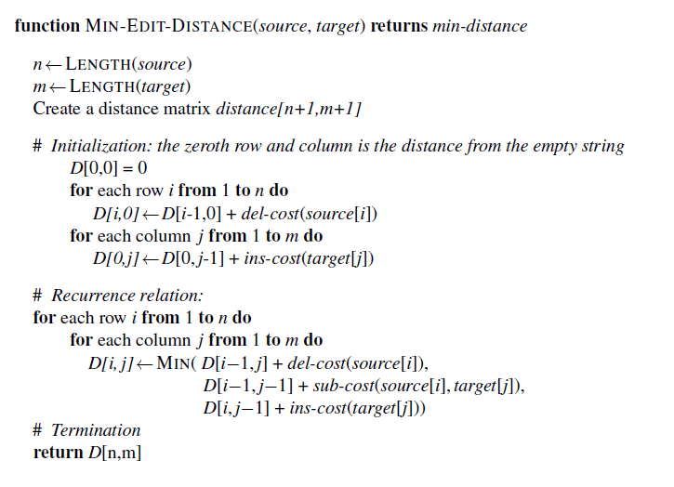
Spelling Correction via Minimum Edit Distance
Levenshtein (1966)
Notes:
https://phiresky.github.io/levenshtein-demo/

Slide 57
Spelling Correction via Minimum Edit Distance
i
 | a | p | p | l | i | c | a | t | i | o | n
a
p
l
i
k
a
t
i
i
n
D(x[0:i], y[0:j]) = min{
D(x[0:i-1], y[0:j-1]) + x[i] ↔ y[j]
D(x[0:i], y[0:j-1]) + 1
D(x[0:i-1], y[0:j]) + 1
}
j
x[i] ≠ y[j] → 2
x[i] = y[j] → 0

Slide 58
Spelling Correction via Minimum Edit Distance
i
 | a | p | p | l | i | c | a | t | i | o | n
a
p
l
i
k
a
t
i
i
n
D(x[0:i], y[0:j]) = min{
D(x[0:i-1], y[0:j-1]) + x[i] ↔ y[j]
D(x[0:i], y[0:j-1]) + 1
D(x[0:i-1], y[0:j]) + 1
}
j
x[i] ≠ y[j] → 2
x[i] = y[j] → 0
D(x[0:n], y[0:m])

Slide 59
Spelling Correction via Minimum Edit Distance
 | a | p | p | l | i | c | a | t | i | o | n
a | 0 | 1 | 2 | 3 | 4 | 5 | 6 | 7 | 8 | 9 | 10
p | 1
l | 2
i | 3
k | 4
a | 5
t | 6
i | 7
i | 8
n | 9
D(x[0:n], y[0:m])

Slide 60
Spelling Correction via Minimum Edit Distance
 | a | p | p | l | i | c | a | t | i | o | n
a | 0 | 1 | 2 | 3 | 4 | 5 | 6 | 7 | 8 | 9 | 10
p | 1 | 0 | 1 | 2 | 3 | 4 | 5 | 6 | 7 | 8 | 9
l | 2
i | 3
k | 4
a | 5
t | 6
i | 7
i | 8
n | 9
Backtrace:
1. No Change
2. No Change
3. Insert
4. Insert
5. Insert
6. Insert
7. …
D(x[0:n], y[0:m])

Slide 61
Spelling Correction via Minimum Edit Distance
 | a | p | p | l | i | c | a | t | i | o | n
a | 0 | 1 | 2 | 3 | 4 | 5 | 6 | 7 | 8 | 9 | 10
p | 1 | 0 | 1 | 2 | 3 | 4 | 5 | 6 | 7 | 8 | 9
l | 2 | 1
i | 3 | 2
k | 4 | 3
a | 5 | 4
t | 6 | 5
i | 7 | 6
i | 8 | 7
n | 9 | 8
Backtrace:
1. No Change
2. No Change
3. Insert
4. Insert
5. Insert
6. Insert
7. …
D(x[0:n], y[0:m])

Slide 62
Spelling Correction via Minimum Edit Distance
 | a | p | p | l | i | c | a | t | i | o | n
a | 0 | 1 | 2 | 3 | 4 | 5 | 6 | 7 | 8 | 9 | 10
p | 1 | 0 | 1 | 2 | 3 | 4 | 5 | 6 | 7 | 8 | 9
l | 2 | 1 | 2 | 1
i | 3 | 2 | 3 | 2
k | 4 | 3
a | 5 | 4
t | 6 | 5
i | 7 | 6
i | 8 | 7
n | 9 | 8
Backtrace:
1. No Change
2. No Change
3. Insert
4. Delete
D(x[0:n], y[0:m])

Slide 63
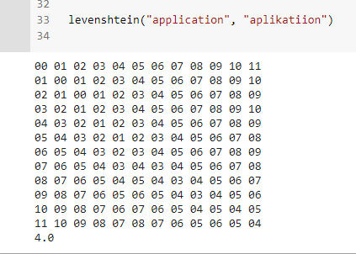
Spelling Correction via Minimum Edit Distance

Slide 64
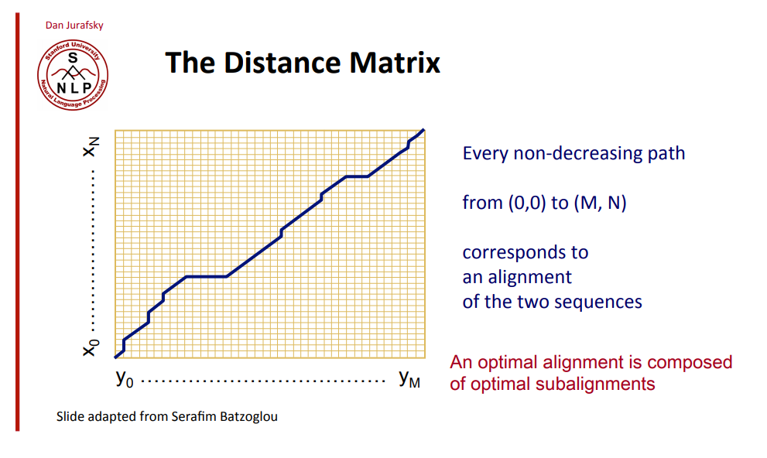
Spelling Correction via Minimum Edit Distance

Slide 65
Spelling Correction via Minimum Edit Distance
Levenshtein (1966): Complexity
Time: ?
Space: ?

Slide 66
Spelling Correction via Minimum Edit Distance
Levenshtein (1966): Complexity: Filling the matrix
Time: O(n*m)
Space: O(n*m)

Slide 67
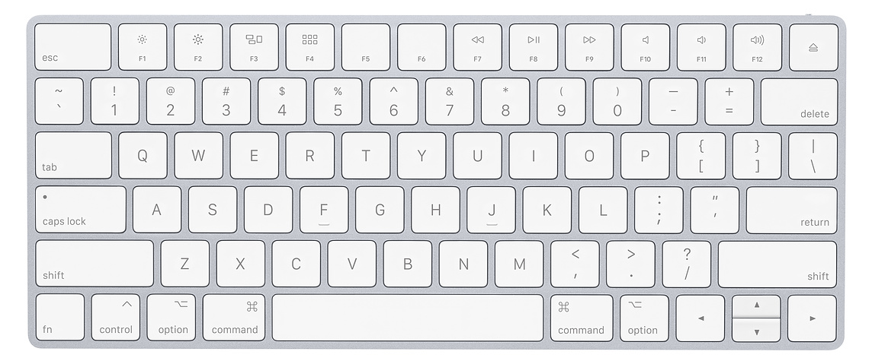
Learn to Spelling Correction
Keyboard
Online texts (e.g., emails) depends on keyboards.
Misspells happens more on characters that sit next to each other on the keyboard.
Speed of typing is a source of error → Transposition: ‘Desing’ ‘Design’
Weighted Minimum Edit Distance
Notes:
https://phiresky.github.io/levenshtein-demo/

Slide 68
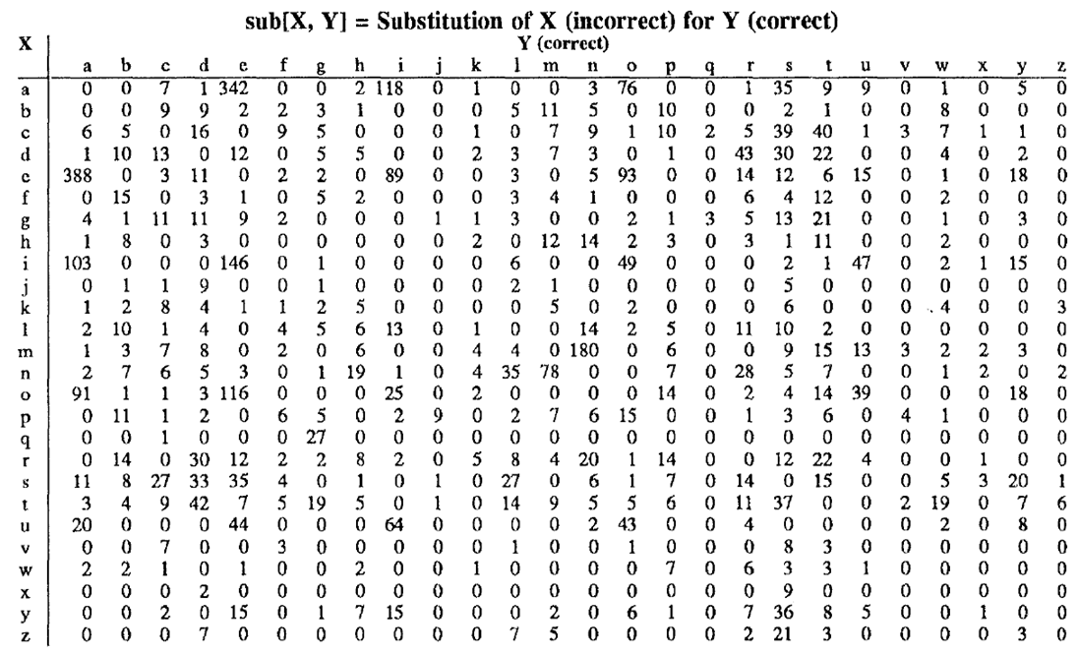

Slide 69
Spelling Correction via Minimum Edit Distance
D(x[0:i], y[0:j]) = min{
D(x[0:i-1], y[0:j-1]) + x[i] ↔ y[j]
D(x[0:i], y[0:j-1]) + insert(y[j])
D(x[0:i-1], y[0:j]) + delete(x[i])
}
x[i] ≠ y[j] → sub(x[i], y[j])
x[i] = y[j] → 0
Notes:
https://phiresky.github.io/levenshtein-demo/

Slide 70
Spelling Correction via Minimum Edit Distance
Applications:
Finding the closest word from Dictionary as the correct spell
Autocorrection
Finding the closest word from Dictionary as the correct meaning!?
Finding the closest word from Dictionary as the prediction!?
Autocompletion
Computational Biology
Aligning two sequences of protein
Daniel Jurafsky: https://www.youtube.com/watch?v=IL0-bD_e8s4
Notes:
https://phiresky.github.io/levenshtein-demo/

Slide 71
