Slide 1
Sentiment analysis Naïve Bayes

Slide 2
OPINION MINING & EMOTION ANALYSIS
Sentiment Analysis, aka Opinion Mining
Definition: processing a text in order to identify and extract its subjective information
Although an opinion is a belief, while a sentiment is a feeling!
Not an easy job even for humans, two people disagree on the sentiment expressed a text!
Motivation:
E.g., Online Marketing → Customer Feedback, …
E.g., the age and geographic differences in the levels of happiness were analyzed as well. [Dodds and Danforth, 2010].
Peter Sheridan Dodds and Christopher M Danforth. Measuring the happiness of large-scale written expression: Songs, blogs, and presidents. Journal of Happiness Studies, 11(4):441–456, 2010. DOI: 10.1007/s10902-009-9150-9. 47

Slide 3
DOCUMENT CLASSIFICATION

Slide 4
SENTIMENT ANALYSIS & DOCUMENT CLASSIFICATION
Tasks:
Identify the overall polarity of a document {positive, negative} → Binary Classes
Identify the overall polarity of a document {positive, negative, neutral} → Multiclass
The polarity magnitude, e.g., p ∈ N^{[1, 5]} stars for reviews → Multiclass
The polarity magnitude, e.g., p ∈ R^{[1, 5]} → Regression
A document may be about different topics/parts of a concept/product
Aspect Detection
Polarity of each aspects
“like the location but poor quality” → Hotel(location: +, quality: -)
“food was great but the service was poor.” → Hotel(food: +, service: -)
[Pang and Lee, 2008]. Bo Pang and Lillian Lee. Opinion mining and sentiment analysis. Foundations and trends in information retrieval, 2(1-2):1–135, 2008. DOI: 10.1561/1500000011. 47

Slide 5
SENTIMENT ANALYSIS & DOCUMENT CLASSIFICATION
Tasks:
Identify the overall polarity of a document {positive, negative} → Binary Classes
Identify the overall polarity of a document {positive, negative, neutral} → Multiclass
The polarity magnitude, e.g., p ∈ N^{[1, 5]} stars for reviews → Multiclass
The polarity magnitude, e.g., p ∈ R^{[1, 5]} → Regression
A document may be about different topics/parts of a concept/product
Aspect Detection
Polarity of each aspects
“like the location but poor quality” → Hotel(location: +, quality: -)
“food was great but the service was poor.” → Hotel(food: +, service: -)
[Pang and Lee, 2008]. Bo Pang and Lillian Lee. Opinion mining and sentiment analysis. Foundations and trends in information retrieval, 2(1-2):1–135, 2008. DOI: 10.1561/1500000011. 47

Slide 6
APPROACHES

Slide 7
lexicon-based
Avoids statistical learning altogether!
Classify documents by counting words against positive and negative sentiment word lists(Taboada et al., 2011).
General Inquirer (Stone et al., 1966)
LIWC (Pennebaker et al., 2007)
MPQA Subjectivity Lexicon (Wilson et al., 2005).
E.g., the MPQA has 6885 words
2718 positive
4912 negative
Each marked for whether it is strongly or weakly biased
Positive : admirable, beautiful, confident, dazzling, ecstatic, favor, glee, great
Negative: awful, bad, bias, catastrophe, cheat, deny, envious, foul, harsh, hate

Slide 8
lexicon-based
Avoids statistical learning altogether!
Classify documents by counting words against positive and negative sentiment word lists(Taboada et al., 2011).
Irrealis mood (https://en.wikipedia.org/wiki/Irrealis_mood)
“It would be nice if you acted like you understood.”
Negation
“That’s not bad for the first day.”
“This is not the worst thing that can happen.”
“Disturbingly good”
Sarcasm & Irony
“That's just what I needed today!”
“Nice perfume. How long did you marinate in it?”

Slide 9
Learning to Classify: Classifiers
Bayesian Classifier
Naïve Bayes
Logistic Regression (Linear)
Decision Tree → Ensemble Random Forest → Boosted Tree
Neural Network (non-Linear)

Slide 10
Learning to Classify: Classifiers
Tokens
Sentences
Documents
f: D → {0,1} : f(x) a Boolean function

Slide 11
Learning to Classify: Classifiers
Tokens
Sentences
Documents
f: D → R^{[0,1]} : f(x) probability value
f: D → R^{[-1,1]} : f(x) confidence score

Slide 12

Learning to Classify: Classifiers
Tokens
Sentences
Documents
f: D → ${\{0,1\}}^{R^{[0,1]}}$
mixture or overlapping classification

Slide 13
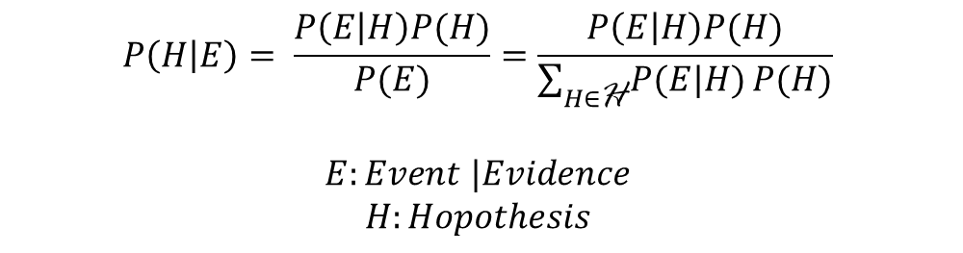
Bayesian Inference
$$P\left(H | E\right)= \frac{P\left(E | H\right)P(H)}{P(E)}=\frac{P\left(E | H\right)P(H)}{\sum_{H∈\text{H}}{P(E|H)}P(H)}$$
$E:Event$ $|Evidence$
$$H:Hopothesis$$

Slide 14

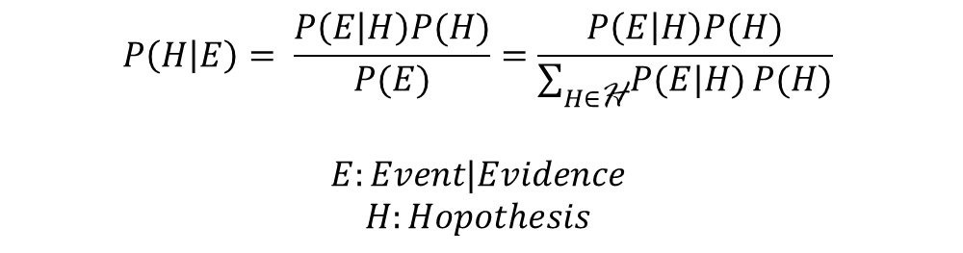
Posterior: Evidence $→$Hypothesis
This is what we want to know! the probability of a hypothesis given the observed evidence
$$P\left(H | E\right)= \frac{P\left(E | H\right)P(H)}{P(E)}=\frac{P\left(E | H\right)P(H)}{\sum_{H∈\text{H}}{P(E|H)}P(H)}$$
$$E:Event|Evidence$$
$$H:Hopothesis$$

Slide 15
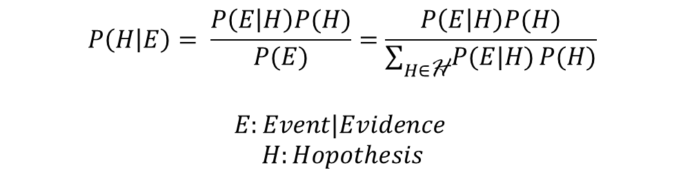
Prior: The Chance of Hypothesis H
is the estimate of the probability of the hypothesis H before E, the current evidence, is observed
$$P\left(H | E\right)= \frac{P\left(E | H\right)P(H)}{P(E)}=\frac{P\left(E | H\right)P(H)}{\sum_{H∈\text{H}}{P(E|H)}P(H)}$$
$$E:Event|Evidence$$
$$H:Hopothesis$$

Slide 16
You tell me?
$$P\left(H | E\right)= \frac{P\left(E | H\right)P(H)}{P(E)}=\frac{P\left(E | H\right)P(H)}{\sum_{H∈\text{H}}{P(E|H)}P(H)}$$
$$E:Event|Evidence$$
$$H:Hopothesis$$

Slide 17

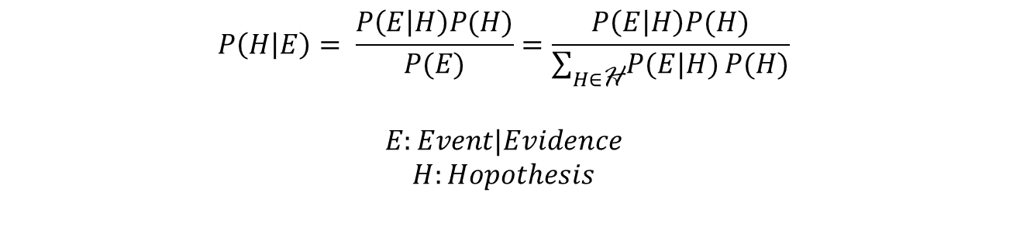
Likelihood: Hypothesis $→\text{Evidence}$
$$P\left(H | E\right)= \frac{P\left(E | H\right)P(H)}{P(E)}=\frac{P\left(E | H\right)P(H)}{\sum_{H∈\text{H}}{P(E|H)}P(H)}$$
$$E:Event|Evidence$$
$$H:Hopothesis$$

Slide 18

Marginal Likelihood: Normalize over all H
$$P\left(H | E\right)= \frac{P\left(E | H\right)P(H)}{P(E)}=\frac{P\left(E | H\right)P(H)}{\sum_{H∈\text{H}}{P(E|H)}P(H)}$$
$$E:Event|Evidence$$
$$H:Hopothesis$$

Slide 19
Example: Hypothesis in Iran
H0: Spring | H1: Summer | H2: Fall | H3: Winter
Sunny Days
Likelihood
0.7
Likelihood
0.5
Likelihood
0.3
Likelihood 0.1
Priors = P(H_{i}) = 1/4

Slide 20
Example: Hypothesis in Canada
H0: Spring | H1: Summer | H2: Fall | H3: Winter
Sunny Days
Likelihood
0.7
Likelihood
0.5
Likelihood
0.3
Likelihood 0.1
Priors = P(H_{i}) → Not uniform! → P(H_{i}) = [0.25, 0.3,0.05, 0.4]

Slide 21

Example: Evidence $→$ Hypothesis
We see a sunny day in Iran! What is the season?
P(Spring|Sunny) = ?
P(Summer|Sunny) =?
P(Fall|Sunny) =?
P(Winter|Sunny) =?

Slide 22
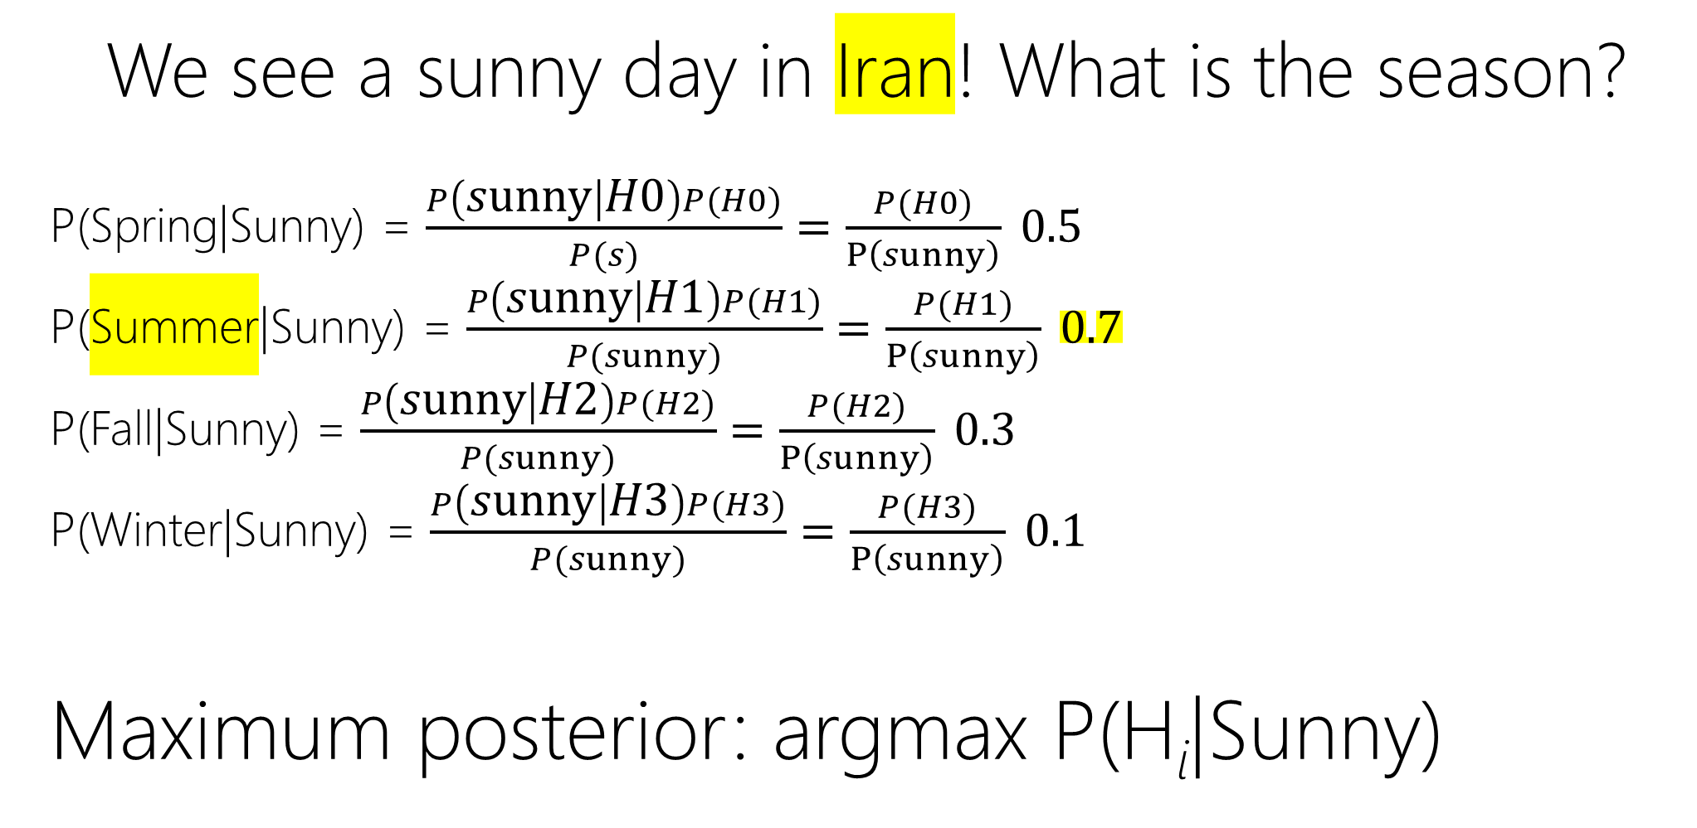
Example: Evidence $→$ Hypothesis
We see a sunny day in Iran! What is the season?
P(Spring|Sunny) = $\frac{P\left(sunny | H0\right)P(H0)}{P(s)}=\frac{P(H0)}{P\left(sunny\right)} 0.5$
P(Summer|Sunny) = $\frac{P\left(sunny | H1\right)P(H1)}{P(sunny)}=\frac{P(H1)}{P\left(sunny\right)} 0.7$
P(Fall|Sunny) = $\frac{P\left(sunny | H2\right)P(H2)}{P(sunny)}=\frac{P(H2)}{P\left(sunny\right)} 0.3$
P(Winter|Sunny) = $\frac{P\left(sunny | H3\right)P(H3)}{P(sunny)}=\frac{P(H3)}{P\left(sunny\right)} 0.1$
Maximum posterior: argmax P(H_{i}|Sunny)

Slide 23
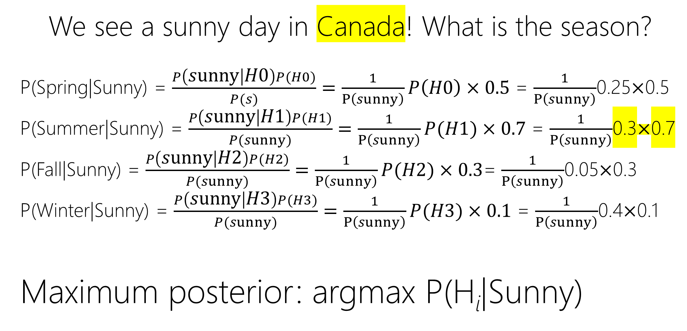
Example: Evidence $→$ Hypothesis
We see a sunny day in Canada! What is the season?
P(Spring|Sunny) = $\frac{P\left(sunny | H0\right)P(H0)}{P(s)}=\frac{1}{P\left(sunny\right)}P\left(H0\right)×0.5$ = $\frac{1}{P\left(sunny\right)}$0.25$×$0.5
P(Summer|Sunny) = $\frac{P\left(sunny | H1\right)P(H1)}{P(sunny)}=\frac{1}{P\left(sunny\right)}P(H1)×0.7$ = $\frac{1}{P\left(sunny\right)}$0.3$×$0.7
P(Fall|Sunny) = $\frac{P\left(sunny | H2\right)P(H2)}{P(sunny)}=\frac{1}{P\left(sunny\right)}P(H2)×0.3$= $\frac{1}{P\left(sunny\right)}$0.05$×$0.3
P(Winter|Sunny) = $\frac{P\left(sunny | H3\right)P(H3)}{P(sunny)}=\frac{1}{P\left(sunny\right)}P(H3)×0.1$ = $\frac{1}{P\left(sunny\right)}$0.4$×$0.1
Maximum posterior: argmax P(H_{i}|Sunny)

Slide 24
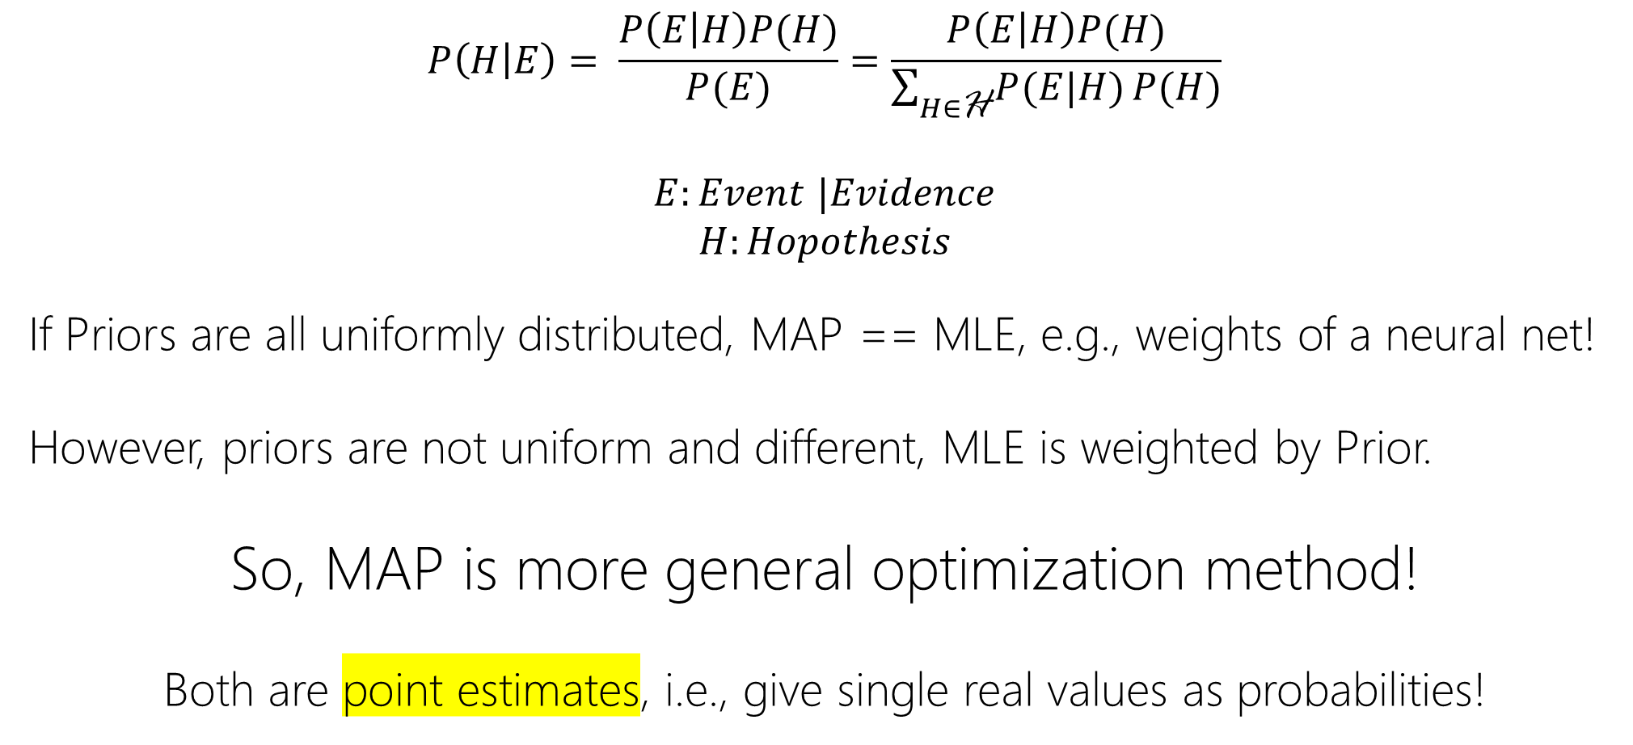
MAP (maximum a posteriori) vs. MLE (maximum likelihood estimation)
$$P\left(H | E\right)= \frac{P\left(E | H\right)P(H)}{P(E)}=\frac{P\left(E | H\right)P(H)}{\sum_{H∈\text{H}}{P(E|H)}P(H)}$$
$E:Event$ $|Evidence$
$$H:Hopothesis$$
If Priors are all uniformly distributed, MAP == MLE, e.g., weights of a neural net!
However, priors are not uniform and different, MLE is weighted by Prior.
So, MAP is more general optimization method!
Both are point estimates, i.e., give single real values as probabilities!

Slide 25
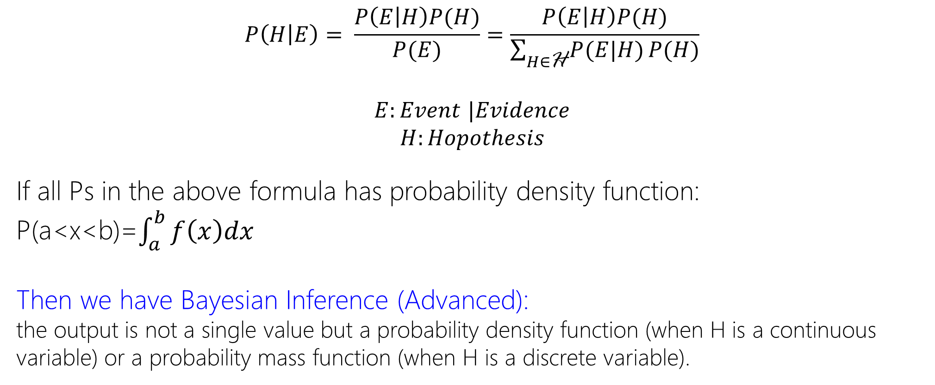
MAP (maximum a posteriori) vs. MLE (maximum likelihood estimation)
$$P\left(H | E\right)= \frac{P\left(E | H\right)P(H)}{P(E)}=\frac{P\left(E | H\right)P(H)}{\sum_{H∈\text{H}}{P(E|H)}P(H)}$$
$E:Event$ $|Evidence$
$$H:Hopothesis$$
If all Ps in the above formula has probability density function:
P(a<x<b)=$\int_{a}^{b}{f\left(x\right)dx}$
Then we have Bayesian Inference (Advanced):
the output is not a single value but a probability density function (when H is a continuous variable) or a probability mass function (when H is a discrete variable).

Slide 26
Classification
Tokens
Sentences
Documents
Inputs → Events | Evidences
Classes | Labels
Outputs → Hypotheses

Slide 27
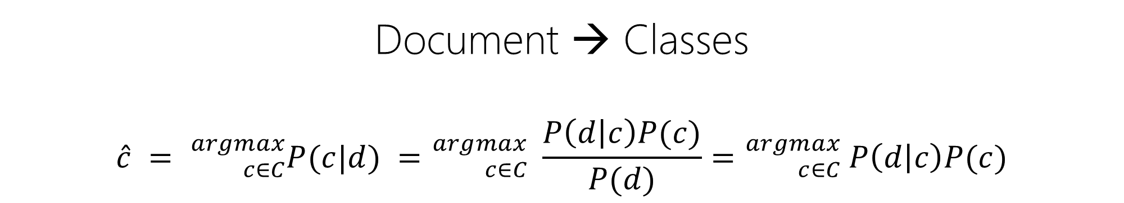
Bayes
Document → Classes
$$\hat{c} = {}_{c∈C}^{argmax}{P(c|d)} ={}_{c∈C}^{argmax}{ \frac{P\left(d | c\right)P(c)}{P(d)}}={}_{c∈C}^{argmax}{ P\left(d | c\right)P(c)}$$

Slide 28
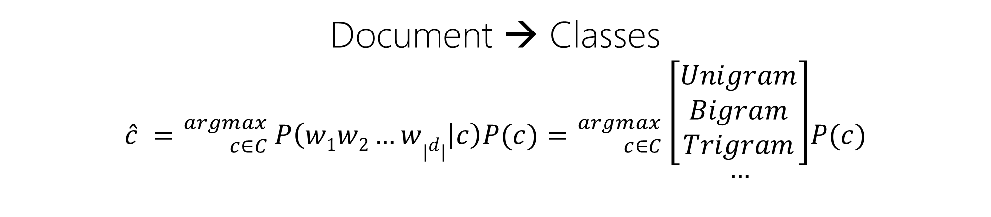
Bayes
Document → Classes
$$\hat{c} ={}_{c∈C}^{argmax}{ P\left(w1w2…w|d| | c\right)P(c)}={}_{c∈C}^{argmax}{ \begin{matrix}\left[\begin{aligned}Unigram \\ Bigram \\ Trigram\end{aligned}\right] \\ … \\ \end{matrix}P(c)}$$

Slide 29
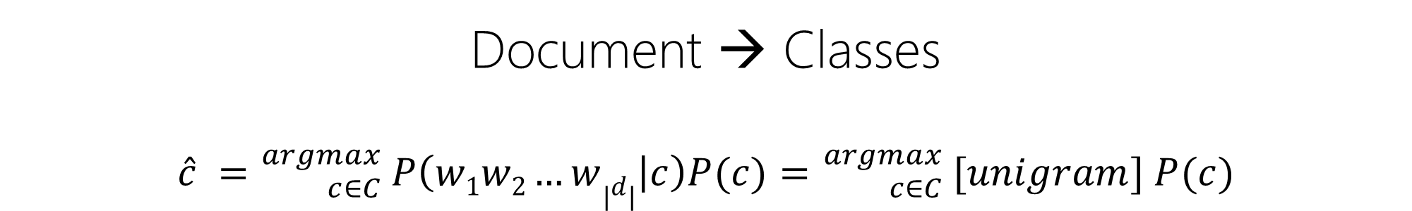
Naïve Bayes
Document → Classes
$$\hat{c} ={}_{c∈C}^{argmax}{ P\left(w1w2…w|d| | c\right)P(c)}={}_{c∈C}^{argmax}{ [unigram] P(c)}$$

Slide 30
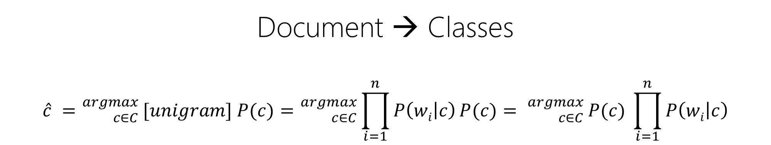
Naïve Bayes
Document → Classes
$$\hat{c} ={}_{c∈C}^{argmax}{ [unigram] P(c)}={}_{c∈C}^{argmax}{ \prod_{i=1}^{n}{P\left(wi | c\right)}P(c)}= {}_{c∈C}^{argmax}{ P(c) \prod_{i=1}^{n}{P\left(wi | c\right)}}$$

Slide 31
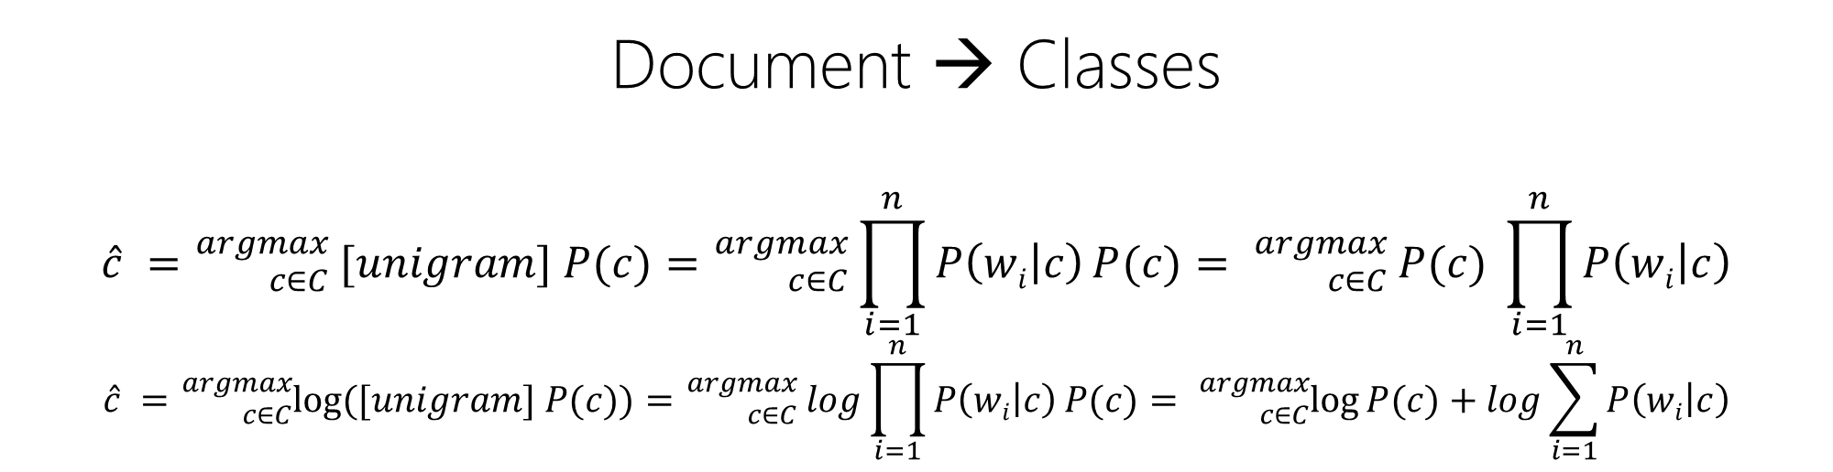
Naïve Bayes
Document → Classes
$$\hat{c} ={}_{c∈C}^{argmax}{ [unigram] P(c)}={}_{c∈C}^{argmax}{ \prod_{i=1}^{n}{P\left(wi | c\right)}P(c)}= {}_{c∈C}^{argmax}{ P(c) \prod_{i=1}^{n}{P\left(wi | c\right)}}$$
$$\hat{c} ={}_{c∈C}^{argmax}{\log{([unigram] P(c))}}={}_{c∈C}^{argmax}{ log\prod_{i=1}^{n}{P\left(wi | c\right)}P(c)}= {}_{c∈C}^{argmax}{\log{P(c)}+log\sum_{i=1}^{n}{P\left(wi | c\right)}}$$

Slide 32
Naïve Bayes: Example
 | Documents (Sentence) | Class (Label)
Train | just plain boring | Neg (-)
 | entirely predictable and lacks energy | Neg (-)
 | no surprises and very few laughs | Neg (-)
 | very powerful | Pos (+)
 | the most fun film of the summer | Pos (+)
Test | predictable with no fun | ?

Slide 33
Naïve Bayes: Example
 | Documents (Sentence) | Class (Label)
Train | S₀: just plain boring | Neg (-)
 | S₁: entirely predictable and lacks energy | Neg (-)
 | S₂: no surprises and very few laughs | Neg (-)
 | S₃: very powerful | Pos (+)
 | S₄: the most fun film of the summer | Pos (+)
Test | S₅: predictable with no fun | = max(P(- | Test), P(+ | Test))
0
1
5
3
2
4
P($\text{−}$| Test) = $\frac{1}{P(Test)}\text{P}\text{(}\text{Test}\text{|}\text{−)} \text{P}\text{(−)}∝ \text{P}\text{(−) }\text{P}\text{(}\text{predictable}\text{|−)}\text{P}\text{(}\text{with}\text{|−)}$ $\text{P}\text{(}\text{no}\text{|−)}$ $\text{P}\text{(}\text{fun}\text{|−)}\text{ = ? }$
P(+| Test) = $\frac{1}{P(Test)}\text{P}\text{(}\text{Test}\text{|+}\text{)} \text{P}\text{(+)}∝\text{P}\text{(+) }\text{P}\text{(}\text{predictable}\text{|+)}\text{P}\text{(}\text{with}\text{|+)}$ $\text{P}\text{(}\text{no}\text{|+)}$ $\text{P}\text{(}\text{fun}\text{|+) = ?}$

Slide 34
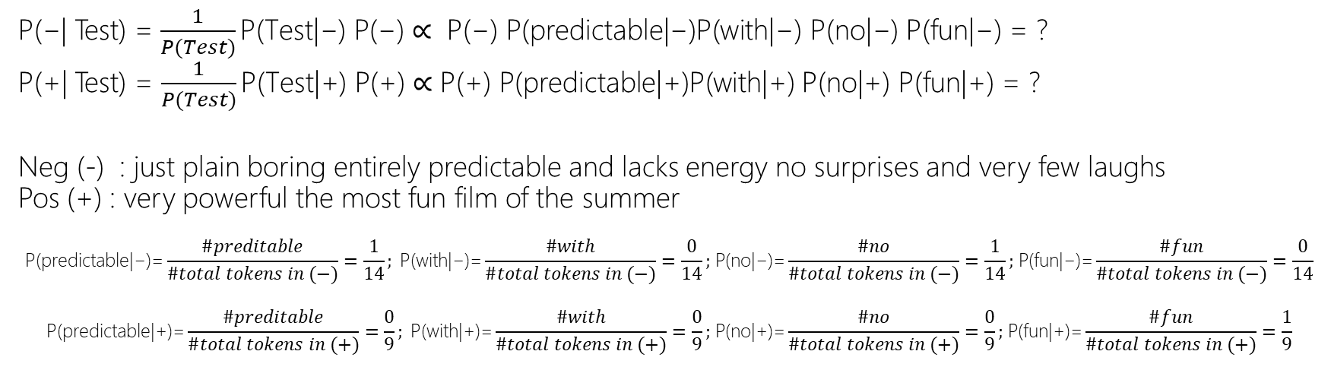
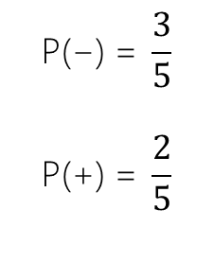
Naïve Bayes: Example
 | Documents (Sentence) | Class (Label)
Train | S₀: just plain boring | Neg (-)
 | S₁: entirely predictable and lacks energy | Neg (-)
 | S₂: no surprises and very few laughs | Neg (-)
 | S₃: very powerful | Pos (+)
 | S₄: the most fun film of the summer | Pos (+)
Test | S₅: predictable with no fun | = max(P(- | Test), P(+ | Test))
0
1
$$\text{P}\text{(−) = }\frac{3}{5}$$
$$\text{P}\text{(+) = }\frac{2}{5}$$
5
3
2
4
P($\text{−}$| Test) = $\frac{1}{P(Test)}\text{P}\text{(}\text{Test}\text{|}\text{−)} \text{P}\text{(−)}∝ \text{P}\text{(−) }\text{P}\text{(}\text{predictable}\text{|−)}\text{P}\text{(}\text{with}\text{|−)}$ $\text{P}\text{(}\text{no}\text{|−)}$ $\text{P}\text{(}\text{fun}\text{|−)}\text{ = ? }$
P(+| Test) = $\frac{1}{P(Test)}\text{P}\text{(}\text{Test}\text{|+}\text{)} \text{P}\text{(+)}∝\text{P}\text{(+) }\text{P}\text{(}\text{predictable}\text{|+)}\text{P}\text{(}\text{with}\text{|+)}$ $\text{P}\text{(}\text{no}\text{|+)}$ $\text{P}\text{(}\text{fun}\text{|+) = ?}$
Neg (-) : just plain boring entirely predictable and lacks energy no surprises and very few laughs
Pos (+) : very powerful the most fun film of the summer
$$\text{P}\text{(}\text{predictable}\text{|−)=}\frac{\#preditable}{\#total tokens in (−)}=\frac{1}{14}; \text{P}\text{(}\text{with}\text{|−)}\text{=}\frac{\#with}{\#total tokens in (−)}=\frac{0}{14}\text{; }\text{P}\text{(}\text{no}\text{|−)=}\frac{\#no}{\#total tokens in (−)}=\frac{1}{14}\text{; }\text{P}\text{(}\text{fun}\text{|−)=}\frac{\#fun}{\#total tokens in (−)}=\frac{0}{14}$$
$$\text{P}\text{(}\text{predictable}\text{|+)=}\frac{\#preditable}{\#total tokens in (+)}=\frac{0}{9}; \text{P}\text{(}\text{with}\text{|}\text{+}\text{)}\text{=}\frac{\#with}{\#total tokens in (+)}=\frac{0}{9}\text{; }\text{P}\text{(}\text{no}\text{|}\text{+}\text{)=}\frac{\#no}{\#total tokens in (+)}=\frac{0}{9}\text{; }\text{P}\text{(}\text{fun}\text{|}\text{+}\text{)=}\frac{\#fun}{\#total tokens in (+)}=\frac{1}{9}$$

Slide 35
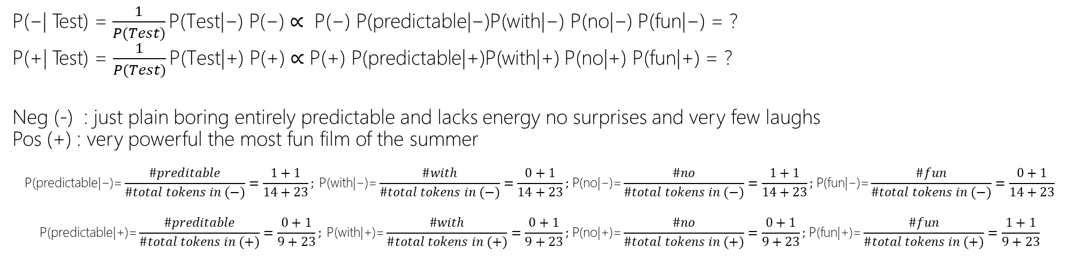
Naïve Bayes + Smoothing: Example
 | Documents (Sentence) | Class (Label)
Train | S₀: just plain boring | Neg (-)
 | S₁: entirely predictable and lacks energy | Neg (-)
 | S₂: no surprises and very few laughs | Neg (-)
 | S₃: very powerful | Pos (+)
 | S₄: the most fun film of the summer | Pos (+)
Test | S₅: predictable with no fun | = max(P(- | Test), P(+ | Test))
0
1
$$\text{P}\text{(−) = }\frac{3}{5}$$
$$\text{P}\text{(+) = }\frac{2}{5}$$
5
3
2
4
P($\text{−}$| Test) = $\frac{1}{P(Test)}\text{P}\text{(}\text{Test}\text{|}\text{−)} \text{P}\text{(−)}∝ \text{P}\text{(−) }\text{P}\text{(}\text{predictable}\text{|−)}\text{P}\text{(}\text{with}\text{|−)}$ $\text{P}\text{(}\text{no}\text{|−)}$ $\text{P}\text{(}\text{fun}\text{|−)}\text{ = ? }$
P(+| Test) = $\frac{1}{P(Test)}\text{P}\text{(}\text{Test}\text{|+}\text{)} \text{P}\text{(+)}∝\text{P}\text{(+) }\text{P}\text{(}\text{predictable}\text{|+)}\text{P}\text{(}\text{with}\text{|+)}$ $\text{P}\text{(}\text{no}\text{|+)}$ $\text{P}\text{(}\text{fun}\text{|+) = ?}$
Neg (-) : just plain boring entirely predictable and lacks energy no surprises and very few laughs
Pos (+) : very powerful the most fun film of the summer
$$\text{P}\text{(}\text{predictable}\text{|−)=}\frac{\#preditable}{\#total tokens in (−)}=\frac{1+1}{14+23}; \text{P}\text{(}\text{with}\text{|−)}\text{=}\frac{\#with}{\#total tokens in (−)}=\frac{0+1}{14+23}\text{; }\text{P}\text{(}\text{no}\text{|−)=}\frac{\#no}{\#total tokens in (−)}=\frac{1+1}{14+23}\text{; }\text{P}\text{(}\text{fun}\text{|−)=}\frac{\#fun}{\#total tokens in (−)}=\frac{0+1}{14+23}$$
$$\text{P}\text{(}\text{predictable}\text{|+)=}\frac{\#preditable}{\#total tokens in (+)}=\frac{0+1}{9+23}; \text{P}\text{(}\text{with}\text{|+)=}\frac{\#with}{\#total tokens in (+)}=\frac{0+1}{9+23}\text{; }\text{P}\text{(}\text{no}\text{|+)=}\frac{\#no}{\#total tokens in (+)}=\frac{0+1}{9+23}\text{; }\text{P}\text{(}\text{fun}\text{|+)=}\frac{\#fun}{\#total tokens in (+)}=\frac{1+1}{9+23}$$
Notes:
Why 23 is added to the denominator?
[w0,w1,w2,….,wn]
Assuming w0 and w1 is members of + class, then # tokens in (+) is [1,1,0,0, ….,0]
If we add 1 to all: # tokens in (+) becomes [1+1,1+1,0+1,0+1, ….,0+1] which is #before + |V|

Slide 36
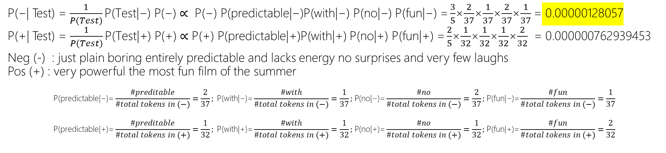
Naïve Bayes + Smoothing: Example
 | Documents (Sentence) | Class (Label)
Train | S₀: just plain boring | Neg (-)
 | S₁: entirely predictable and lacks energy | Neg (-)
 | S₂: no surprises and very few laughs | Neg (-)
 | S₃: very powerful | Pos (+)
 | S₄: the most fun film of the summer | Pos (+)
Test | S₅: predictable with no fun | = max(P(- | Test), P(+ | Test))
0
1
$$\text{P}\text{(−) = }\frac{3}{5}$$
$$\text{P}\text{(+) = }\frac{2}{5}$$
5
3
2
4
P($\text{−}$| Test) = $\frac{1}{P(Test)}\text{P}\text{(}\text{Test}\text{|}\text{−)} \text{P}\text{(−)}∝ \text{P}\text{(−) }\text{P}\text{(}\text{predictable}\text{|−)}\text{P}\text{(}\text{with}\text{|−)}$ $\text{P}\text{(}\text{no}\text{|−)}$ $\text{P}\text{(}\text{fun}\text{|−)}\text{ =}\frac{3}{5}$×$\frac{2}{37}$×$\frac{1}{37}$×$\frac{2}{37}$×$\frac{1}{37}$ = 0.00000128057
P(+| Test) = $\frac{1}{P(Test)}\text{P}\text{(}\text{Test}\text{|+}\text{)} \text{P}\text{(+)}∝\text{P}\text{(+) }\text{P}\text{(}\text{predictable}\text{|+)}\text{P}\text{(}\text{with}\text{|+)}$ $\text{P}\text{(}\text{no}\text{|+)}$ $\text{P}\text{(}\text{fun}\text{|+) =}\frac{2}{5}$×$\frac{1}{32}$×$\frac{1}{32}$×$\frac{1}{32}$×$\frac{2}{32}$ = 0.000000762939453
Neg (-) : just plain boring entirely predictable and lacks energy no surprises and very few laughs
Pos (+) : very powerful the most fun film of the summer
$$\text{P}\text{(}\text{predictable}\text{|−)=}\frac{\#preditable}{\#total tokens in (−)}=\frac{2}{37}; \text{P}\text{(}\text{with}\text{|−)}\text{=}\frac{\#with}{\#total tokens in (−)}=\frac{1}{37}\text{; }\text{P}\text{(}\text{no}\text{|−)=}\frac{\#no}{\#total tokens in (−)}=\frac{2}{37}\text{; }\text{P}\text{(}\text{fun}\text{|−)=}\frac{\#fun}{\#total tokens in (−)}=\frac{1}{37}$$
$$\text{P}\text{(}\text{predictable}\text{|+)=}\frac{\#preditable}{\#total tokens in (+)}=\frac{1}{32}; \text{P}\text{(}\text{with}\text{|+)=}\frac{\#with}{\#total tokens in (+)}=\frac{1}{32}\text{; }\text{P}\text{(}\text{no}\text{|+)=}\frac{\#no}{\#total tokens in (+)}=\frac{1}{32}\text{; }\text{P}\text{(}\text{fun}\text{|+)=}\frac{\#fun}{\#total tokens in (+)}=\frac{2}{32}$$

Slide 37
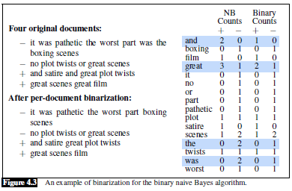
DOCUMENT CLASSIFICATION $⇒$ Sentiment
Per document, whether a word occurs or not seems to matter more than its frequency
word counts → word occurrence
This variant is called binary NB.

Slide 38
DOCUMENT CLASSIFICATION $⇒$ Sentiment
Negation: during text normalization, prepend the prefix NOT to every word after a token of logical negation (n’t, not, no, never) until the next punctuation mark.
“didn't like this movie , but I” ➔ “didn't NOT_like NOT_this NOT_movie , but I”
Statistically,
Words like NOT_like, NOT_recommend more in negative
Words like NOT_bored, NOT_dismiss more in positive
Use of parsing to deal more accurately with the scope relationship between negation words and the predicates they modify!

Slide 39
Naïve Bayes as LM
See Bengio’s LM!
See Mikolov’s Word2Vec!

Slide 40
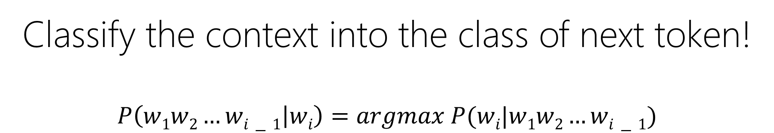
Naïve Bayes as LM
Classify the context into the class of next token!
$$P\left(w1w2…wi−1 | wi\right)=argmax P(wi|w1w2…wi−1)$$

Slide 41
Input Representation
Tokens
Sentences
Documents
Vector Representation
e.g., t-d, t-t, tf-idf, w2v

Slide 42
Naïve Bayes
 | Documents (Sentence) | Class (Label)
Train | S₀: just plain boring | Neg (-)
 | S₁: entirely predictable and lacks energy | Neg (-)
 | S₂: no surprises and very few laughs | Neg (-)
 | S₃: very powerful | Pos (+)
 | S₄: the most fun film of the summer | Pos (+)
Test | S₅: predictable with no fun | = max(P(- | Test), P(+ | Test))
0
1
$$\text{P}\text{(−) = }\frac{3}{5}$$
$$\text{P}\text{(+) = }\frac{2}{5}$$
5
3
2
4
 | just | plain | boring | entirely | … |  |  |  |  |  |  |  |  |  | the | of | very | fun | … | Class (Label)
Train | 1 | 1 | 1 | 0 | 0 | 0 | 0 | 0 | .. | .. | .. | .. | 0 | 0 | 0 | 0 | 0 | 0 | 0 | Neg (-)
 | 0 | 0 | 0 | 0 | 0 | 1 | 1 | 1 | 1 | 1 | 0 | 0 | 0 | 0 | 0 | 0 | 0 | 0 | 0 | Neg (-)
 | 0 | 0 | 0 | 0 | 0 | 0 | 0 | 0 | 0 | 0 | 0 | 1 | 1 | .. | .. | .. | 1 | 0 | 0 | Neg (-)
 | 0 | 0 | 0 | 0 | 0 | 0 | 0 | 0 | 0 | 0 | 1 | 0 | 0 | 0 | 0 | 0 | 1 | 0 | 0 | Pos (+)
 | 0 | 0 | 0 | 0 | 0 | 0 | 0 | 0 | 0 | 0 | 0 | 0 | 1 | 1 | 1 | 1 | 0 | 1 | 0 | Pos (+)
Test | 0 | 0 | 0 | 0 | 1 | 0 | 0 | 0 | 0 | 0 | 0 | 0 | 0 | 1 | 0 | 0 | 0 | 1 | 0 | = max(P(- | Test), P(+ | Test))

Slide 43
Naïve Bayes: Features
 | Documents (Sentence) | Class (Label)
Train | S₀: just plain boring | Neg (-)
 | S₁: entirely predictable and lacks energy | Neg (-)
 | S₂: no surprises and very few laughs | Neg (-)
 | S₃: very powerful | Pos (+)
 | S₄: the most fun film of the summer | Pos (+)
Test | S₅: predictable with no fun | = max(P(- | Test), P(+ | Test))
0
1
$$\text{P}\text{(−) = }\frac{3}{5}$$
$$\text{P}\text{(+) = }\frac{2}{5}$$
5
3
2
4
 | F1 | F2 | F3 | F4 | F5, …, |  |  |  |  |  |  |  |  |  |  |  |  |  | F_{N} | Class (Label)
Train | 1 | 1 | 1 | 0 | 0 | 0 | 0 | 0 | .. | .. | .. | .. | 0 | 0 | 0 | 0 | 0 | 0 | 0 | Neg (-)
 | 0 | 0 | 0 | 0 | 0 | 1 | 1 | 1 | 1 | 1 | 0 | 0 | 0 | 0 | 0 | 0 | 0 | 0 | 0 | Neg (-)
 | 0 | 0 | 0 | 0 | 0 | 0 | 0 | 0 | 0 | 0 | 0 | 1 | 1 | .. | .. | .. | 1 | 0 | 0 | Neg (-)
 | 0 | 0 | 0 | 0 | 0 | 0 | 0 | 0 | 0 | 0 | 1 | 0 | 0 | 0 | 0 | 0 | 1 | 0 | 0 | Pos (+)
 | 0 | 0 | 0 | 0 | 0 | 0 | 0 | 0 | 0 | 0 | 0 | 0 | 1 | 1 | 1 | 1 | 0 | 1 | 0 | Pos (+)
Test | 0 | 0 | 0 | 0 | 1 | 0 | 0 | 0 | 0 | 0 | 0 | 0 | 0 | 1 | 0 | 0 | 0 | 1 | 0 | = max(P(- | Test), P(+ | Test))

