Slide 1
Sentiment analysis Logistic Regression

Slide 2
Logistic Regression (LR)

Slide 3
Generative vs. Discriminative

Slide 4
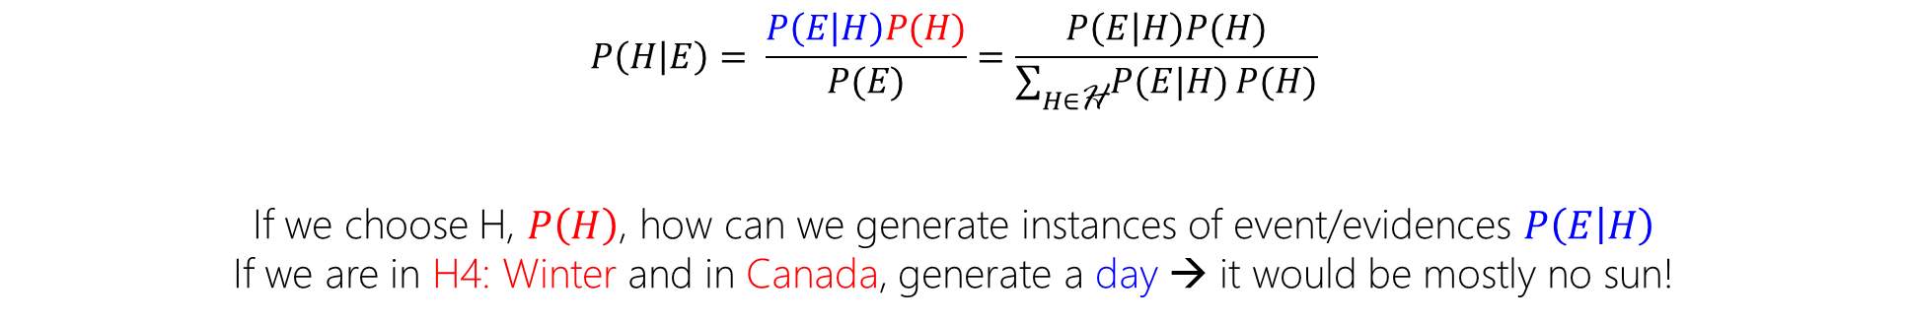
NB is a Generative Model!
$$P\left(H | E\right)= \frac{P\left(E | H\right)P(H)}{P(E)}=\frac{P\left(E | H\right)P(H)}{\sum_{H∈\text{H}}{P(E|H)}P(H)}$$
If we choose H, $P\left(H\right)$, how can we generate instances of event/evidences $P\left(E | H\right)$
If we are in H4: Winter and in Canada, generate a day → it would be mostly no sun!

Slide 5
LR is Discriminative!

Slide 6
Logistic Regression
A step forward to Naïve Bayes!
there may be some correlation in the input features!

Slide 7
Logistic Regression
a neural network can be viewed as a series of logistic regression classifiers stacked on top of each other.

Slide 8
Logistic Regression
Don’t care about hypothesis and their probabilities.
Try to maximize the distance of data from different classes.
Try to discriminate the most!

Slide 9
Logistic Regression
P(+|x₊)=0.50 P(-|x₊)=0.50
P(-|x₋)=0.50 P(+|x₋)=0.50

Slide 10
Logistic Regression
P(+|x₊)=0.55 P(-|x₊)=0.45
P(-|x₋)=0.55 P(+|x₋)=0.45

Slide 11
Logistic Regression
P(+|x₊)=0.65 P(-|x₊)=0.35
P(-|x₋)=0.65 P(+|x₋)=0.35

Slide 12
Logistic Regression
P(+|x₊)=0.75 P(-|x₊)=0.25
P(-|x₋)=0.75 P(+|x₋)=0.25

Slide 13
Logistic Regression
P(+|x₊)=0.85 P(-|x₊)=0.15
P(-|x₋)=0.85 P(+|x₋)=0.15

Slide 14
Logistic Regression
Iterative Process
Optimization = Discriminate classes the most

Slide 15

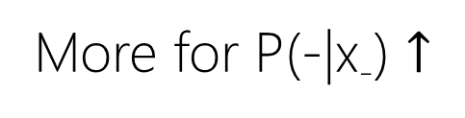
Logistic Regression
More for P(-|x₋) $↑$
More for P(+|x₊) $↑$
P(+|x₊)=0.50 P(-|x₊)=0.50
P(-|x₋)=0.50 P(+|x₋)=0.50

Slide 16
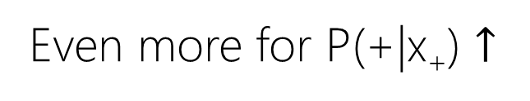
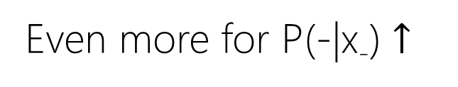
Logistic Regression
Even more for P(-|x₋) $↑$
Even more for P(+|x₊) $↑$
P(+|x₊)=0.55 P(-|x₊)=0.45
P(-|x₋)=0.55 P(+|x₋)=0.45

Slide 17
Logistic Regression
Even more for P(-|x₋) $↑$
Even more for P(+|x₊) $↑$
P(+|x₊)=0.65 P(-|x₊)=0.35
P(-|x₋)=0.65 P(+|x₋)=0.35

Slide 18
Logistic Regression
Even more for P(-|x₋) $↑$
Even more for P(+|x₊) $↑$
P(+|x₊)=0.75 P(-|x₊)=0.25
P(-|x₋)=0.75 P(+|x₋)=0.25

Slide 19


Logistic Regression
Max for P(-|x₋) $↑$
Max for P(+|x₊) $↑$
P(+|x₊)=0.85 P(-|x₊)=0.15
P(-|x₋)=0.85 P(+|x₋)=0.15

Slide 20
Logistic Regression
Iterative Process: We can change the line that discriminate
Optimization = Discriminate classes the most
Maximizing the P(+|x₊) + P(-|x₋)

Slide 21
Logistic Regression
What is that line?
What if we have more than two inputs?

Slide 22
Logistic Regression
Iterative Process: We can change the line that discriminate
Optimization
Max (∏_{x∈{+}}P(+|x₊) + ∏ _{x∈{-}} P(-|x₋))

Slide 23
Logistic Regression
Iterative Process: We can change the line that discriminate
Optimization
Max (∑_{x∈{+}}Log P(+|x₊) + ∑ _{x∈{-}} Log P(-|x₋))

Slide 24
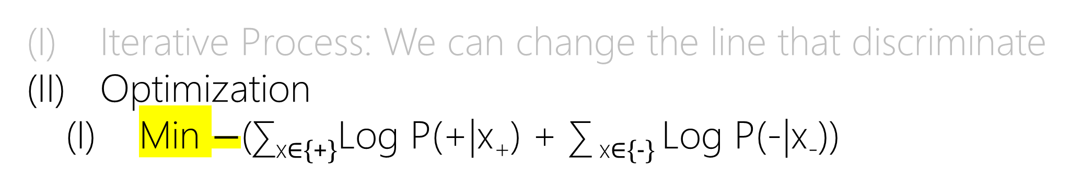
Logistic Regression
Iterative Process: We can change the line that discriminate
Optimization
Min $−$(∑_{x∈{+}}Log P(+|x₊) + ∑ _{x∈{-}} Log P(-|x₋))

Slide 25

Logistic Regression
c= {-, +} → y={0, 1}
Iterative Process: We can change the line that discriminate
Optimization
Min $−$∑_{(x,y)∈D} [(y)Log P(y|x_{y}) + (1-y) Log P(y|x_{y})]

Slide 26
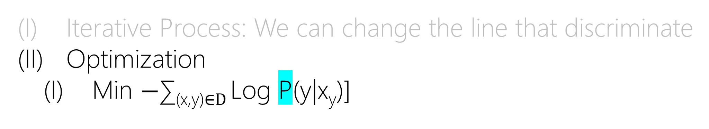
Logistic Regression
c= {-, +} → y={0, 1}
Iterative Process: We can change the line that discriminate
Optimization
Min $−$∑_{(x,y)∈D} Log P(y|x_{y})]

Slide 27
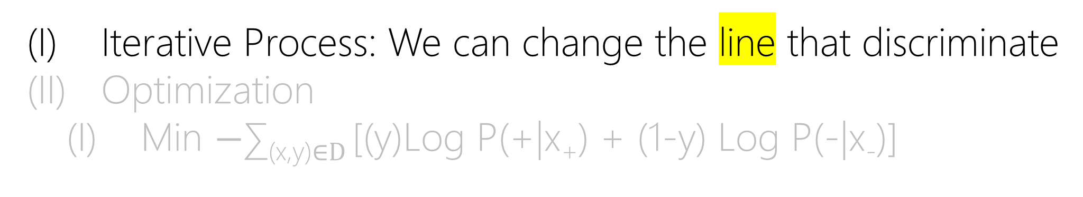
Logistic Regression
c= {-, +} → y={0, 1}
Iterative Process: We can change the line that discriminate
Optimization
Min $−$∑_{(x,y)∈D} [(y)Log P(+|x₊) + (1-y) Log P(-|x₋)]

Slide 28
Logistic Regression
x₁
x’(x’₀,x’₁)
x(x₀,x₁)
x₀
x₁=ax₀+b
0=ax₀-x₁-b

Slide 29
Logistic Regression
x₁
x’(x’₀,x’₁)
x(x₀,x₁)
x₀
x₁=ax₀+b
0>ax₀-x₁-b
0<ax₀-x₁-b

Slide 30
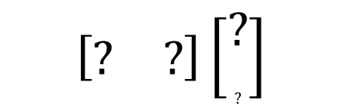
Logistic Regression
x₁
x’(x’₀,x’₁)
x(x₀,x₁)
x₀
0>
0<
$$\left[\begin{matrix}? & ?\end{matrix}\right]\left[\begin{aligned}? \\ ?\end{aligned}\right]$$

Slide 31
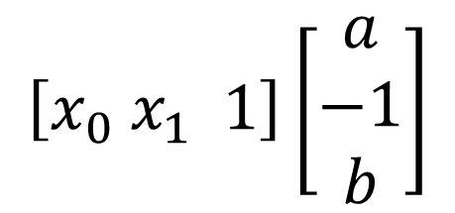
Logistic Regression
x₁
x’(x’₀,x’₁)
x(x₀,x₁)
x₀
0>
0<
$$\left[x_{0} x_{1} 1\right]\left[\begin{aligned}a \\ −1 \\ b\end{aligned}\right]$$

Slide 32
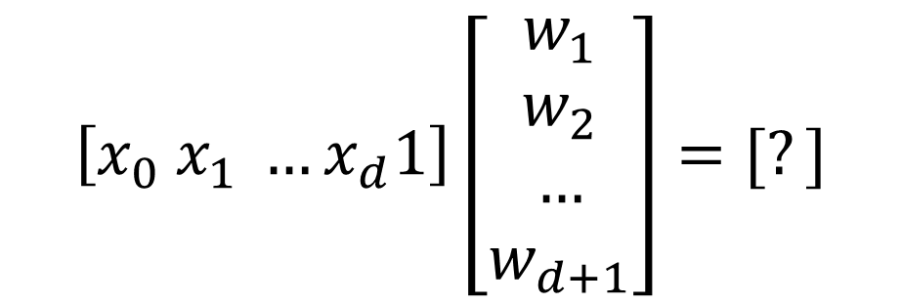
Logistic Regression
$$\left[x_{0} x_{1} …x_{d}1\right]\left[\begin{aligned}w_{1} \\ w_{2} \\ … \\ w_{d+1}\end{aligned}\right]=[?]$$
0>
0<
d = 1 → Line in 2-dimension
d = 2 → Plane in 3 dimension
d = n → Hyperplane in (n+1) dimension

Slide 33


Logistic Regression
0>
0<
$$f\left(X\right)⟶− ∞$$
$$f\left(X\right)⟶+ ∞$$
d = 1 → Line in 2-dimension
d = 2 → Plane in 3 dimension
d = n → Hyperplane in (n+1) dimension

Slide 34
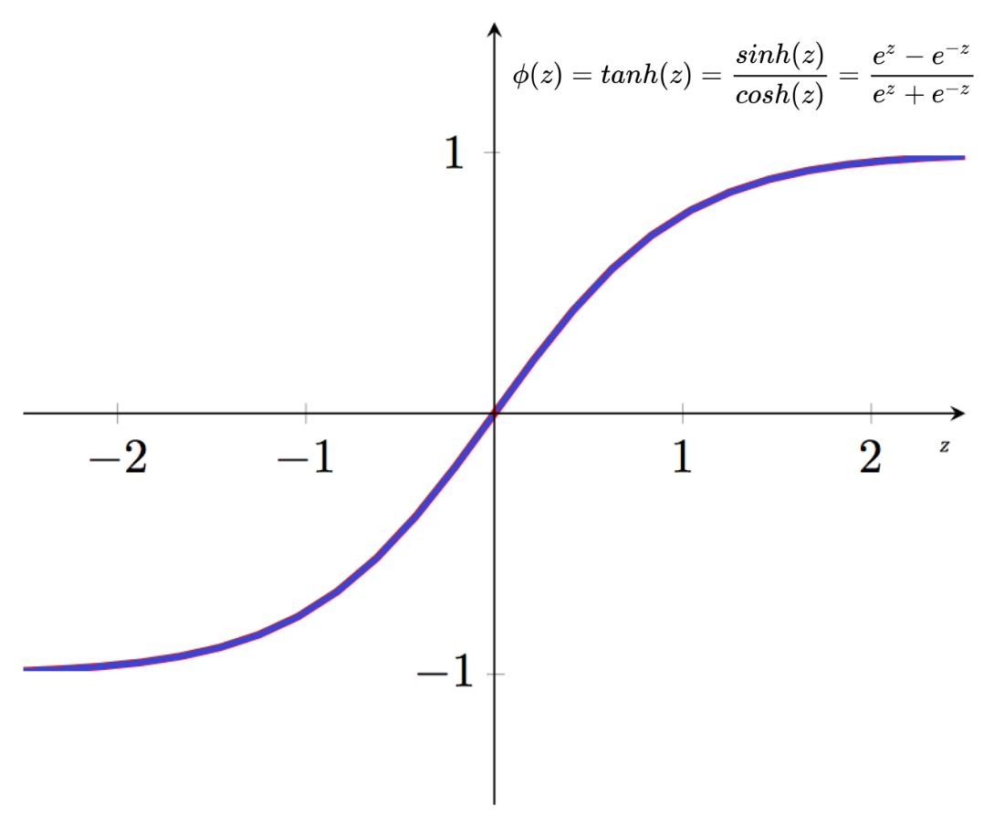


Logistic Regression: Squish by Tanh
0>
0<
$$f\left(X\right)⟶−1$$
$$f\left(X\right)⟶+1$$

Slide 35
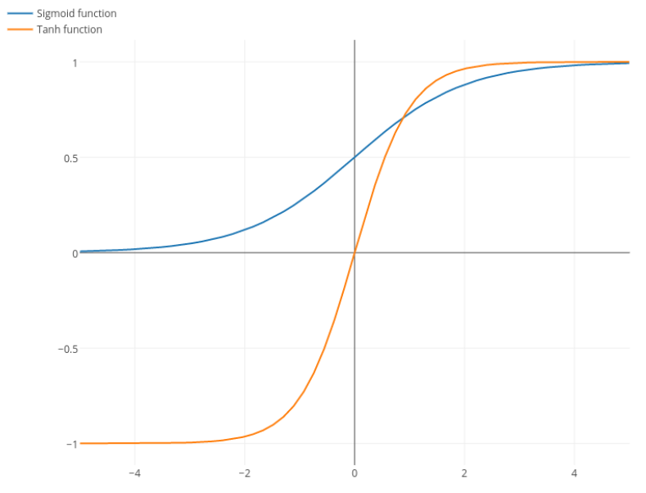


Logistic Regression: Squish by Sigmoid
0>
0<
$$f\left(X\right)⟶0$$
$$f\left(X\right)⟶+1$$
$S\left(f\left(X\right)\right)= \frac{1}{1+e^{−f(X)}}$
Becomes very similar to probability values!

Slide 36
Logistic Regression: Squish
0>
0<
$$f\left(X\right)⟶0$$
$$f\left(X\right)⟶+1$$
$S\left(f\left(X\right)\right)= \frac{1}{1+e^{−f(X)}}$
Becomes very similar to probability values!
But only for positive class (+)
y=1 → P(y|x) = P(+|x) = Sigmoid(x)

Slide 37
Logistic Regression: Squish
0>
0<
$$f\left(X\right)⟶0$$
$$f\left(X\right)⟶+1$$
$S\left(f\left(X\right)\right)= \frac{1}{1+e^{−f(X)}}$
Becomes very similar to probability values!
For negative class (-)?

Slide 38
Logistic Regression: Squish
0>
0<
$$f\left(X\right)⟶0$$
$$f\left(X\right)⟶+1$$
$S\left(f\left(X\right)\right)= \frac{1}{1+e^{−f(X)}}$
Becomes very similar to probability values!
For negative class (-)
P(+|x) + P(-|x) = 1 → P(-|x) = 1 - P(+|x)

Slide 39
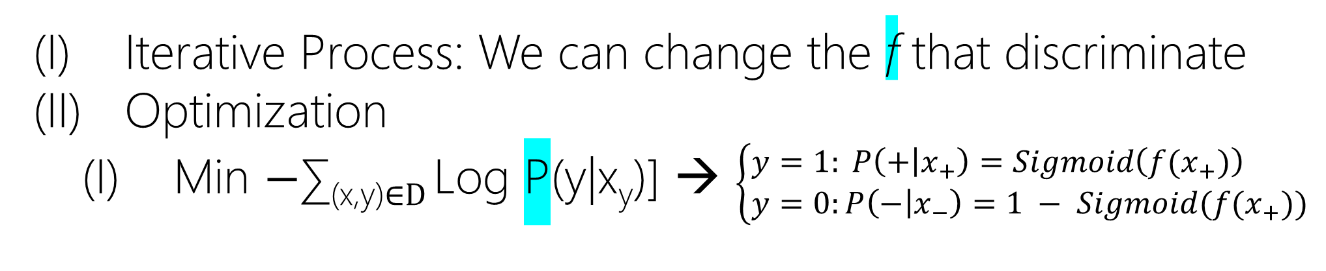
Logistic Regression
c= {-, +} → y={0, 1}
Iterative Process: We can change the f that discriminate
Optimization
Min $−$∑_{(x,y)∈D} Log P(y|x_{y})] → $\left\{\begin{aligned}y=1: P\left(+ | x_{+}\right)=Sigmoid\left(f(x_{+})\right) \\ y=0:P\left(− | x_{−}\right)=1 − Sigmoid(f(x_{+}))\end{aligned}\right.$

Slide 40
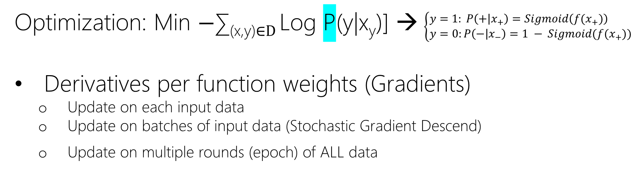
Logistic Regression
Optimization: Min $−$∑_{(x,y)∈D} Log P(y|x_{y})] → $\left\{\begin{aligned}y=1: P\left(+ | x_{+}\right)=Sigmoid\left(f(x_{+})\right) \\ y=0:P\left(− | x_{−}\right)=1 − Sigmoid(f(x_{+}))\end{aligned}\right.$
Derivatives per function weights (Gradients)
Update on each input data
Update on batches of input data (Stochastic Gradient Descend)
Update on multiple rounds (epoch) of ALL data

Slide 41
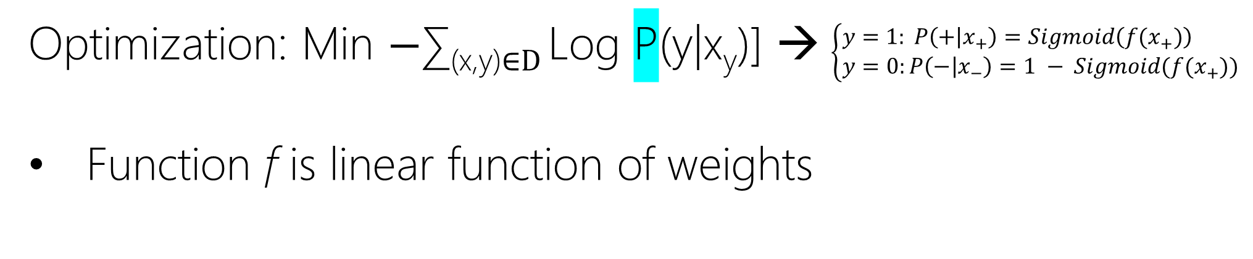
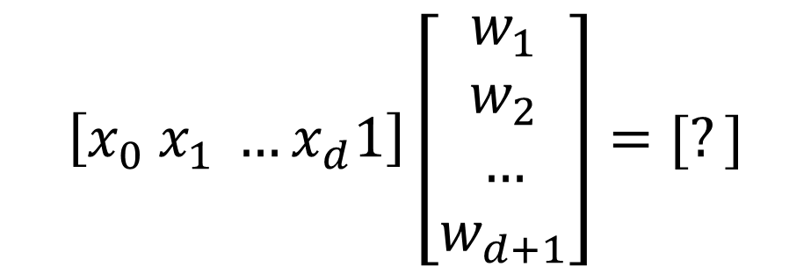
Logistic Regression
Optimization: Min $−$∑_{(x,y)∈D} Log P(y|x_{y})] → $\left\{\begin{aligned}y=1: P\left(+ | x_{+}\right)=Sigmoid\left(f(x_{+})\right) \\ y=0:P\left(− | x_{−}\right)=1 − Sigmoid(f(x_{+}))\end{aligned}\right.$
Function f is linear function of weights
$$\left[x_{0} x_{1} …x_{d}1\right]\left[\begin{aligned}w_{1} \\ w_{2} \\ … \\ w_{d+1}\end{aligned}\right]=[?]$$

Slide 42
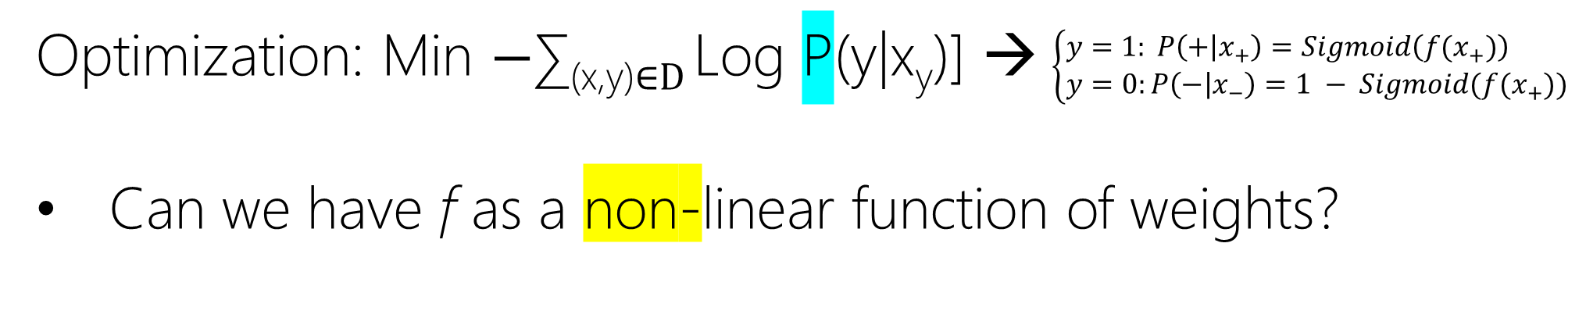
Logistic Regression
Optimization: Min $−$∑_{(x,y)∈D} Log P(y|x_{y})] → $\left\{\begin{aligned}y=1: P\left(+ | x_{+}\right)=Sigmoid\left(f(x_{+})\right) \\ y=0:P\left(− | x_{−}\right)=1 − Sigmoid(f(x_{+}))\end{aligned}\right.$
Can we have f as a non-linear function of weights?

Slide 43
Multiclass with Logistic Regression

Slide 44
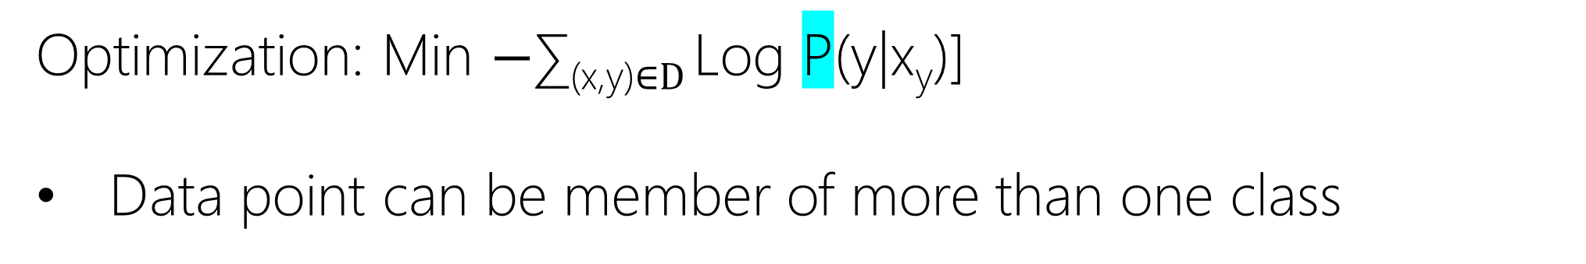


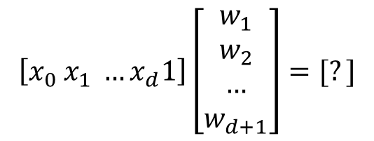
Multi-target (Multi-label)
Optimization: Min $−$∑_{(x,y)∈D} Log P(y|x_{y})]
Data point can be member of more than one class
$$\left[x_{0} x_{1} …x_{d}1\right]\left[\begin{aligned}w_{1} \\ w_{2} \\ … \\ w_{d+1}\end{aligned}\right]=[?]$$
green class vs. else:
Multiple Binary Classification
$$\left[x_{0} x_{1} …x_{d}1\right]\left[\begin{aligned}{w′}_{1} \\ {w′}_{2} \\ … \\ {w′}_{d+1}\end{aligned}\right]=[?]$$
red class vs. else:
$$\left[x_{0} x_{1} …x_{d}1\right]\left[\begin{aligned}{w′′}_{1} \\ {w′′}_{2} \\ … \\ {w′′}_{d+1}\end{aligned}\right]=[?]$$
blue class vs. else:

Slide 45
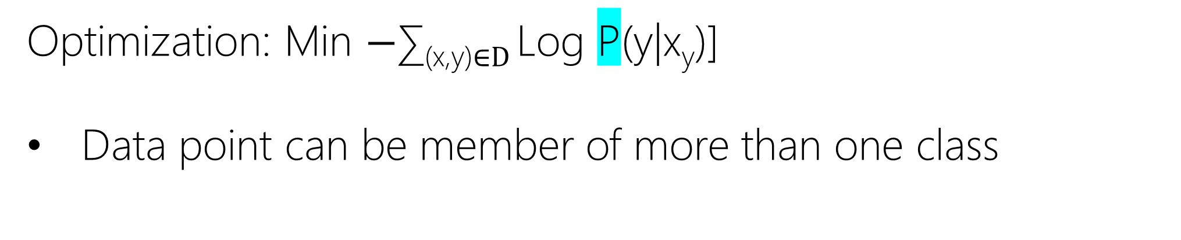
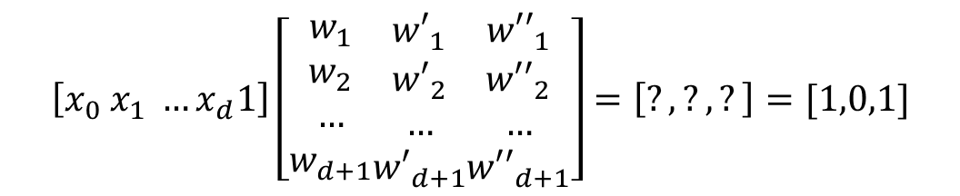
Multi-target (Multi-label)
Optimization: Min $−$∑_{(x,y)∈D} Log P(y|x_{y})]
Data point can be member of more than one class
$$\left[x_{0} x_{1} …x_{d}1\right]\left[\begin{aligned}w_{1} \\ w_{2} \\ … \\ w_{d+1}\end{aligned}\begin{aligned}{w′}_{1} \\ {w′}_{2} \\ … \\ {w′}_{d+1}\end{aligned}\begin{aligned}{w′′}_{1} \\ {w′′}_{2} \\ … \\ {w′′}_{d+1}\end{aligned}\right]=\left[?, ?, ?\right]=[1,0,1]$$

Slide 46
Multinomial Logistic Regression
Logistic Regression → Softmax Regression

Slide 47
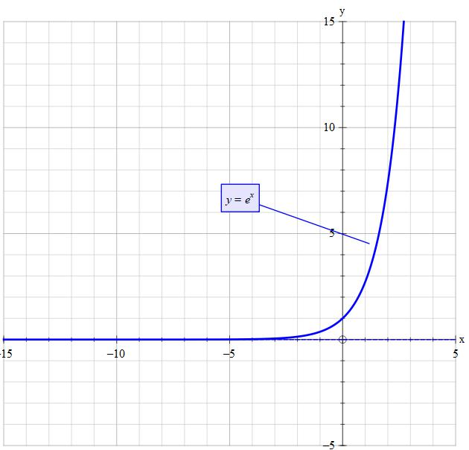
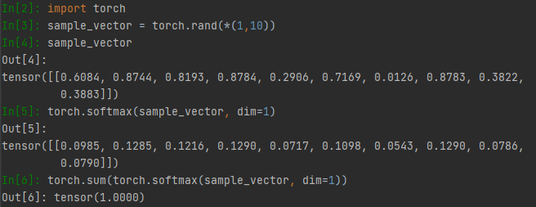
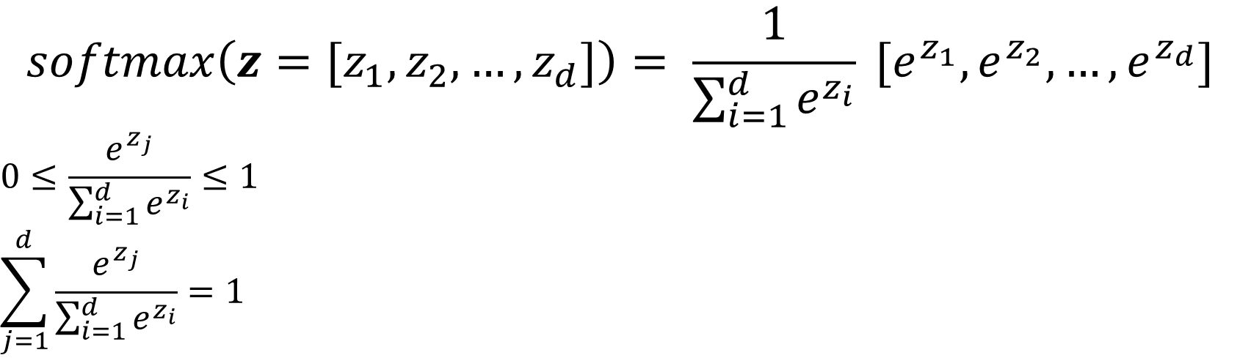
Softmax Regression
$$softmax\left(z=[z_{1},z_{2},…,z_{d}]\right)= \frac{1}{\sum_{i=1}^{d}{e^{z_{i}}}} [e^{z_{1}},e^{z_{2}}, …,e^{z_{d}}]$$
$$0≤\frac{e^{z_{j}}}{\sum_{i=1}^{d}{e^{z_{i}}}}≤1$$
$$\sum_{j=1}^{d}{\frac{e^{z_{j}}}{\sum_{i=1}^{d}{e^{z_{i}}}}}=1$$

Slide 48


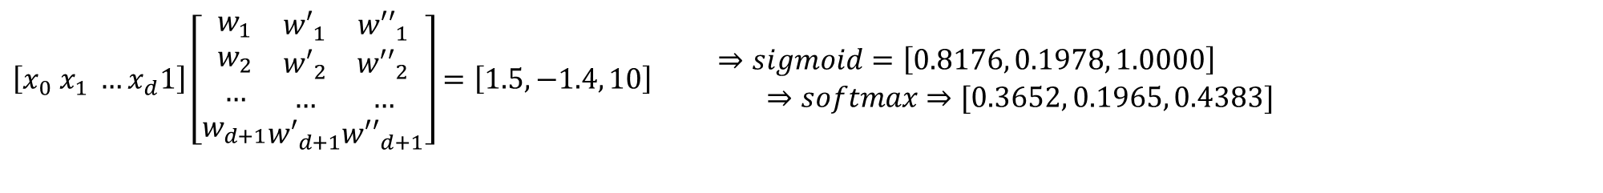
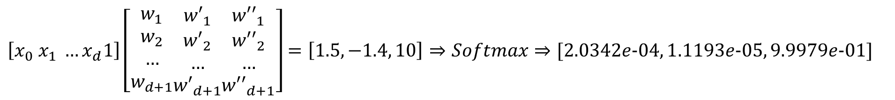
Multi-target (Multi-label)
Optimization: Min $−$∑_{(x,y)∈D} Log P(y|x_{y})]
$$\left[x_{0} x_{1} …x_{d}1\right]\left[\begin{aligned}w_{1} \\ w_{2} \\ … \\ w_{d+1}\end{aligned}\begin{aligned}{w′}_{1} \\ {w′}_{2} \\ … \\ {w′}_{d+1}\end{aligned}\begin{aligned}{w′′}_{1} \\ {w′′}_{2} \\ … \\ {w′′}_{d+1}\end{aligned}\right]=\left[1.5, −1.4, 10\right]⇒Softmax⇒[2.0342e−04, 1.1193e−05, 9.9979e−01]$$
$$\left[x_{0} x_{1} …x_{d}1\right]\left[\begin{aligned}w_{1} \\ w_{2} \\ … \\ w_{d+1}\end{aligned}\begin{aligned}{w′}_{1} \\ {w′}_{2} \\ … \\ {w′}_{d+1}\end{aligned}\begin{aligned}{w′′}_{1} \\ {w′′}_{2} \\ … \\ {w′′}_{d+1}\end{aligned}\right]=\left[1.5, −1.4, 10\right] \begin{matrix}⇒sigmoid=\left[0.8176, 0.1978, 1.0000\right] \\ ⇒softmax⇒[0.3652, 0.1965, 0.4383]\end{matrix}$$

Slide 49
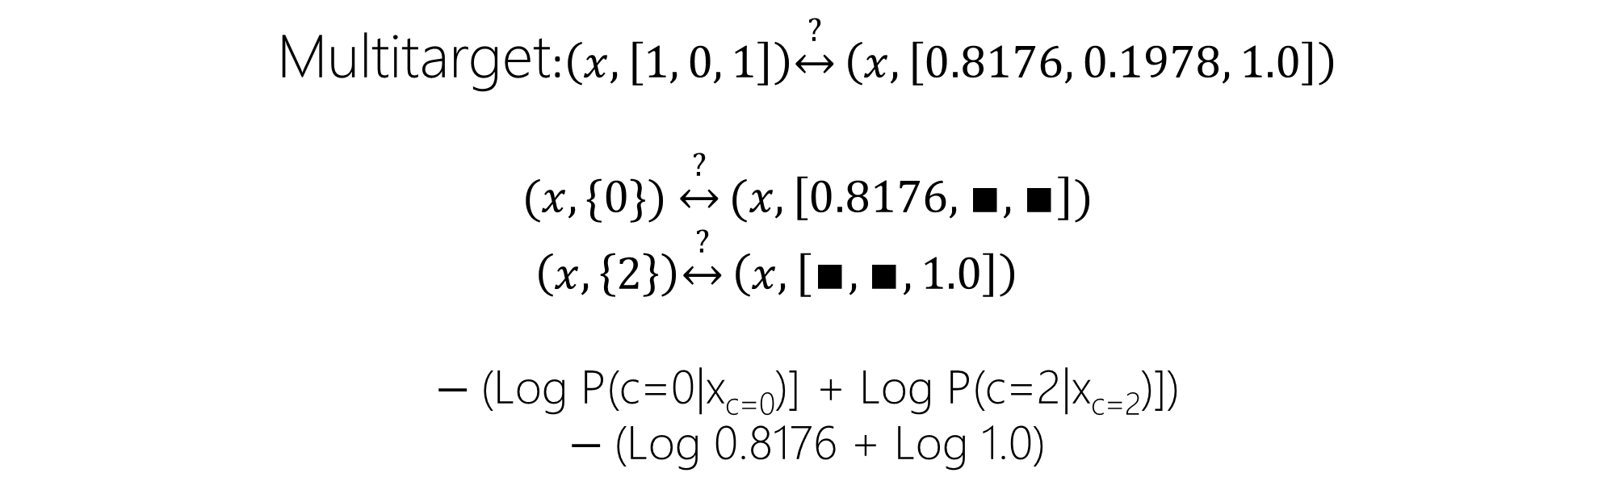
Multi-target (Multi-label)
Optimization: Min $−$∑_{(x,y)∈D} Log P(y|x_{y})]
Multitarget:$\left(x,\left[1, 0, 1\right]\right)\underset{↔}{?}\left(x, \left[0.8176, 0.1978, 1.0\right]\right)$
$$(x,\{0\}) \underset{↔}{?}(x, \left[0.8176,∎,∎\right])$$
$$\left(x,\left\{2\right\}\right)\underset{↔}{?}\left(x, \left[∎,∎, 1.0\right]\right)$$
$−$(Log P(c=0|x_{c=0})] + Log P(c=2|x_{c=2})])
$−$(Log 0.8176 + Log 1.0)

Slide 50
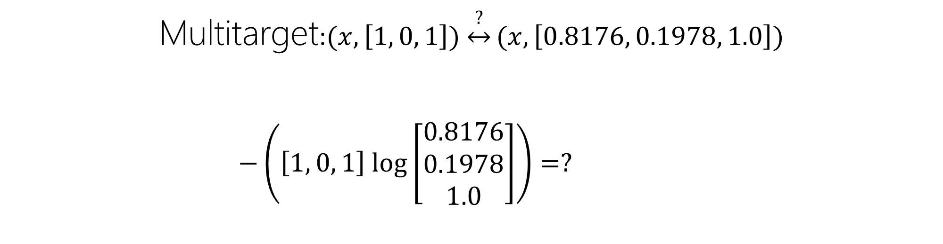
Multi-target (Multi-label)
Optimization: Min $−$∑_{(x,y)∈D} Log P(y|x_{y})]
Multitarget:$(x,\left[1, 0, 1\right]) \underset{↔}{?}(x, \left[0.8176, 0.1978, 1.0\right])$
$$−\left(\left[1, 0, 1\right] log\left[\begin{aligned}0.8176 \\ 0.1978 \\ 1.0\end{aligned}\right]\right)=?$$

Slide 51
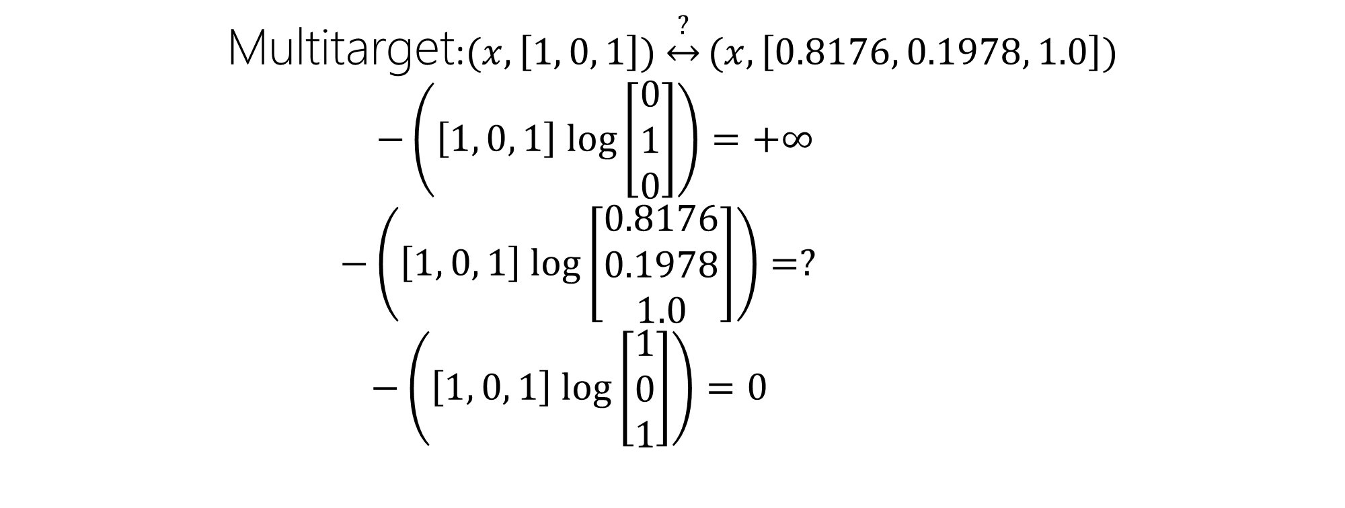
Multi-target (Multi-label)
Optimization: Min $−$∑_{(x,y)∈D} Log P(y|x_{y})]
Multitarget:$(x,\left[1, 0, 1\right]) \underset{↔}{?}(x, \left[0.8176, 0.1978, 1.0\right])$
$$−\left(\left[1, 0, 1\right] log\left[\begin{aligned}0 \\ 1 \\ 0\end{aligned}\right]\right)=+∞$$
$$−\left(\left[1, 0, 1\right] log\left[\begin{aligned}0.8176 \\ 0.1978 \\ 1.0\end{aligned}\right]\right)=?$$
$$−\left(\left[1, 0, 1\right] log\left[\begin{aligned}1 \\ 0 \\ 1\end{aligned}\right]\right)=0$$

Slide 52

Multiclass
Optimization: Min $−$∑_{(x,y)∈D} Log P(y|x_{y})]
Multiclass:$\left(x,\left[0, 1, 0\right]\right)\underset{↔}{?}\left(x, \left[0.3652, 0.1965, 0.4383\right]\right)$
$$(x,\{1\}) \underset{↔}{?}(x, \left[∎,0.1965, ∎\right])$$
$−$Log P(c=1|x_{c=1})
$−$(Log 0.1965)

Slide 53
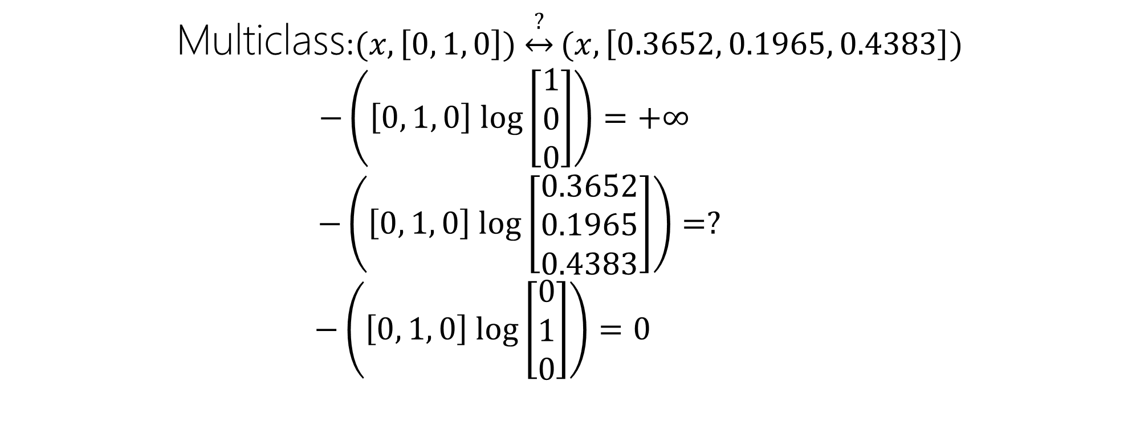
Multiclass
Optimization: Min $−$∑_{(x,y)∈D} Log P(y|x_{y})]
Multiclass:$(x,\left[0, 1, 0\right]) \underset{↔}{?}(x, \left[0.3652, 0.1965, 0.4383\right])$
$$−\left(\left[0, 1, 0\right] log\left[\begin{aligned}1 \\ 0 \\ 0\end{aligned}\right]\right)=+∞$$
$$−\left(\left[0, 1, 0\right] log\left[\begin{aligned}0.3652 \\ 0.1965 \\ 0.4383\end{aligned}\right]\right)=?$$
$$−\left(\left[0, 1, 0\right] log\left[\begin{aligned}0 \\ 1 \\ 0\end{aligned}\right]\right)=0$$

Slide 54
Evaluation

Slide 55
Transparent (Interpretable) Model

