Slide 1
Sentiment analysis Evaluation

Slide 2
Evaluation (binary | Boolean)

Slide 3
“We’re addicted and annotated data is our heroine.” -?
Notes:
Jitendra Malik

Slide 4
Gold Labels
aka. Golden Truth, Golden Standard
Human-defined classes/labels for each document
Human judgment
Manually labeled
Manually annotated

Slide 5
Gold Labels
aka. Golden Truth, Golden Standard
to err is human!

Slide 6
Gold Labels
aka. Golden Truth, Golden Standard
to err is human; to forgive, divine!
“Save This Word! All people commit sins and make mistakes. God forgives them, and people are acting in a godlike (divine) way when they forgive.” - An Essay on Criticism, Alexander Pope.

Slide 7
Silver Labels
aka. Silver Truth, Silver Standard
Gold is very expensive!
Finding gold is needs a lot of effort!
automated-defined classes/labels for each document
Machine judgment
Machine labeled
Machine annotated

Slide 8
Transduction
Transductive Inference
Data has the labels already!
E.g., ?

Slide 9
Transduction
Transductive Inference
Data has the labels already!
Language Models!

Slide 10
Contingency Table
aka. Confusion Matrix
 | Gold Positive | Gold Negative
Model Positive | True Positive | False Positive
Model Negative | False Negative | True Negative

Slide 11
Perfect Classifier
 | Gold Positive | Gold Negative
Model Positive | N+ | 0
Model Negative | 0 | N-

Slide 12
Metrics
A descriptive quantity to show the quality
Single real number (higher better/lower better)
A set of numbers that shows a trend!

Slide 13
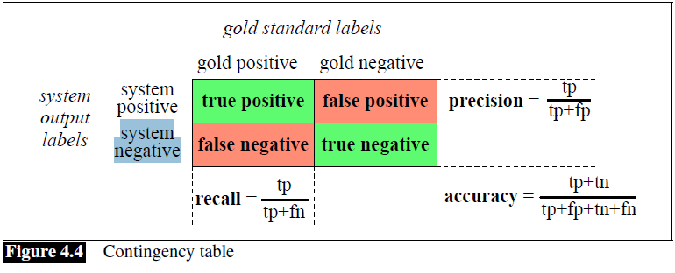
Contingency Table
aka. Confusion Matrix

Slide 14
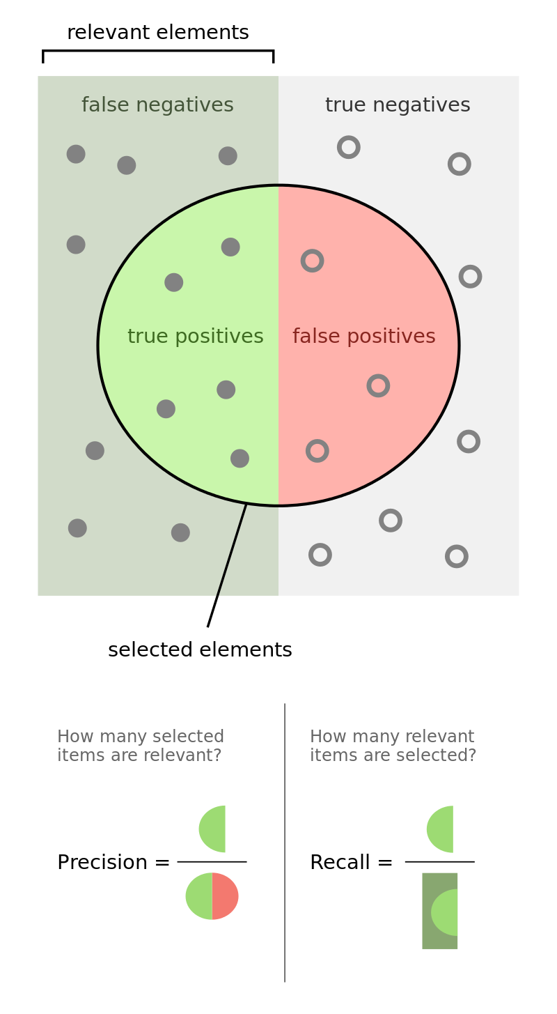
Contingency Table
aka. Confusion Matrix

Slide 15
Precision
High vs. Low
What scenarios require high precision?

Slide 16
Recall
High vs. Low
What scenarios require high recall?

Slide 17
Precision-Recall
Precision
Recall

Slide 18
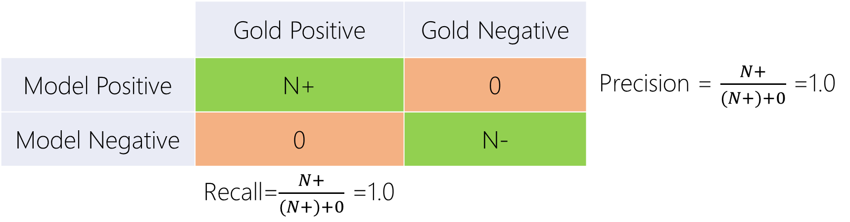
Perfect Classifier
 | Gold Positive | Gold Negative
Model Positive | N+ | 0 | Precision = $\frac{N+}{(N+)+0}$ =1.0
Model Negative | 0 | N-
 | Recall=$\frac{N+}{(N+)+0}$ =1.0

Slide 19
Precision-Recall
Precision
Recall

Slide 20
Balance Classes
~50% Positive, ~50% Negative
 | Gold Positive (50) | Gold Negative (50)
Model Positive
Model Negative

Slide 21
Biased Model
All are Positive
 | Gold Positive (50) | Gold Negative (50)
Model Positive | 50 | 50
Model Negative | 0 | 0

Slide 22
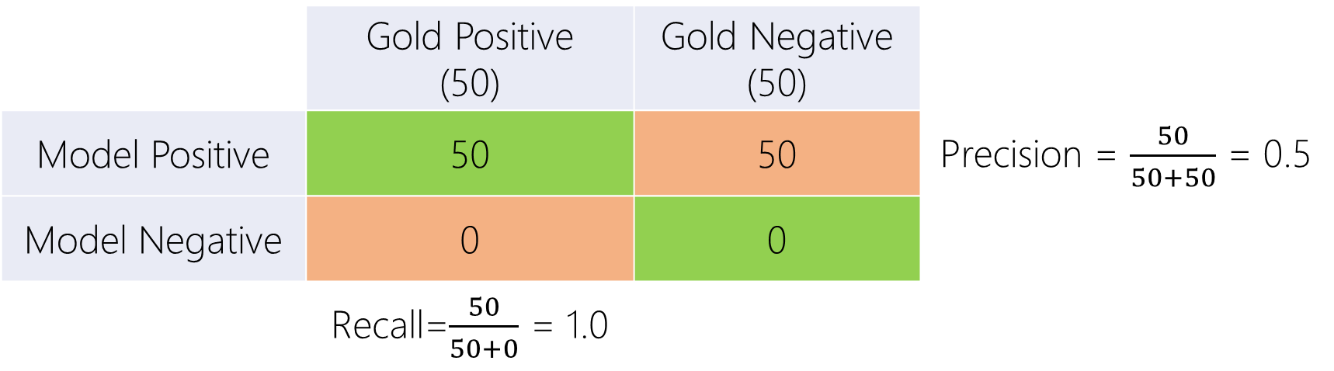
Biased Model
All are Positive
 | Gold Positive (50) | Gold Negative (50)
Model Positive | 50 | 50 | Precision = $\frac{50}{50+50}$ = 0.5
Model Negative | 0 | 0
 | Recall=$\frac{50}{50+0}$ = 1.0

Slide 23
Precision-Recall
Precision
Recall

Slide 24
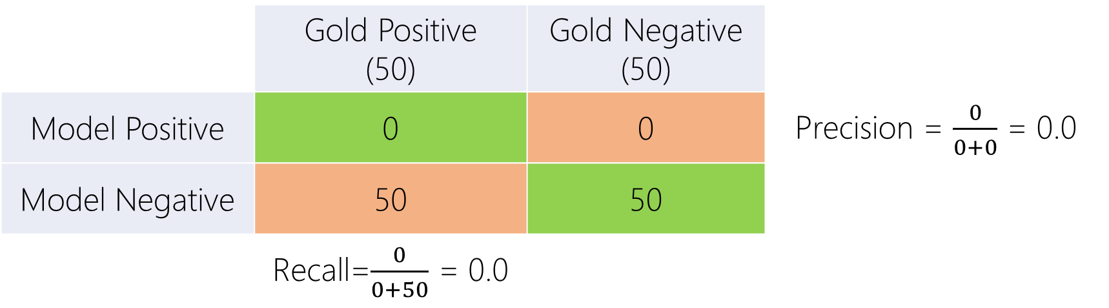
Biased Model
All are Negative
 | Gold Positive (50) | Gold Negative (50)
Model Positive | 0 | 0 | Precision = $\frac{0}{0+0}$ = 0.0
Model Negative | 50 | 50
 | Recall=$\frac{0}{0+50}$ = 0.0

Slide 25
Precision-Recall
Precision
Recall

Slide 26

Uniformly Random Model
 | Gold Positive (50) | Gold Negative (50)
Model Positive | 25 | 25 | Precision = $\frac{25}{25+25}$ = 0.5
Model Negative | 25 | 25
 | Recall=$\frac{25}{25+25}$ = 0.5

Slide 27
Precision-Recall
Precision
Recall

Slide 28
Imbalance (Unbalanced) Classes
~10% Positive, ~90% Negative
 | Gold Positive (10) | Gold Negative (90)
Model Positive
Model Negative

Slide 29
Biased Model
All are Positive
 | Gold Positive (10) | Gold Negative (90)
Model Positive | 10 | 90
Model Negative | 0 | 0

Slide 30

Biased Model
All are Positive
 | Gold Positive (10) | Gold Negative (90)
Model Positive | 10 | 90 | Precision = $\frac{10}{10+90}$ = 0.1
Model Negative | 0 | 0
 | Recall=$\frac{10}{10+0}$ = 1.0

Slide 31
Precision-Recall
Precision
Recall

Slide 32

Biased Model
All are Negative
 | Gold Positive (10) | Gold Negative (90)
Model Positive | 0 | 0 | Precision = $\frac{0}{0+0}$ = 0.0
Model Negative | 10 | 90
 | Recall=$\frac{0}{0+10}$ = 0.0

Slide 33
Precision-Recall
Precision
Recall

Slide 34

Uniformly Random Model
 | Gold Positive (10) | Gold Negative (90)
Model Positive | 5 | 45 | Precision = $\frac{5}{45+5}$ = 0.1
Model Negative | 5 | 45
 | Recall=$\frac{5}{5+5}$ = 0.5

Slide 35
Precision-Recall
Precision
Recall

Slide 36
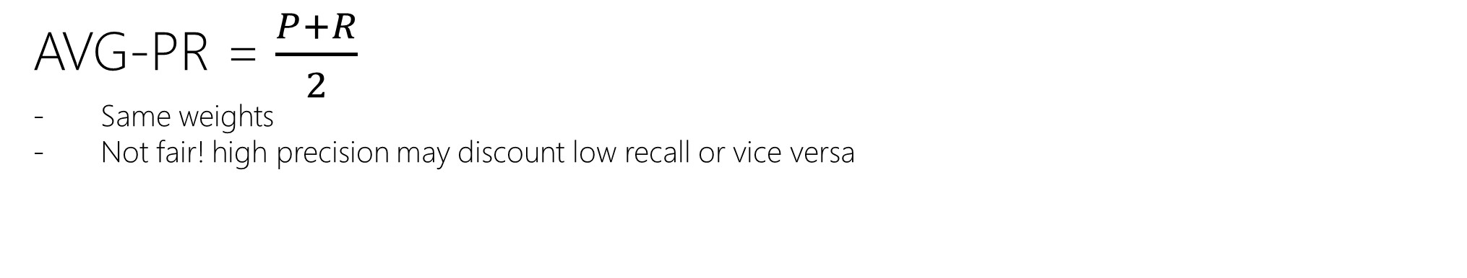
Average of Precision and Recall: A Single Metric
AVG-PR = $\frac{P+R}{2}$
Same weights
Not fair! high precision may discount low recall or vice versa

Slide 37

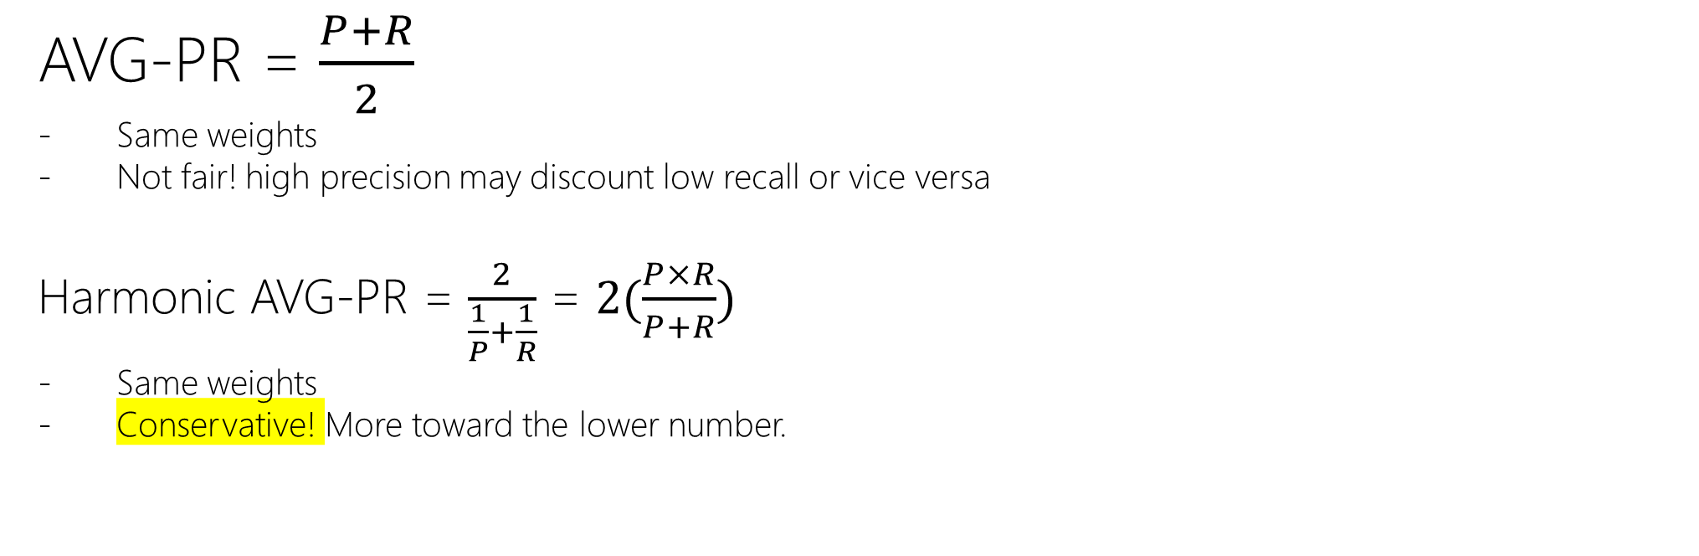
Average of Precision and Recall: A Single Metric
AVG-PR = $\frac{P+R}{2}$
Same weights
Not fair! high precision may discount low recall or vice versa
Harmonic AVG-PR = $\frac{2}{\frac{1}{P}+\frac{1}{R}}$ = $2(\frac{P×R}{P+R})$
Same weights
Conservative! More toward the lower number.

Slide 38



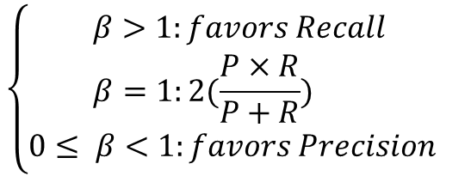
Average of Precision and Recall: A Single Metric
AVG-PR = $\frac{P+R}{2}$
Same weights
Not fair! high precision may discount low recall or vice versa
Harmonic AVG-PR = $\frac{2}{\frac{1}{P}+\frac{1}{R}}$ = $2(\frac{P×R}{P+R})$
Same weights
Conservative! More toward the lower number.
Weighted harmonic mean =
$$\left\{\begin{aligned}β>1:favors Recall \\ β=1:2(\frac{P×R}{P+R}) \\ 0≤ β<1:favors Precision \end{aligned}\right.$$

Slide 39
Curves

Slide 40
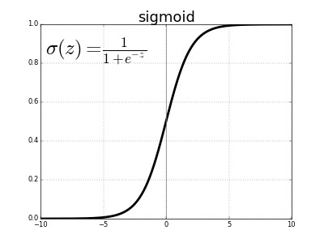
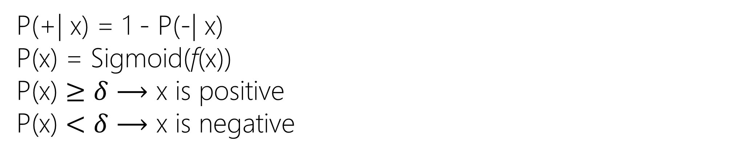
Threshold-based Model
P(+| x) = 1 - P(-| x)
P(x) = Sigmoid(f(x))
P(x) $≥$ $δ$ $⟶$ x is positive
P(x) $<$ $δ$ $⟶$ x is negative

Slide 41

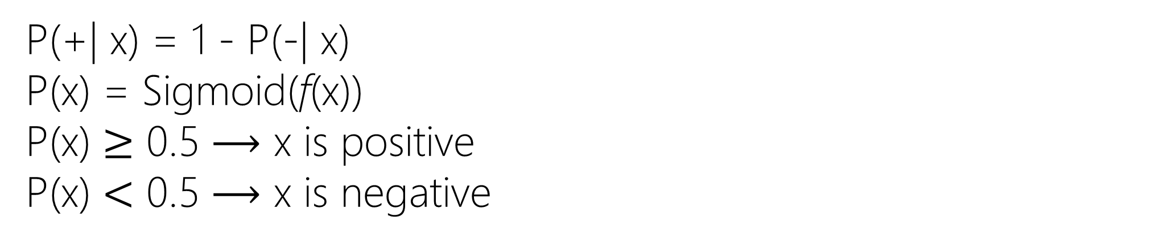
Threshold-based Model
$δ$=0.5
P(+| x) = 1 - P(-| x)
P(x) = Sigmoid(f(x))
P(x) $≥$ 0.5 $⟶$ x is positive
P(x) $<$ 0.5 $⟶$ x is negative
+
+
-
+
-
-

Slide 42
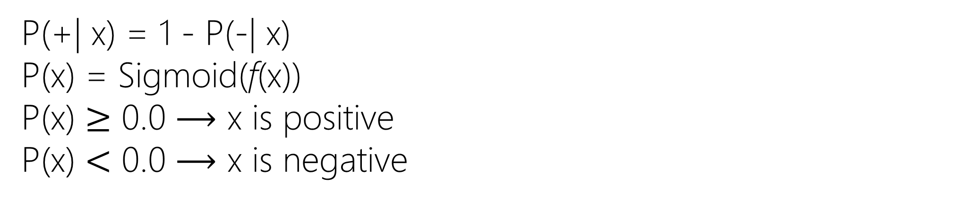

Threshold-based Model
$δ$=0.0 $⟶$Biased Model $⟶$All are positives
P(+| x) = 1 - P(-| x)
P(x) = Sigmoid(f(x))
P(x) $≥$ 0.0 $⟶$ x is positive
P(x) $<$ 0.0 $⟶$ x is negative
+
+
-
+
-
-

Slide 43
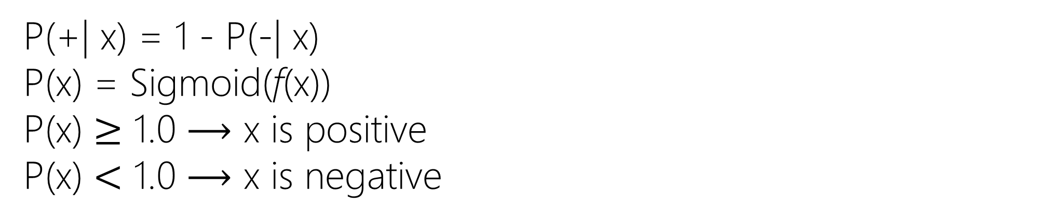

Threshold-based Model
$δ$=1.0 $⟶$Biased Model $⟶$All are negatives
P(+| x) = 1 - P(-| x)
P(x) = Sigmoid(f(x))
P(x) $≥$ 1.0 $⟶$ x is positive
P(x) $<$ 1.0 $⟶$ x is negative
+
+
-
+
-
-

Slide 44
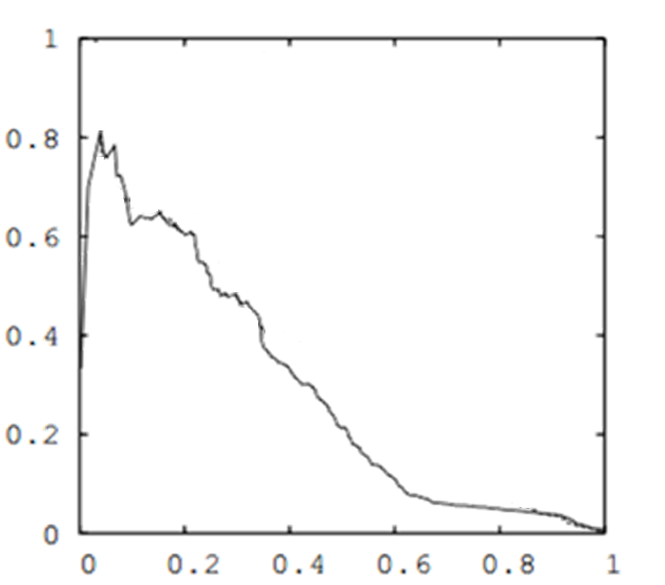

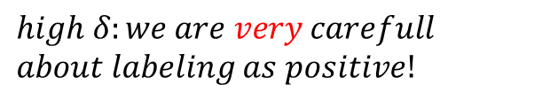



Precision-Recall Curve: Best $δ$
Precision
$$high δ:we are very carefull$$
$$about labeling as positive!$$
+
+
-
+
$$δ?$$
-
-
$$δ:0.0 →1.0$$
$$δ?$$
Recall

Slide 45
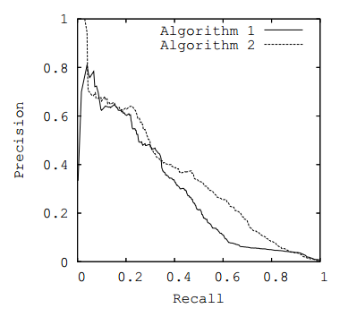
Precision-Recall Curve: Model Comparison
Precision
Recall

