Slide 1

Ukraine International Airlines Flight 752
https://en.wikipedia.org/wiki/Ukraine_International_Airlines_Flight_752

Slide 2
Sentiment analysis Evaluation

Slide 3
Receiver Operating Characteristic
ROC
The ROC curve was first developed by electrical engineers and radar engineers during World War II for detecting enemy objects in battlefield!
Missile attack vs. passenger airplane!

Slide 4
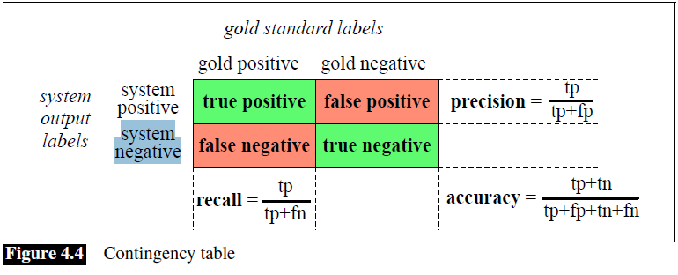
Recall aka True Positive Rate (TPR)
What percentage of positives are captured.

Slide 5
False Positive Rate (FPR)
What percentage are incorrectly captured as positives!

Slide 6
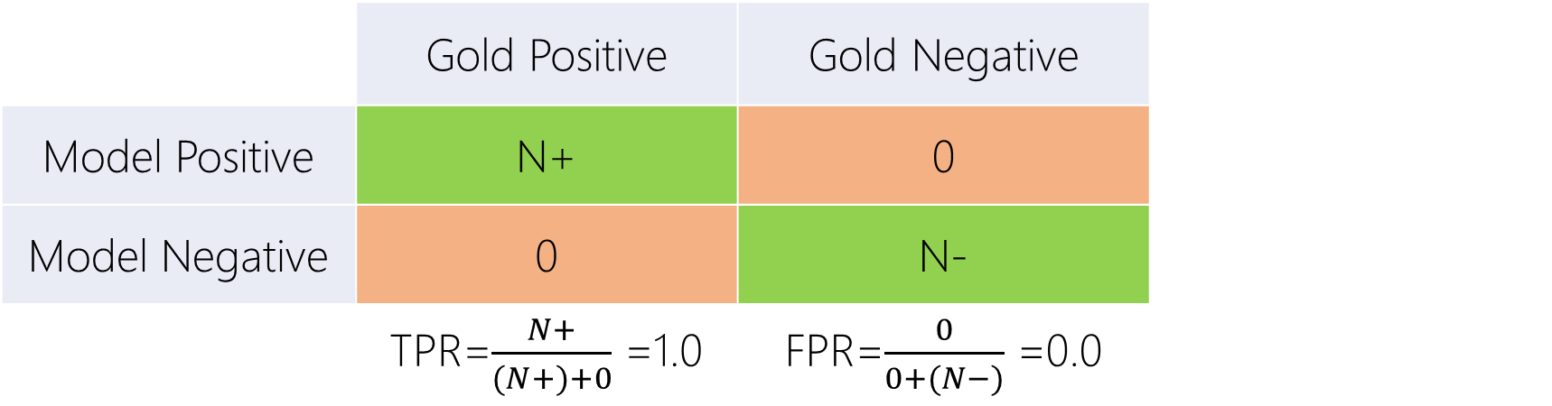
Perfect Classifier
 | Gold Positive | Gold Negative
Model Positive | N+ | 0
Model Negative | 0 | N-
 | TPR=$\frac{N+}{(N+)+0}$ =1.0 | FPR=$\frac{0}{0+(N−)}$ =0.0

Slide 7
TPR-FPR Curve
Recall
TPR
FPR

Slide 8
Perfect Classifier
 | Gold Positive | Gold Negative
Model Positive | N+ | 0
Model Negative | 0 | N-
 | TPR=$\frac{N+}{(N+)+0}$ =1.0 | FPR=$\frac{0}{0+(N−)}$ =0.0

Slide 9
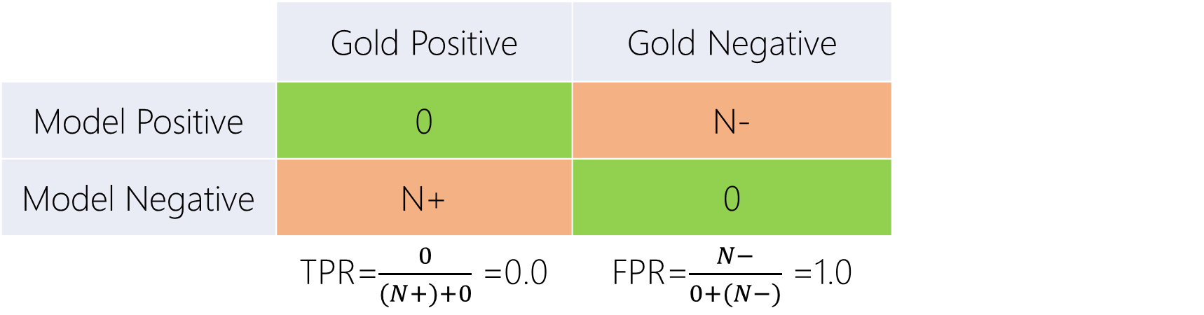
Worst Classifier
 | Gold Positive | Gold Negative
Model Positive | 0 | N-
Model Negative | N+ | 0
 | TPR=$\frac{0}{(N+)+0}$ =0.0 | FPR=$\frac{N−}{0+(N−)}$ =1.0

Slide 10
TPR-FPR Curve
Recall
TPR
FPR

Slide 11
Uniformly Random Classifier
 | Gold Positive | Gold Negative
Model Positive | ? | ?
Model Negative | ? | ?
 | TPR=0.5 | FPR=0.5

Slide 12
TPR-FPR Curve
Recall
TPR
FPR

Slide 13
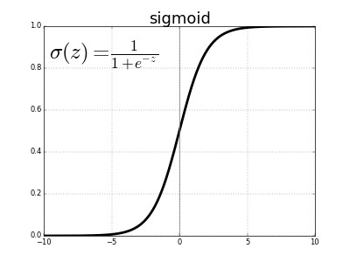


TPR-FPR Curve
Recall
TPR
$$δ?$$
$$δ:0.0 →1.0$$
FPR

Slide 14

TPR-FPR Curve
Recall
TPR
$$δ:0.0 →1.0$$
$$δ?$$
FPR

Slide 15
What is this model?
Recall
TPR
$$δ:0.0 →1.0$$
FPR

Slide 16
ROC
Recall
TPR
$$δ:0.0 →1.0$$
FPR

Slide 17
ROC
Recall
TPR
$$δ:0.0 →1.0$$
FPR

Slide 18
Area Under Curve (AUC): Single Real Point
Recall
TPR
Area Under Curve
(AUC)
Max = ?
Min = ?
$$δ:0.0 →1.0$$
FPR

Slide 19
Area Under Curve (AUC): Single Real Point
Recall
TPR
Best Threshold?
$$δ:0.0 →1.0$$
FPR

Slide 20
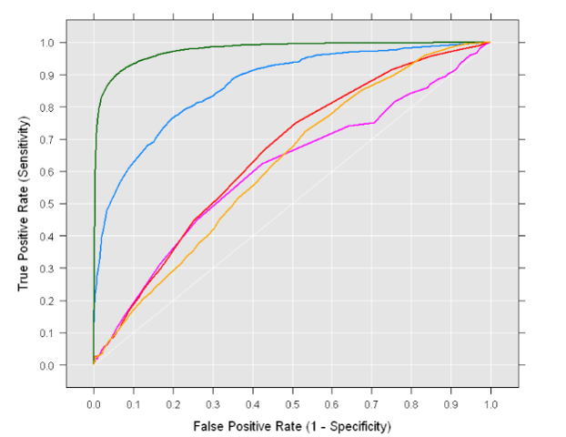





ROC: Model Comparison
$$δ1$$
$$δ2$$
$$δ3$$
$$A$$
$$B$$
Which one? A or B?

Slide 21
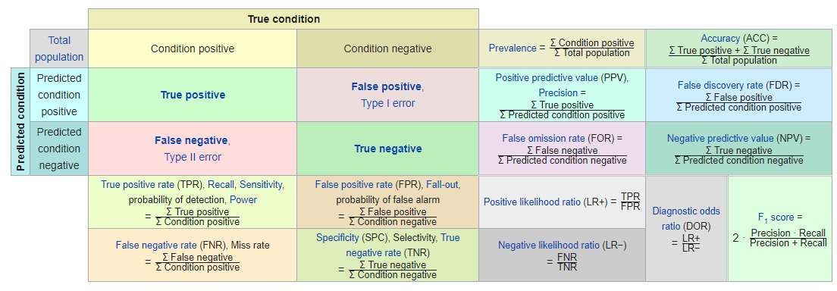
Other Metrics
https://en.wikipedia.org/wiki/Precision_and_recall

Slide 22
Calculate the metrics/curves

Slide 23
Labeled Data = {Train} U {Test}

Slide 24
Labeled Data = {Train} U {Test}
Model
Can See Everything
Train
Sampled World
Real World
Can NOT See Labels
Test

Slide 25
Labeled Data = {Train} U {Test}
{Train} $∩$ {Test} $\overset{?}{=}$ $∅$

Slide 26

Imbalance Labeled Data = {Train} U {Test}
{Train} $∩$ {Test} $\overset{?}{=}$ $∅$
Train and test sets presumably follow same distribution!

Slide 27
Underfit → Balance fit ← Overfit

Slide 28
ROC_{train}
Recall
TPR
The model couldn’t learn anything from training set!
ROC_{Test} =?
Random
ROC_{train}
$$δ:0.0 →1.0$$
FPR

Slide 29
ROC_{test}
Recall
TPR
ROC_{train}
The model performs well on train set. It means it learnt!
But performs poor in test set. It only know train set. Cannot generalize!
Random
ROC_{test}
$$δ:0.0 →1.0$$
FPR

Slide 30
ROC_{test}
Recall
TPR
ROC_{train}
The model performs well on train set. It means it learnt!
But performs poor in test set. It only know train set. Cannot generalize!
ROC_{test}
Random
$$δ:0.0 →1.0$$
FPR

Slide 31
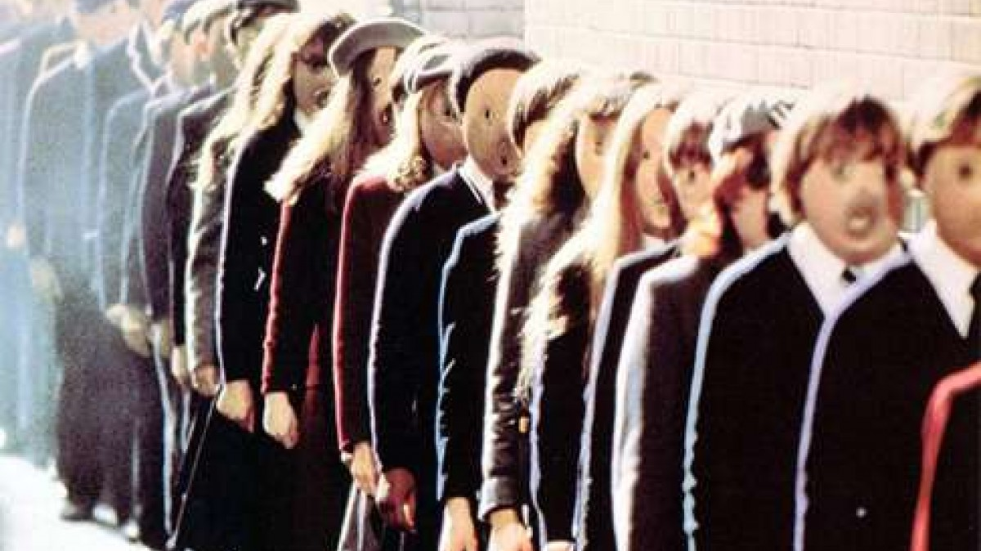

Slide 32
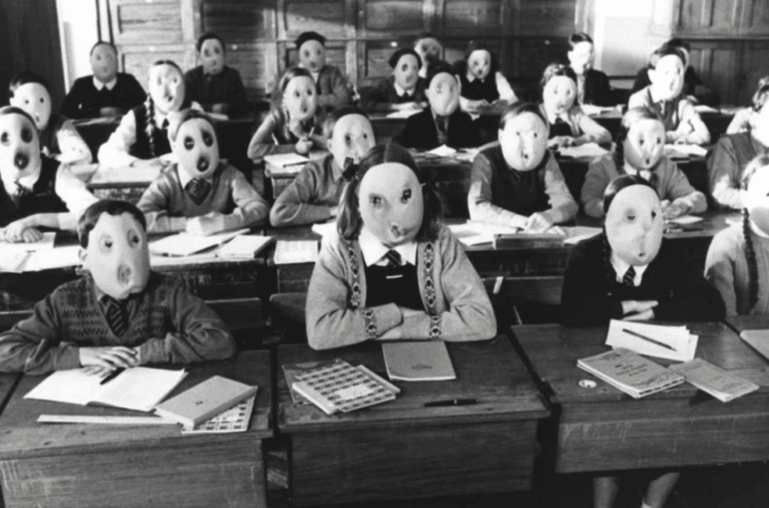
Universe
School
Underfit
Class
Model
Metric
Lecture
Train Set
Data
Student
Evaluation
Test Set
Exam
Overfit
Grade
Life

Slide 33
Model Tuning
Find the best running settings of the mode
#layers
Activation functions
Probs. assumption

Slide 34
Model Tuning
Find the best running settings of the mode
Checking the performance of model on Train and Test
For all different possibilities
Blind grid search! Brute-force

Slide 35
Model Tuning
Find the best running settings of the mode
Learn the performance of model on Train and Test
For all different possibilities
Guided grid search!

Slide 36
Model Tuning
Find the best running settings of the mode
Learn the performance of model on Train and Test
For all different possibilities
Guided grid search!

