Slide 1

Photo By: David Doubilet

Slide 2



CIKM AnalytiCup
Lazada Product Title Quality Challenge
¹$6,000
²$2,000
³$1,000
$2,000
Zillow Prize: Zillow’s Home Value Prediction (Zestimate) $1,200,000

Slide 3

Photo By: Justin Hofman

Slide 4


“hot sexy red clutch rug sack travel backpack unisex cheap with free gift”
$y_{1}$clarity
$y_{2}$conciseness
“Hot Sexy Tom Clovers Womens Mens Classy Look Cool Simple Style Casual Canvas Crossbody Messenger Bag Handbag Fashion Bag Tote Handbag Gray”
Notes:
On Lazada, we have millions of products across thousands of categories.
To stand out from the crowd, sellers employ creative, sometimes disruptive efforts to improve their search relevancy or attract the attention of customers.
Product titles like this degenerate user experience by cluttering the site with irrelevant, misleading titles. In this challenge, we provide you with a set of product titles, description, and attributes, together with the associated title quality scores (clarity and conciseness) as labeled by our internal QC team.
Your task is to build a product title quality model that can automatically grade the clarity and the conciseness of a product title. ‘judging a book by its cover’

Slide 5

Photo By: David Doubilet

Slide 6
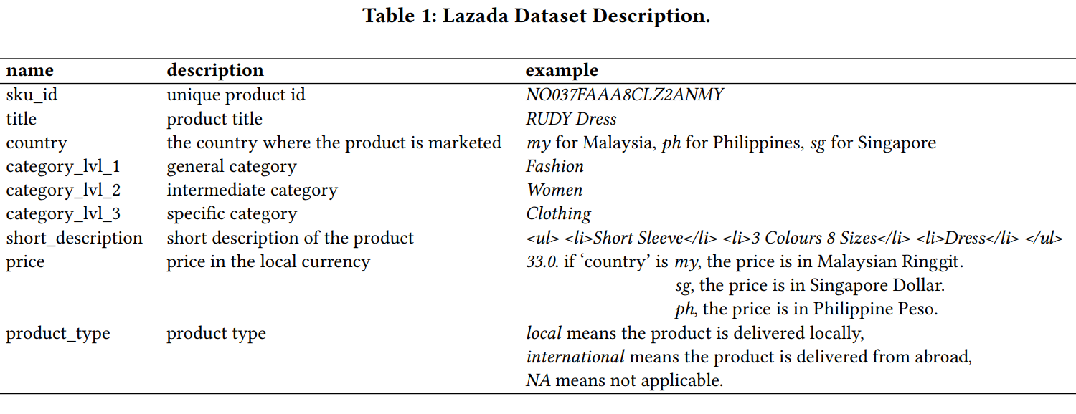
Clarity The title is clear if within five seconds one can understand the title, what the product is, and quickly figure out the key attributes (color, size, model, ...).
Conciseness The title is concise if it is short enough to contain all the necessary information. Otherwise, i.e., the title is too long with many unnecessary words, Or it is too short such that it is unsure what the product is.

Slide 7

Photo By: Keith Monroe

Slide 8
Cleansing
Noise
Missing Values
Outliers
Flirting
Attributes
Labels (if any)
Augmentation
Feature Eng.
Extraction
Reduction
Selection
Model Eng.
Selection
Tuning
Evaluation
ML-DM

Slide 9
Cleansing
Noise
Html tags in ‘short_description’ (%94)
Missing Values
‘product_type’ (less than %1)
‘category_lvl_3’ (about %6) → assign ‘category_lvl_2’
‘description’ (less than %1)
Outliers
‘price’ {-1, 999999, 9999999},
‘price’ Normalization based on country

Slide 10
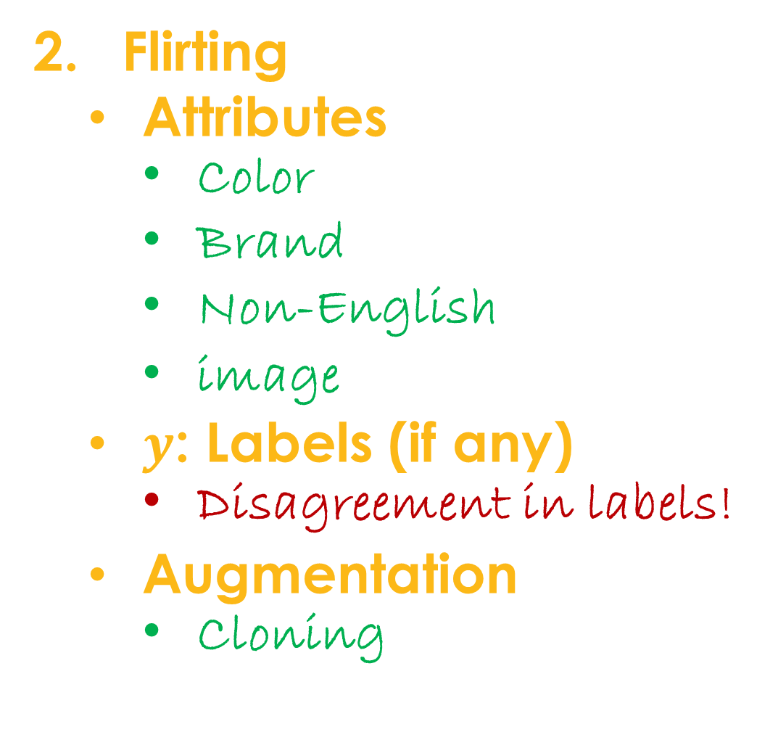
Flirting
Attributes
Color
Brand
Non-English
image
$y$: Labels (if any)
Disagreement in labels!
Augmentation
Cloning

Slide 11
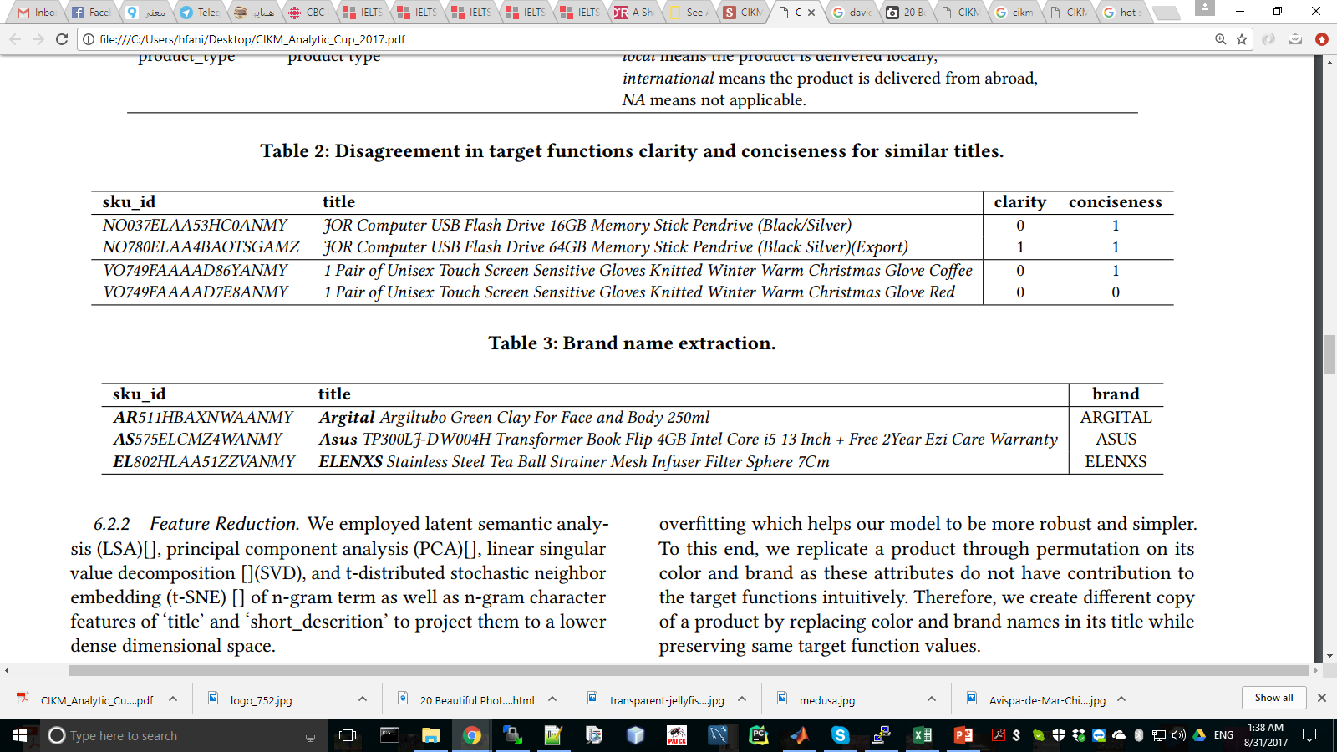

Slide 12
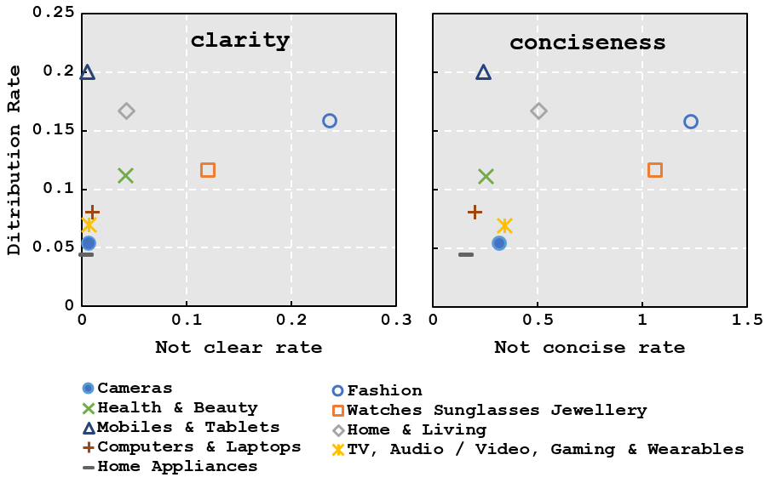

Slide 13
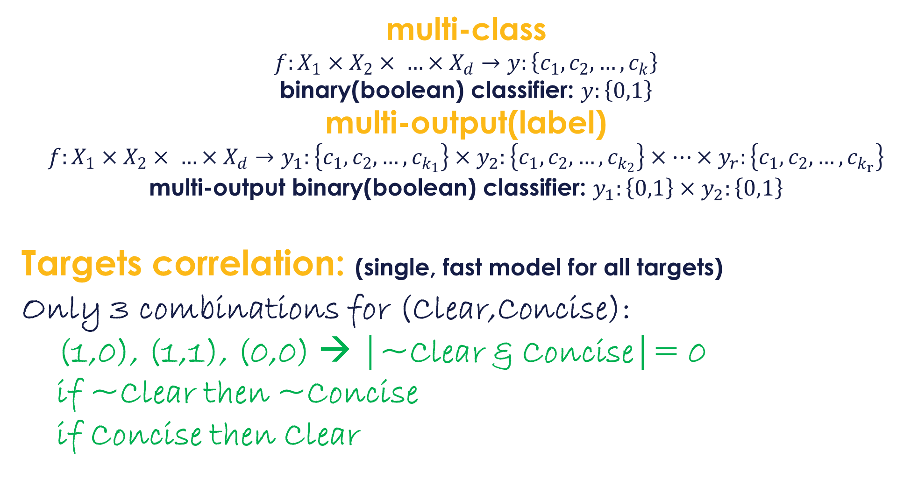
multi-class
$$f:X_{1}×X_{2}× …×X_{d}→y:\left\{c_{1},c_{2},…,c_{k}\right\}$$
binary(boolean) classifier: $y:\left\{0,1\right\}$
multi-output(label)
$$f:X_{1}×X_{2}× …×X_{d}→y_{1}:\left\{c_{1},c_{2},…,c_{k_{1}}\right\}×y_{2}:\left\{c_{1},c_{2},…,c_{k_{2}}\right\}×…×y_{r}:\left\{c_{1},c_{2},…,c_{k_{r}}\right\}$$
multi-output binary(boolean) classifier: $y_{1}:\left\{0,1\right\}{×y}_{2}:\left\{0,1\right\}$
Targets correlation: (single, fast model for all targets)
Only 3 combinations for (Clear,Concise):
(1,0), (1,1), (0,0) → |~Clear & Concise|= 0
if ~Clear then ~Concise
if Concise then Clear
Notes:
Contraposition
Use one target as a feature for the other one. But has problem in practice since we don’t have the validation or test sets’ label.

Slide 14

Photo By: Allen Walker

Slide 15
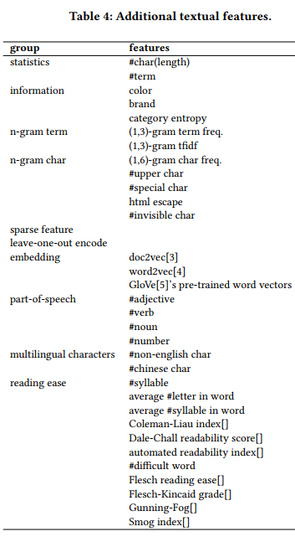
Feature Eng.
Extraction
Reduction
LSA,T-SNE,PCA,SVD
Selection
STD
Correlation X~y
Linear(t-test, chi2)
Non-linear(mi)
Model-driven
LinearSVM
Notes:
Plus the attributes, we extract more features from the textual attributes, title and short_description
stability selection
recursive feature elimination and cross-validation

Slide 16
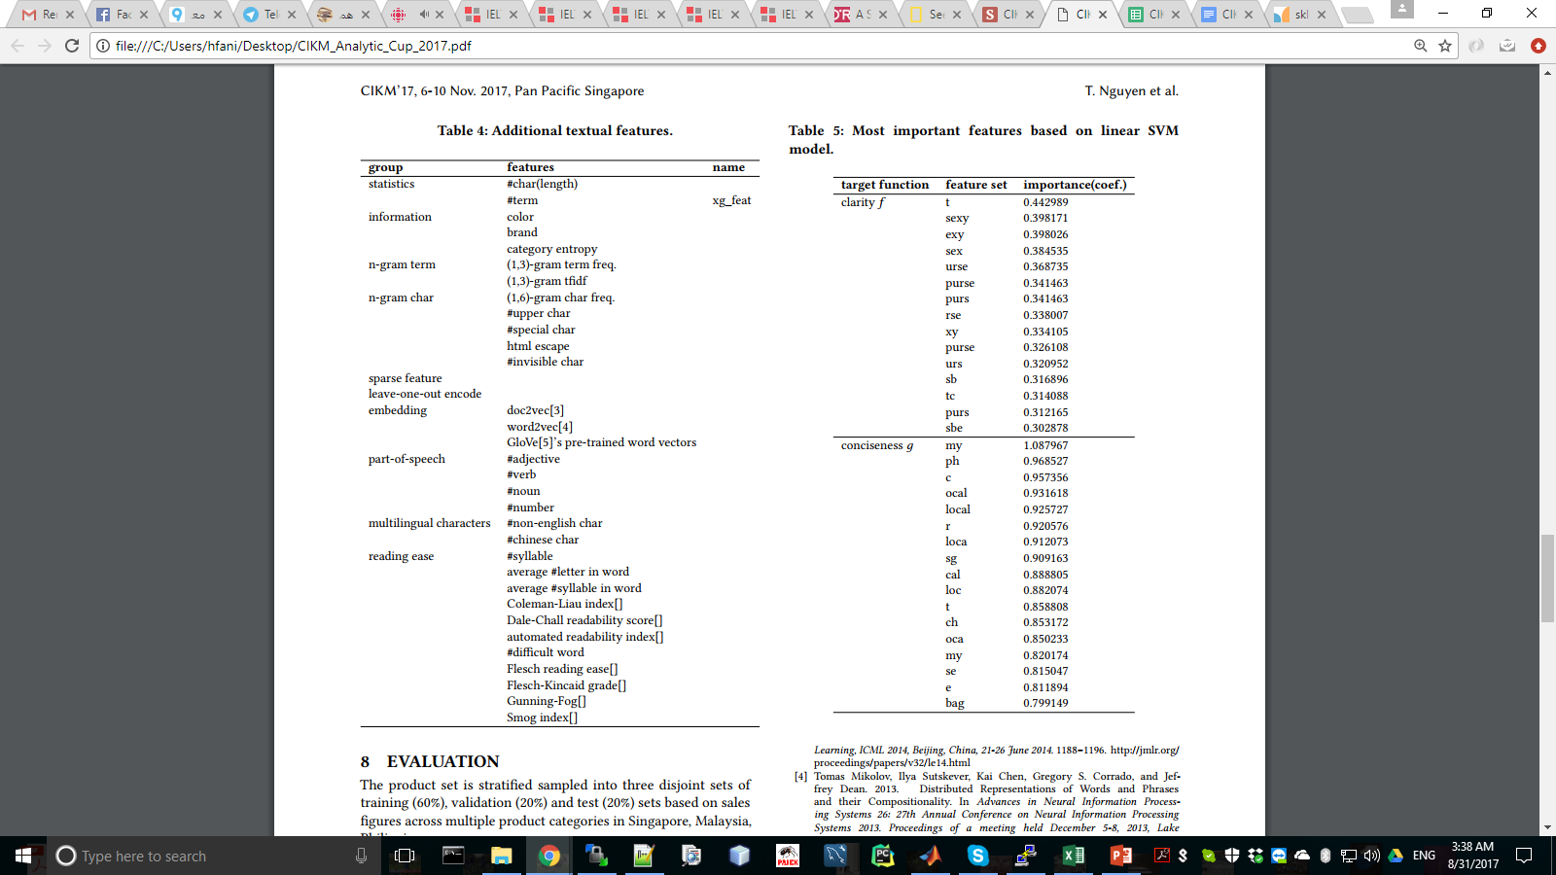

Slide 17

Photo By: Stéphane Ducandas

Slide 18
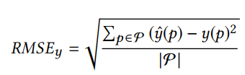

Model Eng.
Selection
Regressor
DT, RF, LR, NB, XGBoost, NNet (DL)
Classifier
Tuning
Grid Search
Randomized
Expert
Evaluation
metrics

Slide 19
Evaluation
metrics
Predefined fold-splits
Train/Valid(2000)/Test(10)
cross-validation
LOO
LPO
K-fold
Stratified k-fold

Slide 21
TAM

Slide 22
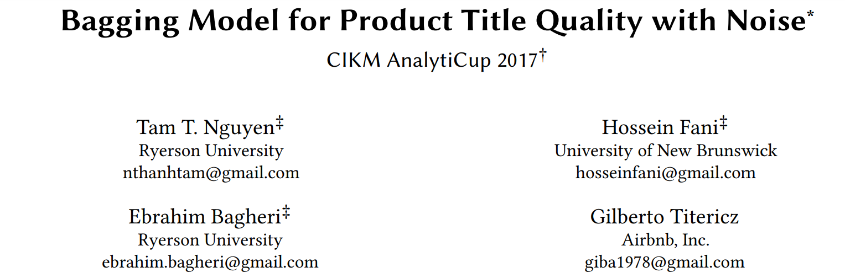
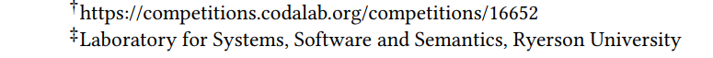

Slide 23
Motivation

Slide 24
Bagging Model
10-Fold Set 1
10-Fold Set 2
10-Fold Set 3
10-Fold Set 4
Base Model
STACK
BLEND
STACK
BLEND
STACK
BLEND
STACK
BLEND
Fold Bagging
Ensemble Model
BLEND
BLEND
BLEND
BLEND
Fold Bagging
BLEND
Set Fold Bagging
Final Prediction

Slide 25

Photo By: Matthew Smith

