Slide 1

GIT

Slide 2
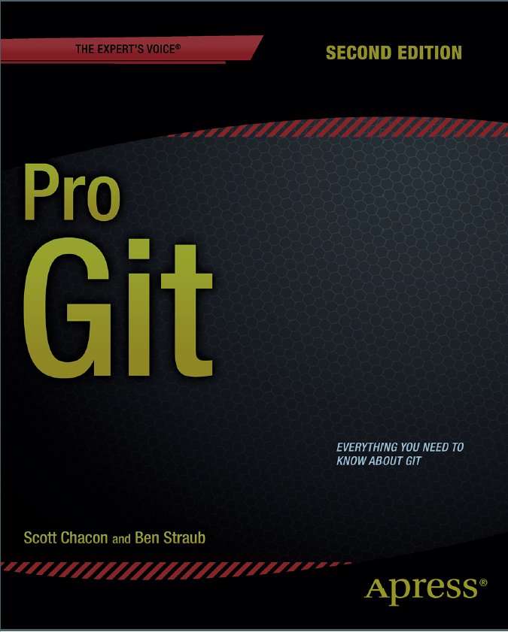
Resource
https://git-scm.com

Slide 3
Version Control Systems
Local Version Control Systems
Centralized Version Control Systems
Distributed Version Control Systems

Slide 4
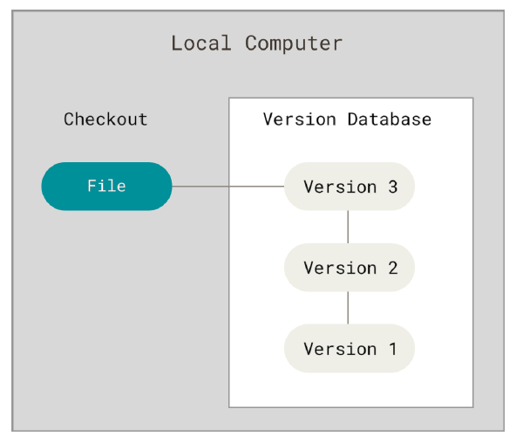
Local Version Control Systems

Slide 5
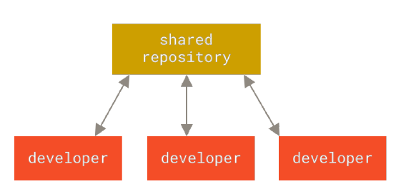
Centralized Version Control Systems

Slide 6
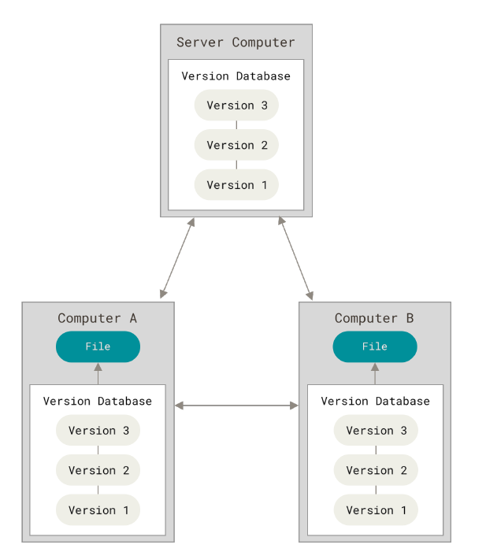
Distributed Version Control Systems

Slide 7
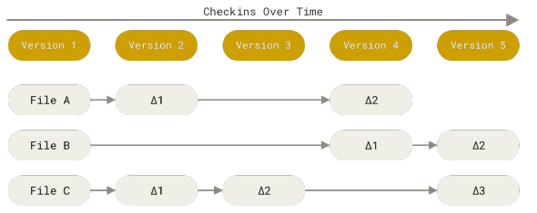
Snapshots, Not Differences
The major difference between Git and any other VCS is the way Git thinks about its data.
The other systems think of the information they store as a set of files and the changes made to each file over time (this is commonly described as delta-based version control).

Slide 8
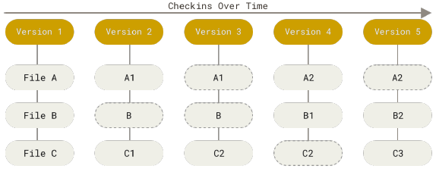
Snapshots, Not Differences
Git thinks of its data more like a series of snapshots of a miniature filesystem. With Git, every time you commit, or save the state of your project, Git basically takes a picture of what all your files look like at that moment and stores a reference to that snapshot. To be efficient, if files have not changed, Git doesn’t store the file again, just a link to the previous identical file it has already stored. Git thinks about its data more like a stream of snapshots.

Slide 9
Nearly Every Operation Is Local
Because you have the entire history of the project right there on your local disk, most operations seem almost instantaneous.
This also means that there is very little you can’t do if you’re offline.

