Slide 1

JavaScript crash course

Slide 2
What is JavaScript?

Slide 3
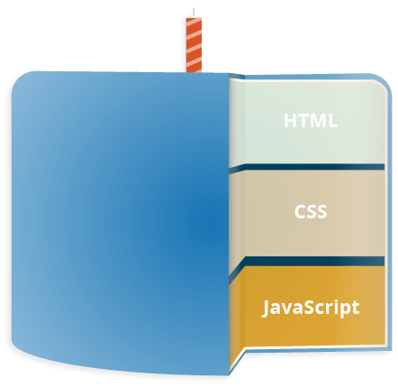
What is JavaScript?
JavaScript is a scripting language that enables you to create dynamically updating content, control multimedia, animate images, ….
It is the third layer of the layer cake of standard web technologies, two of which are HTML and CSS.

Slide 4



JAVASCRIPT TODAY
Front-end Developer
Back-end Developer
Full-stack Developer

Slide 5
JAVASCRIPT TODAY
Real-time Networking Apps
Web / Mobile Apps
Command-line Tools
Games

Slide 6
JavaScript Environments
Browser
Node
JavaScript Engine
Firefox: SpiderMonkey
Chrome: V8

Slide 7
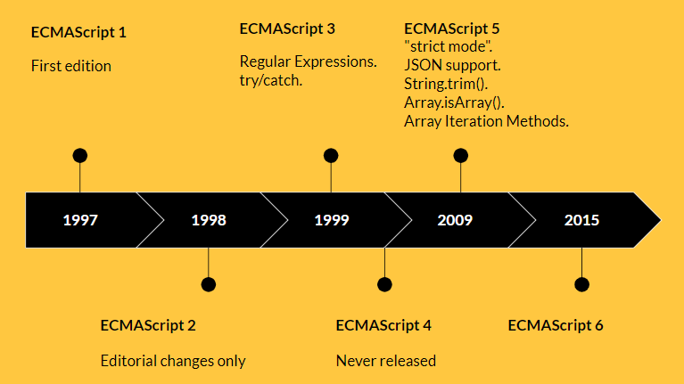
ECMAScript

Slide 8
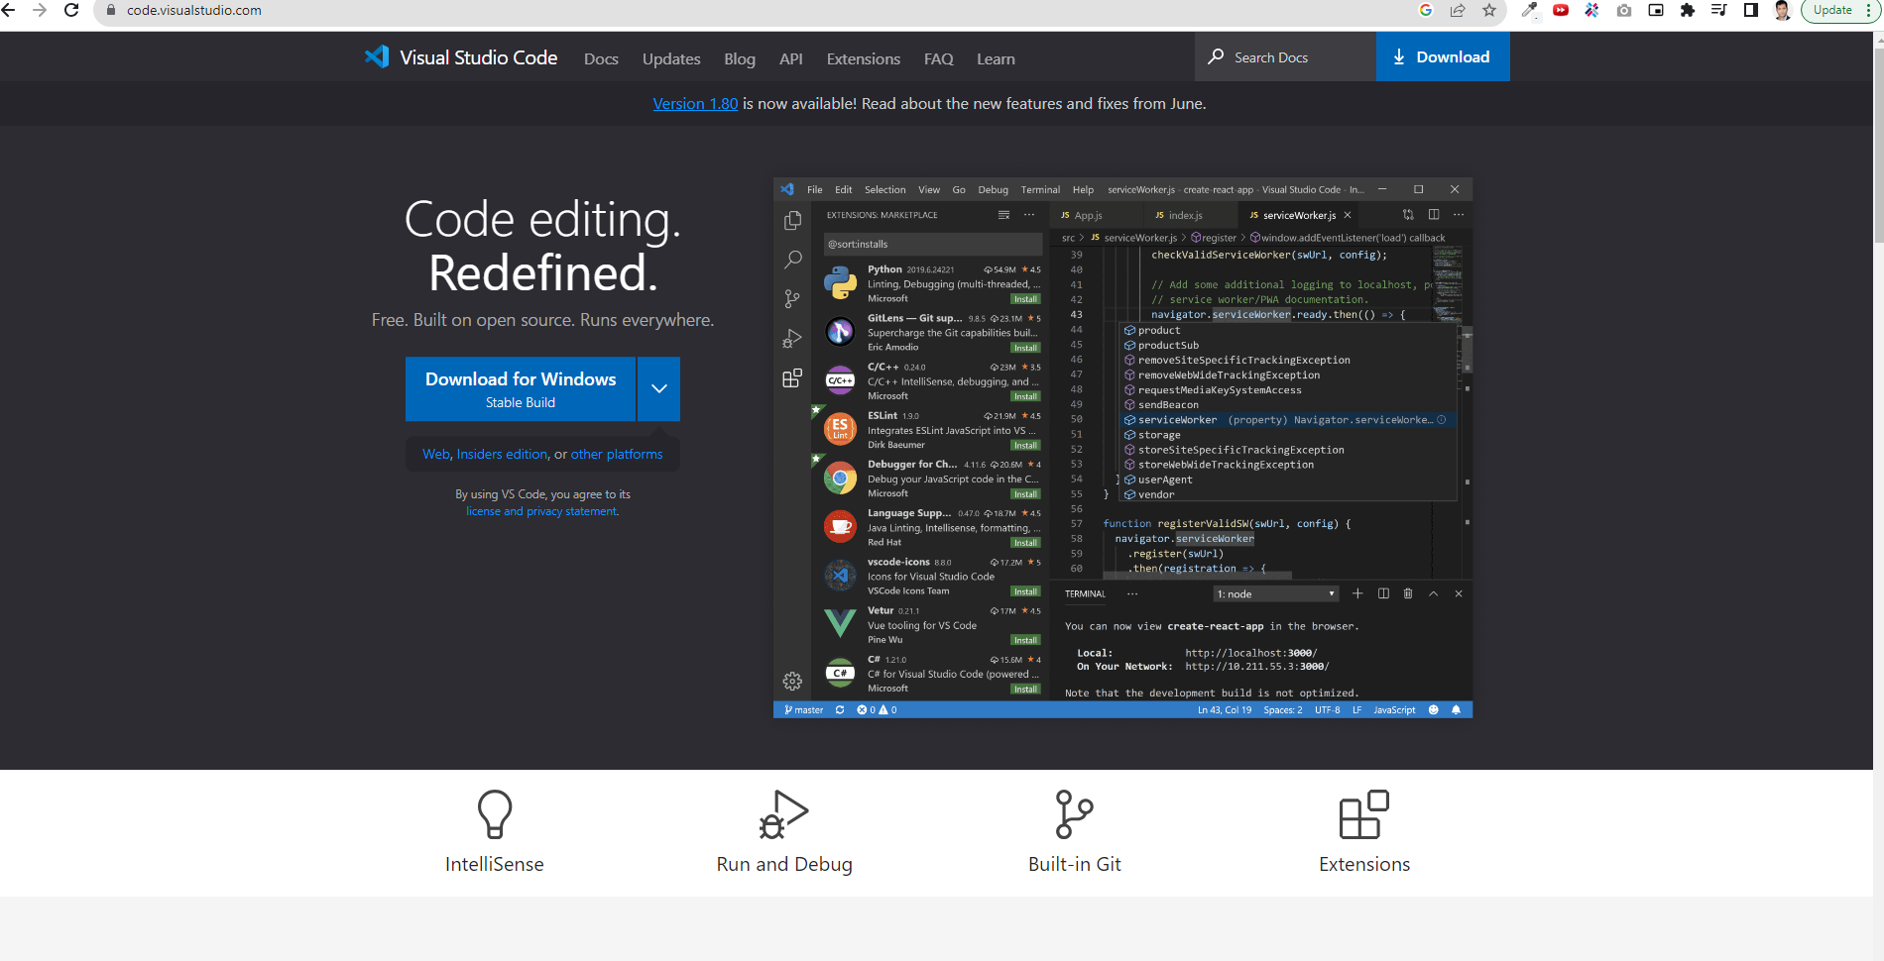
Editor

Slide 9
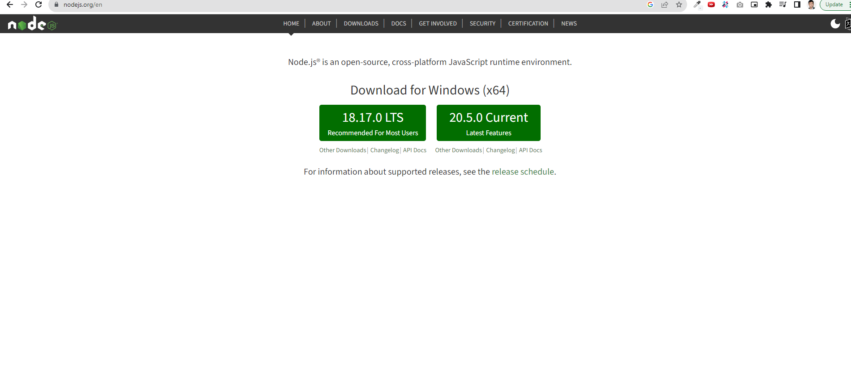
Node.js

Slide 10
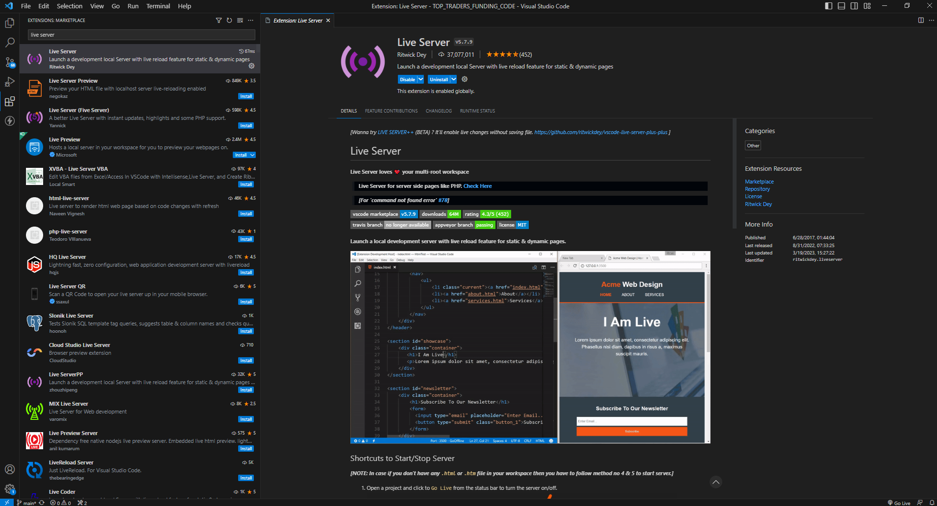
VSCode Extension
Live Server

Slide 11
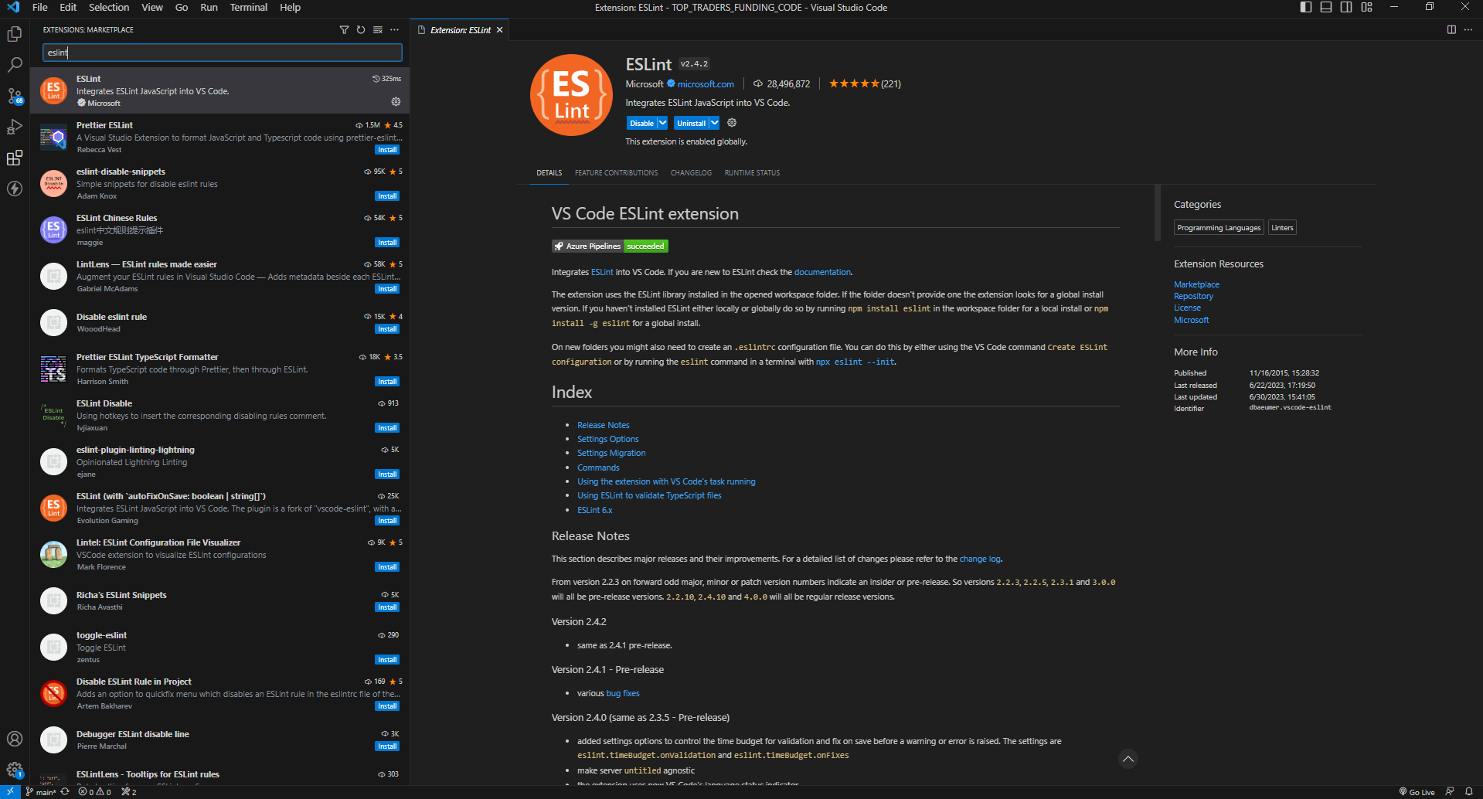
VSCode Extension
ESLint

Slide 12

Why is script tag at the bottom of HTML?
HTML is loaded and executed line by line. So, when the browser encounters a <script> tag, it loads and executes the JavaScript code on the spot. This may slow down the page rendering speed and thus webpage will take more time to load.

Slide 13
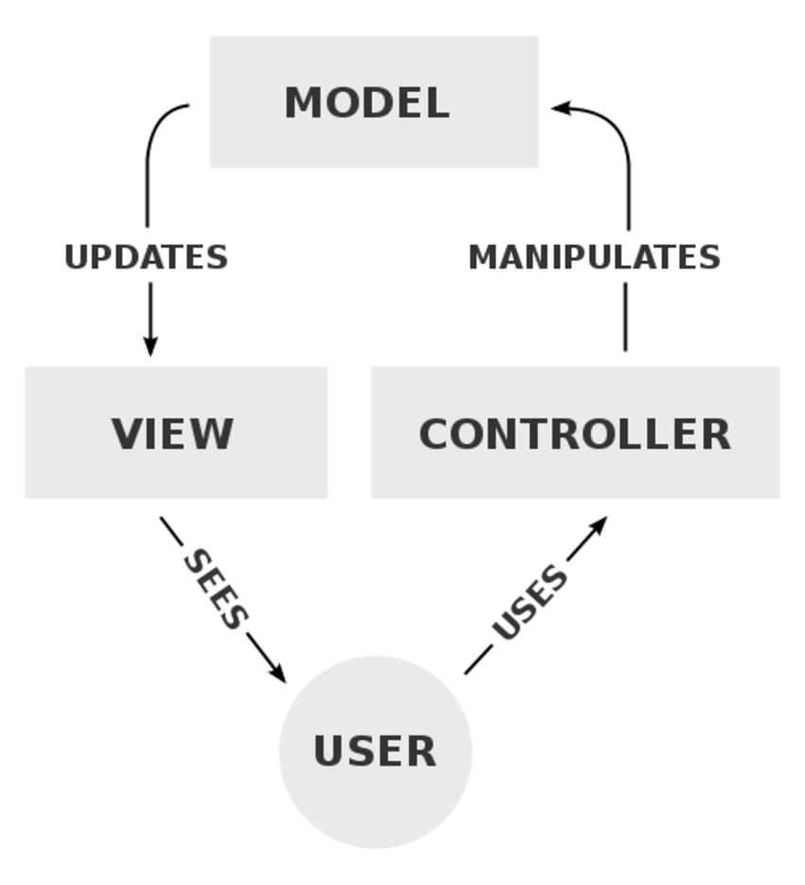
Separation of concerns
Separation of concerns is a principle used in programming to separate an application into units, with minimal overlapping between the functions of the individual units. The separation of concerns is achieved using modularization, encapsulation and arrangement in software layers.

Slide 14
Variables
A variable is a named container for a particular type of data.
Variable name:
Cannot be a reserved keyword
Should be meaningful
Cannot start with a number
Cannot contain a space or hyphen
Are case-sensitive
let keyword

Slide 15
Constants
Constant is an entity that refers to a fixed value of data and which cannot be modified.
Constant name:
Cannot be a reserved keyword
Should be meaningful
Cannot start with a number
Cannot contain a space or hyphen
Are case-sensitive
Constants written in UPPERCASE
const keyword

Slide 16
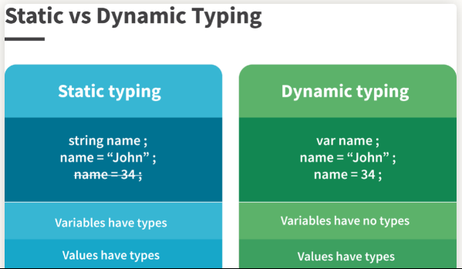
Statically vs Dynamically Typed Languages

Slide 17
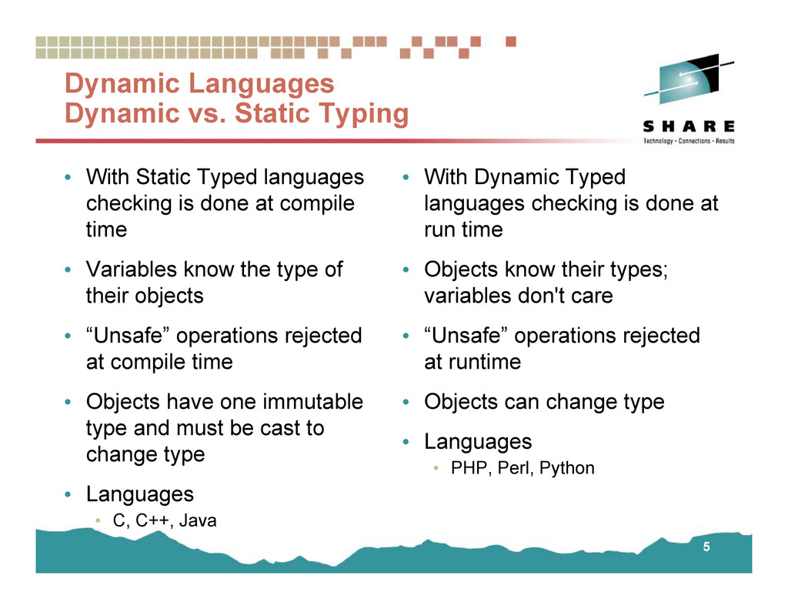
Statically vs Dynamically Typed Languages

Slide 18
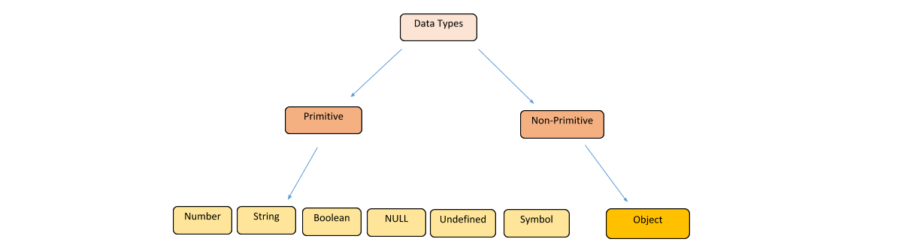
Data Types

Slide 19
Objects
Object are variables too. But objects can contain many values. It will be assigned many values to a variable.
Object literal

Slide 20
Accessing Object Properties
Dot Notation
Bracket Notation

Slide 21
Arrays
An array can hold many values under a single name, and you can access the values by referring to an index number.
Creating an Array:
Array literal

Slide 22
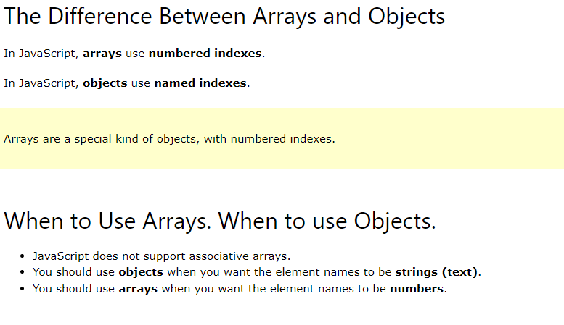
Arrays
Arrays are a special type of objects. The typeof operator in JavaScript returns "object" for arrays.

Slide 23
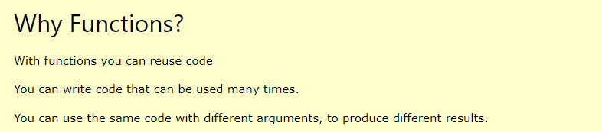
Functions
A JavaScript function is a block of code designed to perform a particular task.
A JavaScript function is executed when "something" invokes it (calls it).

Slide 24
ES6
let / const
let / const

Slide 25
var / let / const

