Slide 1
Hossein Komijani
Overlay measurement code challenge

Slide 2
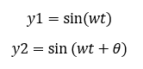
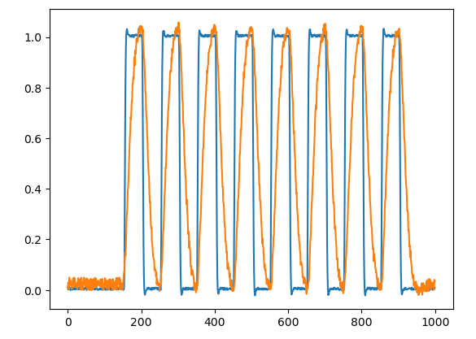
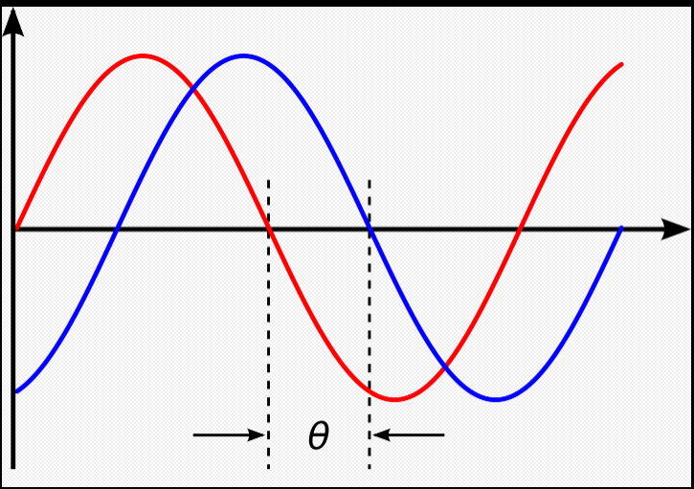
Phase Difference

Slide 3
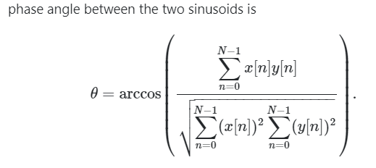
Phase Difference

Slide 4
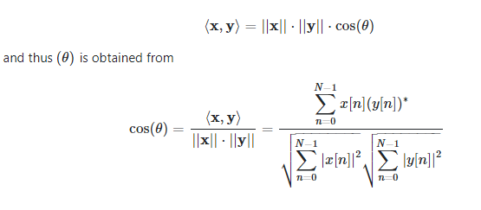

Phase Difference
Of course, these formula can be used for arbitrary signals, not just for pure sinusoids, but then, what you get is the _angle between the two vectors x=(x[0],x[1],…,x[N−1]) and y=(y[0],y[1],…,y[N−1]) in the N-dimensional spaces:

Slide 5
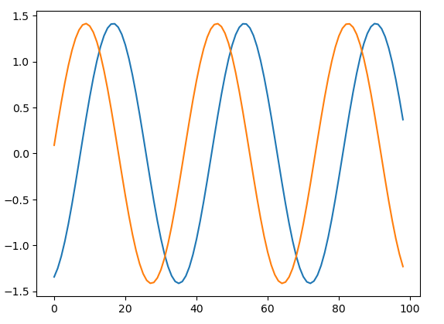
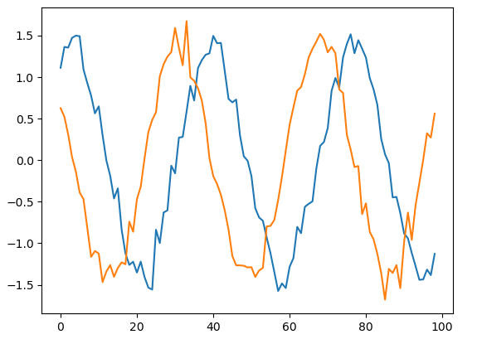

Slide 6

