Slide 1
SUPER MARIO CANNON BROS.
Hossein Mayanloo
Graham Bleaney

Slide 2
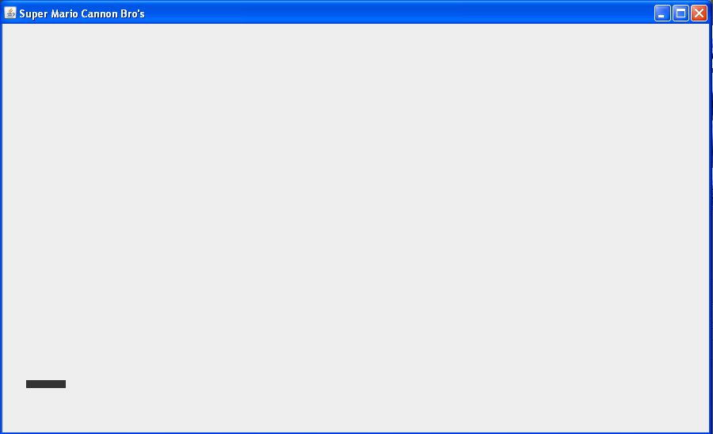
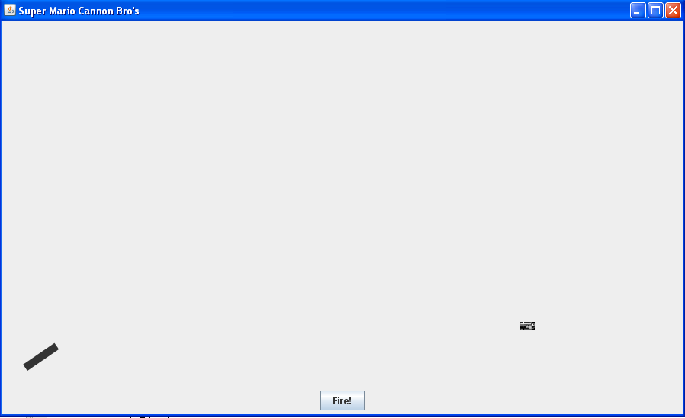
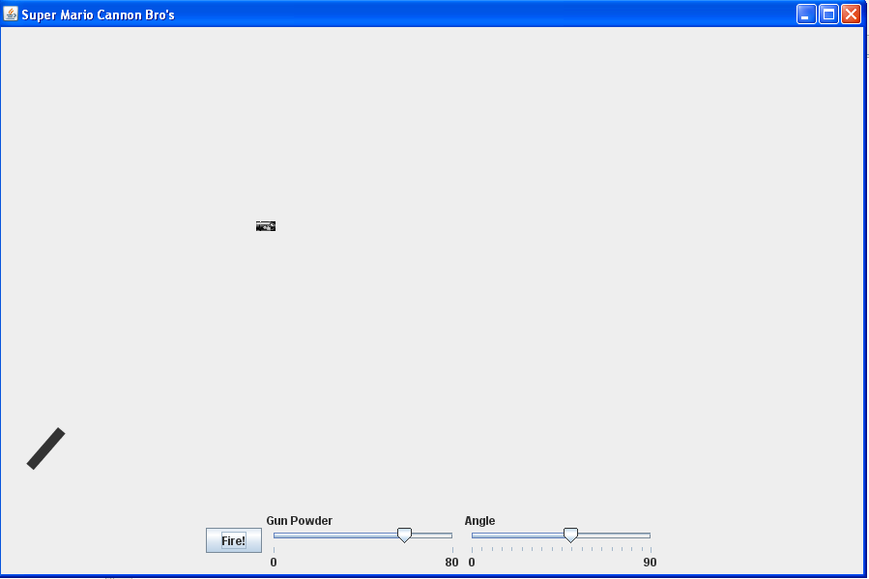
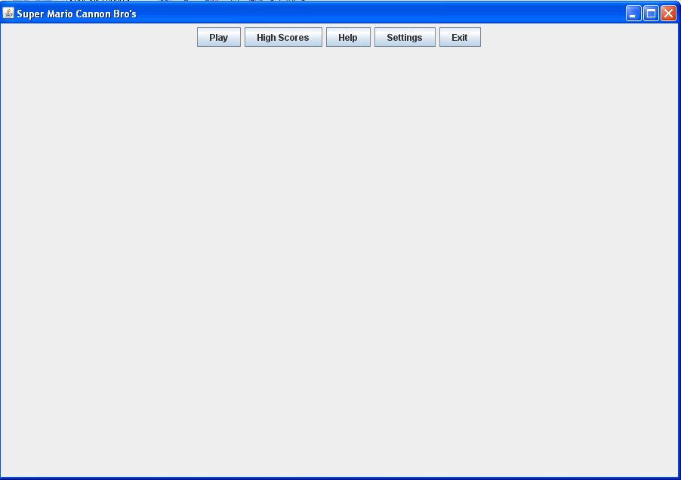
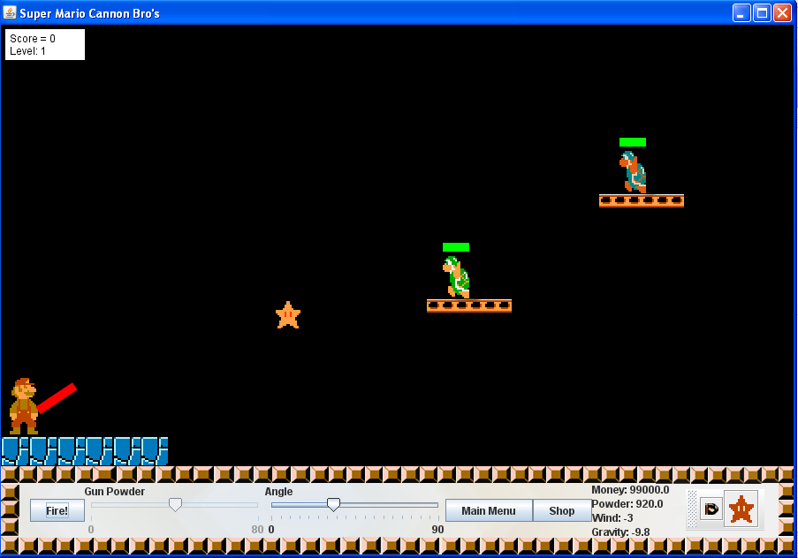
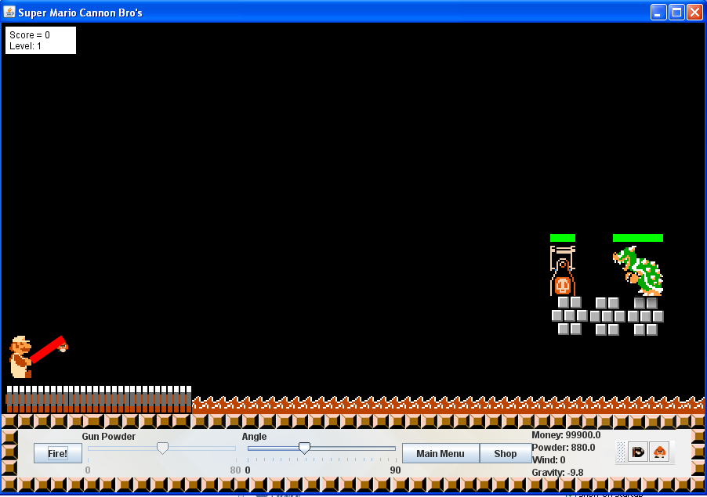
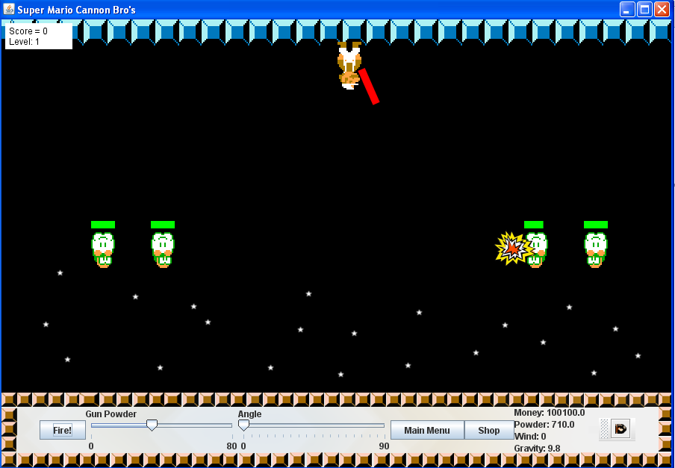

Slide 3
Specifications
Release Name | New incremental features of this release
1.0 “Murky Musket” | This release will determine the game window’s dimensions.
1.1 “The Winchester” | This release will cover basic mouse control of the cannon.
1.3 “Mk 1 Grenade” | This release will sketch the path of the projectile (without physics), so that the path resembles a straight line.
1.5 “Ross Rifle” | The game’s initial physics, such as gravity and velocity, will be created in this important release. The user will be able to shoot a basic projectile that will move in a parabolic-like path.
2.0 “Thompson” | Users will be able to adjust gunpowder and projectiles in this groundbreaking release. Each adjustment would change the path of the projectile.
2.1 “M42” | Further refinements will be added to make the game’s physics more realistic and vary between projectiles in this release.
2.3 “Mk 2 Grenade” | With this release, the game’s UI will be much more easily accessible to the end-user, with the creation of buttons and sliders to adjust gunpowder (velocity) and angle.
2.5 “PPS” | This release will introduce basic endgame rules. Ammunition will be depleted after each shot. By this release, our first Work-In-Progress report will be handed in.
3.0 “KA-BAR” | With this important release, basic artificial intelligence will be developed, and there will be an enemy target that will shoot back after the player’s turn. Collision detection will be added in this release. Also, this release will introduce a text file input/output system, where settings and environments will be defined by external text files.
*Green indicates features added that were not part of
the original release schedule.

Slide 4
Specifications
3.2 “AK-47” | Enemy health will be added and each weapon will be assigned a specific damage value.
3.5 “Remington 870” | This release will introduce a points system to the game. A high score system will be developed, where the user information is stored in text files.
3.6 “Dragunov” | Further refinements to the game’s physics system, such as the blast radius of different projectiles will be added.
4.0 “RPG-7” | This release will introduce a basic leveling system to the game’s AI. After the user has defeated their opponent, they will be fighting a more difficult enemy, with a higher amount of health.
4.2 “AK-74” | Improvements to game’s AI leveling system will be added, including better accuracy towards the player’s cannon, and better projectiles. By this point, our second Work-In-Progress report will be handed in.
5.0 “M4 Carbine” | This release will introduce a basic shop system, where the user is able to purchase upgrades/health improvements to their tank with their points. Shop levels alternate between normal levels.
5.5 “Mk 18” | This release will add a home menu page to the game. This is the initial screen that will be loaded when the user launches the game and loses the game. Also, the high score screen and help screen can be easily accessed from this page.
6.0 “ICBM” | A graphically-pleasing GUI, such as images of characters and projectiles will be added in this release. Game audio will also be introduced in this release.
6.1 “MOAB” | Extra graphics, such as the background image will be added in this release.
6.7 “Tsar Bomba” | This final release will clean up all the bugs and kinks and will also add any extra variables to the game’s physics, such as wind speed. This version will be the final version handed in.
*Red indicates features delayed until later in the release
schedule.

Slide 5
Revised Specifications
5.0 “M4 Carbine” | This release will add more static elements to the game, such as multiple bosses, destructible environments, boundaries, and blast radiuses.
5.5 “Mk 18” | This release will introduce gameplay elements, such as an END. Players will lose if they run out of money and gunpowder. Also, buttons will be added to the high scores list, where the end user will be able to sort the chart alphabetically, or by score, whether it be descending or ascending.
6.0 “ICBM” | The game will feature a competitive element with the introduction of AI in this release. Also, game audio will also be introduced in this release.
6.1 “MOAB” | There will be a help screen added in this release.
6.7 “Tsar Bomba” | This final release will clean up all the bugs and kinks. This version will be the final version handed in.

Slide 6
Accomplishments
Fully customizable
Understandable, efficient code
State-of-the-art 8-bit graphics

Slide 7
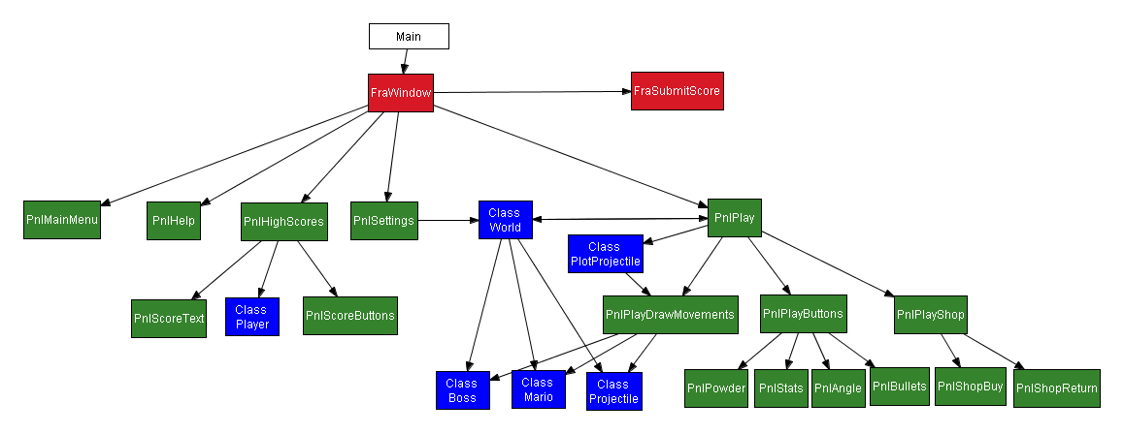
Hierarchical Diagram of our Program

Slide 8
Bugs
GIF files do not animate
Game lags sometimes when the projectile is moving
The menu bar produces errors when torn away from main game frame
The explosion animation does not show when the last boss is hit by a projectile and dies

Slide 9
Advanced Data Structures
Comparators for sorting high scores
ArrayLists for bosses

Slide 10
Now a Lesson!
(handling/passing information between two separate classes unaware of each other)

Slide 11
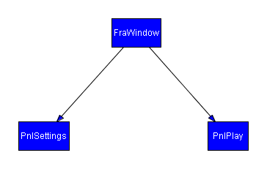

Slide 12
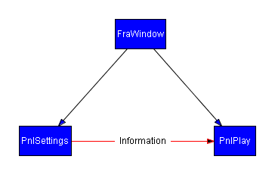

Slide 14
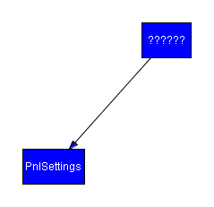

Slide 15


Slide 16
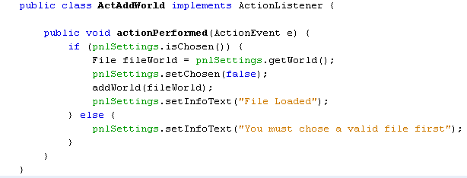
THE SOLUTION!

Slide 17
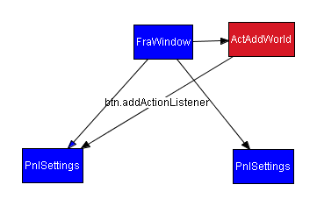

Slide 18
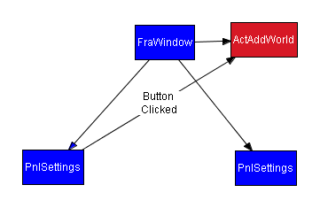

Slide 19
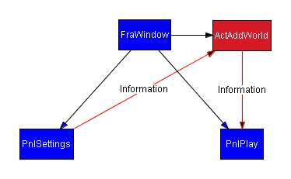

Slide 20
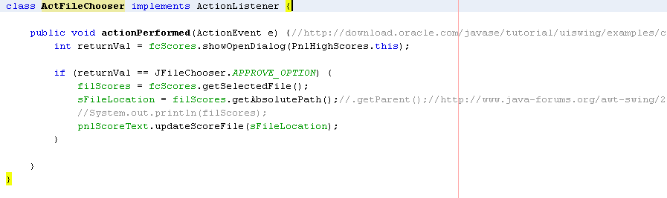
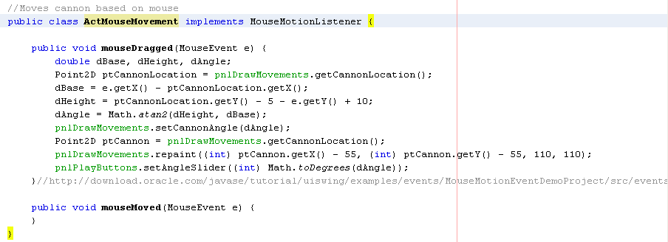
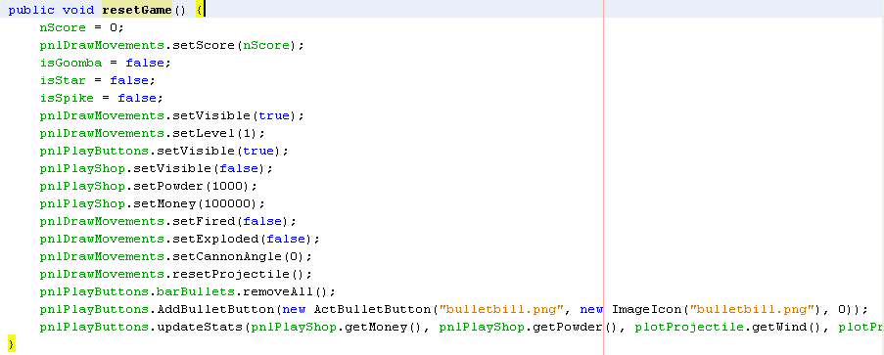
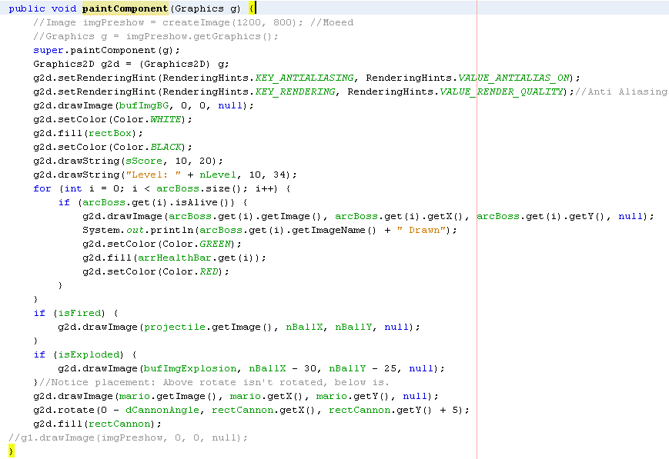
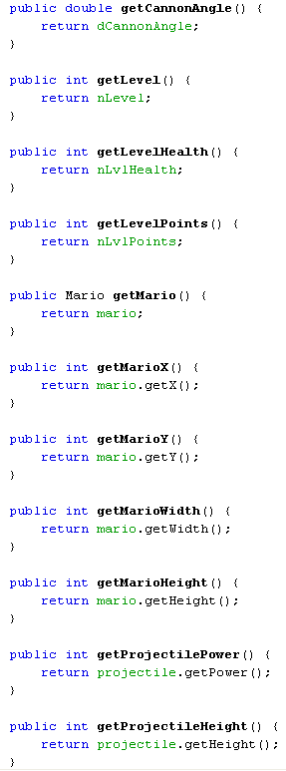
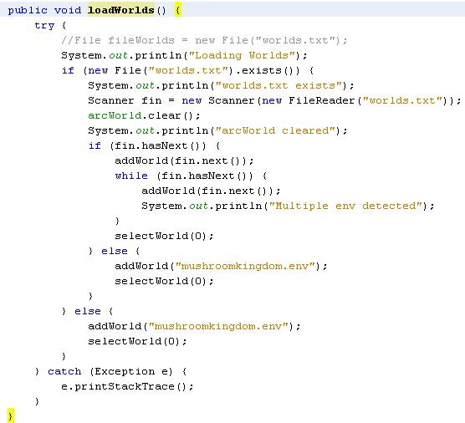
Our Finest Code

Slide 21
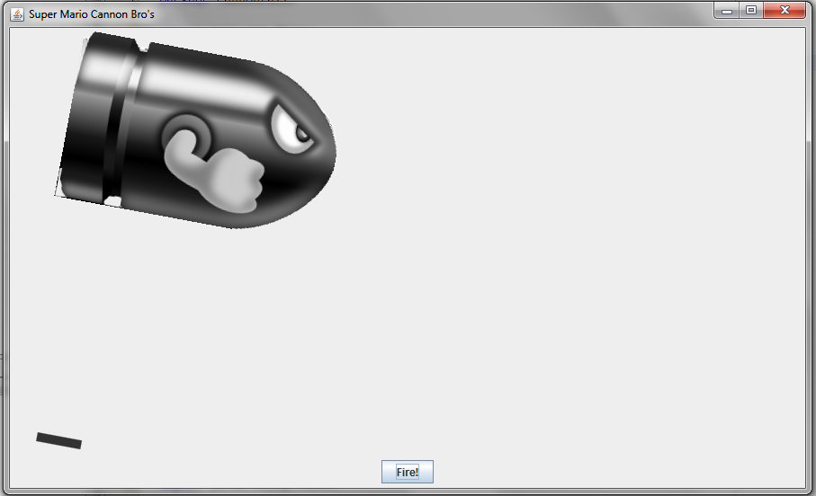
Biggest Frustration?
(aka Super Mario Cannon Bros. “Hammer Edition”)
FAIL.

Slide 22
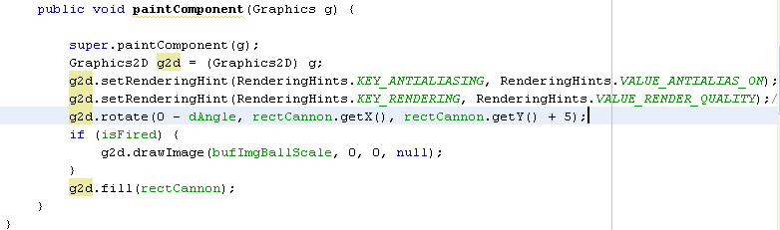
How do you rotate one image but not the other?
We were stuck on this for 3 days.

Slide 23
The Future of our Game?
Add destructible environments
Allow code to be imported along with the destructible environments
Instead of a hardcoded ground, allow one to be imported through .env file with image and location
Add a blast radius to projectiles
Break up the ActFired class (it has 11 nested structures!)
Add a way to lose the game
Make the environment file selector only show .env files and directories
Add Audio
Find alternative or solution to animate GIFs
Notes:
Add destructible environments (obstacles such as bricks that can removed)
Allow code to be imported along with the destructible environments so that anything can happen when a brick is hit, such as increased score, new projectiles, etc.
Instead of a hardcoded ground, allow one to be imported through env file with image and location
The ActFired class runs everything, but it is huge and cumbersome, break it up a bit
Add a blast radius to projectiles, so if they hit near a boss, they still do some damage
Add a way to lose the game (other than exiting to main menu)
Make the environment file selecter only show .env file and directories
Add Audio
Find alternative or solution to animate GIFs

Slide 24



End
The

Slide 25
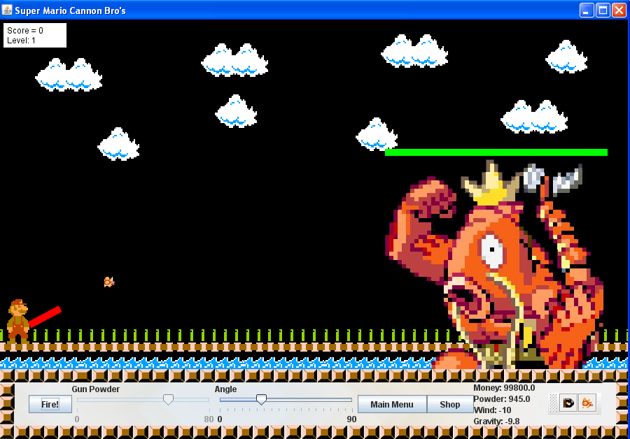
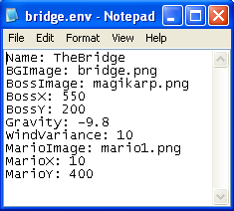

Slide 26
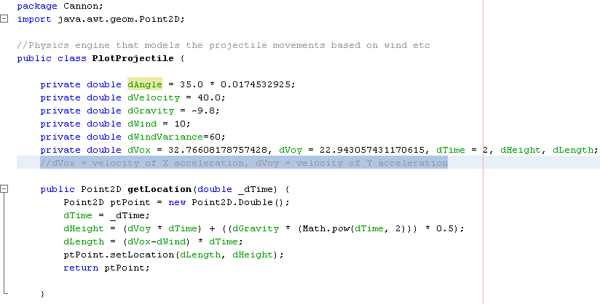
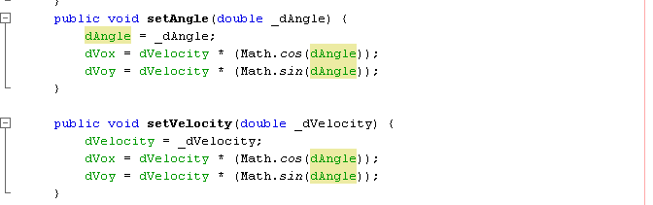

Slide 27
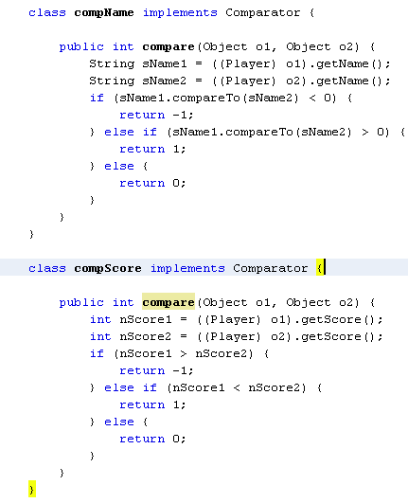

Slide 28
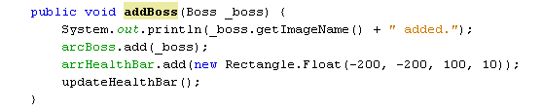
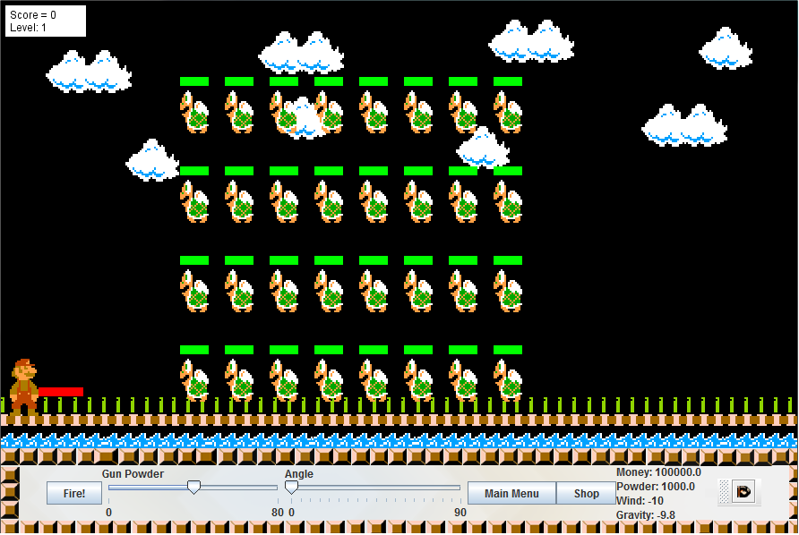
As many bosses as you want.

Slide 29
