Slide 1
Half-Time Exits
Group 7
presents…
Vishal Babu
Graham Bleaney
Hossein Mayanloo
Antoine Mctaggart
Farhan Munshi
Notes:
Hossein:

Slide 2
Background
Retail industry in Canada has a net operating revenue of over $400 billion
Small scale changes can have a large effect!
Stores require customers to line up at cash registers to make purchases
Notes:
Hossein:

Slide 3
The Problem
Inefficiencies produce bottlenecks
Unloading and reloading items when paying
Bottlenecks lead to shopping lines
Store lines frustrate customers
Can lead to loss of customers
Notes:
Hossein:

Slide 4
Current Solutions
Adding more cashiers
More costly for the store/reduces floor space
Self-checkout systems
Inefficient/reduce floor space
Notes:
Hossein:

Slide 5
Objectives
To devise a solution that will fulfill the needs of the customer, store, and manufacturer
To produce a testable prototype and a realistic design
To follow and apply the engineering design process
Notes:
Hossein:

Slide 6
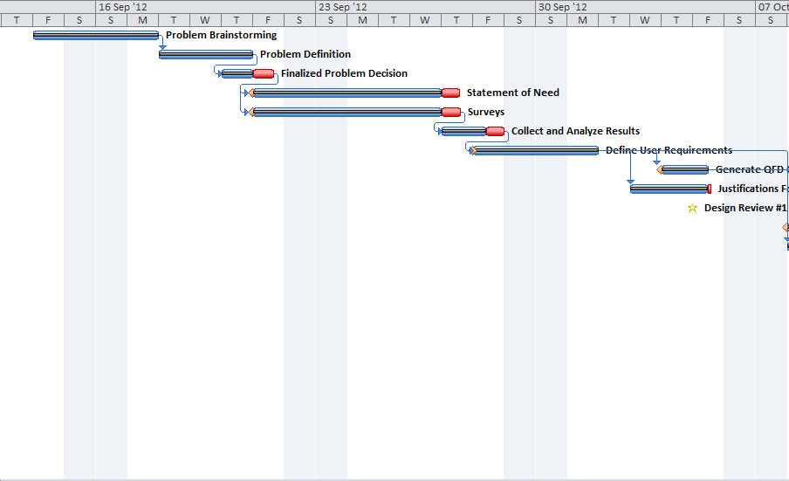
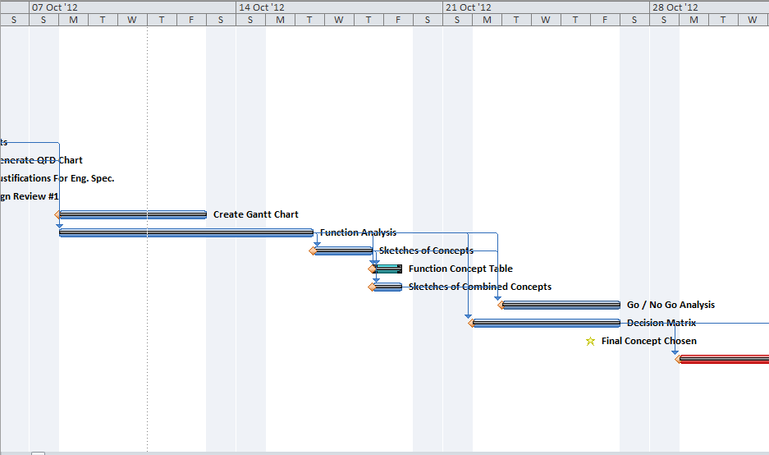
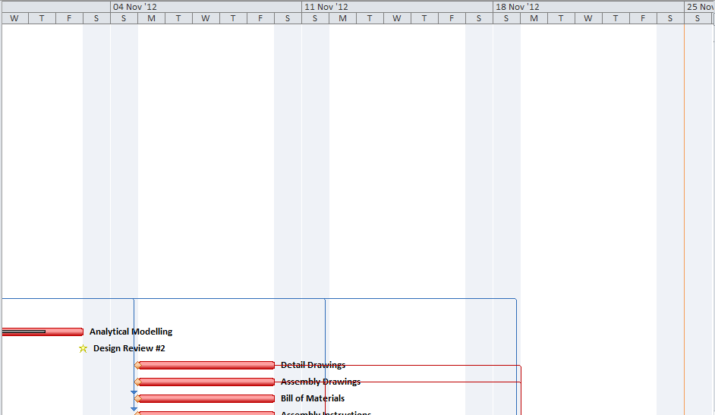
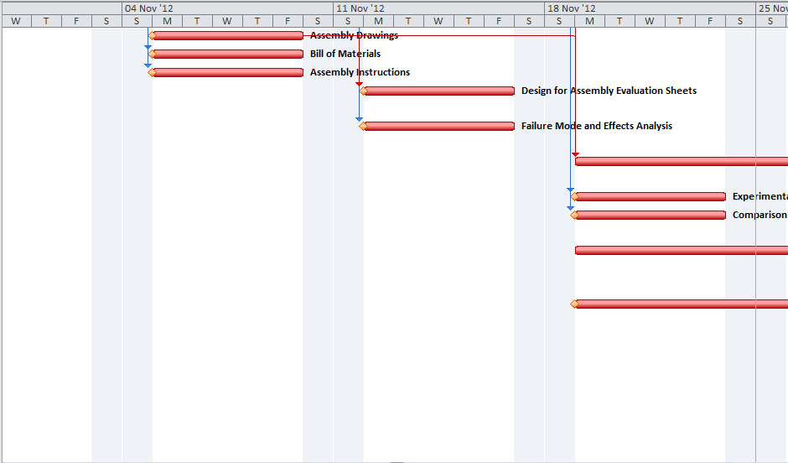
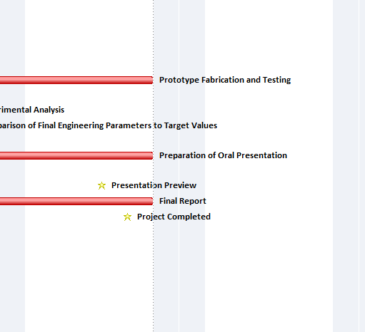

Notes:
This slide is the perfect segue for passing the clicker to the next person

Slide 7
User Requirements and Engineering Specs
User Requirements:
Engineering Specs:
Easy to use
<= than 3 steps to operate
Accessible
<
1m off the ground
All passages > 1m wide
Fast
Faster than current average
Accurate
< 0.1% error rate
Cheap
Net cost < current solutions
Notes:
Antoine:

Slide 8
Development of Design
Brainstormed seven functions:
Record Items into system
Transport Items
Communicate Price
Payment
Return Items
Prevent Thefts
Give Instructions
Notes:
Antoine:

Slide 9
Development of Design
Developed Concepts (some good, some bad):
RFID Scanning
Proof of purchase at exit
Signs with instructions
VS
Analog price meter
Facial recognition payment
Bouncers at exit

Slide 10
Possible Designs
F 3.6 Analog Price Meter
F 6.2 RFID Detectors at exits
0
200
$0
$200
F 5.4 No Refunds
F 1.2 RFID Chip & Scanner
Items
Price
F 2.4 Conveyer Belt
No Refunds
Cash
Step 1
Step 2
Step 3
F 4.1 Cash
F 7.2 Pictorial Instruction
Would hurt customer good will
Requires loading and unloading of items - slow
Looks fancy, but impractical
Notes:
Antoine:

Slide 11
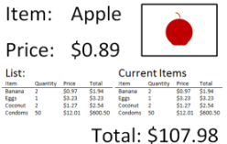
Possible Designs
F 3.3 LCD Screen
F 7.4 Audio – Speakers
F 4.2 Pay pass (NFC Card)
F 1.2 RFID Chip & Scanner
F 2.1 Shopping Cart
F 6.2 RFID Detectors at exits
Payment station at exit eliminates trip to cashier
Notes:
Antoine:

Slide 12


Possible Designs
F 6.3 Camera
F 3.3 LCD Screen
F 1.3 RFID Chip & Scanner
F 3.5 Force Feedback
F 4.6 Credit/Debit Card Payment
F 2.1 Shopping Cart
On-board RFID scanner eliminates need to unload cart when purchasing
On-board credit machines and big displays would be expensive
Notes:
Antoine:

Slide 13
Final Design
Good features from other designs were incorporated
Poor features were eliminated /avoided
Design was tweaked to address issues as they came up
Notes:
Graham:

Slide 14
Final Design
Item
RFID Chip
Unique Item Code
RFID Scanner
Notes:
Graham:

Slide 15
Final Design
Wireless adapter (Connected to store database)
Retrieving Item Data
Data Appears on Screen
Item Recorded in Memory
Notes:
Graham:

Slide 16
Final Design
Payment Terminal
Total Displayed on Both Screens
List of Items
Payment Options
(Weight Checked)
List of Items is Retrieved from Memory
* Some Cashiers Still Present
Weight Sensor
Notes:
Graham:

Slide 17
Final Design
Back Folds Up
Carts Nest
Batteries Charged
Charging Arm
Electric Pads Connect and are shielded by cart body
Electricity
Cart Alignment Piece
Plug
Notes:
Graham:

Slide 18
Design for Manufacturing
Use standard parts:
Design allows a standard cart to be outfitted, rather than needing a custom cart
Use multifunctional parts:
Rubber holds metal charging pads in place, and insulates electricity
Notes:
Graham:

Slide 19
Design for Manufacturing
Minimize parts:
Scanner has hooks to attach to cart built in
Screen
Hooks
Scanner
Notes:
Graham:

Slide 20
Design for Manufacturing
Special characteristics of processes:
As rubber cools, it grips metal pad to eliminate need for adhesives:
Metal Pad
Heat
Expanded Rubber Pad
Notes:
Graham:

Slide 21
Design for Manufacturing
Special characteristics of processes:
Colour added as plastic is injection moulded:
Notes:
Graham:

Slide 22
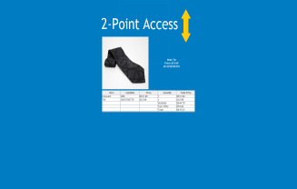
Design for Assembly
1. Device uses a minimal number of parts – 7 major components
5” LCD Screen
RFID scanner/computer
4 conductive pads
11
Electrical cable
Notes:
Assembly drawings can be placed here

Slide 23
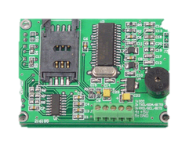
Design for Assembly
2. Subcomponents can only be inserted from a single angle (for scanning device)
RFID Reader*
Li-ion Battery
Motherboard/ processor
11
*Source: http://www.o-digital.com/uploads/2179/2192-1/13_56MHz_OEM_RFID_Reader_s_Module_JMY_680B_958.jpg
Notes:
Assembly drawings can be placed here

Slide 24

Design for Assembly
3. Minimized use of separate fasteners (hooks on the back mean that only two screws are required)
11
Notes:
Assembly drawings can be placed here

Slide 25
Design for Assembly
3. Minimized use of separate fasteners (hooks on the back mean that only two screws are required)
11
Notes:
Assembly drawings can be placed here

Slide 26
Design for Assembly
3. Minimized use of separate fasteners (hooks on the back mean that only two screws are required)
11
Conductive pads use rubber enclosures to connect with shopping cart
Notes:
Assembly drawings can be placed here

Slide 27
Design for Assembly
Problem:
Since device parts are disjointed, there is no common base to organize all of the components (the RFID scanner, screen, conductive pads)
Since the shopping cart is used as a base for the components, outfitting carts of different sizes becomes difficult!
11
Notes:
Assembly drawings can be placed here

Slide 28
Design for Safety
Neither the shopping cart nor the point-of-sale terminal have sharp edges/protrusions
Device is ergonomically sound (scanner and payment is all within arms reach)
Conductive charging pads are made inaccessible by cart body while charging
Electrical parts insulated with rubber or plastic
Notes:
Farhan:
Lack of Sharp edges/protrusions means that it is less likely that clothes/loose objects will be caught
Mention that all calculations/work put into design has been documented for reference

Slide 29
Analytical Model
Charging of the battery on the cart was modeled
Three options were considered:
Induction:
Excessive Waste, difficult to implement
Attached To Cart
Embedded to ground, connected to power
Notes:
Farhan:

Slide 30
Analytical Model
Charging of the battery on the cart was modeled
Three options were considered:
Attaching a dynamo to the wheel:
Low power output
To Battery
Dynamo
Wheel
Notes:
Farhan:

Slide 31
Analytical Model
Charging of the battery on the cart was modeled
Three options were considered:
Charging Station:
Chosen
Scanner
Connection to Power
Electrical Pad
Notes:
Farhan:

Slide 32
Analytical Model
Calculations based off Garmin nuvi 1300 GPS battery as approximation for scanner battery
Each battery provides 1.25 Ah at 3.7V
Same amount is required to charge it (plus 20% for inefficiency)
Notes:
Farhan:

Slide 33
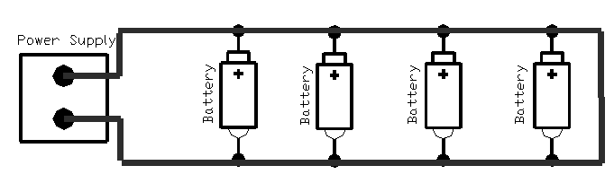



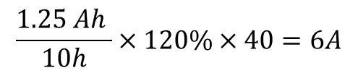

Analytical Model
Circuit created by carts at charging station:
For 40 carts over 10 hours:
$$\frac{1.25 Ah }{10h}×120\%×40=6A$$
$$P=I×V$$
$$P= 6A×3.7V$$
$$P= 22.2W$$
$$∴The power required to charge 40 carts is 22.2W$$
Notes:
Farhan:

Slide 34
Prototype Demonstration
Notes:
Graham

Slide 35
Design Testing
Focus group was used
Participants interacted with prototype
Discussed implementation of system in store
Notes:
Vishal:

Slide 36
Results
More aesthetically appealing design is required
Scanner should be made detachable for larger items
Items should be as easy to remove as they are to scan
Notes:
Vishal:

Slide 37
Results
Shoplifters could still be an issue
Method is required for handling weight based items
Notes:
Vishal:

Slide 38
Final Design vs. Objectives
Goal:
Our Design:
Easy to use
3 steps:
product is scanned
cost is displayed
payment of transaction
Accessible
Payment station inputs 80cm above ground
RFID scanner within arms reach
Notes:
Vishal: In arms reach allows for accessibility to people with handicaps issues.

Slide 39
Final Design vs. Objectives
Goal:
Our Design:
Fast
Transaction takes 30 seconds or less
Accurate
No errors in scans (small sample size)
Notes:
Vishal: Accurate. Too little scans.

Slide 40
Final Design vs. Objectives
Goal:
Our Design:
Cheap
Cost of outfitting one shopping cart: ~$71
Cost of implementing a point of sale terminal: ~$649
Notes:
Vishal: Spread over the life time if the product makes our product a lot cheaper

Slide 41
Conclusions
Store wait times are a waste of time that results from the inefficient checkout process
Scanning items as they are placed in the cart can eliminate this process
The design needs improvement in the areas of aesthetics and theft prevention
Overall concept is feasible, but design is not ready for production
Notes:
Hossein:

Slide 42
Recommendations
Perform survey of larger demographic
Make RFID scanner removable
Add a method for detecting shoplifters
Perform cost-benefit analysis to prove feasibility
Notes:
Hossein:

Slide 43
Recommendations
Expand product to be able to outfit smaller carts or hand baskets
Improve the Graphical User Interface (GUI)
Notes:
Hossein:

Slide 44
Acknowledgements
The authors would like to thank:
Dr. J. Kofman, Ph.D., P.Eng., ing.(OIQ) for the information required to complete this project
Farnoud Kazemzadeh the TA for SYDE 161 for ideas, advice, and warnings
Jordan Sinclair for supplying a shopping cart
Notes:
Hossein:

Slide 45
Acknowledgements
The authors would like to thank:
Engineering students from the University of Waterloo for participating in the prototype testing focus group
Notes:
Vishal:

