Slide 1
  Welcome to the 2000 Shareholder Meeting

Slide 2
Shareholder Meeting 2000
Modifications to models:
  Micro 1800 GL
  Medio 2400 City
  Luxo V8
  Pronto 4000 RS
Contribution Margins
Sales Development
Profit Development

Slide 3
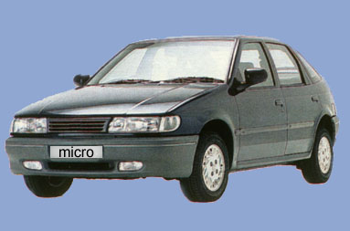
Micro 1800 GL Modifications 2000
4-door model at no extra cost
Accessories:
  Rear headrests
  Power steering
  Power locks
New motor with 10% less consumption
Tune-ups after every 15,000 miles

Slide 4
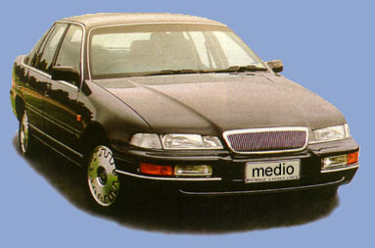
Medio 2400 City Modifications 2000
Accessories:
  Side airbags
  Power windows in front
  Rear headrests
  Alloy rims with 205/60 tires
Tune-ups after every 15,000 miles
Reinforced front stabilizer bar

Slide 5
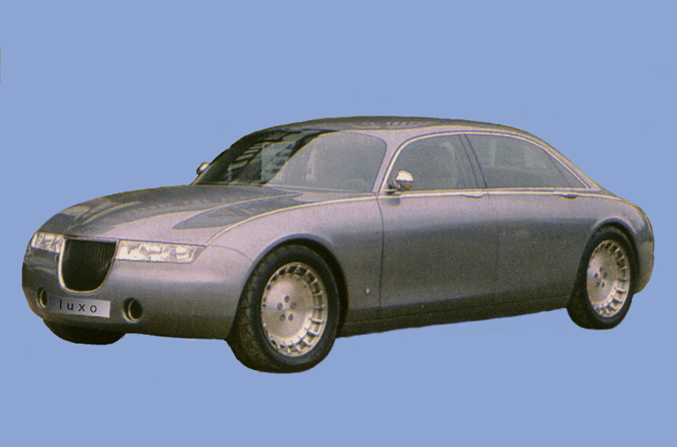
Luxo V8
Modifications 2000
Modifications to grille and rear lights
Accessories:
  Alcantara upholstery
  Power sunroof
  HID Headlights (extra charge)
Tune-ups after every 15,000 miles

Slide 6
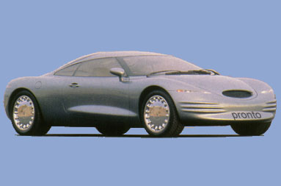
Pronto 4000 RS Modifications 2000
Accessories:
  Tire size 225/55
  Leather steering wheel and gear stick covering
Rear lights tinted black
Tune-ups after every 15,000 miles
Better performance:
305 HP instead of 265 HP

Slide 7
Contribution Margins by Model

Slide 8
Sales Forecast 2000

Slide 9
Profit Development with Forecast for 2000
Increase in material costs 2000 due to higher exchange rates
Profit growth 2000 due to price adjustment of 3% - 6% (depending on model)

