Slide 1
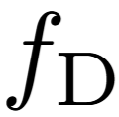
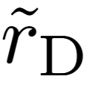
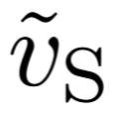

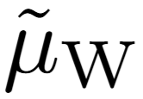
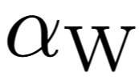
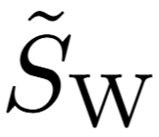

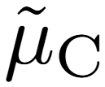

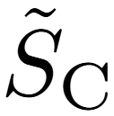
From experiment
Wild-type
Eq. 48
Eq. 43
Eq. 44
Eq. 34
Cancer
Eq. 67
Eq. 68
Eq. 58

Slide 2
From experiment
Wild-type
Eq. 46
Eq. 41
Eq. 42
Eq. 32
Cancer
Eq. 65
Eq. 66
Eq. 56

