Slide 1



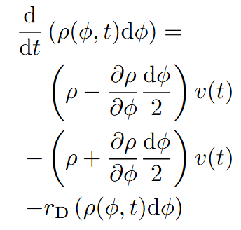






x2
$$v_{G1}$$
$$v_{s}$$
$$0$$
$$π$$
$$2π$$
$$φ$$
G1
S
G2
M
G0/Differentiation

