Slide 1





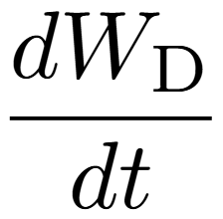
R-point

Slide 2
R-point

