Slide 1
RTS Project Structure

Slide 2
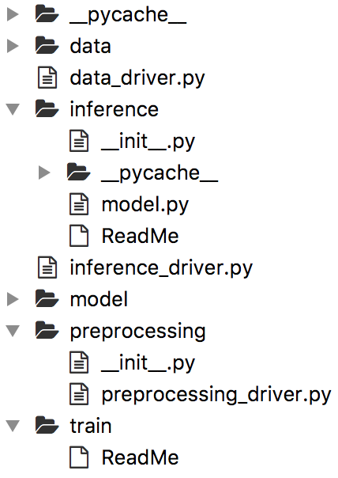
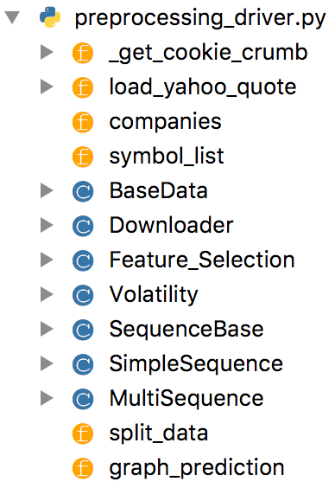
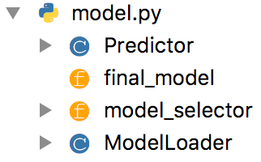

Slide 3
Utils
Data pre-processing
Data preparation
Data fetch
Metric calculation
Data split
Data postprocessing
Core
Models
Model_training
Model_inference

