Slide 1
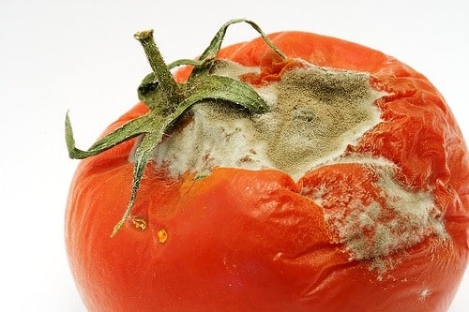
IMDBAnalysis.
Team «rotten tomatoes»

Slide 2
BagOfWords-Model.
1) Building a vocabulary of most frequent words / n-grams
[‘the film’ = 1234, ‘I liked’ = 989, ‘bad’ = 892, …]
2) Vectorize reviews (count occurrences of vocabulary entries)
Review: ‘the film was bad’ → Vector: [1,0,1]
3) Use word count as feature
@attribute ‘the film’ numeric
@attribute ‘I liked’ numeric
@attribute bad numeric
4) Use wekas attributeSelection algorithm to rank features according to their correlation, entropy etc: CorrelationAttributeEval
Notes:
If you don’t want the animations, just go to the ”Animations” tab above, click ”Animation pane”, and delete all the animations in the sidebar.

Slide 3
Our approach.
- We didn’t know about wekas StringToWordVector()
- Idea: Use only words with a sentiment score > |0.25|
SentiWordNet ( ‘good’, ‘A’) → 0.5
Resulting vocabulary: [masterpiece, bad, great, stupid, ‘the best’, poor, ridiculous, terrible, awful, dull, wasted, terrific, poorly, wonderfully, masterpiece, ‘the only thing’, ‘of the worst’, hilarious, …]
- Better score with 1000 prefiltered words than with 20k unfiltered words
Notes:
If you don’t want the animations, just go to the ”Animations” tab above, click ”Animation pane”, and delete all the animations in the sidebar.

Slide 4
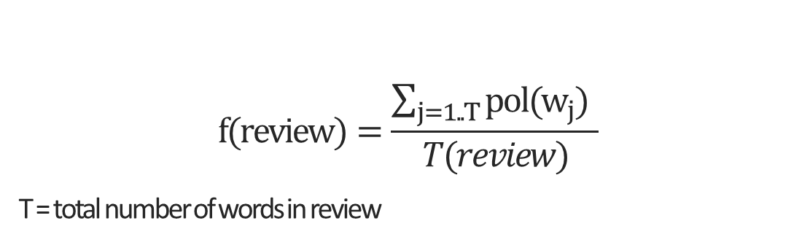
Additional features.
Average review polarity (with SentiWordNet): ~67%
$$f(review)=\frac{\sum_{j=1..T}{pol(w_{j})} }{T(review)}$$
T = total number of words in review
Features.addFeature(new NummericFeature(„avgReviewPolarity", (review) -> { PipelineFactory
.start(Preprocessing.negationFilter) .append(Preprocessing.luceneTokenizer)
.append(SentiAnalysis.sentiWordNet) .append(SentiAnalysis.avgTextPolarity); .run(review); } ));
Notes:
If you don’t want the animations, just go to the ”Animations” tab above, click ”Animation pane”, and delete all the animations in the sidebar.

Slide 5
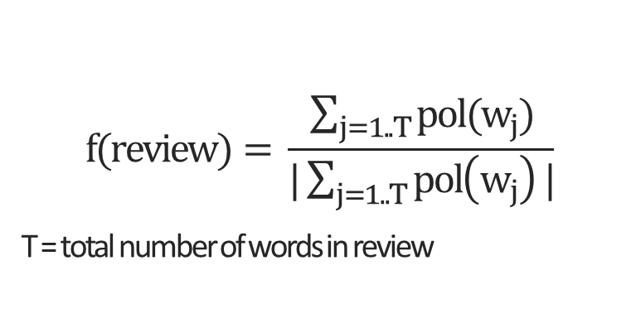
Additional features.
- Average review purity
Review length
Count negative words / Count positive words
Average first sentence polarity,?/! Count, etc. → removed
$$f(review)= \frac{\sum_{j=1..T}{pol(w_{j})}}{|\sum_{j=1..T}{pol\left(w_{j}\right)}|}$$
T = total number of words in review
Notes:
If you don’t want the animations, just go to the ”Animations” tab above, click ”Animation pane”, and delete all the animations in the sidebar.

Slide 6
Conclusion.
Overall score: 88.25%
- Extra work, no real profit
Lessons learned / Pitfalls:
Exclude test-dataset from generation of the BagOfWords vocabulary.
Build separate vocabularies for every sentiment class and merge them.
Performance issues: parallelStream(), caches for pre-processing steps etc.
Notes:
If you don’t want the animations, just go to the ”Animations” tab above, click ”Animation pane”, and delete all the animations in the sidebar.

Slide 7
reviews.parallelStream().forEach(
(review) -> {
List<String> tokens = _cache.getOrDefault(review, null);
if(tokens == null) {
tokens = PipelineFactory
.start(Preprocessing.negationFilter)
.append(Preprocessing.nGramTokenizer)
.append(Preprocessing.stopwordFilter)
.run(review);
}
HashMap<String, Integer> wordVector = new HashMap();
Map<String, Long> wordCount = tokens.stream().collect(
Collectors.groupingBy(Function.identity(),
Collectors.counting())
);
Iterator<Map.Entry<String, Integer> = vocab.keySet().iterator();
while (it.hasNext()) {
String word = it.next();
vec.put(word, wordCount.getOrDefault(word, 0L).intValue());
}
return this.vec;
//…
Notes:
If you don’t want the animations, just go to the ”Animations” tab above, click ”Animation pane”, and delete all the animations in the sidebar.

Slide 8
Questions?
BookMyDoc
Notes:
Simply right-click the image and choose ”Change picture..”

