Slide 1
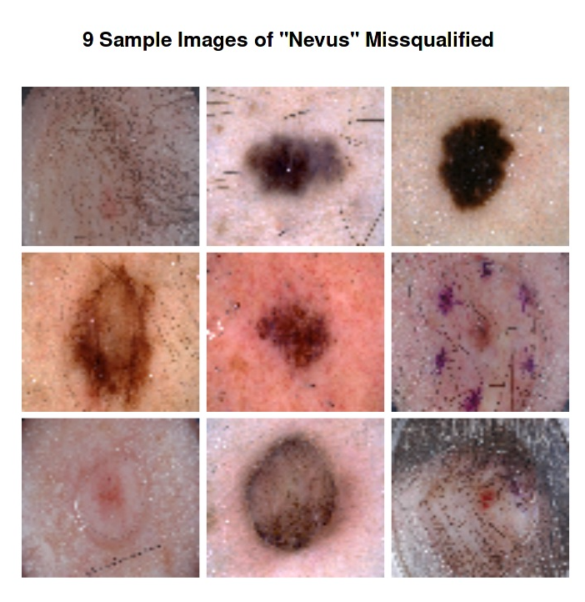
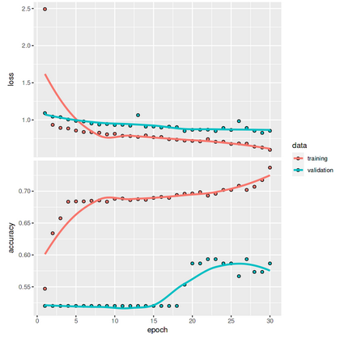
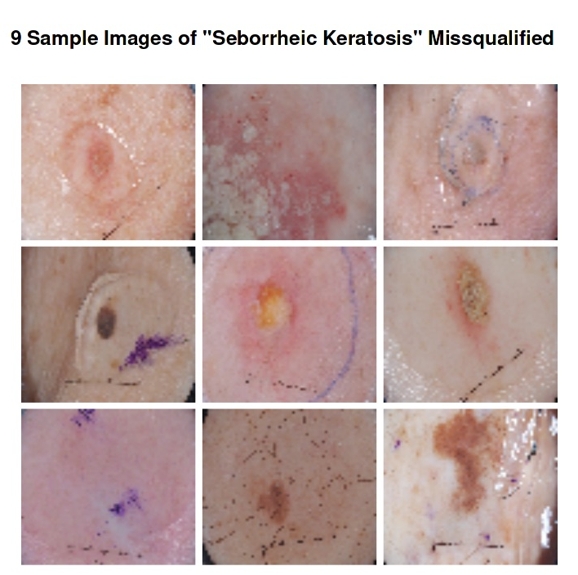
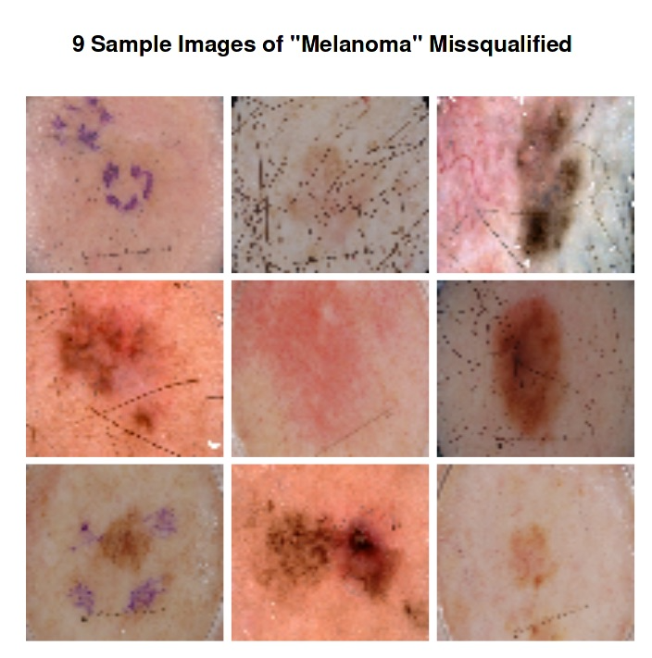
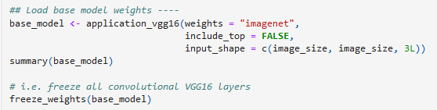
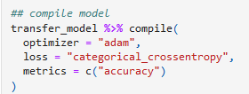
Classification of a Melanoma with Deep Learning
Silvan Hostettler, Urs Mayr, Vera Jäggi
1 Introduction – Classes
[…] 4 Results and Discussion
Goal to classify three types of skin growth.
3. CNN from Scratch:
Overfitting (accuracy of
Train data > test data)
Solution: data augmentation,
neuronal dropout
Class | Nevus | Seborrheic keratosis | Melanoma
Appears at | Birth (congenital) | Increased age | Increased age
Risk | Benign (harmless) | Benign (harmless) | malign (harmfull cancer)
Characetristics | hyperpigmented mostly single colored mostly arised skin Can turn into a Melanoma! | Flat/raised papule /plaque mostly one single smooth, waxy or warty surface Can look similar to a Melanoma | ABCDE Rule (vs. Nevus) - Asymmetry - Border irregular in shape. Color multicolored Diameter > 6mm in diameter, - Evolution change characteristics over time.
2 Data
Melanoma Detection Dataset
from Kaggle.
- Unbalanced data
 | # total images
test | 600
train | 2000
valid | 150
3 Models and Methods
Baseline Model (with RandomForest [RF])
Pretrained Neuronal Network [NN]
Train a ConvolutionalNN from scratch
RF and pretrained NN used the weights of the CNN VGG:
All models were complied
the same:
4 Conclusion
Data difficulties:
Different pixel size/coloring of images
Imbalanced data
Cumbersome data load -> writing of new data import function
Language/Versioning difficulties:
Tensorflow/Keras better documented for Python than for R
Image data augmentation seems to depend on the version of keras and tensorflow. -> data augmentation skipped
Findings:
- Baseline model with RF best classification accuracy
From scratch trained CNN: Minimization of loss and the accuracy vary among the batch_sizes.
-> Effect is not completely understood.
Hypothesis: model optimization algorithm ADAM aims for solution with larger weights -> lower test accuracy
4 Results and Discussion
Model | Loss | Accuracy
Baseline model with RF | NA | 0.70
Pretrained VGG | 1.52 | 0.63
CNN from Scratch | 0.80 | 0.68
Baseline model with RF
The Baseline model using the Random Forest as classification lead to the highest accuracy with 70 %.
RF uses no distribution assumption and can handle well imbalanced data sets (weighted random forest, balanced random forest).
2. Pretrained VGG with
The pretrained VGG has the highest loss function and the lowest accuracy of all the trained models. This is surprising as the model provides 4096 features for the final densely connected classifier.
5 Base script
Skript: https://github.com/hosts1/ethz-deepl-melanoma
References
https://www.kaggle.com/datasets/wanderdust/skin-lesion-analysis-toward-melanoma-detection/code.
https://tensorchiefs.github.io/dl_rcourse_2022/.
https://tensorflow.rstudio.com/.
https://tensorflow.rstudio.com/guides/keras/preprocessing_layers.
https://medium.com/mini-distill/effect-of-batch-size-on-training-dynamics-21c14f7a716e
10. October 2022

