Slide 1
并行程序设计
Lecture 1: Introduction
Shouzhen Gu

Slide 2
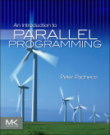
课程信息
时间： 周一13:00-14:40 （1~18周）
地点：教书院319
课本：“An Introduction to Parallel Programming,” Peter Pacheco, Morgan-Kaufmann Publishers, 2011.
课程考核：
  平时成绩：40%（练习20％+编程项目20%）
  期末考试：60%（闭卷）
先修课程：
  C语言、操作系统
Email: szgu@sei.ecnu.edu.cn
Tel：021-62224020
办公室：数学馆东213

Slide 3
课程目标
学习怎样编写并行程序
  认识计算机的并行架构
  掌握用并行的思想考虑问题
  能够编写正确的并行程序
了解目前主流的并行计算相关知识
  了解目前流行的并行编程模型与结构
  了解今后的发展趋势

Slide 4
Today’s Lecture
Introduction
Technology Drivers for Multi-Core Paradigm Shift
Origins of Parallel Programming
Large-scale scientific simulations
Why writing fast parallel programs is hard
Summary

Slide 5
Today’s Lecture
Introduction
Technology Drivers for Multi-Core Paradigm Shift
Origins of Parallel Programming
Large-scale scientific simulations
Why writing fast parallel programs is hard
Summary

Slide 6
Why is this Course Important?
Multi-core and many-core era is here to stay
  Why? Technology Trends
Many programmers will be developing parallel software
  But still not everyone is trained in parallel programming
  Learn how to put all these vast machine resources to the best use!
Useful for
  Joining the work force
  Graduate school
Our focus
  Teach core concepts
  Use common programming models
  Discuss broader spectrum of parallel computing

Slide 7
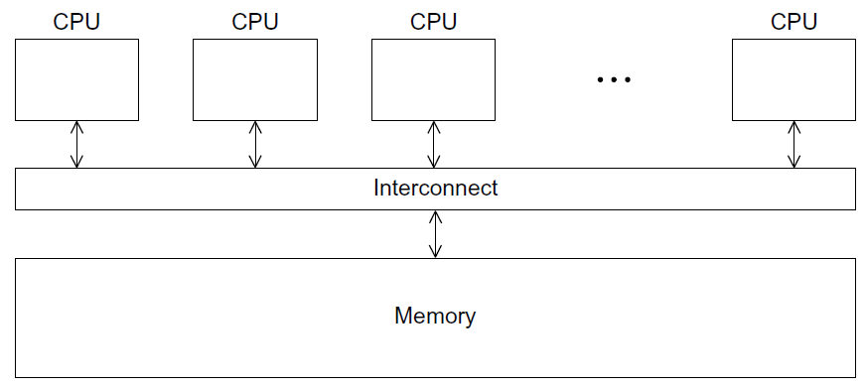
Parallel Computing
Parallel computing (processing):
  the use of two or more processors (computers), usually within a single system, working simultaneously to solve a single problem.
Shared Memory

Slide 8
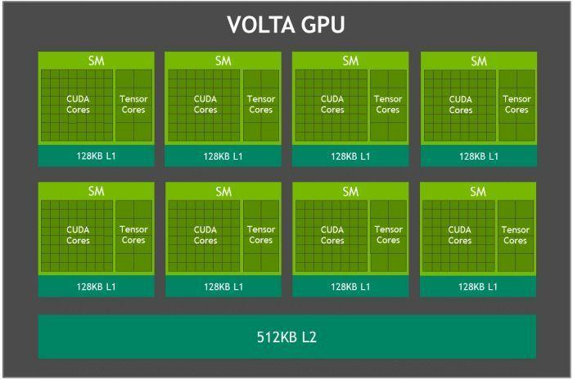
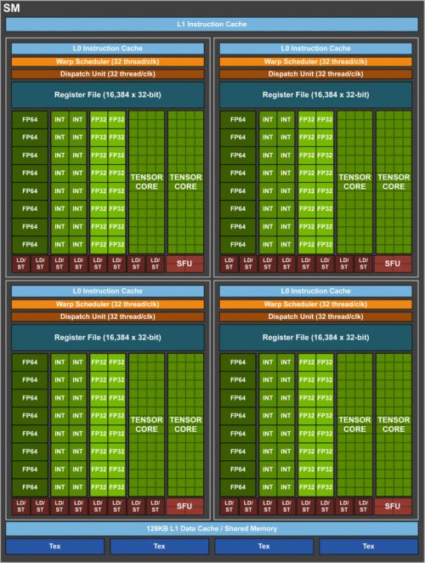
Example: Nvidia Volta
Multiple Streaming
Multiprocessor
hared Main Memory

Slide 9
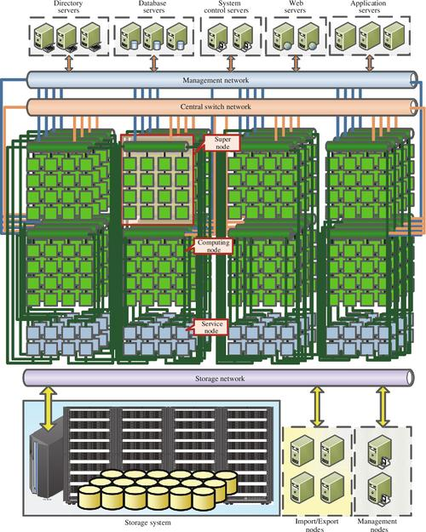
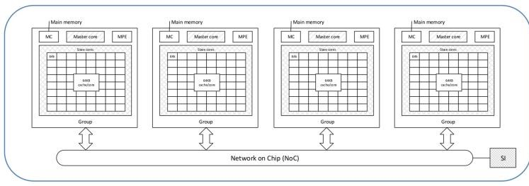
Example:神威·太湖之光
Nodes Architecture: each node has a main memory.

Slide 10
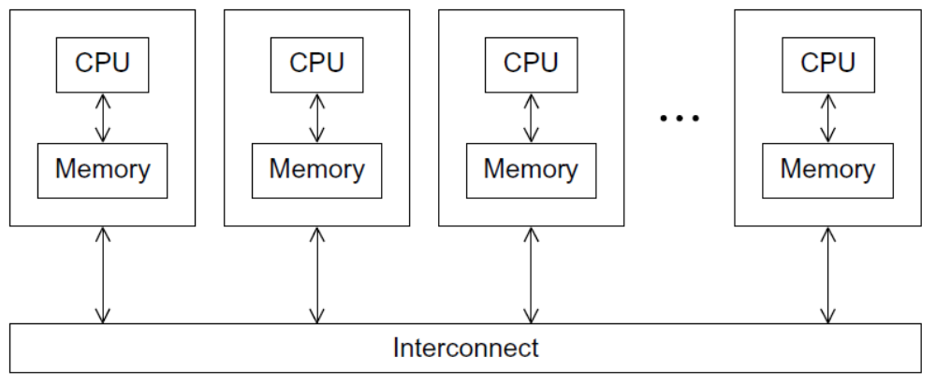
Distributed Computing
Distributed computing (processing):
  any computing that involves multiple computers remote from each other that each have a role in a computation problem or information processing.
Distributed Memory

Slide 11
Parallel Programming
Parallel programming:
  the human process of developing programs that express what computations should be executed in parallel.
T1
T2
T3
T4
Serial Program
P=1
T1
T2
Parallel Program
P=4
T3
T4

Slide 12
Today’s Lecture
Introduction
Technology Drivers for Multi-Core Paradigm Shift
Origins of Parallel Programming
Large-scale scientific simulations
Why writing fast parallel programs is hard
Summary

Slide 13
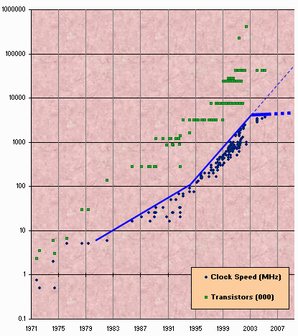
Technology as Driver for “Multi-Core” Paradigm Shift
Transistor count still rising
Do you know why most computers sold today are parallel computers?
Clock speed flattening sharply
Slide source: Maurice Herlihy

Slide 14
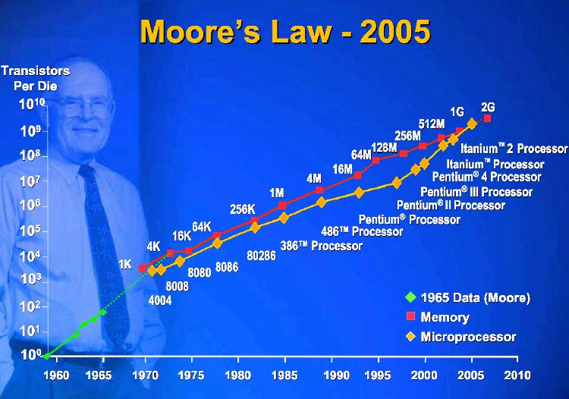
Technology Trends: Moore’s Law
Moore’s Law: Gordon Moore (co-founder of Intel) predicted in 1965 that the transistor density of semiconductor chips would double roughly every 18 ~24months.

Slide 15
Technology Trends
Microprocessor performance increases 50% per year
  Where does the performance gain from? Clock Rate and Capacity
  Clock Rate increases 30% per year
  Transistor count grows much faster than clock rate. Increase 40% per year
What to do with all these transistors?

Slide 16
The Multi-Core or Many-Core Paradigm Shift
Key ideas:
  Movement away from increasingly complex processor design and faster clocks
  Replicated functionality (i.e., parallel) is simpler to design
  Resources more efficiently utilized
All Computers are Parallel Computers.

Slide 17
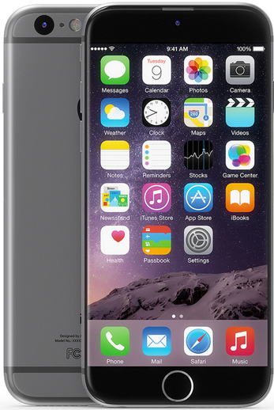
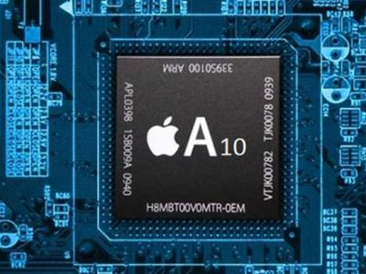
Smartphones
2 billion transistors
2 CPU
4 GPU

Slide 18

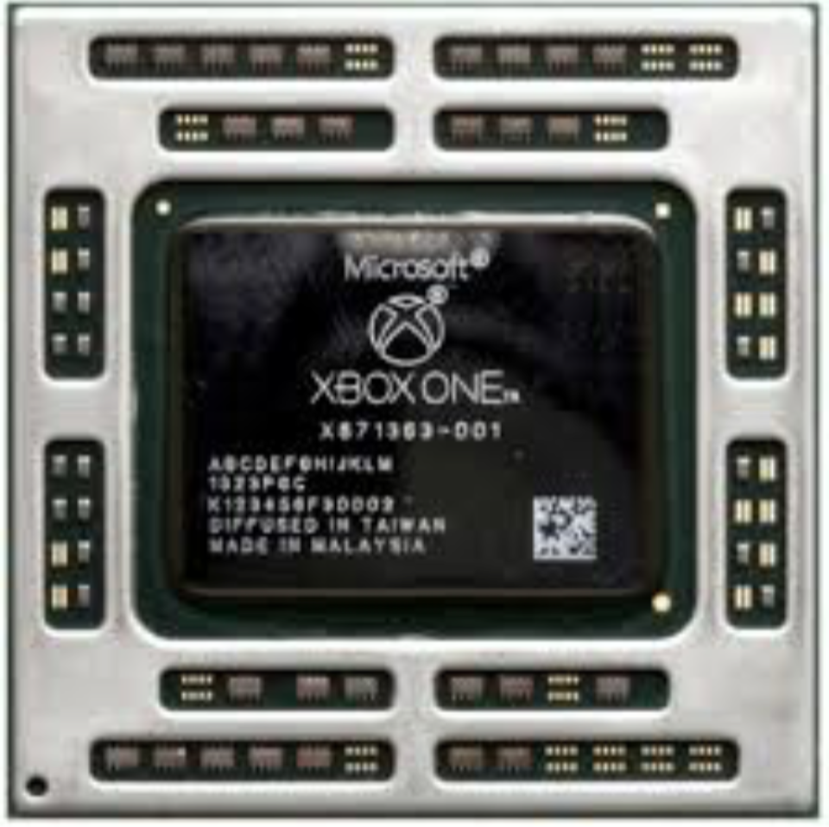
Gaming Console
5 billion transistors
AMD 8 Core CPU
768 Shader Cores

Slide 19
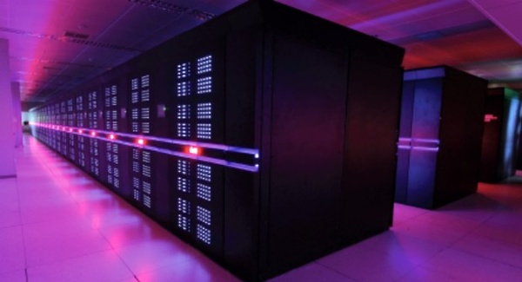
The fastest computer in 2013
天河2号，Tianhe-2 has 16,000 nodes, each with two Intel Xeon IvyBridge processors and three Xeon Phi processors for a combined total of 3,120,000 computing cores.
33.86 petaflops, 12.4PB hard disk,1.4PB main memory

Slide 20
Today’s Lecture
Introduction
Technology Drivers for Multi-Core Paradigm Shift
Origins of Parallel Programming
Large-scale scientific simulations
Why writing fast parallel programs is hard
Summary

Slide 21
Software Challenge
The chip industry's move to multicore processors, which
has caught software developers flat-footed.
"We really don't know how to write software in this new model," David Patterson notes. "It's absolutely critical for the future of IT in the United States and around the world that we figure it out."
From IEEE Spectrum

Slide 22
Scientific Simulation:
The Third Pillar of Science
Traditional scientific and engineering paradigm:
  Do theory or paper design.
  Perform experiments or build system.
Limitations:
  Too difficult -- build large wind tunnels.
  Too expensive -- build a throw-away passenger jet.
  Too slow -- wait for climate or galactic evolution.
  Too dangerous -- weapons, drug design, climate experimentation.
Computational science paradigm:
  Use high performance computer systems to simulate the phenomenon
    Base on known physical laws and efficient numerical methods.

Slide 23
The quest for increasingly more powerful machines
Scientific simulation will continue to push on system requirements:
  To increase the precision of the result
  To get to an answer sooner (e.g., climate modeling, disaster modeling)
Similar Phenomenon in Commodity Systems
  More capabilities in software
  Integration across software
  Faster response
  More realistic graphics
  …

Slide 24
Today’s Lecture
Introduction
Technology Drivers for Multi-Core Paradigm Shift
Origins of Parallel Programming
Large-scale scientific simulations
Why writing fast parallel programs is hard
Summary

Slide 25
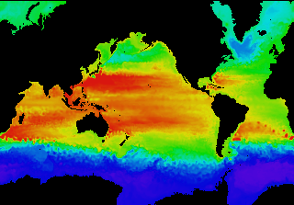
Example: Global Climate Modeling Problem
Problem is to compute:
  f(latitude, longitude, elevation, time) →
  temperature, pressure, humidity, wind velocity
Approach:
  Discretize the domain, e.g., a measurement point every 10 km
  Devise an algorithm to predict weather at time t+δt given t
Uses:
  Predict major events, e.g., El Nino
  Use in setting air emissions standards
Source: http://www.epm.ornl.gov/chammp/chammp.html

Slide 26
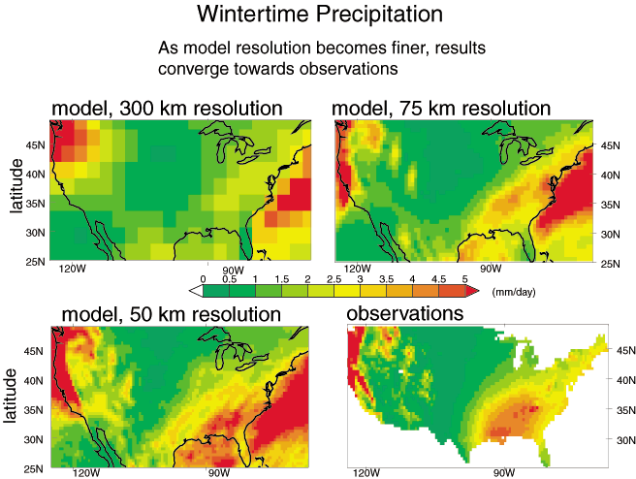
Example: Global Climate Modeling Problem
High Resolution Climate Modeling on NERSC-3 – P. Duffy, et al., LLNL

Slide 27
Example of Discretizing a Domain
One processor
computes this part
Another processor
computes this part in
parallel
Processors in adjacent blocks in the grid communicate their result.

Slide 28
Some Characteristics of Scientific Simulation
Discretize physical or conceptual space into a grid
  Simpler if regular, may be more representative if adaptive
Perform local computations on grid
  Given yesterday’s temperature and weather pattern, what is today’s expected temperature?
Communicate partial results between grids
  Contribute local weather result to understand global weather pattern.
Repeat for a set of time steps
Possibly perform other calculations with results
  Given weather model, what area should evacuate for a hurricane?

Slide 29
Today’s Lecture
Introduction
Technology Drivers for Multi-Core Paradigm Shift
Origins of Parallel Programming
Large-scale scientific simulations
Why writing fast parallel programs is hard
Summary

Slide 30
Finding Enough Parallelism
Suppose only part of an application seems parallel
Amdahl’s law
  let s be the fraction of work done sequentially, so (1-s) is fraction parallelizable
  P = number of processors
Speedup(P) = Time(1)/Time(P)
<= 1/(s + (1-s)/P)
<= 1/s
Even if the parallel part speeds up perfectly
performance is limited by the sequential part

Slide 31
Overhead of Parallelism
Given enough parallel work, this is the biggest barrier to getting desired speedup
Parallelism overheads include:
  cost of starting a thread or process
  cost of communicating shared data
  cost of synchronizing
  extra (redundant) computation
Each of these can be in the range of milliseconds (=millions of flops) on some systems
Tradeoff: Algorithm needs sufficiently large units of work to run fast in parallel (I.e. large granularity), but not so large that there is not enough parallel work

Slide 32
Locality and Parallelism
Conventional
Storage
Hierarchy
Proc
Proc
Proc
Cache
Cache
Cache
L2 Cache
L2 Cache
L2 Cache
L3 Cache
L3 Cache
L3 Cache
potential
interconnects
Memory
Memory
Memory
Large memories are slow, fast memories are small
Program should do most work on local data

Slide 33
Load Imbalance
Load imbalance is the time that some processors in the system are idle due to
  insufficient parallelism (during that phase)
  unequal size tasks
Examples of the latter
  adapting to “interesting parts of a domain”
  tree-structured computations
  fundamentally unstructured problems
Algorithm needs to balance load
Good
Bad

Slide 34
Today’s Lecture
Introduction
Technology Drivers for Multi-Core Paradigm Shift
Origins of Parallel Programming
Large-scale scientific simulations
Why writing fast parallel programs is hard
Summary

Slide 35
Summary of Lecture
Solving the “Parallel Programming Problem”
  Key technical challenge facing today’s computing industry, government agencies and scientists
Scientific simulation discretizes some space into a grid
  Perform local computations on grid
  Communicate partial results between grids
  Repeat for a set of time steps
  Possibly perform other calculations with results
Commodity parallel programming can draw from this history and move forward in a new direction
Writing fast parallel programs is difficult
  Amdahl’s Law ➔Must parallelize most of computation
  Data Locality
  Communication and Synchronization
  Load Imbalance

