Slide 1
并行程序设计
Lecture 2:
Introduction to Parallel Architectures

Slide 2
Today’s Lecture
The Von Neumann Architecture
Basics of Cache
Instruction-level parallelism
Parallel Hardware
Interconnects
Summary

Slide 3
Today’s Lecture
The von Neumann Architecture
Basics of Cache
Instruction-level parallelism
Parallel Hardware
Interconnects
Summary

Slide 4

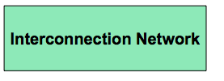

An Abstract Parallel Architecture
How is parallelism managed?
Where is the memory physically located?
Is it connected directly to processors?
What is the connectivity of the network?

Slide 5
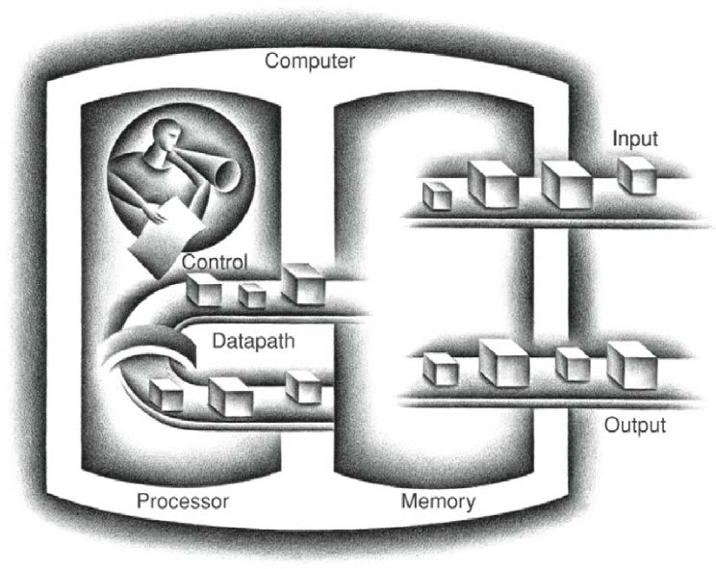
The von Neumann Architecture
Stored-Program Concept
Five main components:
  Control
  Datapath
  Memory
  Input
  Output
Instructions are represented as numbers and, programs are stored in alterable memory (that can be read or written to) just like data.

Slide 6
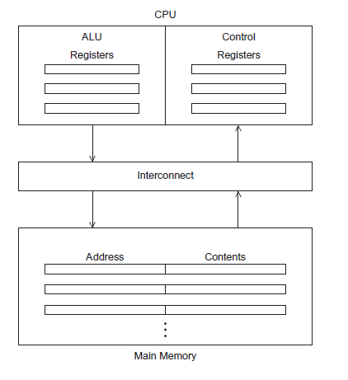
The Von Neumann Architecture
Conceptually, a von Neumann architecture executes one instruction at a time.
Arithmetic and logic Unit (ALU)
Control unit
Figure 2.1

Slide 7
Retrospective
Historically, each parallel machine was unique, along with its programming model and programming language.
It was necessary to throw away software and start over with each new kind of machine.
Now we distinguish the programming model from the underlying machine, so we can write portably correct codes that run on many machines.
Parallel algorithm design challenge is to make this process easy.
  Still somewhat of an open research problem

Slide 8
Why are we looking at a bunch of architectures
There is no canonical parallel computer – a diversity of parallel architectures
  Hence, there is no canonical parallel programming language
Architecture has an enormous impact on performance
  And we wouldn’t write parallel code if we didn’t care about performance
Many parallel architectures fail to succeed commercially
  Can’t always tell what is going to be around in N years
Challenge is to write parallel code that abstracts away architectural features, focuses on their commonality, and is therefore easily ported from one platform to another.

Slide 9




Von Neumann bottleneck
Memory
Von Neumann bottleneck
CPU

Slide 10
Today’s Lecture
The von Neumann Architecture
Basics of Cache
Instruction-level parallelism
Parallel Hardware
Interconnects
Summary

Slide 11
Levels of the Memory Hierarchy
Capacity
Access Time
Cost
Staging
Xfer Unit
Upper Level
CPU Registers
100s Bytes
<10s ns
Registers
faster
Instr. Operands
prog./compiler
1-8 bytes
Cache
K Bytes
1-100 ns
1-0.1 cents/bit
Cache
cache cntl
8-128 bytes
Blocks
Main Memory
G Bytes
100ns- 500ns
$.0001-.00001 cents /bit
Memory
OS
512-4K bytes
Pages
Disk
T Bytes,
(150μs~10 ms)
10 - 10 cents/bit
Disk
-5
-6
user/operator
Mbytes
Files
Larger
Tape infinite
sec-min
10
Lower Level
-8
Tape

Slide 12
Memory Technologies
Static RAM (SRAM)
  0.5ns – 2.5ns, $2000 – $5000 per GB
Dynamic RAM (DRAM)
  50ns – 70ns, $20 – $75 per GB
Magnetic disk
  5ms – 20ms, $0.20 – $2 per GB
Ideal memory
  Access time of SRAM
  Capacity and cost/GB of disk
Solution: organize memory system into a hierarchy
  Entire memory space available in largest, slowest memory
  Incrementally smaller and faster memories, each containing a subset of the memory below it, proceed in steps up toward the processor

Slide 13
Locality and Parallelism
Conventional
Storage
Hierarchy
Proc
Proc
Proc
Cache
Cache
Cache
L2 Cache
L2 Cache
L2 Cache
L3 Cache
L3 Cache
L3 Cache
potential
interconnects
Memory
Memory
Memory
Large memories are slow, fast memories are small
Program should do most work on local data

Slide 14
The Basics of Caching
Cache is a collection of memory locations
  It can be accessed in less time than some other memory locations.
  Locality: programs tend to use data and instructions that are physically close to recently used data and instructions.
  Spatial locality and temporal locality
  Cache blocks or Cache lines
Caches usually store copies of information in slower memory
Proc
Cache
L2 Cache
L3 Cache
float z[1000];
. . .
sum = 0.0;
for ( i = 0; i < 1000; i++)
sum += z[ i ];
Memory

Slide 15

Cache Access: Hit and Miss
Block (aka line): unit of copying
  May be multiple words
If accessed data is present in upper level
  Hit: access satisfied by upper level
    Time taken: hit time
If accessed data is absent
  Miss: block copied from lower level
    Time taken: miss penalty
    Miss rate: misses/accesses
  From then on accessed data supplied from upper level (until the block being replaced)
Performance measured by Average Memory Access Time (AMAT)
AMAT= hit time + miss rate x miss penalty (ns or clocks)
Sometimes people use Misses Per Instructions (MPI)
CPI = CPI₀ + MPI*miss penalty

Slide 16
Cache Mapping
Many-to-One mapping
Mapping can be direct, set-associative or fully associative
  Direct-mapped: each memory block can be mapped to only one cache line
  index = block address % number of cache lines
  Set-associative: each memory block can be mapped to a set of cache lines
  index = block address % number of cache sets
  Fully associative: each memory block can be in any cache line
Full Mapped
Direct Mapped
(12 mod 8) = 4
2-Way Assoc
(12 mod 4) = 0
01234567
01234567
01234567
Cache
1111111111222222222233
01234567890123456789012345678901
Memory

Slide 17
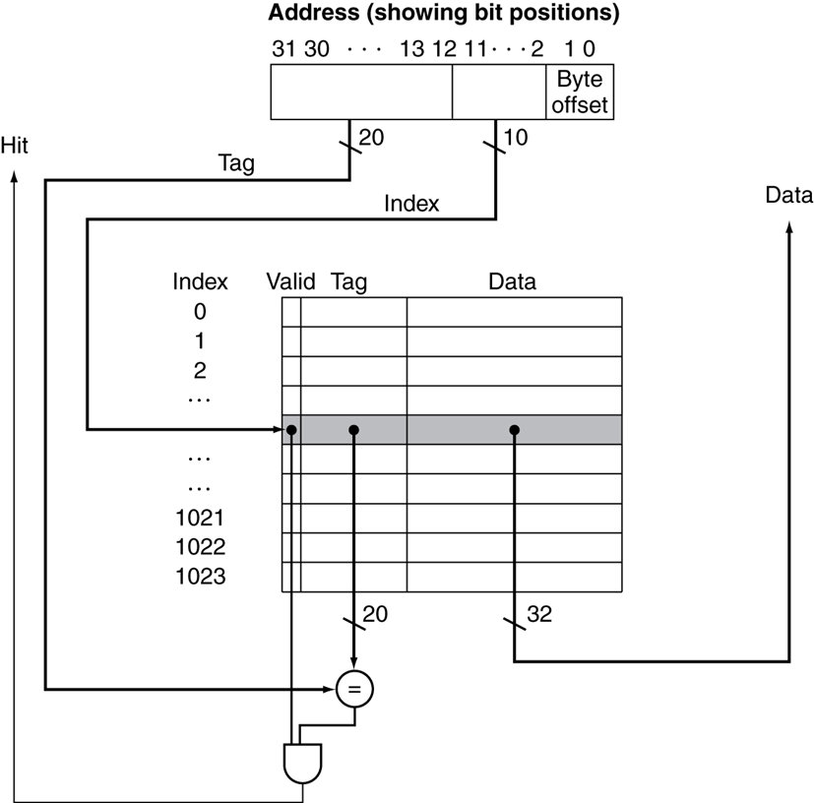
Address Subdivision
How do we know which particular block is stored in a cache location?
  Store block address as well as the data
  Actually, only need the high-order bits Called the tag
What if there is no data in a location?
  Valid bit: 1 = present, 0 = not present
  Initially 0

Slide 18
Replacement Policy
Direct mapped: no choice
Set associative
  Prefer non-valid entry, if there is one
  Otherwise, choose among entries in the set
Least-recently used (LRU)
  Choose the one unused for the longest time
    Simple for 2-way, manageable for 4-way, too hard beyond that
Random
  Gives approximately the same performance as LRU for high associativity

Slide 19
Cache Example – Direct Mapped
8-blocks, 1 word/block, direct mapped
Initial state
Index | V | Tag | Data
000 | N
001 | N
010 | N
011 | N
100 | N
101 | N
110 | N
111 | N

Slide 20
Cache Example – Direct Mapped
Word addr | Binary addr | Hit/miss | Cache block
22 | 10 110 | Miss | 110
Index | V | Tag | Data
000 | N
001 | N
010 | N
011 | N
100 | N
101 | N
110 | Y | 10 | Mem[10110]
111 | N

Slide 21
Cache Example – Direct Mapped
Word addr | Binary addr | Hit/miss | Cache block
26 | 11 010 | Miss | 010
Index | V | Tag | Data
000 | N
001 | N
010 | Y | 11 | Mem[11010]
011 | N
100 | N
101 | N
110 | Y | 10 | Mem[10110]
111 | N

Slide 22
Cache Example – Direct Mapped
Word addr | Binary addr | Hit/miss | Cache block
22 | 10 110 | Hit | 110
26 | 11 010 | Hit | 010
Index | V | Tag | Data
000 | N
001 | N
010 | Y | 11 | Mem[11010]
011 | N
100 | N
101 | N
110 | Y | 10 | Mem[10110]
111 | N

Slide 23
Cache Example – Direct Mapped
Word addr | Binary addr | Hit/miss | Cache block
16 | 10 000 | Miss | 000
3 | 00 011 | Miss | 011
16 | 10 000 | Hit | 000
Index | V | Tag | Data
000 | Y | 10 | Mem[10000]
001 | N
010 | Y | 11 | Mem[11010]
011 | Y | 00 | Mem[00011]
100 | N
101 | N
110 | Y | 10 | Mem[10110]
111 | N

Slide 24
Cache Example – Direct Mapped
Word addr | Binary addr | Hit/miss | Cache block
18 | 10 010 | Miss | 010
Index | V | Tag | Data
000 | Y | 10 | Mem[10000]
001 | N
010 | Y | 10 | Mem[10010]
011 | Y | 00 | Mem[00011]
100 | N
101 | N
110 | Y | 10 | Mem[10110]
111 | N

Slide 25
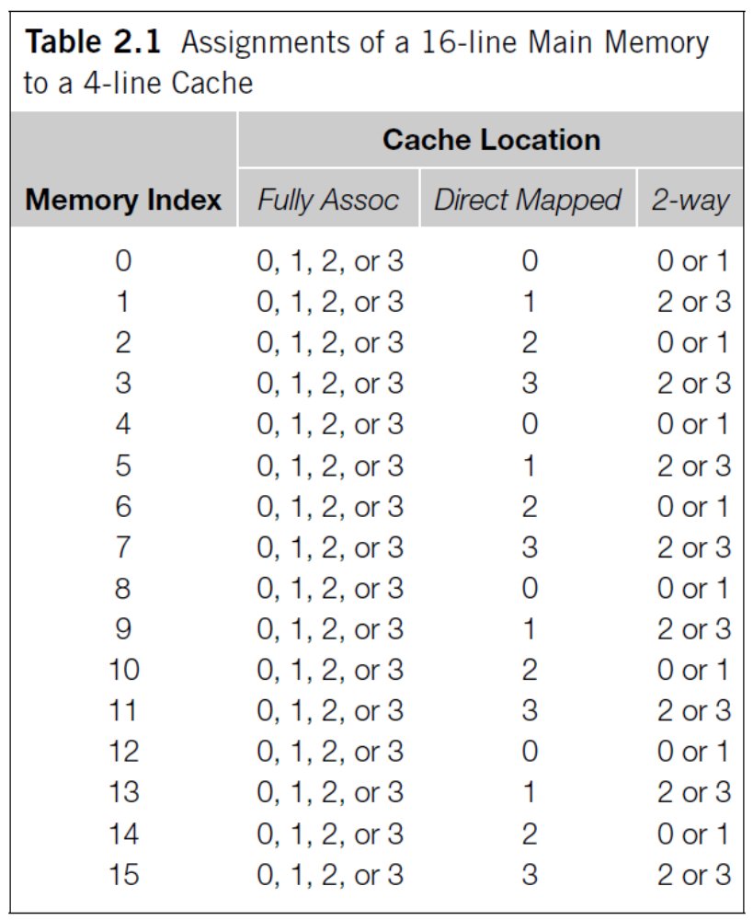
Cache Mapping：example

Slide 26
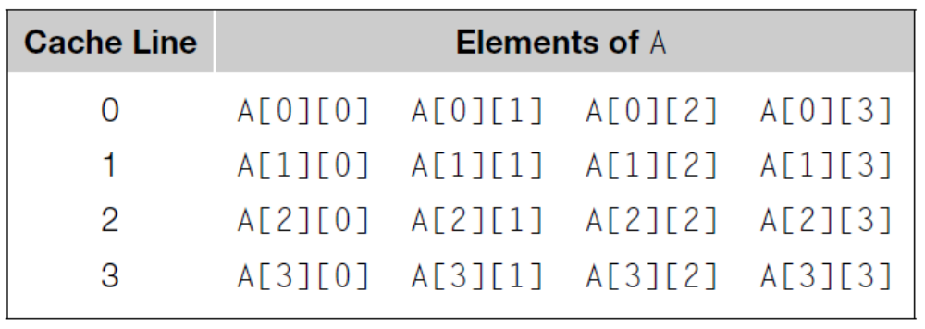
Caches and Programs
double A[MAX][MAX], x[MAX], y[MAX];
. . .
/*Initialize A and x, assign y = 0*/
. . .
/*First pair of loops*/
for ( i = 0; i < MAX; i++)
for ( j = 0; j < MAX; j++)
y[ i ] +=A[ i ][ j ]*x[ j ];
. . .
/*Assign y = 0*/
. . .
/*Second pair of loops*/
for ( j = 0; j < MAX; j++)
for ( i = 0; i < MAX; i++)
y[ i ] +=A[ i ][ j ]*x[ j ];
. . .
MAX=4
4-line Cache
Which is faster? Why?

Slide 27
Caches and Programs
double A[MAX][MAX], x[MAX], y[MAX];
. . .
/*Initialize A and x, assign y = 0*/
. . .
/*First pair of loops*/
for ( i = 0; i < MAX; i++)
for ( j = 0; j < MAX; j++)
y[ i ] +=A[ i ][ j ]*x[ j ];
. . .
/*Assign y = 0*/
. . .
/*Second pair of loops*/
for ( j = 0; j < MAX; j++)
for ( i = 0; i < MAX; i++)
y[ i ] +=A[ i ][ j ]*x[ j ];
. . .
MAX=4
4-line Cache
The first pair of loops is faster

Slide 28
Quiz
Assume there are three small cache, each consisting of four one-word blocks. One cache is fully associative, a second is two-way set-associative, and the third is direct-mapped. Find the number of misses for each cache organization given the following sequence of addresses: 0, 8, 0, 6, and 8. (If there is cache line replacement, please use LRU)
Cache line | Data( one-word)
0
1
2
3

Slide 29
Data Inconsistent
P
update x
x
Variables in cache are copies of variables in memory
After updating x in cache, it must update x in memory to keep data inconsistent.
Write through cache and Write back cache

Slide 30
Data Inconsistent
Write through cache
    A cache line is written to main memory when it is written to the cache.
    Use write buffer to improve performance
    Write buffer: store several cache lines, First In First Out
Cache misses
All accesses
P
cache
Memory
All stores
Write Buffer

Slide 31
Data Inconsistent
Write back cache
    The data is marked as dirty in the cache, and written back to memory when it is replaced by a new cache line
    Use write-back buffer to improve performance
Cache misses
All accesses
P
cache
Memory
Write-back buffer

Slide 32
Cache coherence
Programmers have no control over caches and when they get updated
Time | Core 0 | Core 1
0 | y0 = x; | y1 = 3*x;
1 | x = 7; | Not involving x
2 | Not involving x | z1 = 4 * x;
Core 0
Core 1
Cache 0
Cache 1
Interconnect
x = 2; /* shared variable */
y0 eventually ends up = 2
y1 eventually ends up = 6
z1 = ???
x
y1
y0
z1

Slide 33
Cache coherence
Core 0
Core 0
Core 0
Core 0
Core 0
Core 0
x
2
6
7
z1
y0
x
y1
x
y0
x
y1
x
y0
x
Interconnect
Interconnect
Interconnect
x
6
7
y1
x
y1
x
y1
2
z1
z1
y0
y0
z1
y0
Time 0
Time 1
Time 2
Time | Core 0 | Core 1
0 | y0 = x; | y1 = 3*x;
1 | x = 7; | Not involving x
2 | Not involving x | z1 = 4 * x;
x=2 (cache 1)
x=7 (cache 0 and memory)
z1=8 or 28?

Slide 34
Cache coherence
Core 0
Core 0
Core 0
Core 0
Core 0
Core 0
x
2
6
7
z1
y0
x
y1
x
y0
x
y1
x
y0
x
Interconnect
Interconnect
Interconnect
Need cache coherence！
x
6
7
y1
x
y1
x
y1
2
z1
z1
y0
y0
z1
y0
Time 0
Time 1
Time 2
Time | Core 0 | Core 1
0 | y0 = x; | y1 = 3*x;
1 | x = 7; | Not involving x
2 | Not involving x | z1 = 4 * x;
x=2 (cache 1)
x=7 (cache 0 and memory)
z1=8 or 28?

Slide 35
Cache coherence
Operations performed by caches in multiprocessors to ensure coherence
  Migration of data to local caches
    Reduces bandwidth for shared memory
  Replication of read-shared data
    Reduces contention for access
Snooping protocols
  Each cache monitors bus reads/writes
Directory-based protocols
  Caches and memory record sharing status of blocks in a directory

Slide 36
Snooping Cache Coherence
The cores share a bus
Any signal transmitted on the bus can be “seen” by all cores connected to the bus
When core 0 updates the copy of x stored in its cache it also broadcasts this information across the bus
If core 1 is “snooping” the bus, it will see that x has been updated and it can mark its copy of x as invalid

Slide 37
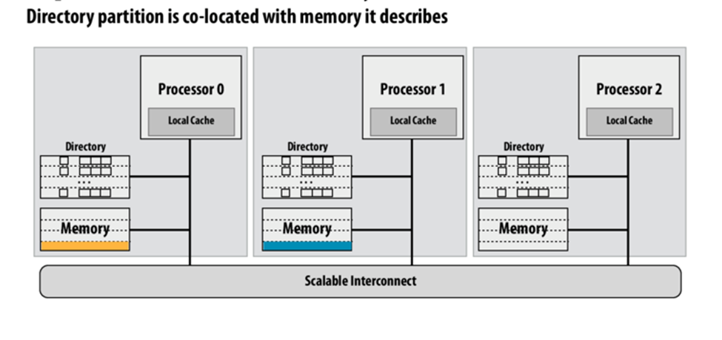
Directory Based Cache Coherence
Uses a data structure called a directory that stores the status of each cache line.
When a variable is updated, the directory is consulted, and the cache controllers of the cores that have that variable’s cache line in their caches are invalidated.

Slide 38
False Sharing
A cache line contains more than one machine word
When multiple processors access the same cache line, it may look like a potential race condition, even if they access different elements.
Can cause coherence traffic
int i, j, m, n;
double y[ m ];
/*Assign y = 0 */
. . .
for ( i = 0; i < m; i++)
for ( j = 0; j < n; j++)
y[ i ] += f[ i, j ];
#cores=2，m=8
Cache line：64 bytes
( 8 doubles)

Slide 39
Today’s Lecture
The von Neumann Architecture
Basics of Cache
Instruction-level parallelism
Parallel Hardware
Interconnects
Summary

Slide 40
Uniprocessor and Parallel Architectures
Achieve performance by addressing the von Neumann bottleneck
Reduce memory latency
  Access data from “nearby” storage: registers, caches, scratchpad memory
Hide or Tolerate memory latency
  Multithreading and, when necessary, context switches while memory is being serviced
  Prefetching, predication, speculation
Uniprocessors that execute multiple instructions in parallel
  Pipelining
  Multiple issue
  SIMD multimedia extensions

Slide 41
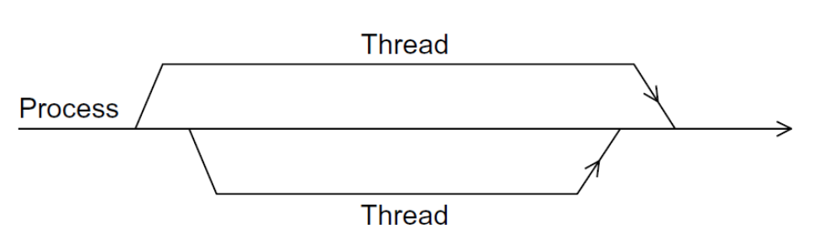
Processes, Multitasking, and threads
A process is an instance of a computer program that is being executed
  The executable machine language program, data segment, a call stack, a heap, descriptors of resources, security information, and information about the state of process.
A multitasking OS provides support for apparent simultaneous execution of multiple programs.
Threading provides a mechanism to divide programs into more or less independent tasks
  Threads are “lighter weight” than processes.
  Switching between threads much faster than switching between processes.

Slide 42
How Does a Parallel Architecture Improve on this Further?
Computation and data partitioning focus a single processor on a subset of data that can fit in nearby storage
Can achieve performance gains with simpler processors
  Even if individual processor performance is reduced, throughput can be increased
Complements instruction-level parallelism techniques
  Multiple threads operate on distinct data
  Exploit ILP within a thread

Slide 43
Parallelism Definitions
Some definitions:
  Token: A group of inputs processed to produce a group of outputs
  Latency: Time for one token to pass from start to end
  Throughput: The number of tokens that can be produced per unit time
Parallelism increases throughput.

Slide 44
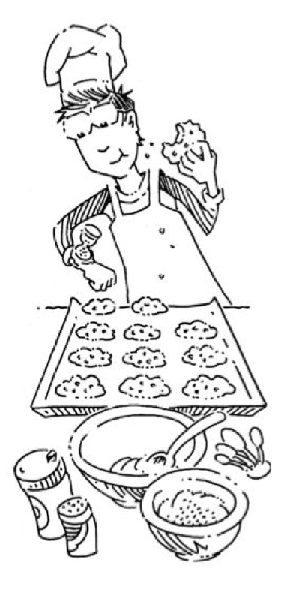
Parallelism Example
Ben is baking cookies. It takes 5 minutes to roll the cookies and 15 minutes to bake them. After finishing one batch he immediately starts the next batch. What is the latency and throughput if Ben doesn’t use parallelism?
Latency =
Throughput =

Slide 45
Parallelism Example
Ben is baking. It takes 5 minutes to roll the cookies and 15 minutes to bake them. After finishing one batch he immediately starts the next batch. What is the latency and throughput if Ben doesn’t use parallelism?
Latency = 5 + 15 = 20 minutes = 1/3 hour
Throughput = 1 tray/ 1/3 hour = 3 trays/hour

Slide 46
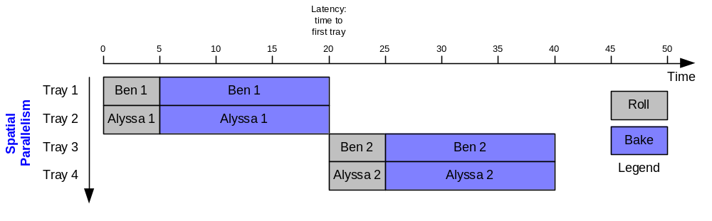
Parallelism Example
What is the latency and throughput if Ben uses parallelism?
  Spatial parallelism: Ben asks Allysa P. Hacker to help, using her own oven
Latency = 5 + 15 = 20 minutes = 1/3 hour
Throughput = 2 trays/ 1/3 hour = 6 trays/hour

Slide 47
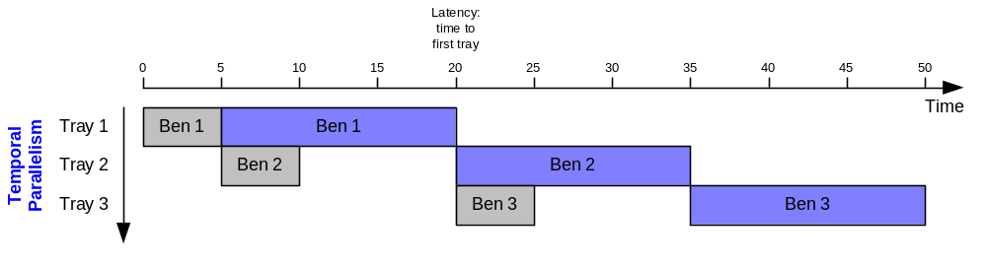
Parallelism Example
What is the latency and throughput if Ben uses parallelism?
  Spatial parallelism: Ben asks Allysa P. Hacker to help, using her own oven
  Temporal parallelism (pipelining): Ben breaks the task into two stages: roll and baking. He uses two trays. While the first batch is baking he rolls the second batch, and so on.
Latency = 5 + 15 = 20 minutes = 1/3 hour
Throughput = 1 trays/ 1/4 hour = 4 trays/hour
Using both techniques, the throughput would be 8 trays/hour

Slide 48
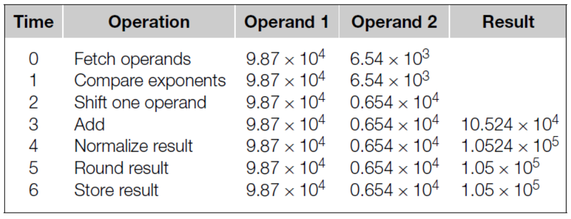
Instruction-level Parallelism: Pipelining
An addition operation can be finished by using following steps
float x[1000], y[1000], z[1000];
. . .
for ( i = 0; i < m; i++)
z[ i ] = x[ i ] + y [ i ];
Each step take 1 nanosecond
7000 nanoseconds

Slide 49
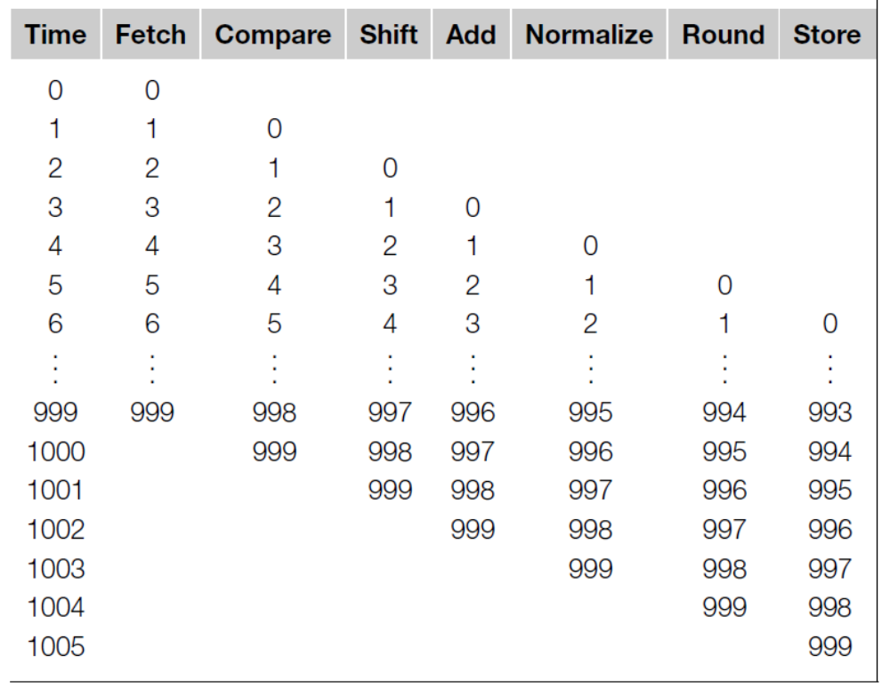
Instruction-level Parallelism: Pipelining
1006 nanoseconds < 7000 nanoseconds

Slide 50
Instruction-level Parallelism: Multiple issues
Multiple functional units
  If we have 2 complete floating point adder, then it may need 3500 nanoseconds.
Functional units schedule
  Static multiple issue
    Compiler groups instructions to be issued together
    Packages them into “issue slots”
    Compiler detects and avoids hazards
  Dynamic multiple issue → superscalar
    CPU examines instruction stream and chooses instructions to issue each cycle
    Compiler can help by reordering instructions
    CPU resolves hazards using advanced techniques at runtime

Slide 51
Today’s Lecture
The von Neumann Architecture
Basics of Cache
Instruction-level parallelism
Parallel Hardware
Interconnects
Summary

Slide 52
Flynn’s Taxonomy
classic von Neumann
SISD
Single instruction stream
Single data stream
(SIMD)
Single instruction stream
Multiple data stream
MISD
Multiple instruction stream
Single data stream
(MIMD)
Multiple instruction stream
Multiple data stream
not covered

Slide 53
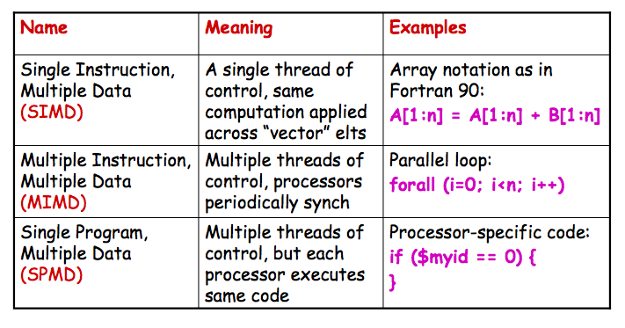
More Concrete: Parallel Control Mechanisms
SIMD: Vector processor and Graphics Processing Units (GPU)

Slide 54
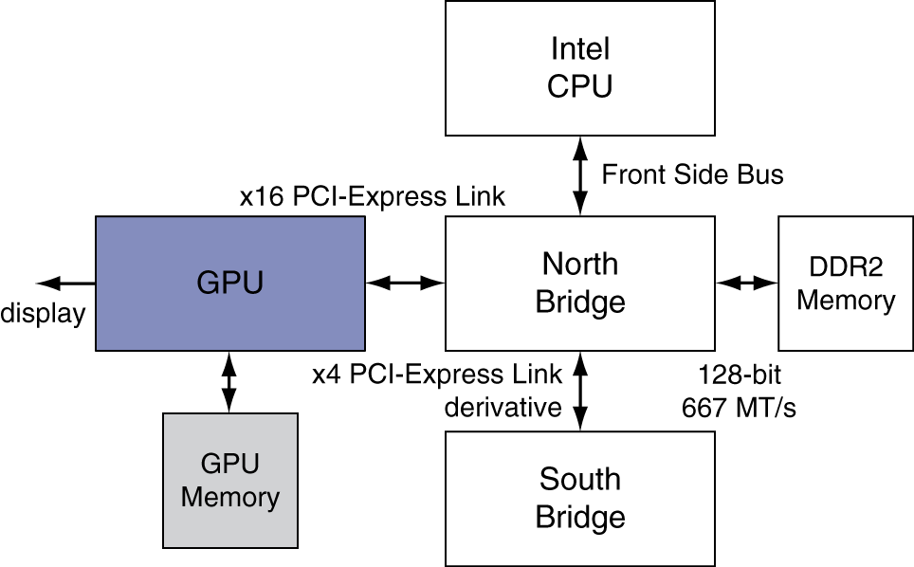
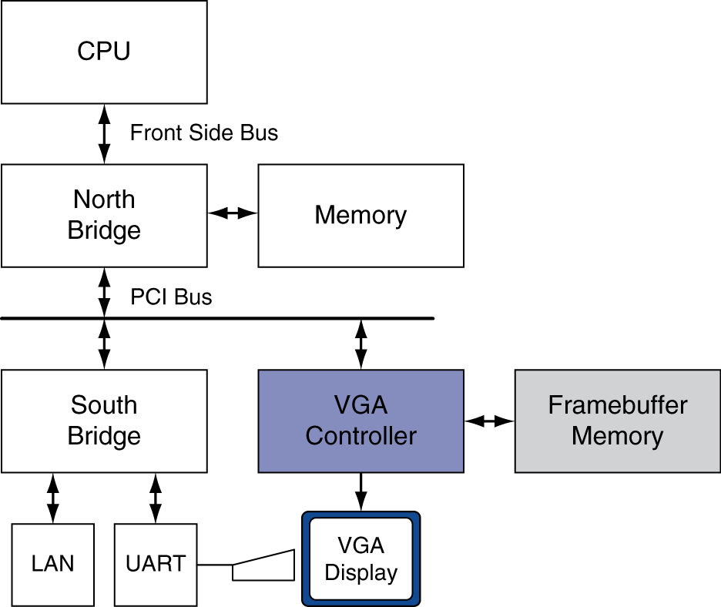
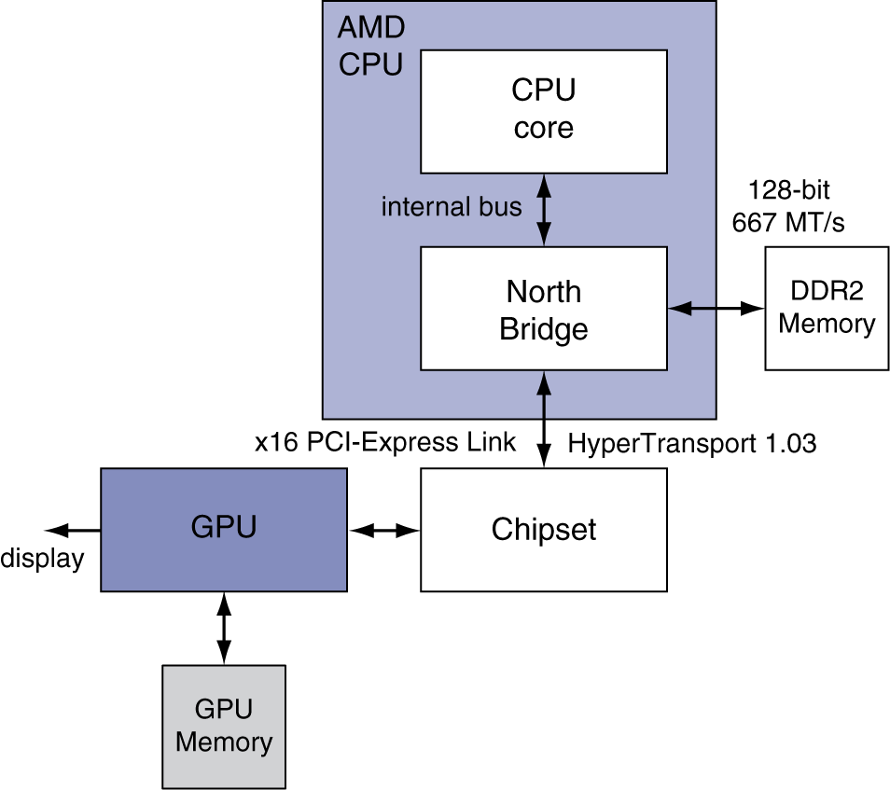
Graphics Processing Units
Processors oriented to 3D graphics tasks
Vertex/pixel processing, shading, texture mapping,
rasterization

Slide 55
GPU Architectures
Processing is highly data-parallel
  GPUs are highly multithreaded
  Use thread switching to hide memory latency
    Less reliance on multi-level caches
  Graphics memory is wide and high-bandwidth
Trend toward general purpose GPUs
  Heterogeneous CPU/GPU systems
  CPU for sequential code, GPU for parallel code
Programming languages/APIs
  DirectX, OpenGL
  C for Graphics (Cg), High Level Shader Language (HLSL)
  Compute Unified Device Architecture (CUDA)

Slide 56
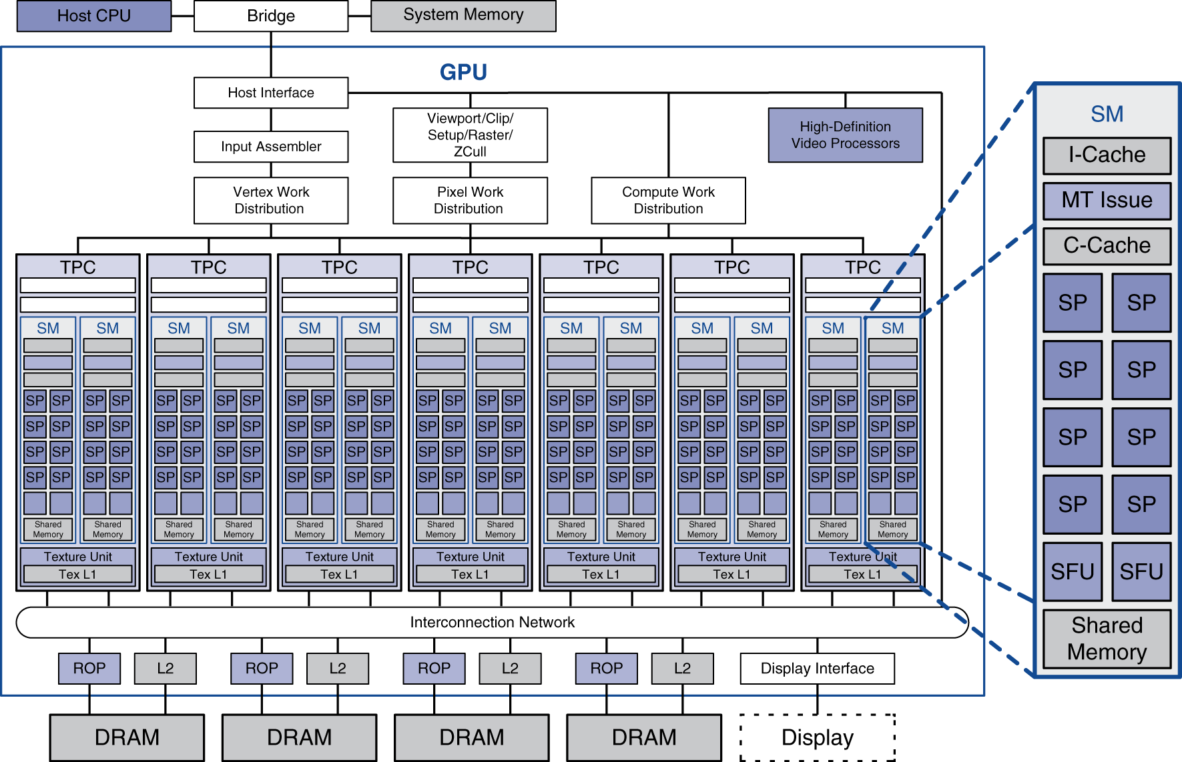
Example: NVIDIA Tesla
Streaming multiprocessor
8 × Streaming
processors

Slide 57
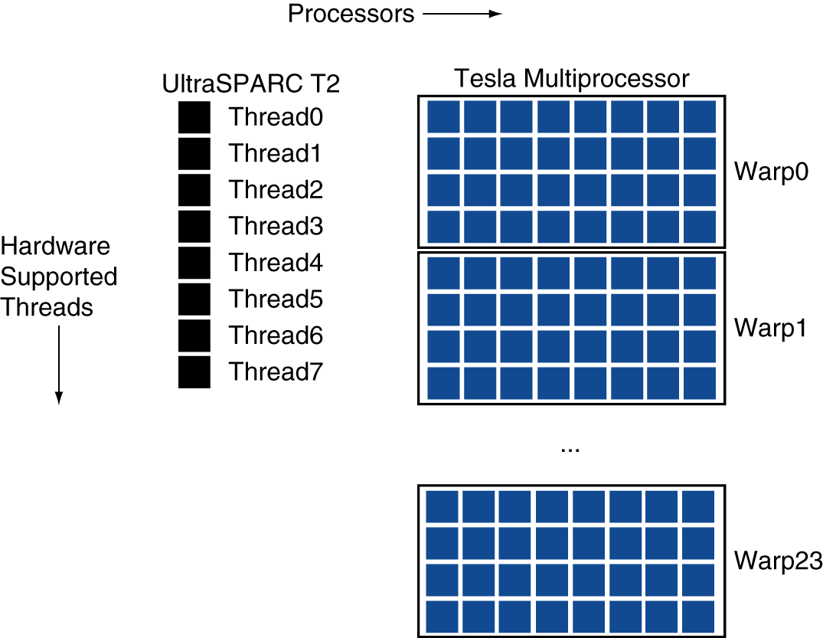
Example: NVIDIA Tesla
Streaming Processors
  Single-precision FP and integer units
  Each SP is fine-grained multithreaded
Warp: group of 32 threads
  Executed in parallel,
  SIMD style
    8 SPs
    × 4 clock cycles
  Hardware contexts
  for 24 warps
    Registers, PCs, …

Slide 58
Two main classes of parallel architecture organizations
Shared memory multiprocessor architectures
  A collection of autonomous processors connected to a memory system.
  Supports a global address space where each processor can access each memory location.
Distributed memory architectures
  A collection of autonomous systems connected by an interconnect.
  Each system has its own distinct address space, and processors must explicitly communicate to share data.
  Clusters of PCs connected by commodity interconnect is the most common example.

Slide 59
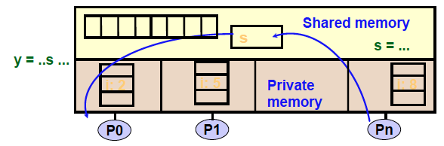
Programming Shared Memory Architectures
A shared-memory program is a collection of threads of control.
  Threads are created at program start or possibly dynamically
  Each thread has private variables, e.g., local stack variables
  Also a set of shared variables, e.g., static variables, shared
common blocks, or global heap.
  Threads communicate implicitly by writing and reading shared variables.
  Threads coordinate through locks and barriers implemented using shared variables.

Slide 60
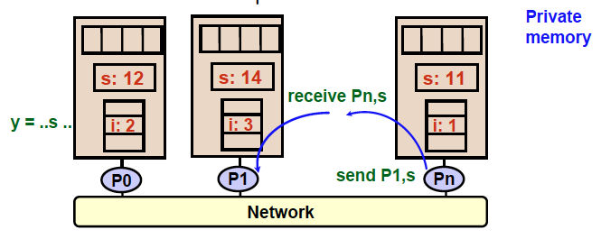
Programming Distributed Memory Architectures
A distributed-memory program consists of named processes.
Process is a thread of control plus local address space -- NO shared data.
Logically shared data is partitioned over local processes.
Processes communicate by explicit send/receive pairs
Coordination is implicit in every communication event.

Slide 61
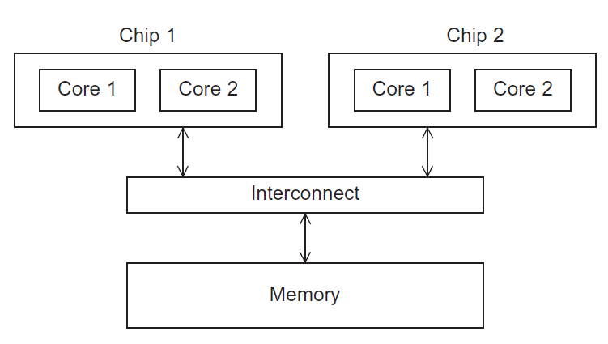
Uniform Memory Access (UMA) multicore system
Figure 2.5
Time to access all the memory locations will be the same for all the cores.
Copyright © 2010, Elsevier Inc. All rights Reserved

Slide 62
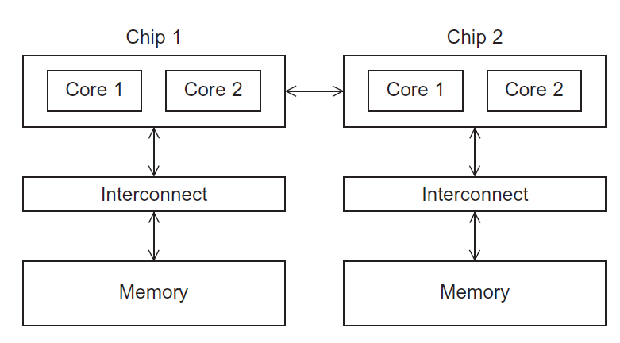
Non-uniform Memory Access (NUMA) multicore system
Figure 2.6
A memory location a core is directly connected to can be accessed faster than a memory location that must be accessed through another chip.
Copyright © 2010, Elsevier Inc. All rights Reserved

Slide 63
Today’s Lecture
The von Neumann Architecture
Basics of Cache
Instruction-level parallelism
Parallel Hardware
Interconnects
Summary

Slide 64
Shared memory interconnects
Bus interconnect
  A collection of parallel communication wires together with some hardware that controls access to the bus.
  Communication wires are shared by the devices that are connected to it.
  As the number of devices connected to the bus increases, contention for use of the bus increases, and performance decreases.
Switched interconnect
  Uses switches to control the routing of data among the connected devices.
  Crossbar –
    Allows simultaneous communication among different devices.
    Faster than buses.
    But the cost of the switches and links is relatively high.
    Crossbars grow as n² making them impractical for large n

Slide 65
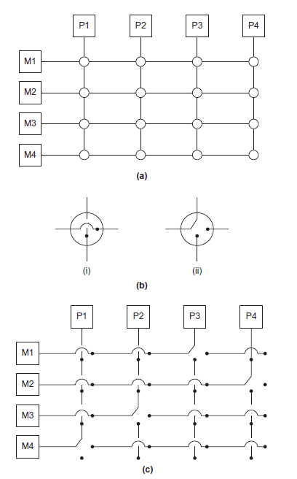
Crossbar
(a)
A crossbar switch connecting 4 processors (Pi) and 4 memory modules (Mj)
(b)
Configuration of internal switches in a crossbar
(c) Simultaneous memory accesses by the processors

Slide 66
Distributed memory interconnects
Two groups
  Direct interconnect
    Each switch is directly connected to a processor memory pair, and the switches are connected to each other.
  Indirect interconnect
    Switches may not be directly connected to a processor.
The cost of an interconnect can be a big part of a machine, governed by
  Number of links
  Number of switches
  Available bandwidth (highly optimized links are expensive)

Slide 67
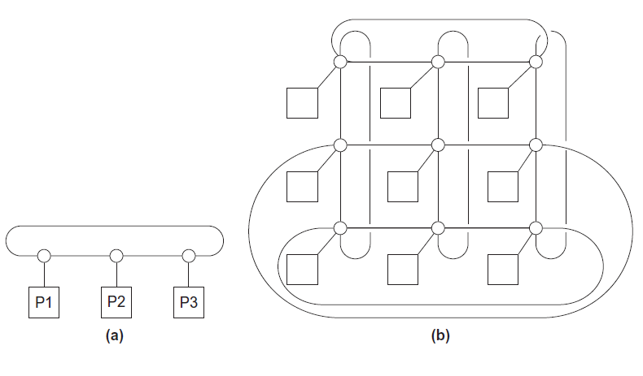
Direct interconnect
Figure 2.8
ring
toroidal mesh

Slide 68
Like memory systems, we also consider bandwidth and latency in message-passing
Message transmission time = l + n / b
latency (seconds)
length of message (bytes)
bandwidth (bytes per second)

Slide 69
Definitions
Bisection width
  A measure of “number of simultaneous communications” or “connectivity”.
  How many simultaneous communications can take place “across the divide” between the halves?
Bisection bandwidth
  A measure of network quality.
  Instead of counting the number of links joining the halves, it sums the bandwidth of the links.

Slide 70
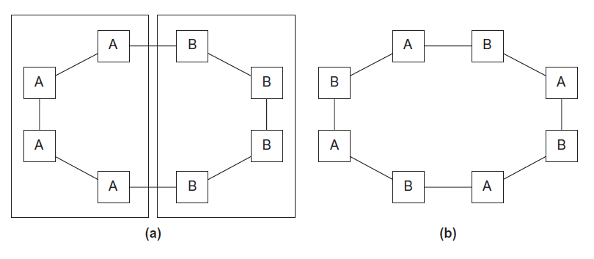
Two bisections of a ring
Figure 2.9

Slide 71
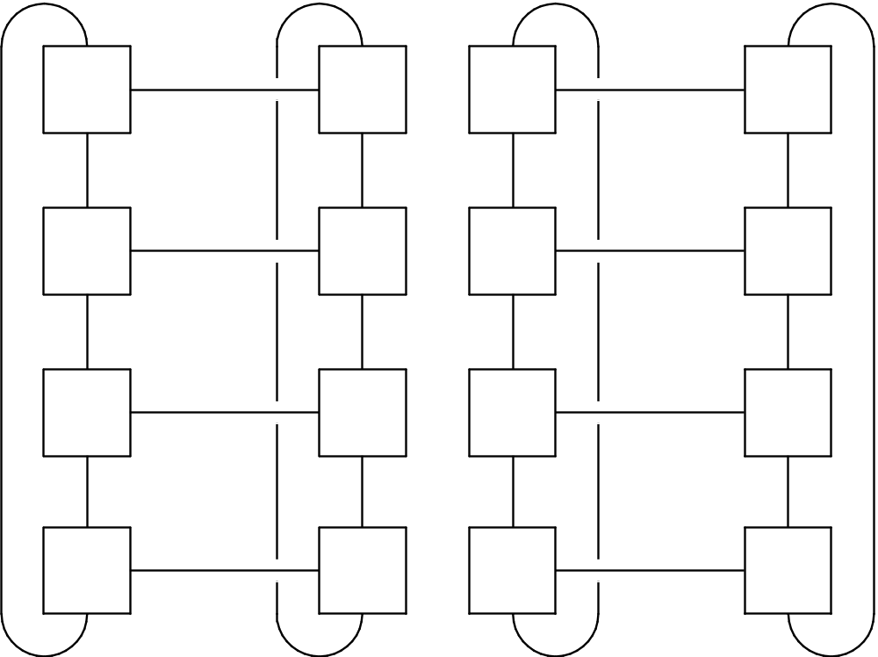
A bisection of a toroidal mesh
Figure 2.10

Slide 72
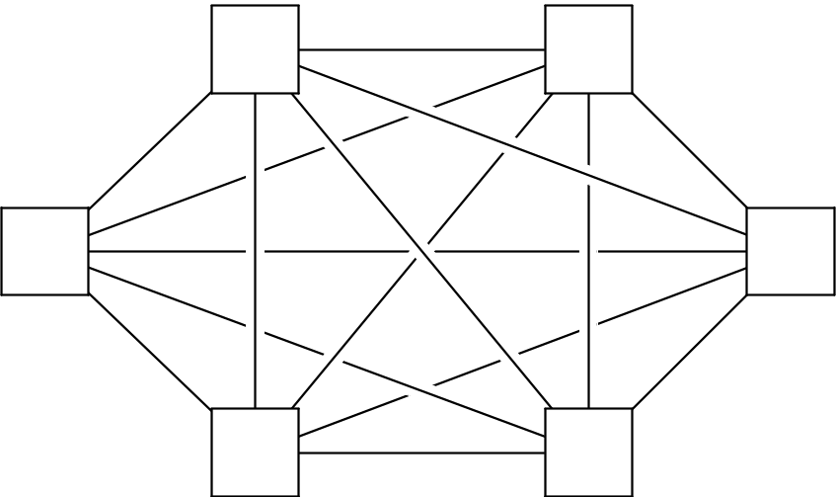
Fully connected network
Each switch is directly connected to every other switch.
impractical
bisection width = p²/4
Figure 2.11

Slide 73
Indirect interconnects
Simple examples of indirect networks:
  Crossbar
  Omega network
Often shown with unidirectional links and a collection of processors, each of which has an outgoing and an incoming link, and a switching network.

Slide 74
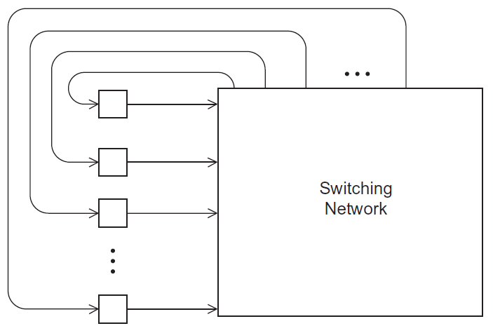
A generic indirect network
Figure 2.13

Slide 75
Today’s Lecture
The von Neumann Architecture
Basics of Cache
Instruction-level parallelism
Parallel Hardware
Interconnects
Summary

Slide 76
Summary of Lecture
The von Neumann architecture
The basics of caching
  Data Inconsistent
  Cache Mappings
Instruction-level parallelism
Parallel Hardware
  SIMD, MIMD
  Shared memory vs. Distributed memory
  UMA vs. NUMA
Interconnects
  Bisection bandwidth

