Slide 1
并行程序设计
Lecture 5:
POSIX Threads (Pthread)

Slide 2
Today’s Lecture
Introduction to POSIX Threads
Hello World!
Matrix-vector multiplication
Critical Section
Barrier and Condition Variables
Read-Write Locks
Summary

Slide 3
Today’s Lecture
Introduction to POSIX Threads
Hello World!
Matrix-vector multiplication
Critical Section
Barrier and Condition Variables
Read-Write Locks
Summary

Slide 4
Shared Memory vs. Distributed Memory Programs
Shared Memory Programming
  Start a single process and fork threads.
  Threads carry out work.
  Threads communicate through shared memory.
  Threads coordinate through synchronization (also through shared memory).
Distributed Memory Programming
  Start multiple processes on multiple systems.
  Processes carry out work.
  Processes communicate through message-passing.
  Processes coordinate either through message-passing or synchronization (generates messages).

Slide 5
Shared Memory Programming
Dynamic threads
  Master thread waits for work, forks new threads, and when threads are done, they terminate
  Efficient use of resources, but thread creation and termination is time consuming.
Static threads
  Pool of threads created and are allocated work, but do not terminate until cleanup.
  Better performance, but potential waste of system resources.

Slide 6
Thread Safety
  A function or library is thread-safe if it operates “correctly” when called by multiple, simultaneously executing threads.
  Since multiple threads communicate and coordinate through shared memory, a thread-safe code modifies the state of shared memory using appropriate synchronization.
  Some features of sequential code that may not be thread safe?

Slide 7
Programming with Threads
PThreads is the POSIX Standard
  Relatively low level
    Programmer expresses thread management and coordination
    Programmer decomposes parallelism and manages schedule
  Portable but possibly slow
  Most widely used for systems-oriented code, and also used for some kinds of application code
OpenMP is newer standard
  Higher-level support for scientific programming on shared memory architectures
    Programmer identifies parallelism and data properties, and guides scheduling at a high level
    System decomposes parallelism and manages schedule
  Arose from a variety of architecture-specific pragmas

Slide 8
Overview of POSIX Threads (Pthreads)
POSIX: Portable Operating System Interface for UNIX
  Interface to Operating System utilities
PThreads: The POSIX threading interface
  System calls to create and synchronize threads
  Should be relatively uniform across UNIX-like OS platforms
PThreads contain support for
  Creating parallelism
  Synchronizing
  No explicit support for communication, because shared memory is implicit; a pointer to shared data is passed to a thread

Slide 9
Today’s Lecture
Introduction to POSIX Threads
Hello World!
Matrix-vector multiplication
Critical Section
Barrier and Condition Variables
Read-Write Locks
Summary

Slide 10
Forking Pthreads
Signature:
int pthread_create(pthread_t *,
const pthread_attr_t *,
void * (*)(void *),
void *);
Example call:
errcode = pthread_create(&thread_id, &thread_attribute,
&thread_fun, &fun_arg);
thread_id is the thread id or handle (used to halt, etc.)
thread_attribute various attributes
  standard default values obtained by passing a NULL pointer
thread_fun the function to be run (takes and returns void*)
fun_arg an argument can be passed to thread_fun when it starts
errorcode will be set to nonzero if the create operation fails

Slide 11
Simple Threading Example
int main() {
pthread_t threads[16];
int tn;
for(tn=0; tn<16; tn++) {
pthread_create(&threads[tn], NULL, ParFun, NULL);
}
for(tn=0; tn<16 ; tn++) {
pthread_join(threads[tn], NULL);
}
return 0;
}
Compile using gcc … –lpthread
This code creates 16 threads that execute the function “ParFun”.
Note that thread creation is costly, so it is important that ParFun do a lot of work in parallel to amortize this cost.

Slide 12
“Hello World” in Pthreads
Some preliminaries
  Number of threads to create (thread_count) is set at runtime and read from command line
  Each thread prints “Hello from thread <X> of <threadcount>”
Also need another function
  int pthread_join(pthread_t *, void **value_ptr)
  From Unix specification: “suspends execution of the calling thread until the target thread terminates, unless the target thread has already terminated.”
  The second parameter allows the exiting thread to pass information back to the calling thread (often NULL).
  Returns nonzero if there is an error

Slide 13
Shared Data and Threads
Variables declared outside of main are shared
Object allocated on the heap may be shared (if pointer is passed)
Variables on the stack are private: passing pointer to these around to other threads can cause problems
Shared data often a result of creating a large “thread data” struct
  Passed into all threads as argument
  Simple example:
    char *message = "Hello World!\n";
    pthread_create( &thread1,
    NULL,
    (void*)&print_fun,
    (void*) message);

Slide 14
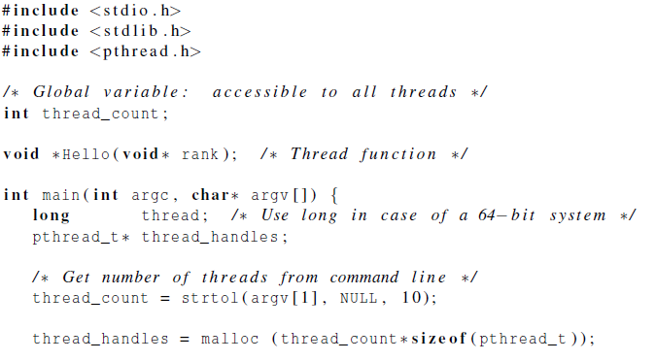
Hello World! (1)
declares the various Pthreads
functions, constants, types, etc.
pthread_t data structure
strtol function
Allocate storage for thread_t of each thread

Slide 15
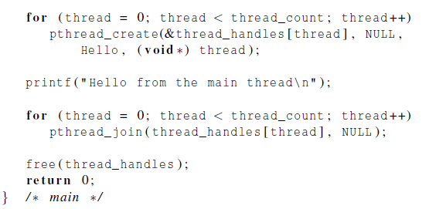
Hello World! (2)
cast the loop variable thread to have type void*

Slide 16
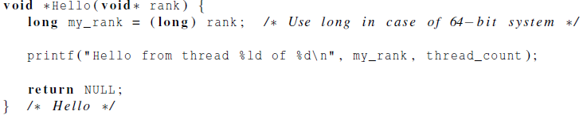
Hello World! (3)
cast the argument back to a long
$ gcc -g -Wall -0 pth_hello pth_hello.c -lpthread
$ ./pth_hello 4
Hello from the main thread
Hello from thread 0 of 4
Hello from thread 1 of 4
Hello from thread 2 of 4
Hello from thread 3 of 4

Slide 17
Today’s Lecture
Introduction to POSIX Threads
Hello World!
Matrix-vector multiplication
Critical Section
Barrier and Condition Variables
Read-Write Locks
Summary

Slide 18
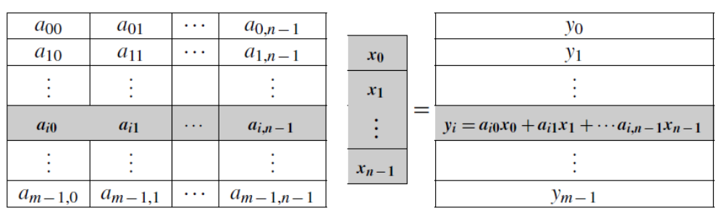

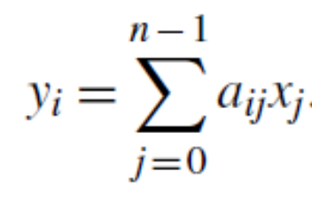
Matrix-vector multiplication
Matrix-vector multiplication:

Slide 19
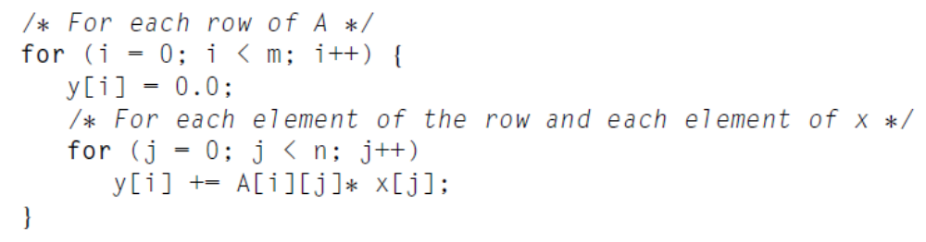
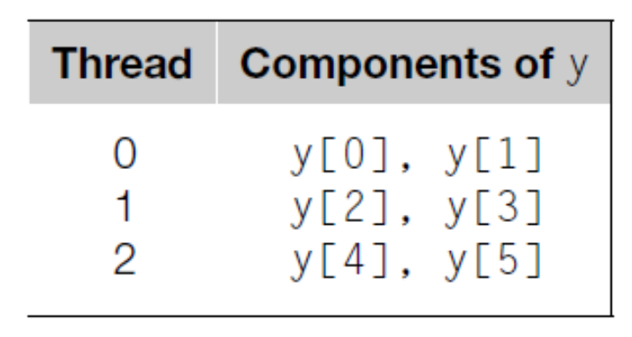
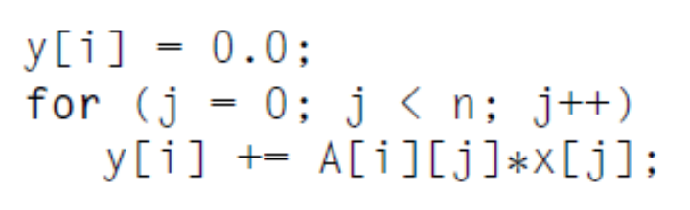
Matrix-vector multiplication
Pseudo-code for a serial program for Matrix-vector multiplication:
m=n=6, #Thread=3
if thread t execute y[i]
X are shared

Slide 20
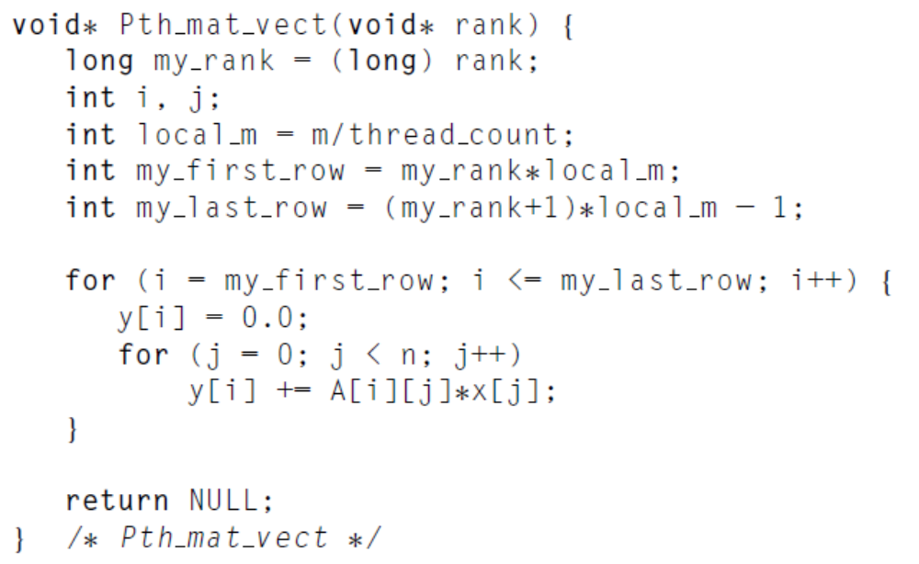
Matrix-vector multiplication

Slide 21
Today’s Lecture
Introduction to POSIX Threads
Hello World!
Matrix-vector multiplication
Critical Section
Barrier and Condition Variables
Read-Write Locks
Summary

Slide 22
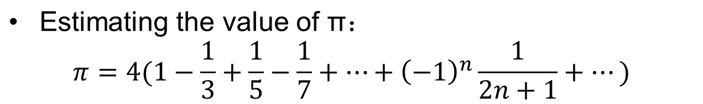
Estimating the value of π
Serial Code:
Let’s parallelize this code!
double factor = 1.0;
double sum = 0.0;
for ( i=0; i<n; i++, factor = -factor){
sum += factor/(2*i+1);
}
pi = 4.0 *sum;
General idea:
Divide up the iterations in the for loop among threads;
Make sum a shared variable

Slide 23
Idea
t : number of threads
n : number of terms in the formula
If m=n/t
For thread q: qm, qm+1, qm+2,…,(q+1)m-1
threads | terms
0 | Add i=0 to m-1 terms
1 | Add i=m to 2m-1 terms
2 | Add i=2m to 3m-1 terms
⁞ | ⁞

Slide 24
Estimating the value of π
Void* Thread_sum(void *rank){
long my_rank = (long)rank;
double factor;
long long i;
long long my_n = n/thread_count;
long long my_first_i = my_n * my_rank;
long long my_last_i = my_first_i + my_n;
if(my_first_i % 2 == 0) //even
factor = 1.0;
else //odd
factor = -1.0;
for(i = my_first_i; i < my_last_i; i++,factor = -factor) { sum += factor / (2 * i +1); }
return NULL;
}
Correct?

Slide 25
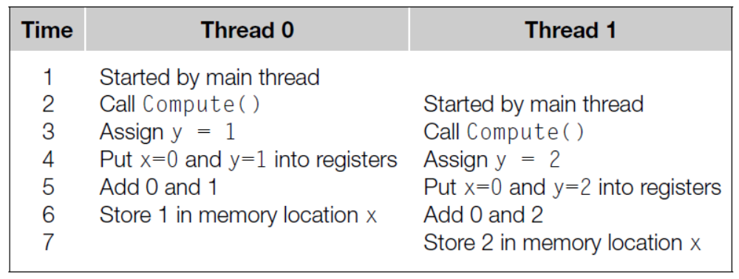
Unpredictable Results
y = Compute(my_rank);
x = x + y;
A fundamental problem in shared-memory programming: when multiple threads attempt to update a shared resource, the result may be unpredictable.

Slide 26
Critical Section
A race condition exists when the result of an execution depends on the timing of two or more events.
A critical section is a block of code that updates a shared resource that can only be updated by one thread at a time.
y = Compute(my_rank);
x = x + y;
Critical section

Slide 27
Using Flag Variable
y = Compute(my_rank);
x = x + y;
Time | Thread 0 | Thread 1
0 | Y=0 | Y=1
1 | While() | While()
2 | x=x+y | While()
3 | Flag++ | While()
4 |  | While()
5 |  | x=x+y
6 |  | Flag++
y = Compute(my_rank);
While(flag!=my_rank);
x = x + y;
flag++;
Thread 1 cannot enter the critical section until thread 0 has completed the execution of flag++

Slide 28
Busy-waiting
While loop is an example of busy-waiting.
In busy-waiting, a thread repeatedly tests a condition until the condition has the appropriate value.
Busy-waiting can be used to avoid conflicting access to critical sections with a flag variable and a while-loop with an empty body.
Note that, compiler optimizations should be turned off when we use busy-waiting,
y = Compute(my_rank);
While(flag!=my_rank);
x = x + y;
flag++;
y = Compute(my_rank);
x = x + y; While(flag!=my_rank);
flag++;

Slide 29
Estimating the value of π with BW
Void* Thread_sum(void *rank){
long my_rank = (long)rank;
double factor;
long long i;
long long my_n = n/thread_count;
long long my_first_i = my_n * my_rank;
long long my_last_i = my_first_i + my_n;
if(my_first_i % 2 == 0) //even
factor = 1.0;
else //odd
factor = -1.0;
for(i = my_first_i; i < my_last_i; i++,factor = -factor) { while(flag != my_rank):
sum += factor / (2 * i +1);
flag=(flag+1)% thread_count }
return NULL;
}

Slide 30
Performance of Busy-waiting
Performance degrade:
for(i = my_first_i; i < my_last_i; i++,factor = -factor) { while(flag != my_rank):
sum += factor / (2 * i +1);
flag=(flag+1)% thread_count }
One way to greatly improve the performance of the sum function is to have each thread use a private variable to store its total contribution to the sum

Slide 31
Estimating the value of π with BW_2
Void* Thread_sum(void *rank){
long my_rank = (long)rank;
double factor, my_sum = 0.0;
long long i;
long long my_n = n/thread_count;
long long my_first_i = my_n * my_rank;
long long my_last_i = my_first_i + my_n;
if(my_first_i % 2 == 0) //even
factor = 1.0;
else //odd
factor = -1.0;
for(i = my_first_i; i < my_last_i; i++,factor = -factor) { my_sum+=factor/(2*i+1) }
while(flag != my_rank):
sum += my_sum;
flag=(flag+1)% thread_count
return NULL;
}

Slide 32
Pthreads Mutexes
Used to guarantee that one thread “excludes” all other threads while it executes the critical section.
The Pthreads standard includes a special type for mutexes: pthread_mutex_t.
int pthread_mutex_init(
pthread_mutex_t* mutex_p;
const pthread _mutexattr_t* attr_p;)
When a Pthreads program finishes using a mutex, it should call
int pthread_mutex_destroy(
pthread_mutex_t* mutex_p;)

Slide 33
Pthreads Mutexes
To gain access to a critical section a thread calls
int pthread_mutex_lock(
pthread_mutex_t* mutex_p;)
When a thread is finished executing the code in a critical section, it should call
int pthread_mutex_unlock(
pthread_mutex_t* mutex_p;)

Slide 34
Pthreads Mutexes
pthread_mutex_lock(&mutex);
sum+=my_sum;
pthread_mutex_unlock(&mutex);
The order in which the threads execute the code in critical section is more or less random;

Slide 35
Estimating the value of π with a mutex
Void* Thread_sum(void *rank){
long my_rank = (long)rank;
double factor, my_sum = 0.0;
long long i;
long long my_n = n/thread_count;
long long my_first_i = my_n * my_rank;
long long my_last_i = my_first_i + my_n;
if(my_first_i % 2 == 0) //even
factor = 1.0;
else //odd
factor = -1.0;
for(i = my_first_i; i < my_last_i; i++,factor = -factor) { my_sum+=factor/(2*i+1) }
pthread_mutex_lock(&mutex);
sum+=my_sum;
pthread_mutex_unlock(&mutex);
return NULL;
}

Slide 36
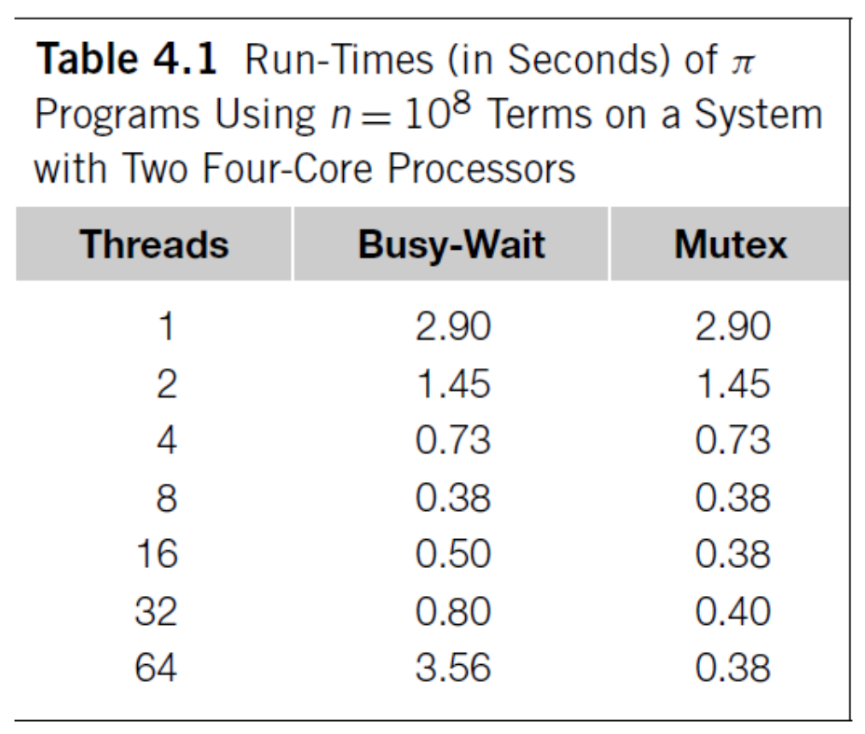
Busy-waiting vs. Mutex
Performance of Busy-wariting can degrade if there are more thread than cores.
The execution of threads using Busy-waiting has an order.

Slide 37
Producer-Consumer Synchronization and Semaphores
A semaphore is the third way to avoid conflicting access to critical sections.
It is an unsigned int together with two operations: sem_wait and sem_post. Semaphores are more powerful than mutexes since they can be initialized to any nonnegative value.
Producer-Consumer synchronization is that a thread can’t proceed until another thread has taken some action.

Slide 38
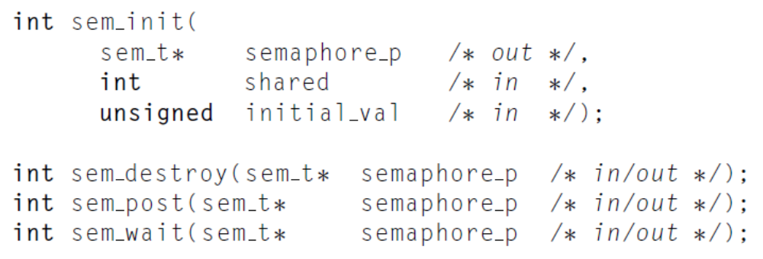

Semaphores
The syntax of various semaphore functions is:
Semaphores are not part of Pthreads.

Slide 39
Today’s Lecture
Introduction to POSIX Threads
Hello World!
Matrix-vector multiplication
Critical Section
Barrier and Condition Variables
Read-Write Locks
Summary

Slide 40
Barriers
Synchronizing the threads to make sure that they all are at the same point in a program is called a barrier.
No thread can cross the barrier until all the threads have reached it.
barrier

Slide 41

Using barriers for debugging
  Point in program we want to reach;
  Barrier;
  If (my_rank==0){
  printf(“All threads reached this point\n”);
  fflush(stdout);
  }

Slide 42
Explicit Synchronization:
Creating and Initializing a Barrier
To (dynamically) initialize a barrier, use code similar to this (which sets the number of threads to 3):
  pthread_barrier_t b;
  pthread_barrier_init(&b,NULL,3);
The second argument specifies an object attribute; using NULL yields the default attributes.
To wait at a barrier, a process executes:
  pthread_barrier_wait(&b);
This barrier could have been statically initialized by assigning an initial value created using the macro
  PTHREAD_BARRIER_INITIALIZER(3)

Slide 43
Barrier: Busy-waiting and a Mutex
Implementing a barrier using busy-waiting and a mutex is straightforward.
We use a shared counter protected by the mutex.
When the counter indicates that every thread has entered the critical section, threads can leave the critical section.
  /*Barrier*/;
  pthread_mutex_lock(&barrier_mutex);
  counter++;
  pthread_mutex_unlock(&barrier_mutex);
  while(counter < thread_count);

Slide 44
Can barriers share variable counter?
  Int counter;
  Int thread_count;
  Pthread_mutex_t barrier_mutex1,barrier_mutex2;
  /*Barrier1*/;
  pthread_mutex_lock(&barrier_mutex1);
  counter++;
  pthread_mutex_unlock(&barrier_mutex1);
  while(counter < thread_count);
  /*Barrier2*/;
  pthread_mutex_lock(&barrier_mutex2);
  counter++;
  pthread_mutex_unlock(&barrier_mutex2);
  while(counter < thread_count);
?

Slide 45
Can barriers share counter?
counter<4
counter=4
barrier1
Reset counter
barrier2
Each barrier has its own counter!

Slide 46
Barrier: semaphores
  Sem_t count_sem; /*Initialize to 1*/
  Sem_t barrier_sem; /*Initialize to 0*/
  Void* Thread_work(){
  /*Barrier*/
  Sem_wait(&count_sem);
  If(counter == thread_count-1){
  counter = 0;
  sem_post(&count_sem);
  for(j=0;j<thread_count-1;j++){
  sem_post(&barrier_sem);
  }else{
  counter++;
  sem_post(&count_sem);
  sem_wait(&barrier_sem);
  }
  }

Slide 47
Semaphore Reuse
1. barrier_sem = 1
blocked
barrier1
2. barrier_sem = 1
barrier2
Counter and count_sem can be reused, barrier_sem can not be reused!

Slide 48
Condition Variables
A condition variable is a data object that allows a thread to suspend execution until a certain event or condition occurs.
When the event or condition occurs another thread can signal the thread to “wake up.”
A condition variable is always associated with a mutex.

Slide 49
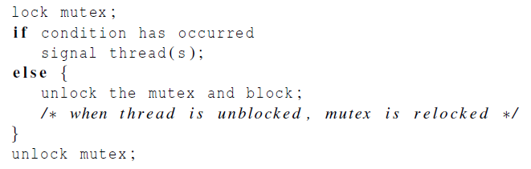
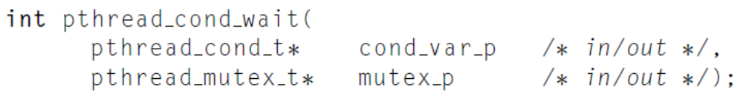
Condition Variables
The constructs in which condition variables are used:
Unlock one and all of the blocked threads:
Unlock the mutex referred to by mutex_p and cause the executing thread to block:

Slide 50
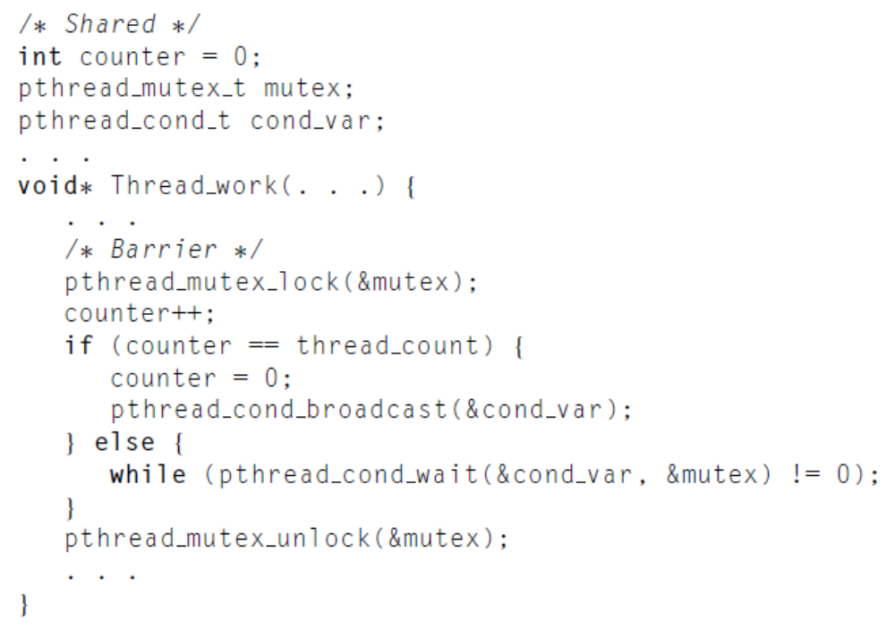
Implements a barrier with Condition Variables
Block the threads

Slide 51
Today’s Lecture
Introduction to POSIX Threads
Hello World!
Matrix-vector multiplication
Critical Section
Barrier and Condition Variables
Read-Write Locks
Summary

Slide 52
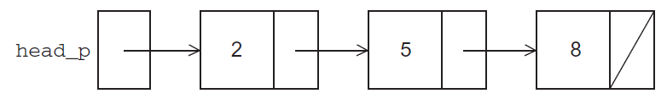
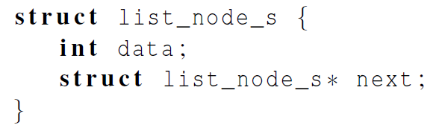
Read-Write Locks
Let’s look at an example.
Suppose the shared data structure is a sorted linked list of ints, and the operations of interest are Member, Insert, and Delete.

Slide 53
Linked List Membership
Read
Read
Read

Slide 54
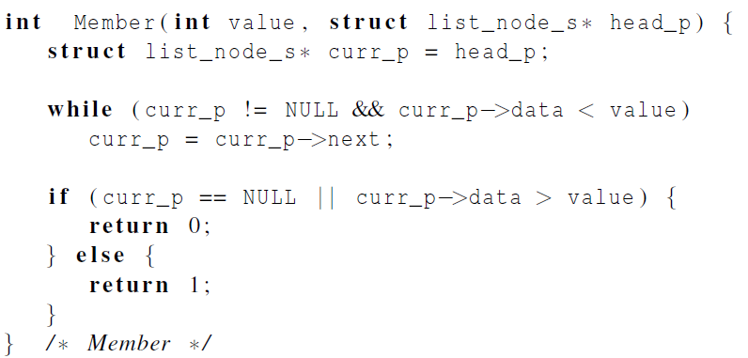
Linked List Membership

Slide 55
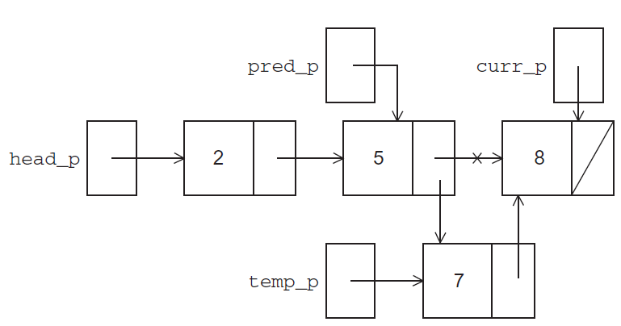
Inserting a new node into a list

Slide 56
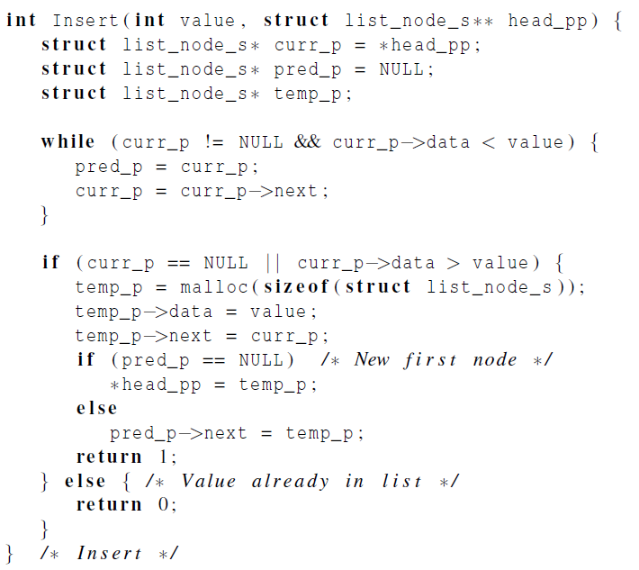
Inserting a new node into a list

Slide 57
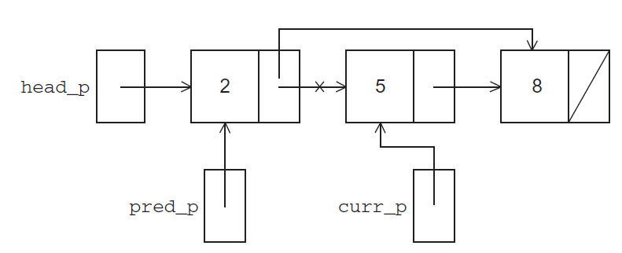
Deleting a node from a linked list

Slide 58
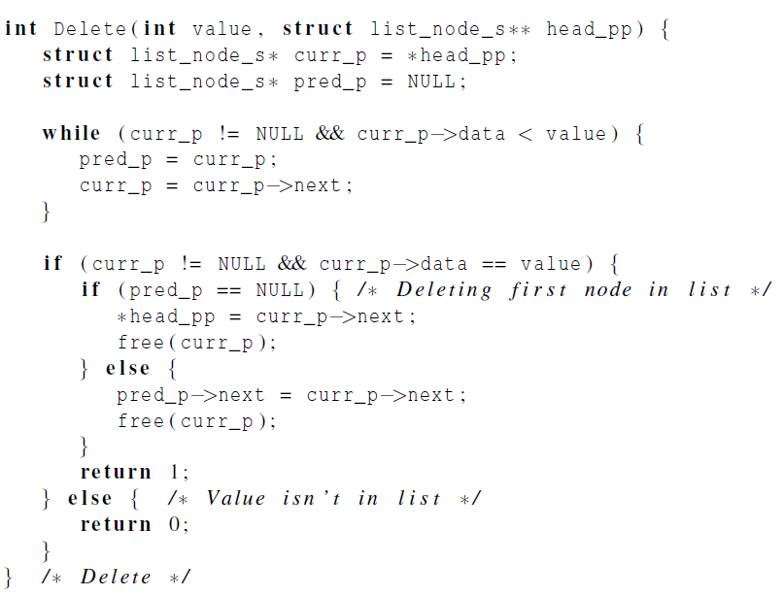
Deleting a node from a linked list

Slide 59
A Multi-Threaded Linked List
Let’s try to use these functions in a Pthreads program.
In order to share access to the list, we can define head_p to be a global (shared) variable.

Slide 60
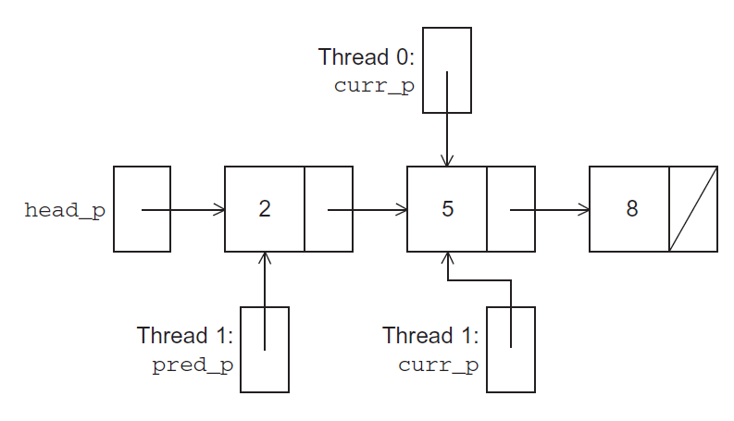
Simultaneous access by two threads
Thread 0 executing Member (5)
Thread 1 executing Delete (5)

Slide 61
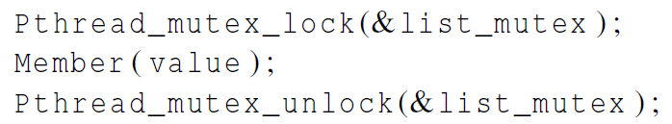
Solution #1
An obvious solution is to simply lock the list any time that a thread attempts to access it.
A call to each of the three functions can be protected by a mutex.
Good?

Slide 62
Issues
We’re serializing access to the list.
If the vast majority of our operations are calls to Member, we’ll fail to exploit this opportunity for parallelism.
On the other hand, if most of our operations are calls to Insert and Delete, then this may be the best solution since we’ll need to serialize access to the list for most of the operations, and this solution will certainly be easy to implement.

Slide 63
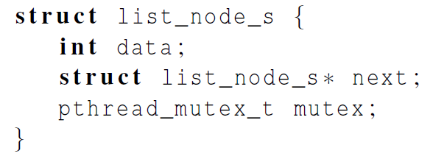
Solution #2
Instead of locking the entire list, we could try to lock individual nodes.
A “finer-grained” approach.
Good?

Slide 64
Issues
This is much more complex than the original Member function.
It is also much slower, since, in general, each time a node is accessed, a mutex must be locked and unlocked.
The addition of a mutex field to each node will substantially increase the amount of storage needed for the list.

Slide 65
Pthreads Read-Write Locks
Neither of our multi-threaded linked lists exploits the potential for simultaneous access to any node by threads that are executing Member.
The first solution only allows one thread to access the entire list at any instant.
The second only allows one thread to access any given node at any instant.
A read-write lock is somewhat like a mutex except that it provides two lock functions.
The first lock function locks the read-write lock for reading, while the second locks it for writing.

Slide 66
Pthreads Read-Write Locks
So multiple threads can simultaneously obtain the lock by calling the read-lock function, while only one thread can obtain the lock by calling the write-lock function.
Thus, if any threads own the lock for reading, any threads that want to obtain the lock for writing will block in the call to the write-lock function.
If any thread owns the lock for writing, any threads that want to obtain the lock for reading or writing will block in their respective locking functions.

Slide 67
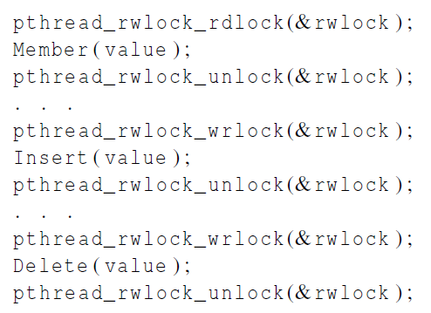
Protecting our linked list functions

Slide 68
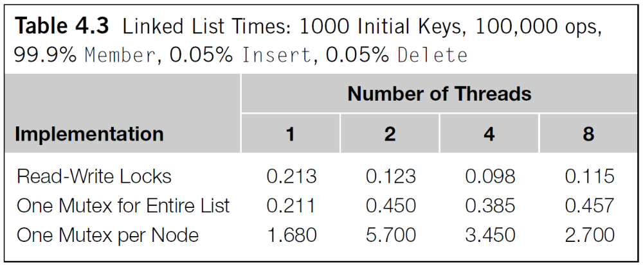
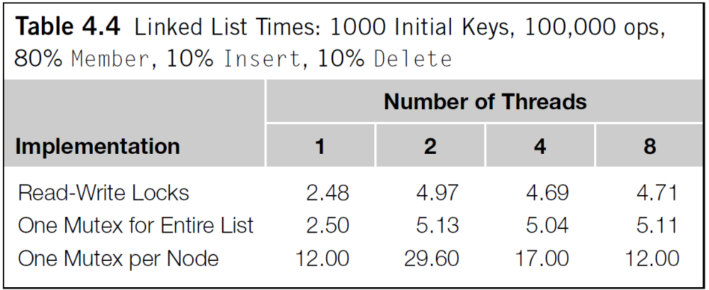
Performance

Slide 69
Today’s Lecture
Introduction to POSIX Threads
Hello World!
Matrix-vector multiplication
Critical Section
Barrier and Condition Variables
Read-Write Locks
Summary

Slide 70
Some basic knowledge
A critical section is a block of code that updates a shared resource that can only be updated by one thread at a time.
Busy-waiting can be used to avoid conflicting access to critical sections with a flag variable and a while-loop with an empty body.
A mutex can be used to avoid conflicting access to critical sections as well.
A semaphore is the third way to avoid conflicting access to critical sections.
    It is an unsigned int together with two operations: sem_wait and sem_post. Semaphores are more powerful than mutexes since they can be initialized to any nonnegative value.
A barrier is a point in a program at which the threads block until all of the threads have reached it.
A read-write lock is used when it’s safe for multiple threads to simultaneously read a data structure, but if a thread needs to modify or write to the data structure, then only that thread can access the data structure during the modification.

