Slide 1
并行程序设计
Programming Example：
Traveling Salesperson Problem （Pthread）

Slide 2
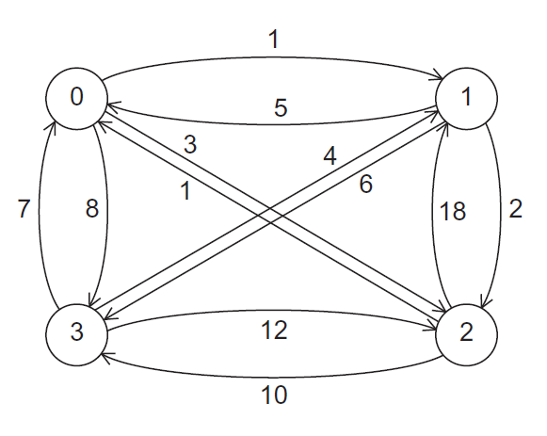

A Four-City TSP
0 is root or single source. What is the shortest path?

Slide 3
Depth-first Search
0,0
0→1,1
0→1→2,3
0→1→2→3→0,20

Slide 4
Depth-first Search
0,0
0→1,1
0→1→2,3
0→1→3,7
0→1→2→3→0,20
0→1→3→2→0,20

Slide 5
Depth-first Search
0,0
0→1,1
0→2,3
0→1→2,3
0→1→3,7
0→2→1,21
0→1→2→3→0,20
0→2→1→3→0,34
0→1→3→2→0,20

Slide 6
Depth-first Search
0,0
0→1,1
0→2,3
0→1→2,3
0→1→3,7
0→2→1,21
0→2→3,13
0→1→2→3→0,20
0→2→1→3→0,34
0→1→3→2→0,20
0→2→3→1→0,22

Slide 7
Depth-first Search
0,0
0→1,1
0→2,3
0→3,8
0→1→2,3
0→1→3,7
0→2→1,21
0→2→3,13
0→3→1,12
0→1→2→3→0,20
0→2→1→3→0,34
0→3→1→2→0,15
0→1→3→2→0,20
0→2→3→1→0,22

Slide 8
Depth-first Search
0,0
0→1,1
0→2,3
0→3,8
0→1→2,3
0→1→3,7
0→2→1,21
0→2→3,13
0→3→1,12
0→3→2,20
0→1→2→3→0,20
0→2→1→3→0,34
0→3→1→2→0,15
0→1→3→2→0,20
0→2→3→1→0,22
0→3→2→1→0,43

Slide 9
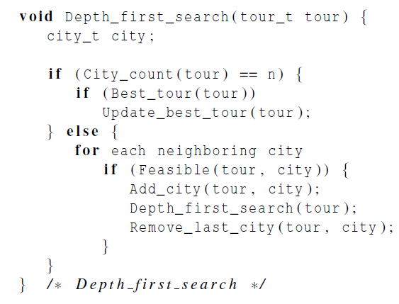
Pseudo-code for a recursive solution to TSP using depth-first search
Functions：
City_count ( tour)
Best_tour (tour)
Feasible (tour, city)

Slide 10
We’ll need to eliminate recursion
Non-recursive implementation is more flexible
  Shared data structures
  Freedom to schedule threads/processes flexibly
How to eliminate recursion
  Explicit management of “stack” data structure
  Loop instead of recursive calls

Slide 11
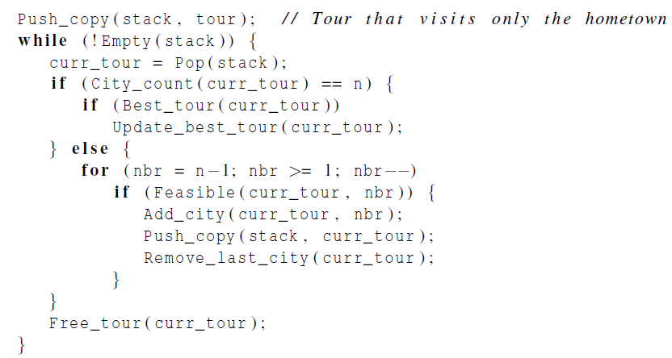
Pseudo-code for a second solution to TSP that doesn’t use recursion
Termination and find best solution
Can this city be added:
on path?
new to path?
shorter than existing paths?

Slide 12
Push_copy
void Push_copy ( my_stack_t stack, tour_t tour){
int loc = stack -> list_sz;
tour_t tmp = Alloc_tour();
Copy_tour (tour, tmp);
stack -> list[loc] = tmp;
stack -> list_sz++;
} /* Push */

Slide 13
Making sure we have the “best_tour”
In the case where a thread tests and decides it has a better global solution, we need to ensure two things:
  1) That the process locks the value with a mutex, preventing a race condition.
  2) In the possible event that the first check was against an old value while another process was updating, we do not put a worse value than the new one that was being written.
We handle this by locking, then testing again.

Slide 14
First scenario
global
tour value
process y
process x
local
tour value
local
tour value
27
30
22
22
27
3. test
1. test
6. lock
2. lock
7. test again
4. update
8. update
5. unlock
9. unlock

Slide 15
Second scenario
global
tour value
process y
process x
local
tour value
local
tour value
30
27
29
27
3. test
1. test
6. lock
2. lock
7. test again
4. update
8. unlock
5. unlock

Slide 16
Update_best_tour
pthread_mutex_lock (best_tour_mutex);
if ( Best_tour (tour))
replace old best tour with tour;
pthread_mutex_unlock (best_tour_mutex);

Slide 17
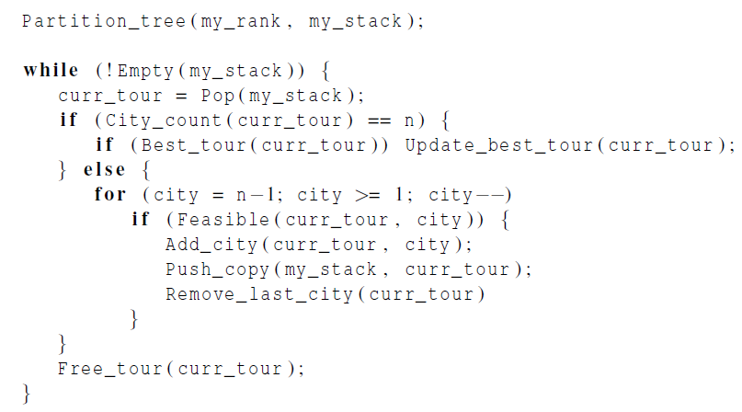
Pseudo-code for a Pthreads implementation of a statically parallelized solution to TSP
Master thread does static partitioning using breadth-first search
Thread operates on its private stack
Needs mutex

Slide 18
A Careful Look at Load Imbalance
Load imbalance very likely
  The master thread is partitioning the work
  Some expensive paths will be pruned early
What to do?
  Schedule some work statically and some dynamically for under-utilized processors
  Minimize cost of moving work
  This could be done a lot smarter than it is
Challenges:
  Which processes are available to take on more work?
  When does execution terminate?

Slide 19
Dynamic Parallelization of Tree Search Using Pthreads
Termination issues: change the test !Empty(my_stack).
Code executed by a thread before it splits:
  It checks that it has at least two tours in its stack.
  It checks that there are threads waiting.
  It checks whether the new_stack variable is NULL.
P0
P1
While{
…
Call pthread_cond_wait to sleep;
}
While{
…
Check if there is sleep pthread;
Splitting its stack;
Call pthread_cond_signal;
}

Slide 20
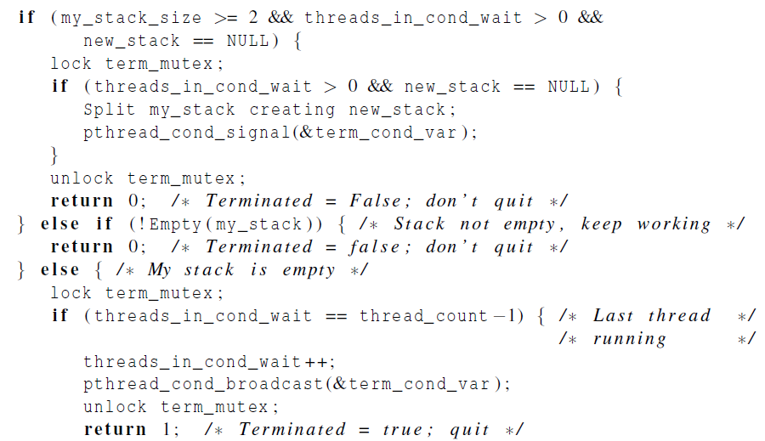
Pseudo-Code for Pthreads Terminated Function
Do I have extra work, and are there idle threads?
Wake up an idle thread
Termination test

Slide 21
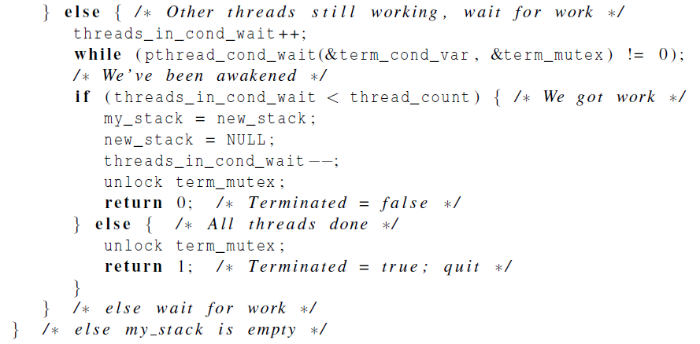
Pseudo-Code for Pthreads Terminated Function, cont.
Idle thread gets new work

Slide 22
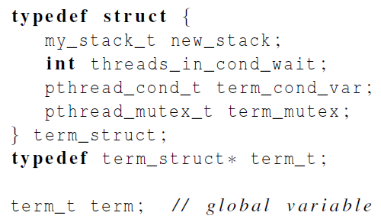
Grouping the termination variables

Slide 23
Summary of Lecture
This “tree search” is the hardest parallel programming challenge we have studied
  Load imbalance leads to the need for dynamic scheduling, which in turn leads to termination challenges requiring elaborate synchronization and communication
  We did not even talk about locality!
This chapter is dense, but getting through it is worth it
  It shows REAL parallel programming and the need for elaborate language constructs
Other “irregular” algorithms are even more difficult

Slide 24
Programming Homework 1
本节树搜索的迭代实现使用的是基于数组的栈。请使用基于链表的栈实现pthreads 的动态分割树搜索并行程序。（提交时间：5月30日 18:00之前发到助教邮箱：sei_sunbiao@163.com，程序命名格式：学号+姓名+PH1）

