Slide 1
并行程序设计
Lecture 6:
MPI

Slide 2
Today’s Lecture
Introduction to Message Passing
Hello World!
The trapezoidal rule
Collective communication
MPI derived datatypes
Summary

Slide 3
Today’s Lecture
Introduction to Message Passing
Hello World!
The trapezoidal rule
Collective communication
MPI derived datatypes
Summary

Slide 4
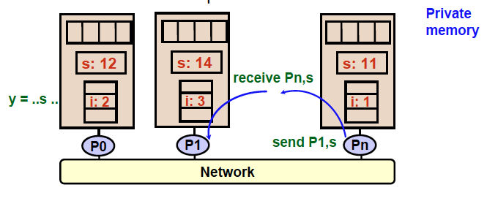
Programming Distributed Memory Architectures
A distributed-memory program consists of named processes.
Process is a thread of control plus local address space -- NO shared data.
Logically shared data is partitioned over local processes.
Processes communicate by explicit send/receive pairs
Coordination is implicit in every communication event.

Slide 5
Message Passing and MPI
Message passing is the principle alternative to shared memory parallel programming, predominant programming model for supercomputers and clusters
  Portable
  Low-level, but universal and matches earlier hardware execution model
What it is
  A library used within conventional sequential languages (Fortran, C, C++)
  Based on Single Program, Multiple Data (SPMD)
  Isolation of separate address spaces
    + no data races, but communication errors possible
    + exposes execution model and forces programmer to think about locality, both good for performance
    Complexity and code growth!

Slide 6
Message Passing Library Features
All communication, synchronization require subroutine calls
  No shared variables
  Program runs on a single processor just like any uniprocessor program, except for calls to message passing library
Subroutines for
  Communication
    Pairwise or point-to-point: A message is sent from a specific sending process (point a) to a specific receiving process (point b).
    Collectives involving multiple processors
      Move data: Broadcast, Scatter/gather
      Compute and move: Reduce, AllReduce
  Synchronization
    Barrier
    No locks because there are no shared variables to protect
  Queries
    How many processes? Which one am I? Any messages waiting?

Slide 7
Today’s Lecture
Introduction to Message Passing
Hello World!
The trapezoidal rule
Collective communication
MPI derived datatypes
Summary

Slide 8
Hello (C)
#include <stdio.h>
#include <string.h>
#include <mpi.h>
const int MAX_STRING = 100;
int main(void){
char greeting[MAX_STRING];
int comm_sz;
int my_rank;
int q;
MPI_Init(NULL,NULL);
MPI_Comm_size(MPI_COMM_WORLD,&comm_sz);
MPI_Comm_rank(MPI_COMM_WORLD,&my_rank);
if(my_rank != 0){
sprintf(greeting,"Greatings from process %d of %d!",my_rank,comm_sz);
MPI_Send(greeting,strlen(greeting)+1,MPI_CHAR,0,0,MPI_COMM_WORLD);
}else{
printf("Greetings from process %d of %d\n",my_rank,comm_sz);
for(q = 1;q < comm_sz; q++){
MPI_Recv(greeting,MAX_STRING,MPI_CHAR,q,0,MPI_COMM_WORLD,MPI_STATUS_IGNORE);
printf("%s\n",greeting);
}
}
MPI_Finalize();
return 0;
Communicator
#processes
The rank of process

Slide 9
Compilation
wrapper script to compile
source file
mpicc -g -Wall -o mpi_hello mpi_hello.c
produce
debugging
information
create this executable file name
(as opposed to default a.out)
turns on all warnings

Slide 10
Execution
mpiexec -n <number of processes> <executable>
mpiexec -n 1 ./mpi_hello
run with 1 process
mpiexec -n 4 ./mpi_hello
run with 4 processes

Slide 11
Execution
mpiexec -n 1 ./mpi_hello
Greetings from process 0 of 1 !
mpiexec -n 4 ./mpi_hello
Greetings from process 0 of 4 !
Greetings from process 1 of 4 !
Greetings from process 2 of 4 !
Greetings from process 3 of 4 !

Slide 12


MPI Components
allocate storage, decide rank, define a communicator
MPI_Init
  Tells MPI to do all the necessary setup.
MPI_Finalize
  Tells MPI we’re done, so clean up anything allocated for this program.
free resources
  A communicator is a collection of processes that can send messages to each other.

Slide 13
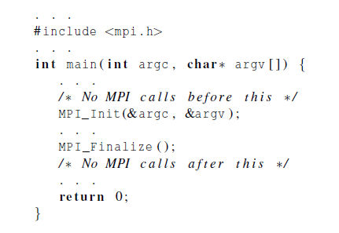
Basic Outline

Slide 14
Finding Out About the Environment
Two important questions that arise early in a parallel program are:
  How many processes are participating in this computation?
  Which one am I?
MPI provides functions to answer these questions:
  MPI_Comm_size reports the number of processes.
  MPI_Comm_rank reports the rank, a number between 0 and size-1, identifying the calling process

Slide 15
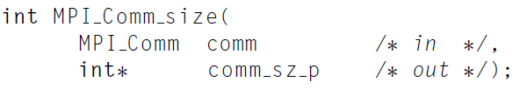

MPI functions
  MPI_Comm_size ：reports the number of processes.
  MPI_Comm_rank： reports the rank, a number between 0 and size-1, identifying the calling process

Slide 16
MPI Basic Send/Receive
We need to fill in the details in
Things that need specifying:
  How will “data” be described?
  How will processes be identified?
  How will the receiver recognize/screen messages?
  What will it mean for these operations to complete?
Process 1
Process 0
Send(data)
Receive(data)

Slide 17
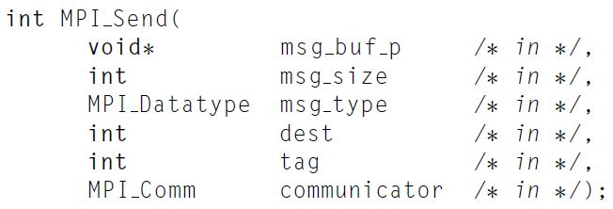
The Syntax of MPI Basic Send
msg_buf_p: a pointer to a block of memory
msg_size and msg_type: determine the amount of data to be set.
communicator: specify communication universes.

Slide 18
MPI Basic (Blocking) Send
A(10)
B(20)
MPI_Send( A, 10, MPI_DOUBLE, 1, …)
MPI_Recv( B, 20, MPI_DOUBLE, 0, … )
MPI_SEND(buffer, size, datatype, dest, tag, comm)
The message buffer is described by (buffer,size, datatype).
The target process is specified by dest, which is the rank of the target process in the communicator specified by comm.
When this function returns, the data has been delivered to the system and the buffer can be reused. The message may not have been received by the target process.

Slide 19
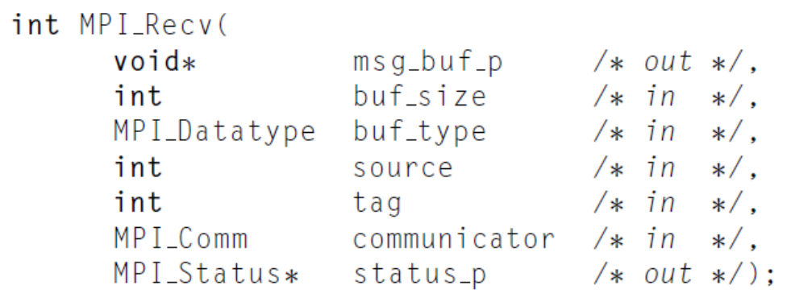
The Syntax of MPI Basic Receive
msg_buf_p: a pinter to a block of memory
msg_size and msg_type: determine the amount of data to be set.
communicator: specify communication universes.

Slide 20
MPI Basic (Blocking) Receive
A(10)
B(20)
MPI_Send( A, 10, MPI_DOUBLE, 1, …)
MPI_Recv( B, 20, MPI_DOUBLE, 0, … )
MPI_RECV(buffer, size, datatype, source, tag, comm, status)
Waits until a matching (both source and tag) message is received from the system, and the buffer can be used
source is rank in communicator specified by comm, or MPI_ANY_SOURCE
tag is a tag to be matched on or MPI_ANY_TAG
receiving fewer than size occurrences of datatype is OK, but receiving more is an error
status contains further information (e.g. size of message)

Slide 21
Message Matching
Process q calls MPI_Send(send_buf_p, send_buf_sz, send_type, dest, send_tag, send_comm);
Process r calls MPI_Recv(recv_buf_p, recv_buf_sz, rece_type, src, recv_tag, recv_comm, &status)
Send and Receive are matching, if
  recv_comm=send_comm
  recv_tag=send_tag
  dest=r, and src=q
  Massage can be received, if
  recv_type=send_type, and
  recv_buf_sz>=send_buf_sz

Slide 22
Some Basic Clarifying Concepts
How to organize processes
  Processes can be collected into groups
  Each message is sent in a context, and must be received in the same context
    Provides necessary support for libraries
  A group and context together form a communicator
  A process is identified by its rank in the group associated with a communicator
There is a default communicator whose group contains all initial processes, called MPI_COMM_WORLD

Slide 23
MPI Datatypes
The data in a message to send or receive is described by a triple (address, count, datatype), where
An MPI datatype is recursively defined as:
  predefined, corresponding to a data type from the language (e.g., MPI_INT, MPI_DOUBLE)
  a contiguous array of MPI datatypes
  a strided block of datatypes
  an indexed array of blocks of datatypes
  an arbitrary structure of datatypes
There are MPI functions to construct custom datatypes, in particular ones for subarrays

Slide 24
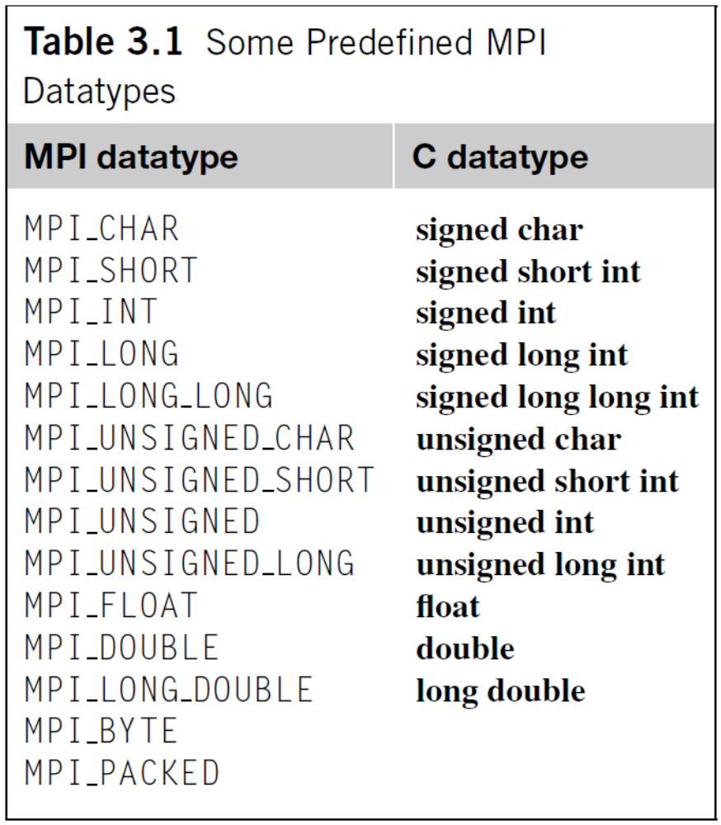
MPI Datatypes

Slide 25
MPI Tags
Messages are sent with an accompanying user-defined integer tag, to assist the receiving process in identifying the message
Messages can be screened at the receiving end by specifying a specific tag, or not screened by specifying MPI_ANY_TAG as the tag in a receive
Some non-MPI message-passing systems have called tags “message types”. MPI calls them tags to avoid confusion with datatypes

Slide 26
Semantics of MPI Send and MPI Recv
The sending process can buffer the message or it can block
The exact behavior of MPI Send is determined by the MPI implementation
  typical implementations have a default “cutoff” message size
      If the size of a message is less than the cutoff, it will be buffered
      If the size of the message is greater than the cutoff, MPI_Send will block.
MPI_Recv always blocks until a matching message has been received.
MPI requires that messages be nonovertaking

Slide 27
A Simple MPI Program
#include “mpi.h”
#include <stdio.h>
int main( int argc, char *argv[])
{
int rank, buf;
MPI_Status status;
MPI_Init(&argv, &argc);
MPI_Comm_rank( MPI_COMM_WORLD, &rank );
/* Process 0 sends and Process 1 receives */
if (rank == 0) {
buf = 123456;
MPI_Send( &buf, 1, MPI_INT, 1, 0, MPI_COMM_WORLD);
}
else if (rank == 1) {
MPI_Recv( &buf, 1, MPI_INT, 0, 0, MPI_COMM_WORLD,
&status );
printf( “Received %d\n”, buf );
}
MPI_Finalize();
return 0;
}

Slide 28
Today’s Lecture
Introduction to Message Passing
Hello World!
The trapezoidal rule
Collective communication
MPI derived datatypes
Summary

Slide 29
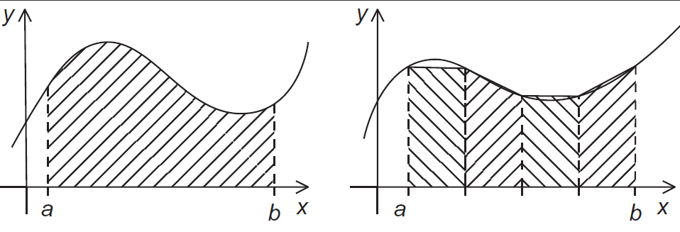
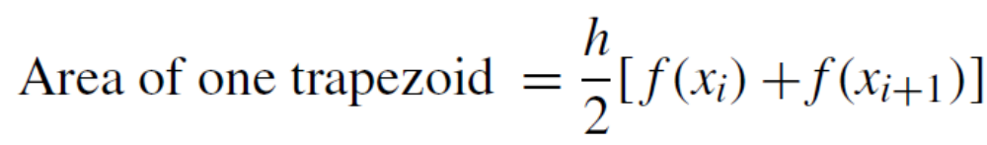
The trapezoidal rule

Slide 30
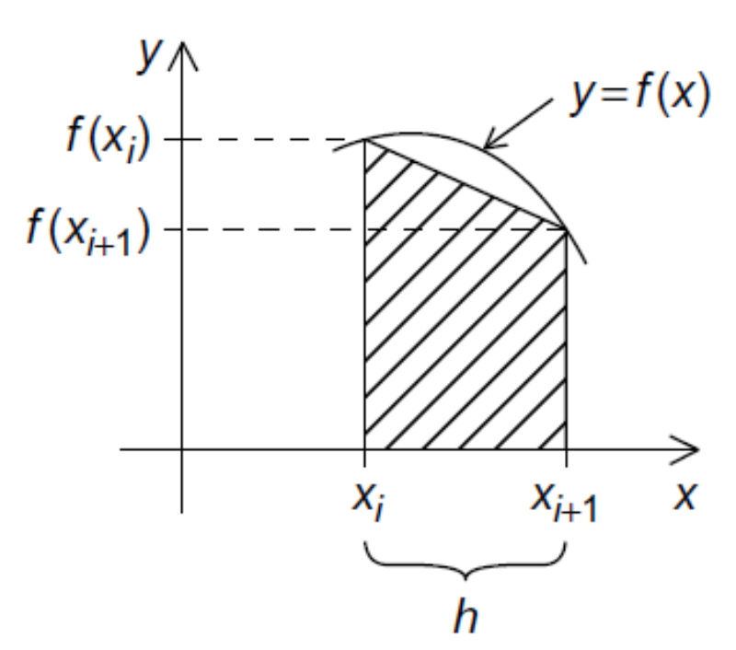
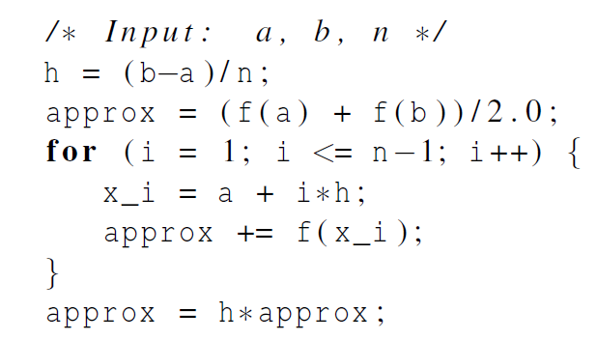
Trapezoidal Rule: Serial algorithm

Slide 31
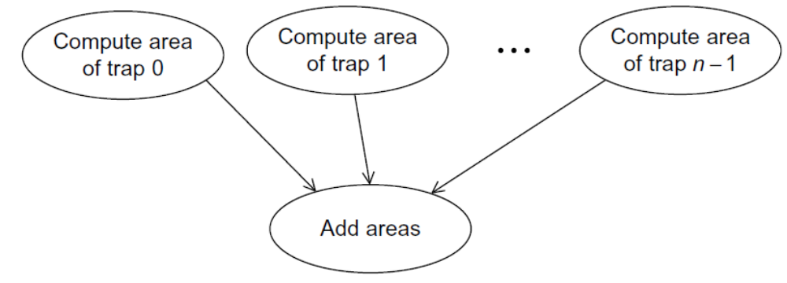
Designing a Parallel Program
Basic steps:
Partition the problem solution into tasks.
Identify the communication channels between the tasks.
Aggregate the tasks into composite tasks.
Map the composite tasks to cores.

Slide 32
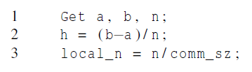
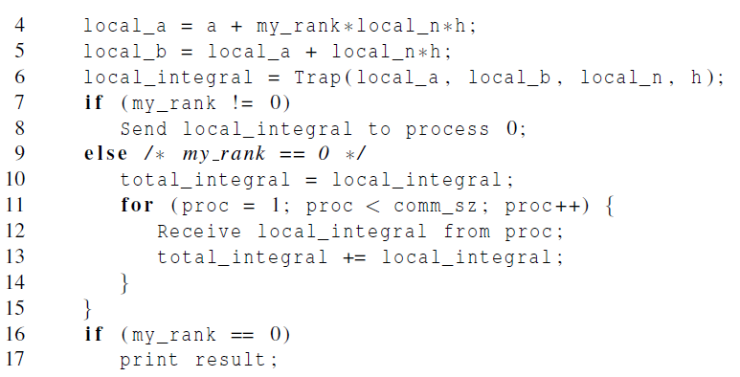
Parallel pseudo-code (Trap)
#trapezoids that each process need to compute
The first trapezoid
The last trapezoid

Slide 33
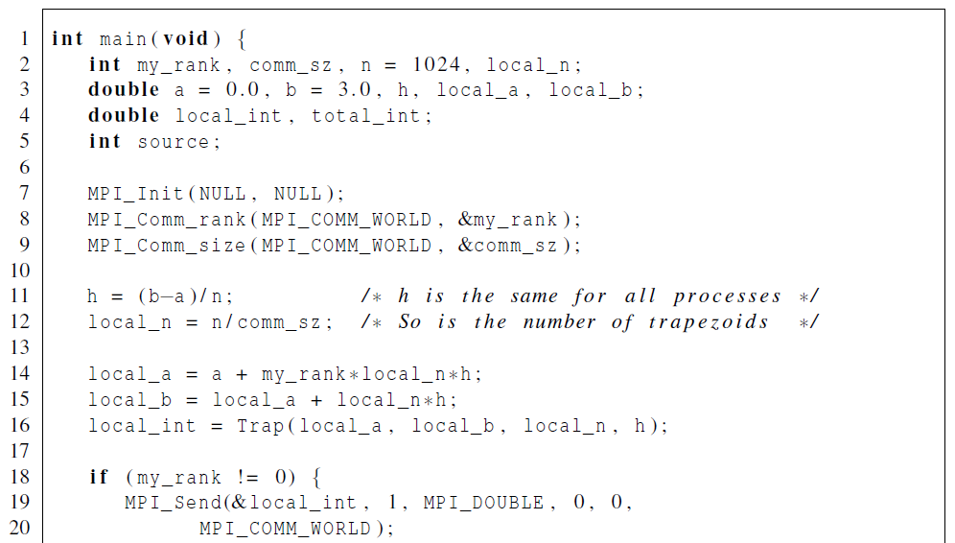
First version (1)

Slide 34
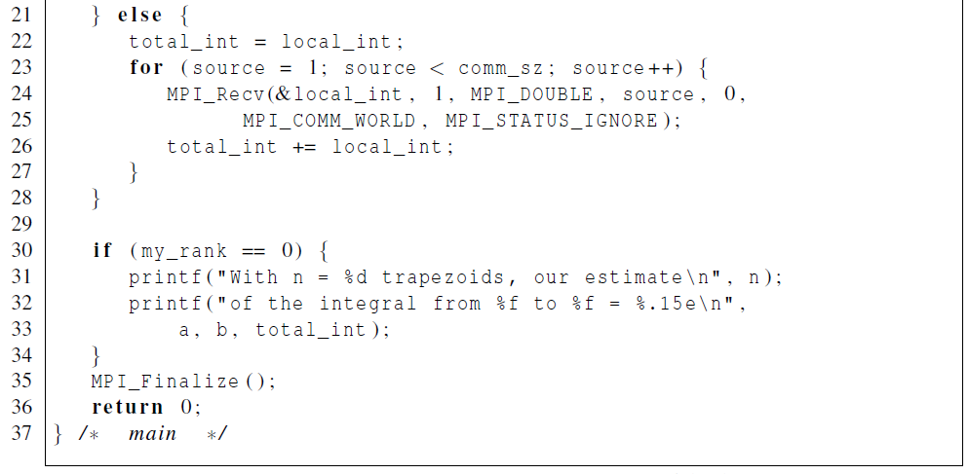
First version (2)

Slide 35
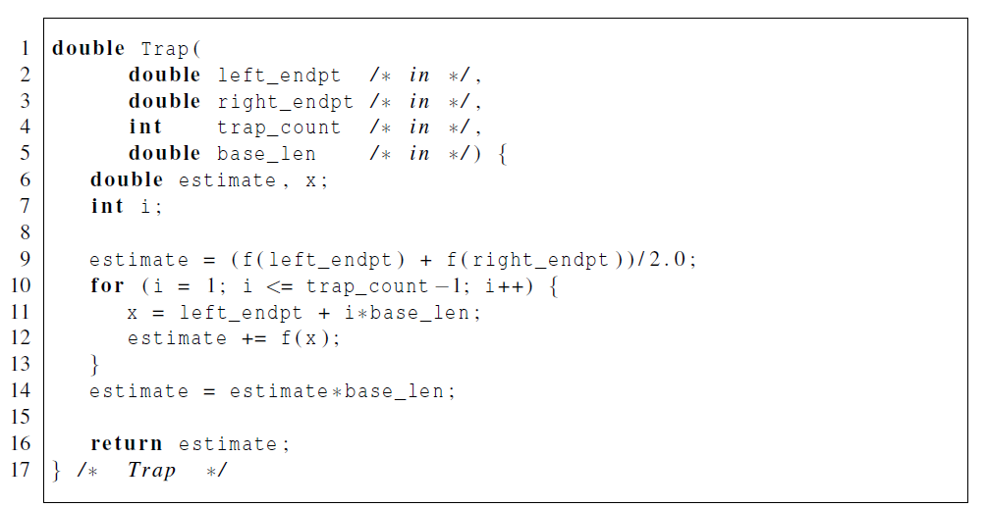
First version (3)

Slide 36
Dealing with I/O
MPI implementations allow all processes to execute printf and fprintf (stderr, ...)
  Output of one process will be interrupted by the output of another process.
Most MPI implementations only allow process 0 in MPI_COMM_WORLD access to stdin.

Slide 37
Today’s Lecture
Introduction to Message Passing
Hello World!
The trapezoidal rule
Collective communication
MPI derived datatypes
Summary

Slide 38
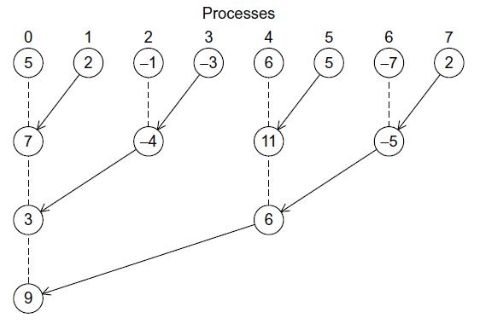
Tree-structured communication
If comm_sz = 1024, then the original scheme requires process 0 to do 1023 receives and additions
New scheme requires process 0 to do only 10 receives and additions

Slide 39
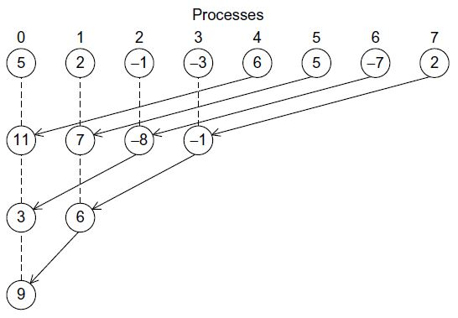
Tree-structured communication
MPI implementations include implementations of global sums.
collective communications: communication functions that involve all the processes in a communicator

Slide 40
Collective communication
Collective communication is defined as communication that involves a group or groups of processes.
Several collective routines such as broadcast and gather have a single originating or receiving process. Such a process is called the root.
The type-matching conditions for the collective operations are more strict than the corresponding conditions between sender and receiver in point-to-point.
Collective communication calls may use the same communicators as point-to-point communication.
The key concept of the collective functions is to have a group or groups of participating processes.
There are two types of communicators: intra-communicators and inter-communicators.

Slide 41
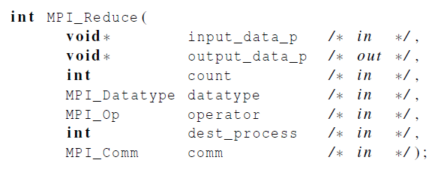
MPI_Reduce
All processes provide input buffers of the same length, with elements of the same type as the output buffer at the root.
The operator is always assumed to be associative.

Slide 42
Collective vs. Point-to-Point Communications
All the processes in the communicator must call the same collective function. For example, a program that attempts to match a call to MPI_Reduce on one process with a call to MPI_Recv on another process is erroneous, and, in all likelihood, the program will hang or crash.
The arguments passed by each process to an MPI collective communication must be “compatible.” For example, if one process passes in 0 as the dest_process and another passes in 1, then the outcome of a call to MPI_Reduce is erroneous, and, once again, the program is likely to hang or crash.

Slide 43
Collective vs. Point-to-Point Communications
The output_data_p argument is only used on dest_process. However, all of the processes still need to pass in an actual argument corresponding to output_data_p, even if it’s just NULL.
Point-to-point communications are matched on the basis of tags and communicators. Collective communications don’t use tags. They’re matched solely on the basis of the communicator and the order in which they’re called.

Slide 44
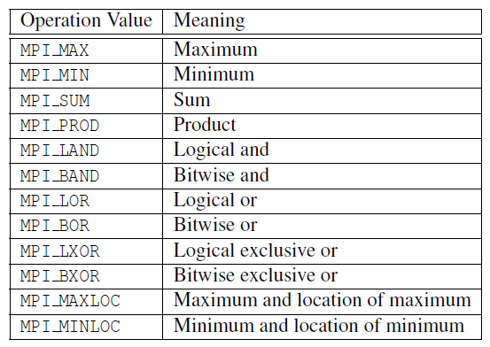
Predefined reduction operators in MPI

Slide 45
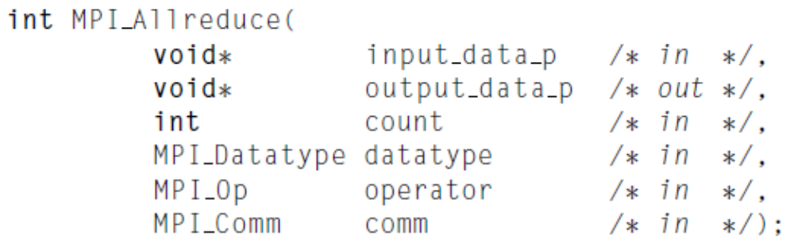
MPI_Allreduce
MPI_Allreduce behaves the same as MPI_Reduce except that the result appears in the receive buffer of all the processes.

Slide 46
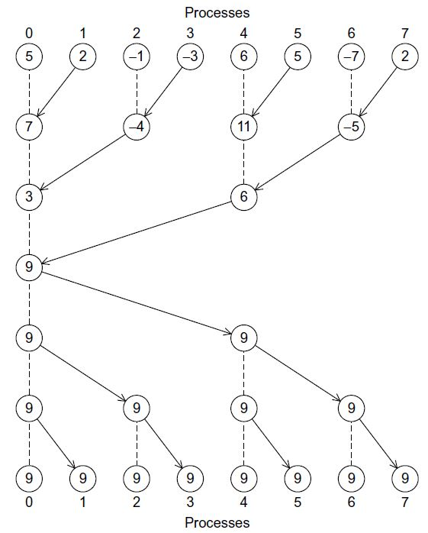
MPI_Allreduce

Slide 47
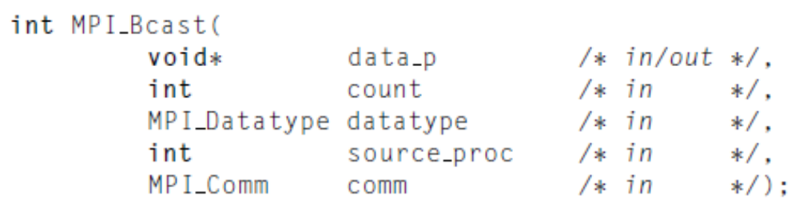
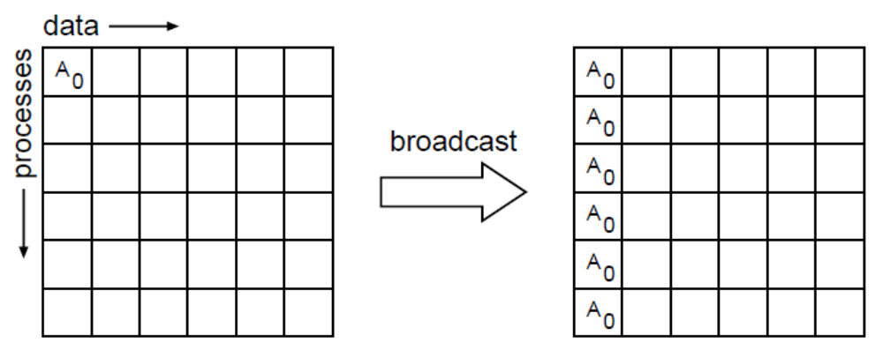
Broadcast
p0
p1
p2
p3
p4
p5

Slide 48
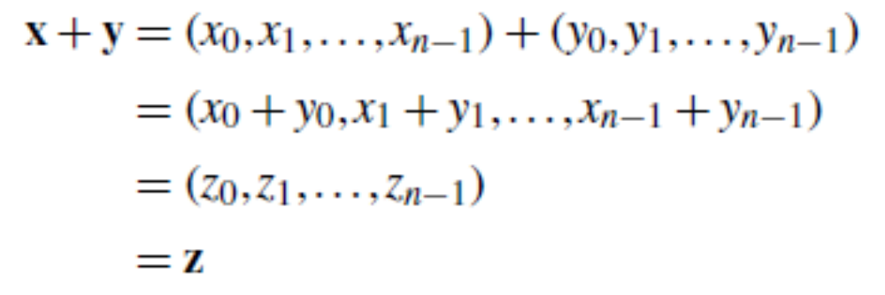
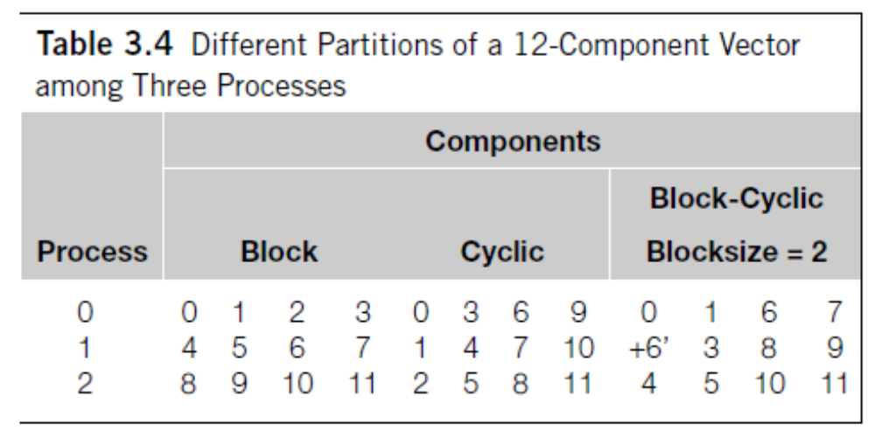
Data distributions
n=12, Comm_sz=3

Slide 49
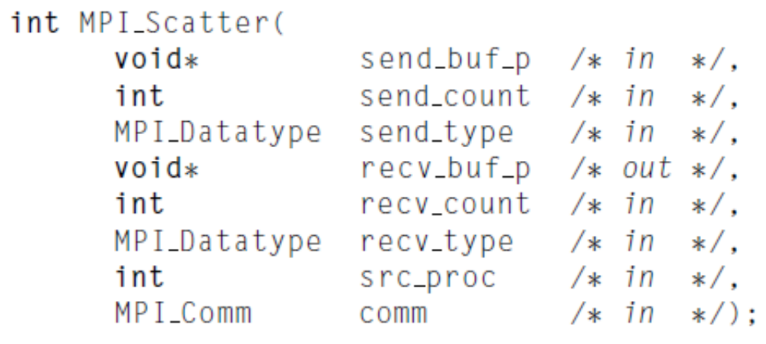
Scatter
the number of items it sends to each process
This message is split into n equal segments, the i-th segment is sent to the i-th process

Slide 50
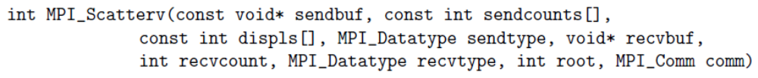
MPI_Scatterv
non-negative integer array (of length group size) containing
the number of elements that are sent to each process.
The data sent to process j is placed into sendbuf of the root process beginning at offset displs[j] elements .

Slide 51
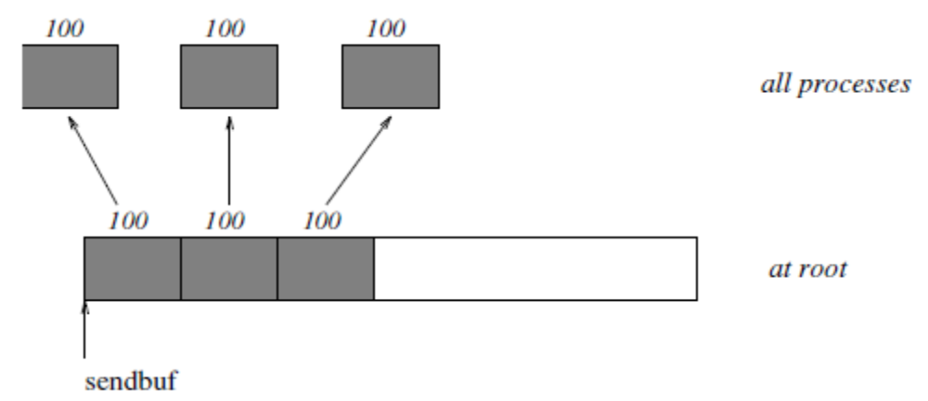
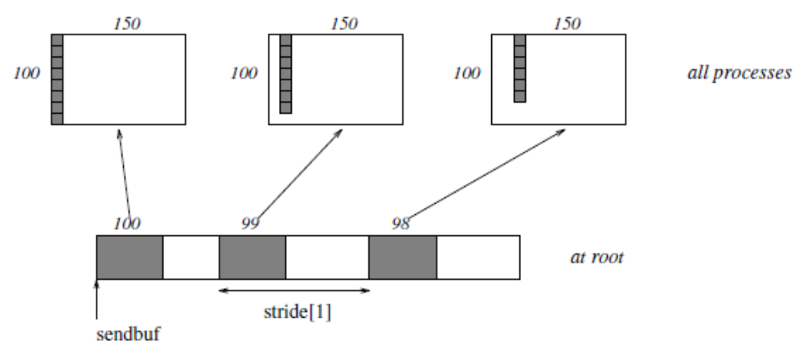
MPI_Scatter vs. MPI_Scatterv

Slide 52
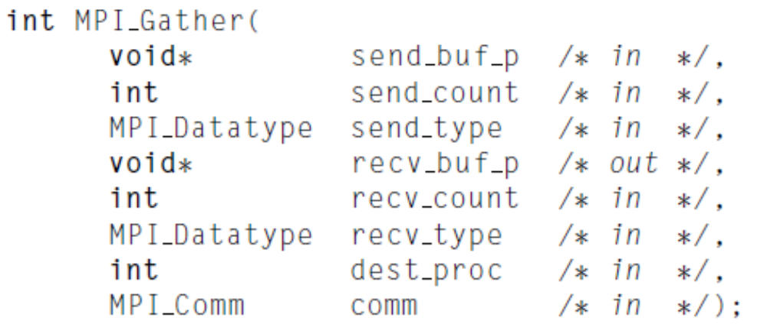
Gather
the number of items it receives from each process
All processes execute：
MPI_Send(sendbuf, sendcount, sendtype, root , ...),
The root execute:
MPI_Recv(recvbuf+i·recvcount·extent(recvtype), recvcount, recvtype, i,...),

Slide 53
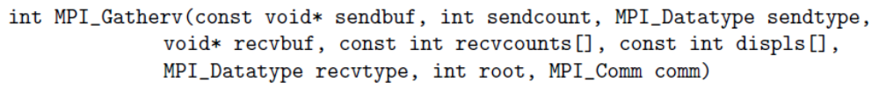
MPI_Gatherv
non-negative integer array (of length group size) containing
the number of elements that are received from each process (significant only at root)
The data received from process j is placed into recvbuf of the root process beginning at offset displs[j] elements (in terms of the recvtype).

Slide 54
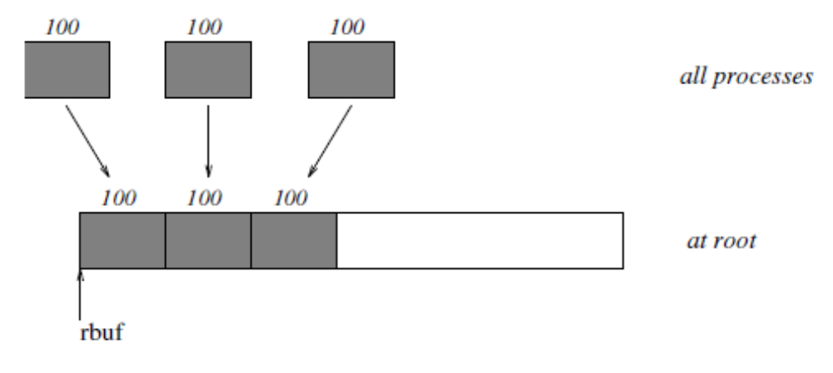
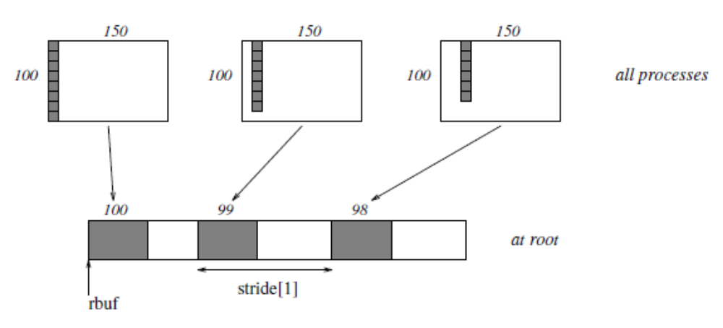
MPI_Gather vs. MPI_Gatherv

Slide 55
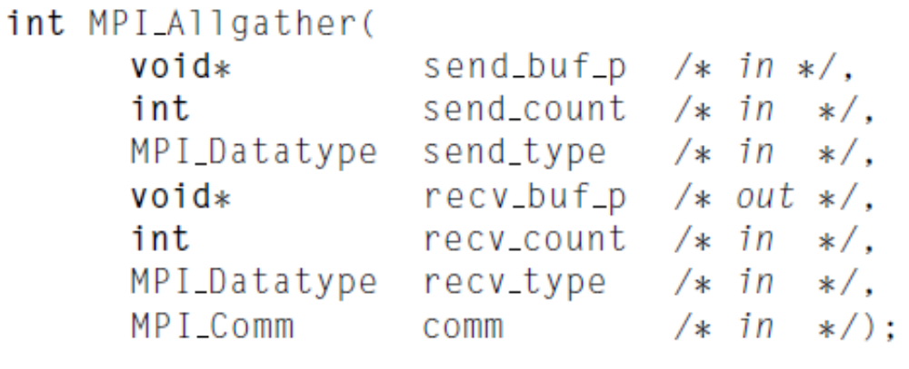
Allgather
MPI_Allgather can be thought of as MPI_Gather, but where all processes receive the result, instead of just the root.
The block of data sent from the j-th process is received by every process and placed in the j-th block of the buffer recv_buf_p.

Slide 56
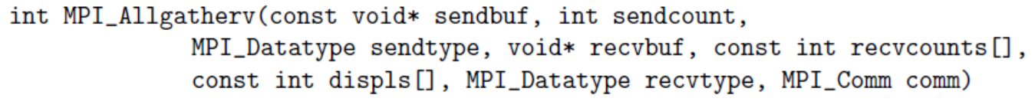
MPI_Allgatherv
MPI_ALLGATHERV can be thought of as MPI_GATHERV, but where all processes receive the result, instead of just the root.
The block of data sent from the j-th process is received by every process and placed in the j-th block of the buffer recvbuf.
These blocks need not all be the same size.

Slide 57
Today’s Lecture
Introduction to Message Passing
Hello World!
The trapezoidal rule
Collective communication
MPI derived datatypes
Summary

Slide 58

The Path of a Message
A blocking send visits 4 address spaces
Besides being time-consuming, it locks processors together quite tightly
the cost of sending a fixed amount of data in multiple messages is usually much greater than the cost of sending a single message with the same amount of data

Slide 59
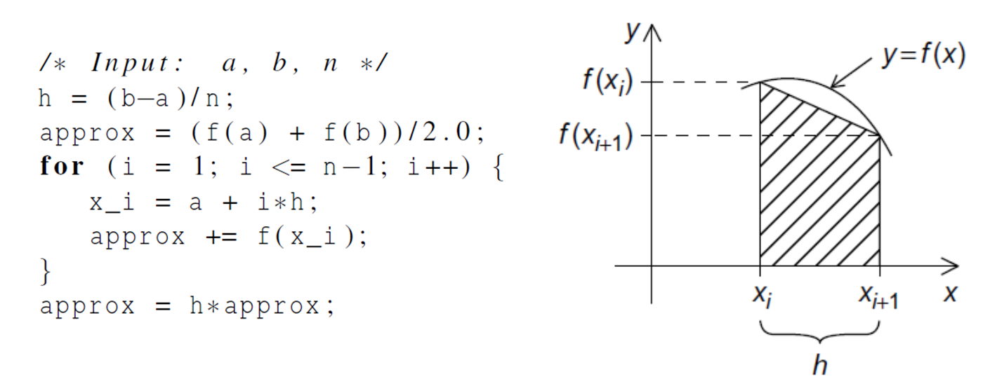
Approaches to Consolidating data
The count argument: can be used to group contiguous array elements into a single message
Derived datatypes: can be used to represent any collection of data items in memory by storing both the types of the items and their relative locations in memory.
MPI Pack/Unpack: Packs data of a given datatype into contiguous memory and communicate.

Slide 60
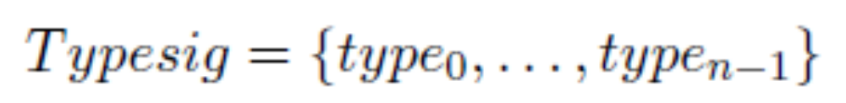
MPI Derived Datatypes
One often wants to pass messages that contain values with different datatypes (e.g., an integer count, followed by a sequence of real numbers)
One often wants to send noncontiguous data (e.g., a sub-block of a matrix).
A derived datatype consists of two parts:
  A sequence of basic datatypes
  A sequence of integer (byte) displacements
Type map: a sequence of pairs {(type₀, disp₀),…,(type_{n-1},disp_{n-1})}, where type_{i} are basic types, and disp_{i} are displacements.
Type signature of the datatype: the sequence of basic datatypes (displacements ignored)

Slide 61
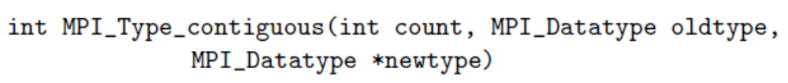
MPI_Type_contiguous
For example:
Let oldtype have type map
MPI_Type_contiguous(3,oldtype,newtype)

Slide 62
MPI_Type_vector
MPI_Type_vector is a more general constructor that allows replication of a datatype into locations that consist of equally spaced blocks.
For example, let oldtype has type map
Then, MPI_Type_vector(2,3,4,oldtype,newtype)

Slide 63
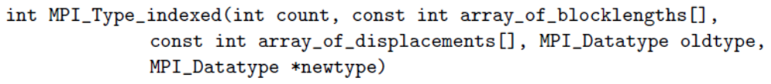
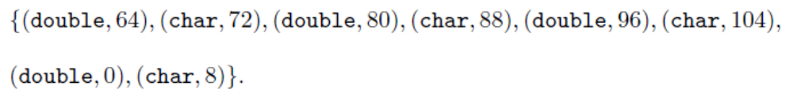
MPI_Type_indexed
MPI_Type_indexed allows replication of an old datatype into a sequence of blocks (each block is a concatenation of the old datatype), where each block can contain a different number of copies and have a different displacement.
For example, let oldtype has type map
Let B=(3,1) and D=(4,0).
Then, MPI_Type_indexed(2,B,D,oldtype,newtype)

Slide 64
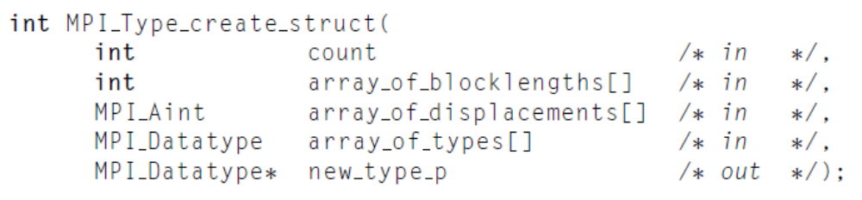
MPI_Type_create_struct
We can use MPI_Type_create_struct to build a derived datatype that consists of individual elements that have different basic types
For example, let type1 has type map
Then, MPI_Type_create_struct(3,B,D,T,newtype)

Slide 65
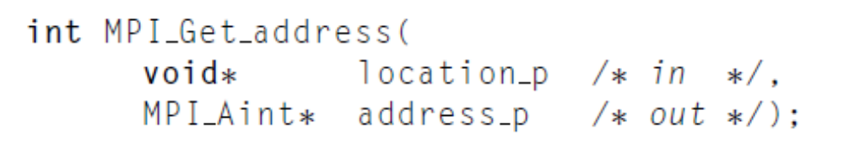
Address and Size Functions
MPI_Bottom: indicate the initial address zero of address space.
MPI_Get_address: find the the address of a location in memory.
MPI_Aint_add: produces a new MPI_Aint value that is equivalent to the sum of the base and disp arguments.
MPI_Aint_diff: produces a new MPI_Aint value that is equivalent to the difference between addr1 and addr2 arguments.
MPI_Type_size: set the value of size to the total size, in
bytes, of the entries in the type signature associated with datatype.

Slide 66
Get displacements
MPI_Aint a_addr, b_addr, n_addr;
MPI_Get_address(&a, &a_addr);
MPI_Get_address(&b, &b_addr);
MPI_Get_address(&n, &n_addr);
array_of_displacements[0]=0;
array_of_displacements[1]=MPI_Aint_diff(&b_addr,&a_addr);
array_of_displacements[2]=MPI_Aint_diff(&n_addr,&a_addr);

Slide 67
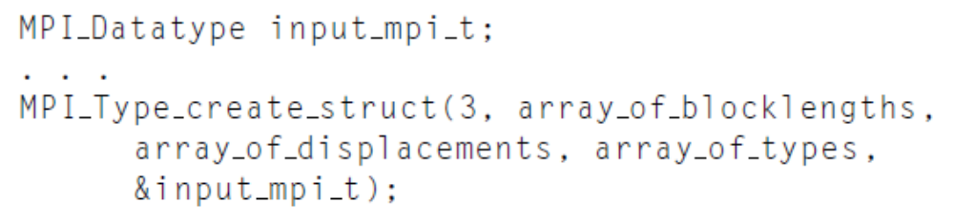
Commit and Free
MPI_Type_commit: A datatype object has to be committed before it can be used in a communication. The commit operation commits the datatype, that is, the formal description of a communication buffer, not the content of that buffer.
MPI_Type_free: Marks the datatype object associated with datatype for deallocation and sets datatype to MPI_DATATYPE_NULL.

Slide 68
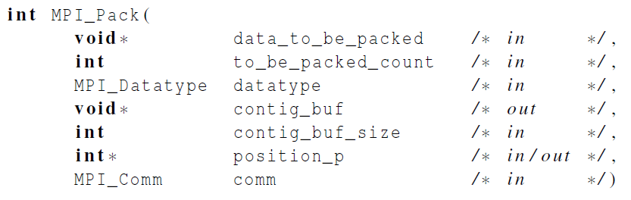

Packing data into a buffer of contiguous memory
Packs the message in the send buffer specified by data_to_be_packed, to_be_paced_count, datatype into the buffer space specified by contig_buf and contig_buf_size.
The output buffer is a contiguous storage area containing contig_buf_size bytes, starting at the address contig_buf.

Slide 69
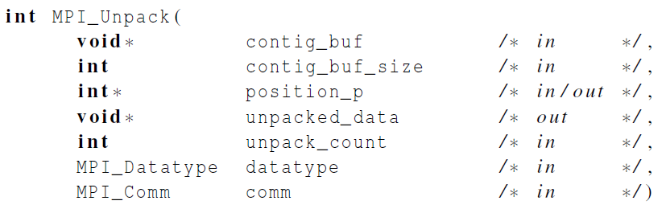

Unpacking data from a buffer of contiguous memory
Unpacks a message into the receive buffer specified by unpacked_data, unpack_count, datatype from the buffer space specified by contig_buf and contig_buf_size. The output buffer can be any communication buffer allowed in MPI_RECV.

Slide 70
Intra-Communicators
Intra-communicators bring together the concepts of group and context.
MPI communication operations reference communicators to determine the scope and the “communication universe" in which a point-to-point or collective operation is to operate.
Each communicator contains a group of valid participants; this group always includes the local process.
For collective communication, the intra-communicator specifies the set of processes that participate in the collective operation (and their order, when significant)
An initial intra-communicator MPI_COMM_WORLD of all processes the local process can communicate with after initialization (itself included) is defined once MPI_INIT or MPI_INIT_THREAD has been called.

Slide 71
Inter-Communicators
An inter-communication is a point-to-point communication between processes in different groups. a summary of the properties of inter-communication and inter-communicators:
The syntax of point-to-point and collective communication is the same for both inter- and intra-communication. The same communicator can be used both for send and for receive operations;
A target process is addressed by its rank in the remote group, both for sends and for receives;
Communications using an inter-communicator are guaranteed not to conflict with any communications that use a different communicator.
A communicator will provide either intra- or inter-communication, never both.

Slide 72
Today’s Lecture
Introduction to Message Passing
Hello World!
The trapezoidal rule
Collective communication
MPI derived datatypes
Summary

Slide 73
Summary
In MPI a communicator is a collection of processes that can send messages to each other. After an MPI program is started, MPI always creates a communicator consisting of all the processes. It’s called MPI_COMM_WORLD.
Collective communications involve all the processes in a communicator.
Functions such as MPI_Send and MPI_Recv are often called point-to-point communications.
Partition problem: block partitioning, cyclic partitioning, or block-cyclic partitioning

