Slide 1
并行程序设计
Programming Example:
Parallel Odd-even Transposition Sort （MPI）

Slide 2
Bubble Sort
void Bubble_sort( int a[], int n) {
int list_length, i, temp;
for (list_length = n; list_length >=2n; list_length--){
for (i = 0; i < list_length-1; i ++){
if (a[i] > a[i+1]) {
temp = a[i];
a[i] = a[i+1];
a[i+1] = temp;
}
}
}
}
The inherently sequential ordering of the comparisons

Slide 3
Serial odd-even transposition sort
void Odd_even_sort( int a[],int n) {
int phase, i, temp;
for (phase = 0; phase < n; phase++)
if (phase % 2 == 0) { / *Even phase */
for (i = 1; i < n; i += 2)
if (a[i-1] > a[i]) {
temp = a[i];
a[i] = a[i-1];
a[i-1] = temp;
}
} else {/ *Odd phase */
for (i = 1; i < n-1; i += 2)
if (a[i] > a[i+1]) {
temp = a[i];
a[i] = a[i+1];
a[i+1] = temp;
}
}
}

Slide 4
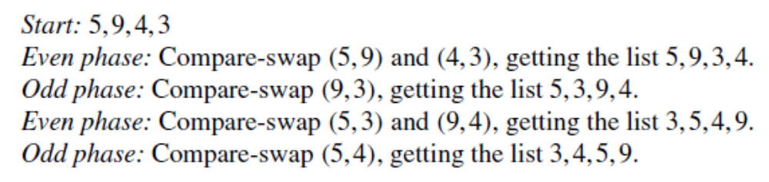
Parallel odd-even transposition sort
Even phases:
Odd phases:
Theorem:
Suppose A is a list with n keys, and A is the input to the odd-even transposition sort algorithm. Then, after n phases A will be sorted.

Slide 5
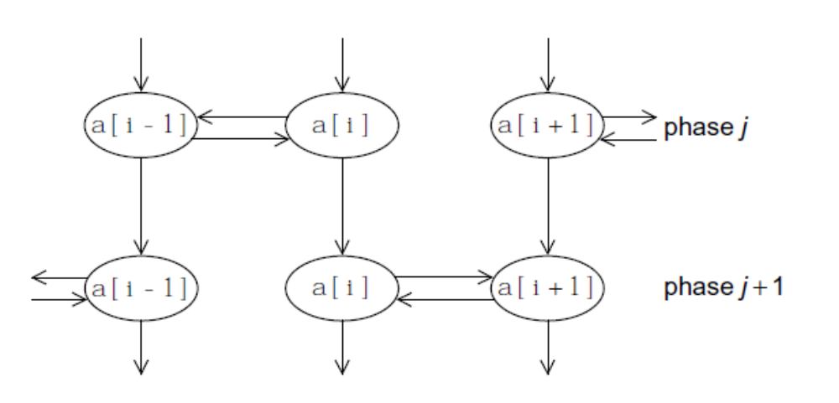
Parallel odd-even transposition sort
Tasks: Determine the value of a[i] at the end of phase j.
Communications: the task needs to communicate with either the task determining the value of a[i-1] or a[i+1]. Also the value of a[i] at the end of phase j needs to be available for determining the value of a[i] at the end of phase j+1.

Slide 6
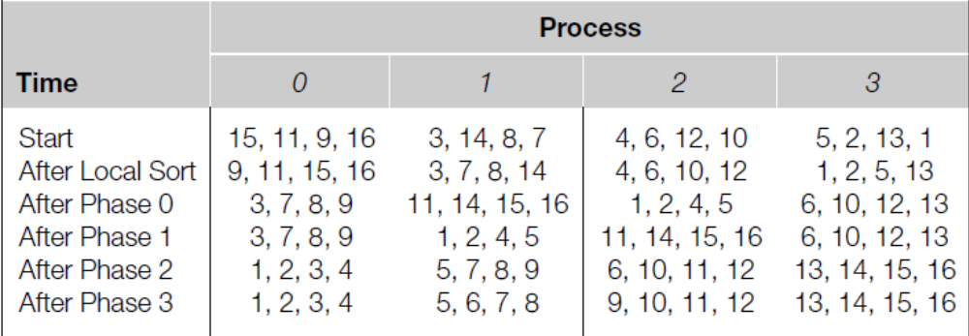
Parallel odd-even transposition sort
Phase0: process 0 and 1 exchange elements. Process 0 keep the four smaller elements and process 1 keep the larger. Process 2 and 3 exchange elements, similarly, process 2 keep the smaller and process 3 keep the larger. (even phase)
Phase1: process 1 and 2 exchange elements, process 1 keep the smaller and process 2 keep the larger. (odd phase)
Theorem:
If parallel odd-even transposition sort is run with p processes, then after p phases, the input list will be sorted.
Notes:
How to decide whether the process is idle

Slide 7
Parallel odd-even transposition sort
Sort local keys;
for (phase = 0; phase < comm_sz; phase++) {
partner = Compute_partner(phase, my_rank);
if (I’m not idle) {
Send my keys to partner;
Receive keys from partner;
if (my_rank < partner)
Keep smaller keys;
else
Keep larger keys;
}
}
how do we compute the partner’s rank?
And what is the partner’s rank when a process is idle?
if my rank = 0 or my rank = comm_sz-1, the partner’s rank can be -1 or comm_sz.

Slide 8
Compute Partner
if (phase % 2 == 0) / *Even phase */
if (my_rank % 2 != 0) /* Odd rank */
partner = my_rank - 1;
else /*Even rank */
partner = my_rank + 1;
else /*Odd phase*/
if (my_rank % 2 != 0) /*Odd rank */
partner = my_rank + 1;
else /*Even rank*/
partner = my_rank - 1;
if (partner == -1 || partner == comm_sz)
partner = MPI_PROC_NULL;
MPI_PROC_NULL is a constant defined by MPI.

Slide 9
Safety in MPI programs
Deadlock: If the MPI_Send executed by each process blocks, no process will be able to start executing a call to MPI_Recv, and the program will hang or deadlock, that is, each process is blocked waiting for an event that will never happen.
Unsafe program: A program that relies on MPI-provided buffering.
In general, how can we tell if a program is safe?
How can we modify the communication in the parallel odd-even sort program so that it is safe?

Slide 10
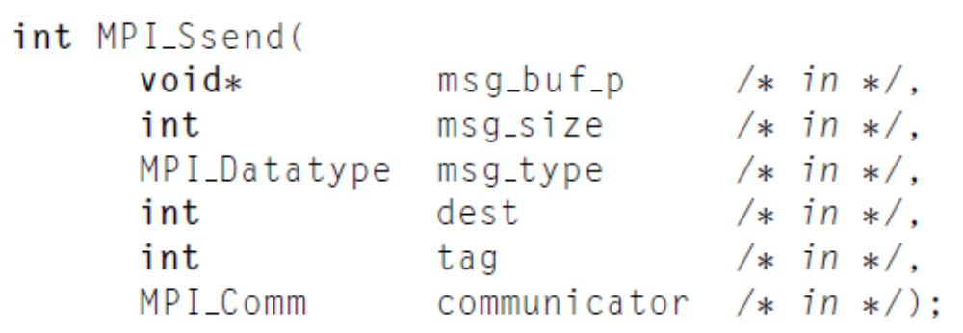
Synchronous mode
The send will complete successfully only if a matching receive is posted, and the receive operation has started to receive the message sent by the synchronous send.
MPI_Ssend is guaranteed to block until the matching receive starts. So, we can check whether a program is safe.

Slide 11
Communication modes
MPI_Bsend: A buffered mode send operation can be started whether or not a matching receive has been posted. If a send is executed and no matching receive is posted, then MPI must buffer the outgoing message.
MPI_Ssend: A synchronous mode send operation can be started whether or not a matching receive was posted. However, the send will complete successfully only if a matching receive is posted.
MPI_Rsend: A send that uses the ready communication mode may be started only if the matching receive is already posted.

Slide 12
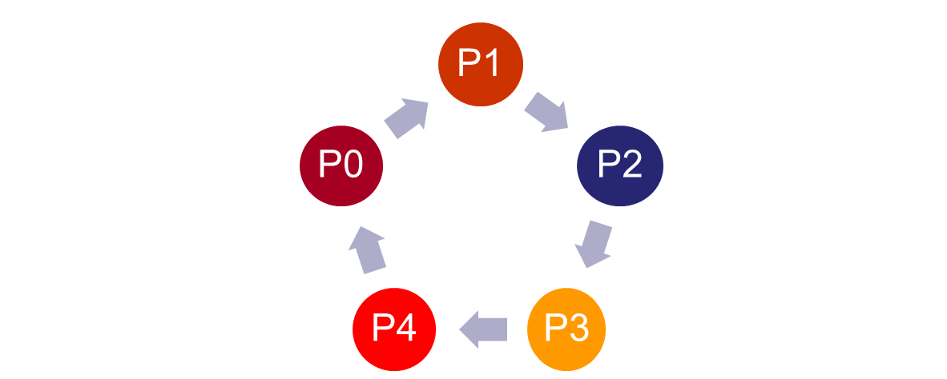
Ring Pass
send
send
send
send
send
if (my rank % 2 == 0) {
MPI_Send(msg, size, MPI_INT, (my rank+1) % comm_sz, 0, comm);
MPI_Recv(new_msg, size, MPI_INT, (my_rank+comm_sz-1) % comm_sz,
0, comm, MPI_STATUS_IGNORE).
} else {
MPI_Recv(new_msg, size, MPI_INT, (my_rank+comm_sz-1) % comm_sz,
0, comm, MPI_STATUS_IGNORE).
MPI_Send(msg, size, MPI_INT, (my_rank+1) % comm_sz, 0, comm);
}

Slide 13
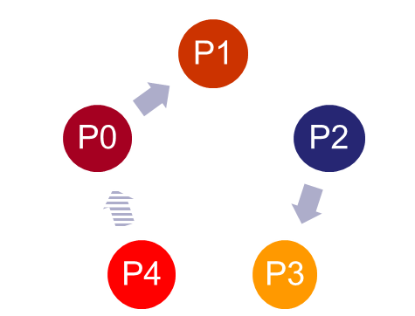
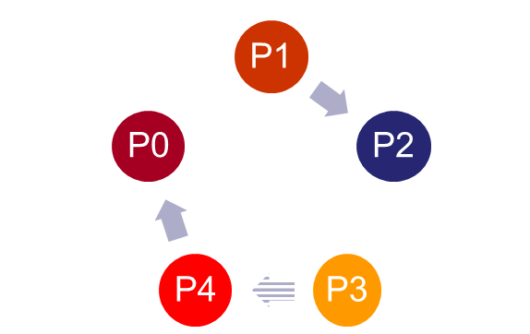
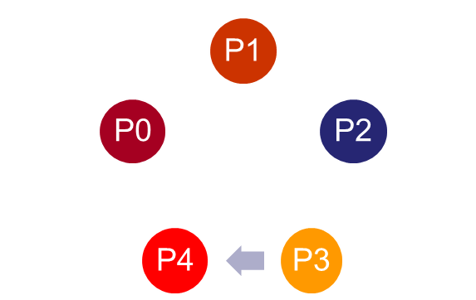
Ring Pass
this will work if comm_sz is even.
It’s not clear if comm_sz is odd.
Time0
Time1
Time2

Slide 14
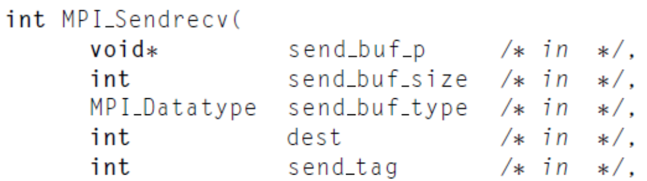
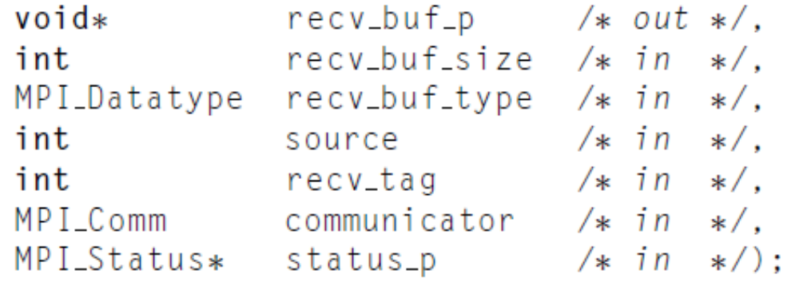
Send-receive
This function carries out a blocking send and a receive in a single call.
The dest and the source can be the same or different.
MPI implementation schedules the communications so that the program won’t hang or crash.
Notes:
M

Slide 15
Summary of MPI
In MPI a communicator is a collection of processes that can send messages to each other.
MPI_Init does the setup needed to run MPI. It should be called before other MPI functions are called. When you’re done using MPI, you should call MPI_Finalize.
Message passing libraries typically provide both blocking and non-blocking primitives.
There are two types of communications in MPI, Collective communications and point-to-point communications.
For ordinary vectors and arrays, we could use block partitioning, cyclic partitioning, or block-cyclic partitioning to partition global data structures among the processes.
MPI provides three methods for reducing the number of messages sent: the count argument to communication functions, derived datatypes, and MPI Pack/Unpack.
Speedup, efficiency and scalability can be use to evaluate the program performance.
Prevent from deadlock or hang. An unsafe MPI program can be made safe in several ways.

Slide 16
Programming Homework 2
Write a MPI program that implements parallel merge sort. 1) Process 0 should read in n and broadcast it to the other processes. Each process should use a random number generator to create a local list of n/comm_sz ints.
2) Each process should then sort its local list, and process 0 should gather and print the local lists.
3) Then the processes should use tree-structured communication to merge the global list onto process 0, which prints the result.
Deadline: 8:00 p.m., June 13

