Slide 1
并行程序设计
Lecture 7:
OpenMP

Slide 2
Today’s Lecture
Introduction to OpenMP
The trapezoidal rule
parallel for
Schedule Clause
Synchronization
Summary

Slide 3
Today’s Lecture
Introduction to OpenMP
The trapezoidal rule
parallel for
Schedule Clause
Synchronization
Summary

Slide 4
Programming with Threads
Pthreads are based on OS features
  Can be used from multiple languages (need appropriate header)
  Familiar language for most programmers
  Ability to shared data is convenient
Pitfalls
  Data races are difficult to find because they can be intermittent
  Deadlocks are usually easier, but can also be intermittent
OpenMP is commonly used today as a simpler alternative, but it is more restrictive
  OpenMP can parallelize many serial programs with relatively few annotations that specify parallelism and independence

Slide 5
OpenMP: Prevailing Shared Memory Programming Approach
Model for shared-memory parallel programming
Portable across shared-memory architectures
Scalable (on shared-memory platforms)
Incremental parallelization
  Parallelize individual computations in a program while leaving the rest of the program sequential
Compiler based
  Compiler generates thread program and synchronization
Extensions to existing programming languages (Fortran, C and C++)
  mainly by directives
  a few library routines

Slide 6
OpenMP Execution Model
Fork-join model of parallel execution
Begin execution as a single process (master thread)
Start of a parallel construct:
  Master thread creates team of threads (worker threads)
Completion of a parallel construct:
  Threads in the team synchronize -- implicit barrier
Only master thread continues execution
Implementation optimization:
  Worker threads spin waiting on next fork
Notes:
。

Slide 7
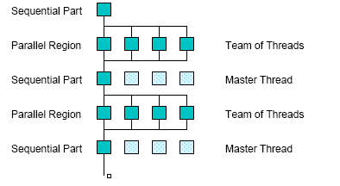
OpenMP Execution Model
fork
join

Slide 8
OpenMP uses Pragmas
Pragmas are special preprocessor instructions.
Typically added to a system to allow behaviors that aren’t part of the basic C specification.
Compilers that don’t support the pragmas ignore them.
The interpretation of OpenMP pragmas
  They modify the statement immediately following the pragma
  This could be a compound statement such as a loop
#pragma omp parallel

Slide 9
OpenMP directive format C
(also Fortran and C++ bindings)
Pragmas, format
#pragma omp directive_name [ clause [ clause ] ... ] new-line
Conditional compilation
#ifdef _OPENMP
  block,
  e.g., printf(“%d avail.processors\n”,omp_get_num_threads());
#endif
Case sensitive
Include file for library routines
#ifdef _OPENMP
#include <omp.h>
#endif

Slide 10
In case the compiler doesn’t support OpenMP
# include <omp.h>
#ifdef _OPENMP
# include <omp.h>
#endif

Slide 11
In case the compiler doesn’t support OpenMP
# ifdef _OPENMP
int my_rank = omp_get_thread_num ( );
int thread_count = omp_get_num_threads ( );
# else
int my_rank = 0;
int thread_count = 1;
# endif

Slide 12
Programming Model – Data Sharing
Parallel programs often employ two types of data
  Shared data, visible to all threads, similarly named
  Private data, visible to a single thread (often stack-allocated)
// shared, globals
int bigdata[1024];
void* foo(void* bar) {
// private, stack
int tid;
#pragma omp parallel \
shared ( bigdata ) \
private ( tid )
{
/* Calc. here */
}
}
PThreads:
  Global-scoped variables are shared
  Stack-allocated variables are private
OpenMP:
  shared variables are shared
  private variables are private
  Default is shared
  Loop index is private

Slide 13
OpenMP runtime library, Query Functions
omp_get_num_threads:
Returns the number of threads currently in the team executing the parallel region from which it is called
int omp_get_num_threads(void);
omp_get_thread_num:
Returns the thread number, within the team, that lies between 0 and omp_get_num_threads()-1, inclusive. The master thread of the team is thread 0
int omp_get_thread_num(void);

Slide 14
Today’s Lecture
Introduction to OpenMP
The trapezoidal rule
parallel for
Schedule Clause
Synchronization
Summary

Slide 15
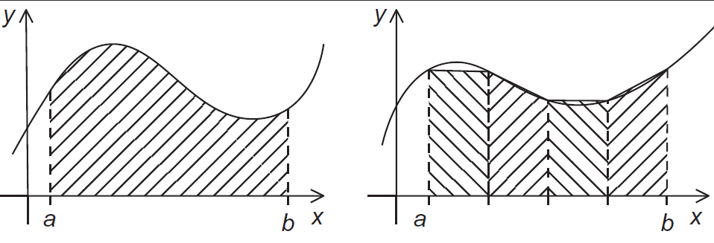
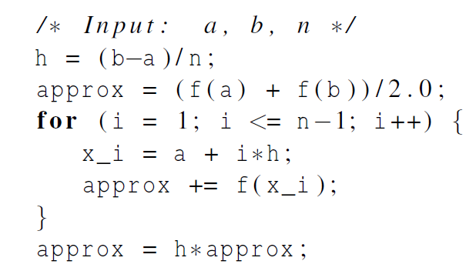
The trapezoidal rule

Slide 16
OpenMP critical directive
Enclosed code
  executed by all threads, but
  restricted to only one thread at a time
#pragma omp critical [ ( name ) ] new-line
structured-block
A thread waits at the beginning of a critical region until no other thread in the team is executing a critical region with the same name.
All unnamed critical directives map to the same unspecified name.

Slide 17
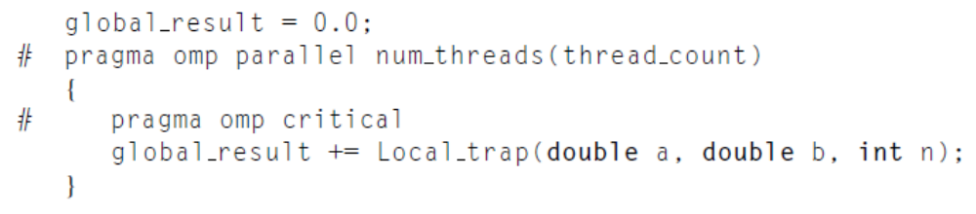
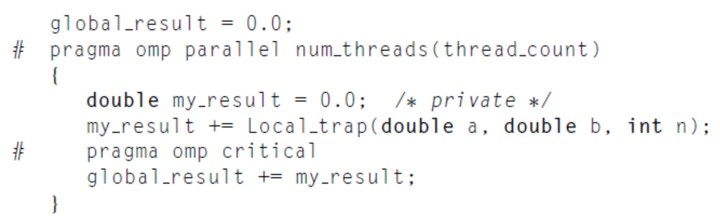
Critical Section
1.
The result is correct. However, the call to Local_trap is executed by one thread at a time.
2.

Slide 18
OpenMP Reductions
OpenMP has reduce operation
sum = 0;
#pragma omp parallel for reduction(+:sum)
for (i=0; i < 100; i++) {
sum += array[i];
}
Reduce ops and init() values (C and C++):
+ 0 bitwise & ~0 logical & 1
- 0 bitwise | 0 logical | 0
* 1 bitwise ^ 0
FORTRAN also supports min and max reductions

Slide 19
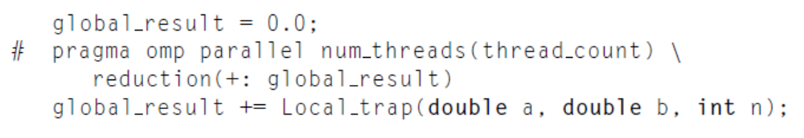
OpenMP Reductions
global_result is shared. However, a private variable is created for each thread in the team.

Slide 20
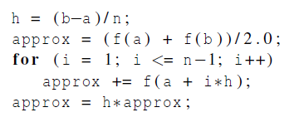
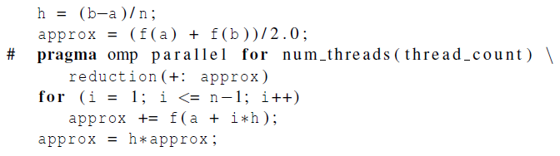
OpenMP trapezoidal rule program

Slide 21
Today’s Lecture
Introduction to OpenMP
The trapezoidal rule
parallel for
Schedule Clause
Synchronization
Summary

Slide 22
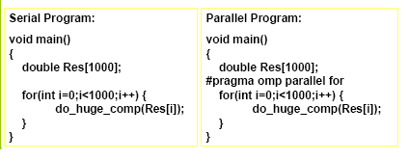
OpenMP Data Parallel Construct: Parallel Loop
All pragmas begin: #pragma
Compiler calculates loop bounds for each thread directly from serial source (computation decomposition)
Compiler also manages data partitioning of Res
Synchronization also automatic (barrier)

Slide 23
Limitations and Semantics
Not all “element-wise” loops can be parallelized
#pragma omp parallel for
for (i=0; i < numPixels; i++) {}
  Loop index: signed integer
  Termination Test: <,<=,>,=> with loop invariant int
  Incr/Decr by loop invariant int; change each iteration
  Count up for <,<=; count down for >,>=
  Basic block body: no control in/out except at top
Threads are created and iterations divvied up; requirements ensure iteration count is predictable

Slide 24
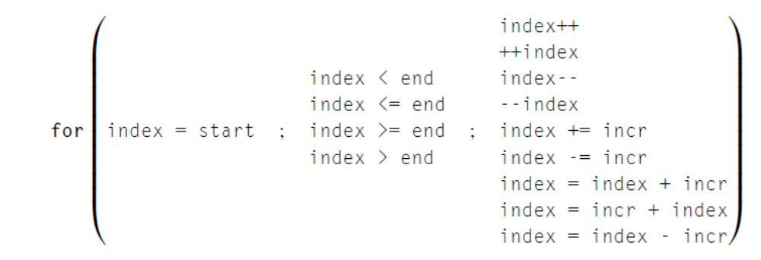
Legal Forms
The variable index must have integer or pointer type (e.g., it can’t be a float).
The expressions start, end, and incr must have a compatible type. For example, if index is a pointer, then incr must have integer type.
The expressions start, end, and incr must not change during execution of the loop.
During execution of the loop, the variable index can only be modified by the “increment expression” in the for statement.

Slide 25
Data Dependences
Serial code:
fibo[0] = fibo[1] = 1;
for (i = 2; i < n; i++)
fibo[i] = fibo[i-1] + fibo[i-2];
Parallel code:
fibo[0] = fibo[1] = 1;
#pragma omp parallel for num_threads(thread count)
for (i = 2; i < n; i++)
fibo[i] = fibo[i-1] + fibo[i-2];
OpenMP compilers don’t check for dependences among iterations in a loop that’s being parallelized with a parallel for directive. It’s up to us, the programmers, to identify these dependences.
A loop in which the results of one or more iterations depend on other iterations cannot, in general, be correctly parallelized by OpenMP.

Slide 26
Data Dependences：Estimate π
double factor = 1.0;
double sum = 0.0;
for ( i=0; i<n; i++){
sum += factor/(2*i+1);
factor= -factor;
}
pi = 4.0 *sum;
double factor = 1.0;
double sum = 0.0;
#pragma omp parallel for num_threads(thread_count)\
reduction(+:sum)
for ( i=0; i<n; i++){
sum += factor/(2*i+1);
factor= -factor;
}
pi = 4.0 *sum;
data dependency

Slide 27
Data Dependences：Estimate π
if (i%2==0)
factor=1.0;
else
factor=-1.0;
sum += factor/(2*i+1);
sum += factor/(2*i+1);
factor= -factor;
factor=(i%2==0) ? 1.0: -1.0;
sum += factor/(2*i+1);
factor is shared variable
double factor = 1.0;
double sum = 0.0;
#pragma omp parallel for num_threads(thread_count)\
reduction(+:sum) private(factor)
for ( i=0; i<n; i++){
factor=(i%2==0) ? 1.0: -1.0;
sum += factor/(2*i+1);
}
pi = 4.0 *sum;

Slide 28
Default directive
default (none) clause determines explicitly variables in parallel code block are shared or private
double factor = 1.0;
double sum = 0.0;
#pragma omp parallel for num_threads(thread_count)\
default (none) reduction(+:sum) private(i,factor) shared(n)
for ( i=0; i<n; i++){
factor=(i%2==0) ? 1.0: -1.0;
sum += factor/(2*i+1);
}
pi = 4.0 *sum;

Slide 29
Today’s Lecture
Introduction to OpenMP
The trapezoidal rule
parallel for
Schedule Clause
Synchronization
Summary

Slide 30
OpenMP：Loop Scheduling
sum=0.0;
for (i=0; <= n; i++)
sum += f( i ) ;
The execution time of f(2i) is two times of f(i).
Loop scheduling: how loop iterations are divided among the thread team.

Slide 31
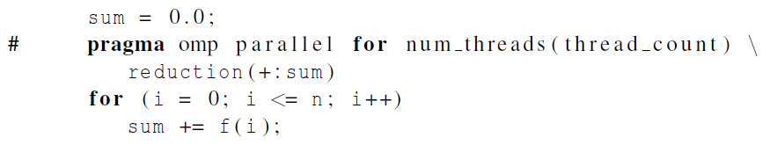
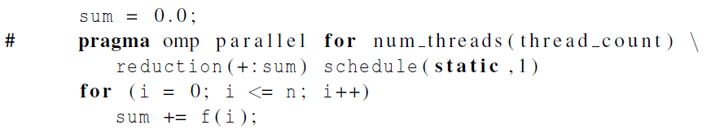
The Schedule Clause
schedule(<type> [, <chunksize>])
Default schedule:
Cyclic schedule:

Slide 32
Programming Model – Loop Scheduling
schedule clause determines how loop iterations are divided among the thread team
  static([chunk]) divides iterations statically between threads
    Each thread receives [chunk] iterations, rounding as necessary to account for all iterations
    Default [chunk] is ceil( # iterations / # threads )
  dynamic([chunk]) allocates [chunk] iterations per thread, allocating an additional [chunk] iterations when a thread finishes
    Forms a logical work queue, consisting of all loop iterations
    Default [chunk] is 1
  guided([chunk]) allocates dynamically, but [chunk] is exponentially reduced with each allocation

Slide 33
More loop scheduling attributes
RUNTIME The scheduling decision is deferred until runtime by the environment variable OMP_SCHEDULE. It is illegal to specify a chunk size for this clause.
AUTO The scheduling decision is delegated to the compiler and/or runtime system.
NO WAIT / nowait: If specified, then threads do not synchronize at the end of the parallel loop.
ORDERED: Specifies that the iterations of the loop must be executed as they would be in a serial program.

Slide 34
OpenMP environment variables
OMP_NUM_THREADS
sets the number of threads to use during execution
when dynamic adjustment of the number of threads is enabled, the value of this environment variable is the maximum number of threads to use
For example,
setenv OMP_NUM_THREADS 16 [csh, tcsh]
export OMP_NUM_THREADS=16 [sh, ksh, bash]
OMP_SCHEDULE
applies only to do/for and parallel do/for directives that have the schedule type RUNTIME
sets schedule type and chunk size for all such loops
For example,
setenv OMP_SCHEDULE GUIDED,4 [csh, tcsh]
export OMP_SCHEDULE= GUIDED,4 [sh, ksh, bash]

Slide 35
Impact of Scheduling Decision
Load balance
  Same work in each iteration?
  Processors working at same speed?
Scheduling overhead
  Static decisions are cheap because they require no run-time coordination
  Dynamic decisions have overhead that is impacted by complexity and frequency of decisions
Data locality
  Particularly within cache lines for small chunk sizes
  Also impacts data reuse on same processor

Slide 36
A Few Words About Data Distribution
Data distribution describes how global data is partitioned across processors.
  a portion of the global address space is physically co-located with each processor
This data partitioning is implicit in OpenMP and may not match loop iteration scheduling
Compiler will try to do the right thing with static scheduling specifications

Slide 37
Common Data Distributions
Consider a 1-Dimensional array to solve the global sum problem, 16 elements, 4 threads
CYCLIC (chunk = 1):
for (i = 0; i<blocksize; i++)
… in [i*blocksize + tid];
BLOCK (chunk = 4):
for (i=tid*blocksize; i<(tid+1) *blocksize; i++)
… in[i];
BLOCK-CYCLIC (chunk = 2):
3
6
7
5
3
5
6
2
9
1
2
7
0
9
3
6
3
6
7
5
3
5
6
2
9
1
2
7
0
9
3
6
3
6
7
5
3
5
6
2
9
1
2
7
0
9
3
6

Slide 38
Today’s Lecture
Introduction to OpenMP
The trapezoidal rule
parallel for
Schedule Clause
Synchronization
Summary

Slide 39
OpenMP Synchronization
Implicit barrier
  At beginning and end of parallel constructs
  At end of all other control constructs
  Implicit synchronization can be removed with nowait clause
Explicit synchronization
  critical
  atomic (single statement)
  barrier

Slide 40
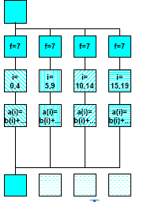
Variation: OpenMP parallel and for directives
Syntax:
#pragma omp for [ clause [ clause ] ... ] new-line
for-loop
clause can be one of the following:
shared (list)
private( list)
reduction( operator: list)
schedule( type [ , chunk ] )
nowait (C/C++: on #pragma omp for)
#pragma omp parallel private(f) {
f=7;
#pragma omp for
for (i=0; i<20; i++)
a[i] = b[i] + f * (i+1);
} /* omp end parallel */

Slide 41
Also, more control on synchronization
#pragma omp parallel shared(A,B,C)
{
tid = omp_get_thread_num();
A[tid] = big_calc1(tid);
#pragma omp barrier
#pragma omp for
for (i=0; i<N; i++) C[i] = big_calc2(tid);
#pragma omp for nowait
for (i=0; i<N; i++) B[i] = big_calc3(tid);
A[tid] = big_calc4(tid);
}

Slide 42
Conditional Parallelization
if (scalar expression)
Only execute in parallel if expression evaluates to true
Otherwise, execute serially
#pragma omp parallel if (n > threshold) \
shared(n,x,y) private(i) {
#pragma omp for
for (i=0; i<n; i++)
x[i] += y[i];
} /*-- End of parallel region --*/
Review:
parallel
for
private
shared

Slide 43
SINGLE and MASTER constructs
Only one thread in team executes code enclosed
Useful for things like I/O or initialization
No implicit barrier on entry or exit
Similarly, only master executes code
#pragma omp single {
<code-block>
}
#pragma omp master {
<code-block>
}

Slide 44
General: Task Parallelism
Recall definition:
  A task parallel computation is one in which parallelism is applied by performing distinct computations – or tasks – at the same time. Since the number of tasks is fixed, the parallelism is not scalable.
OpenMP support for task parallelism
  Parallel sections: different threads execute different code
  Tasks (NEW): tasks are created and executed at separate times
Common use of task parallelism = Producer/consumer
  A producer creates work that is then processed by the consumer
  You can think of this as a form of pipelining, like in an assembly line
  The “producer” writes data to a FIFO queue (or similar) to be accessed by the “consumer”

Slide 45
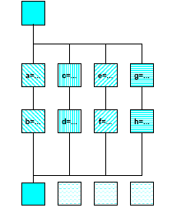
Simple: OpenMP sections directive
#pragma omp parallel
{
#pragma omp sections
#pragma omp section
{{ a=...;
b=...; }
#pragma omp section
{ c=...;
d=...; }
#pragma omp section
{ e=...;
f=...; }
#pragma omp section
{ g=...;
h=...; }
} /*omp end sections*/
} /*omp end parallel*/

Slide 46
Parallel Sections, Example
#pragma omp parallel shared(n,a,b,c,d) private(i)
{
#pragma omp sections nowait {
#pragma omp section
for (i=0; i<n; i++)
d[i] = 1.0/c[i];
#pragma omp section
for (i=0; i<n-1; i++)
b[i] = (a[i] + a[i+1])/2;
} /*-- End of sections --*/
} /*-- End of parallel region

Slide 47
Today’s Lecture
Introduction to OpenMP
The trapezoidal rule
parallel for
Schedule Clause
Synchronization
Summary

Slide 48
Summary of OpenMP
OpenMP, data-parallel constructs only
  Task-parallel constructs later
What’s good?
  Small changes are required to produce a parallel program from sequential (parallel formulation)
  Avoid having to express low-level mapping details
  Portable and scalable, correct on 1 processor
What is missing?
  Not completely natural if want to write a parallel code from scratch
  Not always possible to express certain common parallel constructs
  Locality management
  Control of performance

