Slide 1
Object orient Analysis &Design
面向对象分析与设计
Lecture_01 Thinking in OO
主讲: 姜宁康 博士
日期: 26/11/8

Slide 2
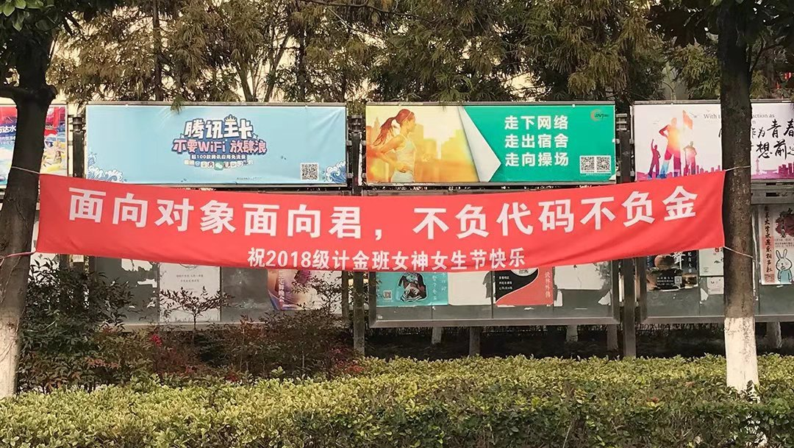
开心一刻！
--- 某高校庆“三八妇女节”标语
OOAD Lecture, Author: NK Jiang
<number>/36
Notes:
别致
符合专业特色
双关语 对象！ 但是，也要注意其间的差异
软件对象，有属性、有行为，可以是主动对象、可以是一般对象；
谈恋爱的对象，一定是有属性、有行为的主动对象，大多指人类，当然也可指具有生命的动物、植物

Slide 3
Goals of the Course
Provide students with knowledge and skills in:
  object oriented concepts
    objects, UML, use cases, analysis activities, design
    OO analysis/design, and implementation techniques
    object oriented design methods
      (aka software development life cycles)
    design patterns, refactoring(重构), testing, concurrency（并发）
    etc.
  Students should view OO software development as a software engineering process that has well-defined stages with each stage requiring specific tools and techniques
OOAD Lecture, Author: NK Jiang
<number>/36

Slide 4
The Difficult about OO
Craig Larman states:
  “OOAD is paramount rather than UML notation or the use of a case tool”
Two side:
  It is complex because shifting gears to learn a totally new way of thinking is not an easy task.
  It is simple in the sense that most people already think in terms of objects.
    People do it without knowing it might be called object-oriented，For example,
    when you saw a person…，you see the person as an object
    A person has attributes, such as eye color, age, height, and so on.
    A person also has behaviors, such as walking, talking, breathing, and so on
OOAD Lecture, Author: NK Jiang
<number>/36
Notes:
Separating the methods and tools from the OO thought process is not easy. Many people are introduced to OO concepts via one of these methods or tools. Many C programmers were first introduced to object orientation by migrating directly to C++—before they were even remotely exposed to OO concepts. Some software professionals were first introduced to object orientation by presentations that included object models using UML—again, before they were even exposed directly to OO concepts.
Craig Larman states
Unfortunately, in the context of software engineering and the UML diagramming language, acquiring the skills to read and write UML notation seems to sometimes be equated with skill in object-oriented analysis and design. Of course, this is not so, and the latter is much more important than the former. Therefore, I recommend seeking education and educational materials in which intellectual skill in object-oriented analysis and design is paramount rather than UML notation or the use of a case tool.

Slide 5
Thinking in OO
Following concepts are basics :基本概念，必须清楚
  Class/Object
  Method / Message
  Encapsulation
  Inheritance
  Interface / Implement
  Polymorphism
  Composition / aggregation
  Abstraction
Advance OO concepts ：逐步理解
  OO principle
  Design Pattern
OOAD Lecture, Author: NK Jiang
<number>/36

Slide 6
Alan Kay (an author) ：
Everything is an object.
A program is a bunch of objects telling each other what to do by sending messages.
Each object has its own memory made up of other objects.
Every object has a type.
  each object is an instance of a class, in which "class" is synonymous with "type."
All objects of a particular type can receive the same messages.
  an object of type "circle" is also an object of type "shape," a circle is guaranteed to accept shape messages. This means you can write code that talks to shapes and automatically handle anything that fits the description of a shape.
OOAD Lecture, Author: NK Jiang
<number>/36
Notes:
Everything is an object. Think of an object as a fancy variable; it stores data, but you can "make requests“ to that object, asking it to perform operations on itself. In theory, you can take any conceptual component in the problem you're trying to solve (dogs, buildings, services, etc.) and represent it as an object in your program. Feedback
· A program is a bunch of objects telling each other what to do by sending messages. To make a
request of an object, you "send a message" to that object. More concretely, you can think of a message as a request to call a method that belongs to a particular object. Feedback
· Each object has its own memory made up of other objects. Put another way, you create a new kind of
object by making a package containing existing objects. Thus, you can build complexity into a program while
hiding it behind the simplicity of objects. Feedback
· Every object has a type. Using the parlance（外交辞令）, each object is an instance of a class, in which "class" is
synonymous with "type." The most important distinguishing characteristic of a class is "What messages can
you send to it?" Feedback
· All objects of a particular type can receive the same messages. This is actually a loaded statement, as
you will see later. Because an object of type "circle" is also an object of type "shape," a circle is guaranteed to
accept shape messages. This means you can write code that talks to shapes and automatically handle
anything that fits the description of a shape. This substitutability is one of the powerful concepts in OOP.

Slide 7
1、What Is a Class?
a class is a blueprint for an object
A class is a description of a set of objects that share the same attributes, operations, relationships, and semantics “共享相同属性、操作、方法、关系或者行为的一组对象的描述符”
  －Rumbaugh
trying to explain class and object is really a chicken-and-egg dilemma. For example,
  a specific bike is an object. However, someone had to have the blueprints (that is, the class) to build the bike
OOAD Lecture, Author: NK Jiang
<number>/36
Notes:
类和对象很少在同一张图中出现，所以可以根据类进行建模的大多数工作，而对象仅用于演示和验证。

Slide 8
2、Instance（Object）
A Class is a template or abstract description of the same type of objects. It defines the common features of the objects, that is the operations and information structure.
  you can think of a class as a template from which objects are made
An Instance is an object created from a class.
  An instance’s behaviour and information structure is defined in the class.
  Its current state (values of instance variables) is determined by operations performed on it.
注意：概念之间的互用
  Data == state == information struct == Attribute
  Method ==behaviour
OOAD Lecture, Author: NK Jiang
<number>/36

Slide 9
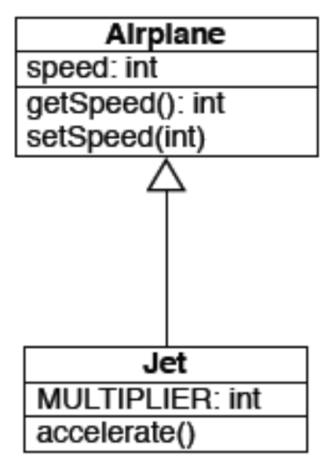
3、Inheritance
The basic principle is simple:
  A class gets the state and behaviour of another class and adds additional state and behaviour
1 public class Airplane {
2
3 private int speed;
4
5 public Airplane(int speed) {
6 this.speed = speed;
7 }
8
9 public int getSpeed() {
10 return speed;
11 }
12
13 public void setSpeed(int speed) {
14 this.speed = speed;
15 }
16
17 }
OOAD Lecture, Author: NK Jiang
<number>/36

Slide 10
3、Inheritance
1 public class Jet extends Airplane {
2
3 private static final int MULTIPLIER = 2;
4
5 public Jet(int id, int speed) {
6 super(id, speed);
7 }
8
9 public void setSpeed(int speed) {
10 super.setSpeed(speed * MULTIPLIER);
11 }
12
13 public void accelerate() {
14 super.setSpeed(getSpeed() * 2);
15 }
16
17 }
18
Note:
extends keyword indicates inheritance
super() and super keyword is used to refer to superclass
No need to define getSpeed() method; its
inherited!
setSpeed() method overrides behavior of
setSpeed() in Airplane
subclass can define new behaviors, such as accelerate()
OOAD Lecture, Author: NK Jiang
<number>/36

Slide 11
How do you express inheritance in C++?
class Car : public Vehicle {
public:
...
};
We state the above relationship in several ways:
  Car is "a kind of a" Vehicle
  Car is "derived from" Vehicle
  Car is "a specialized" Vehicle
  Car is a "subclass" of Vehicle
  Car is a "derived class" of Vehicle
  Vehicle is the "base class" of Car
  Vehicle is the "superclass" of Car
OOAD Lecture, Author: NK Jiang
<number>/36

Slide 12
4、Polymorphism 多态
Original meaning: “Having many forms”
  “When one class inherits from another, then polymorphism allows a subclass to stand in for the superclass.”
  The sender of a stimulus doesn’t need to know the receiver’s class.
  Different receivers can interpret the message in their own way.
Consequence:
  different receivers can response to the same stimulus based on their interpretation.
  So we can have a variety of objects who process the same piece of data in different ways.
OOAD Lecture, Author: NK Jiang
<number>/36

Slide 13
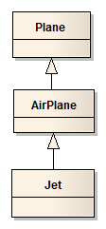
4、Polymorphism 多态
Implication: both of these are legal statements
  Airplane plane = new Airplane()
  Airplane plane = new Jet()
Note：
  Any code that uses the “plane” variable will treat it as an Airplane… this provides flexibility, since that code will run unchanged, indeed it doesn’t even need to be recompiled, when new Airplane subclasses are created
OOAD Lecture, Author: NK Jiang
<number>/36

Slide 14
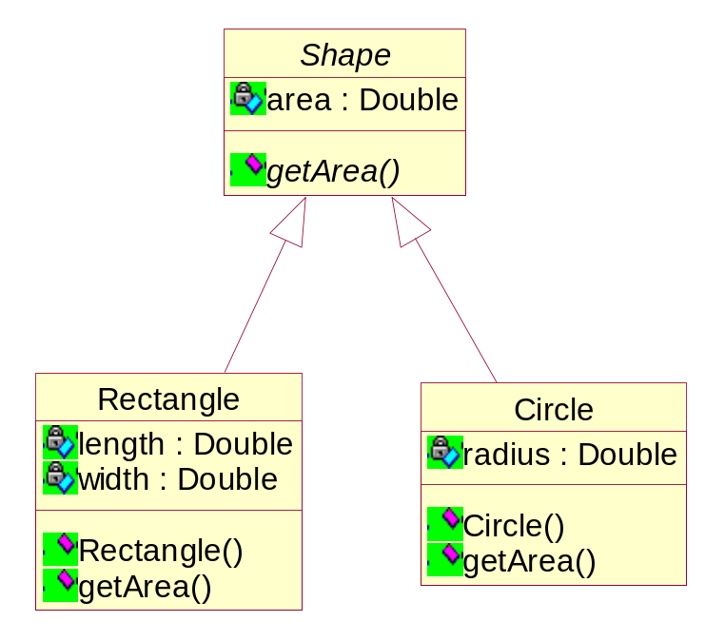
4、Polymorphism：case2
public abstract class Shape{
private double area;
public abstract double getArea();
}
public class Circle extends Shape{
double radius;
public Circle(double r) {
radius = r;
}
public double getArea() {
area = 3.14*(radius*radius);
return (area);
};}
//instantiate the Shape classes
Circle circle = new Circle(5);
Rectangle rectangle = new Rectangle(4,5);
//add these Shape classes to the stack:
stack.push(circle);
stack.push(rectangle);
public class Rectangle extends Shape{
double length; double width;
public Rectangle(double l, double w){
length = l; width = w;
}
public double getArea() {
area = length*width;
return (area);
};
}
//empty the stack, and do not have to care //about what kind of Shape classes are in it:
while ( !stack.empty()) {
Shape shape = (Shape) stack.pop();
System.out.println ("Area = " + shape.getArea());
}
OOAD Lecture, Author: NK Jiang
<number>/36

Slide 15
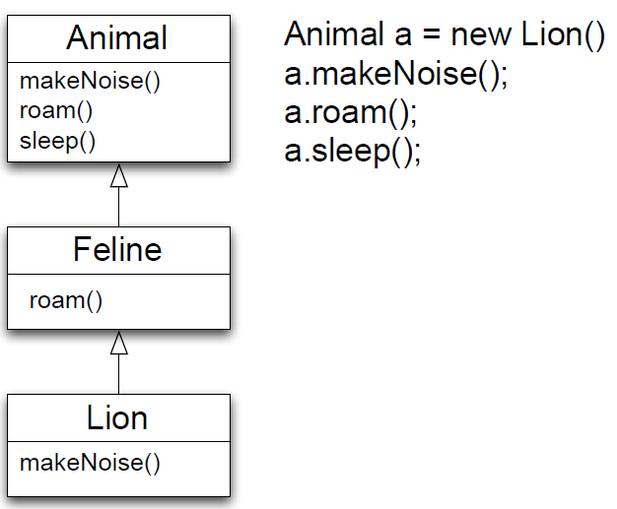
4、Polymorphism: 重要性！
Without polymorphism, the code only calls methods in the Animals class
With polymorphism
  a.roam() invokes Feline.roam()
  a.makeNoise() invokes Lion.makeNoise()
OOAD Lecture, Author: NK Jiang
Notes:
Feline ： 猫，猫科动物；

Slide 16
4、Polymorphism: 重要性！
Why is this important?
  Polymorphism allows us to write very abstract code that is robust with respect to the creation of new subclasses
For instance
public void goToSleep(Animal[] zoo) {
for (int i = 0; i < zoo.length; i++) {
zoo[i].sleep();
}
}
OOAD Lecture, Author: NK Jiang

Slide 17
4、Polymorphism: 重要性！
Why is this important?
  In the previous code
    we don’t care what type of animals are contained in the array
    we just call sleep() and get the correct behavior for each different type of animal
  Indeed, if a new subclass of animal is created
    the above code still functions correctly AND
    it doesn’t need to be recompiled
  It only cares about Animal, not its subclasses
We can view a class’s public methods as establishing a contract that it and its subclasses promise to keep
  if we “code to the (root) contract”, we can create very robust and easy to maintain software systems
  This perspective is known as “design by contract”
OOAD Lecture, Author: NK Jiang

Slide 18
4、Polymorphism: 重要性！
method overloading（方法重载） as “powerful AND dangerous” 方法重载的两面性：功能强大、危险
  The danger comes from the possibility that a subclass may change the behavior of a method such that it no longer follows the contract established by a superclass 危险来自于，子类在重载方法的过程中违背了父类定义的合约规范
    such a change will break previously abstract and robust code
OOAD Lecture, Author: NK Jiang

Slide 19
4、Polymorphism: 重要性！
Consider what would happen if an Animal subclass overrides the sleep() method to make its instances flee from a predator or eat a meal
  Our goToSleep() method would no longer succeed in putting all of the Zoo’s animals to sleep
If we could not change the offending subclass, we would have to modify the goToSleep() method to contain special case code to handle it
  this would break abstraction and seriously degrade the maintainability of that code
OOAD Lecture, Author: NK Jiang
Notes:
flee from a predator 躲避掠食者

Slide 20
5、Aggregation/Composition
Inheritance means that one class inherits the characteristics of another class.
This is also called a “is a” relationship:
Aggregation describes a “has a” relationship. One object is a part of another object.
A car is a vehicle
A student is a person
A car has wheels
A person has legs
OOAD Lecture, Author: NK Jiang
<number>/36

Slide 21
5、Aggregation/Composition
Aggregations indicate that one object
  contains a set of other objects
Aggregation relationships are transitive
  if A contains B an B contains C, then A contains C
  Aggregation relationships are asymmetric
    If A contains B, then B does not contain A
A variant of aggregation is composition which adds the property of existence dependency
  if A composes B, then if A is deleted, B is deleted
OOAD Lecture, Author: NK Jiang
<number>/36

Slide 22

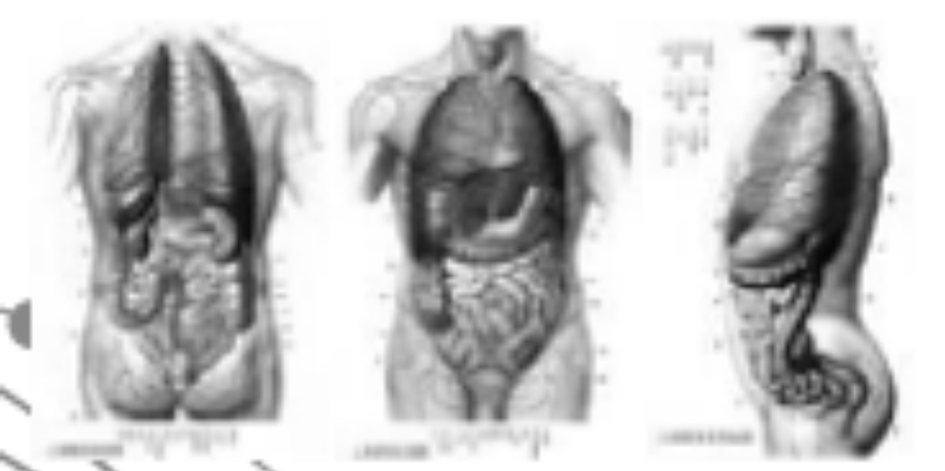
5、Aggregation/Composition
Composition is a type of Strong aggregation
  ‘whole’ can control the life span of ‘portion’
  部分对象只能存在于整体对象之中，整体对象控制部分对象的生命周期。
OOAD Lecture, Author: NK Jiang
<number>/36

Slide 23
6、Encapsulation
Encapsulation
  is the process of hiding the implementation details of an object.
  The internal state is usually not accessible by other objects
  The only access to manipulate the object data is through its interface.
It protects an object’s internal state from being corrupted by other objects.
Also, other objects are protected from changes in the object implementation.
Encapsulation allows objects to be viewed as ‘black boxes’.
Communication is achieved through an ‘interface’.
OOAD Lecture, Author: NK Jiang
<number>/36

Slide 24
6、Example: Encapsulation
The “speed” instance variable is private in Airplane. That means that Jet doesn’t have direct access to it.
Nor does any client of Airplane or Jet objects
Imagine if we changed speed’s visibility to public
The encapsulation of Jet’s setSpeed() method would be destroyed
1 Airplane
2
3 ...
4 public void setSpeed(int speed) {
5 this.speed = speed;
6 }
7 ...
8
9 Jet
10
11 ...
12 public void setSpeed(int speed) {
13 super.setSpeed(speed * MULTIPLIER);
14 }
15 ...
16
OOAD Lecture, Author: NK Jiang
<number>/36
Notes:
How can I prevent other programmers from violating encapsulation by seeing the private parts of my class?
Not worth the effort — encapsulation is for code, not people.
It doesn't violate encapsulation for a programmer to see the private and/or protected parts of your class, so long as they don't write code that somehow depends on what they saw. In other words, encapsulation doesn't prevent people from knowing about the inside of a class; it prevents the code they write from becoming dependent on the insides of the class. Your company doesn't have to pay a "maintenance cost" to maintain the gray matter between your ears; but it does have to pay a maintenance cost to maintain the code that comes out of your finger tips. What you know as a person doesn't increase maintenance cost, provided the code you write depends on the interface rather than the implementation.
Besides, this is rarely if ever a problem. I don't know any programmers who have intentionally tried to access the private parts of a class. "My recommendation in such cases would be to change the programmer, not the code" [James Kanze; used with permission].

Slide 25
6、Encapsulation
Rule:
  An object should only reveal the interfaces needed to interact with it. Details not pertinent to the use of the object should be hidden from other objects.
    This is a general rule of encapsulation
Suggestion:
  Getters and Setters
    supports the concept of data hiding
    Because other objects should not directly manipulate data within another object
For example,
  if a user needs access to an attribute,
    a method is called to return the attribute (a getter).
OOAD Lecture, Author: NK Jiang
<number>/36

Slide 26
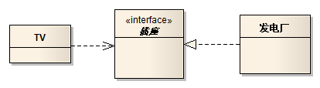
7、Interface /Implementation
interface 接口
  describe how users of the class interact with the class
Implementation（实现） goal
  A change to the implementation should not require a change to the user's code.
  both the user and the implementation must conform to the interface specification.
Where the implementation details are hold?
    Class,
    Component
    Etc;
For example
  TV、电源插座、发电厂之间的关系？
OOAD Lecture, Author: NK Jiang
<number>/36

Slide 27
8、Abstraction （抽象）
客观世界的事物由各种各样的实体（对象）构成
每个对象都有各自的内部状态和运动（状态）规律
根据对象的属性和运动规律的相似性可以将对象分类
复杂对象由相对简单的对象组成
不同对象的组合及其间的相互作用和联系构成了系统
对象间的相互作用通过消息传递，对象根据所接收到的消息做出自身的反应
继承的能力在于它的抽象和组织技术
OOAD Lecture, Author: NK Jiang
<number>/36

Slide 28

8、Abstraction （抽象）
Abstraction
  A process allowing to focus on most important aspects while ignoring less important details.
  allows us to manage complexity by concentrating on essential aspects making an entity different from others.
“抽象表示一个对象与其他所有对象相区别的基本特征，因此提供了同观察者角度有关的清晰定义的概念界限。”
  —— Booch
An example of an order processing abstraction
简单地讲，
  抽象（abstraction）就是过滤掉对象的一部分特性和操作，直到只剩下你所需要的属性和操作。
OOAD Lecture, Author: NK Jiang
<number>/36
Notes:
比如说，
你在解决一个应用题的时候，首先要通过抽象思维建立起一个数学模型，如找各个量的关系，列出方程，这一步就是抽象，实际的问题变成了抽象的数学问题

Slide 29
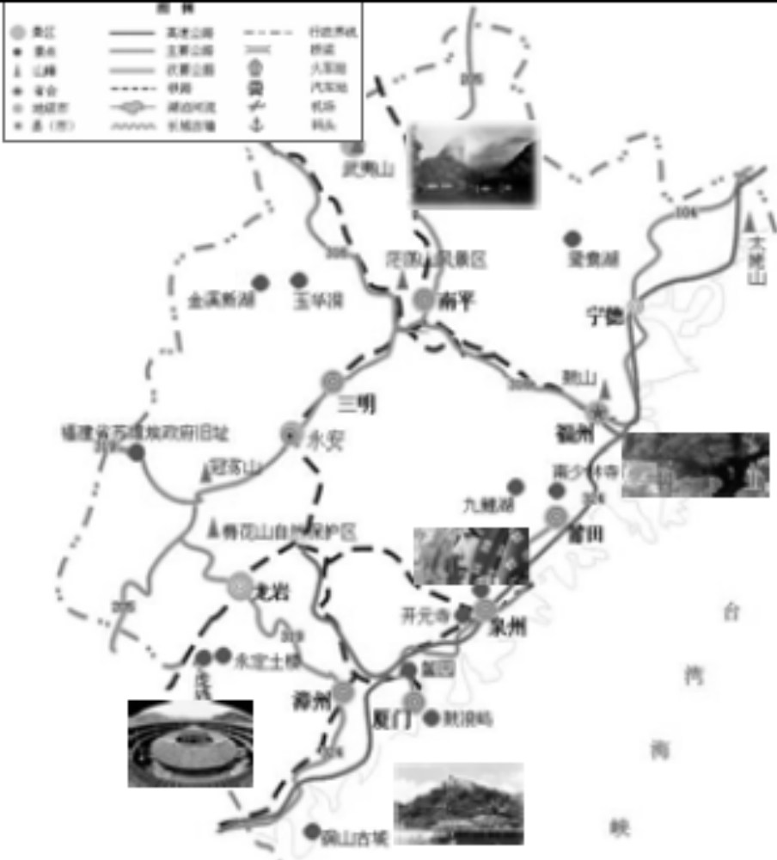
8、Abstraction （抽象）
Class Province
{
  Hotel hotels[];
  Restaurant restaurants[];
  Attraction attractions[];
  ……
  int TotalHotelBeds() {…}
  int TotalTourists() {…}
  int TotalTourismIncome()
  {…}
}
Class Hotel { }
Class Restaurant { }
Class Attraction { }
OOAD Lecture, Author: NK Jiang
<number>/36

Slide 30
8、Abstraction （抽象）
抽象的质量通过两个指标来衡量：
  内聚性，即如果抽象能够简洁地代表一种清晰的概念，那么抽象是内聚的。一个类的所有属性和方法必须直接和概念的表示相关。
  耦合度，即与相关联的类的耦合程度。如果耦合度高，那么重用性就低，因为该抽象与系统中的其它模块相关以致于很难单独维护。
OOAD Lecture, Author: NK Jiang
<number>/36

Slide 31
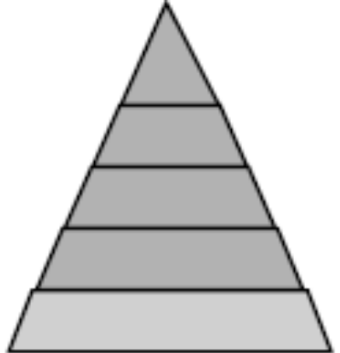
8、Abstraction （抽象）
抽象的层次5：
  第五个抽象层：已知一个类，实现这个类所需要的方法和成员变量的实现(Implementation)。
  在这里OOP最终和POP（Procedure-OrientedProgramming）相融合
抽象的层次4：
  第四个抽象层就是针对一组相似对象，定义一个类，作为生成对象的模板，类定义了对象的对外服务接口以及内部继承接口，而这个抽象层次的典型代表就是接口编程(InterfaceProgramming)。
1
2
3
4
5
OOAD Lecture, Author: NK Jiang
<number>/36

Slide 32
8、Abstraction （抽象）
抽象的层次3：
  代表典型的OOP模式：客户/服务器模型，这主要是用来抽象两个对象之间的交互过程。
  在这个抽象级别上的典型代表就是对象之间的消息机制(Message Passing)。
抽象的层次2：
  是一个对象集单元，也就是一组相互联系的对象
  在程序设计语言级别来看Java中是packages，C#中是name space。
抽象的层次1：
  最高级别的抽象层，程序被看成是由很多相互作用并且遵守契约的对象所组成的对象集合。
  对象之间相互合作完成程序的计算任务。这个抽象级别上的典型代表就是设计模式思想（Design Pattern）。
OOAD Lecture, Author: NK Jiang
<number>/36

Slide 33
9、Designing with Objects
Generally, a solid OO design process will include the following steps：
  Doing the proper analysis
  Developing a statement of work (SoW) that describes the system
  Gathering the requirements from this statement of work
  Developing a prototype for the user interface
  Identifying the classes
  Determining the responsibilities of each class
  Determining how the various classes interact with each other
  Creating a high-level model that describes the system to be built
    Abstraction
OOAD Lecture, Author: NK Jiang
<number>/36

Slide 34
10、Briefly introduce OO Principle
A critical ability in OO development is
  to skillfully assign responsibilities to software objects.
GRASP
  General Responsibility Assignment Software Pattern
    通用职责分配软件模式
  Nine fundamental principles in object design and responsibility assignment are presented and applied
  E.g., Information Expert, Creator, Controller, Low Coupling, High Cohesion…
What are Patterns?
  a good pattern is a named and well-known problem/solution pair that can be applied in new contexts, with advice on how to apply it in novel situations and discussion of its trade-offs, implementations, variations, and so forth.
  E.g., Factory, Observer, bridge, composite…
OOAD Lecture, Author: NK Jiang
<number>/36

Slide 35
Conclusion
good understanding of the following topics
  Encapsulation
    A single object contains both its data and behaviors and can hide what it wants from other objects.
  Inheritance
    take advantage of the attributes and methods defined by the superclass
    allowing you to define relationships between classes that facilitate not only code reuse, but also better overall design
  Polymorphism
    similar objects can respond to the same message in different manners.
  Composition
    an object is built from other objects
  Fundamental unit of OO design is
    class
  The move from the procedural world to an OO world is not trivial
OOAD Lecture, Author: NK Jiang
<number>/36

Slide 36
Conclusion
Fundamental unit of OO design is
  class
  Preparation
    Text Book: CH1~Ch3 /Ch6 \10\13
End of Lecture
OOAD Lecture, Author: NK Jiang
<number>/36

