Slide 1
Object Oriented Analysis & Design
面向对象分析与设计
Lecture_03 面向对象分析（一）
主讲: 姜宁康 博士

Slide 2
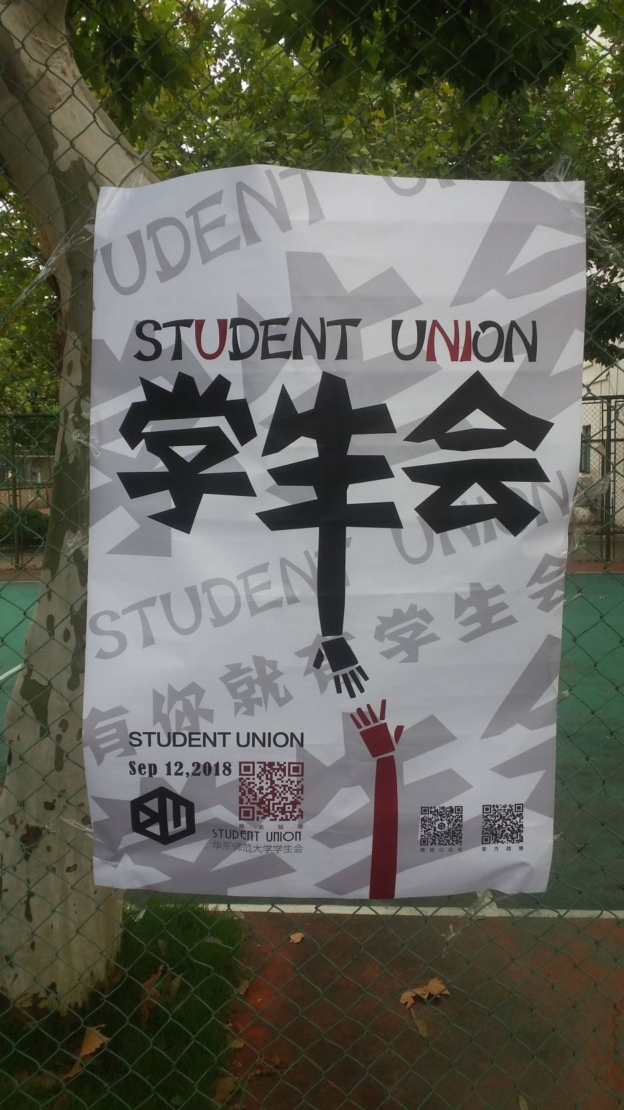
一笑
“张作霖手黑”
【张作霖手墨】
“要会讲故事”
“注意细节”
Notes:
据说有次日本人举行了盛大宴会邀请东三省各个官员，酒至三巡，菜过五味，日本人为了让张作霖难堪，起哄让大帅题字，大家都知道张作霖是绿林草莽出身，大字不识几个根本不会写字，张作霖一推再推，他越是推辞，日本人越是来劲，就想讽刺一下他没什么文化水平而已。
张作霖看实在是推脱不掉，就大喊一声，笔墨伺候。准备齐全后，张作霖走向台前，提笔，蘸足墨水，大笔一挥，一气呵成，写下了一个刚劲有力，挥洒自如，独树一帜的“虎”字，并落款“张作霖手黑”。
随后他就把毛笔一放，大步走回主帅座位，日本官员看的目瞪口呆，惊讶不止，百思不得其解。宴会陪客的一些人就开始嘲笑张作霖没文化，可是张作霖却一直微笑不语。随身的侍卫小声的说“大帅，墨字下面您少写了一个土字”张作霖回答说“我知道的，要什么都可以给，但是土，我是寸土不让。”
日本人听后非常生气，以至于后来张作霖被害，他们在张作霖乘坐的专线列车铁轨上埋了炸药。张作霖被炸成重伤，结果不治身亡，史称皇姑屯事件。没了张作霖坐镇东北，日本人很快就发动了九一八事变，开始正式侵略中国。

Slide 3
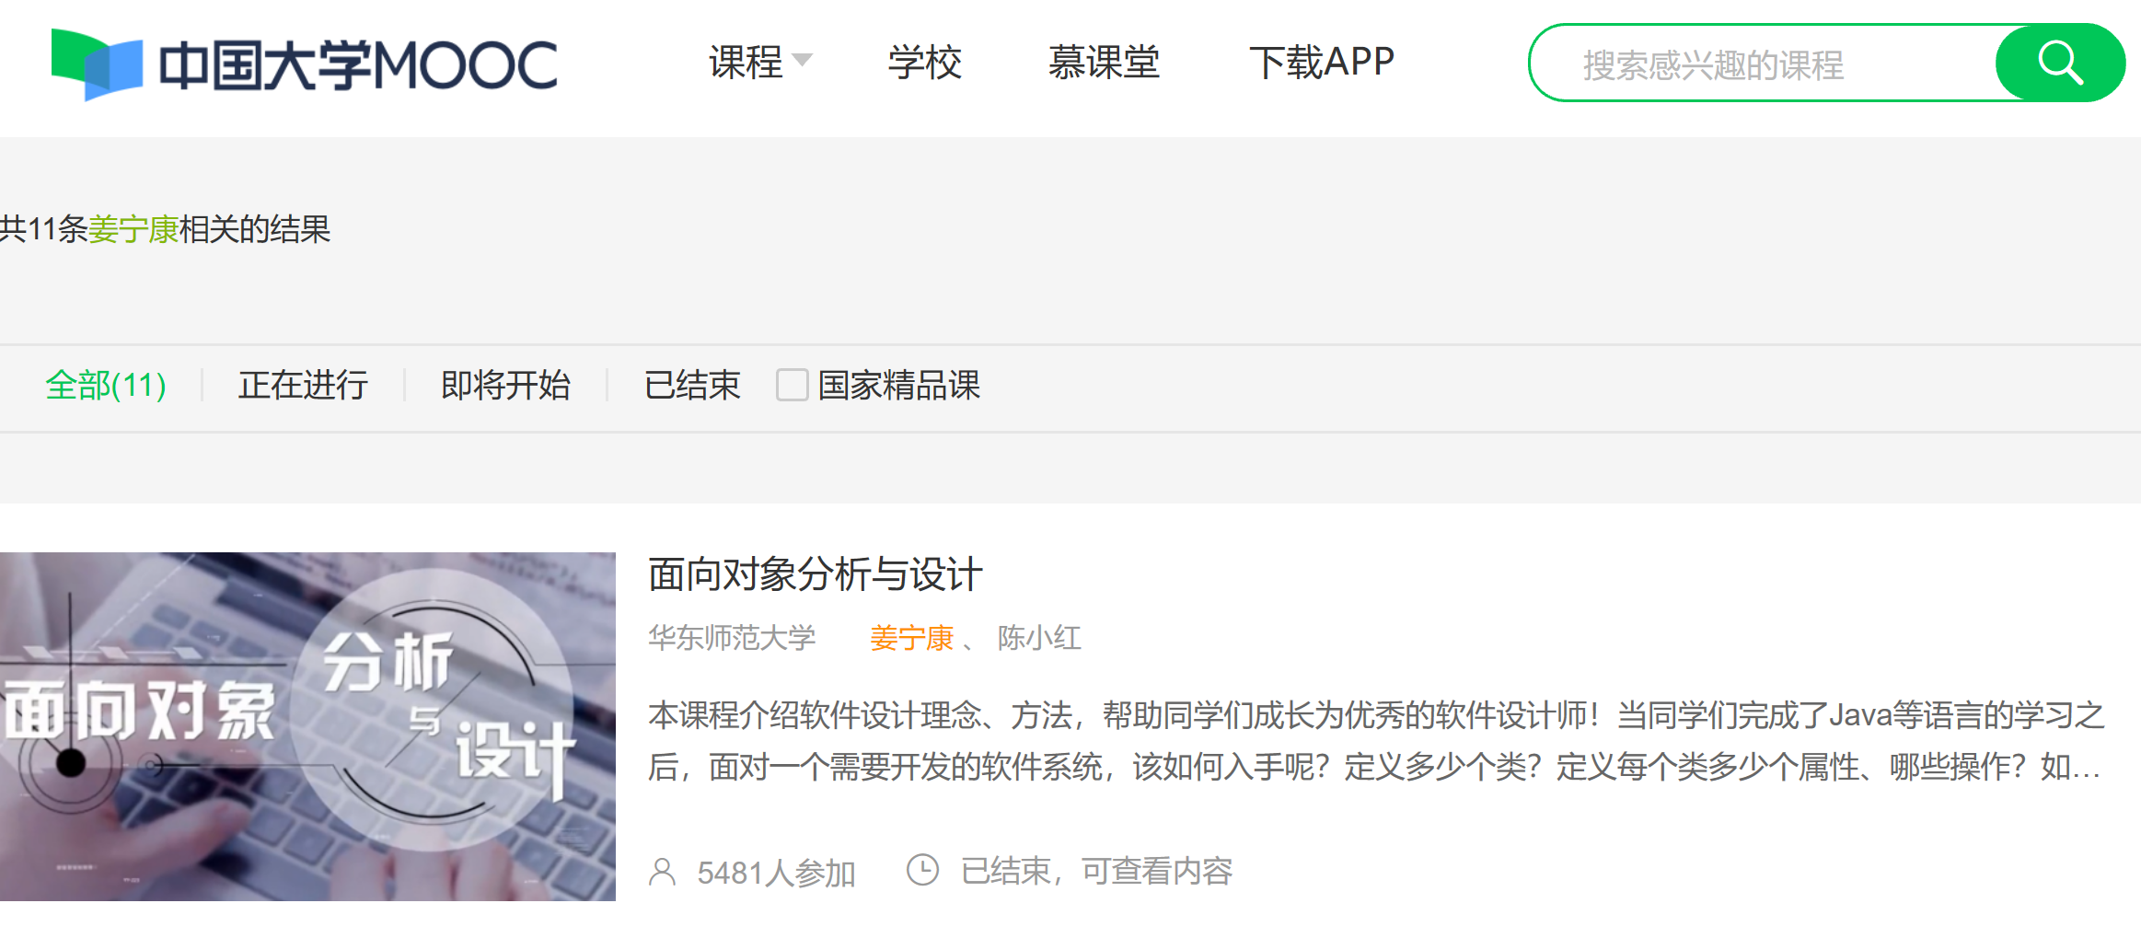
请同学们加入 中国大学MOOC网站的 本课程
https://www.icourse163.org/search.htm?search=%E5%A7%9C%E5%AE%81%E5%BA%B7#/

Slide 4
1、面向对象分析与设计概览…
    Overview of Object-Oriented analysis and design

Slide 5
OOAD Overview
良好的对象设计意味着什么？
  是构建高质量软件系统的基本要求，如
  Architectural cohesion 架构性的内聚
  Reusability 可重用性
  Maintenance 可维护性
  Scalability 可扩展性
  Flexibility 灵活性
UML、面向对象语言（C++/Java）重要吗？足够了吗？
  UML是标准的图形表示工具，是一种思考的工具、沟通的形式，是有用的
  但是，对象思想才是重点和难点
  “Owning a hammer doesn’t make you a home builder“拥有一把锤子未必能成为建筑师”

Slide 6
OOAD Overview
系统设计中的关键问题（是本课程要点）
  应该如何为对象类分配职责（responsibility）?
  对象之间应该如何协作？
  什么样的类应该做什么样的事情？
  某些针对设计问题的、经过反复验证的解决方案，可以（或者已经）被表示成为最佳实践的原则、启示或者模式（pattern），如何用、如何自创？
软件开发过程模型（不是本课程范畴）
  瀑布模型
  螺旋模型
  增量模型
  迭代模型
  喷泉模型
  敏捷模型
  SMF（微软）
  RUP等

Slide 7
OOAD Overview
课程的关键 Key importance:
  A critical ability in OO development is to skillfully assign responsibilities to software objects. 面向对象开发需要掌握的极为重要的能力：为软件对象分配职责。方法：
    Responsibility-driven design 职责驱动的设计
    Performed during Design workflow 在设计的过程中完成职责分配
    Follows GRASP principles 遵循GRASP原则
      General Responsibility Assignment Software Pattern 通用职责分配软件模式
    Successful designs become Patterns 成功的设计可以成为模式
      A named description of a problem, solution, when to apply the solution, and how to apply the solution in new contexts 一个命名的描述：问题、解决方案、何时适用、如何应用在新的环境
相关的知识点
  用例 Use Cases
    文字描述的重要交易和业务场景 Text description of vital transactions and scenarios
    用例不是面向对象的，但面向对象分析设计都会用到 Not OO but usually used in OOAD

Slide 8
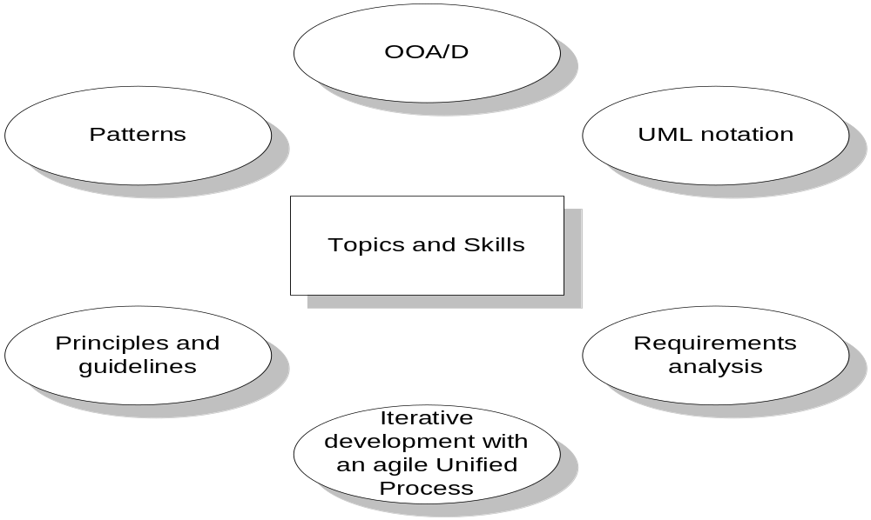

OOAD Overview
Topics and skills covered
  OOAD elements
  OOAD + UML is our focus

Slide 9
OOAD Overview
What is Analysis ?
  Analysis is investigation of the problem and requirements, rather than a solution.
    For example, if a new online trading system is desired,
      how will it be used? What are its functions?
    requirements analysis ：an investigation of the requirements
What is design?
  Design is a conceptual solution that fulfills the requirements 概念性的、满足需求的解决方案
分析与设计的类比：
  用户需求：我要一辆能开动的汽车
  系统功能：引擎、方向盘、油箱轮胎、车架、车门….
Notes:
Emphasis on finding problem entities (conceptual classes概念类), relationships, constraints
Emphasis on designing classes and objects with behavior to allow collaborations to solve particular requests while using patterns 强调带有行为的“设计类与对象，协作完成特定需求，有时可以用一些模式”

Slide 10
OOAD Overview
What is implement? 实现
  Implementation is expression of the design in code
    Emphasis on utilizing the language of choice to implement design classes while exploring visibility, navigability, etc.
What is deployment? 部署
  Deployment is the actual installation in the host environment
Relationship of the Analysis and Design 分析与设计的关系
  记住这句话：
  “ do the right thing (analysis), and do the thing right (design) ”
  做正确的事情（分析）、正确地做事情（设计）

Slide 11

OOAD Overview
What is OOA 面向对象分析?
  finding and describing the objects or concepts in the problem domain 发现并描述问题领域里的对象或者概念（概念类）
What is OOD 面向对象设计?
  defining software objects and how they collaborate to fulfill the requirements 定义软件对象、以及它们之间如何协作完成功能的（设计类）
For example, Airplane example of object and class discovery
  OOA:
    in the case of the flight information system, some of the concepts include： Plane, Flight, and Pilot.
  OOD:
    a Plane software object may have a tailNumber attribute and a getFlightHistory() method
  then, implement…

Slide 12
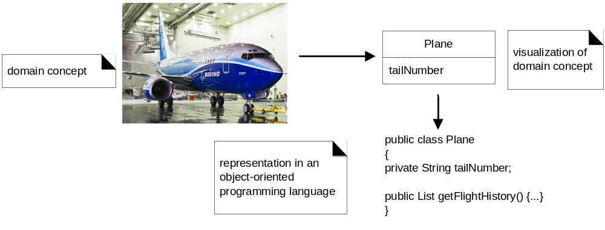
OOAD Overview
实例 For example, Airplane example of object and class discovery

Slide 13

OOAD Simple Example
Rudimentary process 最基本的过程
Dice game example
  software simulates（模仿）a player rolling two dices. If the total is (>=) seven, they win; otherwise, they lose
定义用例
定义领域模型
定义交互图
定义设计类图

Slide 14


OOAD Simple Example
Step1: Use Case
  Player is requested to roll the dice.
  System presents results:
  If the dice face value totals (>=)seven, player wins; otherwise, player loses

Slide 15
OOAD Simple Example
Step2: Domain Model 领域模型
  OOA的结果体现在领域模型中，显示重要的领域概念或者对象
  What is domain model?
    a visual representation of conceptual classes or real-situation objects in a domain [MO95, Fowler96]. 问题领域的概念类以及真实对象的可视化表示
    Domain models have also been called conceptual models , domain object models, and analysis object models. 领域模型也被称为 概念模型、领域对象模型、分析对象模型
  In our example,
    Player,
    Die,
    DiceGame
Notes:
面向对象

Slide 16

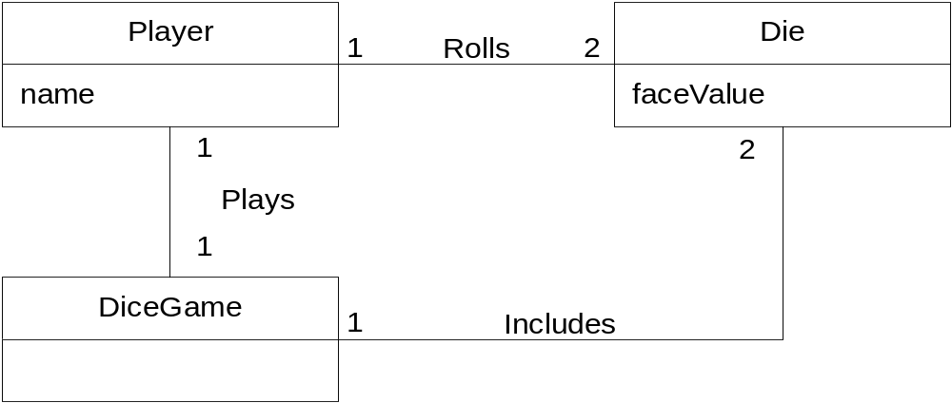
OOAD Simple Example
Text Book Fig 1-3

Slide 17
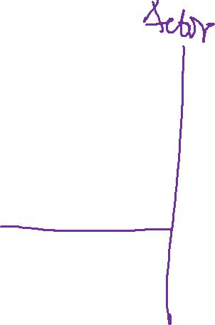
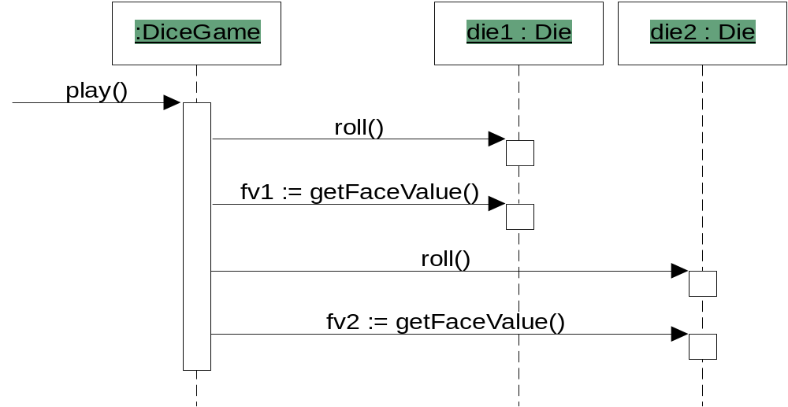
OOAD Simple Example
Step3: Interactions
  Assignment of responsibilities among objects
  Sequence or Communication diagrams
注意 :
在现实里，是Player扔的骰子。在软件设计中，由DiceGame对象扔骰子dice (即,给Die 对象发送一个消息)。 软件设计需要从真实世界的事物中获取一些灵感、启发，但是，不能完全模仿真实世界。
Text Book Fig 1-4

Slide 18

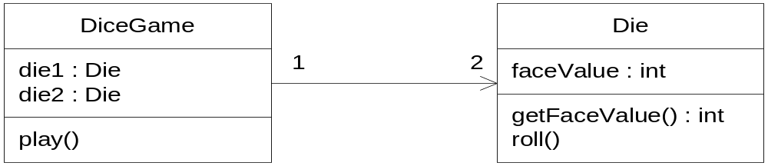
OOAD Simple Example
Step4: Design Class Diagrams (DCD)
    Software classes（软件类） with methods according to responsibilities and attributes according to visibility
  Cf:
    the domain model showing real-world classes
    this diagram shows software classes
  LRG: lower representational gap,低表示差异
    概念类与软件类，有很大的相似度
Figure 1.5. Partial design class diagram
Notes:
Player can be seen as an actor

Slide 19

OOAD概述小结
领域、领域模型、概念类
系统、设计类==软件类
  低表示差异LRG： 概念类可以直接作为软件类
  概念类没有操作、软件类有操作
分析、设计，面向对象分析、面向对象设计
  OOAD的简单完整过程示意
  掌握面向对象思想，重于UML工具、OO语言

Slide 20
2、面向对象分析方法（一）名词法
  Object-Oriented analysis

Slide 21
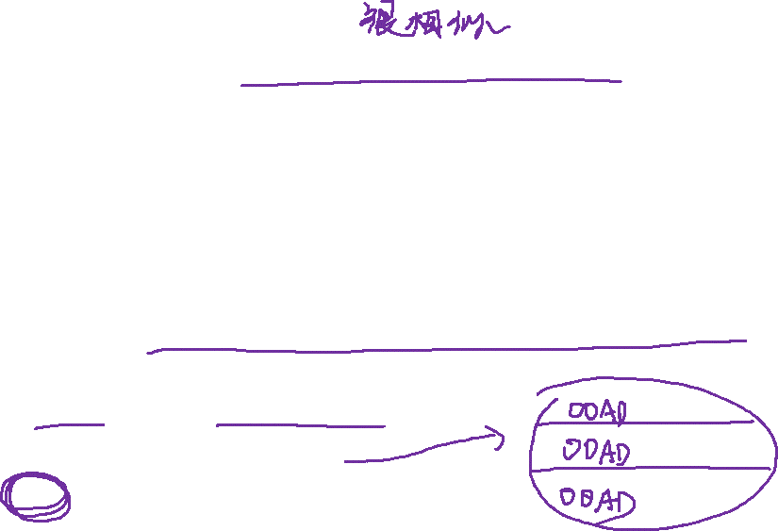
2.1 Analysis Phase
在软件工程，分析是一种过程，把用户需求转变为系统需求
系统规格说明，也称为逻辑结构，是开发人员眼中的系统
  已经有了哪些业务规则、业务逻辑？
  还有哪些事需要提醒客户的？
大的、复杂系统的开发，有两种主要的分析方法
  面向功能的分析Function-oriented analysis
    concentrating on the decomposition of complex functions to simply ones.
  面向对象分析Object-oriented analysis
    identifying objects and the relationship between objects.
  在抽象层面，面向功能的分析法用得多一点
    把系统分成模块
  在模块层面，面向对象分析法用得多一点
    模块的功能如何实现？--- OOAD技术！

Slide 22
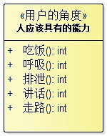
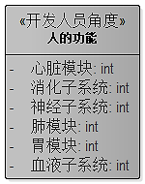
2.1 Analysis Phase
请大家体会一下
  从“用户的角度”到“开发人员的角度”之间的差异
分析
设计

Slide 23
2.2 Object Oriented Analysis 面向对象分析主要步骤
Identifying objects 识别对象
Organising the objects: 组织对象
  classifying the objects identified, so similar objects can later be defined in the same class.
Identifying relationships between objects: 定义对象之间的关系
  this helps to determine inputs and outputs of an object.
Defining operations of the objects: 定义对象的操作
  the way of processing data within an object.
  Also known as ‘responsibility assignment’
  这一步，主要在设计阶段完成
Defining objects internally: 定义对象内部细节
  information held within the objects.

Slide 24



2.3 Three ways to do Object Oriented Analysis (there are more…)
1）Conceptual model (Larman) 概念模型,又称“名词法”
  Produce a “light” class diagram
2）Analysis model with stereotypes (Jacobson) 分析模型
  Boundaries, entities, control.
3）CRC cards (Beck, Cunningham) CRC法,类/职责/协作
  Index cards and role playing.
A good analyst knows more than one strategy and even may mix strategies in order to identify the objects and relationships for the design phase.
一个好的分析师掌握多种技术，知道如何混合使用各种技术。目标只有一个：发现对象、定义对象之间的关系。

Slide 25

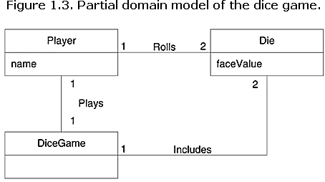
复习 概念模型
概念模型 conceptual model 表示了问题领域的的 “概念”及其关系，也称为领域模型 ‘domain model’
UML图形表示为 “没有定义操作的类图”
  它能够显示：概念 Concepts、概念之间的关系 Associations of concepts、概念的属性 Attributes of concepts

Slide 26

2.4 名词法定义概念类
名词法定义概念（conceptual class）
  重用或者修改已有的模型 Reuse or modify existing models.
    This is the first, best, and usually easiest approach
  借助行业、公司内部法的“概念类列表 ” Concept Category List
  在需求描述中查寻名词（短语）Finding Concepts with Noun Phrase Identification.
复习：
面向对象分析与结构化分析方法之间的最大差异是 A central distinction between object oriented and structures analysis:
  前者根据对象划分系统，而后者根据功能 division by concepts (objects) rather than division by functions.
Notes:
Text book, section 9.5

Slide 27

2.5 概念类列表 The Concept Category List
Table 9.1. Conceptual Class Category List.
Conceptual Class Category 概念类类别 | Examples 案例
business transactions Guideline: These are critical (they involve money), so start with transactions. | Sale, Payment Reservation
transaction line items Guideline: Transactions often come with related line items, so consider these next. | SalesLineItem
product or service related to a transaction or transaction line item Guideline: Transactions are for something (a product or service). Consider these next. | Item Flight, Seat, Meal
where is the transaction recorded? Guideline: Important. | Register (收银台）, Ledger 分类帐 FlightManifest
roles of people or organizations related to the transaction; actors in the use case Guideline: We usually need to know about the parties involved in a transaction. | Cashier, Customer, Store， MonopolyPlayer Passenger, Airline
Notes:
Text book, section 9.5
ledger [简明英汉词典]
[5ledVE]
n.[会计]分类帐, 分户总帐, 底帐, [建](手脚架上的)横木

Slide 28
place of transaction; place of service | Store Airport, Plane, Seat
noteworthy events, often with a time or place we need to remember | Sale, Payment MonopolyGame, Flight
physical objects Guideline: This is especially relevant when creating device-control software, or simulations. | Item, Register Board, Piece, Die, Airplane
descriptions of things | ProductDescription FlightDescription
catalogs Guideline: Descriptions are often in a catalog. | ProductCatalog FlightCatalog
containers of things (physical or information) | Store, Bin Board Airplane
things in a container | Item Square (in a Board) Passenger
other collaborating systems | CreditAuthorizationSystem AirTrafficControl
records of finance, work, contracts, legal matters | Receipt, Ledger MaintenanceLog
financial instruments | Cash, Check, LineOfCredit TicketCredit
schedules, manuals, documents that are regularly referred to in order to perform work | DailyPriceChangeList RepairSchedule

Slide 29

2.6 Finding Concepts with Noun Phrase Identification 名词短语法
方法
  在问题领域的文本描述中，标识出名词、名词短语，把它们作为候选的概念类或者属性 Identify the noun and noun phrases in textual descriptions of a problem domain and consider them as candidate concepts or attributes
  对发现的名称（短语）进行分析，辨别是合适的概念类吗？概念可以合并吗？等等
  定义概念类之间的关系
  定义概念类的属性
注意
  不能机械地转换“名称 ----> 概念类”
  自然语言描述的文字有歧义、重复、一词多意、一意多词等，要仔细分析
  比如英语，复数一般就不需要了，students\student, 只要student即可

Slide 30
小结
领域（用户的角度）、系统（开发人员的角度）
概念模型 == 领域模型
概念类 == 领域概念
如何寻找、定义领域内的概念类？
方法一：名称法
  利用已有
  查找概念类列表
  从问题描述中寻找名词、名词短语，进行分析
方法二：分析模型法
方法三：CRC法

Slide 31
3、面向对象分析方法（一）名词法案例
  通过案例
    帮助同学们理解概念模型、概念类、学会定义概念类

Slide 32
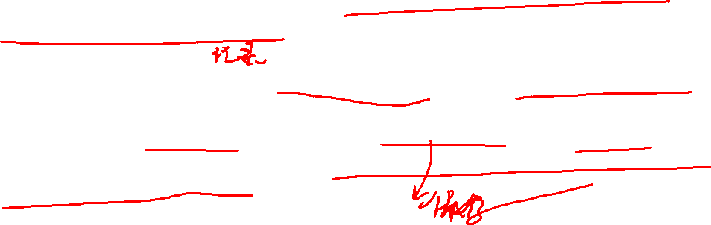
1、名词法定义概念类：废品回收机
用例 Use case：The Recycling machine 废品回收机
The system controls a recycling machine for returnable bottles, cans and crates(板条箱). The machine can be used by several customers at the same time and each customer can return all three types of item on the same occasion. The system has to check, for each item, what type has been returned.
The system will register how many items each customer returns and when the customer asks for a receipt, the system will print out what was deposited , the value of the returned items and the total return sum that will be paid to the customer.
Notes:
crate
[kreit]
n.
板条箱, 柳条箱

Slide 33
1、名词法定义概念类：废品回收机
用例 Use case：The Recycling machine - The “return item”
The system controls a recycling machine for returnable bottles, cans and crates. The machine can be used by several customers at the same time and each customer can return all three types of item on the same occasion. The system has to check, for each item, what type has been returned.
The system will register how many items each customer returns and when the customer asks for a receipt, the system will print out what was deposited , the value of the returned items and the total return sum that will be paid to the customer.

Slide 34
1、名词法定义概念类：废品回收机
recycling machine
bottles, cans, and crates
machine
customers, customer
types of item, item, type, returned items
system
receipt
return sum

Slide 35
2.1 讨论 “recycling machine”
recycling machine
bottles, cans and crates
machine
customers, customer
types of item, item, type, returned items
system
receipt
return sum
This concept is the “overall system”. As we consider only one single use case, it is better to name this concept in the context of this use case, e.g.
  Deposit item receiver

Slide 36
2.2 讨论“bottles, cans, and crates”
deposit item receiver
bottles, cans, and crates
machine
customers, customer
types of item, item, type returned items
system
receipt
return sum
In a conceptual model it is usually better to use singular and multiplicities instead of plural.
As bottle, can and crate have much in common (they are processed as items), they could be generalised to an “item”.
We should remember this for later (inheritance).

Slide 37
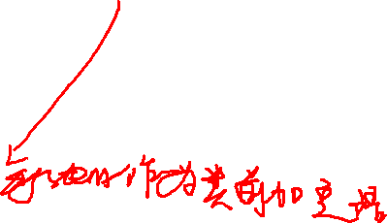

2.3 讨论 “machine” and “system”
deposit item receiver
bottle, can, crate
machine
customers, customer
types of item, item, type, returned items
system
receipt
return sum
“Machine” and “System” mean here the same, namely the “Recycling machine”, i.e. the
  Deposit item receiver

Slide 38
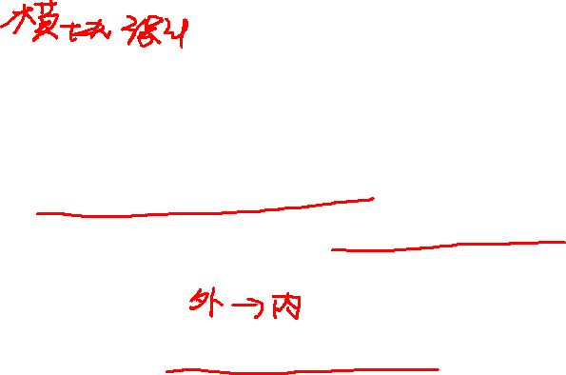
2.4 讨论 “customers” and “customer”
deposit item receiver
bottle, can, crate
customers, customer
types of item, item, type, returned items
receipt
return sum
The customer has already been identified as an actor.
They are outside of the system.
We establish a concept, that interfaces with the customer (and is inside the system):
  Customer panel
  (Note: this is a fabled（虚构的）idea)

Slide 39
2.5 讨论 “item” (etc.)
deposit item receiver
bottle, can, crate
customer panel
types of item, item, type, returned items
receipt
return sum
The items that are inserted in the machine.
Good candidate as superclass for bottle, can, crate.
Let’s call it
  Deposit item, ( instead of ‘item’)

Slide 40
2.6 讨论 “receipt”
deposit item receiver
bottle, can, crate
customer panel
deposit item
receipt
return sum
The concept that “remembers” all items inserted in the machine.
To distinguish it from the piece of paper returned to the customer, call it
  Receipt basis

Slide 41
2.7 讨论 “return sum”
deposit item receiver
bottle, can, crate
customer panel
deposit item
receipt basis
return sum能够推导
出的概念不是概念类
The sum that it is returned to the customer is actually computed by adding up all values of the items stored in the receipt basis.
The sum itself is only a primitive data value, and may therefore not be considered as a concept.

Slide 42
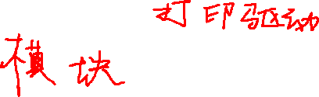
2.8 讨论 其他概念
deposit item receiver
bottle, can, crate
customer panel
deposit item
receipt basis
These are the concepts identified by nouns. Did we forget something?
Check the “Concept Category List” !
The system “interfaces” with the physical object “printer”, so we add an interface concept
  Receipt printer

Slide 43
2.9 最终找到的概念类
deposit item receiver
bottle, can, crate
customer panel
deposit item
receipt basis
receipt printer
So far we have identified:
  Concepts
  A generalisation relationship.
Next step: Finding associations.

Slide 44
3 构建概念模型 conceptual model.
Find the concepts
Draw them in a conceptual model
Add associations
Add attributes

Slide 45
3.1 画出概念 Drawing of Concepts
Customer panel
Deposit item receiver
Receipt basis
Deposit item
Receipt printer
Can
Bottle
Crate

Slide 46
3.2 添加关系 Adding Associations
If one concept needs to know of another concept for some duration, they should be linked by an association.
    Add “Adornment” to association 增加关联关系的一些修饰
Also use the following list in order to identify associations.
A is a part of B
A is contained in B
A is a description for B
A is a line item of B
A is known or reported in B
A is a member of B
A is a organisational subunit of B
A uses or manages B
A communicates with B
A is related to a transaction B
A is a transaction related to another transaction B
A is next to B
A is owned by B

Slide 47

3.2 添加关系 Adding Associations
The Customer panel communicates to the receiver when an item is inserted.
Also when the receipt is requested.
Customer panel
initiates action
Deposit item receiver
Deposit item
Receipt printer
Receipt basis
Can
Bottle
Crate

Slide 48
3.2 添加关系 Adding Associations
The Deposit item receiver manages Deposit items:
  The items are classified.
Customer panel
initiates action
Deposit item receiver
classifies
Deposit item
Receipt basis
Receipt printer
Can
Bottle
Crate

Slide 49
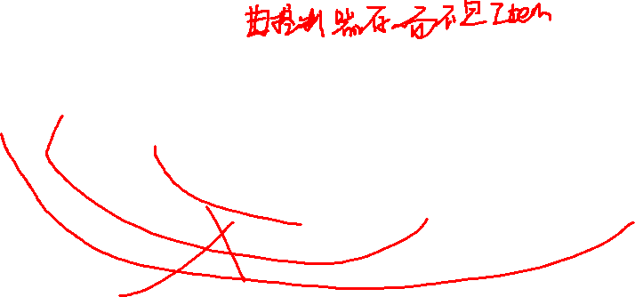
3.2 添加关系 Adding Associations
The Deposit item receiver communicates to Receipt basis:
Items received and classified are stored.
It also creates the receipt basis when it is needed for the first time.
Customer panel
initiates action
Deposit item receiver
creates & notifies
classifies
Deposit item
Receipt basis
Receipt printer
Can
Bottle
Crate

Slide 50
3.2 添加关系 Adding Associations
The Receipt basis collects Deposit items.
Customer panel
initiates action
Deposit item receiver
creates & notifies
classifies
captures
Deposit item
Receipt basis
Receipt printer
Can
Bottle
Crate

Slide 51
3.2 添加关系 Adding Associations
On request by the Customer Panel, the Deposit item receiver initiates printing of a receipt on the printer.
Customer panel
initiates action
Deposit item receiver
creates & notifies
classifies
captures
Deposit item
prints on
Receipt basis
Receipt printer
Can
Bottle
Crate

Slide 52
3.2 添加关系 Adding Associations
Adding multiplicities（多重性）
Only one association here is a 1 to many relationship
All others are 1 to 1.
Customer panel
initiates action
Deposit item receiver
creates & notifies
classifies
captures
Deposit item
prints on
1..*
Receipt basis
Receipt printer
Can
Bottle
Crate

Slide 53
3.3 添加属性 Adding Attributes
An attribute is a logical data value of an object.
Attributes in a conceptual model are simple data values as
  Boolean, Date, Number, String (Text), Time, Address, Colour, Price, Phone Numbers, Product Codes, etc.
Sometimes it is difficult to distinguish between attributed and concepts 有时比较难以区分一个概念，究竟是作为概念类还是作为其他概念的属性
  比如，员工 && 地址？

Slide 54
3.3 添加属性 Adding Attributes
The Deposit item has a value.
Also it will be assigned a number that shows later on the receipt.
Customer panel
initiates action
Deposit item receiver
creates & notifies
classifies
captures
Deposit item
number
value
prints on
1..*
Receipt basis
Receipt printer
Can
Bottle
Crate

Slide 55
3.3 添加属性 Adding Attributes
In order to be classified by the Deposit item receiver each item has also a weight and a size.
However this is the same for each type of item, but different between the types.
Customer panel
initiates action
Deposit item receiver
creates & notifies
classifies
captures
Deposit item
number
value
prints on
1..*
Receipt basis
Receipt printer
Can
weight
size
Bottle
weight
size
Crate
weight
size

Slide 56

4 废品回收机的概念模型
我们得到了最后的结果
NOT in a conceptual model:
  methods, operations, functions
Customer panel
initiates action
Deposit item receiver
creates & notifies
classifies
captures
Deposit item
number
value
prints on
1..*
Receipt basis
Receipt printer
Can
weight
size
Bottle
weight
size
Crate
weight
size

Slide 57
4、面向对象分析方法（二）分析模型法
  通过“废品回收机”案例
    理解边界类、实体类、控制类
    帮助同学们掌握利用分析模型法，构建概念模型

Slide 58
复习：面向对象分析的三种方法
1）Conceptual model (Larman)概念模型,又称“名词法”
  Produce a “light” class diagram
2）Analysis model with stereotypes (Jacobson)分析模型
  Boundaries, entities, control
3）CRC cards (Beck, Cunningham) CRC法,类/职责/协作
  Index cards and role playing
A good analyst knows more than one strategy and even may mix strategies in order to identify the objects and relationships for the design phase. 一个好的分析师掌握多种技术，知道如何混合使用各种技术，目标只有一个：发现对象、定义对象之间的关系。

Slide 59
4.1 分析模型定义
分析模型法 Analysis model with stereotypes
  是由Jacobson提出的
  用于描述系统规格说明
  一个健壮、稳定的模型，必须与实现环境无关
  实现环境的任何变化，不会影响到系统的逻辑结构
  分析模型能够关注到系统的信息、行为、展示（输入/出）等特性

Slide 60
4.2 特性：Behaviour - Information - Presentation
The model is defined in information - behaviour - presentation space.
behaviour
information
presentation

Slide 61
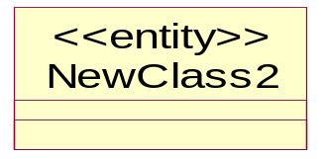

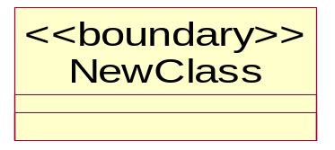
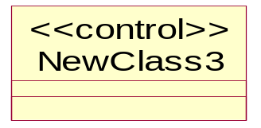
4.3 分析模型的表示符号
On information – behaviour plane and incline to information axis
Entity
Boundary / Interface
On the presentation axis
On information – behaviour plane but incline towards behaviour axis
Control

Slide 62
4.3 分析模型的表示符号
behaviour
information
presentation

Slide 63
4.4 分析模型的语义
An entity object models information that shows the state of a system. This information is often used to record the effects of operations and therefore is related to the behaviours of the system.
A boundary/interface object models inputs and outputs and operations that process them.
A control object models functionality/operations regarding to validate and decide whether to process and pass information from the interface object to the entity object or the way around.

Slide 64
4.4 分析模型的使用
Identifying interface objects
  functions directly related to actors
Identifying entity objects
  information used in an use case and functions of processing the information
Identifying control objects
  functions that link interface objects and entity objects

Slide 65
4.5 分析模型案例：废品回收机
Identifying interface objects
  Printer, Customer Panel
Identifying entity objects
  Long term information: Crate, Bottle, Can
  Superclass: Deposit item
  Short term information: Receipt basis
Identifying control objects
  Deposit item receiver

Slide 66
4.6 废品回收机：接口对象（边界类）
Customer panel
Receipt printer

Slide 67
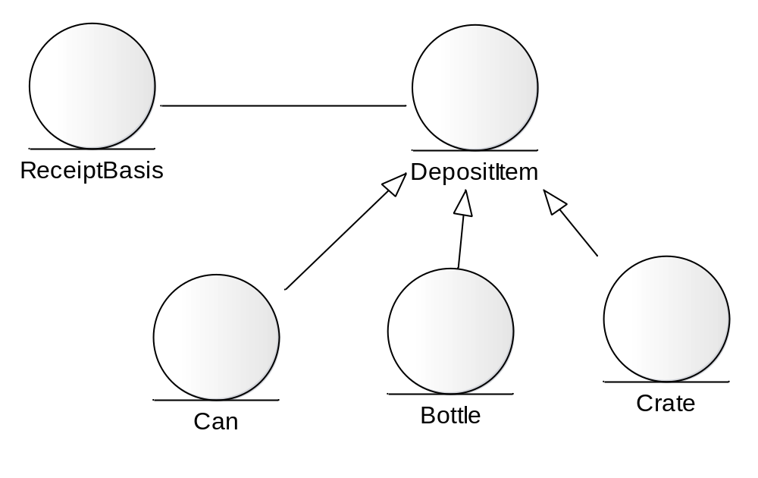
4.7 废品回收机：实体对象

Slide 68
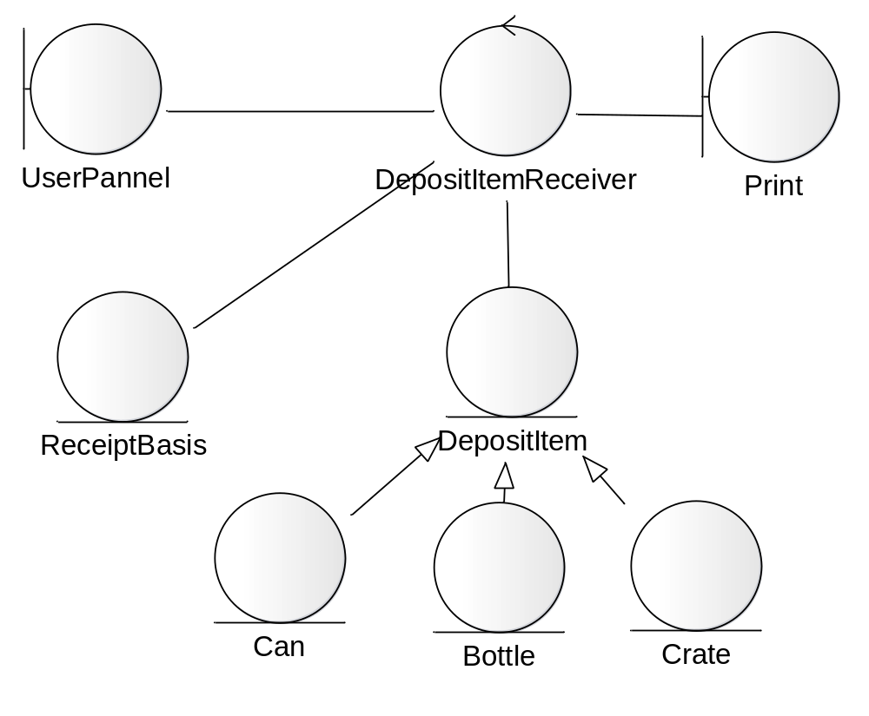
4.8 废品回收机：控制对象

Slide 69
分析模型小结
The main task is identifying the objects
Also: Relationships between objects
Three strategies:
  Conceptual Model (concepts as objects)
  CRC cards (index cards as objects)
  Analysis Model (Stereotypes as objects)
Next step: Design --- →
  “小试”设计
  体会一下分析、设计的全过程

Slide 70
5、面向对象设计（初步）
  Object-Oriented Design
  通过“废品回收机”案例的设计
    帮助同学们理解 在概念模型的基础上进行设计

Slide 71
5.1 一般原则
An object-oriented system is composed of objects sending messages to other objects
The quality of the overall design depends on which object is doing what
  比喻：“人尽其责、各有所长”
That is, the quality depends on how we assign responsibilities to the objects
Problem:
  Define “good quality”？
Notes:
我们的社会现在做到了吗？

Slide 72
5.2 职责驱动的设计 (RDD)
RDD，Responsibility Driven Design
  Pioneered by Wirfs-Brock in early 90s
  Think of objects in terms of what they do or know (the human worker metaphor!) 设计时考虑对象做什么、或者知道什么
  An object’s obligation or contract that it offers to other objects 一个对象对其他对象承担的义务或者合约
  A responsibility is really a behavior the other classes depend on 职责是一个对象的行为，而其他的对象依赖这种行为
同学们想一想
  老师与同学 ？

Slide 73
5.3 职责的定义 Responsibilities
这里定义为两类Knowing、Doing
认知职责 Knowing
  about private encapsulated data
  about related objects
  about things it can derive or calculate
行为职责 Doing
  doing something itself
  initiating action in other objects
  controlling and coordinating activities in other objects
Notes:
Textbook, section 17.3

Slide 74
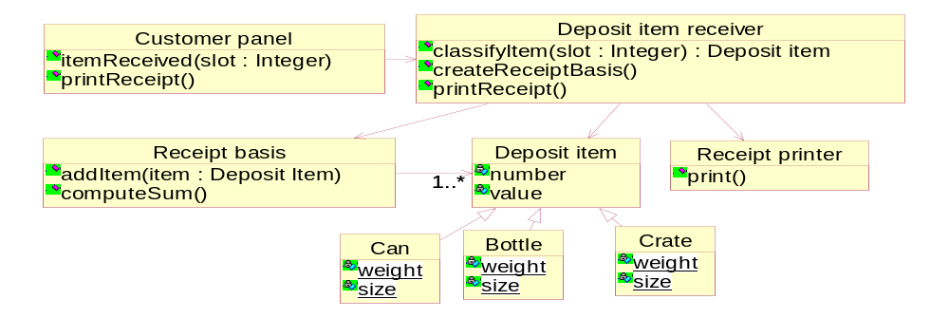
5.4 废品回收机 – Knowing and Doing

Slide 75
5.4 废品回收机
Deposit item knows about private data as number and value
Knowing
  about private encapsulated data
  about related objects
  about things it can derive or calculate

Slide 76
5.4 废品回收机
Customer panel knows about the Deposit item receiver where it sends it messages to.
Knowing
  about private encapsulated data
  about related objects
  about things it can derive or calculate

Slide 77
5.4 废品回收机
Receipt basis knows all the items which have been inserted into the recycling machine and is therefore able to compute the sum of their values.
Knowing
  about private encapsulated data
  about related objects
  about things it can derive or calculate

Slide 78
5.4 废品回收机
The Receipt printer does print receipts.
Doing
  doing something itself
  initiating action in other objects
  controlling and coordinating activities in other objects

Slide 79
5.4 废品回收机
The Customer panel initiates the classification and receipt printing action in the Deposit item receiver.
Doing
  doing something itself
  initiating action in other objects
  controlling and coordinating activities in other objects

Slide 80
5.4 废品回收机
The Deposit item receiver controls the overall system behavior by assigning tasks to other objects (Receipt basis, Receipt printer).
Doing
  doing something itself
  initiating action in other objects
  controlling and coordinating activities in other objects

Slide 81
5.5 Good design vs bad design
关于“废品回收机” ，考虑下列另外一种设计方案：
  定义一个类，负责打印、保存啤酒瓶和柳条箱的数据
  定一个类Can, 它同时也负责顾客的输入、计算总金额
  再定义一个类，负责完成所有剩余的工作
这是一个好的设计吗？

Slide 82
5.5 Good design vs bad design
感觉告诉我们，前一页的设计方案，不是一个“好”的设计方案 Our feeling says that the previous example is not a good design
有没有可能为这种“感觉”给出一个更具体的、更客观的、更加可追溯的，并且更加可理解的基础？Is it possible to give this "feeling" a more solid, more objective, more traceable, and more comprehensible foundation?
Answer:
  Yes, by using patterns. 有，答案就是通过“模式”！
  同学们想想，为什么？

Slide 83
5.6 练习： 领域模型
需要构建一个软件仿真的家庭用水系统。该供水系统的各种部件，如水管、Faucet object（水龙头），可以打开水流/关闭水流/分流、设定流速，返回给定时间段的用水量等等。
供水系统还链接一些常用的电器设备：洗衣机、热水器、淋浴器等。

Slide 84
5.7 练习：以POS 机买单的用例来建领域模型
【用例名称】处理销售
【场景】Who：顾客、收银员 ；Where：商店的收银台 ；When：营业时间
【用例描述】
1. 顾客携带选择好的商品到收银台（这一步没有异常）
2. 收银员逐一扫描商品条形码，系统根据条形码查询商品信息
  2.1 扫描仪坏了，必须支持手工输入条形码
  2.2 商品的条形码无法扫描，必须支持手工输入条形码
  2.3 条形码能够扫描，但查询不到信息，需要收银员和顾客沟通，放弃购买此产品
3. 扫描完毕，系统显示商品总额，收银员告诉顾客商品总额（这一步没有异常）
4. 顾客将钱交给收银员
  4.1 顾客的钱不够，顾客和收银员沟通，删除某商品
  4.2 顾客的钱不够，顾客和收银员沟通，删除某类商品中的一个或几个（例如买了5包烟，去掉两包）
  4.3 顾客觉得某个商品价格太高，要求删除某商品
5. 收银员清点钱数，输入收到的款额，系统给出找零的数目（这一步没有异常）
6. 收银员将找零的钱还给顾客，并打印小票
7. 买单完成，顾客携带商品和小票离开

Slide 85
5.7 练习：以POS 机买单的用例来建领域模型
【用例价值】顾客买完单以后，就可以携带商品离开，而超市也将得到收入
【约束和限制】
9. POS 机必须符合国标XXX
10. 键盘和屏幕使用中文，因为收银员都是中国人
11. 一次买单数额不能超过99999RMB
12. POS 机要非常稳定，至少一天内不要出现故障
【异常出理】
4-A：顾客使用信用卡支付
4-A.1 信用卡支付流程（请读者自行思考完善，可以写在这里，如果太多，也可以另外写一个子用例）
4-B：顾客使用购物卡支付
4-B.1 购物卡支付流程
4-C：顾客使用会员卡积分支付
4-C.1 会员卡积分支付流程

Slide 86
5.7 练习：以POS 机买单的用例来建领域模型
名词列表：
顾客、收银员、收银台、商品、条形码、扫描仪、钱、5 包烟、信用卡、会员卡、小票、买单、键盘、屏幕、中文、中国人
提炼后，得到了真正的 POS 机领域类：
顾客、收银员、商品、扫描仪、钱、信用卡、会员卡、小票、买单、键盘、屏幕

Slide 87
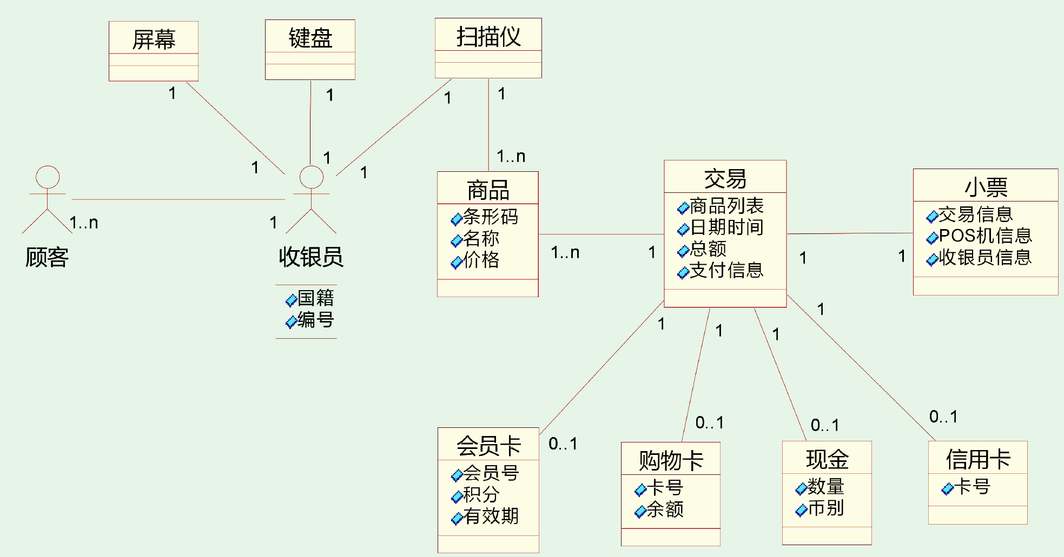
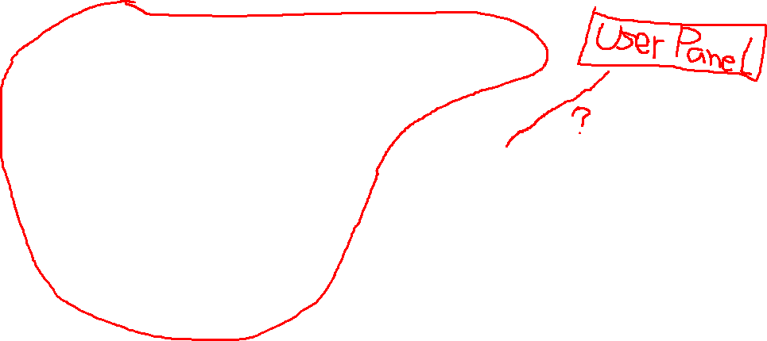
5.7 练习：以POS 机买单的用例来建领域模型

Slide 88
作业：
设计领域模型有哪些难点？
需要开发一个“人民币的零钱交换机系统：接受5元、10元、20纸币，输出1元硬币”，请给出领域模型图，要有分析过程

Slide 89
结束

