Slide 1
Object orient Analysis &Design
面向对象分析与设计师
Identifying Classes and Objects
主讲: 姜宁康 博士
日期: 26/11/8

Slide 2
故事共勉：季子挂剑
季子，名叫“札”，为春秋时代吴国国君寿梦的小儿子。封于延陵，称延陵季子
刘向记载：
  “延陵季子将西聘晋，带宝剑，以过徐君。徐君观剑不言而色欲之，延陵季子为有上国之使，未献也，然其心许之矣。致使于晋故，反则徐君死于楚，于是脱剑致之嗣君。从者止之曰：‘此吴之宝也，非所以赠也。’延陵季子曰：‘吾非赠之也。先日吾来，徐君观吾剑不言而其色欲之，吾为有上国之使，未献也然，吾心许之矣。今死而不进，是欺心也。爱剑伤心，廉者不为也。’遂脱剑致之嗣君，嗣君曰：‘先君无命，孤不敢受剑。’于是季子又以剑带徐君墓树而去。”
为人真诚、不欺！
OOAD Lecture, Author: NK Jiang
<number>/53
Notes:
季子，名札，为春秋时代吴国的公子，吴王寿梦的第四子。季子挂剑的故事，发生在公元前544年春天。
札奉命出使晋国，途经睢suī地（当时睢宁地属古徐国）时，因平时听闻徐君仁义，前去拜访。当他看到徐国人民安居乐业，五谷丰茂，心中不禁暗暗称赞：“徐君素以仁义著闻，果然名不虚传，今得见矣。”于是拜见徐君，倾吐仰慕之情。徐君得知素有贤名的季札来访，十分高兴，盛情款待。
徐君一见到季札，就被他的气质涵养所打动，感到非常的亲切。徐君默视着季札端庄得体的仪容与着装，突然，被他腰间的一把祥光闪动的佩剑深深地吸引住了。在古时候，剑是一种装饰，也代表着一种礼仪。无论是士臣还是将相，身上通常都会佩戴着一把宝剑。季札的这柄剑铸造得很有气魄，几颗宝石镶嵌其中，典丽而又不失庄重（吴越的剑，名牌产品，很难得到、人人羡慕）。只有像季札这般气质的人，才能配得上这把剑。徐君虽然心里喜欢，却不好意思表达出来，只是不住地朝它观望。徐君不便明言，季札虽心知其意，无奈出使诸国，宝剑是身份的象征之一，不能相赠。（身上连把佩剑都没有，有失体统！）季札内心暗想道：等我办完事情之后，一定要回来将这把佩剑送给徐君。
（那个时候很多国家为了一把吴越剑，可以战争相向，是国宝啊）
怎料世事无常，等到季札出使返回，又经过徐国时，徐君却已经过世了。他站在徐君墓前，内心有说不出的悲戚与感伤。他望着苍凉的天空，把那把长长的剑，挂在了树上，心中默默地祷念着：您虽然已经走了，我内心那曾有的许诺却常在。希望您的在天之灵，在向着这棵树遥遥而望之时，还会记得我佩着这把长长的剑向你道别的那个时候。他默默地对着墓碑躬身而拜，然后返身离去。
季札的随从非常疑惑地问他：“徐君已经过世了，您将这把剑悬在这里，又有什么用呢？”季札说：“虽然他已经走了，但我的内心对他曾经有过承诺。徐君非常喜欢这把剑，我心中早就把宝剑送给他了。君子讲求的是诚信与道义，怎么能够因为他的过世，而背弃为人应有的信与义呢？”后人为纪念此事，曾经在季札挂剑处（距睢宁西北50里的故黄河岸上）修建过“季子挂剑台”。
季札挂剑行为获得了徐国人的赞赏，遂作《徐人歌》唱道：“延陵季子兮不忘故，脱千金之剑兮带丘墓。”然而最让人感怀的，还是他的挂剑酬友。明代诗人杨于臣有《咏睢宁》诗曰：“季札报徐君，冢树挂剑锋。至今泗水南，高台遗芳踪。”清代状元李蟠有诗为证：“斯事何关物有神，交情赖此尚留真。三朝仍自称公子，一剑安能负故人。国乱先机脱匕首，君仇遗恨失延津。匣中亦有吴钩在，酹酒西风看几巡。”足以佐证季札挂剑故事的文化影响久远，广为流传。
古人待人真诚，不欺！

Slide 3
复习
良好的对象设计意味着什么？
  是构建高质量软件系统的基本要求，如
  Architectural cohesion 架构性的内聚
  Reusability 可重用性
  Maintenance 可维护性
  Scalability 可扩展性
  Flexibility 灵活性
分析、设计
OOA、OOD
LRG 低表示差异 Low Representation Gap
OOAD Lecture, Author: NK Jiang
<number>/53

Slide 4
Review
Three ways to do Object Oriented Analysis
Conceptual model (Larman)
  Produce a “light” class diagram.
Analysis model with stereotypes (Jacobson)
  Boundaries, entities, control.
CRC cards (Beck, Cunningham)
  Text ch 14.6
  Index cards and role playing.
A good Analyst knows more than one strategy and even may mix strategies in order to identify the objects and relationships for the design phase.
OOAD Lecture, Author: NK Jiang
<number>/53

Slide 5
Identifying Classes and Objects
Example：A partial requirements document:
The user must be allowed to specify each product by
its primary characteristics, including its name and
product number. If the bar code does not match the
product, then an error should be generated to the
message window and entered into the error log. The
summary report of all transactions must be structured
as specified in section 7.A.
Of course, not all nouns will correspond to
a class or object in the final solution
OOAD Lecture, Author: NK Jiang
<number>/53

Slide 6
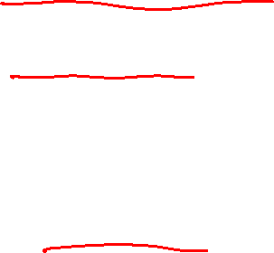
Identifying Classes and Objects（cnt.）
Remember that a class represents a group (classification) of objects with the same behaviors
Generally, classes that represent objects should be given names that are singular nouns
  Examples: Coin, Student, Message
  A class represents the concept of one such object
We are free to instantiate as many of each object as needed
Good selection of object names for the instances can be helpful to understanding
  For example,
  Customer ? Or User : depends on situation
OOAD Lecture, Author: NK Jiang
<number>/53

Slide 7
Identifying Classes and Objects（cnt.）
Sometimes it is challenging to decide whether something should be represented as a class
  For example, should an employee's address be represented as a set of instance variables or as an Address object
General way to do:
  The more you examine the problem and its details， the more clear these issues become
OOAD Lecture, Author: NK Jiang
<number>/53

Slide 8
Identifying Classes and Objects（cnt.）
We want to define classes with the proper amount of detail
  When a class becomes too complex, it often should be decomposed into multiple smaller classes to distribute the responsibilities
  But , not too many classes
For example,
  it may be unnecessary to create separate classes for each type of appliance in a house
  It may be suFficient to define a more general Appliance class with appropriate instance data
It all depends on the details of the problem being solved
OOAD Lecture, Author: NK Jiang
<number>/53

Slide 9



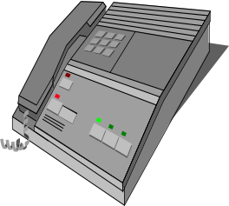


Identifying Classes and Objects（cnt.）
How many classes do you find?
  animal and digital devices 动物 和电子设备
  Indoor and outdoor things室内事物 和 室外事物
  moving and static things 移动事物 和 静止事物
  If only one class?如果只有一个类？
  图标（Icon)
  endangered things 濒危事物
In general, class design depends on application domain 总之，类的选择依赖于应用领域
OOAD Lecture, Author: NK Jiang
<number>/53
Notes:
The purpose of this chart is to motivate the need for classes.
An obvious answer is two: animals and electronic equipment.
Many other names for these classes are possible and that’s
fine. Another possible answer is things found in the house and
things found outside the house. Or things that move and things
that don’t move. Challenge the students to find a single class that
includes all the objects. Suppose you are the maker of this chart?
How many classes do you see? The answer is one: icons.
Another student said that the chart showed “things that were becoming extinct” since it included: a bald eagle, an Indian elephant, a rotary phone, a black and white TV, a mako灰鲭鲨shark and a beta camcorder !! This is good for a laugh.
Bottom line: The classes chosen depend on the application domain.

Slide 10
Identifying Classes and Objects（cnt.）
Part of identifying the classes
  is the process of assigning responsibilities to each class
  need not described in Domain Model, but in design model
Every activity that a system must accomplish must be represented by one or more methods in one or more classes
  We generally use verbs for the names of methods
  In early stages it is not necessary to determine every method of every class
  – begin with primary responsibilities and evolve the design
OOAD Lecture, Author: NK Jiang
<number>/53

Slide 11

CRC
One way to find class and assign its responsibilities
  (“Responsibility-Driven Design”)
From Domain Classes and Use Cases to
Design Classes
OOAD Lecture, Author: NK Jiang
<number>/53

Slide 12

CRC
Stands for:
  Classes (of objects) 新定义的类
  Responsibilities (of the objects in each class) 新定义类的职责
  Collaborations (with objects in other classes) 新定义类的协作者
    In UML, these will be examples of “associations”
OOAD Lecture, Author: NK Jiang
<number>/53
Notes:
Remember that an application may have “singleton” classes (classes instantiated only once).

Slide 13
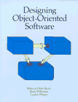

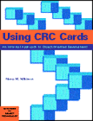
Origin of CRC
Contributors:
  Kent Beck and Ward Cunningham, formerly of Tektronix in Oregon
    also founders of the ideas of XP and design patterns
  Rebecca Wirfs-Brock popularized with “Responsibility-Driven Design” (RDD)
  References
    Rebecca Wirfs-Brock, Brian Wilkerson, Lauren Wiener, Designing Object-Oriented Software, Prentice-Hall, 1990.
    David Bellin and Susan Simone, The CRC Card Book, Addison Wesley Longman, 1997.
OOAD Lecture, Author: NK Jiang
<number>/53

Slide 14
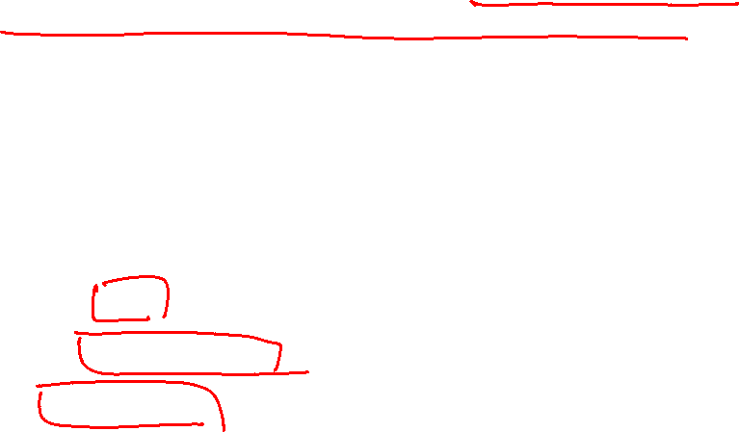
The Basic Idea
CRC cards are paper index cards on which one writes the responsibilities and collaborators of classes.
Each card represents one class.
A CRC modeling session involves
  a group sitting around a table, discussing and writing on the cards as they play "what if" scenarios with the objects,
  considering what they must do and what other objects they must collaborate with
A card contains:
  The name of the class.
  The responsibilities of the class.
  Collaborations: other classes with which this class inter-operates, in conjunction with the attendant responsibility.
OOAD Lecture, Author: NK Jiang
<number>/53

Slide 15
CRC Cards Technique
CRC properties
  Informal, non-detailed
  Used for group brain-storming
  End result is a first cut at classes for an object-oriented model,
  Not intended to provide a complete design
OOAD Lecture, Author: NK Jiang
<number>/53

Slide 16

CRC Input : Use-Case
A good starting point for CRC analysis is a clear statement of all of the use-cases.
Use-cases drive the introduction of CRC cards.
Use-cases, or their accompanying scenarios, can be used as a kind of script for the role-playing method (角色扮演)of checking the CRC cards.
  The role-playing could be replaced with sequence diagrams.
OOAD Lecture, Author: NK Jiang
<number>/53

Slide 17
Sample Application:
A graph-drawing program
Process screen image
Typical Application
Use-Cases:
  Draw shape
  Move shape
  Resize shape
  Connect shapes
  Erase shape
  Erase connector
OOAD Lecture, Author: NK Jiang
<number>/53

Slide 18
Example of CRC card for a graph-drawing program (1)
Class
Shape
OOAD Lecture, Author: NK Jiang
<number>/53

Slide 19
Example of CRC card for a graph-drawing program (2)
Shape
Remember size
Remember position
Remember fill color
Remember border
Remember connectors
Change size
Change position
Responsibilities
OOAD Lecture, Author: NK Jiang
<number>/53

Slide 20
Example of CRC card for a graph-drawing program (3)
Shape
Remember size
Remember position
Remember fill color
Remember border
Remember connectors
Change size
Change position
Line
Collaborations
Connector
OOAD Lecture, Author: NK Jiang
<number>/53

Slide 21
Example of CRC card for a graph-drawing program (4)
Shape
super class: Drawable
sub-classes: Rect, Oval, Group
Super- and
Sub-classes
Remember size
Remember position
Remember fill color
Remember border
Remember connectors
Change size
Change position
Line
Connector
OOAD Lecture, Author: NK Jiang
<number>/53
Notes:
Canvas : Drawable

Slide 22
Example of CRC card for a graph-drawing program (5)
Drawable
super class:
sub-classes: Shape
Responsibilities
Draw self on canvas
Canvas
Collaborations
Note: The Drawable doesn’t necessarily need to remember a Canvas,
since the Canvas could be passed as an argument to the draw method.
OOAD Lecture, Author: NK Jiang
<number>/53

Slide 23
Example of CRC card for a graph-drawing program (6)
Canvas
super class:
sub-classes:
Remember Drawables contained in self.
Responsibilities
Drawable
Collaborations
OOAD Lecture, Author: NK Jiang
<number>/53

Slide 24
Example: Recycling machine
CRC cards
Customer panel
receive items
receive print request
Deposit item receiver
Dep. item receiver
Printer
Deposit Item
Receipt Basis
classify items
create Receipt Basis
print receipt
Etc.
OOAD Lecture, Author: NK Jiang
<number>/53

Slide 25
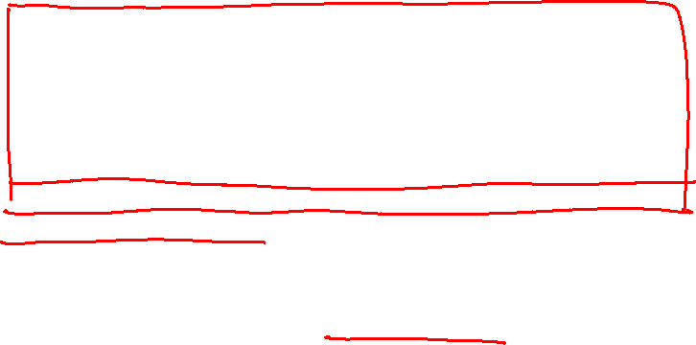
CRC guide
Who Writes CRC Cards?
  No one individual has all needed knowledge
  Best to write CRC cards as a team, rather than individually
  Analysis team should consist of five or six experienced individuals :
    one or two user domain experts
    one or two systems analysts
    one OO software designer
    one team facilitator and leader
    The team can include clients as well as developers (even though we are partly in the design phase)
  Smaller teams lack diversity, larger teams make consensus difficult to achieve
  Facilitator should be skilled at OO and group techniques, not be a "boss" of team
  Writing of CRC cards focuses team activities
OOAD Lecture, Author: NK Jiang
<number>/53

Slide 26

CRC guide
Brainstorming
  Groups work by
    collecting a diverse set of ideas,
    comparing the ideas, and
    synthesizing unanticipated solutions （合成意料之外的解决方案）
  A "brainstorming" session is a good way to collect the ideas quickly and creatively.
  Brainstorming principles [Bellin and Simone]:
    All ideas are potentially good ideas.
      Don't censure(责难) yourself or others -- all ideas are equal
    Think fast and furiously; ponder(沉思)later.
      A fast-paced discussion encourages individual creativity
    Give every voice a turn.
      Include everyone in the group. Don't let the loudmouths dominate.
    A little humor can be a powerful force.
      Humor can help break down barriers, relieve tension, and build trust needed for a cohesive and effective group
OOAD Lecture, Author: NK Jiang
<number>/53
Notes:
censure [简明英汉词典]
[5senFE]
v.责难
n.责难
ponder [简明英汉词典]
[5pCndE]
v.沉思, 考虑
ponder [简明英汉词典]
[5pCndE]
v.沉思, 考虑

Slide 27
CRC guide
Sources for the Candidate Classes
  Before the brainstorming session, assign each team member an investigative task [Bellin and Simone]:
  Read all requirements documents
    Examine the formal requirements document (if any)
    Don't overlook the indirect sources -- memos, meeting minutes, etc.
    Circle nouns and noun phrases -- these are potential classes
  Look carefully at reports
    Examine the reports generated in the system being replaced (manual or automated)
    Examine the profiles for the reports desired in the new system
    Again circle nouns and noun phrases -- these are potential classes
  Conduct interviews
    Talk to experienced users of the current system
    Record interview or take careful, precise notes
    Again identify nouns and noun phrases as candidate classes
  Examine documentation and files
    Review the documentation on the current system
    Try to review any unofficial or personal notes users or maintainers of the system have
    Again identify nouns and noun phrases as candidate classes
  A good analyst is a good detective!
OOAD Lecture, Author: NK Jiang
<number>/53

Slide 28
Once the CRC cards are constructed …
Team can engage in role-playing to verify that use-case scenarios make sense for chosen CRC.
Each person can role-play one or more class cards.
If something doesn’t work, change the class accordingly.
Revision of use-cases might also be indicated.
OOAD Lecture, Author: NK Jiang
<number>/53
Notes:
类似小孩玩‘过家家’

Slide 29
Example:
Using CRC Cards: ATM Case Study
These notes discuss principles and techniques for design using CRC cards using a bank's Automated Teller Machine (ATM) as its example.
OOAD Lecture, Author: NK Jiang
<number>/53

Slide 30
Requirements for an Automated Teller Machine (ATM)
University Bank will be opening in January, 2000. We plan to use a full service automated teller machine (ATM) system.
  The ATM system will interact with the customer through a display screen, numeric and special input keys, a bankcard reader, a deposit slot, and a receipt printer.
  Customers may make deposits, withdrawals, and balance inquires using the ATM machine, but the update to accounts will be handled through an interface to the Accounts system.
  Customers will be assigned a Personal Identification Number (PIN) and clearance(许可) level by the Security system. The PIN can be verified prior to any transaction.
  In the future, we would also like to support routine operations such as a change of address or phone number using the ATM
OOAD Lecture, Author: NK Jiang
<number>/53

Slide 31
Requirements for an Automated Teller Machine (ATM)
University Bank will be opening in January, 2000. We plan to use a full service automated teller machine (ATM) system.
  The ATM system will interact with the customer through a display screen, numeric and special input keys, a bankcard reader, a deposit slot, and a receipt printer.
  Customers may make deposits, withdrawals, and balance inquires using the ATM machine, but the update to accounts will be handled through an interface to the Accounts system.
  Customers will be assigned a Personal Identification Number (PIN) and clearance level by the Security system. The PIN can be verified prior to any transaction.
  In the future, we would also like to support routine operations such as a change of address or phone number using the ATM
OOAD Lecture, Author: NK Jiang
<number>/53

Slide 32
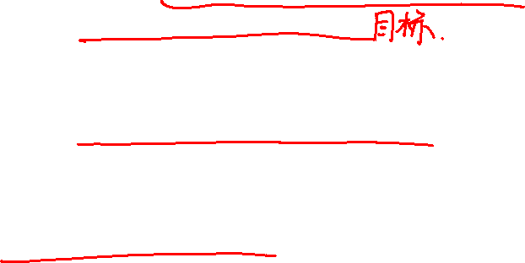
Brainstorming Steps
Review the brainstorming principles
State session objectives
  Each session should have a precise objective--clear to all and narrow enough to accomplish in the session.
  Avoid digression(离题)from the objective.
Use a round-robin technique
  Go around the group from individual to individual.
  Individuals may "pass" if they have nothing to contribute.
  Stop when no one has anything to contribute.
Discuss and select
  Restate the objective, then identify those items that everyone agrees are "winners"
  Then select those items that everyone disagrees are "losers"
  Then discuss the items remaining--the "maybes".
Set a fixed time limit on discussion. Then, for each item, either decide its status or postpone explicitly until more information is available.
OOAD Lecture, Author: NK Jiang
<number>/53
Notes:
digression [简明英汉词典]
[dai5^reFEn]
n.离题, 脱轨, 扯到枝节上

Slide 33
Candidate Classes for the ATM
By brainstorming, we might identify the following candidate classes for University Bank's ATM system
ATM FinancialTransaction BankCard
Bank Customer PIN Account
Savings Account Checking Account Transfer
Withdrawal Deposit Balance Inquiry
Receipt Receipt Printer Keypad
Screen Cash Dispenser ScreenMessage
Display Funds Available DepositEnvelopeFailure
Balance TimeOutKey TransactionLog
Key AccountHolder Printer
ScreenSaver Prompt NumericKey
OOAD Lecture, Author: NK Jiang
<number>/53

Slide 34
Identifying Core Classes
Moving from brainstorming to analysis, divide the candidate classes into categories in the following order:
critical classes (i.e., the "winners"), for which we will definitely write CRC cards Items that directly relate to the main entities of the application
  In the ATM example:
    Account, Deposit, Withdrawal, BalanceInquiry
irrelevant candidates (i.e., the "losers"), which we will definitely eliminate Items that are clearly outside the system scope
  In the ATM example:
  Printer, ScreenSave, and
  Prompt -- related to the user interface subsystem to be done later, but not to the core banking application
undecided candidates (i.e., the "maybes"), which we will review further for categorization
  Items that we may not be able to categorize without first clarifying the system boundaries and definition
  In the ATM example: What is an "ATM"?
OOAD Lecture, Author: NK Jiang
<number>/53

Slide 35
Clarifying System Scope
To continue design, we must determine：
  what is and what is not part of the system.
What is the scope of the ATM system in the example?
Possible questions:
  Does it handle everything--the banking application, the user interface, and the interactions between them?
  Is the ATM responsible for updating accounting records?
  or just recording and mediating the transaction activity?
It is often useful to draw a diagram to record system boundaries.
  ATM example:
    limit its scope to the banking information capture
      -- leaving the user interface and actual account update to other systems
OOAD Lecture, Author: NK Jiang
<number>/53

Slide 36
Eliminate Unnecessary Core Classes
Remove ghost classes
  -- classes that, upon further examination, do not fit within the application
  Look for classes that are related entities but are outside the system.
    We may need to interface to these entities, but do not need to model them within the system.
  ATM example:
    BankCustomer, Printer, and Keypad are relevant but outside the application being developed.
    For example, the system only needs to know about BankCustomer indirectly through the BankCard information such as the PIN.
OOAD Lecture, Author: NK Jiang
<number>/53

Slide 37
Eliminate Unnecessary Core Classes
ComBine Synonyms(同义)
  use only one name for items that are essentially the same
    This situation may arise when different groups within an organization use different names to refer to the same thing.
  ATM example:
    BankCustomer and AccountHolder are probably synonyms. Adopt one of them or create a new name.
Be careful when the same word actually refers to different things!
  New core classes may be needed
OOAD Lecture, Author: NK Jiang
<number>/53

Slide 38
Eliminate Unnecessary Core Classes
Distinguish attributes (data elements) from classes.
  Some candidate classes may turn out to represent information held by other objects instead of being classes themselves.
  A candidate class may be an attribute rather than a class if:
    it does not do anything -- it has no operations
      ATM example:
      Balance and FundsAvailable (mentioned above) have few meaningful operations and both are closely associated with Account.
    it cannot change state
      ATM example:
        Consider a PIN.
        If a PIN is viewed as being immutable(不变的), not changing state, then it probably should be an attribute of Account. However,
        if a PIN can change state--say from among valid, invalid, and suspended--then it should be a class.
OOAD Lecture, Author: NK Jiang
<number>/53
Notes:
immutable [简明英汉词典]
[i5mju:tEbl]
adj.不可变的, 不变的, 不能变的, 永恒的

Slide 39
Annotated Candidate Class List for the ATM
Undecided Classes
BankCustomer (ghost - integrated with
AuthorizeSystemInteraction)
PIN (attribute)
SavingsAccount (attribute of Account)
CheckingAccount (attribute of Account)
ATM (ghost -- system name)
FundsAvailable (attribute)
Balance (attribute)
AccountHolder (synonym
Core Classes
FinancialTransaction
Account
BalanceInquiry
Withdrawal
Deposit
AuthorizeSystemInteraction
BankCard
OOAD Lecture, Author: NK Jiang
<number>/53

Slide 40
Annotated Candidate Class List for the ATM
Irrelevant Items
Transfer (not handled in first version)
Receipt
ReceiptPrinter
Keypad
Screen
CashDispenser
ScreenMessage
Display
DepositEnvelopeFailure
TimeOutKey
TransactionLog
Printer
ScreenSaver
Prompt
Numeric Key
Key
These are outside the scope of the system. Many are candidates for classes in the user interface system.
OOAD Lecture, Author: NK Jiang
<number>/53

Slide 41
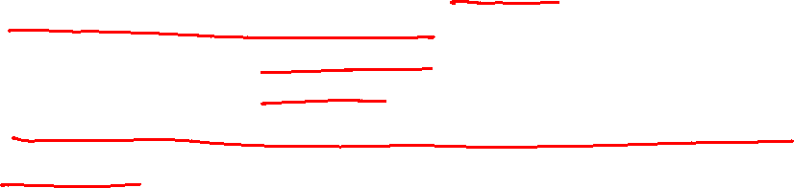
Assigning Responsibilities
After core classes identified, assign responsibilities to classes
  responsibilities for doing operation
  responsibilities for knowing
Write responsibilities on CRC cards for each core class
Task of finding collaborators for classes often intermixed with finding responsibilities
  Use a combination of brainstorming and role-playing of scenarios (see later) to discover responsibilities
Focus on the what, not the how.
  Grady Booch:
    "When considering the semantics of classes and objects, there is the tendency to explain how things work; the proper response is 'I don't care.'"
OOAD Lecture, Author: NK Jiang
<number>/53

Slide 42
Responsibility Detection Pointers
1, Brainstorm first. Refine later.
  Use brainstorming to identify a set of candidate responsibilities for the core classes. Strive for inclusion of relevant responsibilities rather than exclusion. Don't worry about duplication.
  Later refine the lists of responsibilities. Name each carefully.
2, Think simple. Factor out complexity.
  If most the responsibilities fall to one or two classes, then the system is probably biased toward a procedural perspective –
    does not take advantage of polymorphism and encapsulation.
    Many of the classes are reduced to "records" -- simply knowing about the information they hold.
OOAD Lecture, Author: NK Jiang
<number>/53

Slide 43
Responsibility Detection Pointers
ATM example: class Account
  A tendency might be to give most of the responsibility to the Account class, which becomes a strong, busy "manager" procedure giving commands to relatively weak, ill-defined "worker" classes.
    Account is probably too inflexible to be directly reused; the other classes are probably too insignificant to be reused.
Give each class a distinct role in the system. Strive to make each class a well-defined, complete, cohesive abstraction.
    Such a class has higher probability of being reused.
OOAD Lecture, Author: NK Jiang
<number>/53

Slide 44
Responsibility Detection Pointers
ATM example: class Withdrawal
  the responsibility "Withdraw Funds", making it potentially useful to any other class needing to do a withdrawal.
  class Account
    the responsibility "Accept Withdrawal",
      be carried out by collaborating with Withdrawal.
Factoring out complexity also involves identifying specialized behaviors that occurs repeatedly and, as appropriate, spinning off new classes.
    ATM example: The capturing and responding to user requests might be factored out into a new class
      Form
      with a responsibility "ask user for information".
OOAD Lecture, Author: NK Jiang
<number>/53

Slide 45
Responsibility Detection Pointers
3, Use abstraction
  Build hierarchies of classes. Abstract the essence of related classes by identifying
    where they have common responsibilities
    where they do the same thing, but do it differently
      -- same "what", different "how".
  That is, look for opportunities for the classes to use polymorphism to implement the same responsibility differently.
  The new parent classes may be abstract classes. The abstract class exists to link together similar concrete types of objects.
    ATM example:
    Create an abstract class Transaction that is a superclass for Withdrawal, Deposit, etc.
    It can have an abstract responsibility "execute a financial transaction", that is implemented differently for each subclass.
OOAD Lecture, Author: NK Jiang
<number>/53

Slide 46
Responsibility Detection Pointers
4, Do not marry one solution. Play the field first.
  Remember that CRC cards are inexpensive and erasable!!
  Do not hesitate to experiment with different configurations of classes or assignments of responsibilities.
  Changing the CRC cards is easy in the early stages of a project; changing the code later in the project is not easy.
OOAD Lecture, Author: NK Jiang
<number>/53

Slide 47
Assigning Collaborations
Identify relationships among classes
  Each class is specialist in some set of knowledge and behaviors
  Classes must cooperate to accomplish nontrivial tasks
  Thus collaborations between classes are important
Use scenario-based role-play to find and/or test these collaborations
  Scenario is a system behavior and sequence of system events to realize it
  Simulating execution enables team to discover responsibilities and collaborations and/or check correctness of those already found
OOAD Lecture, Author: NK Jiang
<number>/53

Slide 48
Assigning Collaborations
Add collaborations when relationships found
  Identify clients and servers
    Server -- class that provides a resource
    Client -- class that uses a resource
    Server is collaborator of client, not vice versa
  ATM example:
    In a withdrawal operation, Account is a client of the Withdrawal class
  Identify hierarchies of classes
    ATM example:
      Transaction as superclass of Withdrawal, Deposit, etc.
OOAD Lecture, Author: NK Jiang
<number>/53

Slide 49
Hierarchy Identification Tips
Explore is-a ("kind-of") relationships.
  ATM example: “Withdrawal” ~ “Transaction”
    Withdrawal is a (kind of) Transaction. Withdrawal is not "part of" Transaction.
Name key abstractions
Separate mixed classes where necessary
Place super/subclass sets in hierarchies
OOAD Lecture, Author: NK Jiang
<number>/53

Slide 50
Scenario eNactment (场景演示)
Identify and summarize scenarios to be enacted (session agenda) "must do" first, then "can do if"
Assign roles to actors
  distribute CRC cards
  collaborators to different persons
  use domain experts for classes if possible
  rotate assignments from session to session
Initiate scenario
  hold up first class
  ATM example: Start with Customer or BankCard
Watch the action to detect problems
When errors discovered
  correct if minor
  take notes if complex
  stop enactment immediately if significant and complex -- go to assessment
Avoid unnecessary changes
  Especially after considerable role play, avoid creating more problems
Do enactment-assessment on multiple scenarios per session
OOAD Lecture, Author: NK Jiang
<number>/53
Notes:
enactment [简明英汉词典]
[I5nAktm(E)nt]
n.设定, 制定

Slide 51
Scenario Assessment
"Go-around" comments
Identify problem points
Create problem-solving priority list
Change or confirm CRC cards
Identify scenarios that need to be repeated (if any)
OOAD Lecture, Author: NK Jiang
<number>/53

Slide 52
Summary：Steps for creating Model using CRC
总结: 用CRC创建模型需要下面的步骤
1) Build a team建立团队
  Including client, designer, analyst, and a leader. If there are not so many people, the team can consist of only you and your client.包括客户、设计人员、分析人员和一个导引者。如果没有那么多人，那么可以是客户和你自己两个人
2) Find out the nouns and phrases in the requirement, and pay attention that the singular number of plural numbers (usually a set) is the correct one. 找出需求中存在的名词和名词词组，特别注意复数（通常是集合），他们对应的单数才是。
  write down the concepts you first conceive on the paper, no matter how ridiculous they are. 把你第一次想到的所有概念都写在白板或纸上。不管看起来这些概念是如何荒谬，把他们都写下来。
3) Selection筛选。
  Classify objects into three groups, the core object (the first to be realized), optional (uncertainty right now), and the unnecessary object. Your project scope should be confirmed before hand. Some objects which are not belonging to this projects can be put aside. 把对象分为三类，核心对象（必须首先实现），可选的（目前不能确定），以及不需要的对象。这之前最好确定一下你的项目范围。某些不属于本项目范围的对象可以先放一边。
4) Fetching the card 建卡。
  Fetch the CRC card, and write core class down on each card, then write optional class and excluded class down on different papers. 取出CRC卡，把核心类写在每一张卡上，把可选的类和排除的类分别写在不同的纸上。
5) Role play 角色扮演。
  A team is better than a person alone to carry out the task. Everyone is in charge of several classes. For every scenario in use case.
  The leader assign a class to one person, and he will evaluate that if he can complete it independently, if not, everyone will look at their classes, and stand up if he could do it so as to continue this process.
  Anyone can sit down after fulfilling his responsibilities.
  In this process, responsibilities of class would be continuously modified and actor’s name would be written down.
OOAD Lecture, Author: NK Jiang
<number>/53
Notes:
最好是一个团队执行，一个人很难做。每个人负责几个类。对每一个Use case其中的情景。导引者指定从某一个人的类开始，某一个人看一看自己能够独立完成，如果不能完成，大家看一看手中的类，谁能完成，就站起来，宣布自己能够完成，以致继续这个过程，每个人完成自己的职责就坐下。在这过程中不断修改类的责任，并写下协作者的名字。

Slide 53
Exercise yourself
  Review the ATM case and CRC principle and method carefully, and understand the essence of using such method to analyze classes and responsibilities.
  把ATM 案例和CRC原则、方法仔细复习，体会用该方法分析类和责职的精髓
Preparation and come to next Class with comments
  Text: Ch5+Ch7+8+9
End
OOAD Lecture, Author: NK Jiang
<number>/53

