Slide 1
Object orient Analysis &Design
面向对象分析与设计师
Lecture_05 RUP OverView
Text: Ch1~Ch5
主讲: 姜宁康 博士
日期:26/11/8

Slide 2
Purpose of the Lecture
UML in OOAD
UP process
  Detail in Inception（初启）
  Detail in Requirement
Some concept about Agile （敏捷）
Some information about the case study we will use
  NetxGen POS
  Monopoly （大富翁游戏）
OOAD Lecture, Author: NK Jiang
<number>/48

Slide 3
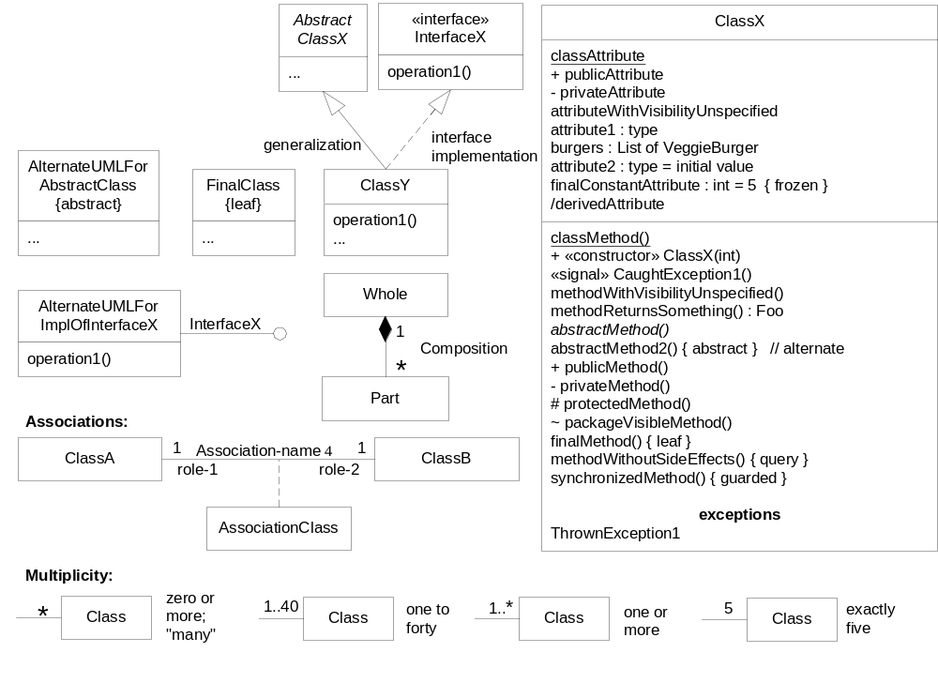
UML
  Unified Modeling Language is a Visual Modeling Language
  “de facto” standard （没有官方认可的事实上的标准）
<<interface>>
+ Constructor:
Signalling
Notes:
UML 的作用：
可视化、详述、构建、文档化

Slide 4
UML Unified Modeling Language
[Fowler] three ways people apply UML
  UML as sketch
    Informal and incomplete diagrams
  UML as blueprint
    Relatively detailed design diagrams used either for
    1) reverse engineering to visualize and better understanding existing code in UML diagrams, or
    2) code generation (forward engineering).
  UML as programming language
    Under constructing….
Key Points：
  Visual modeling using usual notation will be greatly helpful, but it cannot be comparable to the design and thought based on objects 使用常用符号的可视化建模能够带来极大的帮助，但它不可能与：“基于对象的设计和思考”相提并论
OOAD Lecture, Author: NK Jiang
<number>/48

Slide 5
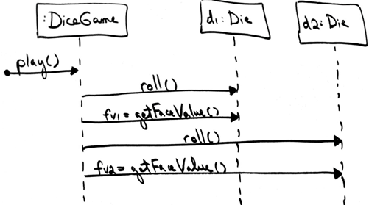
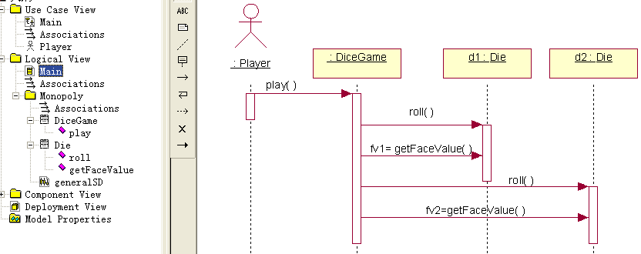
UML Unified Modeling Language
草图，讨论用
正式图，用于文档，UML工具
OOAD Lecture, Author: NK Jiang
<number>/48

Slide 6
Meaning of "Class" in Different Perspectives
Same UML class diagram notation can be used to draw pictures of concepts in the real world or software classes in OOP (OO programming Language,such as Java,C++)
  To keep things clear, this book will use class-related terms consistent with the UML and the UP, as follows:
Conceptual class
  real-world concept or thing. A conceptual or essential perspective.现实世界中的概念或事物，一种概念性或本质性的透视
Specification (Software) class
  a class representing a specification or implementation perspective of a software component, regardless of the process or method.表示软件构件在规格说明或实现视图中的类
Implementation class
  a class implemented in a specific OO language such as Java
OOAD Lecture, Author: NK Jiang
<number>/48

Slide 7
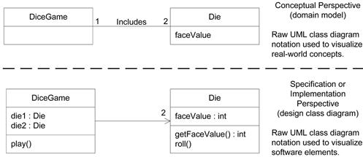
Three Perspectives to Apply UML
Figure 1.6. Different perspectives with UML
Public class diceGame {
private:
Die die1 = new (Die);
Die die2 = new (Die);
public:
play() {
…
}
}
software implementations in a particular technology (such as Java).
OOAD Lecture, Author: NK Jiang
<number>/48

Slide 8
UP 统一过程
UP
  Unified Process
RUP
  Rational Unified Process
OOAD Lecture, Author: NK Jiang
<number>/48

Slide 9
What Is a Process?
Defines Who is doing What, When to do it, and How to reach a certain goal
Software Engineering Process
New or changed Requirements
New or changed System
OOAD Lecture, Author: NK Jiang
<number>/48

Slide 10
Software Development Process
SDP: Software Development Process
  Approach to building, deployment, maintenance of software
  Involves steps, techniques, tools, people, artifacts
SDLC: Software Development Life Cycle
Waterfall lifecycle
  Complete all requirements, with heavy verifying, before moving onto specification, then complete these before moving to design, etc.
  But often requirements are not easily understood or captured or they change (moving target)
  Thus validation fails upon deployment even though all verifications were successful
  In fact, waterfall process are failed process.
Iterative lifecycle
  Development in a number of successive builds. Each build can be validated, and adjustments can be made to accommodate moving targets or misunderstood requirements
  Partly prototyping as some executable ready before final deployment, prototyping not as thrown away，but built onto!
OOAD Lecture, Author: NK Jiang
<number>/48

Slide 11
Iterative, Evolutionary
Iterative development is not OO but has been successfully adopted in OO developments
  Iterative development lies at the heart of how OOA/D is best practiced. 迭代开发是进行OOAD最佳实践的核心
UP
  A flexible iterative process
  Allows a wide range of practices and techniques such as XP, refactoring, etc.
  Needs and allows to be customized
Rational UP （RUP）
  A popular refinement of UP by Rational Company (Now, IBM)
OOAD Lecture, Author: NK Jiang
<number>/48

Slide 12
Iterative (incremental) and Evolutionary
Development progresses in iterations
  Fixed length (sometime objective-based)
  Each iteration culminates (达到定点) with testing and partial executable
  Each new iteration builds upon previous, and possibly refines the previous
  Each iteration culminates with reevaluation of the requirements, and possible refinements
OOAD Lecture, Author: NK Jiang
<number>/48

Slide 13
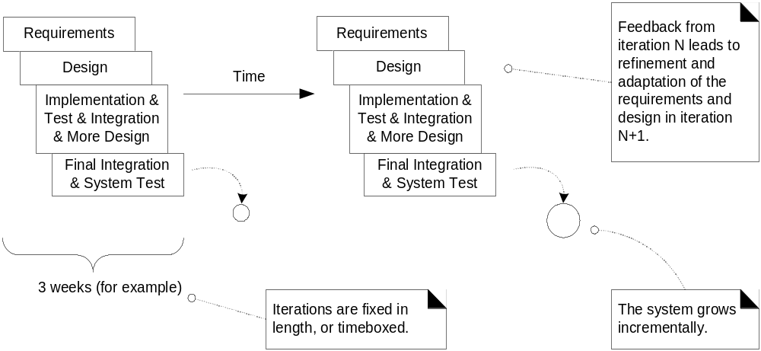
Iterative (incremental) and Evolutionary
The result of each iteration is an executable but incomplete system
The output of an iteration is not an experimental or throw-away prototype, and iterative development is not prototyping. Rather, the output is a production-grade subset of the final system
OOAD Lecture, Author: NK Jiang
<number>/48

Slide 14
Embracing Change
Changes are inevitable
  In the process of software development, the only invariable thing is the invariable change 软件项目开发中，唯一不变的一点就是：始终存在变化。
  Details hard to grasp before some solution is presented
  Business climate changes over time
  Etc.
Iterative development promotes exploration of changes and accommodates them
  Important to start with the “right” subsystem
  Partial executables allow feedback and prototyping
  At the end the “right” system will be deployed
    validation
OOAD Lecture, Author: NK Jiang
<number>/48

Slide 15
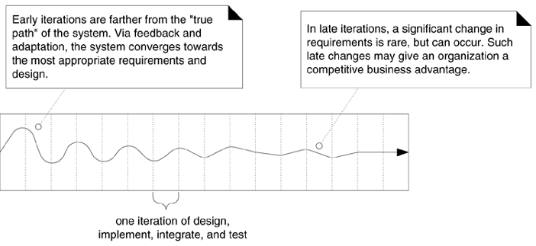
Embracing Change
How to Handle Change on an Iterative Project?
Text, fig 2-2
OOAD Lecture, Author: NK Jiang
<number>/48

Slide 16
Benefits to Iterative Development
less project failure, better productivity, and lower defect rates
  shown by research into iterative and evolutionary methods
early rather than late mitigation（减轻，缓解） of high risks
  (technical, requirements, objectives, usability, and so forth)
early visible progress
early feedback, user engagement and adaptation, leading to a refined system that more closely meets the real needs of the stakeholders(利益相关方、涉众)
managed complexity
  the team is not overwhelmed by "analysis paralysis(瘫痪)" or very long and complex steps
the experience within an iteration can be methodically used to improve the development process itself, iteration by iteration
OOAD Lecture, Author: NK Jiang
<number>/48
Notes:
paralysis [简明英汉词典]
[pE5rAlisis]
n.瘫痪, 麻痹

Slide 17
Iterative Development
How Long Should an Iteration Be? What is Iteration Timeboxing?
  recommend an iteration length between two and six weeks
  Small steps, rapid feedback, and adaptation are central ideas in iterative development
  A key idea is that iterations are timeboxed(时间盒）, or fixed in length
    Reduce the task to keep the date when difficult to meet the deadline
OOAD Lecture, Author: NK Jiang
<number>/48

Slide 18
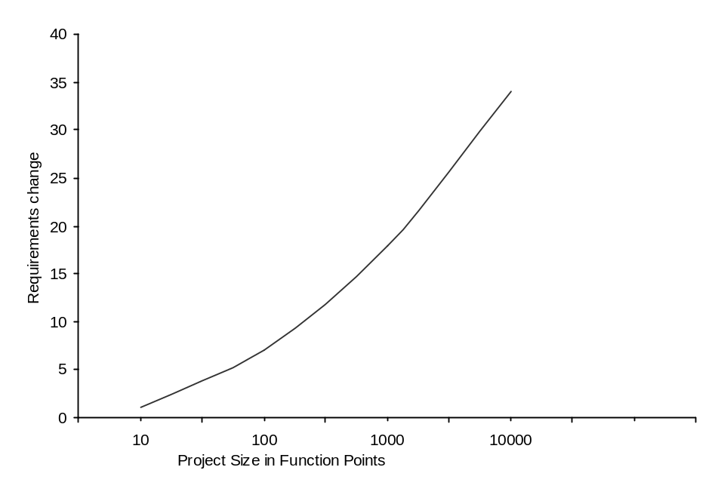
Problems in Non-Iterative Development
High cost of fixing “late” problems
High change rate
  go even higher35% to 50% for large projects
OOAD Lecture, Author: NK Jiang
<number>/48

Slide 19
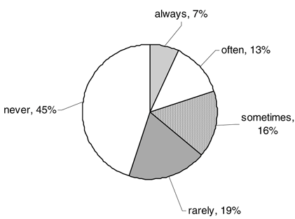
Figure 5.1. Actual use of waterfall-specified features
OOAD Lecture, Author: NK Jiang
<number>/48

Slide 20
How to Iterate? (设计师的主要任务之一)
Start with solid but not complete requirements analysis, including the most important use cases
  identifying just the names of the use cases and features, and key non-functional requirements
  pick 10% from this high-level list (such as 10% of the 30 use case names) : by rules
    1) architecturally significant (if implemented, we are forced to design, build, and test the core architecture),
    2) high business value (features business really cares about), and
    3) high risk (such as "be able to handle 500 concurrent transactions").
    do intensive detailed analysis of the functional and non-functional requirements for 10% . They are deeply analyzed, and 90% are only high-level
It is important to create a big image of the System to be done
OOAD Lecture, Author: NK Jiang
<number>/48

Slide 21
How to Iterate? (项目经理的主要任务之一)
hold an iteration planning meeting
  Select the most architecturally or technologically risky (influential) use cases
  to design, build, and test within a specified time
Select time frame per iteration, and perform it, ending with executable
  Do iteration-1 over three or four weeks
  Analyze feedback and gained insight, refine requirements, and continue
Do the second requirements workshop near the end of iteration-1
hold another iteration planning meeting for the next iteration
Do iteration-2; similar steps
Repeat, for four iterations and five requirements workshops
after a few iterations , team can more reliably answer "what, how much, when."
Note that this large, detailed set of requirements is based on feedback and evolution, and is thus of much higher quality than purely speculative(投机) waterfall specifications
OOAD Lecture, Author: NK Jiang
<number>/48

Slide 22
risk-driven and client-driven iterative planning
UP (and most new methods) encourage a combination of risk-driven and client-driven iterative planning
Risk-driven
  Start with most “important” elements
  Architecture-centric
    Early iterations explore and stabilize the architecture, meaning that early iterations focus on
      building, testing, and stabilizing the core architecture.
    Why? Because not having a solid architecture is a common high risk
Client-driven
  Client stays involved and provides feedback
OOAD Lecture, Author: NK Jiang
<number>/48

Slide 23
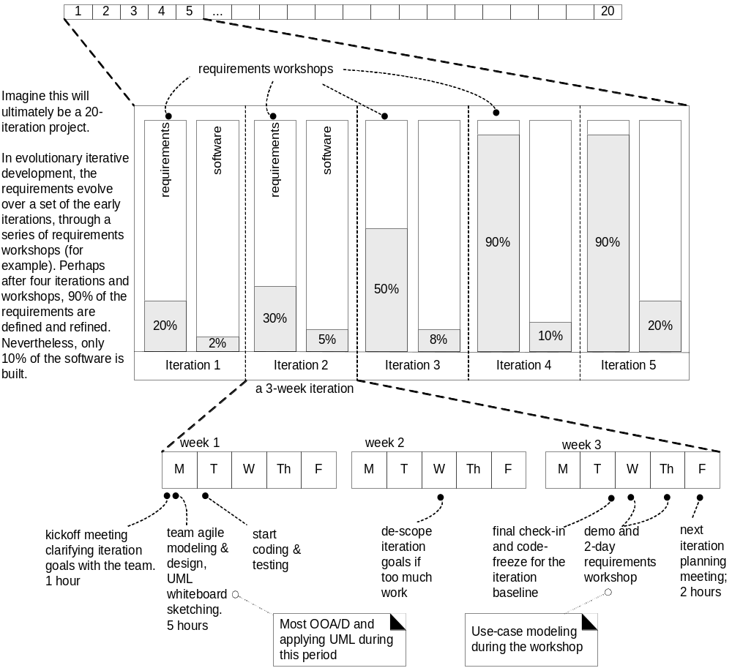
Iterative Development
OOAD Lecture, Author: NK Jiang
<number>/48

Slide 24
UP Phases
Inception 初启
  Scope, vision, business case, estimate
    Note:
      not a requirements phase;
      rather, it is a feasibility phase, where just enough investigation is done to support a decision to continue or stop
Elaboration 精化
  Refined vision, 2-5 iterations for the core architecture or high risk, better estimate, exploration of key requirements
    Note:
      elaboration is not the requirements or design phase;
      rather, it is a phase where the core architecture is iteratively implemented, and high-risk issues are mitigated( 减轻)
Construction 构建
  The remaining iterations
Transition 交付
  System tests, deployment
OOAD Lecture, Author: NK Jiang
<number>/48

Slide 25
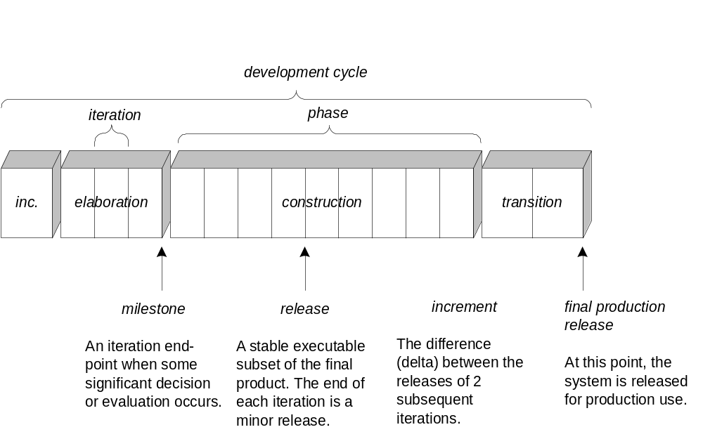
UP Phases
迭代的结束点。
此时有重要决策或评估产生
最终产品的稳定可执行子集。每个迭代的结束点都是小型的发布
两次迭代发布子集之间的差异（增量）
此时为 产品的使用 发布系统
OOAD Lecture, Author: NK Jiang
<number>/48

Slide 26
Analysis and Design in Context
Phases
Process Workflows
Inception
Elaboration
Construction
Transition
Business Modeling
Requirements
Analysis & Design
Implementation
Test
Deployment
Supporting Workflows
Configuration Mgmt
Management
Environment
Preliminary
Iteration(s)
Iter.
#1
Iter.
#2
Iter.
#n
Iter.
#n+1
Iter.
#n+2
Iter.
#m
Iter.
#m+1
Iterations
OOAD Lecture, Author: NK Jiang
<number>/48
Notes:
The purpose of Analysis and Design is to:
Transform the requirements into a design of the system to-be.
Evolve a robust architecture for the system.
Adapt the design to match the implementation environment, designing it for performance.
The Analysis and Design workflow is related to other process workflows.
The Business Modeling workflow provides an organizational context for the system.
The Requirements workflow provides the primary input for Analysis and Design.
The Test workflow tests system designed during Analysis and Design.
The Environment workflow develops and maintains the supporting artifacts that are used during Analysis and Design.
The Management workflow plans the project and each iteration (described in an Iteration Plan).
Review the Rational Unified Process Framework and the relationship of the Analysis and Design workflow to the other workflows in the Rational Unified Process Framework. The Rational Unified Process Framework is discussed in detail in the Unified Software Best Practices course.

Slide 27
UP Disciplines（科目）
Nine disciplines 九大科目：
  It is a group of activities about the target domain, which describes association role, activity, artifacts and their relationships.是关于所关注领域的一组相关活动，它描述了基于一类技能的关联角色、活动与工件，及其关系
Business Modeling
  Domain models
Requirements
  Use Case models, Supplementary Specs (functional and non-functional requirements)
Design
  Architecture, detailed design, Specification models
Implementation
Tests
Deployment
Configuration and change management
Project management
Environment
  setting up the tool and process environment
OOAD Lecture, Author: NK Jiang
<number>/48

Slide 28
UP first phase: Inception text ch4
Initial step to establish common vision(前景) and scope
  Feasibility study
  Business case
    What is the vision and business case for this project?
  Buy/build
  Rough unreliable range of cost:
    Is it $10K,100K or in the millions?
  Risks
    Technological
    Business
  Short span
    Day to weeks
  Should we proceed or stop?
OOAD Lecture, Author: NK Jiang
<number>/48

Slide 29
Inception
The purpose is not to explore all requirements but to understand the most important and technologically risky requirements in order to establish a vision and define a rough scope
  So called “打蛇打七寸”
  What are stakeholders and what is their common goals
  Do we have business case to continue
The actual requirements are explored in detail in elaboration
  About 80%
  About 10% in inception and about 10% in construction
OOAD Lecture, Author: NK Jiang
<number>/48

Slide 30
How Long is Inception?
It depends.
  It may very short if the project must continue
  It may a little long if we need to investigate before making decision
OOAD Lecture, Author: NK Jiang
<number>/48

Slide 31
Inception Artifacts
you may not write it if not necessary 可写可不写时,就不写
As brief as possible, and refine them in later stage 尽量简短, 在后续阶段继续对它们进行完善
Possible artifacts 可能的相关制品有:
  Vision and business case
  Major use cases in Use-case model
  Supplementary specification
    Non-functional reqs plus risks and responses
  Glossary and Dictionary
  Any applicable prototypes
  Plan for the initial iteration (s) for elaboration
  Customized UP
    What customized steps/artifacts are expected
OOAD Lecture, Author: NK Jiang
<number>/48

Slide 32
Inception Artifacts
Target of creating artifacts or models is not the document or diagram itself, but the thinking, analysis, and proactive readiness(前期准备)
  to improve understanding, rather than to document reliable specifications
As General Eisenhower said,
  "In preparing for battle I have always found that plans are useless, but planning indispensable"
OOAD Lecture, Author: NK Jiang
<number>/48

Slide 33
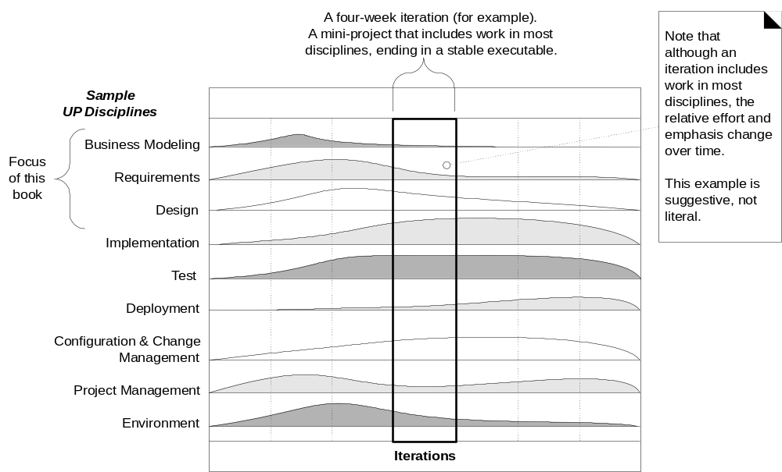
UP Disciplines
OOAD Lecture, Author: NK Jiang
<number>/48
Notes:
during one iteration work goes on in most or all disciplines. However, the relative effort across these disciplines changes over time

Slide 34
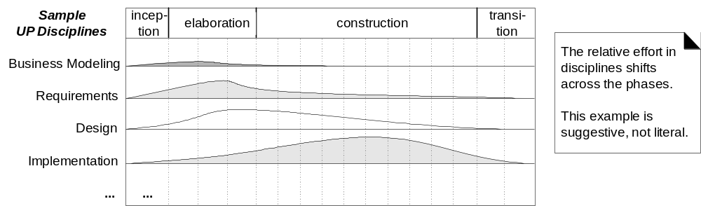
2-dim UP Process
the changing relative effort with respect to the phases; please note these are suggestive, not literal.
In elaboration, for example, the iterations tend to have a relatively high level of requirements and design work, although definitely some implementation as well.
During construction, the emphasis is heavier on implementation and lighter on requirements analysis.
OOAD Lecture, Author: NK Jiang
<number>/48
Notes:
the changing relative effort with respect to the phases; please note these are suggestive, not literal. In elaboration, for example, the iterations tend to have a relatively high level of requirements and design work, although definitely some implementation as well. During construction, the emphasis is heavier on implementation and lighter on requirements analysis.

Slide 35
Evolutionary Requirements（进化式需求）text Ch5.
Requirements
  are capabilities and conditions to which the system and more broadly, the project must conform
Requirements must managed, not avoided nor set in stone
  Do not build the system to “requirements”
  Build the system to client’s needs, with requirements reflecting these
OOAD Lecture, Author: NK Jiang
<number>/48
Notes:
Set in stone : 一成不变

Slide 36
Evolutionary vs. Waterfall requirements
Notice the word “changing” in the definition of what it means to manage requirements.
The UP embraces change in requirements as a fundamental driver on projects
According to study, on average, 25% of the requirements change on software projects
Waterfall
  About 45% of waterfall requirements are never used
  19% were "rarely" used
OOAD Lecture, Author: NK Jiang
<number>/48

Slide 37
Evolutionary Requirements
In Evolutionary approach, key is on
    Finding requirements all the way through development
    Managing inevitable changes and discoveries
General two categories
  Functional
    behavioral
  Non-functional
    others
More specific categories: FURSP+
OOAD Lecture, Author: NK Jiang
<number>/48

Slide 38
FURPS
Functional
  capabilities, features
Usability
  help, docs, users
Reliability
  failures, recovery
Performance
  Response times, volume, throughput, accuracy, availability
Supportability
  adaptability, configurability, maintainability, internationalization, etc
OOAD Lecture, Author: NK Jiang
<number>/48

Slide 39
+
Implementation
  Language, tools, hardware
Interface
  Human and external systems
Operations
  Operational management
Legal
  licensing and so forth
Schedules
Deployment
OOAD Lecture, Author: NK Jiang
<number>/48

Slide 40
Requirements in UP Artifacts
Use-case Model
  Typical transactions, scenarios
  Functional (black-box behavior)
Supplementary Specifications
  All non-functional requirements
  Some additional functional features
Glossary and Dictionary
  Defines key concepts and common terminology
Vision
  Summarizes high-level requirements
  summarizes the business case for the project
  Executive summary of major requirements and the business case
Business Rules (also called Domain Rules )
  required policies in the domain or business, and many applications may need to conform to them.
  An excellent example is government tax laws
OOAD Lecture, Author: NK Jiang
<number>/48

Slide 41
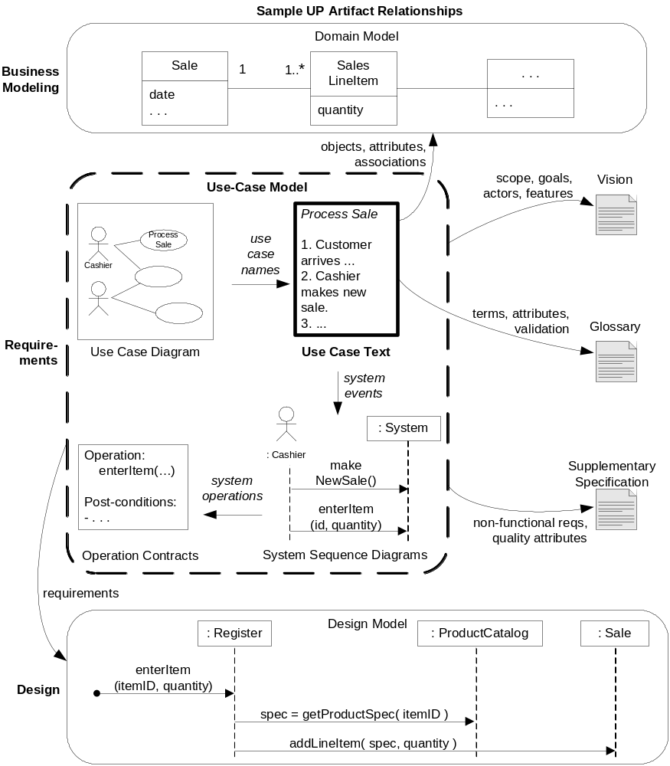
Fig 6-1
OOAD Lecture, Author: NK Jiang
<number>/48

Slide 42
Case study of the book (of the course)
OOAD Lecture, Author: NK Jiang
<number>/48

Slide 43
Case study of the book
Normal IS Application has three layers
  Presentation
  Application logic
  Dada management
OO technology can be applied at all levels, Here, we focuses on the core application logic layer, with some secondary discussion of the other layers
  Other layers are usually very technology/platform dependent
  the OO design of the core logic layer is similar across technologies(C++/C#/j2ee/Python)
  The essential OO design skills learned in the context of the application logic layer are applicable to all other layers or components
  Application Logic is stable relatively compare to UI/Database
OOAD Lecture, Author: NK Jiang
<number>/48

Slide 44
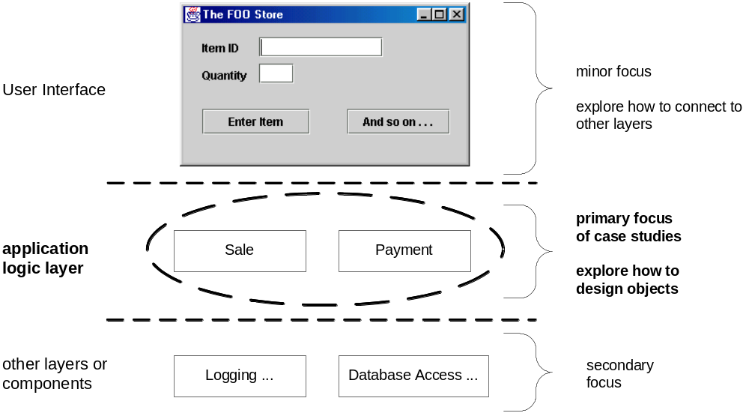
Ch3. Case study: Focus of OO in Software Layers
GUI is usually thin
Persistence layers are storage specific and organized into frameworks
OOAD Lecture, Author: NK Jiang
<number>/48

Slide 45
Case Study
POS: Point Of Sale
  Multiple terminals in a retail store
  Third party inventory control, account receivable, credit authorization, tax calculations
  Flexible for multiple clients of different needs
  预习: text ch6.8~ch6.9
Monopoly Game (有点像“大富翁”)
  Computer simulation after we specify the number of players
OOAD Lecture, Author: NK Jiang
<number>/48

Slide 46
About Agile development text ch2.6~2.8
什么是敏捷开发(Agile)，目前没有统一的定义。
  通常应用“时间定量”的迭代和进化方式、使用自适应计划、提倡增量交付等原则
Agile 和UP
  包括UP在内的任何迭代方法，都可以施加以敏捷精神
  UP是灵活的，以“不管白猫黑猫，抓到耗子就是好猫”的态度引入 敏捷开发的一些思想。
Text book, ch2.6, The Agile Principles (自学）
Agile（敏捷开发）
  Rapid and flexible
  Timeboxed, adaptive
  Incremental delivery
  The purpose of modeling (UML) is to explore and not to suggest
OOAD Lecture, Author: NK Jiang
<number>/48

Slide 47
Thinking…
1. Give and explain the steps of the Unified Process. Explain why this approach reduces the highest risk associated with the waterfall approach to software design.
2. How does the use of the domain model help our overall understanding of the software we are trying to develop?
OOAD Lecture, Author: NK Jiang
<number>/48

Slide 48
End
OOAD Lecture, Author: NK Jiang
<number>/48

