Slide 1
Object orient Analysis &Design
面向对象分析与设计师
Lecture_06 UseCase & Requirements
Text CH6~ch7
主讲: 姜宁康 博士
日期: 26/11/8

Slide 2
Use Cases
Adage（谚语）
  The indispensable first step to get the things you want out of life is: decide what you want
Use Case is the main input of OOAD
Target of the Lecture
  Guide to Identify and write use cases.
  Use the brief, casual, and fully dressed formats, in an essential style.
  Relate use case analysis to iterative development.
  Gathering Requirements /Non-functional Requirements
OOAD Lecture, Author: NK Jiang
Notes:
Indispensable 必不可少的

Slide 3
1. Review Definition: (must understand)
What Scenarios, and Use Cases?
What is Actors?
What is Usecase Diagram?
What is Usecase Model?
OOAD Lecture, Author: NK Jiang

Slide 4
Use Case Elements
Scenario (use-case instance)
  A sequence of actions and interactions between actors and the system in the course of particular story, transaction, or use of the system
  it is also called a use case instance
Use Case
  A collection of related scenarios, some successful some exceptional or failures, describing actors interacting with the system to support a specific goal
OOAD Lecture, Author: NK Jiang

Slide 5
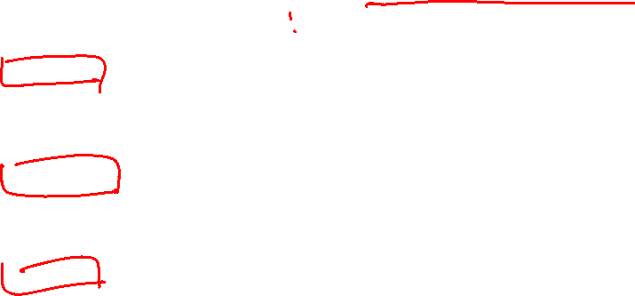
Use Case Elements
Actor
  Entity with behavior, usually external to our system (some are more obviously external, others not), and interact with system
  Can be live, or other system
  There are three types:
    Primary – user has goals fulfilled through using services of the SuD (主要参与者)
      Why identify? To find user goals, which drive the use cases
      For example, the cashier in POS
    Supporting – provides supports such as external systems（协助参与者）
      Example, the automated payment authorization service.
      Often a computer system, but could be an organization or person.
      Why identify? To clarify external interfaces and protocols
    Offstage – has interest in the system’s behavior（幕后参与者）,but is not primary or supporting;
      for example, a government tax agency
      Why identify? To ensure that all necessary interests are identified and satisfied. Offstage actor interests are sometimes subtle or easy to miss unless these actors are explicitly named
OOAD Lecture, Author: NK Jiang

Slide 6
Use Case Elements
Usecase diagram
  The relation among actors, usecases, and show the system boundary
Use case diagrams and use case relationships are secondary in use case model.
Use cases are text documents. Doing use case work means to write text.
  UseCase description is the most important
OOAD Lecture, Author: NK Jiang

Slide 7
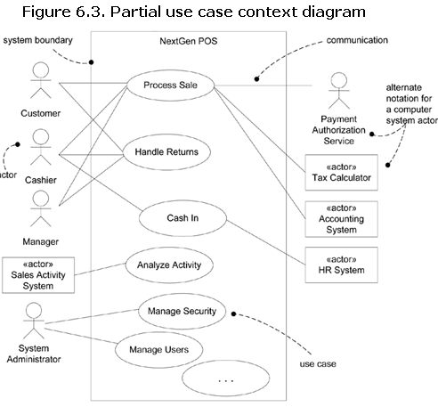
Use Case Diagrams
OOAD Lecture, Author: NK Jiang

Slide 8
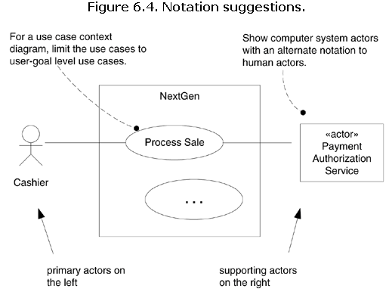
Use Case Diagrams
OOAD Lecture, Author: NK Jiang

Slide 9
Use Case Elements
Use case Model
  The use-case model should serve as a communication medium and can serve as a contract between the customer, the users, and the system developers on the functionality of the system, which allows:
    Customers and users to validate that the system will become what they expected.
    System developers to build what is expected.
  Defined in UP requirement discipline
    the set of all written use cases;
  it is a model of the system's functionality and environment.
  Artifacts
    Use case : functional specification
    Supplementary Specification: non functional specification
    Glossary,
    Vision, and
    Business Rules
use-case modeling is primarily an act of writing text, not drawing diagrams.
OOAD Lecture, Author: NK Jiang

Slide 10
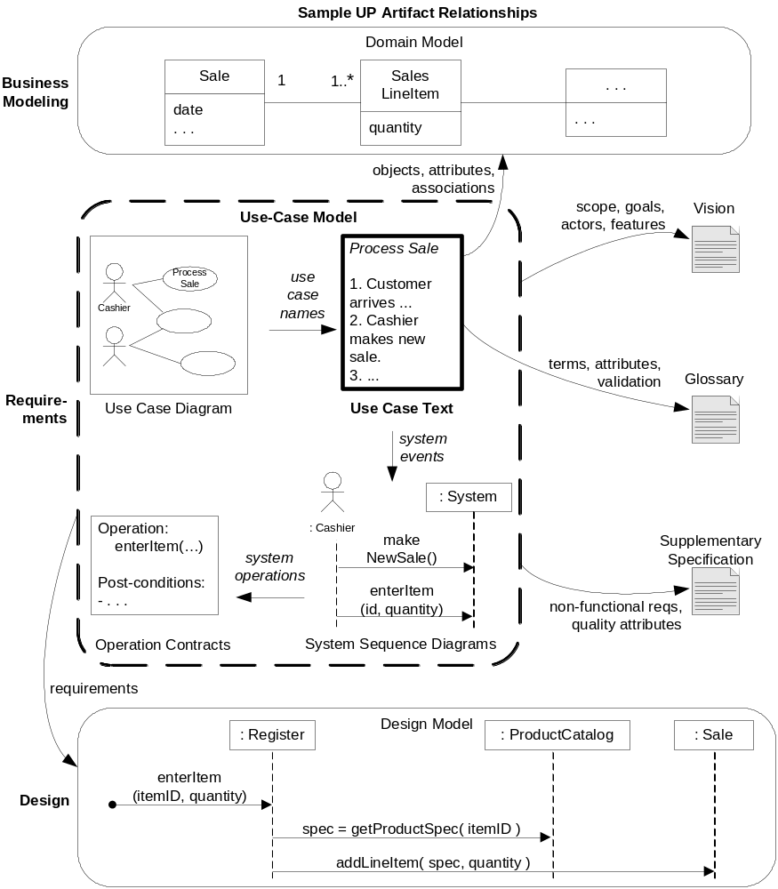
Fig 6-1
OOAD Lecture, Author: NK Jiang

Slide 11
2. Use Case
Three Common Use Case Formats
  brief
    Terse one-paragraph summary, usually of the main success scenario.
    Useful during inception and early analysis in general to identify scope and risks
  casual
    Informal paragraph format. Multiple paragraphs that cover various scenarios.
  fully
    dressed All steps and variAtions are written in detail, and there are supporting sections, such as preconditions and success guarantees
    Needed in Inception for the important use cases to establish glossary, extract concepts, assess risk
    Needed in Elaboration/construction when iterating on
    10% of the critical use cases would be written this way
OOAD Lecture, Author: NK Jiang

Slide 12
2.1 Use Case Example
Brief or Casual format
  For example, use case “Process Sale”:
    A customer arrives at a checkout with items to purchase.
    The cashier uses the POS system to record each purchased item.
    The system presents a running total and line-item details.
    The customer enters payment information, which the system validates and records.
    The system updates inventory.
    The customer receives a receipt from the system and then leaves with the items.
OOAD Lecture, Author: NK Jiang

Slide 13
2.1 Use Case Example
Fully dressed Process Sale
  See the textbook for a template and the actual use case
  Ch6.8
  Notice the template
  shows the ability of use cases to capture complex real-world requirements, and deeply branching scenarios
OOAD Lecture, Author: NK Jiang

Slide 14
2.2 Use case Scope
Scope
  scope bounds the system (or systems) under design
OOAD Lecture, Author: NK Jiang

Slide 15
2.3 Use Case Goals and Levels
It is important to identify all stakeholders and assess their goals
  The purpose of Use Case is to address these interests
  All relevant should be there
  Not irrelevant should be there
User-goal level
  use case is the common kind that describe the scenarios to fulfill the goals of a primary actor to get work done
  it roughly corresponds to
    Elementary Business Process-- EBP
  Fulfillment of primary actor’s goals
Subfunction level
  use case describes substeps required to support a user goal
  Not complete EBP (Elementary Business Process), such as pay by credit (payment is only a part of sale)
OOAD Lecture, Author: NK Jiang

Slide 16
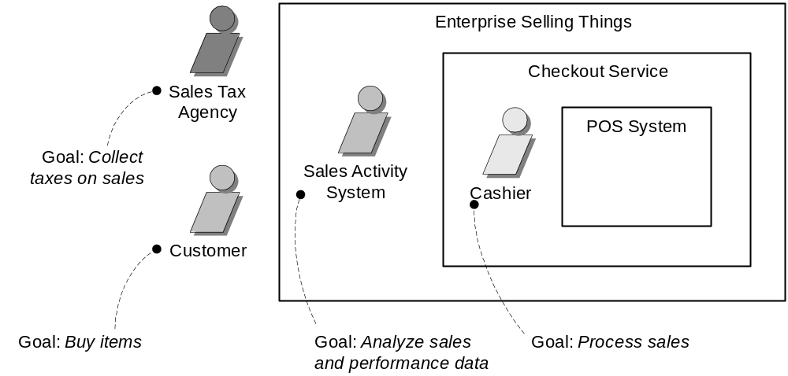
2.3 How to Identify Use Cases
Choose system boundary
  Is the cashier an actor of system?
  Is Credit authorization our responsibility?
OOAD Lecture, Author: NK Jiang

Slide 17
2.3 How to Identify Use Cases
Find all primary actors and their goals
  Who does what or needs what?
    Rather than asking “what you do” ask “what is your role, goal, interest”
  Analyze events
Remember stakeholders and their goals
  Cashier wants easy processing while management wants efficient and secure processing
可以根据下面的一些问题来识别用例：
  ①参与者希望系统提供什么功能；
  ②系统是否存储和检索信息；
  ③当系统改变状态时，是否通知参与者；
  ④是否存在影响系统的外部事件，是哪个参与者通知系统这些外部事件
OOAD Lecture, Author: NK Jiang
Notes:
可以根据下面的一些问题来识别用例：
①参与者希望系统提供什么功能；
②系统是否存储和检索信息；
③当系统改变状态时，是否通知参与者；
④是否存在影响系统的外部事件，是哪个参与者通知系统这些外部事件

Slide 18
2.4 How to Identify Good Use Cases
Which of these is a valid use case?
  Negotiate a Supplier Contract
  Handle Returns
  Log In
  Move Piece on Game Board
Ways：
  Boss test
    Can you excuse your time doing THIS?
  EBP test
    A task performed by one person in one place at one time, in response to a business event, which adds measurable business value and leaves the data in a consistent state
      e.g., Approve Credit or Price Order [original source lost].
  Size test
    Remember that use case(s) will be processed in your time boxes
OOAD Lecture, Author: NK Jiang
Notes:
Ch6.16什么样的测试有助于发现有用的用例?

Slide 19
Example: Applying the Tests
“Negotiate a Supplier Contract”
  Much broader and longer than an EBP. Could be modeled as a business use case, rather than a system use case.
“Handle Returns”
  OK with the boss. Seems like an EBP. Size is good.
“Log In”
  Boss not happy if this is all you do all day!
  But seems meet EBP
“Move Piece on Game Board”
  Single step fails the size test.
OOAD Lecture, Author: NK Jiang

Slide 20
2.4 How to Identify Good Use Cases
如何判断一个用例是否是一个优秀的用例呢？
也可以通过下面的测试方法来检验。
  ①用例是否描述了应该做什么，而不是如何做？用例应该描述系统做什么，但不应该描述系统是如何被实现的。
  ②用例的描述是否采取了参与者的视点？在确定用例的关键特征时，应该依据参与者的视点。也就是说，应该从参与者如何使用系统的角度出发定义用例，而不是从系统自身的角度。
  ③用例是否对参与者有价值？用例不是动作步骤的任意集合，它必须为参与者提供可辨识的价值。
  ④用例描述的时间流是否是一个完整场景？每一个用例必须描述出在一个给定场景下参与者将如何使用系统的完整事件流。这有助于避免产生单步用例、部分用例或者功能分解用例。
  ⑤是否所有的参与者、用例都有相应的关联用例或关联参与者？
OOAD Lecture, Author: NK Jiang

Slide 21
3. Guideline
3.1 (ch6.11) Write use cases in an essential style; keep the user interface out and focus on actor intent.
  1/ Find “the goal of the goal “. Example, “Log on” →
    thinking of a GUI, dialog box, user ID, and password .
    But this is the mechanism, not the goal
    the system analyst arrives at a mechanism-independent goal :
      "identify myself and get authenticated “
      "prevent theft …".
  2/ essential style, example
    “Manage Users” use case
      …
      Administrator identifies self.
      System authenticates identity.
      …
    针对这种描述的设计,可以非常灵活:生物信息读取\GUI 等
OOAD Lecture, Author: NK Jiang

Slide 22
3. Guideline
3.1 (ch6.11) Write use cases in an essential style; keep the user interface out and focus on actor intent.
  3. Concrete Style
    may be avoid during early requirements Work, example,
      …
      Adminstrator enters ID and password in dialog box (see Picture 3).
      System authenticates Administrator.
      System displays the "edit users" window (see Picture 4).
      …
    这种方式可以用, 但尽量不要在需求分析的早期!
OOAD Lecture, Author: NK Jiang

Slide 23
3. Guideline
3.2 (ch6.12) Write Terse(简洁的)Use Cases
  用词简洁
    “系统认证…” ←> “这个系统认证… ”
3.3 (ch6.13) Write Black-Box Use Cases
  do not describe the internal workings of the system, its components, or design.
  Rather, the system is described as having responsibilities
  one can specify what the system must do (the behavior or functional requirements) without deciding how it will do it (the design).
  Example
Black-box style | Not
The system records the sale. | The system writes the sale to a database. …or (even worse): The system generates a SQL INSERT statement for the sale…
OOAD Lecture, Author: NK Jiang
Notes:
terse [简明英汉词典]
[tE:s]
adj.简洁的, 扼要的

Slide 24
3. Guideline
3.4 (ch6.14) Take an Actor and Actor-Goal Perspective
  "an observable result of value to a particular actor” is a subtle but important concept that Jacobson considers critical, because it stresses two attitudes during requirements analysis:
    Write requirements focusing on the users or actors of a system, asking about their goals and typical situations.
    Focus on understanding what the actor considers a valuable result
OOAD Lecture, Author: NK Jiang

Slide 25
3. Guideline
3.5 (ch6.15) How to Find Use Cases
  1. Choose the system boundary.
  2. Identify the primary actors
  3. Identify the goals for each primary actor.
  4. Define use cases that satisfy user goals; name them according to their goal.
For POS system, in/out Sys?
  Cashier?
  payment authorization service:
    No, there is an external payment authorization service actor
  Ask About Actor Goals Rather Than Use Cases
    "What are the system tasks?“
    "Who uses the system and what are their goals?"
    "What do you do?" (roughly a task-oriented question, not good) or,
    "What are your goals whose results have measurable value?"
      Prefer the second question
  Is the Cashier or Customer the Primary Actor?
OOAD Lecture, Author: NK Jiang

Slide 26
Three important questions
To sponsors and users
  Is this what you want (need)?
  Will you be able to tell, upon delivery, whether you got this?
To the developers:
  Can you implement this?
OOAD Lecture, Author: NK Jiang

Slide 27
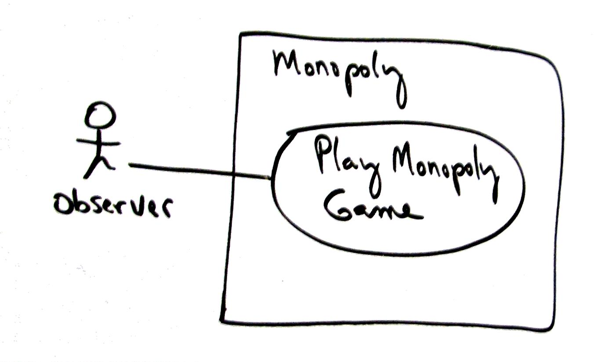
4, Example. Monopoly Game
significant use case : Play Monopoly Game
OOAD Lecture, Author: NK Jiang

Slide 28
4, Example. Monopoly Game
Scope: Monopoly application
Level: user goal
Primary Actor: Observer
Stakeholders and Interests:
  - Observer: Wants to easily observe the output of the game simulation.
Main Success Scenario:
  1.Observer requests new game initialization, enters number of players.
  2.Observer starts play.
  3.System displays game trace for next player move (see domain rules, and "game trace" in glossary for trace details).
  Repeat step 3 until a winner or Observer cancels.
Extensions:
*a. At any time, System fails:
  (To support recovery, System logs after each completed move)
  1. Observer restarts System.
  2. System detects prior failure, reconstructs state, and prompts to continue.
  3. Observer chooses to continue (from last completed player turn).
Special Requirements:
  - Provide both graphical and text trace modes.
OOAD Lecture, Author: NK Jiang

Slide 29
5. Use Cases in UP (Iterative Methods)
Inception
  when only perhaps 10% of the requirements are detailed
    starts building the production core of the system
  POS Example, table6-1,
    Process Sale and Handle Returns
Elaboration
  By the end of elaboration, "80~90%" of the use cases are written in detail.
Construction
  minor use case writing
OOAD Lecture, Author: NK Jiang

Slide 30
5.1 . Requirements
Requirements Analysis
  the process of understanding what is needed or wanted, and expressing the results in writing
Challenges!
  express requirements in ordinary, clear English or Chinese 清晰
  organise the requirements statements into logical groupings 有条理
  arrange for the management of the requirements 安排需求管理
OOAD Lecture, Author: NK Jiang
Notes:
ordinary

Slide 31
5.2 Example: The dog house
Inception: the starting idea
  the client wants a dog house
We want to provide a high quality doghouse-
one that is fit for its purpose
the “purpose” may not be quite what the client or the designer thinks at first look
  depends on where the house are
  depends on owner’s use of or relationship with dog
OOAD Lecture, Author: NK Jiang

Slide 32
5.2 Example: what requirements?
The kennel狗窝 must
  keep the dog alive in freezing Canberra堪培拉winter or
  dry and cool in Brisbane布里斯班
  provide satisfactory (to owner) level of dog happiness
  anchor the dog to the home base
    to provide security and visitor announcement services
  have good enough appearance to satisfy owner’s family, and increase or maintain house property value
  be easy for the owner to keep clean, remove fleas跳蚤etc
  be “right size” for the number and size of dogs
  be maintainable: materials should need attention no more than once in 3 years in the intended location
OOAD Lecture, Author: NK Jiang
Notes:
Canberra [简明英汉词典]
[5kAnbErE]
n.堪培拉(澳大利亚首都)
Brisbane [简明英汉词典]
[5brizbEn]
[澳大利亚东部港市](昆士兰州首府)
flea [简明英汉词典]
[fli:]
n.跳蚤, 低廉的旅馆，生蚤的动物

Slide 33
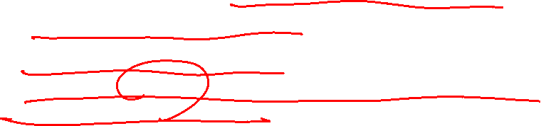
5.2 Example: Dog house requirements
These requirement statements are
  not expressed well: too broad and too vague to enable us to create a design
  not logically organised
  can be managed easily because there are very few requirements listed
How can we gather the full set of requirements?
(Answer by yourself.)
OOAD Lecture, Author: NK Jiang

Slide 34
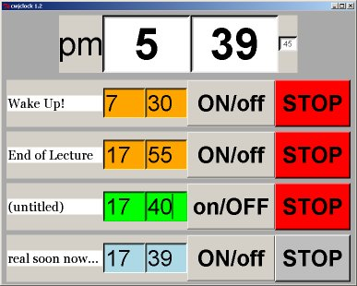
5.3 example: The Multiple Alarm Clock
A simpler
application program example
OOAD Lecture, Author: NK Jiang

Slide 35
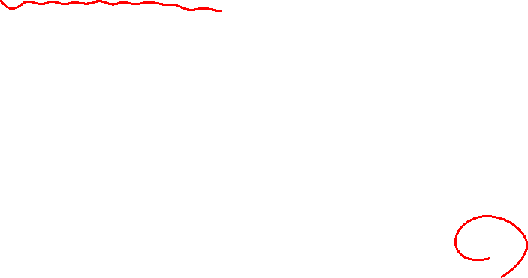

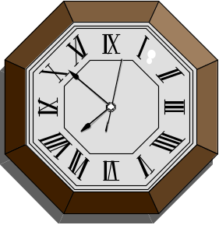
5.3 example: Gathering requirements
Option 1: Make me one just like that!
  The analyst must
  discover all of the functions
  reverse engineer the requirements from the functions of the thing
ON
  This is not easy to do.
  This is probably not what the client actually wants.
19 : 50 : 03
OOAD Lecture, Author: NK Jiang

Slide 36
5.3 example: Alarm Clock Requirements version 0
ON
Option 2: elicit requirements from the client
Title
A Clock Software Requirements Specifications, version 0
Author
Chris Johnson, Dept of Computer Science, ECNU
19 : 50 : 03
Date
Thursday 24 July 2009
Requirements
The alarm clock application emulates a simple alarm clock in an on-screen window.
The clock's timing is accurate, as far as a standalone computer's operating system allows.
The user has a choice of how the clock displays the time, and he can set more than one alarm.
It will not hog(贪婪) the CPU.
User characteristics
We don't really need to say this, but: the user is assumed to know how to use a computer.
Notes:
hog [简明英汉词典]
[hR^; (?@) hC:^]
n.肥(公)猪, 贪婪者
v.(使)拱起

Slide 37
5.3 example: Alarm Clock Requirements version 0 --- critique评论
The alarm clock application emulates a simple alarm clock in an on-screen window.
The clock's timing is accurate, as far as a standalone computer's operating system allows.
The user has a choice of how the clock displays the time, and you can set more than one alarm.
It will not hog the CPU.
What’s good about this requirements specification?
  some of the requirements are made in separate statements
  the requirements state “what” the product must do in terms of an information model of the real world, not “how” a program might do it
This is one of the hardest things for programmers to learn
when gathering and writing requirements.
OOAD Lecture, Author: NK Jiang

Slide 38
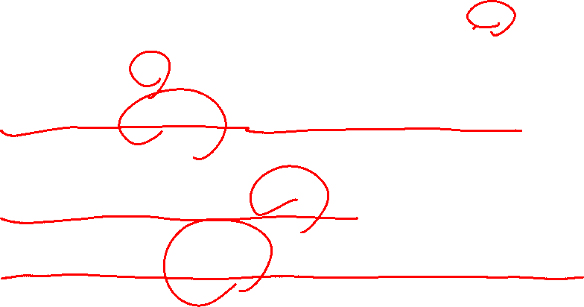

5.3 example: Alarm Clock Requirements version 0 --- critique(2)
The alarm clock application emulates a simple alarm clock
in an on-screen window.
The clock's timing is accurate,
as far as a standalone computer's operating system allows.
The user has a choice of how the clock displays the time,
and you can set more than one alarm.
It will not hog the CPU.
What’s wrong with this?
imprecise vocabulary - no control of nouns, verbs
  what choices of display? what is the “time”? “hog”?
  emulate which “simple alarm clock”? how exactly?
there are no identifying labels –
  statements will be hard to trace ，1,2,1.1,1.2,2.1
these are all imprecise statements - all hard to verify
  nothing stated here can be verified by a specific test of the software
OOAD Lecture, Author: NK Jiang

Slide 39
5.4 Specifying requirements: guide to a good System Requirements Specification (SRS)
A good SRS is
  1. unambiguous
  uses single unique term for each characteristic
  2. complete
  includes all significant requirements, responses to all inputs in all situations, full labeling and referencing of constituent figures, tables, diagrams
  3. verifiable
  4. consistent
  5. modifiable
  6. traceable
OOAD Lecture, Author: NK Jiang

Slide 40
5.4 Specifying requirements: guide to a good System Requirements Specification (SRS)
A good SRS is
  1. unambiguous
  2. complete
3. verifiable
every requirement is capable of being verified in the product, by some cost-effective process of checking (testing etc)
4. consistent
5. modifiable
6. traceable
OOAD Lecture, Author: NK Jiang

Slide 41
5.4 Specifying requirements: guide to a good System Requirements Specification (SRS)
A good SRS is: 1. unambiguous... 2. complete... 3. verifiable...
4. consistent
No subset of the individual requirements is in conflict.
They do not:
  use different terms for the same real world object
  have any conflicting requirements of input or output objects
  have any logical or temporal conflict between actions
5. modifiable
6. traceable
OOAD Lecture, Author: NK Jiang

Slide 42
5.4 Specifying requirements: guide to a good System Requirements Specification (SRS)
1. unambiguous... 2. complete... 3. verifiable... 4. consistent
5. modifiable
easy to read, careful structure and style, is coherent, organised, with no redundancy
so newcomers understand it correctly, and changes do not need to be tracked to many places unnecessarily
6. traceable
the origin of each requirement is clear, can be traced to particular parts of any preceding document, are named or numbered to allow tracing in any following documents (Design & Testing docs)
OOAD Lecture, Author: NK Jiang

Slide 43
5.5 reading a requirements specification for objects
Possible steps
  Use Cases
  CRC Cards
  Do requirements document
  Give your requirements document to your friend
OOAD Lecture, Author: NK Jiang

Slide 44
5.6 Exercise
ALARM CLOCK
  Has alarm
  On / Off button
  Display
OOAD Lecture, Author: NK Jiang

Slide 45
5.6 Exercise :A Clock version 1: (a) define terms
Glossary: Definitions, acronyms and abbreviations
clock a device that has its own value of time in hours, minutes and seconds, which it displays and which it maintains accurately relative to when the time was last reset.
In this document, a "conventional clock" means such a clockwork or electric device in the real world;
"clock" means a computer operating system function that returns at least an absolute or elapsed time as measured by the operating system.
clock time the time relative to the last resetting of the clock.
analogue display
a graphic that shows a traditional clock face, with short and long (and thinner long) radial lines for hands positioned to show the hours and minutes (and seconds).
OOAD Lecture, Author: NK Jiang

Slide 46
5.6 Exercise: AClock version 1: (b) functional requirements
1 Functional requirements
1.1 The user shall be able to choose digital display or analogue display.
1.2 The user shall be able to choose to include seconds in the display, and to choose between 12 or 24 hour display.
1.3 The user shall be able to set the time of the clock to any value.
1.4 The clock shall allow the user to set multiple alarms as one-off or repeating every 24 hours.
1.5 The alarm shall sound for a period of 40 seconds when the alarm time is reached, until the user cancels the alarm.
1.6 The user shall be able to inspect and modify the collection of alarm settings.
1.7 The default starting display mode shall be 12 hour digital with seconds, with no alarms set.
OOAD Lecture, Author: NK Jiang

Slide 47
5.6 Exercise :AClock version 1: (c) interface and performance
2 External interface requirements
EI 2.1 The alarm clock shall use a single window for the display,
with a menu for commands which shall pop up a dialog box with buttons for selecting modes.
3 Performance requirements
P 3.1 The alarm clock shall maintain its time accurate to within one second of the operating system clock.
P 3.2 The alarm clock application shall consume less than 1% of the CPU on any Linux system on a Pentium-family processor of better than 50MHz CPU.
P 3.3 The alarm clock application shall require less than 30MB of memory while executing on a 32 bit Pentium-style processor under Linux.
P 3.4 The maximum number of alarm settings may be limited but shall be at least 10.
OOAD Lecture, Author: NK Jiang

Slide 48
Ch7. Other Requirements
UP Requirements
  Use Cases
    Use Case model is more of analysis
Other Requirements
  Supplementary Specifications
  Glossary
  Vision
  Business Rules
OOAD Lecture, Author: NK Jiang

Slide 49
Other Requirements: when
Inception
  Partial Glossary, Data Dictionary, Vision
Elaboration
  Business Rules
  All completed nearly
Construction
  Minor changed
OOAD Lecture, Author: NK Jiang

Slide 50
Supplementary Specifications: FURPS+
Functionality
  System functions, similar to use cases but not same
    Functionalities common across some use cases
    Processing CC payments is a function but may not be use case
    Security, etc.
Usability
  User’s perspective, what is important
Reliability
  Want to operate POS even when outside system fails
Performance
  As speed of transactione, etc.
Supportability
  Adaptability – different taxes, business rules, etc.
  Configurability – hardware, networks, etc.
OOAD Lecture, Author: NK Jiang

Slide 51
FLURPS+
Implementation constraints
  Timing, technology, etc.
Purchase
  What to purchase vs. develop, such as framework
Interface
  Input/output devices and technology
  GUI for the user
  Interfaces to external systems
Legal, etc.
OOAD Lecture, Author: NK Jiang

Slide 52
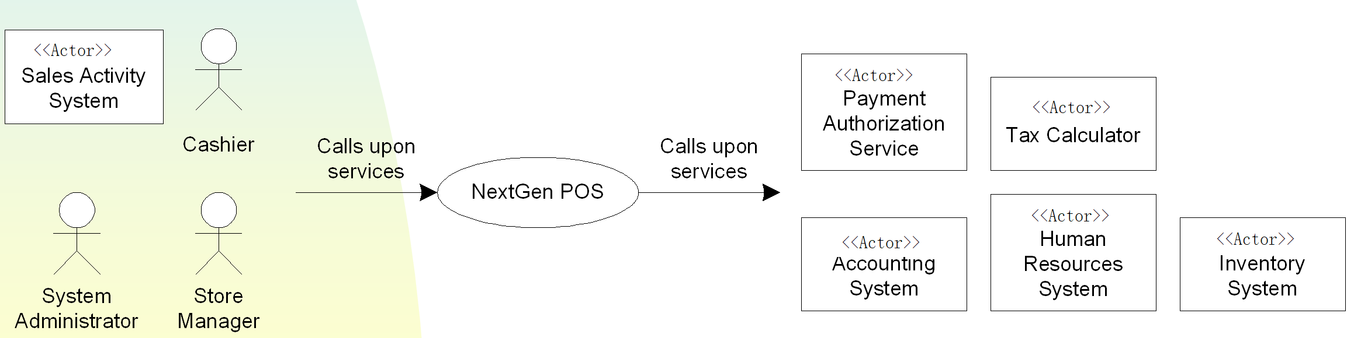
Vision 前景
Short summary of major functions, constraints, etc.
  Problem statement
  Important stakeholders and their important interstes
  Important actors and their important goals
  Product overview
OOAD Lecture, Author: NK Jiang

Slide 53
Example for NextGen POS in Ch7.4
Usability (Human Factors)
  The customer will be able to see a large-monitor display of the POS. Therefore:
    Text should be easily visible from 1 meter.
    Avoid colors associated with common forms of color blindness
Performance
  authorization in less than1 minute, 90% of the time
Implementation Constraints
  NextGen leadership insists on a Java technologies solution, predicting this will improve long-term porting and supportability, in addition to ease of development
OOAD Lecture, Author: NK Jiang

Slide 54
Example for NextGen POS in Ch7.5
Elements of the Supplementary Specification include:
  FURPS+ requirementsfunctionality, usability, reliability, performance, and supportability
  reports
  hardware and software constraints (operating and networking systems, …)
  development constraints (for example, process or development tools)
  other design and implementation constraints
  internationalization concerns (units, languages)
  documentation (user, installation, administration) and help
  licensing and other legal concerns
  packaging
  standards (technical, safety, quality)
  physical environment concerns (for example, heat or vibration)
  operational concerns (for example, how do errors get handled, or how often should backups be done?)
  application-specific domain rules
  information in domain
OOAD Lecture, Author: NK Jiang

Slide 55
Example for NextGen POS in Ch7.6
Vision
  Introduction
    We envision a next generation fault-tolerant point-of-sale (POS) application, NextGen POS, with the flexibility to support varying customer business rules, multiple terminal and user interface mechanisms, and integration with multiple third-party supporting systems.
  Business Opportunity
    There is marketplace dissatisfaction with this inflexible state of affairs, and demand for a POS that rectifies this
  Problem Statement
    Traditional POS systems are inflexible, fault intolerant, and difficult to integrate with third-party systems
  …
OOAD Lecture, Author: NK Jiang

Slide 56
Next class: ch9~10,ch15
  Key topic located in ch9: Domain Model
  Ch10,ch15: System sequence diagram.
    You should already understand(!?)
      Really?
      Please review / preparation
End
OOAD Lecture, Author: NK Jiang

