Slide 1
Object oriented Analysis &Design
面向对象分析与设计
Lecture_07 GRASP
Text Ch17： Designing Objects with Responsibilities
主讲: 姜宁康 博士
华东师范大学
软件学院
日期: 26/11/8

Slide 2
复习：契约Contract
Example,
void _test {
…
    Y = _f(X);
    ….
}
float _f (float x) {
return 1 / x;
}
调用的地方（Client）来判断 x>=0,比较合适
  不满足的时候，就不调用_f(x)
  相对于在 _f(x) (Server) 端判断，速度要快！
OOAD Lecture, Author: NK Jiang
<number>/57

Slide 3
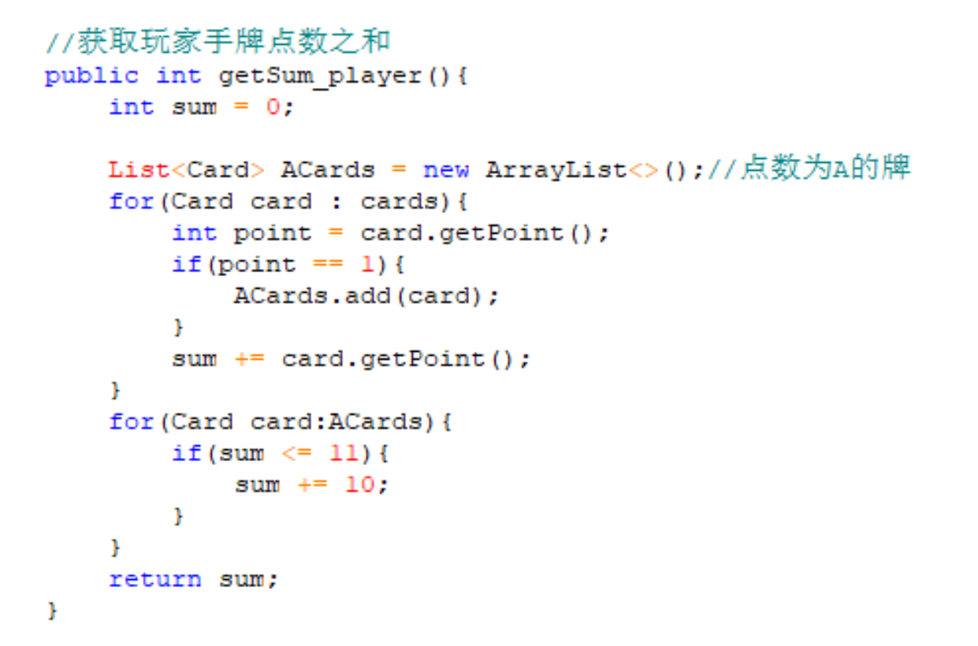

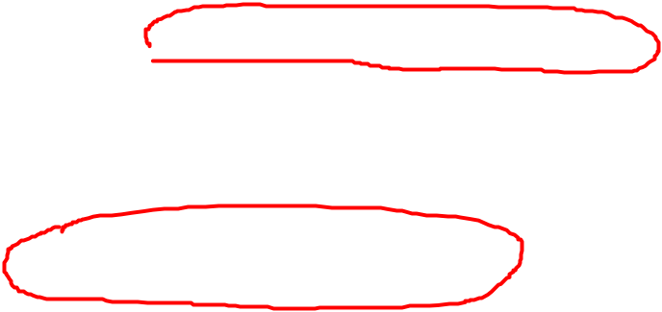
这里有问题吗？
调用两次，降低系统性能
Sum += point;//如何？
OOAD Lecture, Author: NK Jiang
<number>/57

Slide 4
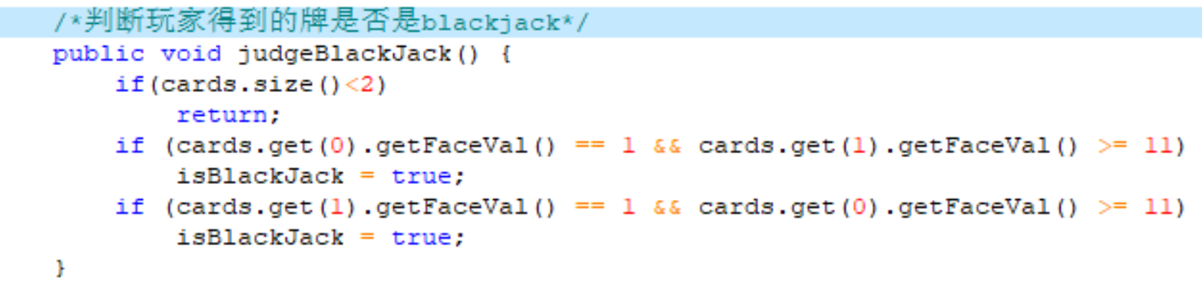
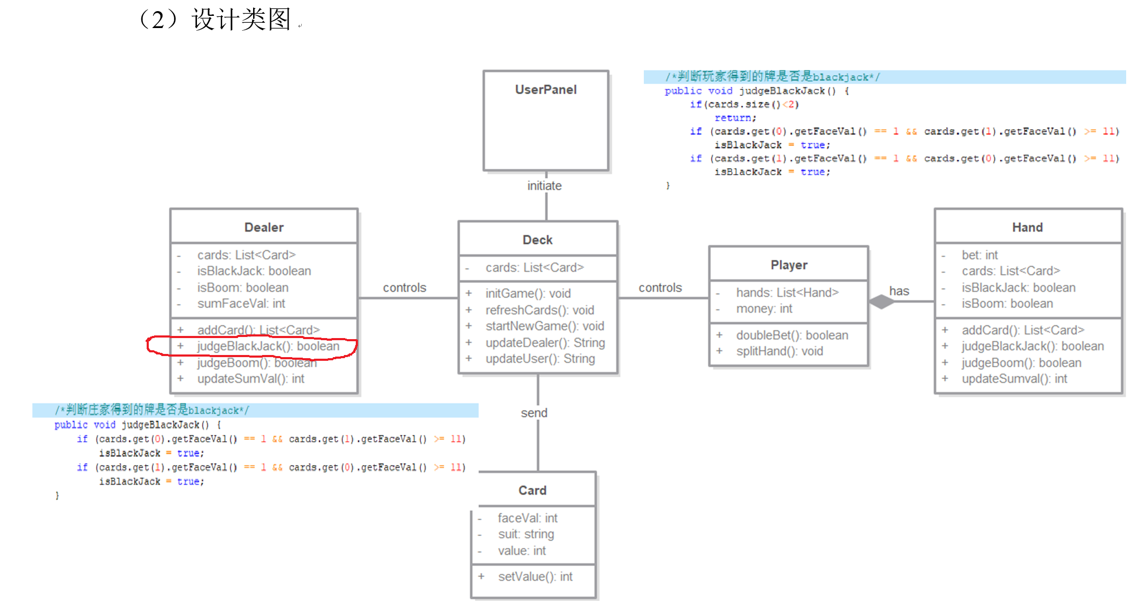

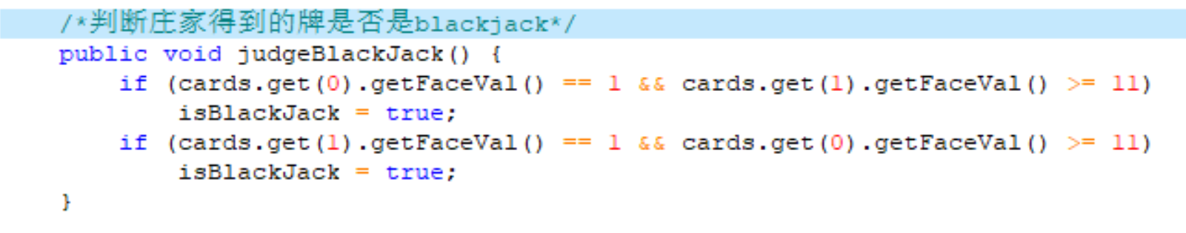
这里有问题吗？
OOAD Lecture, Author: NK Jiang
<number>/57
Notes:
这里有问题吗？
同一项功能（职责），最好不要在两个地方实现，容易不一致
isBlackJack标志: 作用域太广！很难判定这个值中途会否被其他地方修改掉
建议：直接返回 true 或者 FALSE。 在 某一个专门的地方设置 isBlackJack标志值
至少，在此函数的入口，重置一下 isBlackJack = False; 然后进行判断！
只有牌张数==2，才需要判断！？
无论如何，这两个条件都要计算一遍：效率呢？
逻辑运算符支持短路原则：
(表达式1）&&(表达式2) 如果表达式1为假，则表达式2不会进行运算，即表达式2“被短路”
(表达式1）||(表达式2) 如果表达式1为真，则表达式2不会进行运算，即表达式2“被短路”
有同学讨论过 Getter()、Setter（）函数，体会一下

Slide 5
这里有问题吗？
  同一项功能（职责），最好不要在两个地方实现，容易不一致
  isBlackJack标志: 作用域太广！很难判定这个值中途会否被其他地方修改掉
  建议：直接返回 true 或者 FALSE。 在 某一个专门的地方设置 isBlackJack标志值
  至少，在此函数的入口，重置一下 isBlackJack = False; 然后进行判断！
  只有牌张数==2，才需要判断！？
  无论如何，这两个条件都要计算一遍：效率呢？
    逻辑运算符支持短路原则：
    (表达式1）&&(表达式2) 如果表达式1为假，则表达式2不会进行运算，即表达式2“被短路”
    (表达式1）||(表达式2) 如果表达式1为真，则表达式2不会进行运算，即表达式2“被短路”
  有同学讨论过 Getter()、Setter() 函数，体会一下
OOAD Lecture, Author: NK Jiang
<number>/57

Slide 6
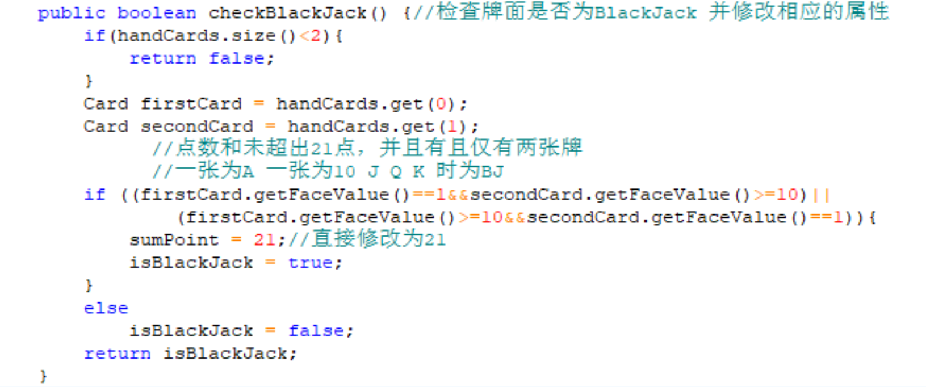
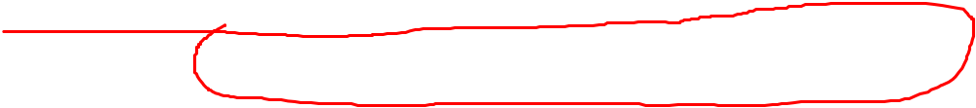
建议思路：
  第一步计算一手牌的总面值
  第二步：两张牌 && （总面值==21 ） ----一定是BlackJack
OOAD Lecture, Author: NK Jiang
<number>/57

Slide 7
1、Definition
GRASP:
  General responsibility assignment Software patterns
GRASP patterns are really more accurately described as best practices
  GRASP patterns outline best practices which can be employed in any object-oriented design (OOD)
  These best practices, if used properly, will lead to maintainable, reusable, understandable, and easy to develop software
OOAD Lecture, Author: NK Jiang
<number>/57

Slide 8
1、Definition
OOD
  defining software objects and how they collaborate to fulfill the requirements
OOD steps
  After identifying your requirements and creating a domain model, then add methods to the appropriate classes, and define the messaging between the objects to fulfill the requirements
  Deciding what methods belong where, and how the objects should interact, is very important and not trivial.
    This is a critical step at the heart of object-oriented development.
  The problem is
    Above advice are too general to be handled
    Deciding what methods belong where and how objects should interact carries consequences and should be undertaken seriously
OOAD Lecture, Author: NK Jiang
<number>/57

Slide 9
1、Definition
Responsibility
  GRASP --- (Responsibility)
    Responsibility-Driven Design (RDD)
    thinking about how to assign responsibilities to collaborating objects
Responsibilities is “a contract or obligation of a classifier” (UML definition)
  Responsibilities can include behaviour, data storage, object creation and more
  They often fall into two categories:
    Doing
    Knowing
OOAD Lecture, Author: NK Jiang
<number>/57

Slide 10
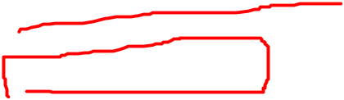
1、Definition
Responsibility
  Doing (行为职责）
    Do it yourself
      such as creating an object or doing a calculation
    initiating action in other objects
    controlling and coordinating activities in other objects
  Knowing（认知职责）
    knowing about private encapsulated data
    knowing about related objects
    knowing about things it can derive or calculate
The translation of responsibilities into classes and methods is influenced by the granu`larity of the responsibility.
  E.g. The responsibility
    “to provide access to relational databases"
    may involve dozens of classes and hundreds of methods, packaged in a subsystem.
  By contrast, the responsibility “to create a Sale" may involve only one or a few methods.
OOAD Lecture, Author: NK Jiang
<number>/57

Slide 11
1、Definition
Responsibilities
  are assigned to classes of objects during object design.
  For example, we may declare that
    "a Sale is responsible for creating SalesLineltems" (a doing), or
    “a Sale is responsible for knowing its total" (a knowing).
  Relevant（实质性的） responsibilities related to "knowing" are often inferable(能推理的) from the domain model, because of the attributes and associations it illustrates.
  与“认知”相关的实质性的职责，通常是可以从领域模型推断的出来的，因为领域模型显示了属性和概念类的关系
OOAD Lecture, Author: NK Jiang
<number>/57

Slide 12
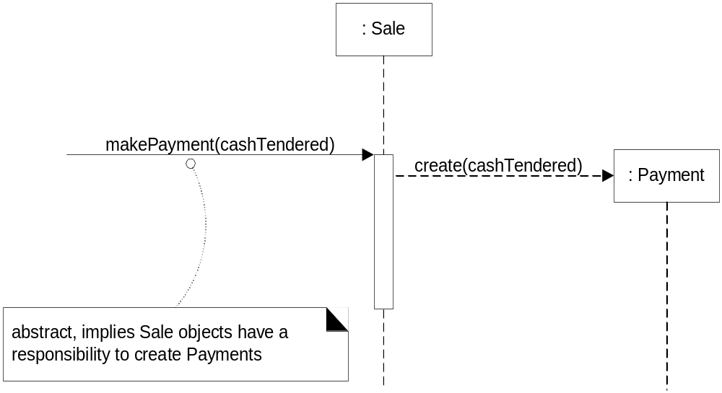
1、Definition
Responsibilities
  are often considered during the creation of interaction diagrams.
  E.g , Sale objects have been given a responsibility to create Payments, which is invoked with a makePayment message and handled with a corresponding makePayment method
System
System Event
OOAD Lecture, Author: NK Jiang
<number>/57

Slide 13
2、Inputs for OO design
  Supplementary Specs
  Glossary
    Data dictionary
  Use Case under development, with System Sequence Diagram (System operations) and Contracts
  Conceptual Model
    Cf: (in OOD, we have Design Model)
OOAD Lecture, Author: NK Jiang
<number>/57

Slide 14
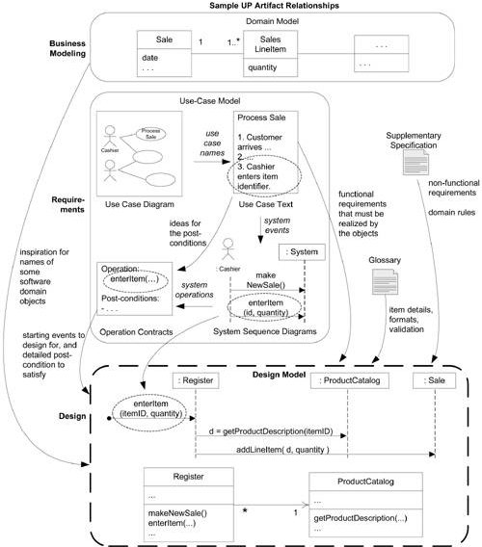
Artifact Influences
OOAD Lecture, Author: NK Jiang
<number>/57

Slide 15
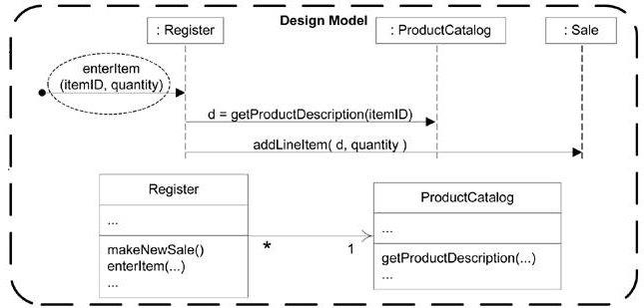
3、Outputs from OO design
Outputs from design: Design Model
  Interactions, class diagram, etc
  Packages
OOAD Lecture, Author: NK Jiang
<number>/57
Notes:
Alexander, C., The Timeless Way of Building, New York: Oxford University Press, 1979
It is important to realize that the Gang of Four did not create the patterns described in the book. Rather, they identified patterns that already existed within the software community, patterns that reflected what had been learned about high-quality designs for specific problems

Slide 16
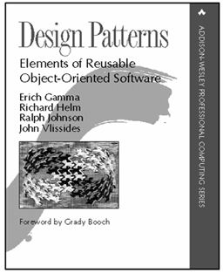

3、Outputs from OO design
How?
  Apply Patterns and principles of responsibility assignments
    GRASP (General responsibility assignment Software pattern)
      A set of (9) principles
    GoF (Gang of Four patterns)
      Famous 23 patterns
    Others
      OCP, …
Design Patterns Explained A New Perspective on Object-Oriented Design Second Edition
By Alan Shalloway, James R. Trott
OOAD Lecture, Author: NK Jiang
<number>/57
Notes:
Alexander, C., The Timeless Way of Building, New York: Oxford University Press, 1979
It is important to realize that the Gang of Four did not create the patterns described in the book. Rather, they identified patterns that already existed within the software community, patterns that reflected what had been learned about high-quality designs for specific problems

Slide 17
4、Patterns
In object technology, a pattern is a named description of a problem and solution that can be applied to new contexts;
ideally, it provides advice in how to apply it in varying circumstances, and considers the forces and trade-off's. Many patterns provide guidance for how responsibilities should be assigned to objects, given a specific category of problem.
Most simply, a pattern is a named problem/solution pair that can be applied in new contexts, with advice on how to apply it in novel situations and discussion of its trade-off's.
Alexander, C., The Timeless Way of Building建筑的永恒之道 , New York: Oxford University Press, 1979
It is important to realize that the Gang of Four did not CREATE the patterns described in the book. Rather, they IDENTIFIED patterns that already existed within the software community, patterns that reflected what had been learned about high-quality designs for specific problems
OOAD Lecture, Author: NK Jiang
<number>/57
Notes:
GRASP模式着重考虑设计类的原则及如何分配类的功能，而GoF模式则着重考虑设计的实现、类的交互及软件质量。可以说，GoF就是符合GRASP模式要求的面向对象设计模式。
模式不是发明与创造，而是来自我们日常设计开发中的发现与总结，是一种实践经验的积累，它带我们走向成熟。

Slide 18
4、Patterns
Experienced object-oriented developers (and other software developers) build up a repertoire of both general principles and idiomatic solutions that guide them in the creation of software.
These principles and idioms, if codified in a structured format describing the problem and solution, and given a name, may be called patterns. For example, here is a sample pattern:
  Pattern Name: Information Expert
  Problem It Solves: What is a basic principle by which to assign responsibilities to objects?
  Solution: Assign a responsibility to the class that has the information needed to fulfill it.
OOAD Lecture, Author: NK Jiang
<number>/57

Slide 19
5、GRASP Patterns
GRASP
  General Responsibility Assignment Software Patterns
  Understanding and being able to apply the ideas behind GRASP while coding or while drawing interaction and class diagrams enables developers new to object technology needs to master these basic principles as quickly as possible; they form a foundation for designing OO systems(对象技术初学者在编码或绘制交互图和类图时，应该理解并应用GRASP的内在思想，以便尽快地掌握这些基本原则，它们是设计OO系统的基础)
The GRASP patterns are a learning aid to help one understand essential object design, and apply design reasoning in a methodical, rational, explainable ways.
  (GRASP原则可以帮助设计人员理解面向对象设计的本质，并以一种有条理的、理性的、可解释的方式应用这些设计原则)
OOAD Lecture, Author: NK Jiang
<number>/57

Slide 20
5、GRASP Patterns
GRASP patterns describe fundamental principles of object design and responsibility assignment. The following is a list of GRASP patterns:
  Information Expert
  Creator
  High Cohesion
  Low Coupling
  Controller
  Polymorphism
  Indirection
  Pure Fabrication
  Protected Variations
OOAD Lecture, Author: NK Jiang
<number>/57

Slide 21
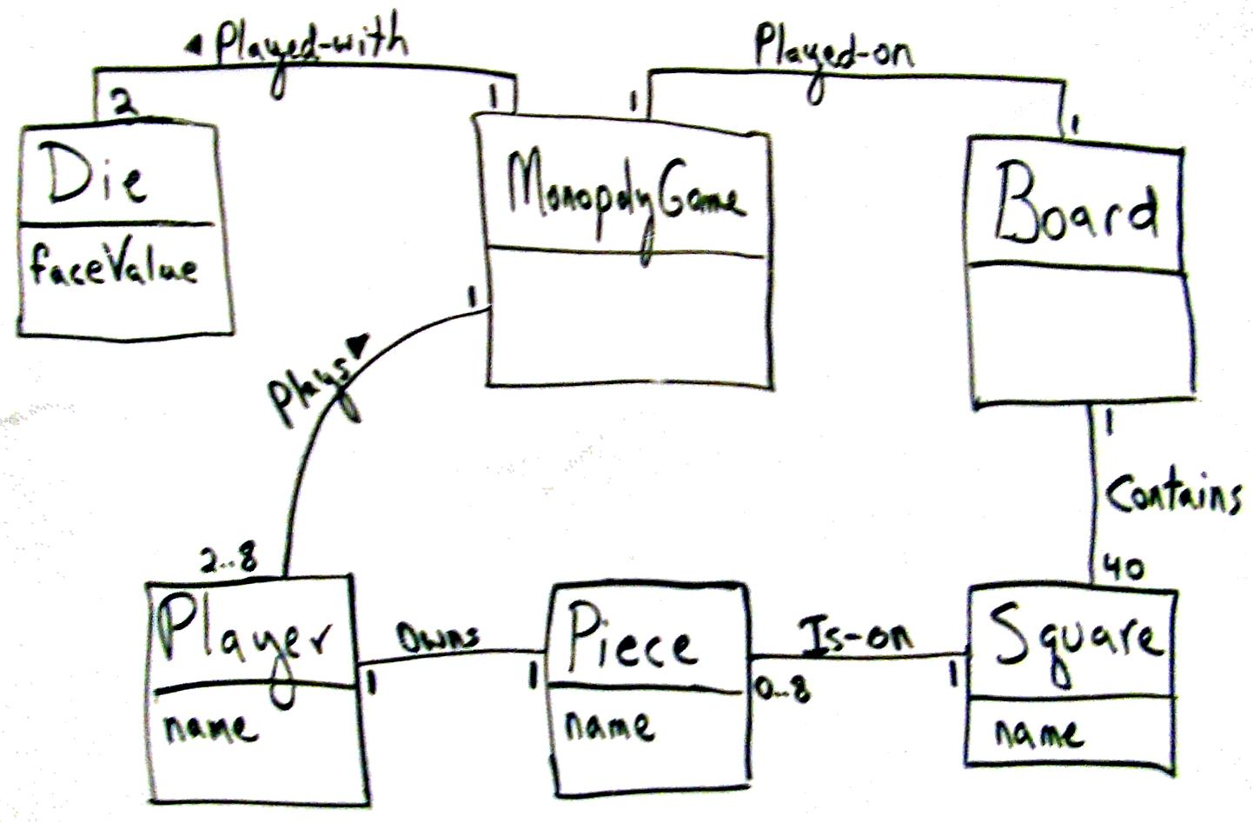
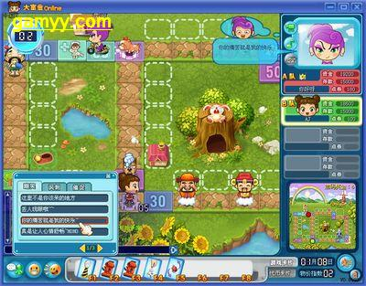
Mini Exercise 1
Figure 17.3. Monopoly iteration-1 domain model
Who will create Square object in Monopoly ? Why?
Thinking steps
  Have no design model, so start with Domain Model
  LRG: Low representational gap — build design model (dynamic and static)
OOAD Lecture, Author: NK Jiang
<number>/57

Slide 22
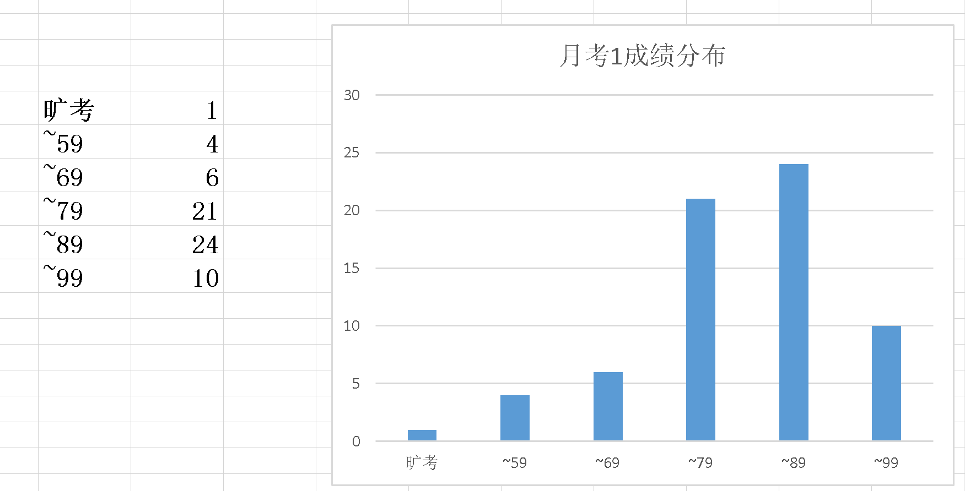
Tip
  如果代码的目的和行为很难读懂，则设计出了问题
  注释，是解释代码中不明显的地方、隐含的知识
    软件架构第二定律：原因比结果重要！
OOAD Lecture, Author: NK Jiang
<number>/57

Slide 23
5.1 GRASP rule1: Creator (创建者)
Name: Creator
Problem:
  Who should be responsible for creating a new instance of some class?
Solution:
  Assign class B the responsibility to create an instance of class A if one of these is true (the more the better) :
  1. B “contains” or compositely aggregates A
  2. B records A
  3. B closely uses A
  4. B has the initializing data for A that will be passed to A when it is created (B is an expert with respect to A)
  如果有一个以上的选项适用，通常首选 聚集 或包含A的类
Note:
  B and A refer to software objects, not domain model objects
OOAD Lecture, Author: NK Jiang
<number>/57
Notes:
With respect to,意思应该译为:关于或很荣幸

Slide 24
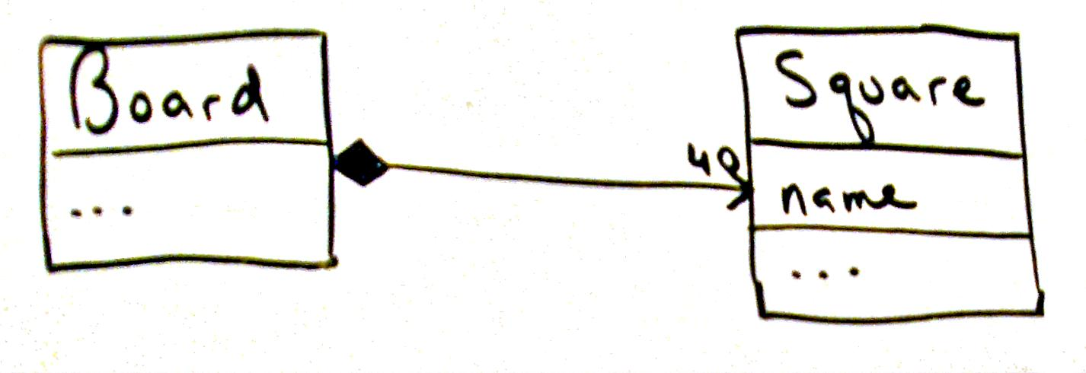
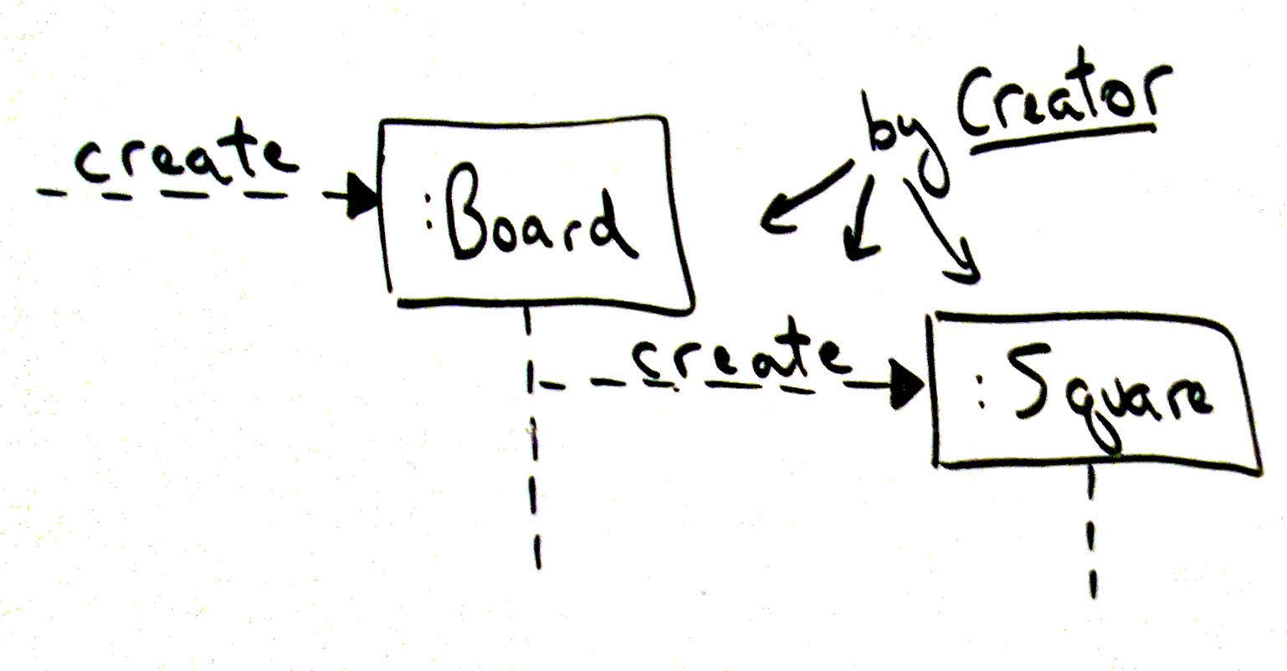
5.1 Creator : example Monopoly
Board create Square
  Because of ‘Board’ contains ‘Square’
Who create ‘Board’?
OOAD Lecture, Author: NK Jiang
<number>/57

Slide 25
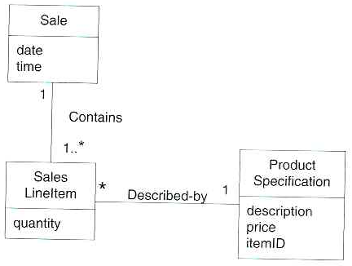
5.1 Creator : POS example
Consider the partial domain model : In the POS application, who should be responsible for creating a SalesLineltem instance?
By Creator, we should look for a class that aggregates, contains, and so on, SalesLineltem instances.
OOAD Lecture, Author: NK Jiang
<number>/57

Slide 26
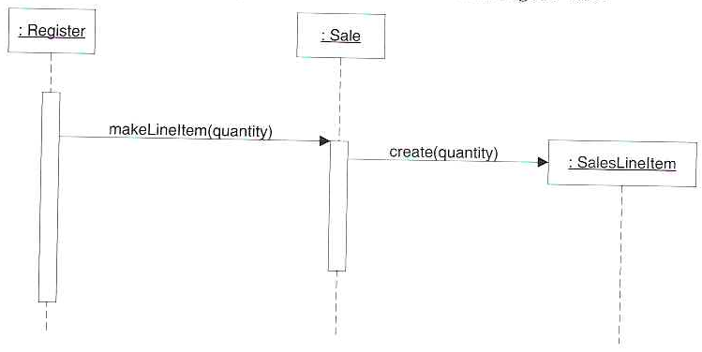
5.1 Creator : POS example
Since a Sale contains (in fact, aggregates) many SalesLineltem objects, the Creator pattern suggests that Sale is a good candidate to have the responsibility of creating SalesLineltem instances.
This leads to a design of object interactions as shown :
Figure 17-13
OOAD Lecture, Author: NK Jiang
<number>/57

Slide 27

Mini Exercise 2
Given a key, which object can tell me about
  …Square in Monopoly
  …Total money of a sale in POS
Note:
  this is a knowing responsibility
OOAD Lecture, Author: NK Jiang
<number>/57

Slide 28
5.2 GRASP rule2: Information Expert
Name: Information Expert(信息专家)
Problem:
  What is a general principle of assigning responsibility to objects?
Solution:
  Assign responsibility to the class that has the information necessary to fulfill responsibility
OOAD Lecture, Author: NK Jiang
<number>/57

Slide 29
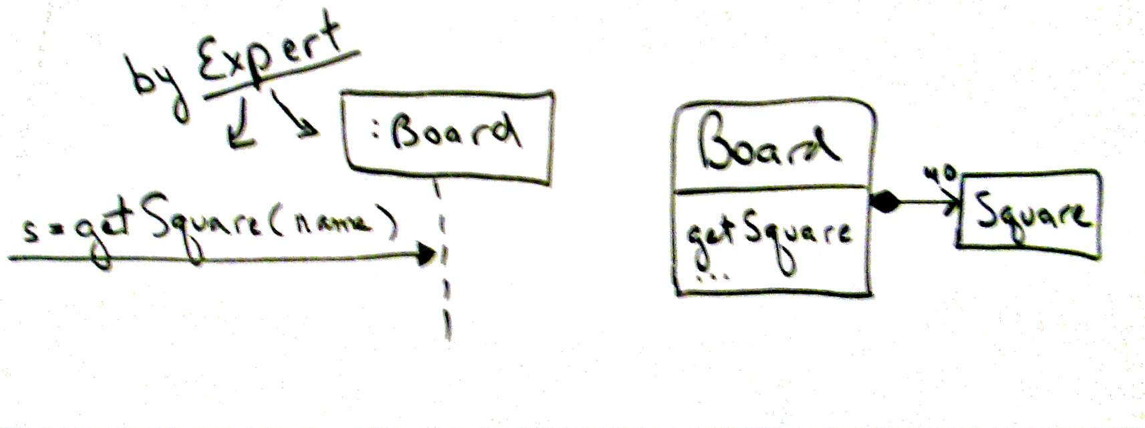
5.2 Information Expert
Information
  an object's own state,
  about other objects, the world around an object,
  information the object can derive,
  and so forth
Answer to Mini exercise 2
Figure 17.6. Applying Expert
OOAD Lecture, Author: NK Jiang
<number>/57
Notes:
鸡鸣狗盗
战国时候，齐国的孟尝君喜欢招纳各种人做门客，号称宾客三千。他对宾客是来者不拒有才能的让他们各尽其能，没有才能的也提供食宿。
有一次，孟尝君率领众宾客出使秦国。秦昭王将他留下，想让他当相国。孟尝君不敢得罪秦昭王，只好留下来。不久，大臣们劝秦王说：“留下孟尝君对秦国是不利的，他出身王族，齐国有封地，有家人，怎么会真心为秦国办事呢？”秦昭王觉得有理，便改变了主意，把孟尝君和他的手下人软禁起来，只等找个借口杀掉。
泰昭王有个最受宠爱的妃子，只要妃子说一，昭王绝不说二。孟尝君派人去求她救助。妃子答应了，条件是拿齐国那一件天下无双的狐白裘（用白色狐腋的皮毛做成的皮衣）做报酬。这可叫孟尝君作难了，因为刚到秦国，他便把这件狐白裘献给了秦昭王。就在这时候，有一个门客说：“我能把狐白裘找来！”说完就走了。
原来这个门客最善于钻狗洞偷东西。他先摸清情况，知道昭王特别喜爱那件狐裘，一时舍不得穿，放在宫中的精品贮藏室里。他便借着月光，逃过巡逻人的眼睛，轻易地钻进贮藏室把狐裘偷出来。妃子见到
狐白裘高兴极了，想方设法说服秦昭王放弃了杀孟尝君的念头，并准备过两天为他饯行，送他回齐国。
孟尝君可不敢再等过两天，立即率领手下人连夜偷偷骑马向东快奔。到了函谷关（在现在河南省灵宝县，当时是秦国的东大门）正是半夜。按秦国法规，函谷关每天鸡叫才开门，半夜时候，鸡可怎么能叫呢？大家正犯愁时，只听见几声“喔，喔，喔”的雄鸡啼鸣，接着，城关外的雄鸡都打鸣了。
原来，孟尝君的另一个门客会学鸡叫，而鸡是只要听到第一声啼叫就立刻会跟着叫起来的。怎么还没睡踏实鸡就叫了呢？守关的士兵虽然觉得奇怪，但也只得起来打开关门，放他们出去。
天亮了，秦昭王得知孟尝君一行已经逃走，立刻派出人马追赶。追到函谷关，人家已经出关多时了。
孟尝君靠着鸡鸣狗盗之士逃回了齐国。

Slide 30
5.2 Information Expert — How to?
1. Clearly state the responsibility
2. Look in Design Model for relevant classes
3. Else look in Domain Model and create design classes
OOAD Lecture, Author: NK Jiang
<number>/57

Slide 31
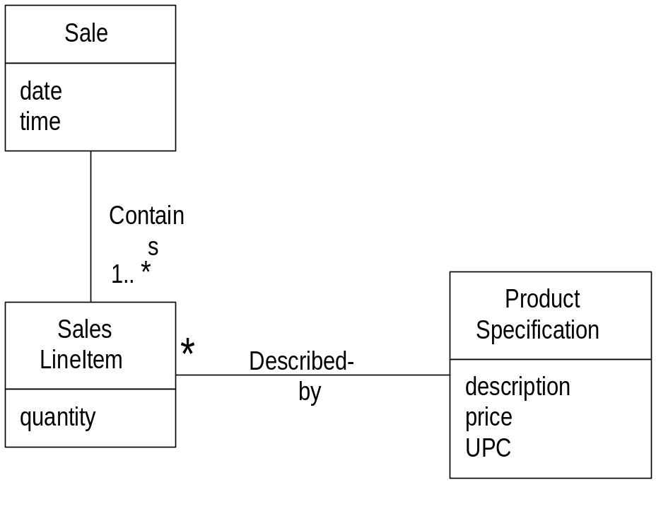
5.2 Information Expert — Sale Total Example
Who should know the grand total (总计) of a sale?
Total = ∑price_{i} *qty_{i}
Tell me the total money?
Product Specification has information about Price so it is expert for that (getPrice method)
SalesLineItems has information about ProductSpec and Quantity so it is expert for PriceTotal (getPriceTotal method)
Sale has information SalesLineItems with associated PriceTotal so it is expert for SaleTotal (getSaleTotal method)
OOAD Lecture, Author: NK Jiang
<number>/57

Slide 32
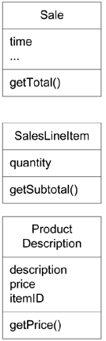
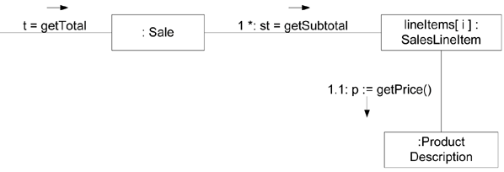

5.2 Information Expert — Sale Total
Figure 17.17. Calculating the Sale total
getSubTotal == getPriceTotal
getTotal == getSaleTotal
OOAD Lecture, Author: NK Jiang
<number>/57

Slide 33
5.2 Information Expert — Sale Total
Hence responsibilities assign to the 3 classes.
Class
Responsibility
Sale
knows sale total
SalesLineItem
knows line item subtotal
ProductSpecification
knows product price
OOAD Lecture, Author: NK Jiang
<number>/57

Slide 34
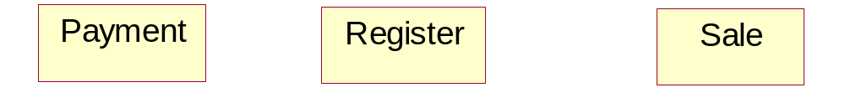
Mini-Exercise 3
Who creates the Payment?
makePayment method invoked in Register
A Payment has to be associated with the Sale
Who creates the Payment instance?
  By creator ➔ Register, Sale are candidates
OOAD Lecture, Author: NK Jiang
<number>/57

Slide 35
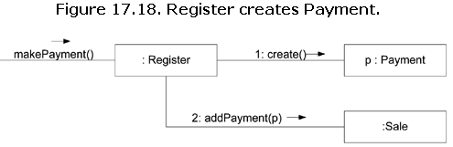
Mini-Exercise 3
Solution 1
Solution 1 — Justification
  Register records Payment
    Creator pattern
  addPayment method passes p instance of Payment as parameter
  Register coupled to Payment class
OOAD Lecture, Author: NK Jiang
<number>/57

Slide 36
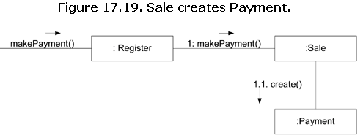
Mini-Exercise 3
Solution 2
OOAD Lecture, Author: NK Jiang
<number>/57

Slide 37
Coupling
Measure of how strongly one element is:
  1. connected to
  2. has knowledge of
  3. relies on
another element
(耦合：一个元素与其它元素的联接、感知以及依赖的程度的度量)
Cohesion,内聚：模块内的操作之间联系紧密的程度
Coupling，耦合：两个子模块之间联系的强度
OOAD Lecture, Author: NK Jiang
<number>/57

Slide 38
Coupling
Problems with High Coupling
  Forced local changes because of changes in related class
    If there is coupling or dependency, then when the depended-upon element changes, the dependant may be affected.
  Harder to understand in isolation
  Harder to reuse — drags in more classes
OOAD Lecture, Author: NK Jiang
<number>/57

Slide 39
5.3 GRASP rule3： Low Coupling
Name: Low Coupling
Problem:
  How to support low dependency, low change impact and increased reuse?
Solution:
  Assign responsibility so coupling remains low.
    Use this principle to evaluate alternatives
    All other things being equal prefer the low coupling solution
Note: Information Expert encourages Low Coupling
Why most secret service (spy) is one-way contact? 为什么特务工作都是单线联系？
OOAD Lecture, Author: NK Jiang
<number>/57

Slide 40
5.3 Low Coupling
Low Coupling is a principle to keep in mind during all design decisions; it is an underlying goal to continually consider.
It is an evaluative principle that a designer applies while evaluating all design decisions.
(For Example, in Java),
common forms of coupling from X to Y include:
X has an attribute that refers to Y.
X calls on services of Y.
X has a method that references Y (parameter, local variable, or return value).
X is a direct or indirect subclass of Y.
Y is an interface, and X implements that interface.
OOAD Lecture, Author: NK Jiang
<number>/57

Slide 41
5.3 Low Coupling
The extreme case of Low Coupling is when there is no coupling between classes.
  This is not desirable
    because a central metaphor of object technology is a system of connected objects that communicate via messages
    Too little coupling means we aren’t a “collaborating community of objects”
  it yields a poor design
    because it leads to a few incohesive, bloated, and complex active objects that do all the work, with many very passive zero-coupled objects that act as simple data repositories.
Some moderate degree of coupling between classes is normal and necessary
  to create an object-oriented system in which tasks are fulfilled by a collaboration between connected objects
OOAD Lecture, Author: NK Jiang
<number>/57

Slide 42
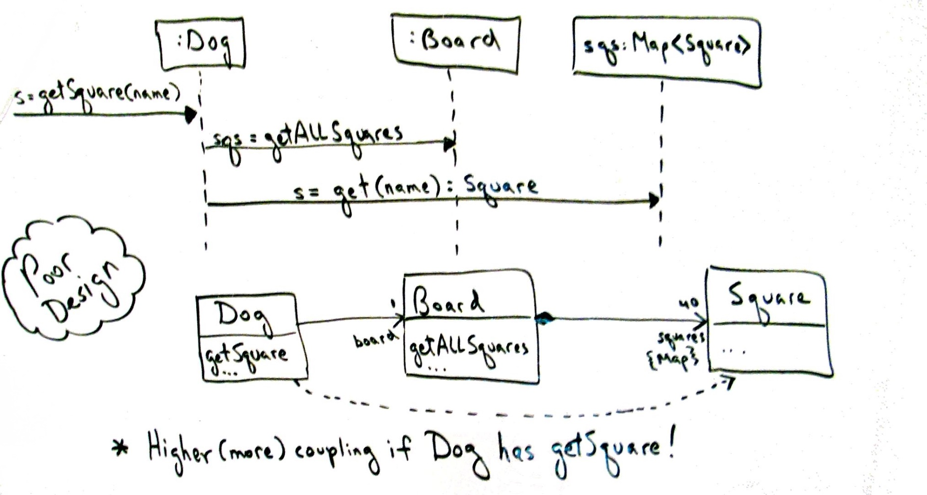
5.3 Example : Low Coupling
Why not assign getSquare to Dog (i.e., some arbitrary other class)?
Minimal coupling will reduce change (dependency)
OOAD Lecture, Author: NK Jiang
<number>/57

Slide 43
Mini Exercise 4
For Monopoly game, Which object starts the game?
Understanding the Problem
  SSD — boundary between the User and SUD (system under development)
  UI layer “catches” the request
  The request is a system operation — public interface
  Model-View Separation principle says UI must not contain business logic
  Problem: to which domain layer object should the UI pass the system operation ?
OOAD Lecture, Author: NK Jiang
<number>/57

Slide 44
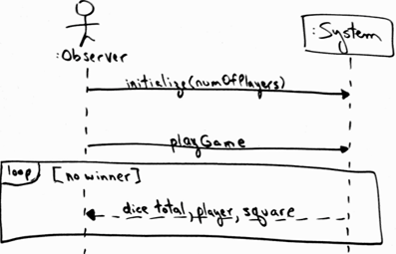
Figure 17.8. SSD for the Monopoly game.
Note the playGame operation
OOAD Lecture, Author: NK Jiang
<number>/57

Slide 45
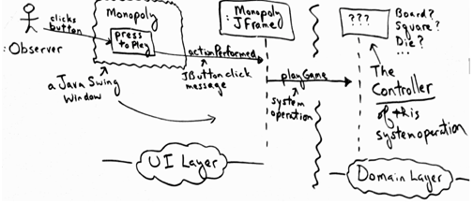
Assign responsibility to receive the system operations by an object which
  Representing System/subsystem/device or
  Handling just this use case
OOAD Lecture, Author: NK Jiang
<number>/57

Slide 46
5.4 GRASP rule4: Controller
Name: Controller
Problem:
  What first object beyond the UI layer receives and co-ordinates (controls) a system operation
Solution:
  Assign the responsibility to a class representing one of the following choices:
  1. Facade(外观) Controller :
    represents the overall system, a root object, a device that the object is running within, or a major sub-system
  2. Use Case or Session Controller :
    represents a use case scenario within which the system event occurs
OOAD Lecture, Author: NK Jiang
<number>/57

Slide 47
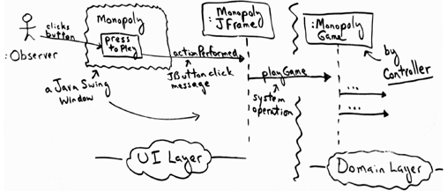
Mini Exercise 4 — Solution
The use case that the playGame system operation occurs within is called Monopoly Game.
  Thus, a software class such as PlayMonopolyGameHandler
OOAD Lecture, Author: NK Jiang
<number>/57

Slide 48
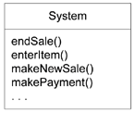
5.4 Controller — NextGen POS Example
Figure 17.20. Some system operations of the NextGen POS application
Conceptual representation — what is the class that handles these operations?
OOAD Lecture, Author: NK Jiang
<number>/57

Slide 49
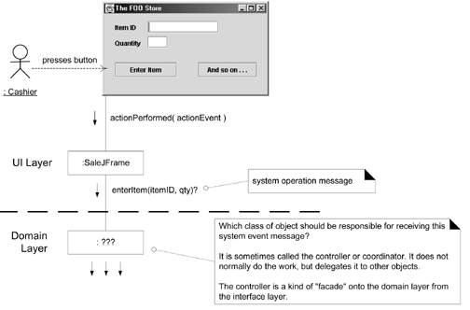
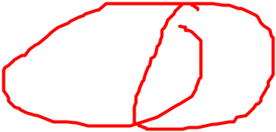
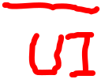
Figure 17.21. What object should be the Controller for enterItem?
OOAD Lecture, Author: NK Jiang
<number>/57

Slide 50
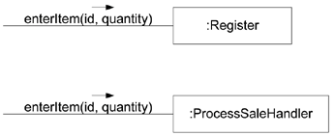
5.4 Controller Example for POS
(Solution) options
  Facade: Register, POSSystem
  Session: ProcessSaleHandler, ProcessSaleSession
Figure 17.22. Controller choices
OOAD Lecture, Author: NK Jiang
<number>/57

Slide 51
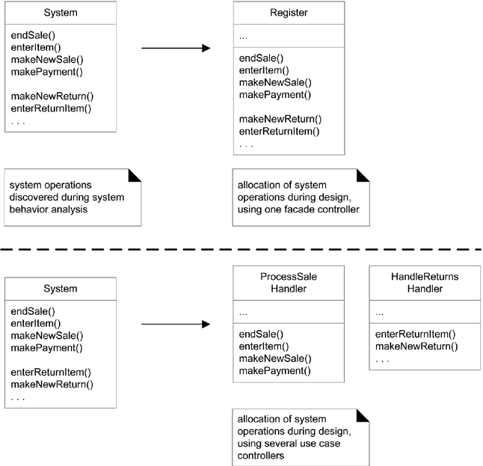
Figure 17.23. Allocation of system operations
OOAD Lecture, Author: NK Jiang
<number>/57

Slide 52
5.4 Controller — Observations
Delegation pattern
External input events may come from human actors or other systems
  Facade — the “face” of the domain layer to the world
    Ex: Register
  Handler — deals with a clear cut part of the issue事物一个明确的组成部分
    Ex: ProcessSale
  Note : Session — conversation where information needs to be retained between steps
OOAD Lecture, Author: NK Jiang
<number>/57

Slide 53
5.4 Controller — Facade
Facade外观模式：
  Provide a consistent interface for a set of interfaces in subsystem为子系统中的一组接口提供一个一致的界面
  “cover” over the other layers of the application
  Abstraction of an overall physical unit
    — Register, PizzaShop
  The entire software system
    — POSSystem
  Abstraction of some other overall system or sub-system concept
    — MonopolyGame
Suitable for
  relatively small systems
  and/or system with limited number of system operations
  in message handling system when can’t direct messages to alternative controllers
    — Internet application servers
OOAD Lecture, Author: NK Jiang
<number>/57
Notes:
Facade外观模式：为子系统中的一组接口提供一个一致的界面

Slide 54
5.4 Session Controller — Use Case
Pure Fabrication
  — ProcessSaleHandler is not a domain concept in Domain Model
When assigning to facade may lead to high coupling or low cohesion (“Bloat”)
Many system operations across different processes
Conceptually easier to understand and build
Session Controllers Naming conventions:
    <UseCaseName> Handler or
    <UseCaseName> CoOrdinator or
    <UseCaseName>Session
  Use same controller class for all system operations in the use case scenario
  Session is a type of conversation between the actor and the SUD
OOAD Lecture, Author: NK Jiang
<number>/57

Slide 55
5.5 GRASP rule 5：High Cohesion
Name：High Cohesion
Problem:
  How to keep objects focused, understandable and manageable, and as a side effect support Low Coupling?
Solution:
  Assign responsibility so cohesion remains high.
Dosage(用法):
  Used as an evaluation tool
OOAD Lecture, Author: NK Jiang
<number>/57

Slide 56
Cohesion Defined
measure of how strongly related and focused the responsibilities of an object are
  Cohesion,内聚：程序中的操作之间联系紧密的程度
  Cf: Coupling，耦合：两个子模块之间联系的强度
Metaphor: “不是一家人，不进一家门”
  Here, “人” compared to “?”
  “门” compared to “?”
Goal:
  highly related responsibilities
  small number of responsibilities
Judge：?
  An object with 100 methods in 2000 SLOC
        SLOC: 代码行数source lines of code
  Other object with 10 method in 200 SLOC
  Are you sure the big object can complete task without reference to outside object? (which will increase coupling)
OOAD Lecture, Author: NK Jiang
<number>/57
Notes:
代码行数(source lines of code

Slide 57
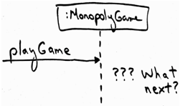
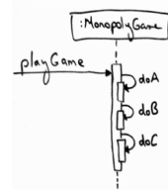
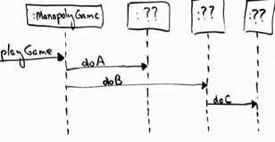

5.5 High Cohesion: Monopoly example
Based on the Controller decision, we are now at the design point
  two contrasting design approaches worth considering
OOAD Lecture, Author: NK Jiang
<number>/57
Notes:
不良内聚不只是意味着对象仅依靠自己工作，它或许 需要和大量其他对象进行协作
类比：为什么要软件外包？

Slide 58
Homework
  Review : Read Text book Ch17~18
End
OOAD Lecture, Author: NK Jiang
<number>/57

