Slide 1
Object orient Analysis &Design
面向对象分析与设计师
Lecture_13 More GRASP Pattern
Ch (22~24,)25
主讲: 姜宁康 博士
日期: 26/11/8

Slide 2
Ch 22. UML Tools and UML as Blueprint
three ways people wish to apply UML include:
  UML as sketch
  UML as blueprint
    This applies to both code and diagram generation. Relatively detailed diagrams guide some code generation (e.g., Java) with a tool.
    And diagrams are generated from the code to visualize the code base.
    After generating code, many fine details are usually filled in by developers while programming.
  UML as programming language Complete executable specification of a software system in UML
(Forward| Reverse|and Round-Trip)Engineering
  visualization learning aid to understand existing code
OOAD Lecture, Author: NK Jiang
<number>/50

Slide 3
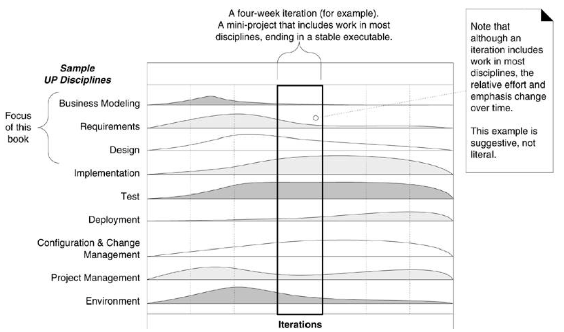
Ch 23. Iteration 2: More Patterns
（复习）Text Fig 2.7
OOAD Lecture, Author: NK Jiang
<number>/50

Slide 4
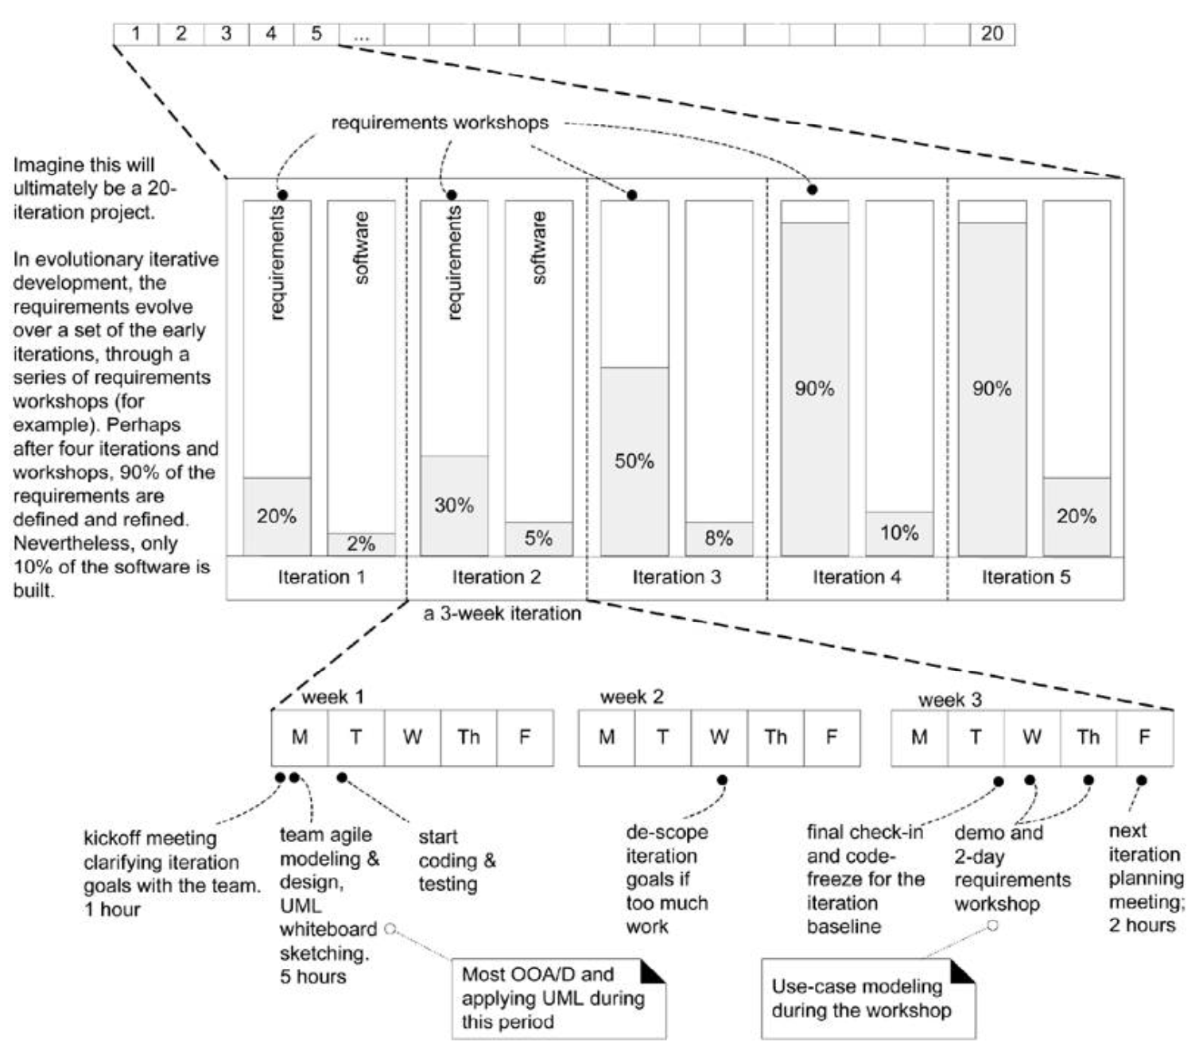
复习Text Fig 2.4
OOAD Lecture, Author: NK Jiang
<number>/50

Slide 5
Ch 23. Iteration 2: More Patterns
When iteration-1 ends, the following should be accomplished
  software tested: unit, acceptance, load, usability, and so on
  Customers engaged in and feedback
  stabilized baseline internal release
Prepare for next iteration
  需求变化、业务规则细化、考虑更多的用例
  制定本次迭代的计划活动等
  Ex, monopoly game,
    When a player lands on the Go square, the player receives $200.
    When a player lands on the Go-To-Jail square, they move to the Jail square.
    When a player lands on the Income-Tax square, the player pays the minimum of $200 or 10% of their worth.
OOAD Lecture, Author: NK Jiang
<number>/50

Slide 6
Chapter 23. Iteration 2: More Patterns
Identifying a superclass and subclasses ，when:
  The subclass has additional attributes of interest.
  The subclass has additional associations of interest.
  The subclass concept is operated on, handled, reacted to, or manipulated differently than the superclass or other subclasses, in noteworthy（显著） ways 如果子类在操作行为、处理方式或者反应等方面显著地不同于父类或者其他子类，则重新考虑“父类--子类”的关系
    比如，是否提炼公共方法？还是子类各自去做自己的事？
OOAD Lecture, Author: NK Jiang
<number>/50
Notes:
一般在一次迭代结束后，需要对出现的变化：需求、领域模型，进行相应的处理、精化。

Slide 7
More Input for OOD
  Additional requirements will be considered when design:
    Support for variations in third-party external services
    Complex pricing rules
    Pluggable business rules
    GUI window updates when information changes
  These points concern the same use case scenario, but address mostly non-functional requirements
  These requirements have a minor impact on the Domain Model
OOAD Lecture, Author: NK Jiang
<number>/50

Slide 8
Chapter 24. Quick Analysis Update
Identifying a superclass and subclasses ，when:
  The subclass has additional attributes of interest.
  The subclass has additional associations of interest.
  The subclass concept is operated on, handled, reacted to, or manipulated differently than the superclass or other subclasses, in noteworthy显著 ways
OOAD Lecture, Author: NK Jiang
<number>/50
Notes:
一般在一次迭代结束后，需要对出现的变化：需求、领域模型，进行相应的处理、精化。

Slide 9
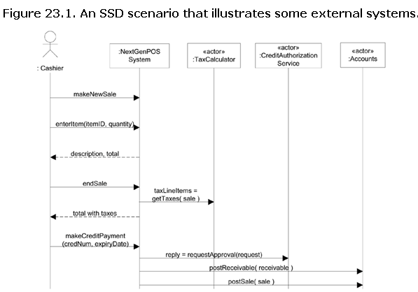
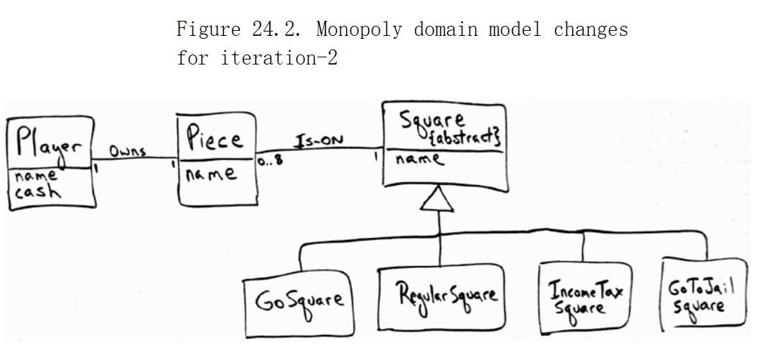
Chapter 24. Quick Analysis Update
  Usecase
    是否需要修改? It depends.
  System Operation Contracts ？
  SSD
    Add external interface
  Domain model
请注意与图25.2进行比较
OOAD Lecture, Author: NK Jiang
<number>/50
Notes:
一般在一次迭代结束后，需要对出现的变化：需求、领域模型，进行相应的处理、精化。

Slide 10
Ch25. More GRASP patterns
  Information Expert:
    responsibilities should be assigned to objects that contain relevant information
  Creator:
    the creator of an object is usually an object that contains, or aggregates it
  High Cohesion:
    responsibilities of a certain class must be highly related
  Low Coupling:
    interdependency between classes should remain low
  Controller:
    class which handles external system events
  Polymorphism: ???
  Indirection: ???
  Pure Fabrication: ???
  Protected Variations: ???
OOAD Lecture, Author: NK Jiang
<number>/50

Slide 11
1,Polymorphism(多态)
  Problem: How to handle alternative behaviors based on type? How to create pluggable software components?
  Solution: When related alternatives or behaviors vary by type (class), assign responsibility for the behavior using polymorphic operations to the types for which the behavior varies (使用多态操作 为 依据类型变化的行为 进行职责分配)
Corollary(推论): Do not test for the type of an object and use conditional logic to perform varying alternatives based on type.
  That is, don’t use conditional logic, but assign the same name to services (methods) in different classes.
  The different classes usually implement a common interface or are related in an implementation hierarchy with a common superclass (this is language-dependent)
OOAD Lecture, Author: NK Jiang
<number>/50
Notes:
Polymorphism has definition
A property of object oriented software by which an abstract operation may be performed in different ways in different classes
exists when several classes which each implement the operation either have a common superclass in which the operation exists, or else implement an interface that contains the operation
gets power from dynamic binding
is one of the fundamental features of the object oriented paradigm
dynamic binding
has definition The process of binding a call to a particular method. This is performed dynamically at run-time due to the presence of polymorphism
gives power to polymorphism
is needed when the compiler determines that there more than one possible method that could be executed by a particular call
is a kind of process
prevents programmers from having to write conditional statements to explicitly choose which code to run

Slide 12
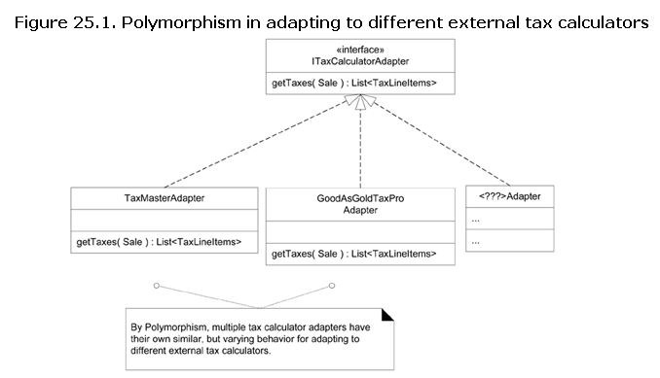
1, Polymorphism: example1
What objects should be responsible for handling these varying external tax calculator interfaces?
Adding a new tax calculator Adapter class with its own polymorphic
getTaxes method will have minor impact on the existing design.
OOAD Lecture, Author: NK Jiang
<number>/50

Slide 13
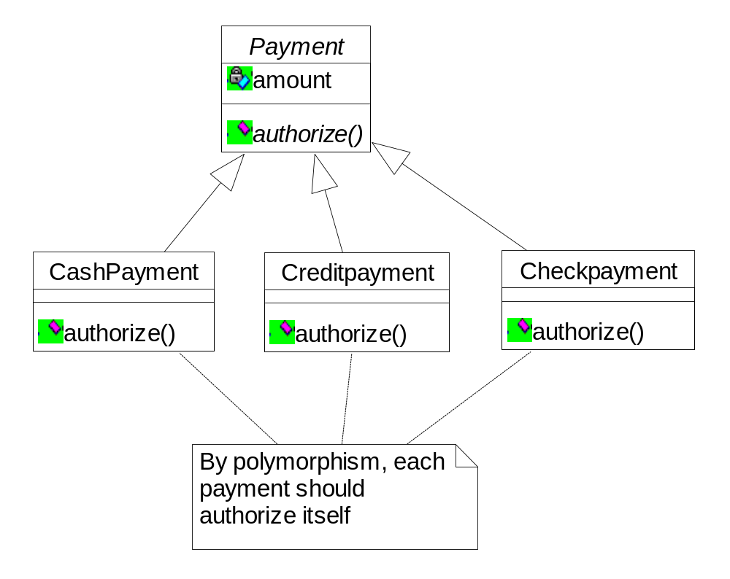
1, Polymorphism: example2
In the POS application, who should be responsible for authorising different kinds of payments?
– Note: Payments may be in
• cash (authorising involves determining if it is counterfeit)
• credit (authorising involves communication with bank)
• check (authorising involves driver license record)
OOAD Lecture, Author: NK Jiang
<number>/50
Notes:
In the point -of -sale application, who should be responsible
for authorising different kinds of payments?
– Note: Payments may be in
• cash (authorising involves determining if it is
counterfeit)
• credit (authorising involves communication with bank)
• check (authorising involves driver license record)

Slide 14
1, Polymorphism: example3
  Consider a bank application with two types of accounts: CheckingAccount and SavingsAccount.
    Suppose that you want to evaluate for each account the interest accumulated over a period.
    The implementation of evaluating interest is different for each account type. It uses a different set of interest rates.
OOAD Lecture, Author: NK Jiang
<number>/50

Slide 15
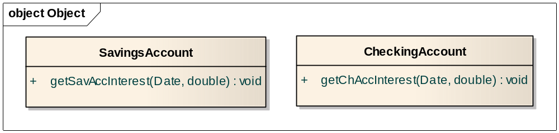
1, Polymorphism: example3(cont.)
  Solution 1: Class SavingsAccount with method getSavAccInterest(startDate, endDate), and class CheckingAccount with method getChAccInterest(startDate, endDate).
    First go through objects of class SavingsAccount and invoke their method getSavAccInterest(…)
    Then go through objects of class CheckingAccount and invoke their method getChAccInterest(…)
OOAD Lecture, Author: NK Jiang
<number>/50

Slide 16
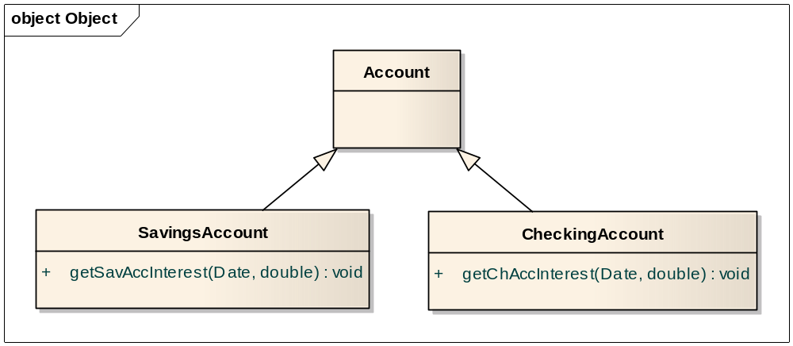
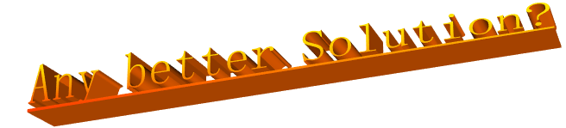
  Solution 2: Same as Solution 1, but SavingsAccount and CheckingAccount have the same superclass Account.
    Go through all objects of class Account. If an object is of subclass SavingsAccount, invoke getSavAccInterest(…), else invoke getChAccInterest(…)
OOAD Lecture, Author: NK Jiang
<number>/50

Slide 17
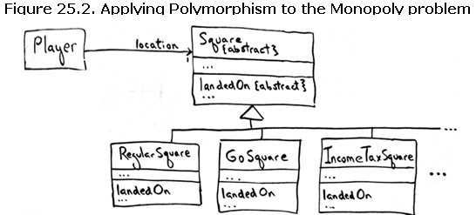
1, Polymorphism: example4
Monopoly Problem: How to Design for Different Square Actions?
// bad design
SWITCH ON square.type
CASE GoSquare: player receives $200
CASE IncomeTaxSquare: player pays tax
…
Solution（better design）：Applying Polymorphism rule
  to create a polymorphic operation for each type for which the behavior varies
  Landedon()
OOAD Lecture, Author: NK Jiang
<number>/50

Slide 18
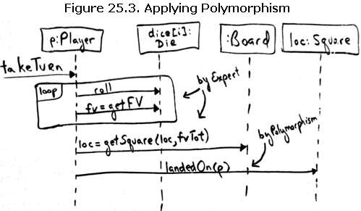
1, Polymorphism: example4
What object should send the landedOn message to the square that a player lands on?
  by the principles of Low Coupling and by Expert
    Player
OOAD Lecture, Author: NK Jiang
<number>/50

Slide 19
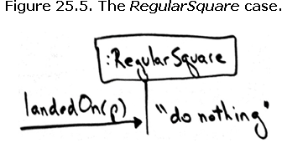
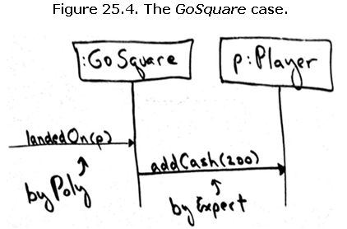
1, Polymorphism: example4
consider each of the polymorphic cases
  GoSquare: increase $200
consider each of the polymorphic cases
  1) Regular square : do nothing
OOAD Lecture, Author: NK Jiang
<number>/50

Slide 20
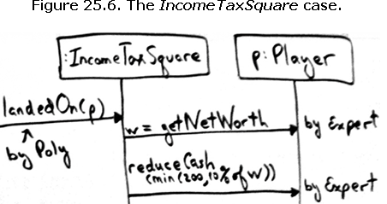
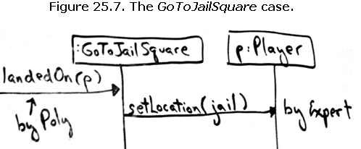
1, Polymorphism: example4
  2) Income Taxsquare :decrease 10% of total money
  3) GoToJail Square
OOAD Lecture, Author: NK Jiang
<number>/50

Slide 21
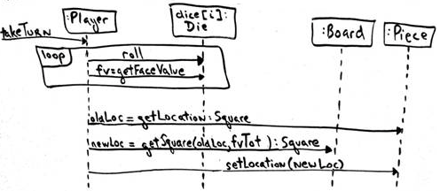
1, Polymorphism: example4
Improve the Coupling
  Figure 18.25. Dynamic design for playGame.
  a refactoring opportunity to improve coupling when object A keeps needing the data in object B, it implies either
    1) object A should hold that data, or
    2) object B should have the responsibility (by Expert) rather than object A.
Piece remembers the square location but the player does not！
…<再想想>
Piece 不一定需要了
OOAD Lecture, Author: NK Jiang
<number>/50

Slide 22
2, Pure Fabrication
  Problem: What objects should have the responsibility, when you do not want to violate High Cohesion and Low Coupling, or other goals, but solutions offered by Expert (for example) are not appropriate?
  问题：既不违反低耦合、高内聚或其他的原则，但依据信息专家原则获得的解决方案又不合适的情况下，如何把职责分配给对象？
  Solution: Assign a highly cohesive set of responsibilities to an artificial or convenience class that does not represent a problem domain concept – something made up to support high cohesion, low coupling, and reuse.
  解决方案： 把高度内聚的职责分配给人为虚构出来的一个类，这个类在领域模型里没有对应的概念。
  这种方式在有的场合能起到支持低耦合高内聚、重用的效果
OOAD Lecture, Author: NK Jiang
<number>/50

Slide 23
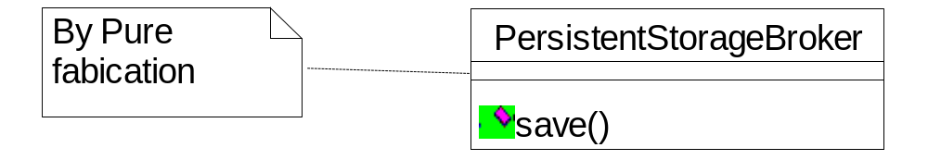
2, Pure Fabrication: example1
  Where to assign the responsibility to save a Sale object?
    Even though the Sale is a logical candidate to save itself in the database (by virtue of Information Expert), it leads to a design with low cohesion (why?) and low reuse potential (why?)
  Solution: Fabricate a new class PersistentStorage with the purpose of managing objects in persistent storage medium
The Sale remains well design, with high cohesion and low coupling
The PersistentStorageBroker class is itself relatively cohesive
The PersistentStorageBroker class is a very generic and reusable object
OOAD Lecture, Author: NK Jiang
<number>/50

Slide 24
2, Pure Fabrication: example2
  Assign a highly cohesive set of responsibilities to an artificial or convenience class that does not represent a problem domain concept – something made up to support high cohesion, low coupling, and reuse.
  Example: Consider a bank application with objects of class Account, Customer, Transaction etc. that need to be inserted into, updated, or deleted from the database.
  Solution 1: By Information Expert, assign methods insertIn(OODB db), update(OODB db), deleteFrom(OODB db) to classes Account, Customer, Transaction etc.
  Solution 2: Use polymorphism and assign methods insertIn(OODB db), update(OODB db), deleteFrom(OODB db) to superclass Object.
OOAD Lecture, Author: NK Jiang
<number>/50

Slide 25
2, Pure Fabrication: example2(cont.)
  Solution 3: Since these functions are highly correlated, and they do not concern domain logic, group them together into class OODB with methods insert(Object obj), delete(Object obj), update(Object obj).
  What are the advantages of solution 2 over solution 1?
  What are the advantages of solution 3 over solution 2?
OOAD Lecture, Author: NK Jiang
<number>/50

Slide 26
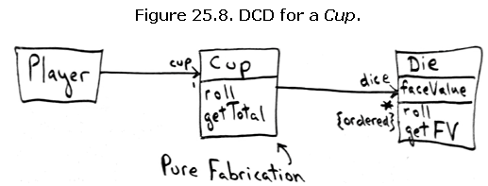
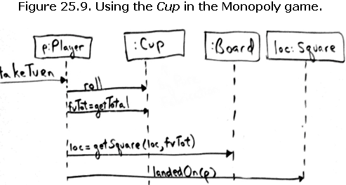
2, Pure Fabrication: example3
Monopoly Problem: Handling the Dice
OOAD Lecture, Author: NK Jiang
<number>/50

Slide 27
2, Pure Fabrication
Lessons from Fabrication
  A Pure Fabrication should be designed with high potential for reuse.
    – The responsibilities must remain small and cohesive.
    Reuse potential should increase
  Many existing object-oriented patterns are examples of Pure Fabrication.
  It is partitioned on related functionality, and so is a kind of function-centric object.
  High Cohesion is supported if functions are highly related
  DANGER:
    design of objects can be broadly divided into two groups:
      representational decomposition, ex, sale
      behavioral decomposition, ex, PersistentStorage
    may lead to function or process-oriented analysis and design implemented in an OO language
  The spirit must remain object-centric
OOAD Lecture, Author: NK Jiang
<number>/50
Notes:
Lessons from Fabrication
• A Pure Fabrication should be designed with high
potential for reuse.
– The responsibilities must remain small and
cohesive.
• It is partitioned on related functionality, and so is a
kind of function-centric object.
• Many existing object-oriented patterns are examples
of Pure Fabrication.
• High Cohesion is supported if functions are highly related
• Reuse potential should increase
• DANGER: may lead to function or process-oriented analysis
and design implemented in an OO language
– The spirit must remain object-centric
• there is a somebody in charge of this

Slide 28
3, Indirection
  Problem: Where to assign a responsibility to avoid direct coupling between two or more objects? How to de-couple objects so that reuse potential remains higher?
  Solution: Assign the responsibility to an intermediate object to mediate between other components or services so that they are not directly coupled.
OOAD Lecture, Author: NK Jiang
<number>/50
Notes:
Discussion:
"Most problems in computer science can be solved by another level of indirection" is an old adage with particular relevance to object-oriented designs

Slide 29
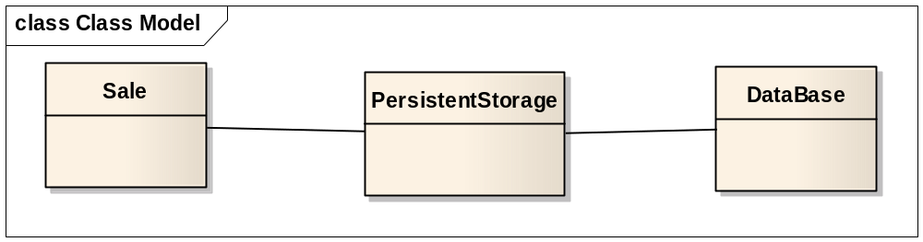
3, Indirection: example1
  Introduce a PersistestStorage class in order to decouple the Sale from the relational database services
    The PersistentStorage acts as a intermediary between the Sale and database
OOAD Lecture, Author: NK Jiang
<number>/50

Slide 30
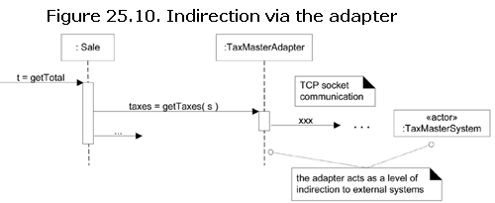
3, Indirection: example2
  Introduce a TaxAdapter class in order to decouple the Sale from an external (potentially remote) tax-calculating class
OOAD Lecture, Author: NK Jiang
<number>/50
Notes:
Assume that :
A point-of-sale terminal application needs to manipulate a modem in order to transmit credit payment request
The operating system provides a low-level function call API for doing so.
A class called CreditAuthorizationService is responsible for talking to the modem
If CreditAuthorizationService invokes the low –level API function calls directly, it is highly coupled to the API of the particular operating system. If the class needs to be ported to another operating system, then it will requiure modification.
Add an intermediate Modem class between the CreditAuthorizationService and the modem API. It is responsible for translating abstract modem requests to the API and creating an Indirection between the CreditAuthorizationService and the modem.

Slide 31
3, Indirection: example3
  Avoid creating multiple couplings to an unstable class C1↔UnstClass, C2 ↔UnstClass,…, Cm ↔UnstClass. Instead相反, devise a mediator stable class StableClass, and use it to connect indirectly C1, …, Cm with UnstClass.
  Example: Suppose that our company initially decides to use an object-oriented database system. If performance issues arise, the company will switch to a relational db. How should we perform database-related operations for storing objects of classes Transaction, Account, Customer, etc.?
  Solution 1: Wherever db operations are needed in the code , interact directly with an object of class OODB to perform them.
OOAD Lecture, Author: NK Jiang
<number>/50
Notes:
纯虚构和间接表现形式一样，都是新增虚拟类，某种程度上是一样的。两者目的不同，纯虚构一般用于将功能过于强大的类再细分，划分出单一功能的类，实现高内聚低耦合；间接一般用于隔离变化接口、分层设计转换接口，保持原设计模型的完整性，屏蔽具体实现语言或平台的差异，方便更换平台或库。

Slide 32
Indirection example
  Solution 2: Wherever db operations are needed in the code interact with an object of a new class PersistentStorage to perform them. The methods of PersistentStorage (insert, update, delete) invoke the corresponding methods of OODB.
  Which solution do you prefer?
  What is the impact of change (to relational DB) for each one of the solutions?
OOAD Lecture, Author: NK Jiang
<number>/50

Slide 33
4, Protected Variations (PV)
  Problem: How to design objects, systems and subsystems so that the variations and instability in these elements does not have an undesirable impact on other elements?
  Solution: Identify points of predicted variation or instability; assign responsibilities so that you create a stable interface around them.
“隔离可能的变化”是一个设计原则，它鼓励使用一个稳定的接口来封装变更的可以预知点。以下技巧都使用了PV
  数据封装
  多态
  数据-驱动设计，
  服务查询，
  配置文件
  接口
  ….等都是这种机制的不同实现
OOAD Lecture, Author: NK Jiang
<number>/50

Slide 34
4, Protected Variations: examples
  The previous example of different tax calculators and the use of Polymorphism illustrate Protected variation
  Protected Variations is a root principle that motivates most of the mechanisms and patterns in design and programming
OOAD Lecture, Author: NK Jiang
<number>/50

Slide 35
4, Protected Variations: discussion
  Two points of change are worth defining:
    Variation point: variations in the existing current system or requirements
    Evolution point: speculative types of variation that may arise in the future, but which are not present in the existing requirements
OOAD Lecture, Author: NK Jiang
<number>/50
Notes:
Caution: some times the cost of speculative future-proofing at evolution points outweighs the cost incurred by simple, more brittle design.

Slide 36
5, other OO principle (pattern)
Name: Law of Demeter 迪米特法则（不要和陌生人讲话)
Problem:
To avoid knowing about the structure of indirect objects?
Solution:
If two classes have no other reason to be directly aware of each other or otherwise coupled, then the two classes should not directly interact.
Note: it is a special case of PV
OOAD Lecture, Author: NK Jiang
<number>/50

Slide 37
5.1Law of Demeter
Law of Demeter
  Only talk to your immediate friend.
LoD give your suggest:
Someone
Someone
Friend
Stranger
Friend
Stranger
你走你的阳关道，我过我的独木桥
井水不犯河水
OOAD Lecture, Author: NK Jiang
<number>/50

Slide 38
5.1Law of Demeter
It states that within a method, messages should only be sent to the following objects:
The this object (or self)
A parameter of the method
An attribute of self
An element of a collection which is an attribute of self
An object created within the method
OOAD Lecture, Author: NK Jiang
<number>/50

Slide 39
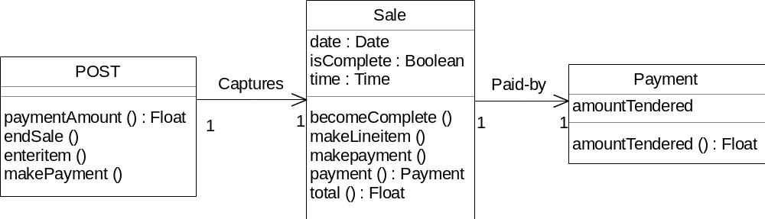
5.1Law of Demeter: example
In a POS, assume that a Post instance has an attribute referring to a sale, which has an attribute referring to a payment.
Also,
Post instances support the paymentAmount operation, which returns the current amount tendered for the payment.
Sale instances support the payment operation, which returns the Payment instance associated with the sale.
OOAD Lecture, Author: NK Jiang
<number>/50
Notes:
In a point-of-sale application, assume that a Post instance has an attribute referring to a sale, which has an attribute referring to a payment.
Also,
Post instances support the paymentAmount operation, which returns the current amount tendered for the payment.
Sale instances support the payment operation, which returns the Payment instance associated with the sale.

Slide 40
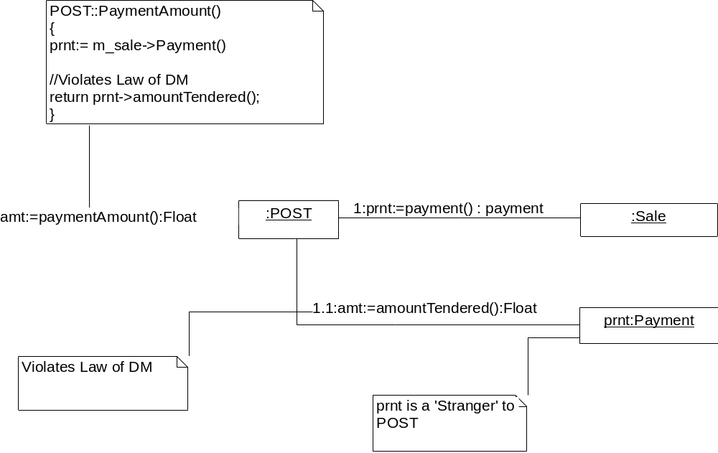
5.1Law of Demeter: example
OOAD Lecture, Author: NK Jiang
<number>/50
Notes:
The solution is a violation of this law because the POST instances is sending a message to an indirect object --- the Payment is not one of the five candidates ‘familiars’.

Slide 41
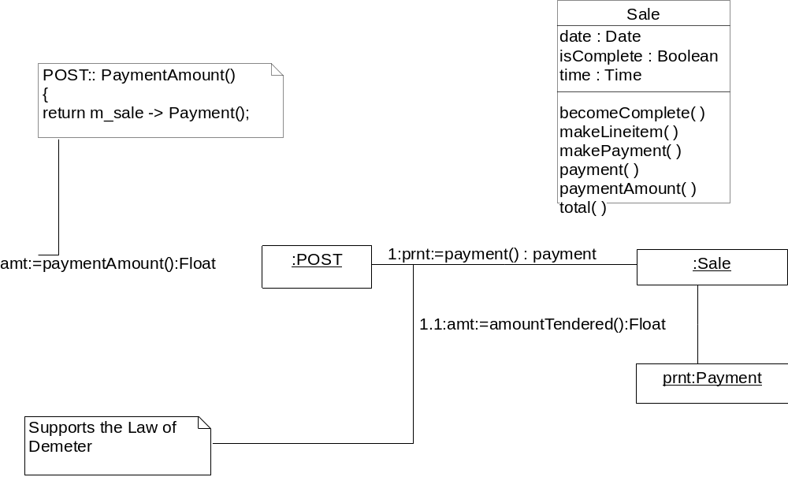
5.1Law of Demeter: example
OOAD Lecture, Author: NK Jiang
<number>/50
Notes:
The solution as the pattern suggests, is to add the responsibility to the direct object – the sale in this case – to return the payment amount to the POST. This is known as promoting the interface, which is the general solution to support this principle. Therefore , a paymentAmount operation is added to sale so that the POST does not have to talk to a stranger.

Slide 42
5.1Law of Demeter
Keeps coupling between classes low and makes a design more robust
Adds a small amount of overhead in the form of indirect method calls
OOAD Lecture, Author: NK Jiang
<number>/50

Slide 43
Law of Demeter: 代码示例(符合原则)
1 public class Car {
2 Engine engine;
3
4 public Car() {
5 //initialize engine,etc.
6 }
7
8 public void start(Key key) {
9 Doors doors = new Doors();
10 boolean authorized = key.turns();
11
12 if(authorized) {
13 engine.start();
14 updateDashboardDisplay();
15 doors.lock();
16 }
17
18 public void updateDashboardDisplay() {
19 //update display
20}
21
22 }
第10行－key.turns()：key对象是通过参数传入start()方法的。
第13行－engine.start()：engine对象是包含在Car的对象之中的。
第14行－UpdateDashboardDisplay()：UpdateDashboardDisplay()方法是Car对像自身的方法。
第15行－doors.lock()：doors对象是在start()方法中创建的对象。
OOAD Lecture, Author: NK Jiang
<number>/50

Slide 44
Law of Demeter: 代码示例(不符合原则)
1 public float getTemp() {
2 Thermometer thermometer = station.getThermometer();
3 return thermometer.getTemperature();
4 }
上面的方法中station对象是immediate friends。但是上面的代码却从station对象中返回了一个Thermometer对象，然后调用了thermometer对象的getTemperature()方法
改进
1 public float getTemp() {
2 return station. getTemperature();
3 }
我们在Station类中添加一个方法getTemperature()。这个方法将调用Station类中含有的Thermometer对象的getTemperature()。这样getTemp()方法就只知道Station对象而不知道Thermometer对象。
总结：笛米特法则告诉我们要尽量只和离自己最近的对象进行交互。离自己最近的对象包括：自身包含的对象，方法中创建的对象，通过参数传进的对象，还有自己本身。
OOAD Lecture, Author: NK Jiang
<number>/50

Slide 45
5.2 Liskov Substitution Principle
(LSP,里氏替换原则)
What is wanted here is something like the following substitution property:
  If for each object o1 of type S there is an object o2 of type T such that for all programs P defined in terms of T, the behavior of P is unchanged when o1 is substituted for o2 then S is a subtype of T
  如果对于类型S的每一个对象o1，都有一个类型T的对象o2，使对于任意用类型T定义的程序P，将o2替换为o1，P的行为保持不变，则称S为T的一个子类型
    子类型必须能够替换它的基类型。LSP又称里氏替换原则。
    对于这个原则，通俗一些的理解就是，父类的方法都要在子类中实现或者重写
OOAD Lecture, Author: NK Jiang
<number>/50

Slide 46
Information
Appendix
  http://www.csci.csusb.edu/dick/cs375/12.html#GRASP
  http://www.csci.csusb.edu/dick/cs375/12q.html
OOAD Lecture, Author: NK Jiang
<number>/50

Slide 47
Q&A
1/ Is GRASP a template to master OOD? What does GRASP do?
  Yes.... a set of guidelines that you can use to do better designs.
  It guides you to better designs.
2/ Should we strive for low coupling and high cohesion in most cases?
  YES.
3/ Is it ever a good idea to use low-cohesion classes?
  Only if there is a really good other reason.
4/ object sizes :What is the ideal size of an object, I think i have a tendency to make them too large but when their to small it seem like a waste of time and code.
  This is a common mistake made people who a new to object-oriented design. We have some names for these large low cohesion classes: "The God Class", "A Mudball class".
5/ How big does object get before you break it up?
  It depends on the cohesion. In theory you might have hundreds of operations that an object can do! Similary it can encapsulate a lot of data.
  It is not a matter of size but whether things belong together, in some sense or other: do all the methods need the same data? Is all the data needed by several methods/operations?
6/ Which GRASP is most popular
  Information Expert. First noticed, most often needed, and few will argue against it.
7/ should an object have responsibility for doing and knowing?
  Nearly all object know something and can do things. Sometimes you will need an object that knows nothing but knows how to do something.
  What is a bit dangerous is a method in an object that both does something (to the object) and also returns some data.
8/ Is a Controller in GRASP part of the system or an actor
  A controller is part of the system. It is not an external actor. The external actors may have special user interface classes and then a controller and so the controller is a kind of mask for the real user.
OOAD Lecture, Author: NK Jiang
<number>/50

Slide 48
Q&A
9/ Explain the difference between coupling and cohesion
  Coupling occurs between classes and measures the dependency between them.
  Cohesion is a property of a single class and measures how well the class has a single purpose, common data, and intertwingled operations.
10/ Why only 5 of the GRASP principles -- are these the most important
  The human mind can handle about 7 ideas at once and so Larman treats the 5 commonest and simplest ones first.
  All are useful -- and so important -- in some project.
11/ What is the best way to name a pattern?
  They are given short catchy names -- typically one or two words.
  Attach the GRASP patterns to operations rather than to classes. One class may be a creator of one object and an expert for another!
12/ In good practice , you should have low coupling but division between all different layers of your code for example, ui,domain,system?
  Yes -- the coupling within a package should be higher than the coupling between packages. In other words each package tends to be a coherent collection of classes.
  However, certain couplings are needed to make the system work -- for example UI calling controllers in the domain, and the domain model calling the data base technical classes.
OOAD Lecture, Author: NK Jiang
<number>/50

Slide 49
Q&A
13/ What is a Facade?
  A curtain. A single class that covers up a lot of detail.
14/ what is a use case realization and how to use it in OO, can you go into more detail.
  A use case realization is a collection of objects that make the use case work.
15/ The book talks about GRASP as a learning aid. Is this just to get us thinking about the ways we can design systems, or should we try to design our systems after these patterns?
  I hope it can be more than a learning aid. I think they will guide you to good solutions -- even if used silently.
16/ Do you mix and match different patterns while you design?
  Yes! Patterns overlap in a design. Any part of it could fit several patterns at once. The more the better!
17/ Do you cycle through all of these patterns, and see which best fits with what you\'re trying to do/design?
  You shouldn't have to cycle thru either the GRASP or the GoF patterns. You need to describe the current problem in terms of responsibilities and let that remind you of a suitable pattern:
18/ So what happens when the user clicks that button?
A building is made of parts, where do the parts come from?
Which object should calculate the Value Added Tax?
  I'm not sure which design is best....
  By the way -- it is quite OK to come with the designs intuitively and then label them "Controler", "Creator", "Expert", ...
19/ How does GRASP compare with the Gang of Four design patterns?
  GRASP is simpler and more general. GoF are more code oriented and tend to be rather sophisticated. They came first and tend to be better known.
  Good Luck in your design
OOAD Lecture, Author: NK Jiang
<number>/50

Slide 50
End
OOAD Lecture, Author: NK Jiang
<number>/50

