Slide 1
Object orient Analysis &Design
面向对象分析与设计师
Lecture_12 GRASP refactor
Ch19~Ch21
主讲: 姜宁康 博士
日期: 26/11/7

Slide 2
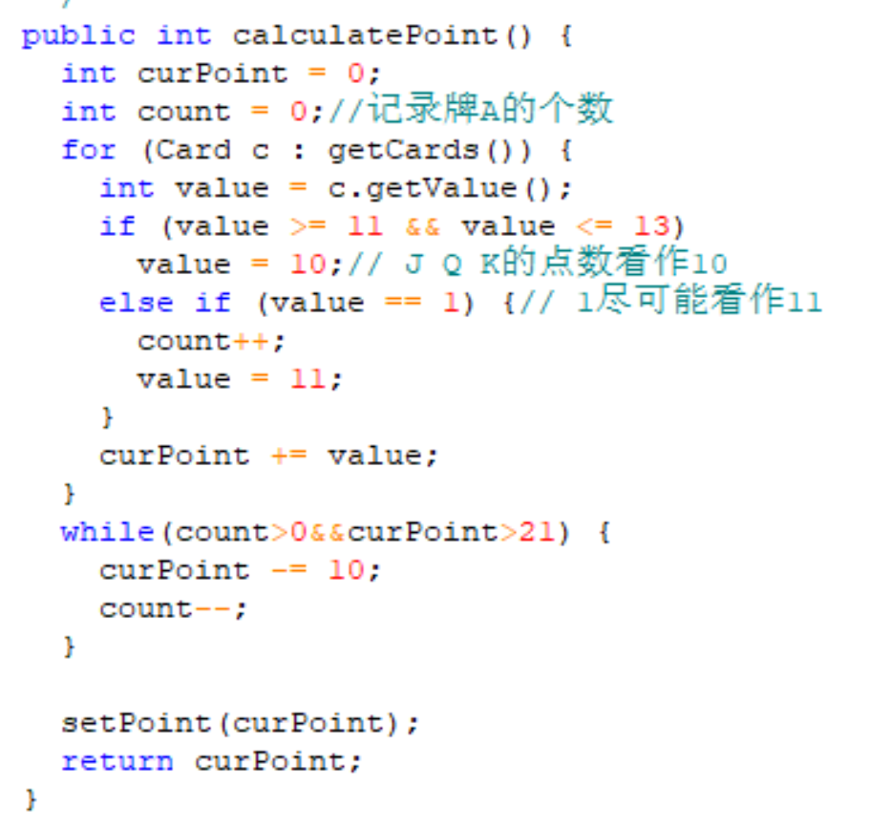
The Command-Query Separation Principle : CQS原则
It is important.
// style #1; used in the official solution public void roll() {
faceValue = // random num eneration
}
public int getFaceValue() {
return faceValue;
}
// style #2; why is this poor?
public int roll()
{
faceValue = // random num generation
return faceValue;
}
不允许直接修改成员变量的值
只能通过Setter（）
OOAD Lecture, Author: NK Jiang
<number>/54

Slide 3
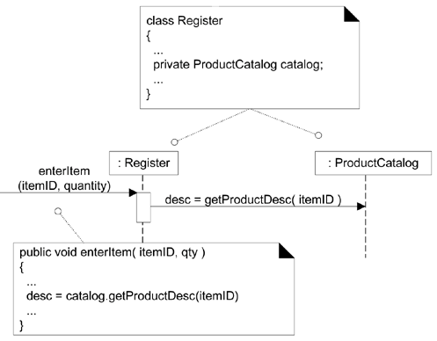
Chapter 19. Designing for Visibility 【review】
Visibility Between Objects
  For a sender object to send a message to a receiver object, the sender must be visible to the receiver
    For an object A to send a message to an object B, B must be visible to A.
  the sender must have some kind of reference or pointer to the receiver object
OOAD Lecture, Author: NK Jiang
<number>/54

Slide 4
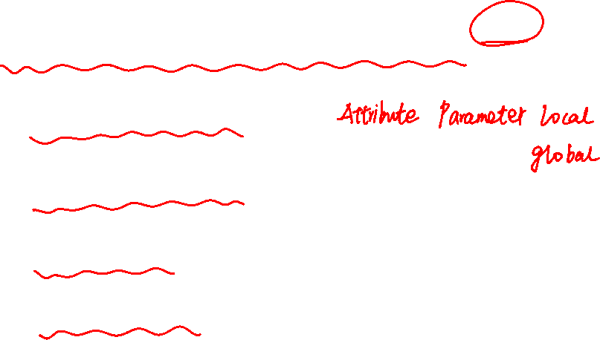

What is Visibility? 【review】
visibility is the ability of an object to "see" or have a reference to another object
four common ways
  Attribute visibility
    B is an attribute of A.
  Parameter visibility
    B is a parameter of a method of A.
  Local visibility
    B is a (non-parameter) local object in a method of A.
  Global visibility
    B is in some way globally visible
OOAD Lecture, Author: NK Jiang
<number>/54

Slide 5
Attribute Visibility 【review】
OOAD Lecture, Author: NK Jiang
<number>/54

Slide 6
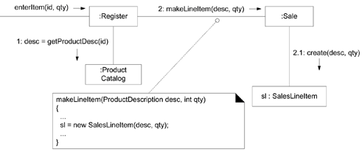
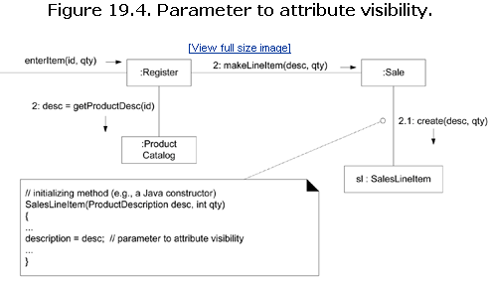
Parameter Visibility
Figure 19.3. Parameter visibility
OOAD Lecture, Author: NK Jiang
<number>/54

Slide 7
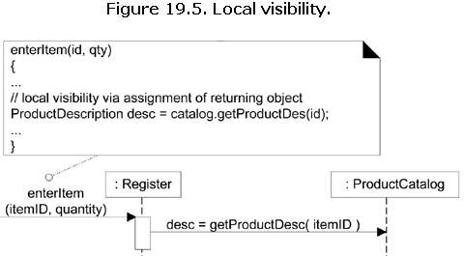
Local Visibility
Two common means by which local visibility is achieved
  Create a new local instance and assign it to a local variable.
  Assign the returning object from a method invocation to a local variable将方法调用返回的对象分配给局部变量
OOAD Lecture, Author: NK Jiang
<number>/54

Slide 8
Chapter 20. Mapping Designs to Code
The creation of code in an OO language,such as Java or C#is not part of OOA/D, it's an end goal
  Creativity and Change During Implementation
Implementation in an object-oriented language requires writing source code for:
  class and interface definitions
  method definitions
Coding by artifacts of Design Model
  DCD
  SD
  Collection Classes in Code
  Exceptions and Error Handling
OOAD Lecture, Author: NK Jiang
<number>/54

Slide 9
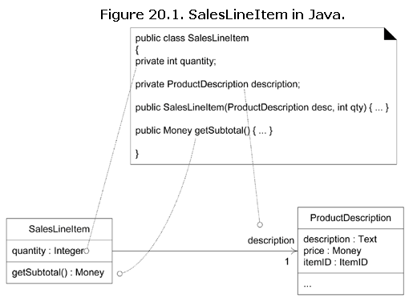
DCD to code
OOAD Lecture, Author: NK Jiang
<number>/54

Slide 10
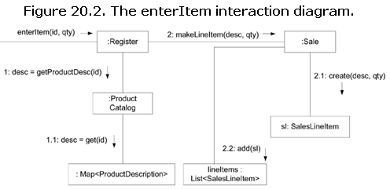
from Interaction Diagrams
The enterItem message is sent to a Register instance; therefore, the enterItem method is defined in class Register.
  public void enterItem(ItemID itemID, int qty)
Message 1: A getProductDescription message is sent to the ProductCatalog to retrieve a ProductDescription.
  ProductDescription desc = catalog.getProductDescription(itemID);
Message 2: The makeLineItem message is sent to the Sale.
  currentSale.makeLineItem(desc, qty);
makeLineItem()定义在哪个类理面？
OOAD Lecture, Author: NK Jiang
<number>/54

Slide 11
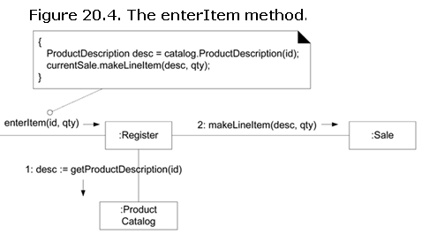
Please read ch20.11 and the code by yourself, and understand object-oriented programming.请同学们自学ch20.11, 代码，体会 面向对象的编码：
  类之间的关系如何在代码中体现 how to reflect the association between classes in code.
  Compared with the various design diagram in previous chapter, understand the connection between designing and programming.和书本前面章节的各种设计图 对照，体会设计和编码之间的联系
OOAD Lecture, Author: NK Jiang
<number>/54

Slide 12
Ch21 Refactoring (重构)
Refactoring
  Structured method to rewrite code maintaining external behavior while applying small internal changes (transformations)
  Continuously tested with unit tests and regression tests
Mostly for beautification
OOAD Lecture, Author: NK Jiang
<number>/54

Slide 13
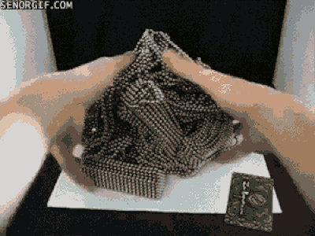
高级开发人员重构代码
OOAD Lecture, Author: NK Jiang
<number>/54

Slide 14
Refactoring
Reorganize instructions in a programs, perhaps rewriting
Key:
  Preserve semantics of the program
Objective:
  Improve structure (aka design),
  improve readability
Doesn’t add/remove any functionality
  当然，细小的功能也可以加一点
OOAD Lecture, Author: NK Jiang
<number>/54

Slide 15
Value Argument
Impact on near term profit = 0，Why Improve Structure? （近期收益几乎为0，为何还要做呢）
Value Argument
  Readability
  More readable less chances of inadvertent（无意的） errors
  Adding features in future will be less cumbersome
  Invest today, reap later
OOAD Lecture, Author: NK Jiang
<number>/54

Slide 16
Common Refactoring Techniques
Refactoring | Description
Extract Method | Transform a long method into a shorter one by factoring out a portion into a private helper method.
Extract Constant | Replace a literal constant（字面常量） with a constant variable（常量变量）.
Introduce Explaining Variable (specialization of Extract Local Variable) | Put the result of the expression, or parts of the expression, in a temporary variable with a name that explains the purpose.
Replace Constructor Call with Factory Method | In Java, for example, replace using the new operator and constructor call with invoking a helper method that creates the object (hiding the details).
OOAD Lecture, Author: NK Jiang
<number>/54

Slide 17
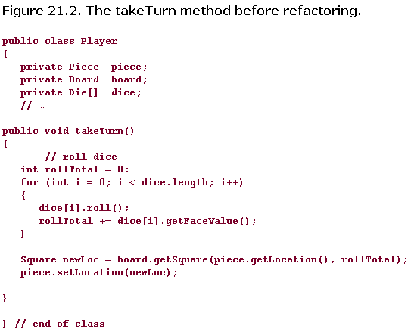
Sample: before refactor
OOAD Lecture, Author: NK Jiang
<number>/54

Slide 18
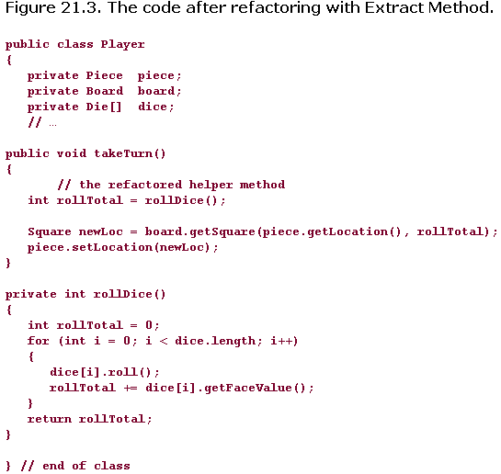
Sample: After refactor
OOAD Lecture, Author: NK Jiang
<number>/54

Slide 19
Refactoring: Split Complex Condition
if ((a || b) && (c || d)) {
…
}
Becomes
if (a || b) {
if (c || d) {
…
}
}
The inverse of this can sometimes also be useful
OOAD Lecture, Author: NK Jiang
<number>/54

Slide 20
Refactoring: Name The Condition
if ((a || b) && (c || d)) {
…
}
Becomes
meaningfulVariable = a || b;
anotherVariable = c || d;
if (meaningfulVariable && anotherVariable) {
…
}
OOAD Lecture, Author: NK Jiang
<number>/54

Slide 21
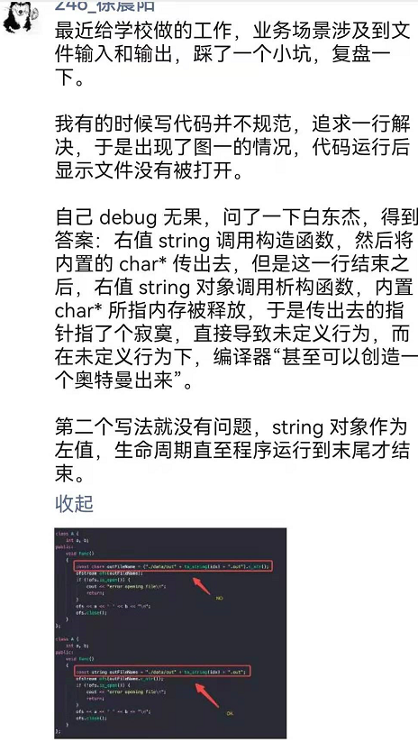
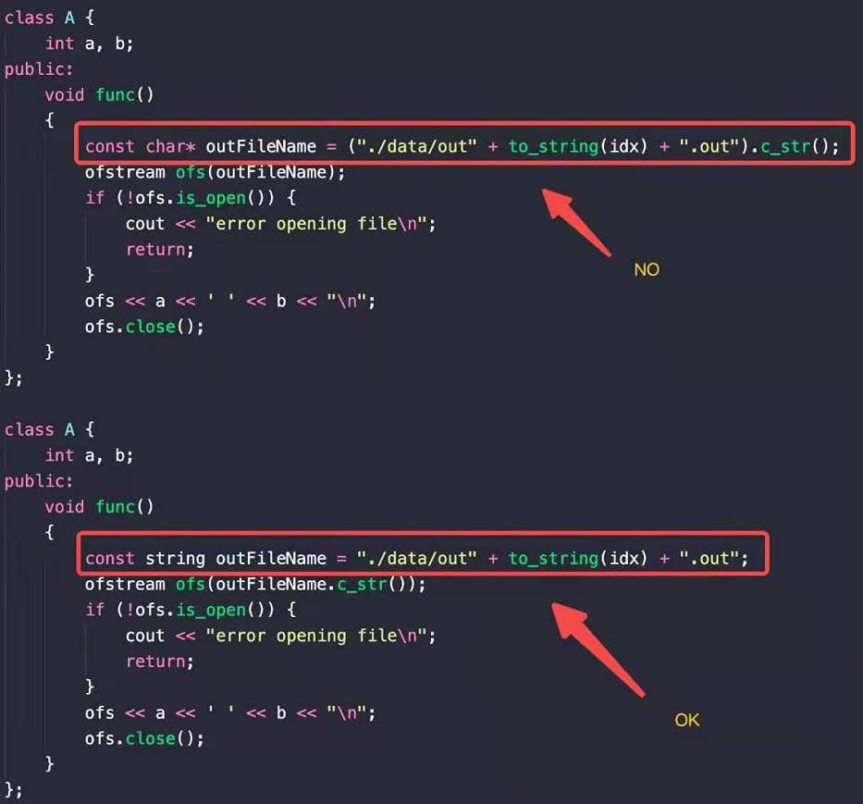

OOAD Lecture, Author: NK Jiang
<number>/54
Notes:
2018级本科生 的体会

Slide 22
End
OOAD Lecture, Author: NK Jiang
<number>/54

