Slide 1
Object orient Analysis &Design
面向对象分析与设计师
Design Pattern
---Factory
--- Abstract factory
主讲: 姜宁康 博士
日期: 26/11/8
Notes:
建立对象实例的职责交给子类

Slide 2
review
OO基础
  – 抽象、封装、多态、继承
OO原则
  – 封装变化
  – 优先使用组合而不是继承
  – 面向接口编程 而不是 面向实现编程
  – 在相互影响的对象间努力做到松散耦合设计
  – 类的开-闭原则、依赖倒置（DIP）原则 （后续解释）
OO模式
  – 策略模式Strategy
  – 观察者模式Observer
  _ 单实例模式Singleton
  _ 适配器 Adapter
  _ 外观 Facade
OOAD Lecture, Author: NK Jiang
<number>/49

Slide 3
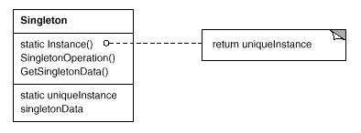
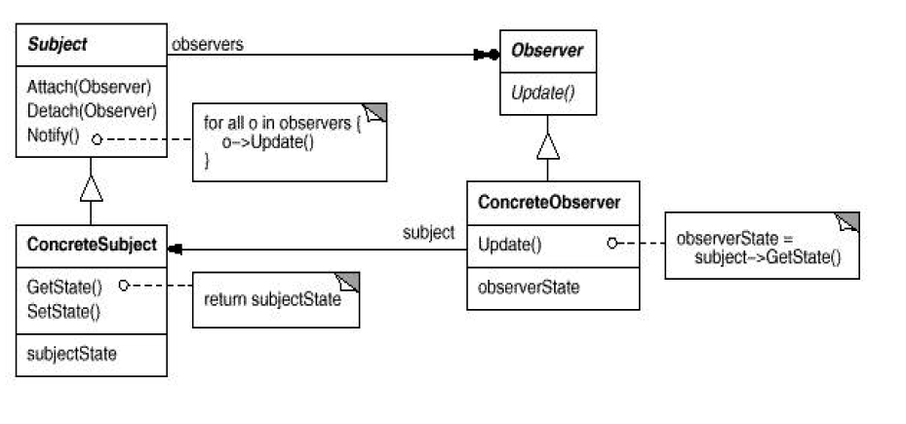
OOAD Lecture, Author: NK Jiang
<number>/49

Slide 4
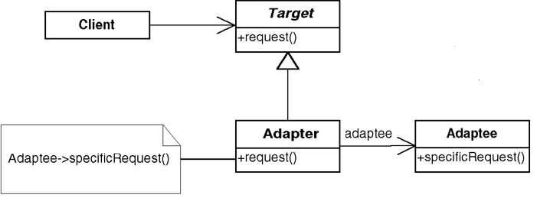
OOAD Lecture, Author: NK Jiang
<number>/49

Slide 5
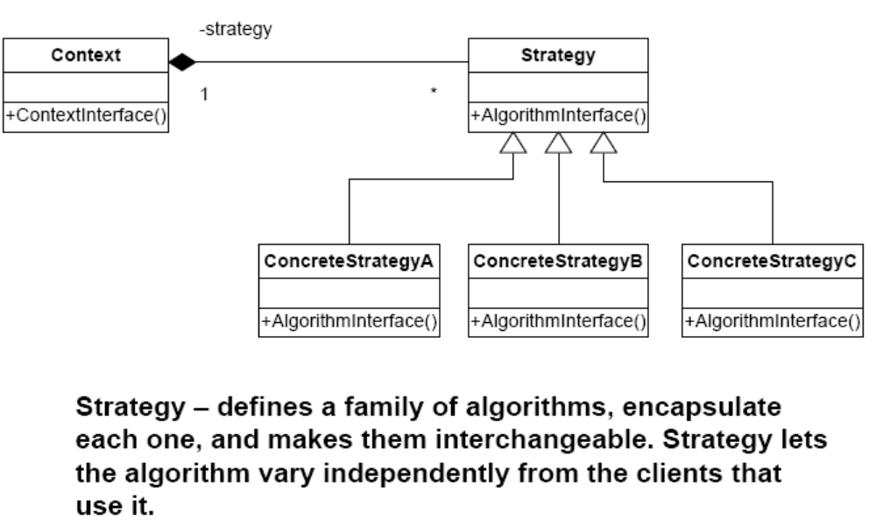
{
strategy.AlgorithmInterface()；
}
这里的 strategy是什么呢？
OOAD Lecture, Author: NK Jiang
<number>/49

Slide 6
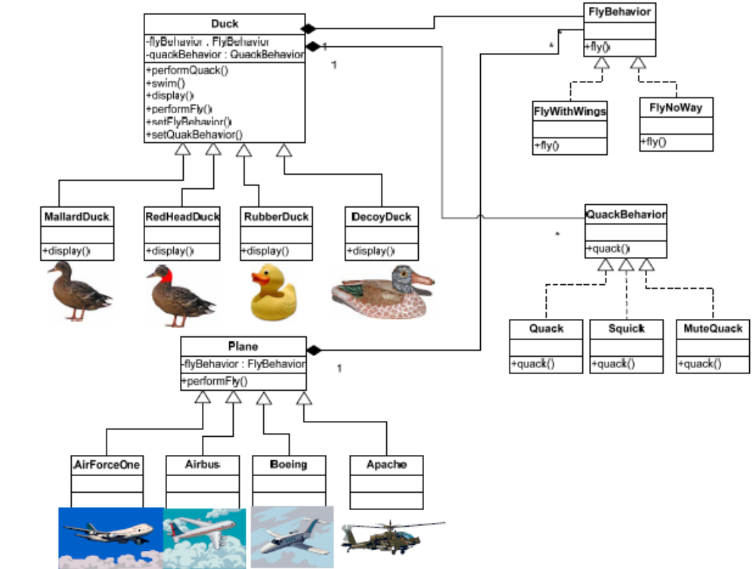
策略模式 案例
OOAD Lecture, Author: NK Jiang
<number>/49

Slide 7
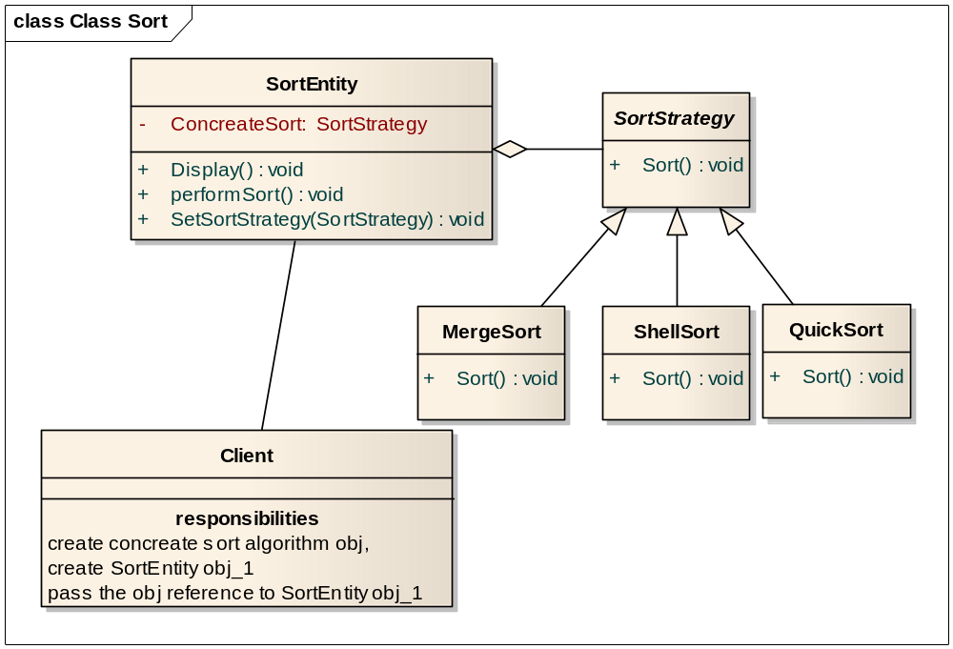
Review： Exercise
某一个应用系统需要用到排序算法，同时允许用户动态地选择不同的排序算法。请用设计模式给出设计方案。
performSort(){
ConcreateSort.Sort(); //
}
OOAD Lecture, Author: NK Jiang
<number>/49

Slide 8
推荐阅读“面试官一问就懵的设计模式题，是时候该怼回去了”
【以下观点仅供参考】
  写了多年代码，编程功力却长进不大，该怎么办呢？
  事实上，代码光“够用”是远远不够的，还要“好用”。如果说数据结构和算法是教你如何写出高效的代码，那设计模式讲的就是如何写出可扩展、可读、可维护的高质量代码
  代码是衡量程序员基础素养的直接标准——你的代码就是你名片
  工作中少不了会遇到稍复杂的代码设计和开发。该如何分层、分模块？怎么划分类？怎么设计类之间的交互？用继承还是组合，接口还是抽象类？怎样做到解耦、高内聚低耦合？等等诸如此类的问题，都要求你对设计模式的知识有深入地了解和积累。
  掌握了设计模式，就不会每次碰到需求变更就只能推倒重来，读源码、学框架都会事半功倍。
OOAD Lecture, Author: NK Jiang
<number>/49

Slide 9
OO原则：Open-Closed Principle (OCP)
"Software Systems change during their life time"
  both better designs and poor designs have to face the changes;
  good designs are stable
Software entities should be open for extension,
but closed for modification (OCP)
two criteria:
  Open for Extension - the behavior can be extended to meet new requirements
  CLosed for Modification - the source code of the module is not allowed to change
OCP attacks software rigidity and fragility!
  When one change causes a cascade of changes
OCP states:
  we should attempt to design modules that never need to be changed.
  extend the behavior of the system by adding new code. We do not modify old code
  the module is closed to modification in ways that affect clients
OOAD Lecture, Author: NK Jiang
<number>/42

Slide 10
Example: “Closed Client”
Client
Server
Client and Server are concrete classes
Client class uses Server class
If Client object wants to switch to a different Server object, what would need to happen?
Client code needs to be modified to name the new Server class
OOAD Lecture, Author: NK Jiang
<number>/42

Slide 11
Example : “Open Client”
Client
AbstractServer
Server
How is this “open” ?
Since the Client depends on the AbstractServer, we can simply switch the Client to using a different Server, by providing a new Server implementation. Client code is unaffected!
OOAD Lecture, Author: NK Jiang
<number>/42

Slide 12
Factory Patterns
All OO languages have an idiom for object creation
  Java => new
  C++ => malloc, new
Factory pattern allow us to write methods that create new objects without explicitly using the new operator
Allows writing of methods that can instantiate different objects and can be extended to instantiate newly-developed objects, all without modifying the method’s code!
允许写一个方法去实例化不同的对象，也可以实例化今后新开发的类。这样做不需要修改该方法的代码。
  Name the principle at play here!! 这就是 工厂模式的原则
OOAD Lecture, Author: NK Jiang
<number>/49

Slide 13
“new” = “concrete”
Design Principle: “Don’t program to an implementation, program to an interface （abstraction）”
However, every time you do a “new” you need to deal with a “concrete” class, not an abstraction.
  Duck duck = new MallardDuck ( );
With a whole set of related concrete classes:
{…
Duck duck;
if (picnic) duck = new MallardDuck ();
else if (hunting)
duck = new DecoyDuck ( );
else if (inBathTub)
duck = new RubberDuck ( );
}
We want to use interfaces to keep code flexible
But we have to create an instance of a concrete class
Whats wrong with this?
What principle is broken here?
OOAD Lecture, Author: NK Jiang
<number>/49
Notes:
当看到这样的代码，我们可以理解：如果需求改变了或者功能扩展，将花费我们大量时间，我们不得不重新打开代码来检查到底哪些地方需要增加（或者修改和删除）。
通常这种类型的代码将使得应用程序的维护和更新变得更加困难，并且很容易出错

Slide 14
What can you do?
Principle: Identify the aspects that vary and separate them from what stays the same.
How might you take all the parts of your application that instantiate concrete classes and separate or encapsulate them from the rest of your application? 那么，如何获得应用中实例化具体类的所有场合、并且把它们与应用的其余部分隔离或者封装起来？
OOAD Lecture, Author: NK Jiang
<number>/49

Slide 15

new()方法有什么问题呢？
从技术的角度来说，通过new来创建对象是没错的，毕竟，它是OOP中提供的一项基本功能。其实问题在我们经常会犯的错，就是“变化”，以及变化对我们使用new方法带来的影响。
如果是面向接口的编程，我们可以隔离一些可能使得系统崩溃的变化。
为什么呢？如果我们的代码是面向接口的，那么它可以为任何新的、通过多态实现了这个接口的类工作。
但是你不得不在某些地方创建一个对象，并且Java中只提供了一种方法（new）来创建对象，不是吗？难道还有
其他途径吗？
不过，当代码需要使用很多具体的类时，我们将发现一些麻烦，增加新的具体类的时候，我们不得不修改代码。
所以，换句话说，我们的代码并不是“拒绝修改”的；如果要扩展新的具体类时，我们不得不重新打开代码进行修改.
﹜
这里不符合”开-闭原则了”!
那怎么办呢?让我们回想一下我们前面学习的 一个GRASP设计原则:
识别在程序中的那些多变的特征， 并且把它们和稳定的特征分离开来
GRASP principle: Protected variation
OOAD Lecture, Author: NK Jiang
<number>/49

Slide 16

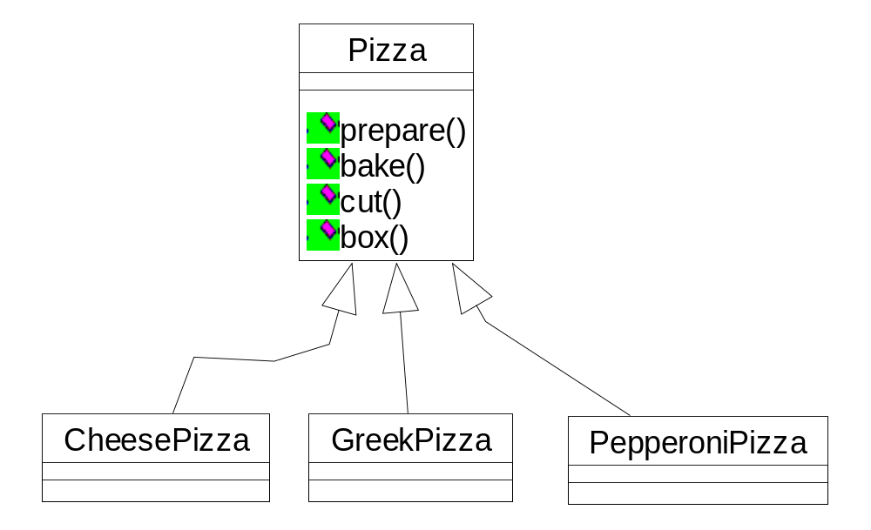
Identifying aspects that Vary
/*Own a pizza store in cutting edge Objectville!
public class PizzaStore {
  Pizza orderPizza ( ) {
  Pizza pizza = new Pizza ( );
  pizza.prepare () ;
  pizza.bake ();
  pizza.cut ();
  pizza.box ();
  return pizza;
  }
}
在高科技的“对象村”拥有一家pizza店 */
For flexibility it would be nice if this wasn’t concrete, but we can’t instantiate abstract classes!
为了使得代码具备灵活性和扩展能
力，我们非常希望这是一个抽象类
或者是个接口，但如果作为抽象类
或者接口，我们将不能直接实例化
它。
OO inheritance can help us
OOAD Lecture, Author: NK Jiang
<number>/49

Slide 17
Identifying Aspects that Vary （2）
But you need more than one type of pizza:
Pizza orderPizza ( String type) {
Pizza pizza;
if (type.equals (“cheese”)) {
pizza = new CheesePizza ();
} else if (type.equals(“greek”)) {
pizza = new GreekPizza ( );
} else if (type.equals(“pepperoni”)) {
pizza = new PepperoniPizza ( );
}
pizza.prepare () ;
pizza.bake ();
pizza.cut ();
pizza.box ();
return pizza;
}
//通过参数传递比萨的类型
Pass in the type of Pizza to orderPizza( )
Instantiate based on type of pizza
// Pepperoni 意大利辣香肠
Prepare the pizza
每一个Pizza的子类型都均
已实现了prepare()，
bake()，cut()，box() 方
法
一旦我们获取了一种Pizza
类（具体类），我们就调
用该具体类的已经实现
prepare()，bake()，
cut()，box()的方法来制
作，烘烤，切边以及装
盒。
OOAD Lecture, Author: NK Jiang
<number>/49

Slide 18
But the pressure is on to add more pizza types….
Need to add a couple trendy pizzas to their menu: Clam and Veggie. Greek is not selling so well - so take it out!
你意识到你所有的竞争者在其菜单中已经增加了一组时尚的比萨种类： Clam Pizza（蛤蜊比萨）和Veggie Pizza（素食比萨）。很显然，你需要保持竞争力，因此你应当在你的菜单中也加入这两种比萨。并且你已经很久没有卖Greek Pizza（希腊比萨）了，所以你决定从菜单中删除掉它。
What do you think would need to vary and what would stay constant?
OOAD Lecture, Author: NK Jiang
<number>/49

Slide 19
Modified orderPizza ( )
Pizza orderPizza ( String type) {
Pizza pizza;
if (type.equals (“cheese”) {
pizza = new CheesePizza ();
} else if (type.equals(“greek”)) {
pizza = new GreekPizza ( );
} else if (type.equals(“veggie”)) {
pizza = new VeggiePizza ( );
} else if (type.equals(“pepperoni”) {
pizza = new PepperoniPizza ( );
}
pizza.prepare () ;
pizza.bake ();
pizza.cut ();
pizza.box ();
return pizza;
}
This code is not closed for modification!
This is what varies
This is what we expect will stay the same
OOAD Lecture, Author: NK Jiang
<number>/49
Notes:
这些就是我们期望看到的不会变化的部分。对于大
多数比萨种类来说，其制作，烹饪，和包装在多年
都是不会产生变化的。所以我们不希望这部分代码
产生变化，让具体的pizza自己操作自己的方法就可
以了。

Slide 20
Encapsulating Object Creation
Move the object creation out of the orderPizza ( ) method.
How?
  Move the creation code into a special purpose object that is concerned with only creating pizzas ： SimplePizzaFactory
if (type.equals (“cheese”) {
pizza = new CheesePizza ();
} else if (type.equals(“greek”)) {
pizza = new GreekPizza ( );
} else if (type.equals(“veggie”)) {
pizza = new VeggiePizza ( );
} else if (type.equals(“pepperoni”) {
pizza = new PepperoniPizza ( );
}
Pizza orderPizza ( String type) {
Pizza pizza;
pizza.prepare () ;
pizza.bake ();
pizza.cut ();
pizza.box ();
return pizza;
}
Pull it out
What’s going to go here?
We place this code into a separate object
SimplePizzaFactory
OOAD Lecture, Author: NK Jiang
<number>/49

Slide 21
Building a Simple Pizza Factory
public class SimplePizzaFactory {
public Pizza createPizza (String type ) {
Pizza pizza = null;
if (type.equals (“cheese”) ) {
pizza = new CheesePizza ();
} else if (type.equals(“greek”)) {
pizza = new GreekPizza ( );
} else if (type.equals(“veggie”)) {
pizza = new VeggiePizza ( );
} else if (type.equals(“pepperoni”) {
pizza = new PepperoniPizza ( );
}
}
Factories handle the details of the object creation.
Code is still parameterized by the type of pizza, just like the original code.
Here’s code we plucked out of the orderPizza() method.
OOAD Lecture, Author: NK Jiang
<number>/49

Slide 22
Reworking the PizzaStore class
public class PizzaStore {
SimplePizzaFactory factory;
public PizzaStore(SimplePizzaFactory factory) {
this.factory = factory;
}
public Pizza orderPizza (String type){
Pizza pizza;
pizza = factory.createPizza (type);
pizza.prepare () ;
pizza.bake ();
pizza.cut ();
pizza.box ( );
return pizza;
}
}
PizzaStore has a reference to the factory
PizzaStore gets the factory passed in the constructor
New operator replaced by create method!
OOAD Lecture, Author: NK Jiang
<number>/49

Slide 23

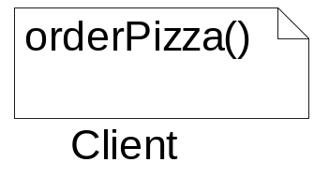
orderPizza()和SimplePizzaFactory的关系
负责具体生产或创建 Pizza
SimplePizzaFactory
--在此处orderPizza()方法变成了对象SimplePizzaFactory的客户端
了。当orderPizza()方法需要一份比萨时，它就要求
SimplePizzaFactory生产一份给它。
--原来方案,orderPizza()需要知道Greek与Clam比萨之间制作上的区别，但现在只需要关心它可以获得一个比萨对象就可以了，这个对象已经实现了Pizza接口，因此它可以调用prepare()，bake()，cut()，box()等方法。
OOAD Lecture, Author: NK Jiang
<number>/49

Slide 24
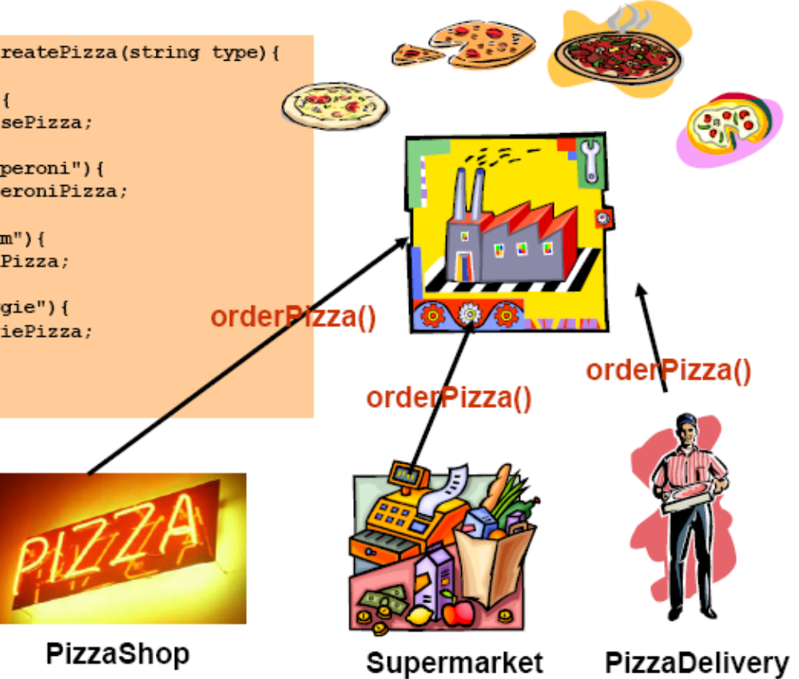
Why is this better?
SimplePizzaFactory may have many more clients than orderPizza ( ) method
  PizzaShopMenu, HomeDelivery etc.
Client code does not have any concrete classes anymore!!
SimpleFactory is not really a design pattern but the actual Factory patterns are based on it!
OOAD Lecture, Author: NK Jiang
<number>/49

Slide 25
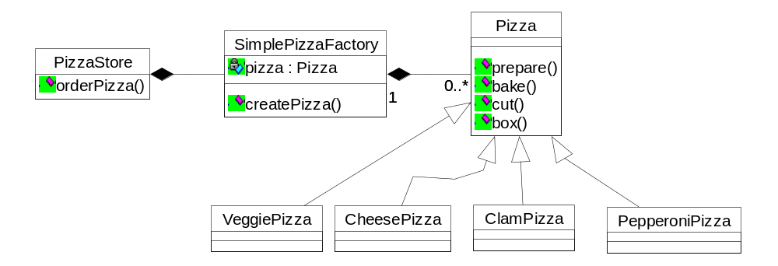

SimpleFactory Pattern
This is the factory where we create pizzas; this should be the only part of our application that refers to concrete Pizza classes.
Product of the factory (abstract)
create method sometimes declared static.
Client of the factory. Goes through factory to get instances of Pizza
Abstract class with some helpful implementations that can be overridden.
Concrete products. Each product needs to implement the Pizza interface.
OOAD Lecture, Author: NK Jiang
<number>/49

Slide 26
Onwards with the Pizza Branch（专卖、连锁店）
Branches in different cities
  Must ensure quality of pizza
  Must account for regional differences (NY, Chicago..)
Want Branch store to leverage your PizzaStore
  Code(要求) --> pizzas are prepared the same way,
  but
    NY needs a factory that makes NY style pizza
    Chicago needs a factory that makes Chicago style pizza
OOAD Lecture, Author: NK Jiang
<number>/49
Notes:
Account for 对…负责
leverage英 [ˈli:vərɪdʒ] 美 [ˈli:vərɪdʒ]
n.杠杆作用; 影响力; 优势，力量; 举债经营;

Slide 27
If Applying SimpleFactory Pattern …
Here we create a factory for making NY style pizza
NYPizzaFactory nyFactory = new NYPizzaFactory ( );
PizzaStore nyStore = new PizzaStore (nyFactory);
nystore.order (“Veggie”);
ChicagoPizzaFactory CFactory = new ChicagoPizzaFactory ( );
PizzaStore CStore = new PizzaStore (CFactory);
Cstore.order (“Veggie”);
Then we create a PizzaStore and pass it a reference to the NY factory
…and when we make pizzas we get NY style pizzas
Issues:
Branchs using your factory to create pizza, but using homegrown(自己的) procedures for baking etc.
Yet, each Branch “needs room for adding own improvements”
  You don’t want to know what they put on their pizza - detail that should be “exposed” only to the individual stores.
  Yet you want to have some control (quality control!)
What is needed is a framework that ties the store and pizza creation together, yet allows for flexibility.
OOAD Lecture, Author: NK Jiang
<number>/49
Notes:
当我们试销SimpleFactory，我们发现专卖店使用我们的工厂来生产pizza，但
雇佣他们自己的家庭成员来做剩下的流程：烘烤程序有些不同，忘了切边并
且用不适配的盒子。
再来想想这些问题，其实我们明白我们真正想要做的是建立一套框架
（framework）来约束专卖店和pizza的生产，当然我们还要使得这个框架保
证其扩展能力。
在我们早期的代码中，在PizzaPactory之前，我们把制造pizza和
PizzaStore绑在一起，这样使得系统不具备扩展能力。那么我们如何来解决这个矛盾呢？

Slide 28
A Framework
Need a mechanism to “localize” all pizza making activities to the PizzaStore class and yet give Branchs freedom to have their own regional style!
public abstract class PizzaStore {
public Pizza orderPizza (String type) {
Pizza pizza;
pizza = createPizza (type);
pizza.prepare ( );
pizza.bake ( );
pizza.cut ( );
pizza.box ( );
return pizza;
}
abstract createPizza (String type);
}
Now createPizza is back to being a call to a method in the PizzaStore rather than a Factory object!
All this is the same. Break out into orderPizza ( ) method.
Our factory method is now abstract in PizzaStore.
Allows each individual subclass to decide which Factory to invoke.
All subclasses MUST implement the createPizza method.
OOAD Lecture, Author: NK Jiang
<number>/49
Notes:
有一个方法可以使得PizzaStore类中的pizza制作活动变得本地化，并且可以给经销商一些自由, 使之拥有自己地域的风味。
我们将要做的是把createPizza()方法再放回PizzaStore中，但是这一次是一个抽象方法（abstract method），我们可以在PizzaStore的子类实现符合本地风味。来看看PizzaStore的变化：

Slide 29
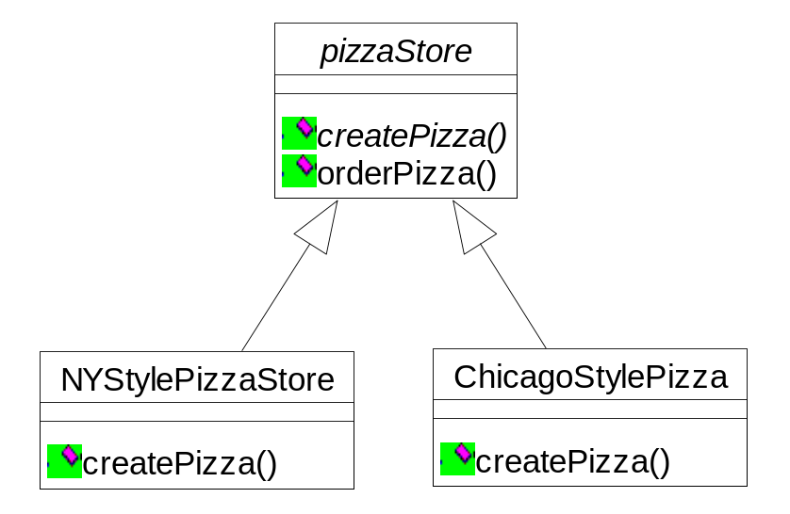
Allowing the subclasses to decide…
Each subclass overrides the createPizza ( ) method, while all subclasses make use of the orderPizza () method defined in the PizzaStore.
If Branch wants NY style pizzas for its customers, it uses the NY subclass, which has its own createPizza ( ) method, creating NY style pizzas.
orderPizza () { conStore.createPizza（）}
createPizza () returns a Pizza and the subclass is fully responsible for which concrete Pizza it instantiates
public Pizza createPizza (type) {
if (type.equals(“cheese”))
pizza = new NYStyleCheesePizza ( );
else if (type.equals (“pepperoni”))
pizza = new NYStylePepperoniPizza ( );
}
Here’s where the concrete classes are being created!
Note: orderPizza ( ) method in superclass has no clue which Pizza we are creating. It only knows it can prepare, bake, cut and box it!
OOAD Lecture, Author: NK Jiang
<number>/49

Slide 30

子类如何决定呢？
我不明白。PizzaStore的子类只是子类而已。它如何被决定？
我在NYStylePizzaStore中没有看见任何逻辑决策的代码……
1/ orderPizza()方法是在抽象类
PizzaStore中而不是在子类中定
义的，因此子类在实际运行代码
和 下pizza订单时 由这个方法来统一
执行。
pizza=createPizza();
Pizza->prepare();
Pizza->bake();
Pizza->cut();
Pizza->box();
2/ orderPizza() 调用createPizza()来获取一个pizza对象。但是它获取什么类型的pizza呢？
orderPizza() 并不能决定，它也
不知道怎么做，那么由谁来做
决定呢？
3/ 由下订单对应的PizzaStore来决
定生产哪种类型的pizza。
OOAD Lecture, Author: NK Jiang
<number>/49

Slide 31
A Factory Method Up Close!
A “Factory” method handles object creation and encapsulates it in a subclass. This decouples the client code in the superclass from the object creation code in the subclass.
A factory method may or may not be parameterized to select among several variations of a product.
A factory method is abstract so the subclasses are counted on to handle object creation.
abstract Product factoryMethod (String type)
A factory method returns a Product that is typically used within methods defined in the superclass.
A factory method isolates the client (the code in the superclass, like orderPizza ( )) from knowing what kind of concrete Product is actually created.
OOAD Lecture, Author: NK Jiang
<number>/49

Slide 32
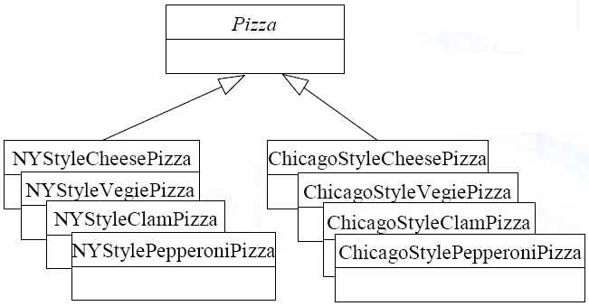
从平行的角度来看类的层次
从平行的角度来看看类的
层次：两个都是抽象类，
均可以派生出具体的类
The Product Classes
The Creator Classes
NYStylePizzaStore 把如何
制作纽约风味Pizza封装了
起来。
工厂方法是封装“知识”的关键
OOAD Lecture, Author: NK Jiang
<number>/49

Slide 33
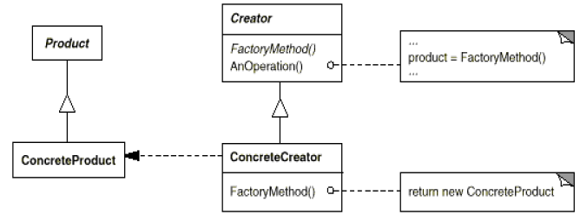
Factory Method Pattern Defined
The Factory Method Pattern defines an interface for creating an object
but lets the subclasses decide which class instantiate. Factory method lets
a class defer instantiation to subclasses.定义一个用于创建对象的接口，让子类
决定实例化哪个子类。该模式把实例化延迟到其子类。
The Creator is the class that contains the implementations for all the methods to manipulate the products, except for the factory method!
The abstract factoryMethod ( )is what all Creator subclasses must implement.
All products must implement the same interface so that the classes which use the products can refer to the interface, not the concrete class.
The ConcreteCreator implements the factoryMethod ( ), which is the method that actually produces the products.
The ConcreteCreator is responsible for creating one or more concrete products. It is the only class that has knowledge of how to create these products.
OOAD Lecture, Author: NK Jiang
<number>/49

Slide 34
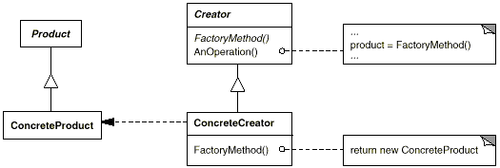
工厂方法的定义
GOF 定义: 工厂方法定义了一个创建产品对象的工厂接口，
将实际创建工作推迟到子类中
除了工厂方法是抽象的
外，Creator类包含了操作产品的所有方法的实现，
所有的产品必须实现同一个接口，这样，使用产品的类可以指向该接口而不是指向具体的类。
所有创建者子类必须实现FactoryMethod方法
ConcreteCreator负责一个
或者多个具体产品的创
建。只有它才知道如何创建产品
ConcreteCreator 必须实现FactoryMethod，这个方法实现实际的产品创建。
OOAD Lecture, Author: NK Jiang
<number>/49

Slide 35
The Factory Method Pattern: Key Features
Intent | Define an interface for creating an object, but let subclasses decide which class to instantiate. Defer instantiation to subclasses.
Problem | A class needs to instantiate a derivation of another class, but doesn't know which one. Factory Method allows a derived class to make this decision.
Solution | A derived class makes the decision on which class to instantiate and how to instantiate it.
Participants and collaborators | Product is the interface for the type of object that the Factory Method creates. Creator is the interface that defines the Factory Method.
Consequences | Clients will need to subclass the Creator class to make a particular ConcreteProduct.
Implementation | Use a method in the abstract class that is abstract (pure virtual in C++). The abstract class' code refers to this method when it needs to instantiate a contained object but does not know which particular object it needs.
OOAD Lecture, Author: NK Jiang
<number>/49

Slide 36
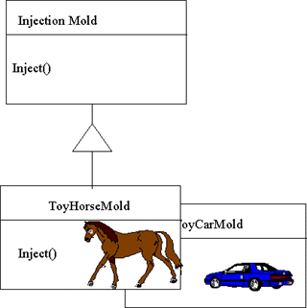

Example : Factory Pattern
Manufacturers of plastic toys process plastic molding powder, and inject the plastic into molds of the desired shapes. The class of toy (car, action figure, etc.) is determined by the mold.
OOAD Lecture, Author: NK Jiang
<number>/49

Slide 37
回答同学提问2019.12.4
1. 在简单工厂的例子中，新建了一个 SimplePizzaFactory用于创建披萨类，但是在工厂模式中直接将PizzaStore改变为抽象类，这样做是不是相当于将原有的类改变为工厂类？
  【姜宁康: 工厂模式定义一个框架，适合在不同的地区开店、销售不同风味的产品。将PizzaStore改变为抽象类，便于在不同的地方实例化不同的 PizzaStore.。 没有"工厂类"这一说法，只有 “工厂函数”这一概念，由具体的 某一地区的 工厂 负责实例化。】﻿﻿﻿﻿﻿﻿﻿﻿
2. 在工厂模式的披萨店例子中，纽约披萨店（NYPizzaStore) 中根据披萨的风味创建披萨，是否是相当于在工厂模式中使用了简单工厂方法？
  【姜宁康：可以这么说！ 但是，工厂模式的核心，是：允许不同地区 开设 连锁店，销售相同规范的略有差异的 产品！具体到某一地区的店、及该店销售的产品：这是简单工厂﻿﻿﻿﻿】
OOAD Lecture, Author: NK Jiang
<number>/49

Slide 38
Meanwhile, back at the PizzaStore….
Things are going good, but you have learned that a few Branchs are substituting inferior ingredients ->（替代劣质成分）
  bringing down the Objectville(公司名字) name!（败坏公司名誉）
How are you going to ensure each factory is using quality ingredients?
  You are going to build a factory that produces them and ships them to your Branchs!
  One problem: Branchs are located in different regions so what is red sauce in NY is not red sauce in Chicago!
So: same product families (dough生面团, cheese, sauce etc.) but different implementations based on region.
OOAD Lecture, Author: NK Jiang
<number>/49
Notes:
dough [简明英汉词典]
[dEu]
n.生面团, <美俚> 钱, 金钱

Slide 39
Building the Ingredient Factory
Ingredient factory: creates each ingredient in the ingredient family (but does not handle regional differences yet!)
For each ingredient we define a create method in our interface.
public Interface PizzaIngredientFactory {
public Dough createDough ( );
public Sauce createSauce ( );
public Cheese createCheese ( );
public Veggies [ ] createVeggies ( );
public Pepperoni createPepperoni ( );
public Clams createClams ( );
}
If we had some common “machinery” to implement in each instance of factory, we could have made this abstract instead.
Lots of new classes here, one per ingredient
What to do next?
Build a factory for each region. To do this, create a subclass of PizzaIngredientFactory that implements each create method.
Implement a set of ingredient classes to be used with the factory, like RedPeppers, ThickCrustDough, etc. These classes can be shared among regions where appropriate.
Then we still need to hook all this up by working our new ingredient factories into the old PizzaStore code.
OOAD Lecture, Author: NK Jiang
<number>/49
Notes:
pepperoni英 [ˌpepəˈrəʊni] 美 [ˌpepəˈroʊni]
n.意大利辣香肠;

Slide 40
(1) The New York Ingredient Factory
The NY ingredient factory implements the interface for all ingredient factories
public class NYPizzaIngredientFactory implements PizzaIngredientFactory {
public Dough createDough ( ){
return new ThinCrustDough ( );
}
public Sauce createSauce ( ){
return new MarinaraSauce ( );
}
public Cheese createCheese ( ) {
return new ReggianoCheese ( );
}
public Veggies [ ] createVeggies ( ){
Veggies veggies[ ] = { new Garlic ( ), new Onion ( ), new Mushroom ( )};
return veggies;
}
// other ingredients
}
For each ingredient in the ingredient family, we create the NY version.
OOAD Lecture, Author: NK Jiang
<number>/49

Slide 41
Reworking the Pizzas
public abstract class Pizza {
String name;
Dough dough;
Sauce sauce;
Veggies veggies[];
Cheese cheese;
Pepperoni pepper;
Clams clams;
abstract void prepare ( );
void bake ( ) {
System.out.println ( “Bake for 25 minutes at 350”);
}
void cut ( ) { }
void box ( ) { }
void setName (String name) { this.name = name;}
String getName ( ) { return name; }
}
}
Each pizza holds a set of ingredients that are used in its prep.
The prepare () method is abstract. This is where we are going to collect the ingredients needed for the pizza which will come from the ingredient factory.
Other methods remain the same
OOAD Lecture, Author: NK Jiang
<number>/49

Slide 42
Reworking the Pizzas (contd.)
To make a pizza now, we need a factory to provide the ingredients. So each class gets a factory passed
into its constructor, and its stored in an instance variable.
public class CheesePizza extends Pizza {
PizzaIngredientFactory ingredientFactory;
public CheesePizza ( PizzaIngredientFactory ingredientFactory) {
this.ingredientFactory = ingredientFactory;
}
void prepare ( ){
System.out.println (“Preparing: “ + name );
dough = ingredientFactory.createDough ( );
sauce = ingredientFactory.createSauce ( );
cheese = ingredientFactory.createCheese ( );
}
}
Here’s where the magic happens!
The prepare ( ) method steps through the creating a cheese pizza, and each time it needs an ingredient, it asks the factory to produce it.
OOAD Lecture, Author: NK Jiang
<number>/49

Slide 43
Code Up Close!
The createSauce () method returns the sauce that is used in its region. If this is NY ingredient factory, then we get marinara sauce.
We are setting the pizza instance variable to refer to the specific sauce used in this pizza
sauce = ingredientFactory.createSauce ( );
This is the ingredient Factory. The pizza does not care which factory is used, as long as it is an ingredient factory.
OOAD Lecture, Author: NK Jiang
<number>/49

Slide 44
Revisiting the Pizza Store
The NY Store is composed with a NY pizza ingredient factory. This will be used to produce the ingredients for all NY style pizzas.
public class NYPizzaStore extends PizzaStore {
protected Pizza createPizza (String item) {
Pizza pizza = null;
PizzaIngredientFactory ingredientFactory = new NYPizzaIngredientFactory ( );
if (item.equals(“cheese”)){
pizza = new CheesePizza (ingredientFactory);
pizza.setName(“New York Style Cheese Pizza”);
} else if (item.equals(“veggie”)){
pizza = new VeggiePizza (ingredientFactory);
pizza.setName (“New York Style Veggie Pizza”);
} // same for all other pizza types.
return pizza;
}
}
We now pass each pizza the factory that should be used to produce its ingredients.
For each type of pizza we instantiate a new Pizza and give it the factory that it needs to get its ingredients.
OOAD Lecture, Author: NK Jiang
<number>/49

Slide 45

What have we done?
Defines the interface
We provided a means of creating a family of ingredients for pizzas by introducing a new type of factory called -- Abstract Factory.
Abstract Factory:
  Gives an interface for creating a family of products.
  By writing code that uses this interface we decouple our code from the actual factory that creates the products.
  Allows us to implements a variety of factories that produce products meant for different contexts.
  Decoupling
    --> enables substitution of different factories to get different behaviors.
Objectville Abstract IngredientFactory
NY
Chicago
Provides implementations for products
Pizza Store
Pizza made with ingredients produced by the concrete factory
OOAD Lecture, Author: NK Jiang
<number>/49

Slide 46
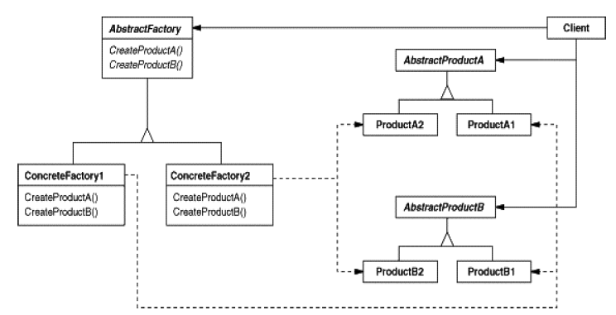
The Abstract Factory Pattern
The Abstract Factory Pattern provides an interface for creating families of related or dependent objects without specifying their concrete classes.
The AbstractFactory defines the interface that all Concrete factories must implement, which consists of a set of methods for producing products.
The client is written against the abstract factory and then composed at runtime with an actual factory.
This is the product family. Each concrete factory can produce an entire set of objects.
The concrete factories implement the different product families. To create a product, the client uses one of these factories, so it never has to instantiate a product object.

Slide 47
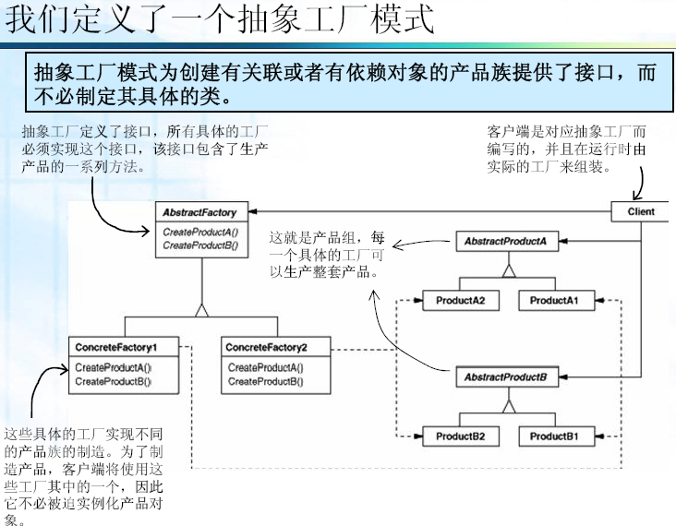

Slide 48
The Abstract Factory Pattern: Key Features
Intent | You want to have families or sets of objects for particular clients (or cases).
Problem | Families of related objects need to be instantiated.
Solution | Coordinates the creation of families of objects. Gives a way to take the rules of how to perform the instantiation out of the client object that is using these created objects.
Participants and collaborators | The AbstractFactory defines the interface for how to create each member of the family of objects required. Typically, each family is created by having its own unique ConcreteFactory.
Consequences | The pattern isolates the rules of which objects to use from the logic of how to use these objects.
Implementation | Define an abstract class that specifies which objects are to be made. Then implement one concrete class for each family. Tables or files can also be used to accomplish the same thing.
OOAD Lecture, Author: NK Jiang
<number>/49

Slide 49
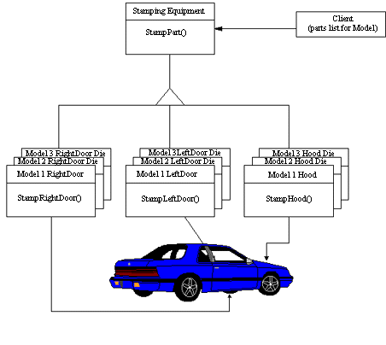
抽象工厂：举例
The purpose of the Abstract Factory is to provide an interface for creating families of related objects, without specifying concrete classes.
This pattern is found in the sheet metal stamping equipment used in the manufacture of automobiles.
The stamping equipment is an Abstract Factory which creates auto body parts.
The same machinery is used to stamp right hand doors, left hand doors, right front fenders, left front fenders, hoods, etc. for different models of cars.
Through the use of rollers to change the stamping dies（冲模）, the concrete classes produced by the machinery can be changed within three minutes
OOAD Lecture, Author: NK Jiang
<number>/49

Slide 50
Summary
All factories encapsulate object creation
Simple factory, while not a bona fide（真实的) design pattern, is a simple way to decouple your clients from concrete classes.
Factory method relies on inheritance:
  object creation is delegated to subclasses which implement the factory method to create objects
Abstract Factory relies on object composition:
  object creation is implemented in methods exposed in the factory interface.
All factory methods promote loose coupling by reducing the dependency of your application on concrete classes.
The intent of Factory method is to allow a class to defer instantiation to its subclasses.
The intent of the Abstract Factory is to create families of related objects without having to depend on their concrete classes.
Factories are a powerful technique for coding to abstractions, not concrete classes.
OOAD Lecture, Author: NK Jiang
<number>/49
Notes:
bona fide
[bEJnE 5faIdI]
adv.
adj.真诚地(的), 真实地(的)

Slide 51
End
OOAD Lecture, Author: NK Jiang
<number>/49

