Slide 1
Object orient Analysis &Design
面向对象分析与设计师
Design Pattern:
Command Pattern
Encapsulating Invocation
主讲: 姜宁康 博士
日期: 26/11/8

Slide 2
A Motivating Example
Goal:
  Program a Remote Control that can be used to control the devices in the house
Requirements:
  Remote control features seven programmable slots（7个可编程控制钮）
  Each slot can be assigned to a different household device
  Each slot has a corresponding on/off button
  Remote has a global undo button that undoes the last button pressed.
  A set of vendors classes are provided to give you an idea of the interfaces of the objects that need to be controlled from the remote.
看作是家用电器厂商为该电器提供的接口
OOAD Lecture, Author: NK Jiang
<number>/35

Slide 3
A Pictorial View
On and off buttons for each of the seven slots
These two control device 1
on
Off
Vendor Classes
Seven slots to program
Each slot contains a different device and is controlled via the buttons.
CeilingLight
on ( )
off ( )
dim ( )
FaucetControl
openValue ( )
closeValue ( )
TV
on ( )
off ( )
setInputChannel ( )
setVolume ( )
Thermostat
setTemperature ( )
Hottub
circulate ( )
jetsOn ( )
jetsOff ( )
setTemperature ( )
Global “undo” button
OOAD Lecture, Author: NK Jiang
<number>/35

Slide 4
Observations, anyone?
Expectation:
  see a bunch of classes with on ( ) and off ( ) methods --> common interface
Instead:
  each vendor class has its own API: dim ( ), setTemperature ( ), setVolume ( ), setDirection ( )
Observation:
  Separation of concerns:
    remote should know how to interpret button presses and make requests, but it really should not know anything about home automation or how to turn on a hot tub.
  Any issues?
  Requirement: There will be more vendor classes in the future
    - design must accommodate for that
If the remote is dumb, how do we design a remote so that it can invoke an action - turn on a light?
OOAD Lecture, Author: NK Jiang
<number>/35

Slide 5
Enter → The Command Pattern!
Command Pattern allows you to decouple the requester of an action from the object that actually performs the action
  Requester == remote control, Object == vendor classes
How does it work?
  Introduce “command objects” into your design.
    A command object encapsulates a request to do something (like turn on a light) on a specific object (say, the living room light).
    命令对象中 有一个通用的方法: execute();
  Every time a remote button is pressed, its corresponding command object goes to work!
  Remote does not have any idea what the work is, it just has a command object that knows how to talk to the right object to get the work done.
  命令对象（系统中有多个）的所有客户（remote），把每个命令对象看作是一个‘black box’. 当客户需要请求对象的服务时，只要简单地调用对象的虚拟execute() 方法。
  Here the remote is decoupled from the object that actually performs the action!
OOAD Lecture, Author: NK Jiang
<number>/35

Slide 6




A Diner Example - A Brief Introduction to the Command Pattern (Ordering in Objectville(餐厅名))
Start Here
order
createOrder ( )
takeOrder ( )
The Waitress takes the Order, and when she gets around to it, she calls its ord PlaceOrder ( ) method to begin the Order’s preparation.
The customer knows what he/she wants and creates an order
The Order has all the instructions needed to prepare the meal. The Order directs the Short Order Cook(矮个厨师) with methods like makeBurger ( ).
The Short Order Cook follows the instructions of the Order and produces the meal.
order
OOAD Lecture, Author: NK Jiang
<number>/35

Slide 7
The Objectville Diner Objects and Responsibilities
Order Slip: encapsulates a request to prepare a meal
Waitress: take the Order Slips and invoke the PlaceOrder ( ) method on them
The Short Order Cook: has the knowledge required to prepare the meal!
OOAD Lecture, Author: NK Jiang
<number>/35

Slide 8

From the Diner to the Command Pattern
public void execute {
receiver.action1 ();
receiver.action2 ();
}
The actions and the Receiver are bound together in the command object.
The Command Object provides one method, execute ( ), that encapsulates the actions and can be called to invoke the actions on the Receiver.
action1( )
action2( )
Receiver
(1) createCommandObject ( )
The client is responsible for creating the command object. The command object consists of a set of actions on a receiver
execute ( )
create Command object ( )
Start here
Command
The client calls setCommand ( ) on an Invoker object and passes it the command object, where it gets stored until it is needed.
Client
(3)
(2) setCommand ( )
setCommand ( )
Loading the Invoker
The client creates a command object.
The client does a setCommand ( ) to store the command object in the invoker.
Later… the client asks the invoker to execute the command . Note: once the command is loaded into the invoker, it may be used and discarded or it may remain and be used many times.
Invoker
At some point in the future the Invoker calls the Command object’s execute () method.
execute ( )
execute ( )
…which results in the actions being invoked on the Receiver
Command
action1 ( )
action2 ( )
action1 () , action2 ( )
Receiver
OOAD Lecture, Author: NK Jiang
<number>/35

Slide 9
Coding Our First Command Object (1/3)
Implementing the Command Interface:
public interface Command {
public void execute ( );
}
Implementing a Command to turn the light on
public class LightOnCommand implements Command {
Light light;
public LightOnCommand (Light light) {
this.light = light;
}
public void execute ( ) {
light.on ( );
}
}
Simple. All we need is one method called execute ( ).
This is a command, so we need to implement the Command interface.
The constructor is passed the specific light that this command is going to control - say the living room light - and stores it in the light instance variable. When execute ( ) gets called, this is the light object that is going to be the Receiver of the request.
The execute method calls the on ( ) method on the receiving object, which is the light that we are controlling.
//由供应商提供的灯类，具有开灯及关灯两种方法
public class Light {
public void on () {
System.out.println ("Light is on ");
}
public void off () {
System.out.println ("Light is off");
}
}
OOAD Lecture, Author: NK Jiang
<number>/35

Slide 10
Coding the First Command Object (2/3)
Using the Command Object
public class SimpleRemoteControl {
Command slot;
public SimpleRemoteControl ( ) { }
public void setCommand (Command command) {
slot = command;
}
public void buttonWasPressed ( ) {
slot.execute ( );
}
}
We have one slot to hold our command, which will control one device.
We have a method for setting the command the slot it’s going to control. This could be called multiple times if the client of this code wanted to change the behavior of the remote button.
SimpleRemoteControl 是 invoker
This method is called when the button is pressed. All we do is take the current command bound to the slot and call its execute ( ) method.
OOAD Lecture, Author: NK Jiang
<number>/35

Slide 11
Coding the First Command Object (3/3)
Creating a Simple test to use the Remote Control
public class RemoteControlTest {
public static void main (String [] args) {
SimpleRemoteControl remote = new SimpleRemoteControl ( );
Light light = new Light ( );
LightOnCommand lightOn = new LightOnCommand (light);
remote.setCommand (lightOn);
remote.buttonWasPressed ( );
}
}
This is our client in Command Pattern-speak
The remote is our Invoker; it will be passed a command object that can be used to make requests.
Now we create a Light Object - this will be the Receiver of the request.
Here pass the command to the Invoker.
Here, create a command and pass it to the Receiver.
Then, we simulate the button being pressed.
Result:
Light is on
OOAD Lecture, Author: NK Jiang
<number>/35

Slide 12

The Command Pattern Defined
The Command Pattern encapsulates a request as an object, thereby letting you parameterize other objects with different requests, queue or log requests, and support undoable operations.
命令模式将一个请求封装成一个对象，从而能以不同的请求来参数化客户对象、把所有请求存入队列或者写入日志，并且支持撤销操作。
Command object encapsulates a request by binding together a set of actions on a specific receiver.
To achieve this it packages the actions and the receiver into an object that exposes just one method execute ( ).
From the outside no other objects really know what actions get performed on what receiver. They just call the execute () to service their request!
An encapsulated request
action ()
Receiver
execute ( ) {
receiver.action ( );
}
Command
OOAD Lecture, Author: NK Jiang
<number>/35

Slide 13
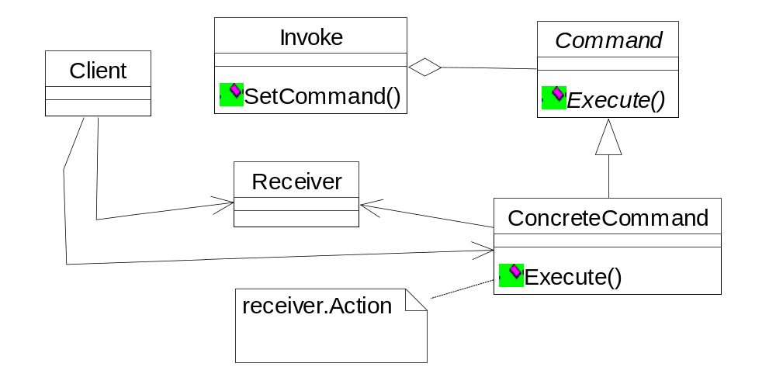
The Command Pattern Defined
The client is responsible for creating a ConcreteCommand and setting its Receiver.
Invoker holds a command and at some point asks the command to carry out a request by calling its execute ( ) method.
Command declares an interface for all commands
The execute method invokes the action(s) on the Receiver needed to fulfill request.
The Receiver knows how to perform the work needed to carry out any request. Any class can act as a Receiver.
Concrete Command defines a binding between an action and a Receiver. The Invoker makes a request by calling execute ( ) and the ConcreteCommand carries it out by calling one or more actions on the Receiver.
public void execute ( ) {
receiver.action ( )
}
OOAD Lecture, Author: NK Jiang
<number>/35

Slide 14
Implementing the RemoteControl
This time around the remote is going to handle seven On and Off Commands which we will hold in the corresponding array.
public class RemoteControl {
Command[] onCommands;
Command[] offCommands;
public RemoteControl() {
onCommands = new Command[7];
offCommands = new Command[7];
Command noCommand = new NoCommand(); //特殊的 空 命令。这是一种编程技巧，“哨兵”
for (int i = 0; i < 7; i++) {
onCommands[i] = noCommand;
offCommands[i] = noCommand;
}
}
public void setCommand(int slot, Command onCommand, Command offCommand) {
onCommands[slot] = onCommand;
offCommands[slot] = offCommand;
}
public void onButtonWasPushed(int slot) {
onCommands[slot].execute();
}
public void offButtonWasPushed(int slot) {
offCommands[slot].execute();
}
public String toString() {
// code here }
In the constructor all we need to do is instantiate the on and off arrays.
The setCommand() method takes a slot position and an On and Off command to be stored in that slot. It puts these commands in the On and Off array for later use.
When an On or a Off button is pressed, the hardware takes care of calling the corresponding methods OnButtonWasPushed ( ) or OffButtonWasPushed ( ).
Used for testing.
OOAD Lecture, Author: NK Jiang
<number>/35

Slide 15
Implementing the Commands
public class LightOffCommand implements Command {
Light light;
public LightOffCommand(Light light) {
this.light = light;
}
public void execute() {
light.off();
}
}
public class StereoOnWithCDCommand implements Command {
Stereo stereo;
public StereoOnWithCDCommand(Stereo stereo) {
this.stereo = stereo;
}
public void execute() {
stereo.on();
stereo.setCD();
stereo.setVolume(11);
}
}
An instance of the stereo we are going to control is passed to constructor.
The LightOffCommand works exactly like the LightOnCommand, except that we are binding the receiver to a different action: the off() command.
To carry out this request we need to call three methods on the stereo: first, turn it on, then set it to play the CD, and finally set the volume to 11 !
OOAD Lecture, Author: NK Jiang
<number>/35

Slide 16
client (Testing the Code)
public class RemoteLoader {
public static void main(String[] args) {
RemoteControl remoteControl = new RemoteControl();
Light livingRoomLight = new Light("Living Room");
LightOnCommand livingRoomLightOn =
new LightOnCommand(livingRoomLight);
LightOffCommand livingRoomLightOff =
new LightOffCommand(livingRoomLight);
remoteControl.setCommand(0, livingRoomLightOn, livingRoomLightOff);
remoteControl.onButtonWasPushed(0);
remoteControl.offButtonWasPushed(0);
}
Create all the devices
Create all the Command objects
Load the command objects
Ready to roll! Test out the remote!
OOAD Lecture, Author: NK Jiang
<number>/35

Slide 17
What is the NoCommand?
In the remote control, we didn’t want to check to see if a command was loaded for every slot. To do this we would need to do:
public void onButtonWasPushed (int slot) {
if (onCommands[slot] != null ){
onCommands[slot].execute ( );
}
}
To get around it, we introduce a new “NoCommand” object
public class NoCommand implements Command {
public void execute ( ) { };
}
Fixing the RemoteControl constructor:
Command noCommand = new NoCommand ( );
for (int j=0; I < 7; j++ ){
onCommands[I] = noCommand;
off Commands[I] = noCommand;
}
NoCommand is an example of a null object. A null object is useful when you don’t have a meaningful object to return, yet you want to remove the responsibility for handling null from the client.
OOAD Lecture, Author: NK Jiang
<number>/35

Slide 18
Adding the Undo Feature
When commands support undo, they have an undo ( ) method that mirrors the execute ( ) method. Whatever execute ( ) last did, undo ( ) reverses it.
public interface Command {
public void execute ( );
public void undo ();
}
For example, Implement the undo method in the LightOnCommand
public class LightOnCommand implements Command {
public LightOnCommand (Light light){
this.light = light;
}
public void execute ( ) {
light.on ( );
}
public void undo ( ) {
light.off ( );
}
}
execute ( ) turns the light on so undo turns it off. Reverse for LightOffCommand.
OOAD Lecture, Author: NK Jiang
<number>/35

Slide 19
Updating the RemoteControl class
To add support for the undo button we only have to make a few small changes to RemoteControl class
public class RemoteControl {
Command[] onCommands;
Command[] offCommands;
Command undoCommand;
public RemoteControl() {
onCommands = new Command[7];
offCommands = new Command[7];
Command noCommand = new NoCommand();
for (int i = 0; i < 7; i++) {
onCommands[i] = noCommand;
offCommands[i] = noCommand;
}
undoCommand = noCommand;
}
This is where we will remember the last command executed for the undo button
Just like the other slots this is initialized to a NoCommand.
OOAD Lecture, Author: NK Jiang
<number>/35

Slide 20
RemoteControl Class
public void setCommand(int slot, Command onCommand, Command offCommand) {
onCommands[slot] = onCommand;
offCommands[slot] = offCommand;
}
public void onButtonWasPushed(int slot) {
onCommands[slot].execute();
undoCommand = onCommands[slot];
}
public void offButtonWasPushed(int slot) {
offCommands[slot].execute();
undoCommand = offCommands[slot];
}
public void undoButtonWasPushed ( ) {
undoCommand.undo ( );
}
public String toString() {
// code here }
}
When the button is pressed we take the command and first execute it; then we save a reference to it in the undoCommand instance variable. We do this for both “on” and “off” commands.
When the undo button is pressed, we invoke the undo ( ) method of the command stored in the undoCommand. This reverses the operation that was last executed.
OOAD Lecture, Author: NK Jiang
<number>/35

Slide 21
Using State to Implement Undo
public class CeilingFan {
public static final int HIGH = 3;
public static final int MEDIUM = 2;
public static final int LOW = 1;
public static final int OFF = 0;
String location;
int speed;
public CeilingFan(String location) {
this.location = location;
speed = OFF; }
public void high() {
speed = HIGH;
System.out.println(location + " ceiling fan is on high"); }
public void medium() {
speed = MEDIUM;
System.out.println(location + " ceiling fan is on medium"); }
public void low() {
speed = LOW;
System.out.println(location + " ceiling fan is on low"); }
public void off() {
speed = OFF;
System.out.println(location + " ceiling fan is off"); }
public int getSpeed() {
return speed; }
}
Holds local state
Set the speed of the ceiling fan.
Can get the current speed.
OOAD Lecture, Author: NK Jiang
<number>/35

Slide 22
Ex，Adding Undo to Ceiling Fan Commands
public class CeilingFanHighCommand implements Command {
CeilingFan ceilingFan;
int prevSpeed;
public CeilingFanHighCommand(CeilingFan ceilingFan) {
this.ceilingFan = ceilingFan;
}
public void execute() {
prevSpeed = ceilingFan.getSpeed();
ceilingFan.high();
}
public void undo() {
if (prevSpeed == CeilingFan.HIGH) {
ceilingFan.high();
} else if (prevSpeed == CeilingFan.MEDIUM) {
ceilingFan.medium();
} else if (prevSpeed == CeilingFan.LOW) {
ceilingFan.low();
} else if (prevSpeed == CeilingFan.OFF) {
ceilingFan.off();
}
}
}
Added local state to keep track of the previous speed of the fan.
In execute ( ), before we change the speed we need to first record its previous state, just in case we need to undo our actions.
To undo, we set the speed of the fan back to its previous state.
OOAD Lecture, Author: NK Jiang
<number>/35

Slide 23
The Party Mode
Executing multiple commands with one
  Push one button to dim the lights, turn on the stereo and the TV and set the to DVD.
public class MacroCommand implements Command {
Command[] commands;
public MacroCommand (Command[ ] commands){
this.commands = commands;
}
public void execute ( ) {
for (int j = 0; j < commands.length; j++){
commands[j].execute ( );
}
}
}
Take an array of Commands and store them in the MacroCommand
When the macro gets executed by the remote, execute those commands one at a time.
OOAD Lecture, Author: NK Jiang
<number>/35

Slide 24
Using the Macro(宏) Command
Create the set of commands we want to go into the macro.
Create two arrays, one for the On Commands and the other for the Off Commands and load them with the corresponding commands.
Assign the macroCommand to the button as before.
Then push some buttons to test it out!
OOAD Lecture, Author: NK Jiang
<number>/35

Slide 25
More Uses of the Command Pattern - Queuing Requests
Commands provide a nice mechanism to package a piece of computation (a receiver and a set of actions) and pass it around
Imagine a job queue:
  Add commands to the queue on one end, and on the other end sits a group of threads
  Threads run the following script:
    Remove command from the queue
    Call its execute method
    Wait for the call to finish
    Discard the command object and retrieve the new one.
Here job queues are totally decoupled from the objects that are doing the computation
  - one minute the thread may be doing a financial computation and the next retrieving something from the network.
OOAD Lecture, Author: NK Jiang
<number>/35

Slide 26
More Uses: Logging Requests
Semantics of some applications require that we log all actions and be able to recover after a crash by re-invoking those actions.
The Command Pattern can store these semantics with the addition of two new methods:
  store ( ) and load ( ).
  In Java we could use serialization to implement this.
How does it work?
  As we execute commands, we store a history of them on disk
  When a crash occurs, we reload the command objects and invoke their execute () methods in batch and in order.
OOAD Lecture, Author: NK Jiang
<number>/35

Slide 27
Summary
The Command pattern decouples an object making a request from one that knows how to perform it.
A Command object is at the center of this decoupling and encapsulates a receiver with an action (or set of actions)
An invoker makes a request of a Command object by calling its execute () method, which invokes those actions on the receiver.
Invokers can be parameterized with the Commands, even dynamically at runtime.
Commands may support undo by implementing an undo method that restores the object to its previous state before the execute ( ) method was last called.
Macro commands are a simple extension of Command that allow multiple commands to be invoked.
Commands may also be used to implement logging and transactional systems.
OOAD Lecture, Author: NK Jiang
<number>/35

Slide 28
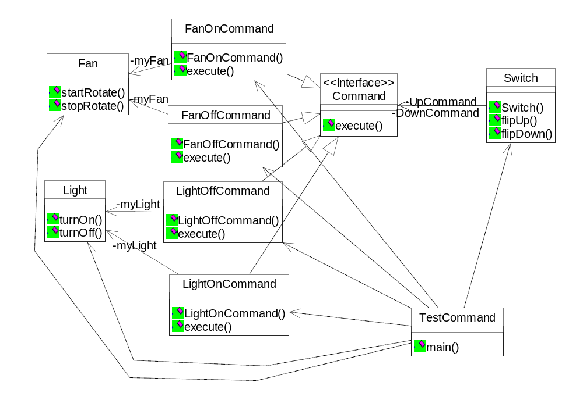
看程序学 命令模式
OOAD Lecture, Author: NK Jiang
<number>/35

Slide 29
Command Pattern
End
OOAD Lecture, Author: NK Jiang
<number>/35

