Slide 1
Object orient Analysis &Design
面向对象分析与设计师
Design Pattern:
Composite Pattern
，
主讲: 姜宁康 博士
日期: 26/11/8

Slide 2
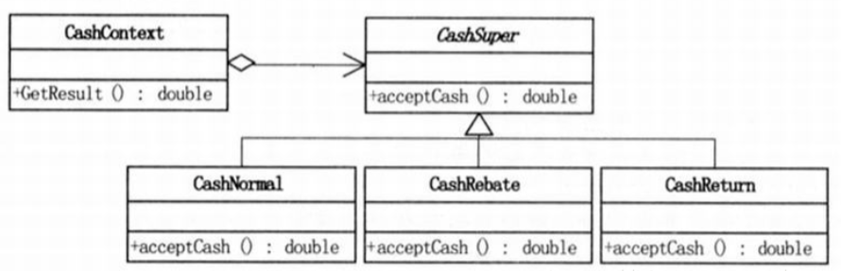
这是什么设计模式？
OOAD Lecture, Author: NK Jiang

Slide 3
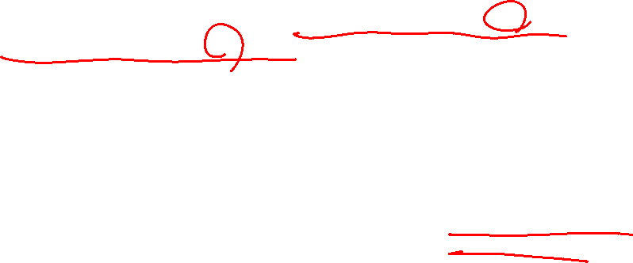
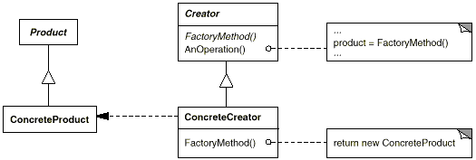
Review:工厂方法的定义
GOF 定义: 工厂方法定义了一个创建产品对象的工厂接口，
将实际创建工作推迟到子类中
除了工厂方法是抽象的
外，Creator类包含了操作产品的所有方法的实现，
所有的产品必须实现同一个接口，这样，使用产品的类可以指向该接口而不是指向具体的类。
所有创建者子类必须实现FactoryMethod方法
ConcreteCreator负责一个
或者多个具体产品的创
建。只有它才知道如何创建产品
ConcreteCreator 必须实现FactoryMethod，这个方法完成实际的产品创建。
OOAD Lecture, Author: NK Jiang
<number>/35

Slide 4
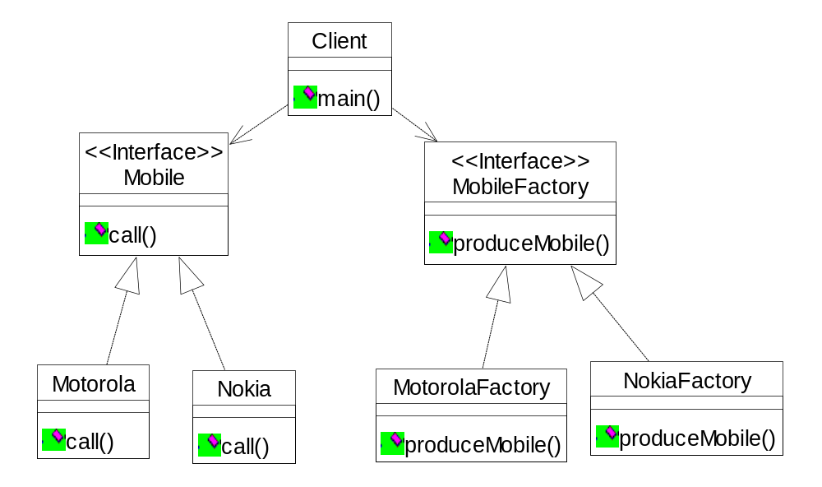
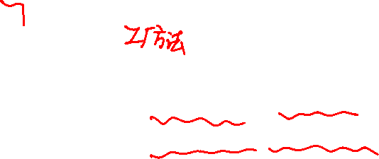
例：工厂模式
public class Client {
public static void main(String argv[])
{
MobileFactory mf;
Mobile m;
mf=new MotorolaFactory();
m=mf.produceMobile();
m.call();
mf=new NokiaFactory();
m=mf.produceMobile();
m.call();
}
public class MotorolaFactory implements MobileFactory {
public Mobile produceMobile() {
System.out.print("摩托罗拉工厂制造了");
return new Motorola();
}
}
OOAD Lecture, Author: NK Jiang
<number>/35

Slide 5
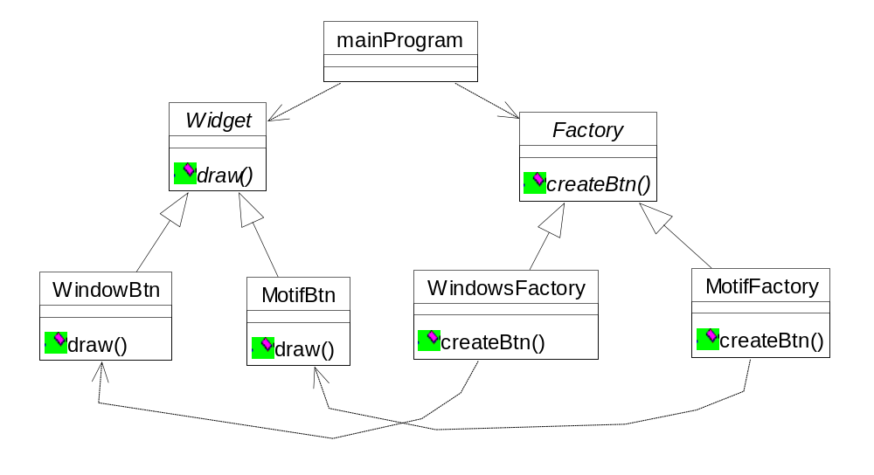

案例：抽象工厂
..\Abstract_fac\Abstract_fac
void main( void ) {
Factory* factory; //面向接口编程
#ifdef MOTIF //通过配置，灵活创建
factory = new MotifFactory; //具体工厂
#else // WINDOWS
factory = new WindowsFactory;
#endif
// w 是抽象产品指针，可以指向任意具体产
//品。由具体工厂去产生 具体产品
Widget* w = factory->createBtn();
w->draw();
此例的抽象工厂 Factory，仅生产一种产品 button,因此，提供一种操作：
  createBtn()
两个具体的工厂分别生产不同风格的button:
  Windows 风格
  Motif 风格
mainProgram 在此处是客户，
OOAD Lecture, Author: NK Jiang
<number>/35

Slide 6
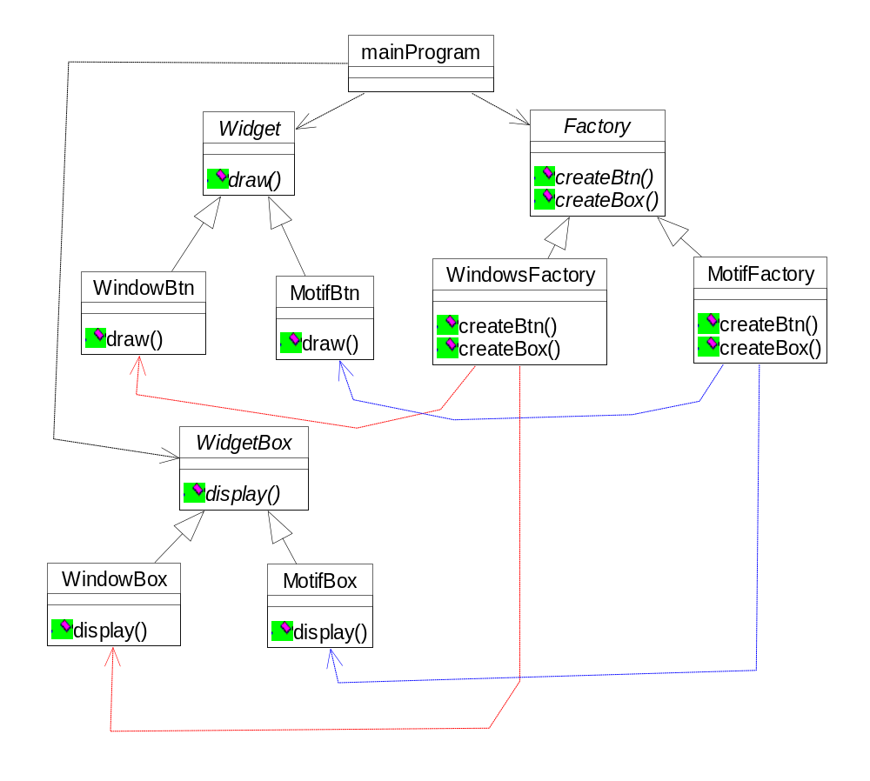

在前案例的基础上，抽象工厂能生产更多产品
用户输入1：
This is Motif factory
This is Motif Btn
This is Motif Box
3,因此，在抽象工厂中定义生产两样产品的抽象方法
2，在每个产品系列中有两种 产品：button和box
4,每个具体工厂能生产一种系列（风格）下的所有产品（ button和box）
1,系统配置有两个产品系列（风格）：Windows和Motif
用户输入2：
This is Windows factory
This is Windows Btn
This is Windows Box
OOAD Lecture, Author: NK Jiang
<number>/35

Slide 7
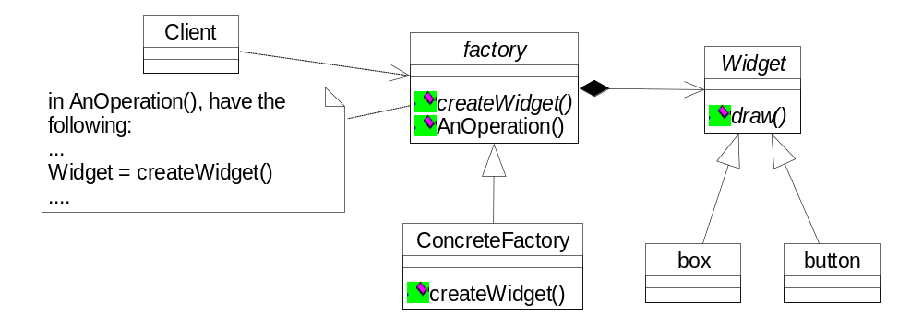

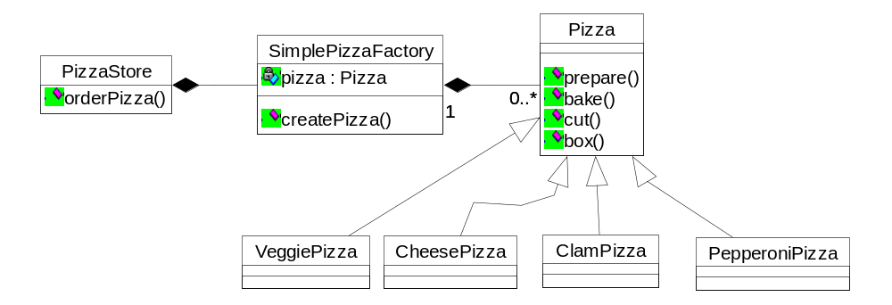
Review: 工厂模式(factory design pattern)
工厂模式
简单工厂（模式）
OOAD Lecture, Author: NK Jiang
<number>/35

Slide 8


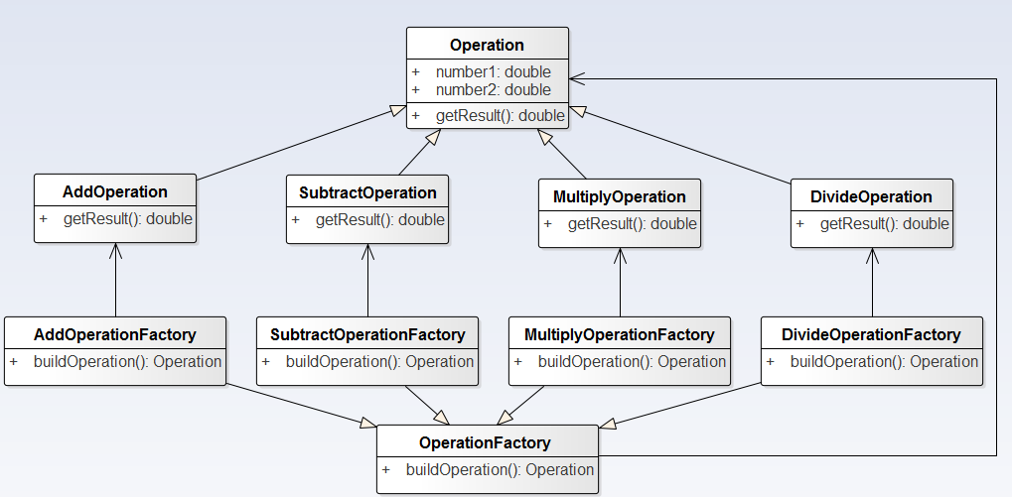
这是什么设计模式？
OOAD Lecture, Author: NK Jiang

Slide 9

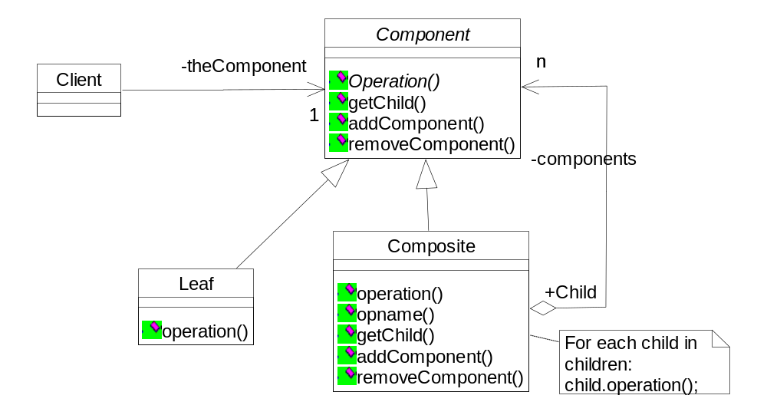
Composite Pattern 组合（合成）模式
The Component（构件） defines an interface for all objects in the composition both the composite and the leaf
node
The Component may implement a default behavior for Add(),
Remove(), GetChild() and its operations
The Cilent uses the
Component interface to
manipulate the objects in
the commposition
Note that Leaf will inherit
Add(), Remove().
GetChild() which don’t
make a lot of sense for a
Leaf node
The Composite’s （组合）role is to define behavior of the components having children and to store child components.
It also implements Leaf related operations. Some of them might not make sense in Composite and exceptions might be Generated
A Leaf （叶子节点）has no children. A Leaf defines the behavior for the elements in the composition. It does this by implementing the the operations that the Composite supports
OOAD Lecture, Author: NK Jiang

Slide 10
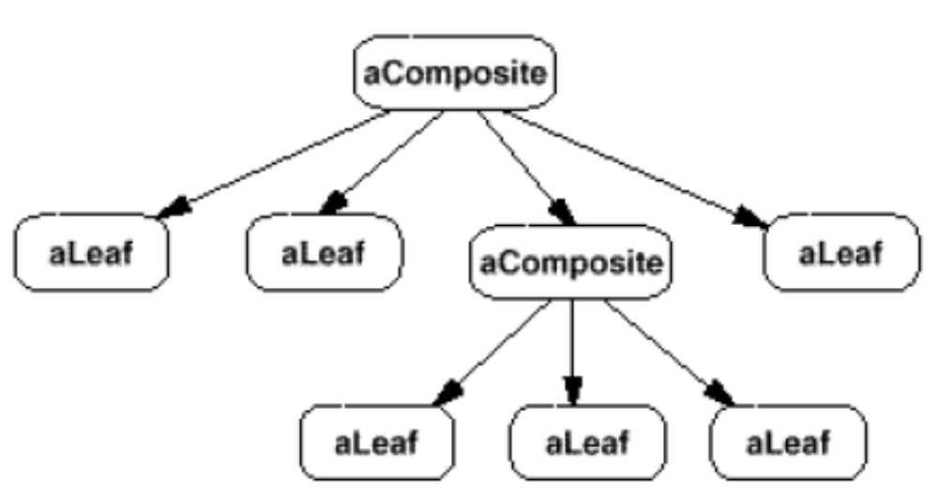
Composite Pattern 组合模式
OOAD Lecture, Author: NK Jiang

Slide 11

Composite Pattern
Applicability
You want to be able to ignore the difference between compositions of objects and individual objects. Clients will treat all objects in the composite structure uniformly.
Participants
Component（构件）
-- declares the interface for objects in the composition
-- implements default behavior for the interface common to all classes, as
appropriate
-- declares an interface for accessing and managing its child components.
Leaf （叶子）
-- defines behavior for primitive objects in the composition.
Composite（组合）
-- defines behavior for components having children.
-- stores child components
-- implements child-related operations in the Component interface.
OOAD Lecture, Author: NK Jiang

Slide 12
Composite Pattern
Collaborations
Clients use the Component class interface to interact with object in the composite structure. If the recipient is a Leaf, then the request is handled directly. If the recipient is a Composite, then it usually forwards request to its child components, possibly performing additional operations before and/or after forwarding.
Consequences
Defines class hierarchies consisting of primitive objects and composite objects. Wherever client code expects a primitive object, it can also take a composite object.
Makes the client simple. Clients can treat composite structures and individual objects uniformly.
Makes it easier to add new kinds of components. Newly defined Composite or Leaf subclasses work automatically with existing structures and client code.
Can make your design overly general.
OOAD Lecture, Author: NK Jiang

Slide 13
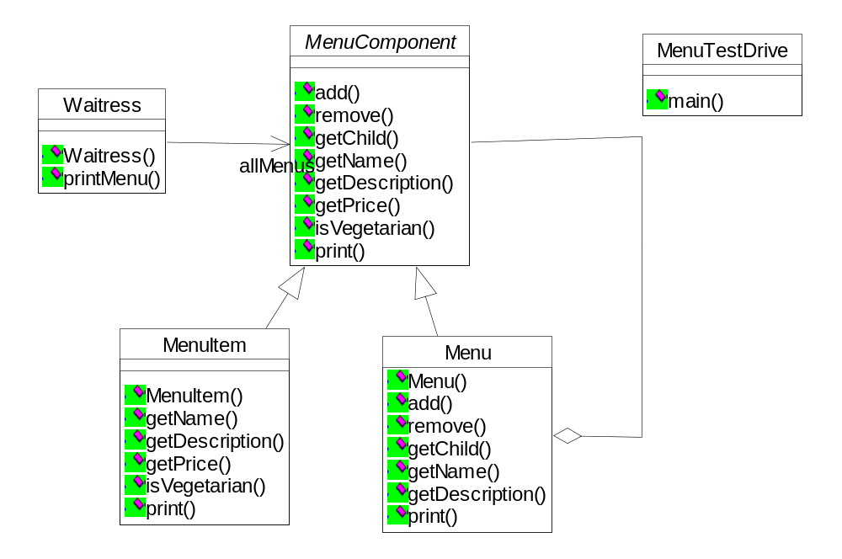
The Menu Composite（打印所有菜单项）
The Waitress is going to
use the MenuComponent
interface to access both
Menus and MenuItems
Methods for manipulating
the components. The
components are MenuItem
and Menu
MenuComponent
represents the interface for
both MenuItem and Menu.
MenuItem overrides the
methods that make sense, an uses the default implementation in MenuComponent for those that don’t make sense
Menu also overrides the
methods that make sense,
like a way to add and
remove menu items.
OOAD Lecture, Author: NK Jiang

Slide 14
The Menu Component
public abstract class MenuComponent {
public void add (MenuComponent menuComponent) {
throw new UnsupportedOperationException();
}
public void remove(MenuComponent menuComponent) {
throw new UnsupportedOperationException();
}
public MenuComponent getChild(int i) {
throw new UnsupportedOperationException();
}
public String getName() {
throw new UnsupportedOperationException();
}
public String getDescription() {
throw new UnsupportedOperationException();
}
public double getPrice() {
throw new UnsupportedOperationException();
}
public boolean isVegetarian() {
throw new UnsupportedOperationException();
}
The composite methods
Operations used by MenuItems
OOAD Lecture, Author: NK Jiang

Slide 15
The MenuItem
public class MenuItem extends MenuComponent {
String name;
String description;
boolean vegetarian;
double price;
public MenuItem(String name, String description, boolean vegetarian, double price) {
this.name = name;
this.description = description;
this.vegetarian = vegetarian;
this.price = price;
}
public String getName() { return name; }
public String getDescription() { return description;}
public double getPrice() { return price; }
public boolean isVegetarian() { return vegetarian; }
public void print() {
System.out.print(" " + getName());
if (isVegetarian()) {
System.out.print("(v)");
}
System.out.println(", " + getPrice());
System.out.println(" -- " + getDescription());
}
}
OOAD Lecture, Author: NK Jiang

Slide 16
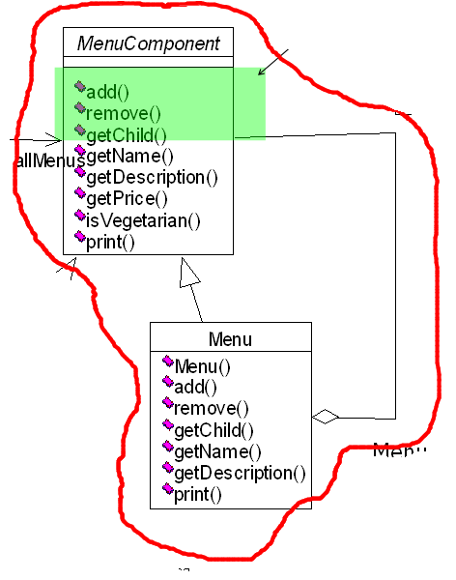
The Menu
public class Menu extends MenuComponent {
  ArrayList menuComponents = new ArrayList();
  String name;
  String description;
  public Menu(String name, String description) {
  this.name = name;
  this.description = description;
  }
  public void add(MenuComponent menuComponent) {
  menuComponents.add(menuComponent);
  }
  public void remove(MenuComponent menuComponent) {
  menuComponents.remove(menuComponent);
  }
  public MenuComponent getChild(int i) {
  return (MenuComponent)menuComponents.get(i);}
  public String getName() { return name;}
  public String getDescription() { return description;}
  public void print() {
    System.out.print("\n" + getName());
    System.out.println(", " + getDescription());
    Iterator iterator = menuComponents.iterator();
    while (iterator.hasNext()) {
      MenuComponent menuComponent = (MenuComponent)iterator.next();
      menuComponent.print();
    }}
}
OOAD Lecture, Author: NK Jiang

Slide 17
The Waitress Code
public class Waitress {
MenuComponent allMenus;
public Waitress(MenuComponent allMenus) {
this.allMenus = allMenus;
}
public void printMenu() {
allMenus.print();
}
}
OOAD Lecture, Author: NK Jiang

Slide 18
Runing the Restaurant
public class MenuTestDrive {
  public static void main(String args[] ) {
    MenuComponent pancakeHouseMenu = new Menu("PANCAKE HOUSE MENU", "Breakfast");
    MenuComponent dinerMenu = new Menu("DINER MENU", "Lunch");
    MenuComponent cafeMenu = new Menu("CAFE MENU", "Dinner");
    MenuComponent dessertMenu = new Menu("DESSERT MENU", "Dessert of course!");
    MenuComponent coffeeMenu = new Menu("COFFEE MENU", "Stuff for the afternoon coffee");
    MenuComponent allMenus = new Menu("ALL MENUS", "All menus combined");
    allMenus.add(pancakeHouseMenu);
    allMenus.add(dinerMenu);
    allMenus.add(cafeMenu);
    pancakeHouseMenu.add(new MenuItem( "K&B's Pancake Breakfast",
    "Pancakes with scrambled eggs, and toast", true, 2.99));
    ....
    dinerMenu.add(new MenuItem( "Vegetarian BLT",
    "(Fakin') Bacon with lettuce & tomato on whole wheat", true, 2.99));
    .....
    dinerMenu.add(dessertMenu);
    dessertMenu.add(new MenuItem( "Apple Pie",
    "Apple pie with a flakey crust, topped with vanilla icecream", true, 1.59));
    .....
    cafeMenu.add(new MenuItem( "Veggie Burger and Air Fries", "Veggie burger on a whole wheat
    bun, lettuce, tomato, and fries", true, 3.99));
    ....
    cafeMenu.add(coffeeMenu);
    coffeeMenu.add(new MenuItem( "Cofwfaelen uCtask"e,"t,ru"eC,r1u.m5b9l)y) ;cake topped with cinnamon and
    Waitress waitress = new Waitress(allMenus);
    waitress.printMenu();
  }
}
OOAD Lecture, Author: NK Jiang

Slide 19
Result: Runing the Restaurant
ALL MENUS, All menus combined
---------------------
PANCAKE HOUSE MENU, Breakfast
---------------------
K&B's Pancake Breakfast(v), 2.99
-- Pancakes with scrambled eggs, and toast
Regular Pancake Breakfast, 2.99
-- Pancakes with fried eggs, sausage
Blueberry Pancakes(v), 3.49
-- Pancakes made with fresh blueberries, and blueberry syrup
Waffles(v), 3.59
-- Waffles, with your choice of blueberries or strawberries
DINER MENU, Lunch
---------------------
Vegetarian BLT(v), 2.99
-- (Fakin') Bacon with lettuce & tomato on whole wheat
BLT, 2.99
-- Bacon with lettuce & tomato on whole wheat
Soup of the day, 3.29
-- A bowl of the soup of the day, with a side of potato salad
Hotdog, 3.05
-- A hot dog, with saurkraut, relish, onions, topped with cheese
Steamed Veggies and Brown Rice(v), 3.99
-- Steamed vegetables over brown rice
Pasta(v), 3.89
-- Spaghetti with Marinara Sauce, and a slice of sourdough bread
DESSERT MENU, Dessert of course!
---------------------
OOAD Lecture, Author: NK Jiang

Slide 20
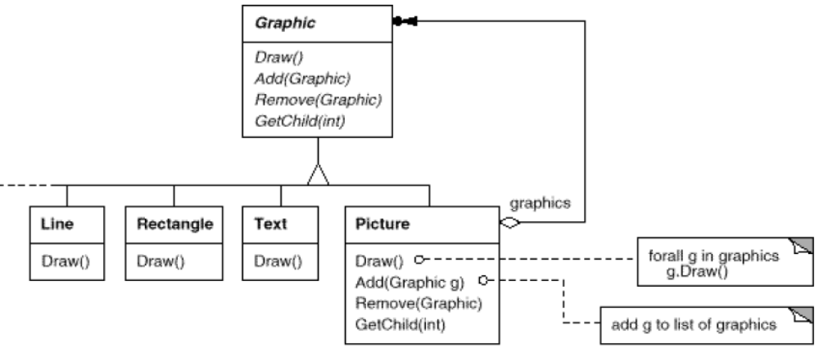
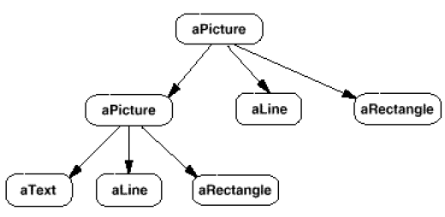
Composite Pattern - Example
OOAD Lecture, Author: NK Jiang

Slide 21
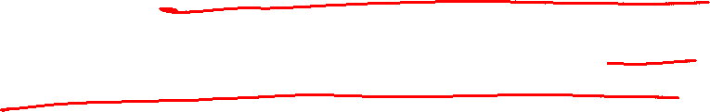
Summary
The Composite Pattern provides a structure to hold both the individual objects and composites.
The Composite Pattern allows clients to treat composites and individual objects uniformly.
A Component is any object in a composite structure. Components may be other composites or leaf nodes
OOAD Lecture, Author: NK Jiang

Slide 22
End
OOAD Lecture, Author: NK Jiang

