Slide 1
Object orient Analysis &Design
面向对象分析与设计师
Applying GoF Design Pattern
Ch26
主讲: 姜宁康 博士
日期: 26/11/8

Slide 2
《课程论坛话题》：关于敏捷开发
敏捷由来
  2001年，Kent Beck 和16位软件开发相关者共同签署了“敏捷软件开发宣言”: 敏捷联盟宣言
  “我们正在通过亲身实践以及帮助他人实践的方式来揭示更好地软件开发之路，通过这项工作，我们认识到：
    个人和他们之间的交流 胜过了 开发过程和工具
    可运行的软件 胜过了 宽泛的文档
    客户合作 胜过了 合同谈判
    对变更的良好响应 胜过了 按部就班地遵循计划 ”
  即，虽然上述右边的各项很有价值，但我们认为左边的各项具有更大的价值
OOAD Lecture, Author: NK Jiang
<number>/50

Slide 3
《课程论坛话题》：关于敏捷开发
敏捷原则-12条
  1 我们最优先要做的是，通过尽早、持续交付有价值的软件来使客户满意
  2 即使在开发的后期，也欢迎需求变更。敏捷过程利用变更为客户创造竞争优势
  3 经常交付可运行软件，交付的间隔可以从几个星期到几个月，交付的时间间隔越短越好
  4 在整个项目开发期间，业务人员和开发人员必须天天都在一起工作
  5 围绕有积极性的个人构建项目，给他们提供所需要的环境和支持，并且信任他们能够完成工作
  6 在团队内部，最富有效果和效率的信息传递方式是面对面交流
OOAD Lecture, Author: NK Jiang
<number>/50

Slide 4
《课程论坛话题》：关于敏捷开发
敏捷原则-12条
  7 可运行软件是进度的首要度量标准
  8 敏捷过程提倡可持续的开发速度。责任人(sponsor)、开发者和用户应该能够长期保持稳定的开发速度
  9 不断地关注优秀的技能和好的设计,会增强敏捷能力
  10 简单: 使不必做的工作最大化的艺术--- 是必要的
  11 最好的架构、需求和设计出自于 自组织团队
  12 每隔一定时间，团队会反省如何才能更有效地工作,并相应调整自己的行为。
注意
  这些内容，原则上是一种敏捷精神，各团队可以取舍
OOAD Lecture, Author: NK Jiang
<number>/50

Slide 5
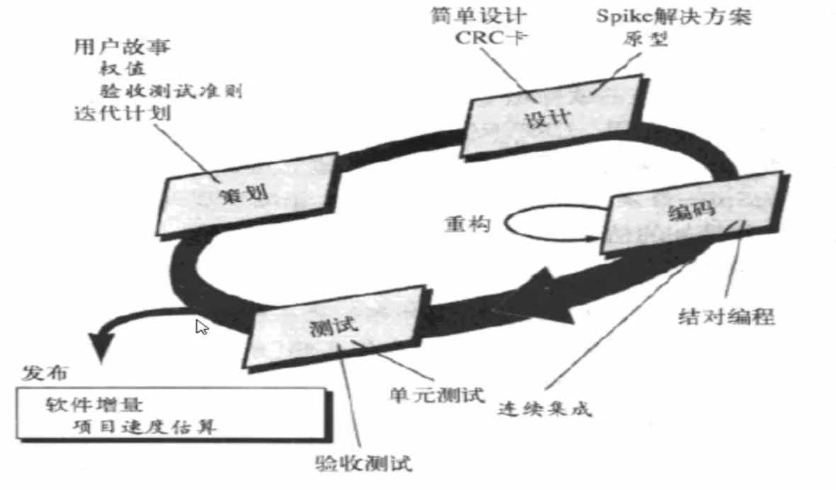
《课程论坛话题》：关于敏捷开发
极限编程 XP （eXtreme Programming ）
  是敏捷软件开发中，使用最广泛的一种方法
  XP使用面向对象方法作为推荐的开发范型
  XP包含了 策划、设计、编码和测试 4个框架活动的规则和实践
<number>/50

Slide 6
《课程论坛话题》：关于敏捷开发
其他的4种敏捷模型 （略，不展开）
  Scrum
  动态系统开发方法 DSSD
  敏捷建模 AM
  敏捷统一过程 AUP
OOAD Lecture, Author: NK Jiang
<number>/50

Slide 7
Review：we have learnt GoF…
Singleton
Observer
Strategy
Adapter
Factory / Abstractor Factory /(Simple Factory)
Façade
Command
Composite
要求： 名称、解决的问题、解决问题的方法、类图、实现的要点
OOAD Lecture, Author: NK Jiang
<number>/50

Slide 8
Reuse Design Pattern 设计模式的作用
Reuse Design 重用设计
  设计方案的重用比代码的重用更有意义，它会自动带来代码重用
Common Vocabulary 为设计提供共同的词汇
  每个模式名就是一个设计词汇，其概念使得程序员间的交流更加方便
Easy Documentation 编写开发文档更加容易
  在开发文档中采用模式词汇可以让其他人更容易理解设计师的想法，理解设计师为什么这么做？做了些什么？
Easy refactor 应用设计模式可以让重构系统变得容易
  为其他应用程序提供很好的系统架构
  设计模式与编程语言无关

Slide 9
模式的学习阶段
模式的学习是一个渐进的过程
  误解了模式是什么
  误解了模式能做什么
注意：
  下决心学习模式、弄明白模式的本质, 并不断地应用熟悉，以后的收益是不可估量的
  模式不会为你提供什么保证，它只能提高你的潜能，让你的软件设计更加成熟
知识
获益
熟悉
明白
开始学习
惊愕
无知
时间
误解地区
OOAD Lecture, Author: NK Jiang
<number>/50

Slide 10
Review GRASP
Responsibility 定义
  Knowing
    knowing about private encapsulated data
    knowing about related objects
    knowing about things it can derive or calculate
  Doing
    Do it yourself,
      such as creating an object or doing a calculation
    initiating action in other objects
    controlling and coordinating activities in other objects
GRASP ：General Responsibility Assignment Software Patterns
  Creator / Information Expert / Controller/Low Coupling / High Cohesion
  Polymorphism
  Pure fabrication
    GOF (Abstract Factory)
  Indirection
    GOF (Facade)
  Protected Variations 隔离变化/保护变化
    Similar to OCP,开闭原则（Open for…, Closed for …）
    GoF (Adapter)
GRASP ~ GOF 的关系
OOAD Lecture, Author: NK Jiang
<number>/50

Slide 11
Text Book Ch 26
  请大家仔细阅读、体会、练习
OOAD Lecture, Author: NK Jiang
<number>/50

Slide 12
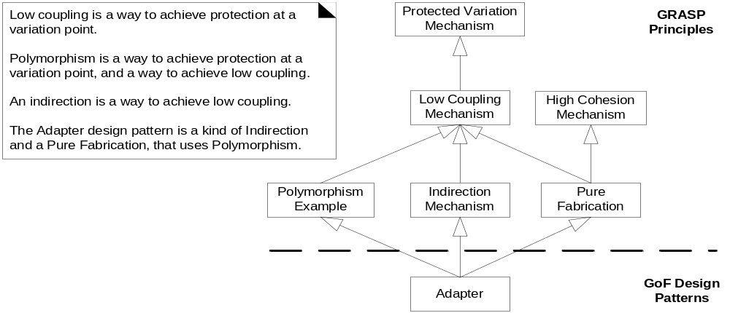
Fig. 26.3
GRASP And GoF
UML generalization relationships are used to suggest the conceptual connections
Very important conceptual model!
Notice, PV is the most fundamental principle
Specific GOF patterns are concrete applications of GRASP
OOAD Lecture, Author: NK Jiang
<number>/50

Slide 13
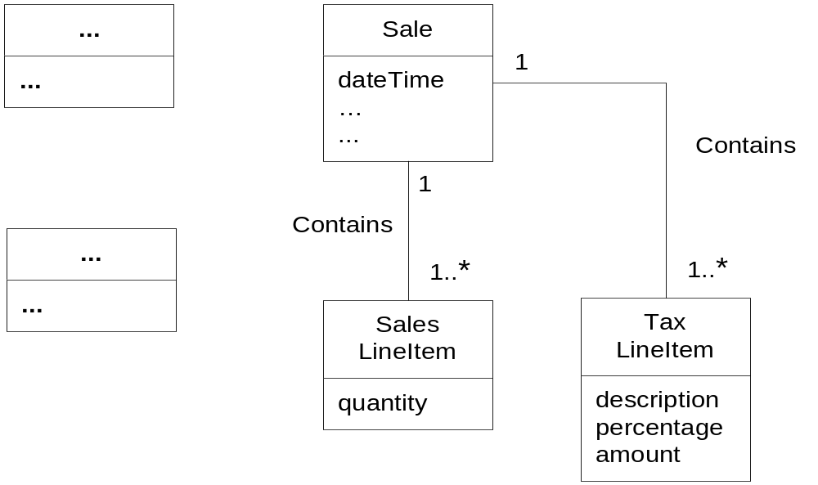
Fig. 26.4
“Analysis" Discoveries During Design: Domain Model
Design modeling discovers new domain concept:
TaxLineItem class added to domain class diagram
Very common to discover new analysis concepts during design
OOAD Lecture, Author: NK Jiang
<number>/50

Slide 14
问题一、POS系统需要支持多种第三方外部服务，如，
税金计算器
信用卡授权认证服务
库存系统
帐务系统
它们都具有不同的API，而且无法改变，怎么办？
应用 Adapter 模式，增加一间接层（适配器）
OOAD Lecture, Author: NK Jiang
<number>/50
Notes:
使用

Slide 15
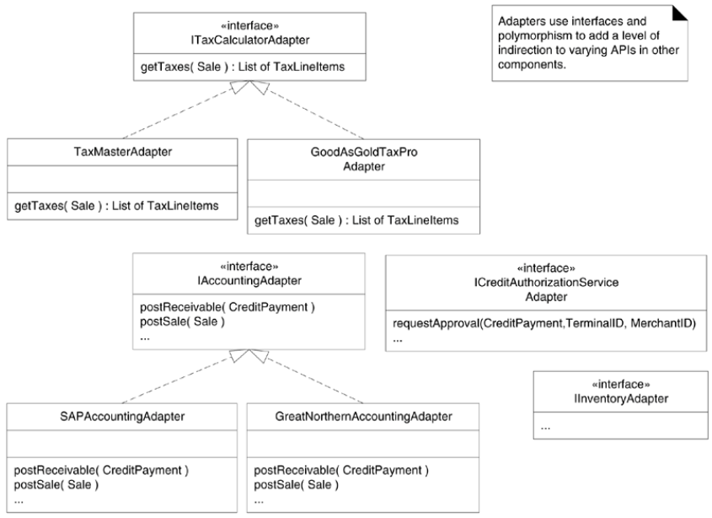
Fig. 26.1
OOAD Lecture, Author: NK Jiang
<number>/50

Slide 16
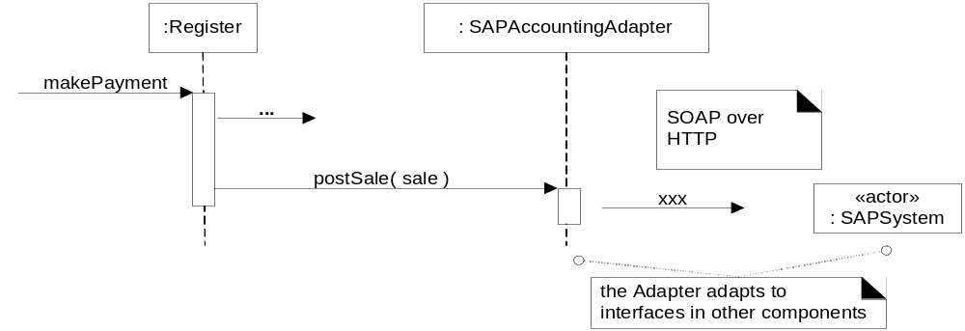
Fig. 26.2
<<Actor >>
Register posts the sale to an Adapter
Adapter communicates with the SAP accounting system
SAP accounting system exposes functionality as a web service
Clients send message to Adapter; Enables Plug n’ Play WRT 3rd party SW!
Notice adherence to good naming conventions
OOAD Lecture, Author: NK Jiang
<number>/50

Slide 17
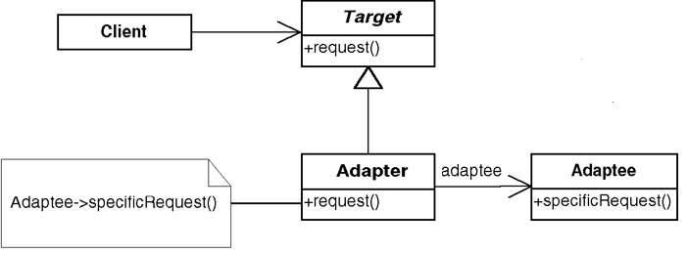
GOF Patterns
Adapter – One of the most useful
  Problem:
    How to resolve incompatible interfaces
    How to provide a stable interface to similar components with different interfaces
  Solution (advice):
    Hide the incompatible/unstable interface behind the adapter’s interface
    Client collaborates with stable adapter
    Adapter relays messages to unstable interface
    Uses Protected Variations, Polymorphism, Indirection
OOAD Lecture, Author: NK Jiang
<number>/50

Slide 18
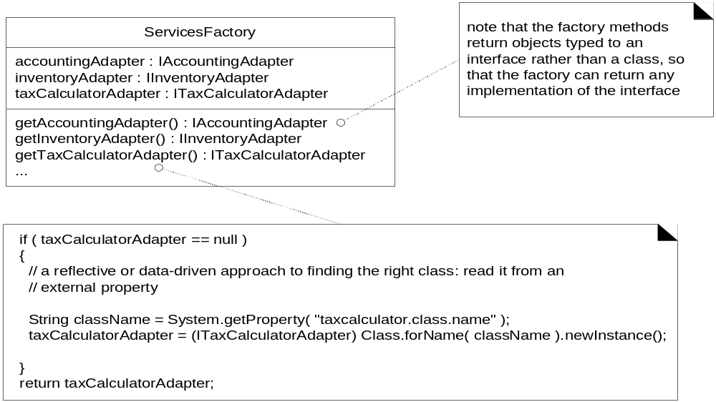
Fig. 26.5
问题2：在前述适配器模式的解决方案中，对外部服务有不同的接口，那么是谁创建了这些适配器？并且如何决定创建哪类适配器（TaxMasterAdapter or GoodAsTaxProAdapter）?
解决：用工厂模式
ServicesFactory creates adapter objects for many 3rd party services
Each get..Adapter() method checks to make sure no instance already exists
The concrete adapter class is read from an external property file
Class.forName(..) returns a reference to a class given its name:string
First call to get..Adapter() creates adapter, subsequent calls access it
OOAD Lecture, Author: NK Jiang
<number>/50
Notes:
在前述适配器模式的解决方案中，对外部服务有不同的接口，那么是谁创建了这些适配器？
并且如何决定创建哪类适配器（TaxMasterAdapter or GoodAsTaxProAdapter）?

Slide 19
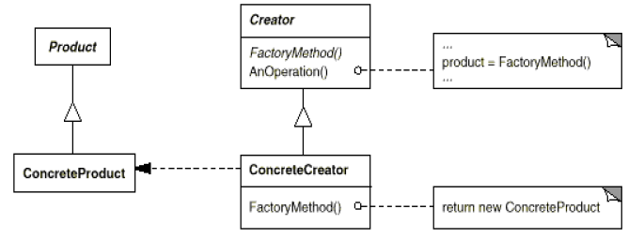
GOF Patterns
Factory (related to Simple or Concrete Factory)
  Simplified version of GOF Abstract Factory
  Problem:
    Who should be the Creator when creation causes incohesiveness (非内聚), or it involves complex creation logic
  Solution (advice):
    Assign creation responsibility to a pure fabrication Factory object
    Commonly implemented via the Singleton pattern
client
OOAD Lecture, Author: NK Jiang
<number>/50
Notes:
incohesive [简明英汉词典]
[7inkEu5hi:siv]
adj.无凝聚力的

Slide 20
问题3：由谁来创建工厂自身？ 如何访问工厂？
注意
  在该过程中只需要一个工厂实例
  需要在代码的不同位置调用工厂中的方法
解决：
1/ 全局变量
2/ 用单实例模式 Singleton 模式
public class Register
{
public void initialize()
{
… do some work …
// accessing the singleton Factory（ServicesFactory） via the getInstance call
accountingAdapter =
ServicesFactory.getInstance().getAccountingAdapter();
… do some work …
}
// other methods…
} // end of class
OOAD Lecture, Author: NK Jiang
<number>/50

Slide 21
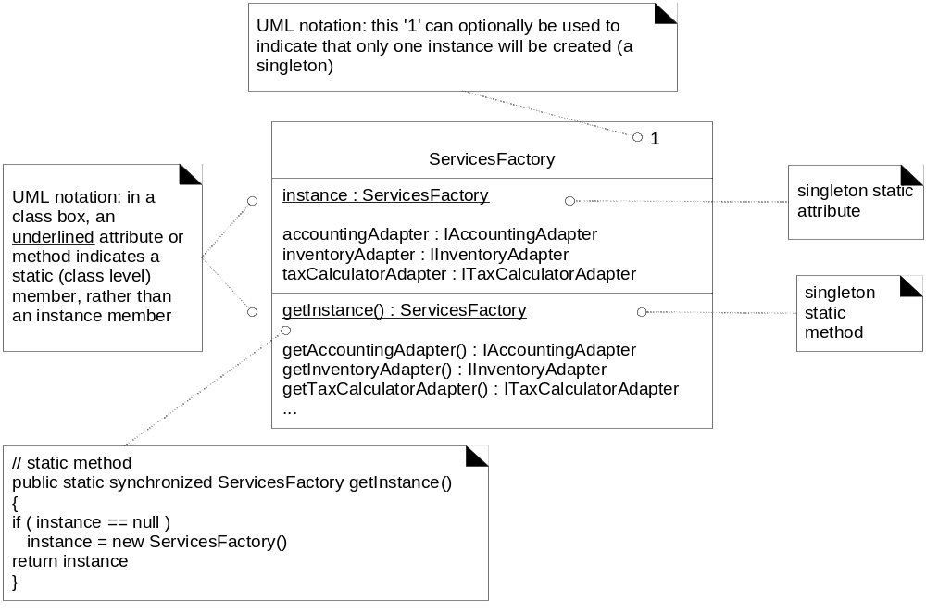
Fig. 26.6
All clients have global visibility to static method getInstance()。
First call to getInstance() creates a ServicesFactory singleton，
Subsequent calls just access the singleton。
OOAD Lecture, Author: NK Jiang
<number>/50

Slide 22
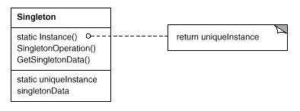
GOF Patterns
Singleton
  Problem:
    Exactly one instance of a class is needed/allowed
    Other objects need single, global point of access to it
  Solution (advice):
    Define a static method of a class that returns the Singleton
    The static method can only create one instance
OOAD Lecture, Author: NK Jiang
<number>/50

Slide 23
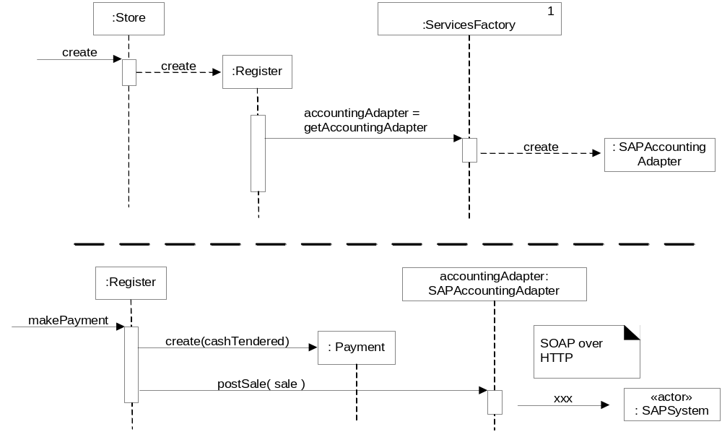
Fig. 26.8
模式的混合使用：可以组合使用多种模式来 解决具体问题
例如，使用适配器、工厂和单实例类模式的结合， 为具有不同接口的外部税金计算器、帐务系统等提供 适应外部变化的 解决方案
Adapter, Factory & Singleton used together
OOAD Lecture, Author: NK Jiang
<number>/50

Slide 24
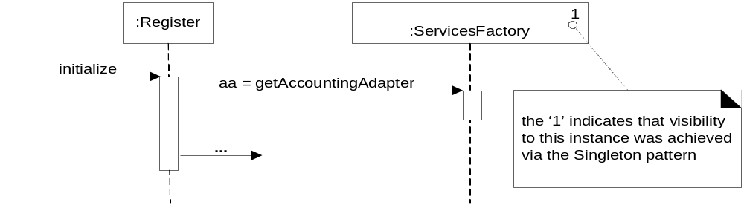
Fig. 26.7
At any point, can write following code:
SingletonClass.getInstance().getXXAdapter();
The getInstance() message is implied in the sequence diagram
OOAD Lecture, Author: NK Jiang
<number>/50

Slide 25
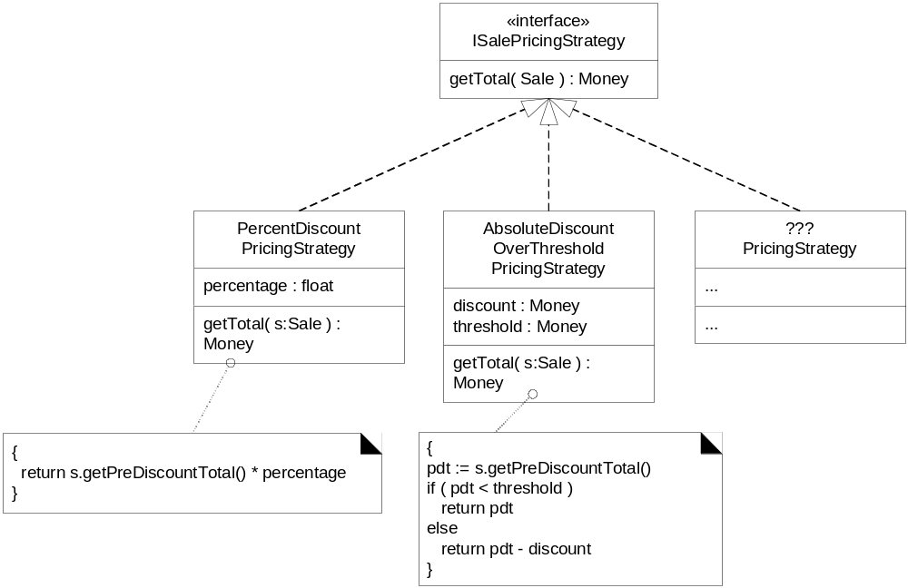
问题4。 POS系统需要提供更为复杂的定价逻辑，例如，商店在某天的折扣、根据年龄的折扣、根据销售额的折扣等
问题-〉如何针对不同的而又相关的算法、规则等进行设计？ 使设计结果能适应这种变化？
解决方法： 用策略模式
Each pricing strategy subclass implements a different pricing algorithm
All implement the getTotal(..) method
Strategy object attached to a context object (Sale, in this case)
《interface》
Fig. 26.9
context object the object to which it applies the algorithm. In this example, the context object is a Sale.
OOAD Lecture, Author: NK Jiang
<number>/50

Slide 26
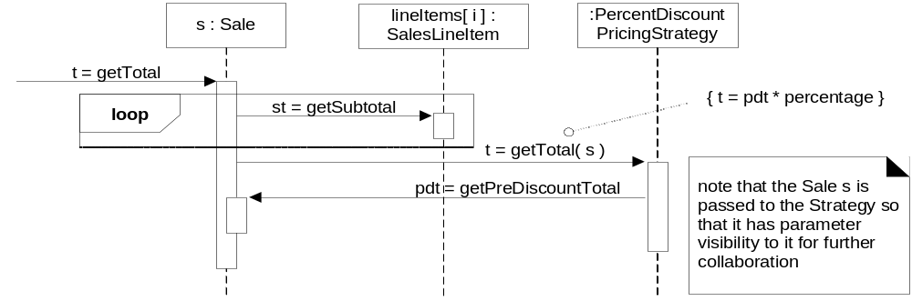
Fig. 26.10
Strategy collaboration
context object pass a reference to itself (this) on to the strategy object, so that the strategy has parameter visibility to the context object, for further collaboration.
Client tells Sale to getTotal(), Sale gets subtotals from all SaleLineItems
Sale passes ‘this’ reference to its strategy object
So strategy can obtain needed data from its context object, Sale
OOAD Lecture, Author: NK Jiang
<number>/50

Slide 27
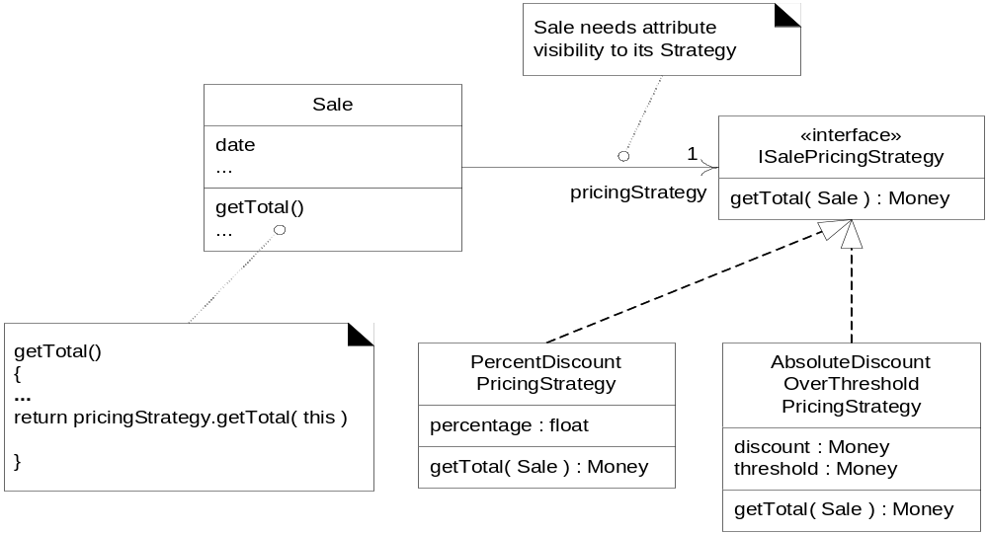
Fig. 26.11
Context object needs attribute visibility to its strategy
《interface》
Strategy collaboration class diagram
Sale has attribute visibility to its strategy object
Strategy has parameter visibility back to its context object, Sale
OOAD Lecture, Author: NK Jiang
<number>/50

Slide 28
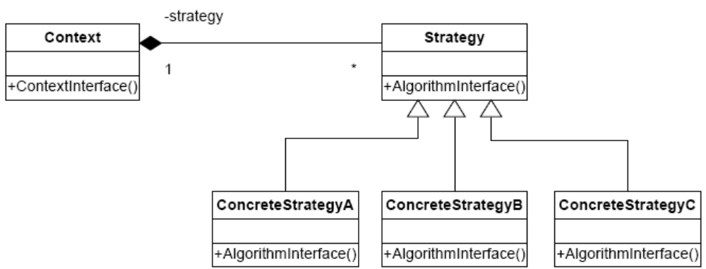
GOF Patterns
Strategy
  Problem:
    How to design for variable algorithms, policies or business rules
    Yet insulate clients from algorithmic details
  Solution (advice):
    Define separate class for each algorithm, policy or rule,
    Where each class implements same interface
Strategy – defines a family of algorithms, encapsulate
each one, and makes them interchangeable. Strategy lets
the algorithm vary independently from the clients that
use it.
OOAD Lecture, Author: NK Jiang
<number>/50

Slide 29
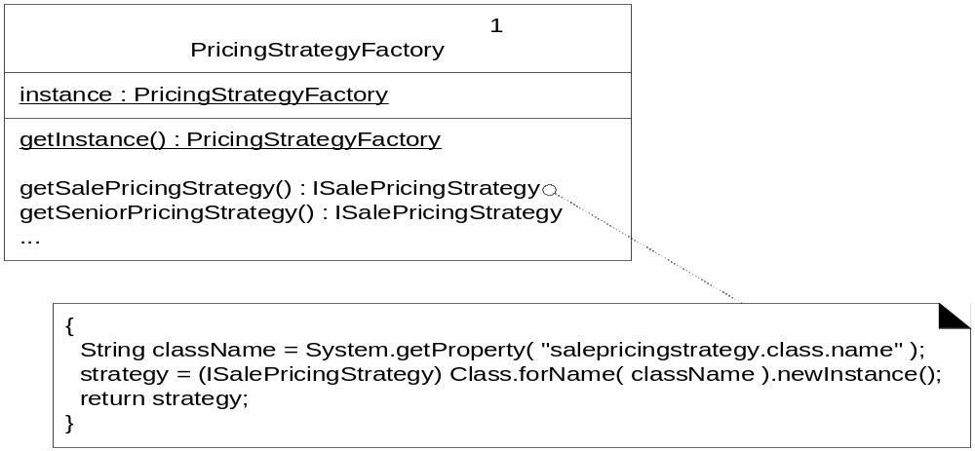
Fig. 26.12
问题4.1 不同的定价算法或策略会随时间而变化，谁应该创建策略呢？
单实例 工厂模式
Using a factory to create a strategy object for a Sale
Each newly created Sale uses the factory to create its pricing strategy object
OOAD Lecture, Author: NK Jiang
<number>/50

Slide 30
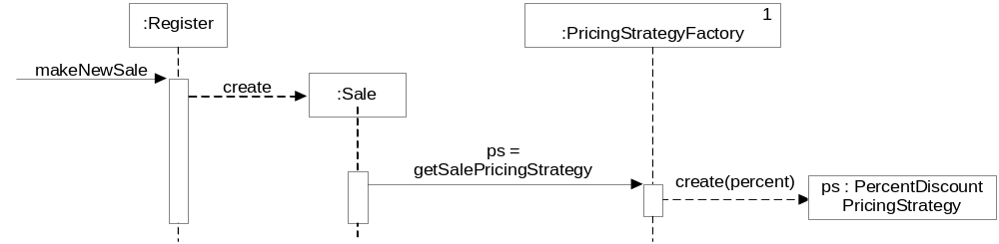
Fig. 26.13
Creation of a strategy object for Sale
OOAD Lecture, Author: NK Jiang
<number>/50

Slide 31
问题5 如何来处理多个互相冲突的定价策略？
例如：
- 20% senior discount policy
- preferred customer discount of 15% off sales over $400
- on Monday, there is $50 off purchases over $500
- buy 1 case of Darjeeling tea, get 15% discount off of everything
解决冲突的策略：
- 对顾客最有利
-对商店最有利
- 一个销售有多个定价策略
- - 创建策略对象时需要知道顾客类型、或产品类型等
如何使销售对象（sale）不需要知道是否要处理一个或多个定价策略，而且同时还能够提供一种设计来解决冲突？
解决方案：
使用组合模式 （Composite pattern）
OOAD Lecture, Author: NK Jiang
<number>/50

Slide 32
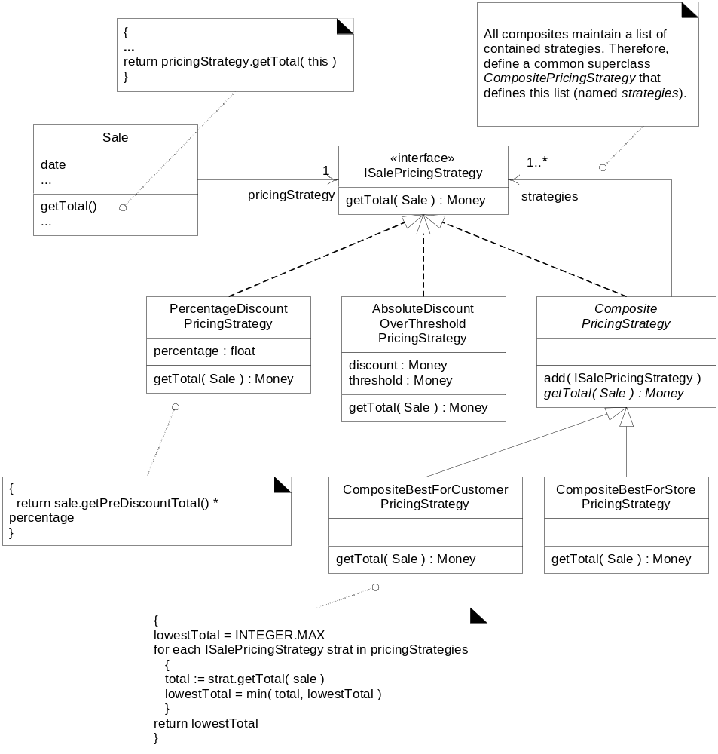
Fig. 26.14
Composite pricing strategy class diagram
Can add atomic or other composite pricing strategies to the composite
OOAD Lecture, Author: NK Jiang
<number>//50

Slide 33
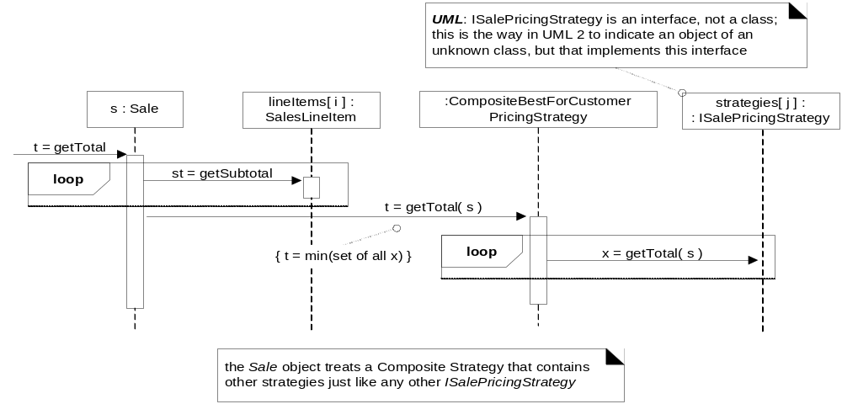
Fig. 26.15
Composite sequence diagram
Composite object iterates over its collection of atomic strategy objects
See sample code on p. 455
OOAD Lecture, Author: NK Jiang
<number>/50

Slide 34
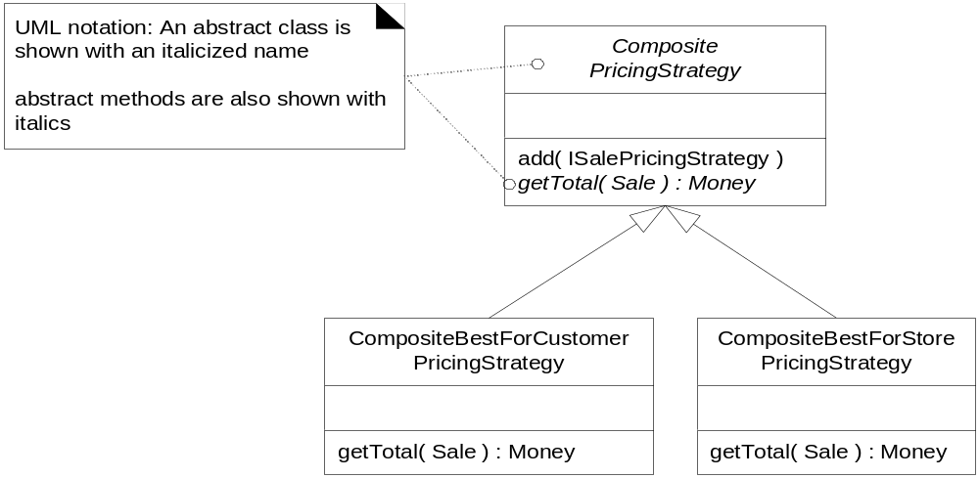
Fig. 26.16
Each subclass implements getTotal(…) which iterates over a collection of
strategy objects
OOAD Lecture, Author: NK Jiang
<number>/50

Slide 35
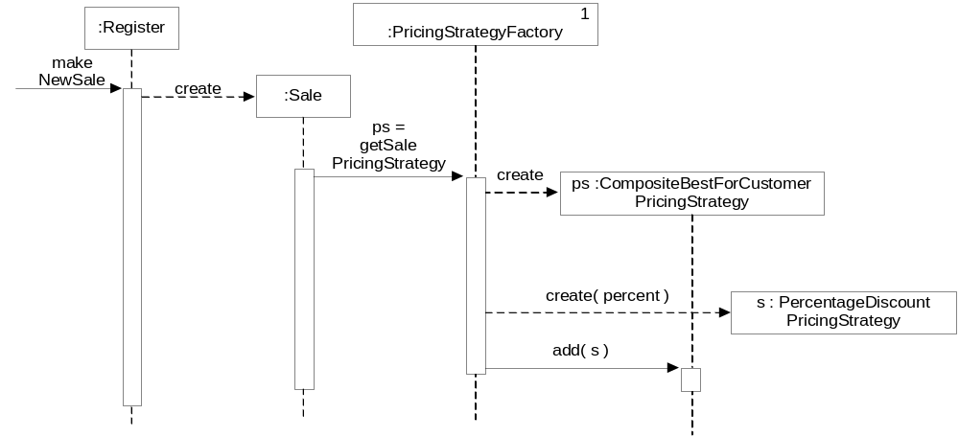
Fig. 26.17
Using Abstract Factory to create a Composite Strategy
Composite returns a ‘built-in’ Composite Strategy defined store-wide
OOAD Lecture, Author: NK Jiang
<number>/50

Slide 36
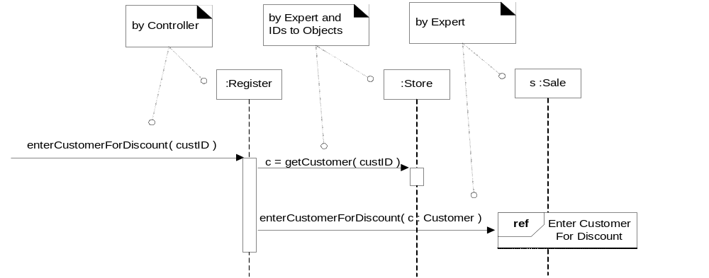
Fig. 26.18
Creation of Composite based on customer saying “I get a special discount!”
Notice new system operation for Process Sale UC
ID to Object Pattern: Store converts customer ID into a customer reference &
Register passes it to Sale
Next figure shows creation details….
Note use of ‘ref’ block to reference another UC
OOAD Lecture, Author: NK Jiang
<number>/50

Slide 37
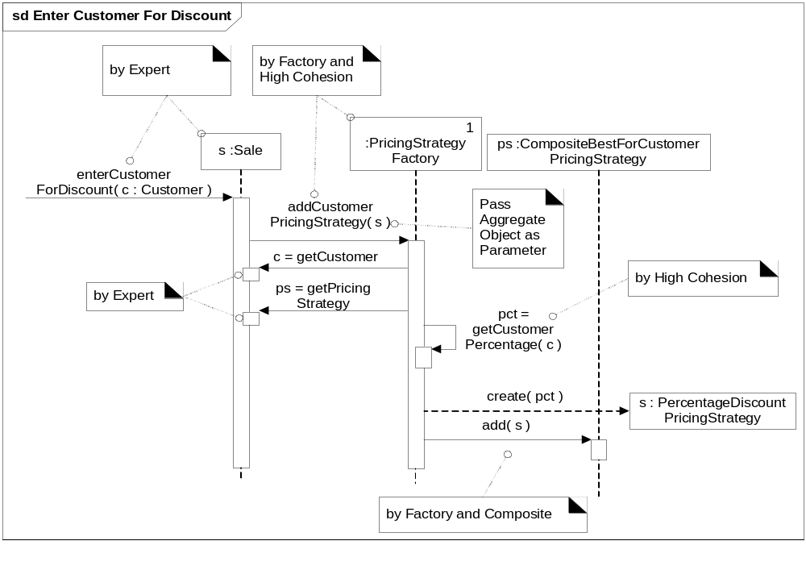
Fig. 26.19
Detailed creation of customer-specific Composite Strategy
Note: Initial message is same as the inbound msg for the ref block in prior diagram
Sale is passed to Factory which callsback for needed information
Avoid extracting child objects from parent object
More flexible; accommodates future design changes
OOAD Lecture, Author: NK Jiang
<number>/50

Slide 38
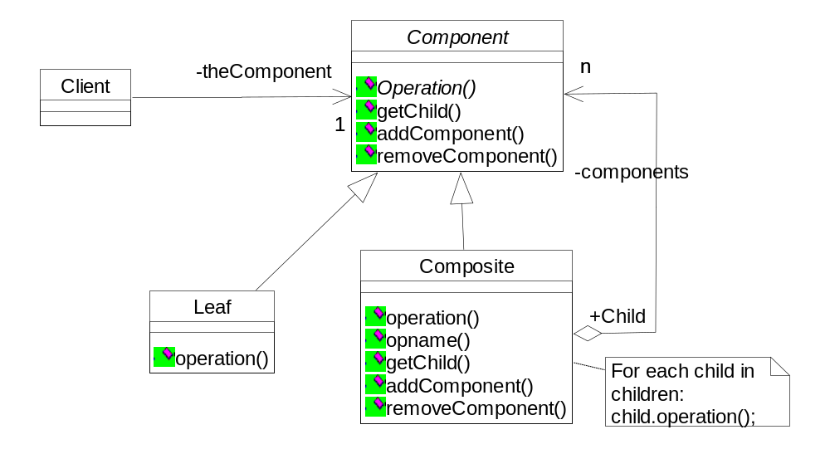
GOF Patterns：Composite
  Problem:
    How to treat a group of objects the same way as though they were a single object?
  Solution (advice):
    Define a composite object that has the same interface as the atomic objects
    Composite object can contain many atomic objects…all of which can be invoked by same method
OOAD Lecture, Author: NK Jiang
<number>/50

Slide 39
GOF Patterns
Composite
  A strategy object implements a specific atomic algorithm/rule/policy
  To handle compound rules, we need an object that is composed of several atomic strategy objects
  Allows customized rules based on blending of atomic rules
  Composite object has an attribute that is a list of atomic objects
OOAD Lecture, Author: NK Jiang
<number>/50

Slide 40
案例：抵押申请审核
抵押申请要得到三个审核：
  检查在银行是不是有足够存款
  抵押物价格是不是合理
  客户信誉评估是不是好。
这三个评估交给三个子系统独立完成。抵押申请审核要调用这三个子系统的方法，统一结果后决定审核是否合格
请问可以用何种设计模式来解决这个问题，请画出类图
OOAD Lecture, Author: NK Jiang
<number>/50

Slide 41
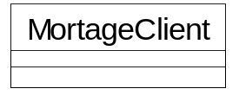
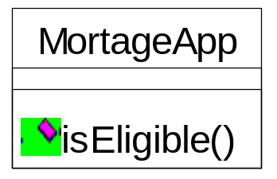
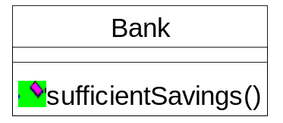
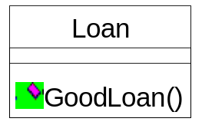
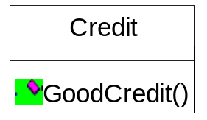
案例：抵押申请审核 解决方案
// "Facade"
class MortgageApplication {
  int amount;
  private Bank bank = new Bank();
  private Loan loan = new Loan();
  private Credit credit = new Credit();
  // Constructors
  public MortgageApplication( int amount ){
  this.amount = amount;
  }
  public bool IsEligible( Customer c ) { //检查信用是否值得
  if ( !bank.SufficientSavings( c ) ) return false;
  if ( !loan.GoodLoan( c ) ) return false;
  if( !credit.GoodCredit( amount, c )) return false;
  return true;
  }
}
Facade design pattern (外观模式)
银行是否有足够的存款
抵押物是否价格合理
抵押人信誉如何
OOAD Lecture, Author: NK Jiang
<number>/50

Slide 42
GOF Patterns
Facade
  Problem:
    Need a common interface to a variable set of interfaces, perhaps within a subsystem
    Want to minimize coupling to the interfaces
    Want to expose only a subset of the interfaces’ functionality
  Solution (advice):
    Define an object that represents a single point-of-contact to the set of interfaces
    Clients communicate with ‘front-end’ Façade object
    Essentially an Adapter for multiple interfaces
OOAD Lecture, Author: NK Jiang
<number>/50

Slide 43
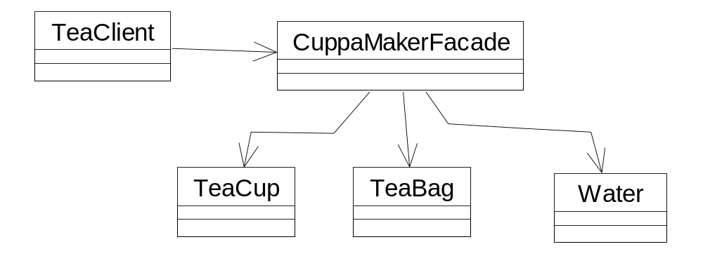
案例：泡茶
假定我们要设计一个泡茶系统，包括茶杯、水、茶叶包各类。我们创建一个Facade类来耦合各个类以完成操作
OOAD Lecture, Author: NK Jiang
<number>/50

Slide 44
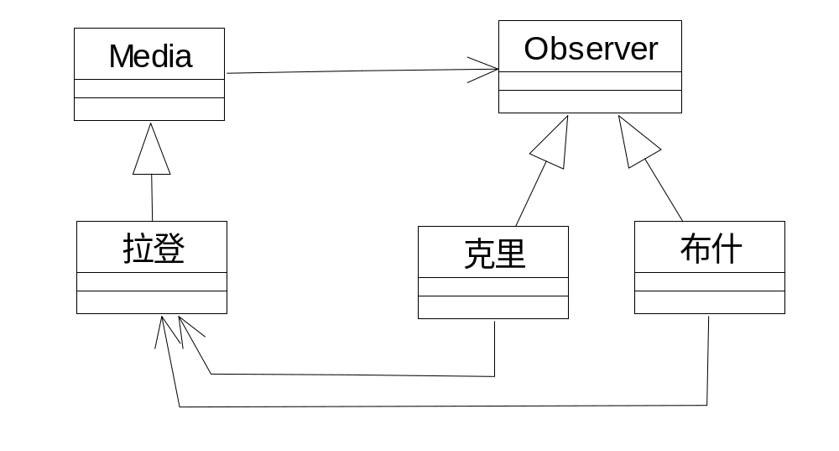
案例：拉登显身了
只要拉登在某电台一出现，无论是美国总统布什还是他的竞争对手克里，都会关注并且表情都不一样
应用 观察者模式（Observer)
OOAD Lecture, Author: NK Jiang
<number>/50

Slide 45
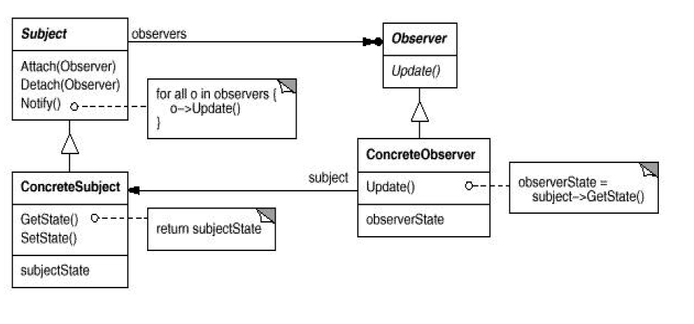
Observer/Publish-Subscribe/Delegation
  Problem:
    An observer (e.g., a GUI) needs to know about state changes in a publisher (e.g. a domain object) without direct coupling between objects
  Solution (advice):
    Subscribers implement a ‘Listener’ interface
    Publishers dynamically register listeners
    Publishers automatically notify listeners when event occurs
    Publishers coupled to generic interface instead of concrete object
OOAD Lecture, Author: NK Jiang
<number>/50

Slide 46
案例：总开关
设计一个总开关，它可以开关风扇，也可以开关灯。开关类会有两个方法：开和关，它不用知道具体控制的事物。
解决方案：Command pattern
  Command 类
  Switch 类
  用户对开关的请求 变成命令对象，传给switch. 这个请求可以存储或转交给其他对象：调用command 的execute() 操作
  Light 类 和fan 类：提供原有的接口
  具体命令类：实现了抽象接口。
OOAD Lecture, Author: NK Jiang
<number>/50

Slide 47
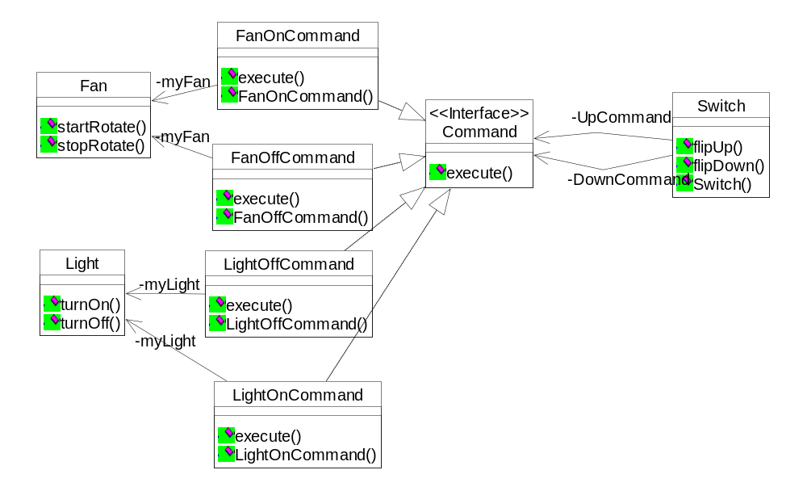
案例：总开关
类图
OOAD Lecture, Author: NK Jiang
<number>/50

Slide 48
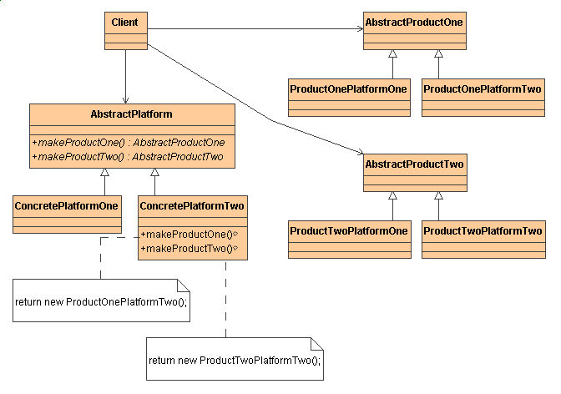
测试：这是什么模式？
OOAD Lecture, Author: NK Jiang
<number>/50
Notes:
(abstract factory) {
a velel of indirection that provides creation services
supports a "family" of products
supports many creation strategies: choice of derived class, reusing cached objects, distributed creation, choice of platform or address space
the "new" statement considered harmful
}

Slide 49
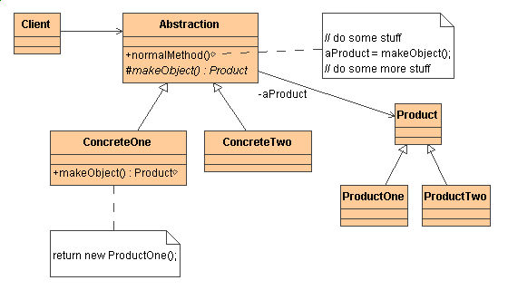
测试：这是什么模式？
OOAD Lecture, Author: NK Jiang
<number>/50
Notes:
factory){
indirect creation through inheritance
virtual constructor
the "new" statement considered harmful!
}

Slide 50
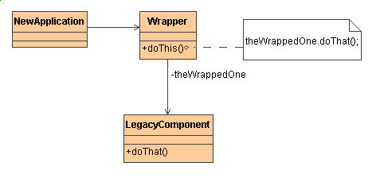
测试：这是什么模式？
OOAD Lecture, Author: NK Jiang
<number>/50
Notes:
adapter){
wrap an existing class with a new interface
impedance match an old component with a new system
wrapper/delegate structure
}

Slide 51
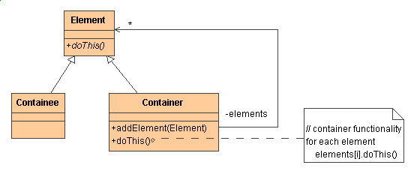
测试：这是什么模式？
OOAD Lecture, Author: NK Jiang
<number>/50
Notes:
composite) {
recursive composition
1-to-many "has a" up the "is a" hierarchy
examples:
file system hierarchy
GUI(menus, layout managers)
}

Slide 52
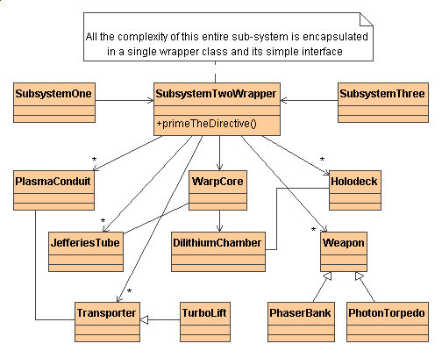
测试：这是什么模式？
OOAD Lecture, Author: NK Jiang
<number>/50
Notes:
facade){
wrape an existing system with a new interface
a simple entry point to a large sub-system
a layer of indirection that hides legacy complexity
}

Slide 53
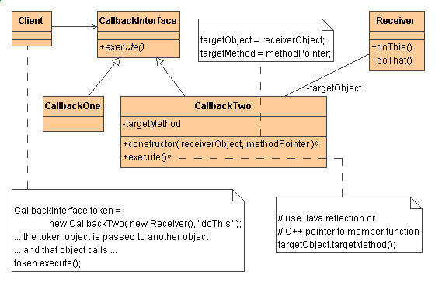
测试：这是什么模式？
OOAD Lecture, Author: NK Jiang
<number>/50
Notes:
(command){
object-oriented callback
a magic cookie that encapsulates a "method invocation"
"execute"
}

Slide 54
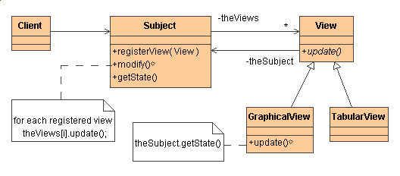
测试：这是什么模式？
OOAD Lecture, Author: NK Jiang
<number>/50
Notes:
observer){
wrapper/delegate structure
wrapper encapsulates the core business logic
each delegate provides user-configurable, optional functionality
example:
a data presentation application with graph, bar chart, pie chart, and table views
}

Slide 55
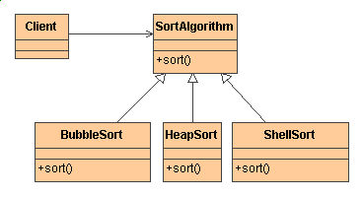
测试：这是什么模式？
OOAD Lecture, Author: NK Jiang
<number>/50
Notes:
strategy){
configure choice of algorithm
wrapper/delegate structure
the client is the wrapper
the algorithm object is teh delegate
}

Slide 56
End
OOAD Lecture, Author: NK Jiang
<number>/50

