Slide 1
Object orient Analysis &Design
面向对象分析与设计师
面向对象设计原则 Object-Oriented Design Principles
主讲: 姜宁康 博士
日期: 26/11/8

Slide 2
Signs of Rotting(变坏) Design
Rigidity (僵硬性)
  code difficult to change
  management reluctance(拒绝) to change anything becomes policy
Fragility (易碎性)
  even small changes can cause cascading effects
  code breaks in unexpected places
Immobility(固定性)
  code is so tangled(纠结) that it's impossible to reuse anything
Viscosity(黏滞性)
  much easier to hack(乱砍) than to preserve original design
[rɪ'dʒɪdətɪ ] [frə'dʒɪlətɪ] [ˌɪmə'bɪlətɪ] [vɪ'skɒsətɪ]
Notes:
[frə'dʒɪlətɪ] [rɪ'dʒɪdətɪ [ˌɪmə'bɪlətɪ] [vɪ'skɒsətɪ]

Slide 3
Causes of Rotting Design
Changing Requirements
  is inevitable
  "All systems change during their life-cycles. This must be borne in mind when developing systems expected to last longer than the first version".
    I. Jacobson, OOSE, 1992
Dependency Management
  the issue of coupling and cohesion
  Complexity increased during the life cycle of software

Slide 4
Principle #1 : Open-Closed Principle (OCP)
"Software Systems change during their life time"
  both better designs and poor designs have to face the changes;
  good designs are stable
Software entities should be open for extension,
but closed for modification (OCP)
B. Meyer, 1988 / quoted by R. Martin, 1996
Modules that conform to OCP meet two criteria:
  Open for Extension - the behavior can be extended to meet new requirements
  CLosed for Modification - the source code of the module is not allowed to change
OCP attacks software rigidity and fragility!
  When one change causes a cascade of changes
OCP states:
  we should attempt to design modules that never need to be changed.
  extend the behavior of the system by adding new code. We do not modify old code
  the module is closed to modification in ways that affect clients

Slide 5
Example: “Closed Client”
Client
Server
Client and Server are concrete classes
Client class uses Server class
If Client object wants to switch to a different Server object, what would need to happen?
Client code needs to be modified to name the new Server class

Slide 6
Example : “Open Client”
Client
AbstractServer
Server
How is this “open” ?
Since the Client depends on the AbstractServer, we can simply switch the Client to using a different Server, by providing a new Server implementation. Client code is unaffected!
Notes:
这也是GRASP原则中的 间接

Slide 7
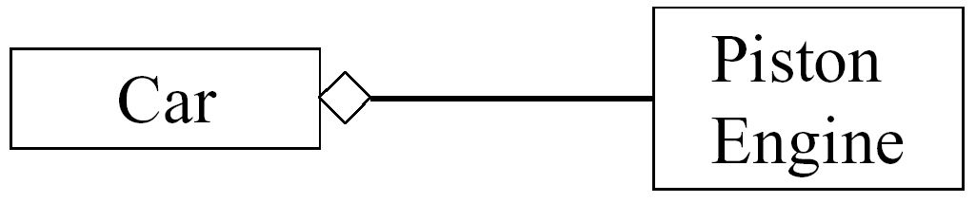
Open the door ...
How to make the Car run efficiently with a TurboEngine?
Only by changing the Car!
  ...in the given design

Slide 8
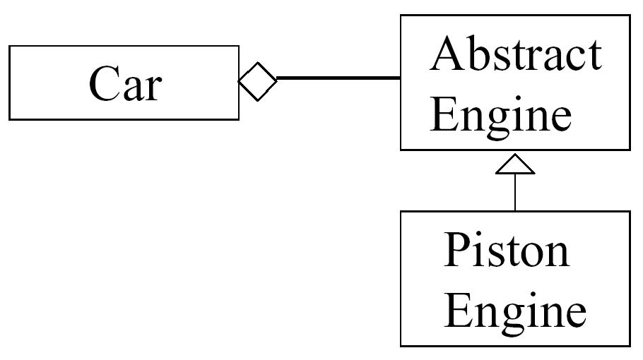
... But Keep It Closed!
A client must not depend on a concrete class!
It must depend on an abstract class ...
...using polymorphic dependencies (calls)
  Notice：Closure not complete but strategic(战略的)！
"No significant program can be 100% closed "
R.Martin, “The Open-Closed Principle,” 1996

Slide 9
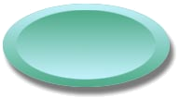
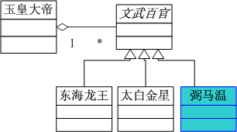

Example
OCP Example
Close
Doesn’t affect existing system
Ultimate Rules
Open
Encapsulate what varies
GRASP: 隔离变化
Add a new place
Notes:
bì mǎ wēn

Slide 10

OCP Heuristics
Make all object-data private
No Global Variables!
Changes to public data are always at risk to “open” the module
  They may have a rippling effect requiring changes at many unexpected locations;
  Errors can be difficult to completely find and fix. Fixes may cause errors elsewhere.

Slide 11
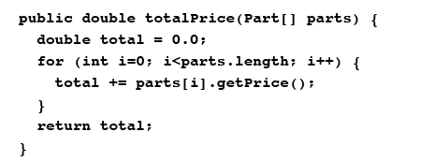
Another OCP Example
Consider the following method:
The job of the above method is to total the price of all parts in the specified array of parts.
Does this conform to OCP?
YES! If Part is a base class or an interface and polymorphism is being used, then this class can easily accommodate new types of parts without having to be modified!

Slide 12
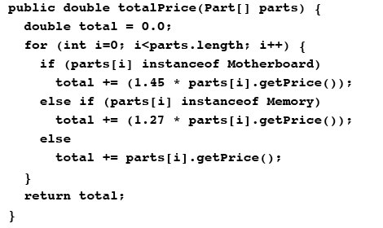
OCP Example (contd.)
But what if the Accounting Department now decreed(判决) that motherboard parts and memory parts have a premium applied when figuring the total price?
Would the following be a suitable modification? Does it conform to OCP ?

Slide 13
OCP Example - OCP Conformance
No! Every time the Accounting Department comes out with a new pricing policy, we have to modify totalPrice ( ) method. This is not “Closed for modification”
These policy changes have to be implemented some place, so what is a solution?
Version 1 - Could incorporate the pricing policy in getPrice ( ) method of Part.

Slide 14
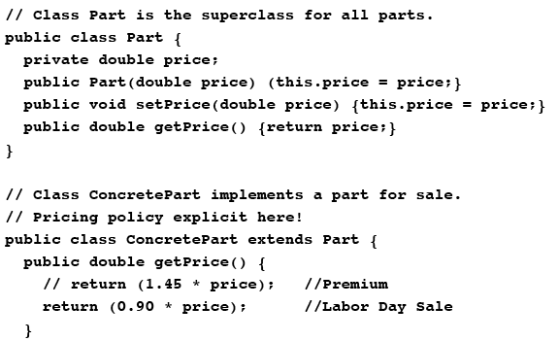
OCP Example (contd.)
Here are example Part and Concrete Part classes:
Add method
Code in concrete classes
Does this work? Is it “closed for modification”?
  No. We must now modify each subclass of Part whenever the pricing policy changes!

Slide 15
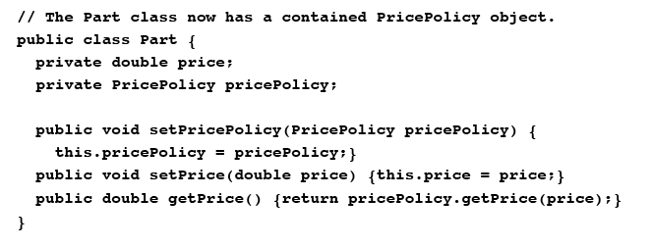
How to make it “Closed for Modification”
Better idea - have a PricePolicy class which can be used to provide different pricing policies:
Notes:
Price 标准价格。 在标准价格的基础上打折，不同的折扣。

Slide 16
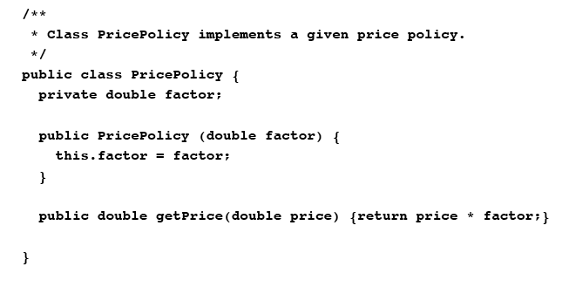
OCP Example (contd.)
With this solution we can dynamically set pricing policies at run time by changing the PricePolicy object that an existing Part object refers to

Slide 17
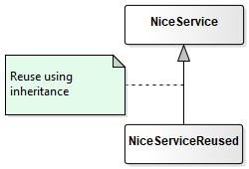
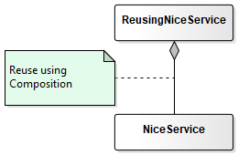
Principle #2 :Favor object composition over class inheritance
What this statement says is that there are basically two ways to reuse code in OO

Slide 18
Analysis --Class inheritance
Class inheritance
  You get the “whole packet” and “tweak a bit” by overriding a single or few methods
    Fast and easy
    Explicit in the code, supported by language
      (you can directly write “extends”)
But...
  “inheritance breaks encapsulation”
    leading to high coupling between super- and subclass ☹
  A) Inheritance is a static / compile-time binding
    the only way to change behaviour in the future is through the edit-compile-debug-edit-compile-debug cycle

Slide 19
Analysis --Class inheritance
But …
  B) You have to buy the full package !
    you cannot access only part of the behaviour of the superclass – you get it all.
    For example
      A nice C++ String implementation in a Library was compiled to have dependencies with 2MB other parts of the library ☹
  C) Superclass define (part) of physical representation
    Example:
      superclass uses a List data structure, but subclass would be much more efficient using a tree structure ☹
    subclasses usually simple refer to public and protected data members, which means, changing implementation details in superclass effect all subclasses !!!
      yes – we know :
      review all subclasses
      retest all subclasses
    have to read the superclass code to fully understand (in contrast to only reading an interface)

Slide 20
Analysis --Class inheritance
Inheritance is OK but you must use it for what it handles really nice
  Modelling of concepts in a generalisation hierarchy 泛化的层次关系
NOT for handling
  ad hoc reuse
  modelling roles
  variance of behaviour

Slide 21
Analysis -- Object composition
Object composition
A) object composition is a dynamic / run-time binding
  you may change behaviour at run-time by “switching” an object reference
B) Loose coupling by respecting the interface borders
  No peeking and poking in semi-private data members!
  No heavy luggage in the form of data structures that are useless
  No reliance on idiosyncratic(异质的) behaviour
No breaking encapsulation !!!
Notes:
idiosyncratic [简明英汉词典]
adj.特殊物质的, 特殊的, 异质的
peeking and poking 偷窥

Slide 22
Analysis -- Object composition
C) Clear division of responsibilities !!!
  each object is clearly focused on a single/few tasks
    easier to understand
    easier to maintain
  understanding by reading interfaces only
    (at least in theory ☺)
  easier to test in isolation
    if used to your advantage leads to more reliable designs
  each class remains small
    avoiding the “Blob” anti-pattern where one class seems to “suck in” all functionality...
  larger potential for reuse in other contexts

Slide 23
Principle# 3 : The Dependency Inversion Principle (DIP)
I. High-level modules should not depend on low-level modules.
Both should depend on abstractions.
II. Abstractions should not depend on details.
Details should depend on abstractions
R. Martin, 1996
A base class in an inheritance hierarchy should not know any of its subclasses
Modules with detailed implementations are not depended upon（不被上层所依赖）, but depend themselves upon abstractions （而是自身依赖上层抽象）
OCP states the goal; DIP states the mechanism

Slide 24
Why “Inversion” ?
Traditional functional programming:
  High level modules: business/application rules
  Low level modules: implementation of the business rules
  High level modules complete their functionality by calling/invoking the low level implementation provided by the low level modules
    High level depends on the lower level
Policy layer
Mechanism
layer
Utility layer

Slide 25
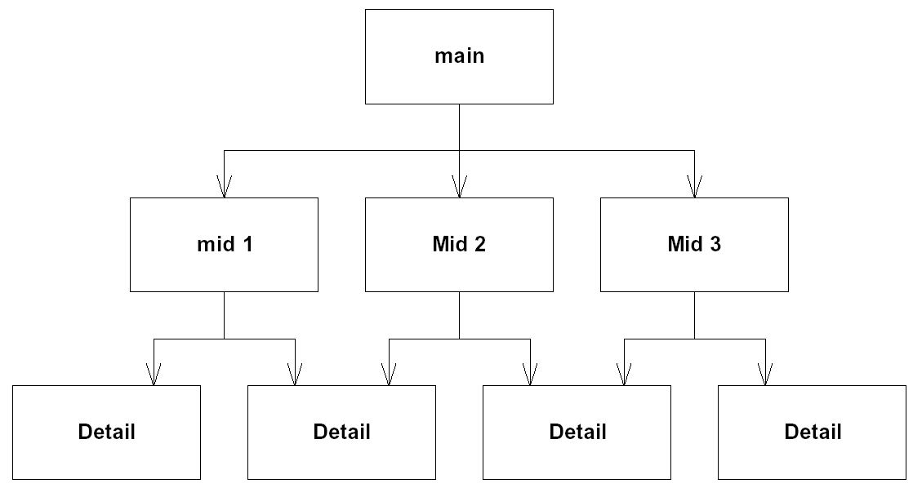
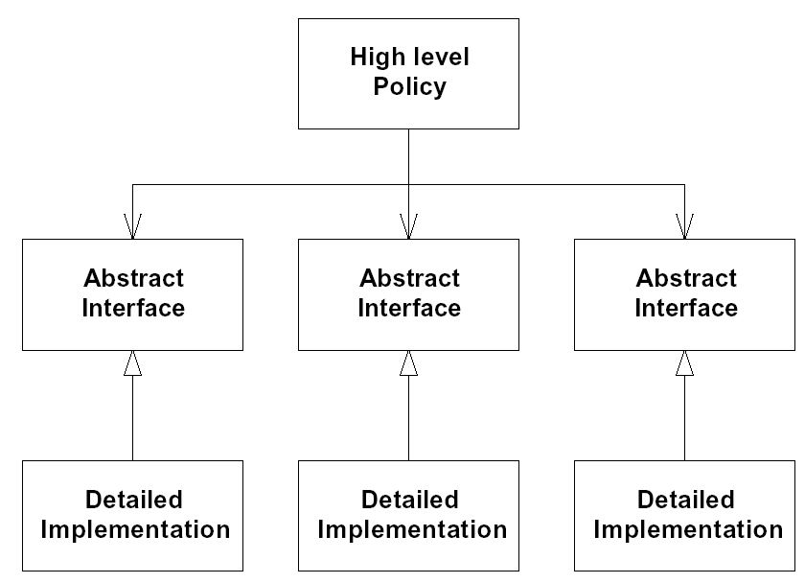
Procedural vs. OO Architecture
Procedural
Architecture
Object-Oriented
Architecture

Slide 26
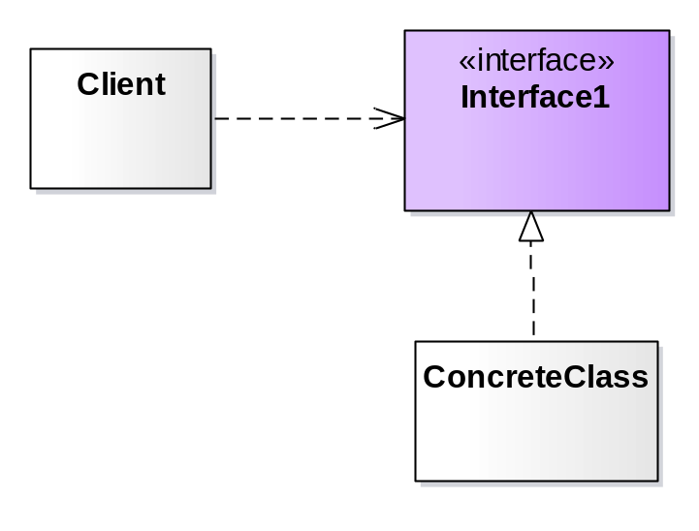
DIP Related Heuristic
Design to an interface,
not an implementation!
Use inheritance to avoid direct bindings to classes:
Interface
(abstract class)
Implementation
(concrete class)

Slide 27
Design to an Interface
Abstract classes/interfaces:
  tend to change much less frequently
  abstractions are ‘hinge points’ where it is easier to extend/modify
  shouldn’t have to modify classes/interfaces that represent the abstraction (OCP)
Exceptions
  Some classes are very unlikely to change;
    therefore little benefit to inserting abstraction layer
    Example: String class
  In cases like this can use concrete class directly
    as in Java or C++
Notes:
hinge points英 [hɪndʒ pɔɪnts] 美 [hɪndʒ pɔɪnts] 铰链点

Slide 28
DIP Related Heuristic
Avoid Transitive Dependencies
Avoid structures in which higher-level layers depend on lower-level abstractions:
  In example below, Policy layer is ultimately dependant on Utility layer.
Policy
Layer
Depends on
Mechanism
Layer
Depends on
Utility
Layer
like GRASP
: Indirection 间接

Slide 29
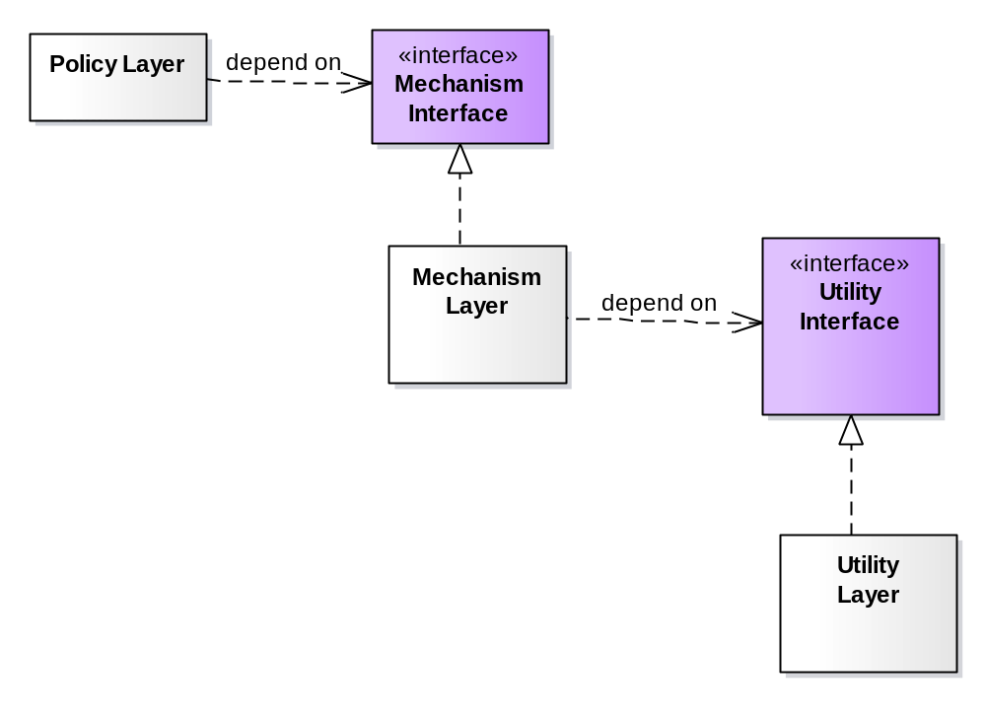
Solution to Transitive Dependencies
Use inheritance and abstract ancestor classes【or interface 】 to effectively eliminate transitive dependencies:
如果不用接口、而用继承机制，类图是怎样的？

Slide 30
DIP - Related Heuristic
When in doubt, add a level of indirection
If you cannot find a satisfactory solution for the class you are designing, try delegating responsibility to one or more classes:
Problem
Holder
Problem
Solver

Slide 31
When in doubt ...
It is generally easier to remove or by-pass existing levels of indirection than to add them later:
mid class’s indirect message calls to red class fail to meet some criteria (e.g. real-time constraints, etc.)
So, first class re-implements some or all of mid class’s responsibilities for efficiency and calls red object directly
X

Slide 32
DIP Example
Dependency Inversion Principle can be applied whenever one class sends a message to another.
Consider the case of a Button and Lamp object.
  Button:
    senses the external environment
      receives poll message
      Determines whether or not user has “pressed” it.
  Lamp:
    Affects the external environment
      On receiving turnOn message, illuminates the light
      On receiving turnOff message, extingishes the light.
  Actual physical mechanism for the Lamp and the Button is irrelevant.

Slide 33
DIP Example：Naïve Design
public class Button {
private Lamp itsLamp;
public Button (Lamp l) { itsLamp = l;}
public void poll ( ){
if (/* some condition*/)
itsLamp.turnOn ( );
else
itsLamp.turnOff ( );
}
}
public class Lamp {
public void turnOn ( );
public void turnOff ( );
}
Button
Lamp
+ poll ( )
+ turnOn ( )
+ turnOff ()
Why is this a naïve design?

Slide 34
DIP Example：Why is the design naïve?
The dependency between Lamp and Button implies that Lamp cannot be modified without changing (at least recompiling) the code
Also - not possible to reuse the Button class to control a Motor/Portal object.
The Button and Lamp code violates the DIP.

Slide 35
DIP Example：Applying DIP (a)
Button
<< interface >>
Button Server
+ poll ( )
+ turnOn ( )
+ turnOff ()
Lamp

Slide 36
Adding More Abstraction
If there can be multiple types of buttons or switching devices, abstraction can used to further refine the design!
Button
(Abstract)
ButtonClient
(Abstract)
Button
(Implementation)
Lamp

Slide 37
DIP-Conforming Code
public abstract class ButtonClient {
public abstract void turnOn ( );
public abstract void turnOff ( );
};
public abstract class Button {
protected ButtonClient bc;
Button (ButtonClient b) { bc = b; }
public abstract boolean getState ( );
public void detect ( ) {
boolean buttonOn = getState ( );
if (buttonOn)
bc.turnOn ( );
else bc.turnOff ( );
}
}
public class Lamp extends ButtonClient {
public void turnOn ( ) { //code }
public void turnOff ( ) { // code}
}
public class ButtonImplementation extends Button {
ButtonImplementation (ButtonClient b)
{
super(b);
}
public boolean getState ( ) { // code}
}

Slide 38
The Dependency Inversion Principle
Corollary:
  if a class/modules are concrete but extremely stable this principle can be relaxed.
Notes:
英 [kəˈrɒləri]

Slide 39
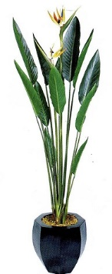
End

