Slide 1
Object oriented Analysis &Design
面向对象分析与设计
Lecture 9 GRASP
Text Ch18：Object Design Examples with GRASP
主讲: 姜宁康 博士
日期: 26/11/8

Slide 2
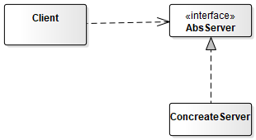
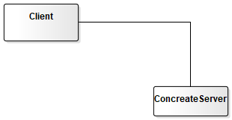
问题：
谁应该创建一个类的实例？
GRASP在设计中是否一定会用到？
为对象分配职责的基本原则是什么？
低内聚在什么情况下可以被接受？
UI层如何连接到应用逻辑层？
真的需要用到 多态？接口？
Notes:
两种方案，好坏之分？

Slide 3
Review: Operation Contract
Operation: | Name of operation, and parameters
Cross References: | Use cases this operation can occur within
Preconditions: | important assumptions about the state of the system or objects in the Domain Model before execution of the operation. These are non-trivial assumptions the reader should be told.
Postconditions: | This is the most important section. The state of objects in the Domain Model after completion of the operation.
  postconditions Domain model state changes include
    -- instances created / deleted,
    -- associations formed or broken,
    -- and attributes changed.
OOAD Lecture, Author: NK Jiang
<number>/75
Notes:
Post-conditions are only an estimate.
However, it is essential to recognize that the previously defined use-cases and post-conditions are merely an initial best guess or estimate of what must be achieved.
Use-case and post-conditions may not be accurate.
The spirit of iterative development is to capture a reasonable degree of information during requirements analysis, filling in details during design and implementation.

Slide 4
Review OOD
OOD
  Definition
  Responsibility
  Input for OOD
  Output from OOD
  GRASP
    Deciding what methods belong where and how objects should interact carries consequences and should be undertaken seriously
    responsibility-driven design (RDD)
  Pattern
    Pattern Name: Information Expert
    Problem It Solves: What is a basic principle by which to assign responsibilities to objects?
    Solution: Assign a responsibility to the class that has the information needed to fulfill it.
OOAD Lecture, Author: NK Jiang
<number>/75

Slide 5
Review : GRASP Patterns
GRASP patterns describe fundamental principles of object design and responsibility assignment. The following is a list of GRASP patterns:
  Information Expert
  Creator
  High Cohesion
  Low Coupling
  Controller
  Polymorphism
  Indirection
  Pure Fabrication
  Protected Variations
OOAD Lecture, Author: NK Jiang
<number>/75

Slide 6
The Objective of this Lecture
本讲目标：
  Design use-case realizations 用例实现
  Apply the GRASP patterns to assign responsibilities to classes
  Apply UML to illustrate and think through the design of objects
    （或者说）Use the UML interaction diagram notation to illustrate the design of objects
Ch18.4
  Please be attentive to read and understand. 请同学们仔细地去看、体会
OOAD Lecture, Author: NK Jiang
<number>/75

Slide 7
Use-Case Realizations
Use-Case Realizations
  Describes how a particular use case is realized within the design model, in terms of collaborating objects.
  A designer can describe one or more scenarios(场景) of a use case.
    Each of these is called a use case realization
  UML interaction diagrams are used to illustrate use-case realizations.
  Principles and Patterns can be applied during this design work.
  The interaction diagrams involve message interaction between software objects whose names are sometimes inspired by the names of conceptual classes in the Domain Model, plus other classes of objects.
OOAD Lecture, Author: NK Jiang
<number>/75

Slide 8
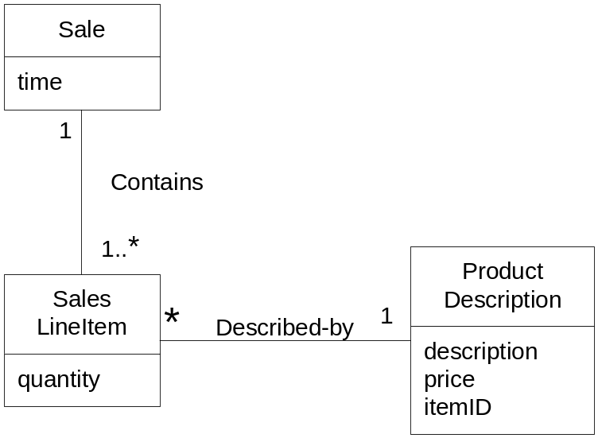
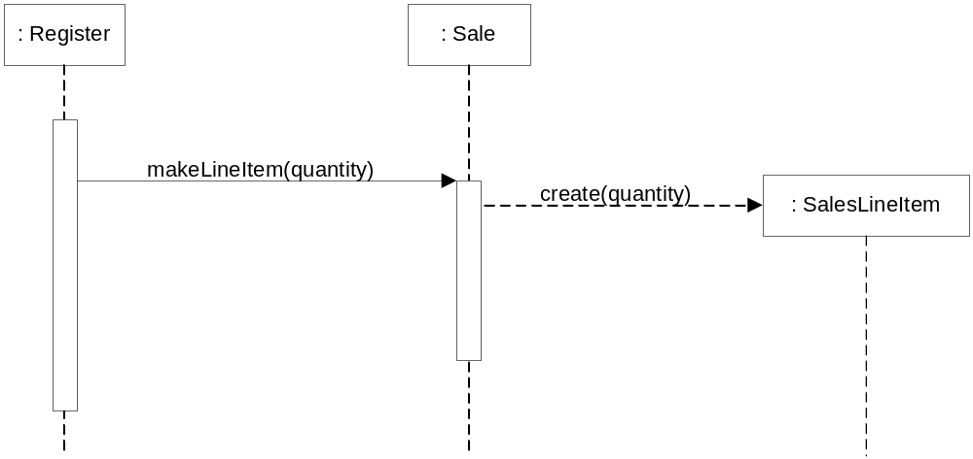
POS: Creator Example
In the NextGen POS application, who should be responsible for creating a SalesLineItem instance?
-- who aggregates, contains, and so on, SalesLineItem ?
Domain Model
OOAD Lecture, Author: NK Jiang
<number>/75

Slide 9
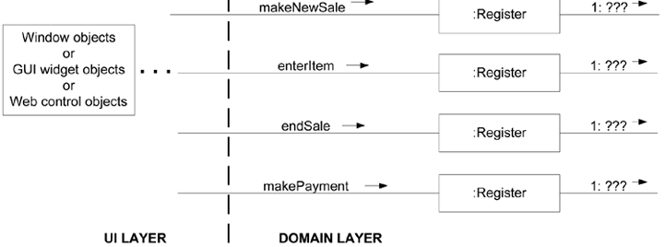
Usecase-realization Example
Process Sale use case , → system operation
  makeNewSale
  enterItem
  endSale
  makePayment
How to handle system operation?
MakeNewSale is the system operation from SSD. Each main interaction diagram begins from controller objects where system operations entering domain layer.
makeNewSale等是来自SSD的系统操作
每个主要交互图都从进入领域层控制器对象（如Register)的系统操作开始
<number>/75

Slide 10
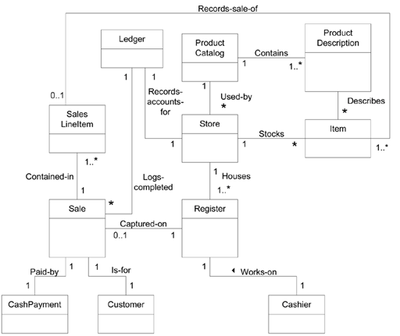
Review： NextGen POS partial domain model教材图9-27
OOAD Lecture, Author: NK Jiang
<number>/75

Slide 11
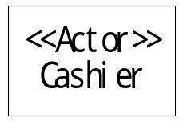
Review： Use case realization (presented by SD )
makeNewSale
Cashier
Register
Sale
SalesLineItem
1: makeNewSale
1.1: create
1.1.1: create
By Controller Pattern
By CreatorPattern
OOAD Lecture, Author: NK Jiang
<number>/75

Slide 12
Use Case Realizations for the NextGen Iteration
1. Guideline
  Initialization and the 'Start Up' Use Case
  When coding, program at least some Start Up initialization first.
  But during OO design modeling, consider the Start Up initialization design last, after you have discovered what really needs to be created and initialized.
  Then, design the initialization to support the needs of other use case realizations
OOAD Lecture, Author: NK Jiang
<number>/75

Slide 13
Use Case Realizations for the NextGen Iteration
2. How to Design makeNewSale?
2.1 Contract CO1: makeNewSale
Contract CO1: makeNewSale
Operation: | makeNewSale()
Cross References: | Use Cases: Process Sale
Preconditions: | none
Postconditions: | - A Sale instance s was created (instance creation). - s was associated with the Register (association formed). - Attributes of s were initialized.
OOAD Lecture, Author: NK Jiang
<number>/75

Slide 14
Use Case Realizations for the NextGen Iteration
2.2 Choosing the Controller Class
  Candidates
    Facade controller
      Store a kind of root object because we think of most of the other domain objects as "within" the Store.
      Register a specialized device that the software runs on; also called a POSTerminal.
      POSSystem a name suggesting the overall system
    Usecase controller
      ProcessSaleHandler constructed from the pattern <use-case-name> "Handler" or "Session"
      ProcessSaleSession
  Principle
    a few system operations and if the facade controller is not taking on too many responsibilities
  Result
    Register
    Note: this Register is a software object in the Design Model. It isn't a physical register
OOAD Lecture, Author: NK Jiang
<number>/75

Slide 15
Use Case Realizations for the NextGen Iteration
2.3 Creating software ‘Sale’ object
  Creator + Doamin Model + LRG
    Register
2.4 Create an empty collection to record all the future ‘SalesLineItem’ instances
OOAD Lecture, Author: NK Jiang
<number>/75

Slide 16
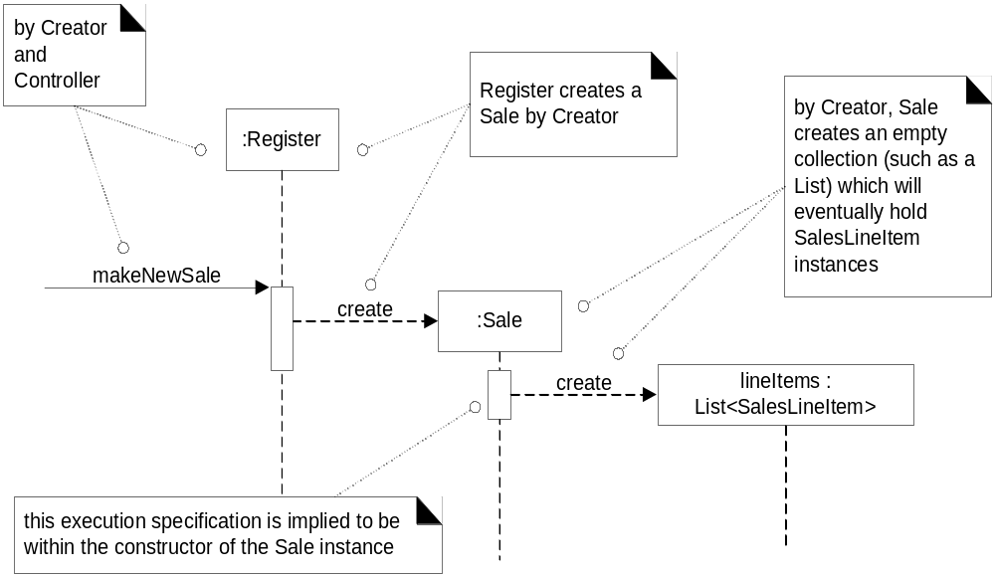
POS: makeNewSale Interactions
OOAD Lecture, Author: NK Jiang
<number>/75

Slide 17
Use Case Realizations for the NextGen Iteration
3. How to Design endSale?
3.1 Contract
3.2 Choosing the Controller Class
  Register
3.3 Setting the Sale.isComplete Attribute
  Who do it?
    ‘Sale’ irself after receiving message from ‘Register’
Contract CO3: endSale
Operation: | endSale()
Cross References: | Use Cases: Process Sale
Preconditions: | There is an underway sale.
Postconditions: | Sale.isComplete became true (attribute modification).
OOAD Lecture, Author: NK Jiang
<number>/75

Slide 18
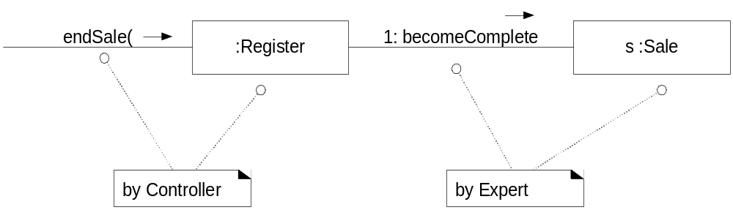
POS: endSale Interaction
OOAD Lecture, Author: NK Jiang
<number>/75

Slide 19
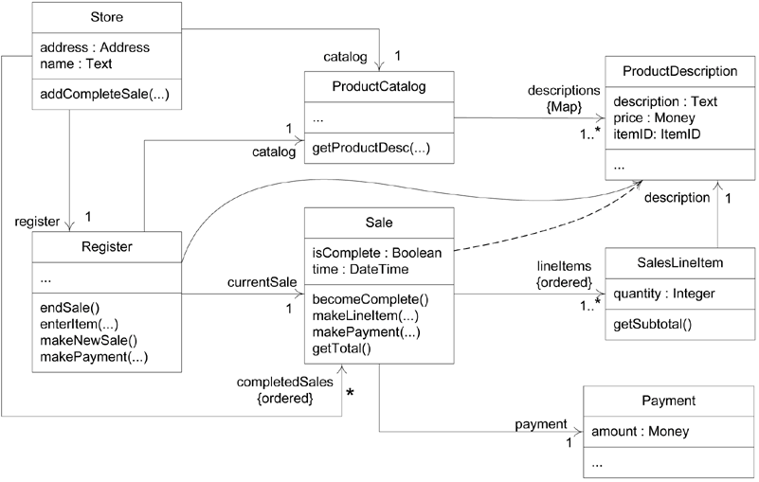
Figure 18.17. A more complete DCD reflecting most design decisions
OOAD Lecture, Author: NK Jiang
<number>/75

Slide 20
Use Case Realizations for the NextGen Iteration
4. How to Connect the UI Layer to the Domain Layer?
  4.1 UI layer obtain visibility to objects in the domain layer
    1) initializer object
    E.g.
    public class Main {
    public static void main( String[] args )
    {
    // Store is the initial domain object.
    // The Store creates some other domain objects.
    Store store = new Store();
    Register register = store.getRegister();
    ProcessSaleJFrame frame = new ProcessSaleJFrame( register );
    ...
    } }
    2) from a well-known source
OOAD Lecture, Author: NK Jiang

Slide 21
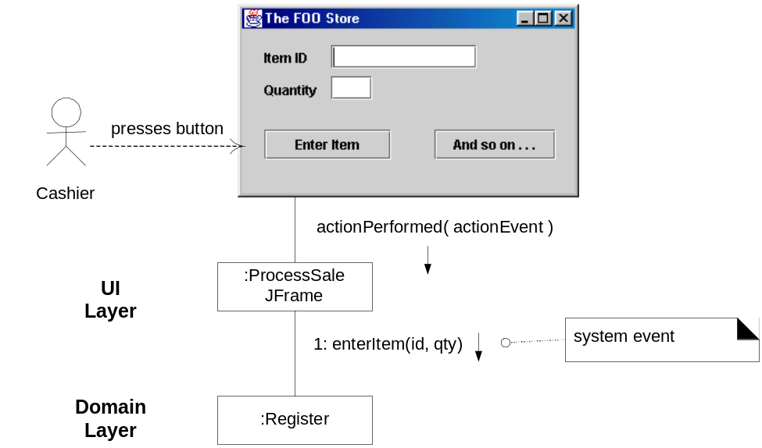
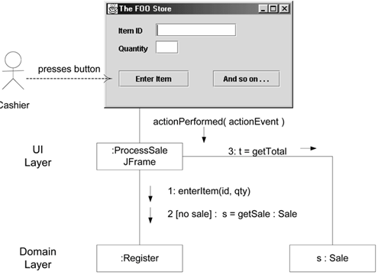
Use Case Realizations for the NextGen Iteration
4.2. we want the window to show the running total after each entry
  S1: UI -> Register -> Sale
    expand the interface of the Register object, making it less cohesive
  S2: UI -> get reference of Sale -> send msg to Sale directly
    higher coupling in and of itself is not a problem; rather, coupling to unstable things is a real problem
OOAD Lecture, Author: NK Jiang

Slide 22
Use Case Realizations for the NextGen Iteration
5. Initialization and the 'Start Up' Use Case
  5.1 When to Create the Initialization Design?
    Guideline
      Do the initialization design last.
  5.2
    initial domain object ：Main()
    Main will create other objects
    Objects will create its sub-objects
  Guideline
    Choose as an initial domain object a class at or near the root of the containment or aggregation hierarchy of domain objects(选择位于或接近于领域对象包含或聚合层次的根类，作为初始领域对象).
    This may be a facade controller, such as Register,
    or some other object considered to contain all or most other objects, such as a Store.
OOAD Lecture, Author: NK Jiang

Slide 23
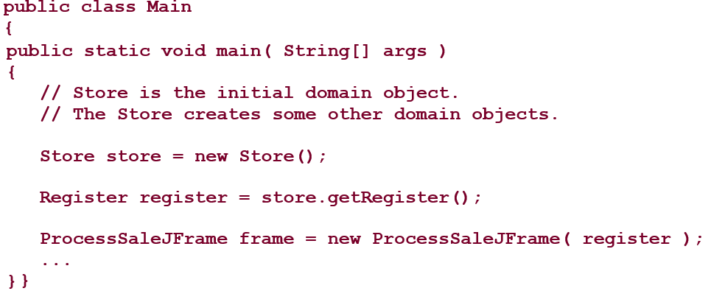
Use Case Realizations for the NextGen Iteration
  5.3. Store.create()
  identify the following initialization work
    Create a Store, Register, ProductCatalog, and ProductDescriptions.
    Associate the ProductCatalog with ProductDescriptions.
    Associate Store with ProductCatalog.
    Associate Store with Register.
    Associate Register with ProductCatalog
OOAD Lecture, Author: NK Jiang

Slide 24
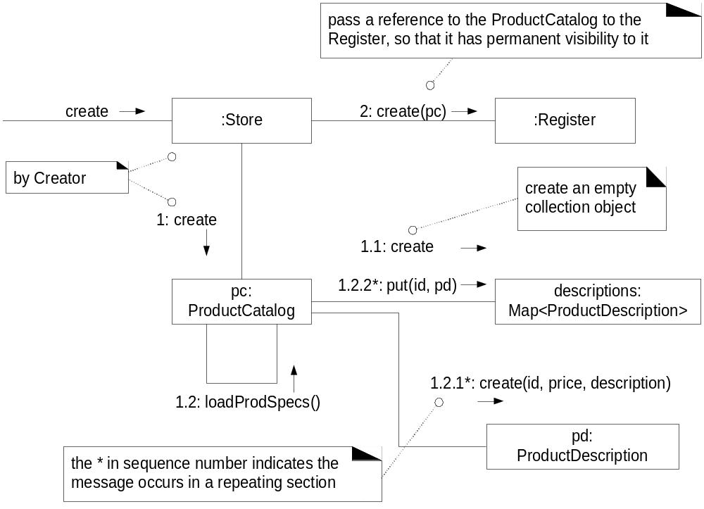
POS: StartUp （text fig. 18.20）
OOAD Lecture, Author: NK Jiang
<number>/75

Slide 25
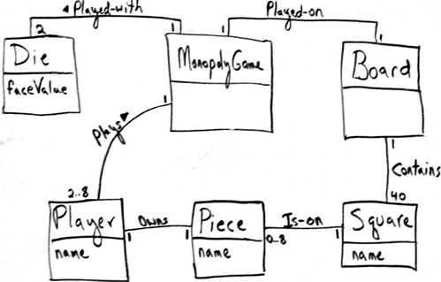
Use Case Realizations for the Monopoly Iteration （教材18.5）
案例二：请注意，务必认真阅读教材的案例分析过程并思考！
  Figure 18.21. Iteration-1 Domain Model for Monopoly
System Operation
  playGame
OOAD Lecture, Author: NK Jiang
<number>/75

Slide 26
Use Case Realizations for the Monopoly Iteration
6.1 Choosing the Controller Class
Represents the overall "system," "root object," a specialized device, or a major subsystem. | 1）MonopolyGame ，a kind of root object: We think of most of the other domain objects as "contained within" the MonopolyGame. 2）Abbreviated MGame in most of the UML sketches. 3）MonopolyGameSystem， a name suggesting the overall system
Represents a receiver or handler of all system events of a use case scenario. | 1）PlayMonopolyGameHandler， constructed from the pattern <use-case-name> "Handler" 2）PlayMonopolyGameSession
We select MonopolyGame (abv. MGame)
OOAD Lecture, Author: NK Jiang
<number>/75

Slide 27
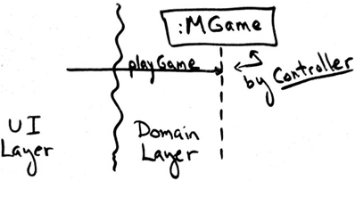
Figure 18.22. Applying Controller to the playGame system operation
6.2 Who is Responsible for Controlling the Game Loop?
  Turn轮次: a player rolling the dice and moving the piece
  Round回合: all the players taking one turn
  What information is needed for the responsibility?
OOAD Lecture, Author: NK Jiang
<number>/75

Slide 28
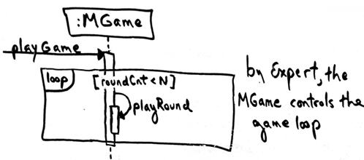
Use Case Realizations for the Monopoly Iteration
Information Needed | Who Has the Information?
the current round count(当前回合数) | No object has it yet, but by LRG, assigning this to the MonopolyGame object is justifiable.
all the players (so that each can be used in taking a turn) | Taking inspiration from the domain model, MonopolyGame is a good candidate.
MonopolyGame is a good candidate
OOAD Lecture, Author: NK Jiang
<number>/75

Slide 29
Use Case Realizations for the Monopoly Iteration
6.3 Who Takes a Turn轮次?
  What information is needed for the responsibility?
Information Needed | Who Has the Information?
current location of the player (to know the starting point of a move) | Taking inspiration from the domain model, a Piece knows its Square and a Player knows its Piece. Therefore, a Player software object could know its location by LRG.
the two Die objects (to roll them and calculate their total) | Taking inspiration from the domain model, MonopolyGame is a candidate since we think of the dice as being part of the game.
all the squares the square organization (to be able to move to the correct new square) | By LRG, Board is a good
three partial information experts for the "take a turn" responsibility: Player, MonopolyGame, and Board.
OOAD Lecture, Author: NK Jiang
<number>/75

Slide 30
Solution
Guideline1: When there are multiple partial information experts to choose from, place the responsibility in the dominant information expert the object with the majority of the information.
  This tends to best support Low Coupling.
Guideline2: When there are alternative design choices, consider the coupling and cohesion impact of each, and choose the best.
  This can be applied.
  MonopolyGame is already doing some work, so giving it more work impacts its cohesion, especially when contrasted with(比较) a Player and Board object, which are not doing anything yet.
  But we still have a two-way tie with these objects.
Guideline3: When there is no clear winner from the alternatives other guidelines, consider probable（可能）future evolution of the software objects and the impact in terms of Information Expert, cohesion, and coupling
So , Who Takes a Turn?
  Player is most suitable
OOAD Lecture, Author: NK Jiang
<number>/75
Notes:
Turn 轮次 ： 游戏者投掷塞子并且移动琪子
round 回合 ： 所有游戏者完成一个轮次

Slide 31
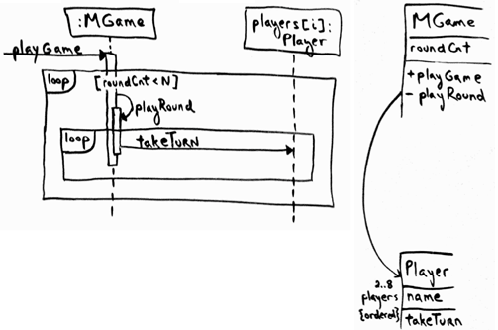
Figure 18.24. Player takes a turn by Expert
OOAD Lecture, Author: NK Jiang
<number>/75

Slide 32
6.4 Taking a Turn 回合
  calculating a random number total between 2 and 12 (the range of two dice)
  calculating the new square location
  moving the player's piece from an old location to a new square location
6.5 Who Coordinates All This?
  Player
6.6 The Problem of Visibility
  Player will need visibility to the Die, Board, and Piece objects each and every turn
6.7 The Final Design of playGame
OOAD Lecture, Author: NK Jiang
<number>/75
Notes:
round 回合 ： 所有游戏者完成一个轮次

Slide 33
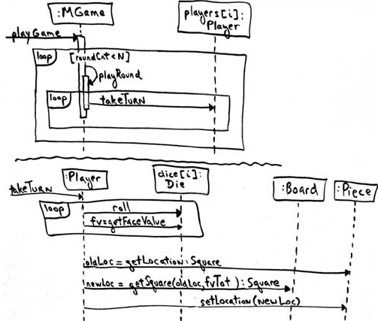
Figure 18.25. Dynamic design for playGame
OOAD Lecture, Author: NK Jiang
<number>/75

Slide 34
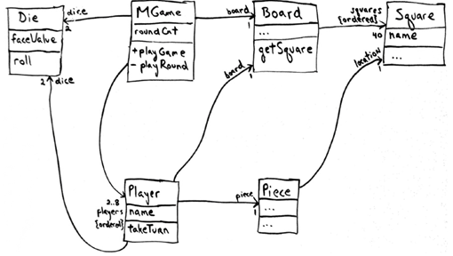
Figure 18.26. Static design for playGame
OOAD Lecture, Author: NK Jiang
<number>/75

Slide 35
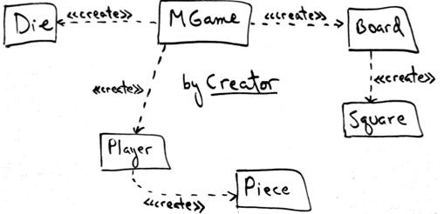
6.8 Initialization and the 'Start Up' Use Case
OOAD Lecture, Author: NK Jiang
<number>/75

Slide 36
关于GRASP原则的讨论
OOAD Lecture, Author: NK Jiang
<number>/75

Slide 37
Discuss1: Creator — When Not to Use
When want to reuse existing instances for performance purposes (caching)
    比如，连接数据库的“线程池”
conditionally creating an instance from one of a family of similar classes based upon some external property value
  GOF pattern
Delegate responsibility further down
Other more complex situations
OOAD Lecture, Author: NK Jiang
<number>/75

Slide 38
Discuss1: Creator — Benefits
Existing associations means created class is in any case visible to creator
High cohesion
Does not increase coupling
OOAD Lecture, Author: NK Jiang
<number>/75

Slide 39
Discuss2: Information Expert
NextGEN POS application, some class needs to know the grand total of a sale.
First Step: Start assigning responsibilities by clearly stating the responsibility
  Who should be responsible for knowing the grand total of a sale?
Second Step: Where to find the class
  Design Model first
  Domain Model Second
Result: Sale knows
  All the SalesLineItem instances of a sale and the sum of their subtotals
OOAD Lecture, Author: NK Jiang
<number>/75

Slide 40
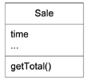


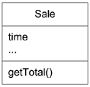

POS: Expert Example
A New method
How to determine the line item subtotal?
This notation will imply we are iterating over all elements of a collection
A New method
OOAD Lecture, Author: NK Jiang
<number>/75

Slide 41
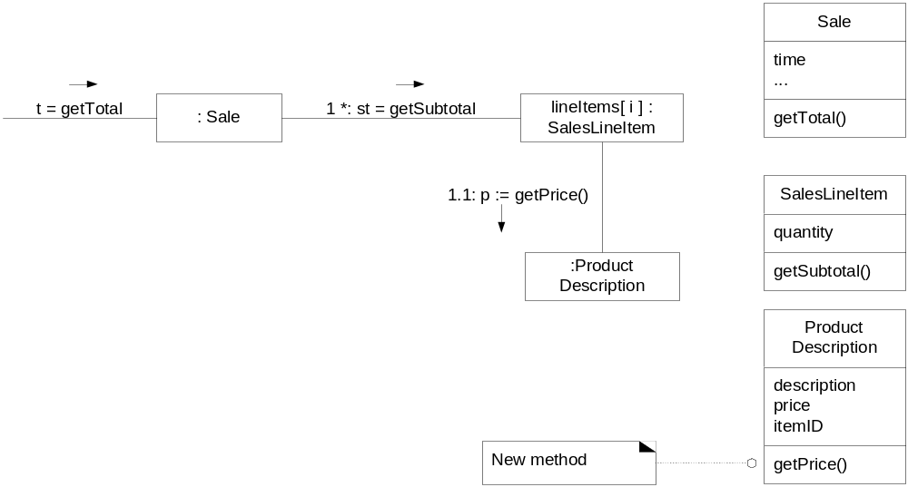
POS: Expert Example cont.
Get Price
OOAD Lecture, Author: NK Jiang
<number>/75

Slide 42
Discuss2: Information Expert Benefits
Encapsulation
  objects support their own information
  supports low coupling
Behavior is distributed across classes
  supports high cohesion
OOAD Lecture, Author: NK Jiang
<number>/75

Slide 43
Eg, How to control game loop?
Monopoly is played as a series of rounds in which each player takes a turn.
  What object should control the game loop to manage the rounds?
By the Expert Pattern, the playRound can be managed by the MonopolyGame.
:MonopolyGame
playGame
Assigned by the
Expert Pattern
Loop
[roundCount<N]
playRound
OOAD Lecture, Author: NK Jiang
<number>/75

Slide 44
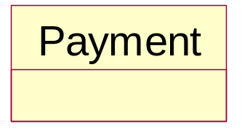
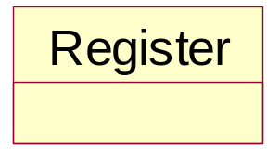
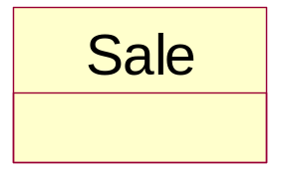
Discuss3: Low Coupling
POS: Low Coupling Example bad and good
Assume we need to create a Payment instance and associate it with the Sale. What class should be responsible for this?
OOAD Lecture, Author: NK Jiang
<number>/75

Slide 45
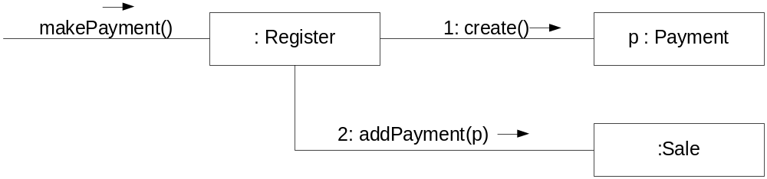
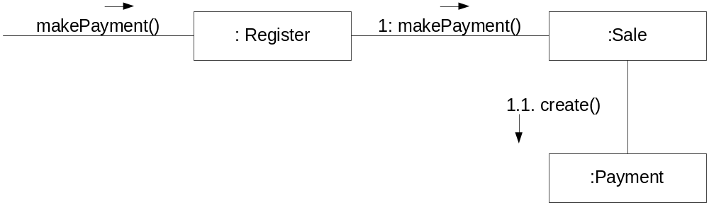
Discuss3: Low Coupling
POS: Low Coupling Example bad and good
the Creator pattern suggests Register as a candidate for creating the Payment
supports Low Coupling
OOAD Lecture, Author: NK Jiang
<number>/75

Slide 46
Discuss3: Low Coupling
Low Coupling supports the design of classes that are more independent, which reduces the impact of change.
It can't be considered in isolation from other patterns such as Expert and High Cohesion, but rather needs to be included as one of several design principles that influence a choice in assigning a responsibility.
  是药，三分毒
  不同食物之间可以互补、也会互斥…
A subclass is strongly coupled to its superclass.
  The decision to derive from a superclass needs to be carefully considered since it is such a strong form of coupling.
OOAD Lecture, Author: NK Jiang
<number>/75
Notes:
Ultimate target elivate

Slide 47
Discuss3: Low Coupling
There is no absolute measure of when coupling is too high.
What is important is that a developer can gauge(评估) the current degree of coupling, and assess if increasing it will lead to problems.
In general, classes that are inherently very generic(一般、通用) in nature, and with a high probability for reuse, should have especially low coupling.
OOAD Lecture, Author: NK Jiang
<number>/75

Slide 48
Discuss3: Low Coupling
The extreme case of Low Coupling is when there is no coupling between classes.
  This is not desirable
    because a central metaphor of object technology is a system of connected objects that communicate via messages
    Too little coupling means we aren’t a “collaborating community of objects”
  it yields a poor design
    because it leads to a few incohesive, bloated（臃肿）, and complex active objects that do all the work, with many very passive zero-coupled objects that act as simple data repositories.
Some moderate degree of coupling between classes is normal and necessary
  to create an object-oriented system in which tasks are fulfilled by a collaboration between connected objects
OOAD Lecture, Author: NK Jiang
<number>/75

Slide 49
Discuss3: Low Coupling — When Not To
High coupling to stable elements and to pervasive elements is seldom a problem.
    e.g. language libraries
    For example, a Java J2EE application can safely couple itself to the Java libraries (java.util, and so on)
    because they are stable and widespread.
Low Coupling Benefits
  Not affected by changes in other components
  Simple to understand in isolation
  Convenient to reuse
OOAD Lecture, Author: NK Jiang
<number>/75

Slide 50
Discuss4: Controller — Facade
Facade外观模式：
  Provide a consistent interface for a set of interfaces in subsystem为子系统中的一组接口提供一个一致的界面
  “cover” over the other layers of the application
  Abstraction of an overall physical unit
    — Register, PizzaShop
  The entire software system
    — POSSystem
  Abstraction of some other overall system or sub-system concept
    — MonopolyGame
Suitable for
  relatively small systems
  and/or system with limited number of system operations
  in message handling system when can’t direct messages to alternative controllers
    — Internet application servers
OOAD Lecture, Author: NK Jiang
<number>/75
Notes:
Facade外观模式：为子系统中的一组接口提供一个一致的界面

Slide 51
Discuss4: Session Controller — Use Case
Pure Fabrication
  — ProcessSaleHandler is not a domain concept in Domain Model
When assigning to facade may lead to high coupling or low cohesion (“Bloat”)
Many system operations across different processes
Conceptually easier to understand and build
Session Controllers Naming conventions:
    <UseCaseName> Handler or
    <UseCaseName> CoOrdinator or
    <UseCaseName>Session
  Use same controller class for all system operations in the use case scenario
  Session is a type of conversation between the actor and the SUD
OOAD Lecture, Author: NK Jiang
<number>/75

Slide 52
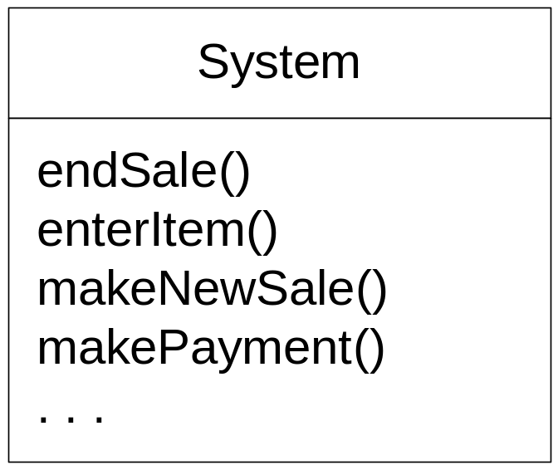
POS: Controller Example
NextGen application contains several system operations
during design, a controller class is assigned the responsibility for system operations
OOAD Lecture, Author: NK Jiang
<number>/75

Slide 53
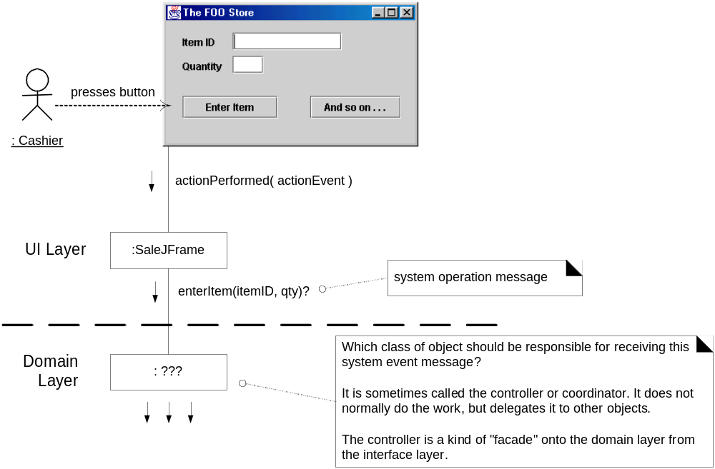
POS: Controller Example
OOAD Lecture, Author: NK Jiang
<number>/75

Slide 54
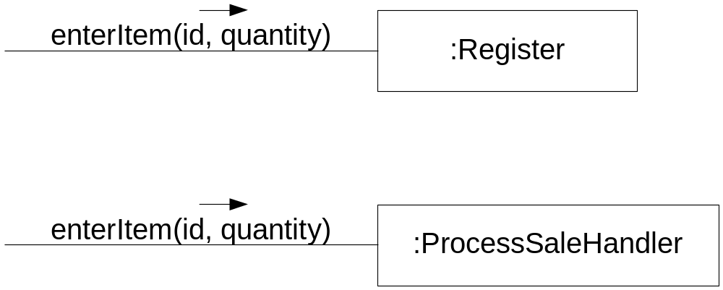
POS: Controller Example - choices
Who should be the controller for system events such as enterItem and endSale?
some choices
Represents the overall "system," "root object," device, or subsystem. | Register, POSSystem
Represents a receiver or handler of all system events of a use case scenario | ProcessSaleHandler, ProcessSaleSession
OOAD Lecture, Author: NK Jiang
<number>/75

Slide 55
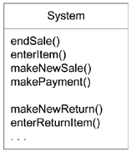
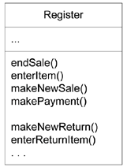
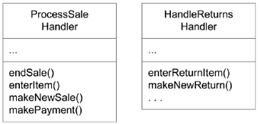
POS: Controller Example - choices
During design, the system operations are assigned to one or more controller classes, such as Register
Find system operations in analyzing system behaviors
在系统行为分析中发现系统操作
Use one Facade controller to assign system operations in design在设计过程中使用一个外观控制器分配系统操作
Use several use case controller to assign system operations in design
在设计过程中使用若干用例控制器分配系统操作
OOAD Lecture, Author: NK Jiang
<number>/75

Slide 56
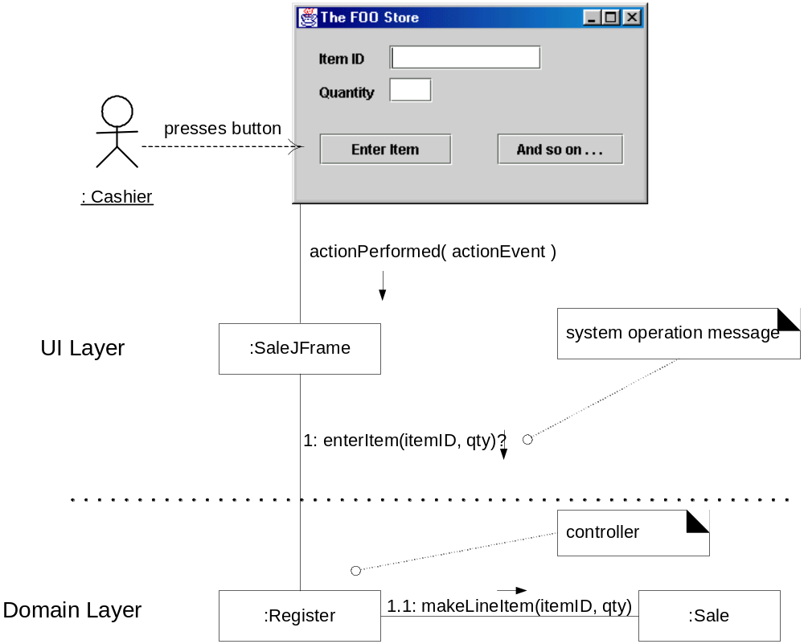
POS: Controller Example – final choice (conformity to physical entity)
OOAD Lecture, Author: NK Jiang
<number>/75

Slide 57
Discuss4: Controller vs. UI
UI should not have responsibility for fulfilling system operations
System operations handled in domain layer
  本书把 应用逻辑层 又称为 架构的 领域层（ref ch13.6)
Controller is responsible for forwarding messages.
OOAD Lecture, Author: NK Jiang
<number>/75

Slide 58
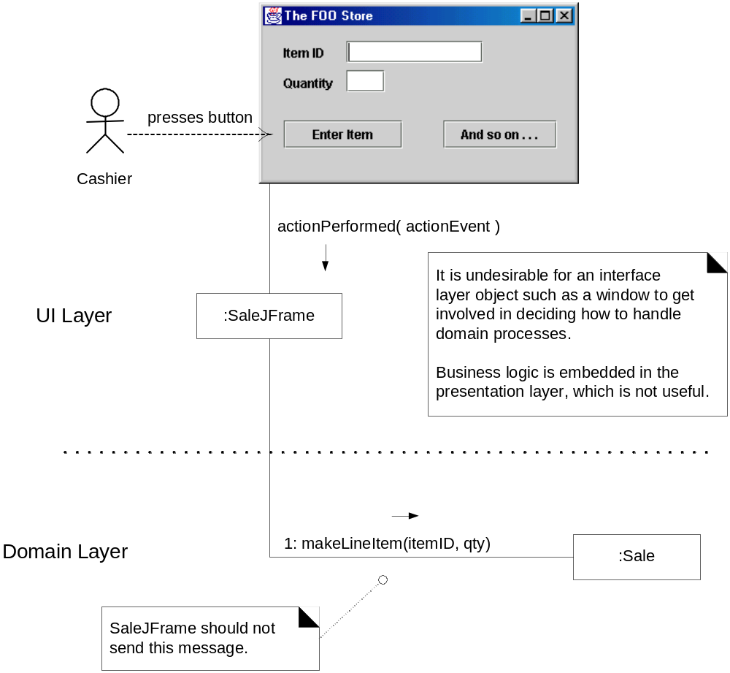
POS: UI Thin Layer should not handle System Operations (bad example)
OOAD Lecture, Author: NK Jiang
<number>/75

Slide 59
Discuss4: Controller — Benefits
Allows for easy change of UI and/or alternative UI
Allows for reuse of domain layer code (UI is usually application specific)
Helps ensure sequence of operation which may differ from UI input
Can reason about system state — UI does not preserve state
OOAD Lecture, Author: NK Jiang
<number>/75

Slide 60
Discuss4: Bloated(臃肿的) Controllers — The Problem
Low cohesion — unfocused and handling too many areas of responsibility:
  When have a facade controller handling all of many system events
  When the controller performs many of the system operations instead of delegating
  When the controller has many attributes (much information) about the system
    which should be distributed to or duplicates from elsewhere
OOAD Lecture, Author: NK Jiang
<number>/75

Slide 61
Discuss4: Bloated Controllers — The Solution
Add more controllers
  — “session controller” instead of facade
Design the controller so that it delegates operations to other objects
High Cohesion is itself a GRASP principle
OOAD Lecture, Author: NK Jiang
<number>/75

Slide 62
Discuss5: Cohesion Defined
An element has high cohesion
  with highly related responsibilities,
  and which does not do a tremendous amount of work
A class with low cohesion
  does many unrelated things,
  or does too much work.
  Such classes are undesirable.
Low cohesion classes often represent
  a very large grain of abstraction, (大粒度的抽象)
  or have taken on responsibilities that should have been delegated to other objects.
OOAD Lecture, Author: NK Jiang
<number>/75

Slide 63
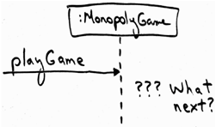
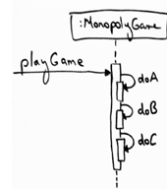
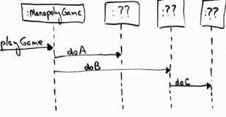

Discuss5: High Cohesion: Monopoly example
Based on the Controller decision, we are now at the design point
  two contrasting design approaches worth considering
OOAD Lecture, Author: NK Jiang
<number>/75
Notes:
不良内聚不只是意味着对象仅依靠自己工作，它或许 需要和大量其他对象进行协作
类比：为什么要软件外包？

Slide 64
Discuss5: Low Cohesion — The Problem
Hard to understand
Hard to reuse
Hard to maintain
Subject to constant need to change (usually high coupling)
OOAD Lecture, Author: NK Jiang
<number>/75

Slide 65
Discuss5: High Cohesion — NextGen POS Example
The same example problem used in the Low Coupling pattern can be analyzed for High Cohesion. Assume we have a need to create a (cash) Payment instance and associate it with the Sale.
What class should be responsible for this?
Since Register records a Payment in the real-world domain, the Creator pattern suggests Register as a candidate for creating the Payment.
The Register instance could then send an addPayment message to the Sale, passing along the new Payment as a parameter
OOAD Lecture, Author: NK Jiang
<number>/75

Slide 66
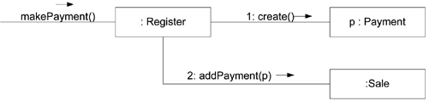
Discuss5: High Cohesion — NextGen POS Example
This assignment of responsibilities places the responsibility for making a payment in the Register. The Register is taking on part of the responsibility for fulfilling the makePayment system operation.
In this isolated example, this is acceptable;
but if we continue to make the Register class responsible for doing some or most of the work related to more and more system operations, it will become increasingly burdened with tasks and become incohesive.
OOAD Lecture, Author: NK Jiang
<number>/75

Slide 67
Discuss5: High Cohesion — NextGen POS Example
Imagine that there were fifty system operations, all received by Register. If it did the work related to each, it would become a "bloated" incohesive object.
The point is not that this single Payment creation task in itself makes the Register incohesive, but as part of a larger picture of overall responsibility assignment, it may suggest a trend toward low cohesion.
And most important in terms of developing skills as an object designer, regardless of the final design choice, the valuable thing is that at least a developer knows to consider the impact on cohesion.
OOAD Lecture, Author: NK Jiang
<number>/75

Slide 68
Discuss5: High Cohesion — NextGen POS Example
By contrast, as shown in next Figure , the second design delegates the payment creation responsibility to the Sale, which supports higher cohesion in the Register.
Since the second design supports both high cohesion and low coupling, it is desirable.
In practice, the level of cohesion alone can't be considered in isolation from other responsibilities and other principles such as Expert and Low Coupling.
Like Low Coupling, High Cohesion is a principle to keep in mind during all design decisions; it is an underlying goal to continually consider.
It is an evaluative principle that a designer applies while evaluating all design decisions.
OOAD Lecture, Author: NK Jiang
<number>/75

Slide 69
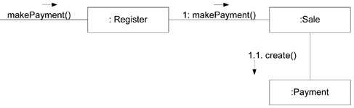
Discuss5:
Delegating to Sale creates greater cohesion in Register
OOAD Lecture, Author: NK Jiang
<number>/75

Slide 70
Discuss5: High Cohesion — When Not to
One case is the grouping of responsibilities or code into one class or component to simplify maintenance by one person.
  For example, suppose an application contains embedded SQL statements that by other good design principles should be distributed across ten classes, such as ten "database mapper" classes.
  Now, it is common that only one or two SQL experts know how to best define and maintain this SQL. The software architect may decide to group all the SQL statements into one class, so that it is easy for the SQL expert to work on the SQL in one location.
Another case for components with lower cohesion is with distributed server objects. (Performance issues demand grouping a set of operations together)
  Because of overhead and performance implications associated with remote objects and remote communication, it is sometimes desirable to create fewer and larger, less cohesive server objects that provide an interface for many operations.
OOAD Lecture, Author: NK Jiang
<number>/75

Slide 71
Discuss5: High Cohesion
As a rule of thumb, a class with high cohesion:
  has a relatively small number of methods, with highly related functionality,
  and does not do too much work.
  It collaborates with other objects to share the effort if the task is large.
A class with high cohesion is advantageous because it is relatively easy to maintain, understand, and reuse.
The high degree of related functionality, combined with a small number of operations, also simplifies maintenance and enhancements.
OOAD Lecture, Author: NK Jiang
<number>/75

Slide 72
Discuss5: High Cohesion a real-world analogy
The High Cohesion pattern has a real-world analogy.
  It is a common observation that if a person takes on too many unrelated responsibilities--especially ones that should properly be delegated to others--then the person is not effective.
  This is observed in some managers who have not learned how to delegate. These people suffer from low cohesion; they are ready to become "unglued."
Coupling and cohesion are truly fundamental principles in design, and should be appreciated and applied as such by all software developers.
OOAD Lecture, Author: NK Jiang
<number>/75

Slide 73
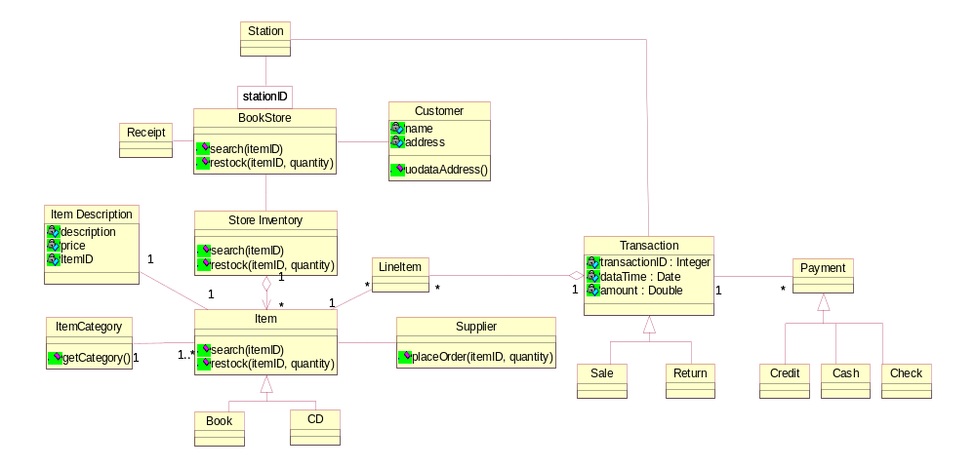
Exercise
Which class should be responsible for creating the Transaction class?
Select any 1 option:
  LineItem
  Customer
  Station
  Payment
  Cashier
OOAD Lecture, Author: NK Jiang
<number>/75

Slide 74
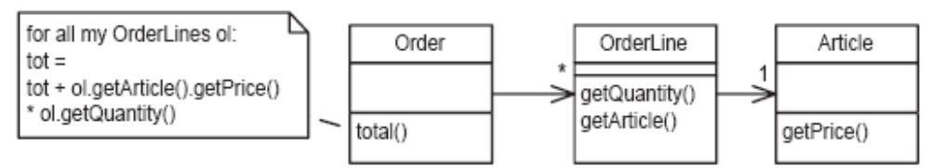
Exercise
A well designed Object Oriented System : (Single select)
A. Is loosely cohesive and loosely coupled.
B. Is tightly cohesive and loosely coupled.
C. Is tightly cohesive and tightly coupled.
D. Is loosely cohesive and tightly coupled.
Consider the following design.
How would the introduction of a subtotal() method in OrderLine improve the design?
(a) It enhances the coherence of Article.
(b) It reduces the coupling of Order.
(c) It reduces the coherence of Order.
(d) It enhances the coupling of Article.
OOAD Lecture, Author: NK Jiang
<number>/75

Slide 75
Preparation: Read Text book Ch21 “refactoring”
End
OOAD Lecture, Author: NK Jiang
<number>/75

