Slide 1
UML及形式化建模
Unified Modeling Language
Lecture01_03面向对象基础
主讲: 姜宁康 博士
日期: 26/11/8

Slide 2
UML和面向对象（OO）
软件开发
面向对象分析设计
构建系统，满足客户需要
01
02
给出软件解决方案
UML
03
04
C++/Java/Python
建模工具，表达设计思想
实现解决方案
“磨刀不误砍柴工”：UML是软件设计必备工具；设计是成功软件必经之路

Slide 3
UML和面向对象（OO）
注意
  UML不是面向对象的技术！
  UML的符号、语义可以用来描述面向对象的概念
    比较：拿着榔头的人就是建筑师吗？ UML就是这把榔头
  在用面向对象技术解决实际问题时，更重要的是面向对象思考问题的思想，而不是UML
  但UML是表达这种思想的有效工具！
什么是面向对象方法?
  “放眼望去, 你看到的一切都是对象（object）”
  C++/Java编程
什么是面向过程方法？
  C语言编写的程序
UML Lecture_01, Author: NK Jiang
<number>/34

Slide 4
面向对象方法和面向过程方法（结构化）的比较
面向对象描述一件事
竹笋炒肉片
  竹笋
    数量：500克
    处理：用刀切成细丝，过油
  肉片
    数量：200克
    处理：切片，用酱油、酒、黑醋腌制 30 分钟
  芡汁
    制作：太白粉调上适量的水
    芶芡：将芡汁倒入锅中
  工具
  青椒处理好、肉片处理好、芡汁制作好，放入锅中快炒 1 分半后用芡汁芶芡即可。
面向过程描述一件事：
竹笋炒肉片
  取出竹笋500克，用刀切成细丝，过油
  取出猪肉200克，切片，用酱油、酒、黑醋腌制 30 分钟
  起油锅、放入肉片炒及青椒大火快炒1 分半
  拿出太白粉、水调在一起，这个称为芡汁。
  将芡汁倒入锅中搅拌，会产生黏稠现象这叫芶芡
  完成。
接下来就可用对象间的互动行为来描述整件事情是如何发生的。
(这部份的描述称为“主程序”)

Slide 5
案例：下一节课到哪里去上？
Suppose, you are an instructor at a conference. People in your class have another class to attend following yours, but don't know where it is located. One of your responsibilities is to make sure everyone knows how to get to the next class.
If you were to follow a structured programming approach, you might do the following:
1. Get list of people in the class.
2. For each person on this list, do the following:
  a. Find the next class he or she is taking.
  b. Find the location of that class.
  c. Find the way to get from your classroom to the person's next class.
  d. Tell the person how to get to his or her next class.
To do this would require the following procedures:
1. A way of getting the list of people in the class
2. A way of getting the schedule for each person in the class
3. A program that gives someone directions from your classroom to any other classroom
4. A control program that works for each person in the class and does the required steps for each person
但是，现实中，你会这样子做吗？
UML Lecture_01, Author: NK Jiang
<number>/34

Slide 6
案例：下一节课到哪里去上？
Most likely you will take this way :
  post directions to go from this classroom to the other classrooms and then tell everyone in the class:
    "I have posted the locations of the classes following this in the back of the room, as well as the locations of the other classrooms. Please use them to go to your next classroom."
  You would expect that everyone would know what his or her next class was, and that everyone could find the right classroom from the list and could then follow the directions to get to the correct classrooms
What is the difference between these approaches?
  Shifting responsibility from yourself to individuals
    Individual is ‘Object’
UML Lecture_01, Author: NK Jiang
<number>/34

Slide 7
What is an object? 什么是对象 ch2
E.g., when you look at a person, you see the person as an object
  A person has attributes
    such as eye color, age, height, and so on.
  A person also has behaviors
    such as walking, talking, breathing, and so on
And also，
  When you look at a water bottle, you should see it as an object
  Attribute…
  Operation…
UML Lecture_01, Author: NK Jiang
<number>/34

Slide 8
What is an Object?
Basic definition
  an object is an entity that contains both behavior and data 拥有数据和行为的一个实体
    ‘both’ is the key difference between the traditional programming methodology and OO programming.
有不同的名词，但意义一样
  An object is an entity which consists of a number of operations and a state which remembers the effect of the operations.
  State is regarded as information which is saved in a set of variables.
  Operations (aka. methods) read and/or affect the information.
  The only part that can be seen by an outsider are the operations. For this reason, operations are also known as behaviours.
  Information is hidden to the outsider.
UML Lecture_01, Author: NK Jiang
<number>/34

Slide 9
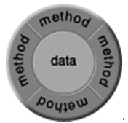
What is an Object?
Analogy to an Object
An object represents
  an individual, identifiable item, unit, or entity, either real or abstract, with a well-defined role in the problem domain.
Informally, an object represents an entity, either physical, conceptual, or software
方法
f(2)
f(1)
数据
接口
UML Lecture_01, Author: NK Jiang
<number>/34

Slide 10

What is an Object?
For Example,
  Physical entity，Tangible Things： as a car, printer, ...
  Conceptual entity
    such as a chemical process, a bank transaction, a purchase order,
    credit history, or interest rate
    Roles as employee, boss, ...
    Incidents as flight, overflow, ...
    Interactions as contract, sale, ...
    Specifications as colour, shape, …
  Software entity
Truck
Chemical Process
Linked List
Notes:
An object is a computer representation of an entity, either real-world or invented. An object can represent something concrete from the problem domain, such as a truck or a computer. An object also can represent a concept, such as a chemical process, a bank transaction, a purchase order, credit history, or interest rate.
In object-oriented systems, objects also are used to represent software structures such as linked lists, binary trees, and files. These objects typically are not found in the problem domain. Rather, they are invented to help facilitate the implementation.
对象是一件事、一个实体，可以获得的某种东西，可以想象有自己标识的任何东西。
一些对象是活的，一些对象不是。现实世界中的例子有：汽车、人、房子、桌子、狗、植物、支票簿或雨衣。
对象有属性：例如，汽车有厂家、型号、颜色和价格。
狗有种类、年龄、颜色和喜欢的玩具。
对象有行为：汽车可以从一个地方移动到另一个地方，狗会吠。
不要被面向对象开发中常见的 把软件对象想象成人的理论、把人的特性赋予没有生命的对象或动物吓住。

Slide 11
What Is a Class? 什么是类
定义
  “共享相同属性、操作、方法、关系或者行为的一组对象的描述符”
    －Rumbaugh
  a class is a blueprint for an object
Note：
  trying to explain classes and objects is really a chicken-and-egg dilemma
    For example, a specific bike is an object. However, someone had to have the blueprints (that is, the class) to build the bike
UML Lecture_01, Author: NK Jiang
<number>/34
Notes:
类和对象很少在同一张图中出现，所以可以根据类进行建模的大多数工作，而对象仅用于演示和验证。

Slide 12
Example: Describe A Person as an Class
类
Information:
Name,
Age,
Address,
Friends,
...
Information:
Sue Smith,
25,
华师大理科楼,
李四,
...
Behaviour:
jump
bend legs
stretch legs
lift arms,
...
walk
talk
Behaviour:
jump
bend legs
stretch legs
lift arms,
...
walk
talk
对象
UML Lecture_01, Author: NK Jiang
<number>/34

Slide 13
Java code of the Person class
Name
public class Person {
private String name;
private int yearOfBirth;
public Person(String theName, int theYear) {
name = theName;
yearOfBirth = theYear;
}
public void jump() {
System.out.println(name + “ jumps”);
}
public int getAge(int thisYear) {
return thisYear - yearOfBirth;
}
创建对象：
Person aPerson = new Person(“Sue Smith”,25);
Private data
(attributes)
Initialisation
(constructor)
Public
behaviour
(methods)
UML Lecture_01, Author: NK Jiang
<number>/34

Slide 14
C++ code of the Person class
#include <iostream>
class Person{
private:
char name[20];
int yearOfBirth;
public:
Person(char *theName, int theYear) {
yearOfBirth = theYear;
sprintf(name, theName);
}
void jump() {
std::cout << name <<
" jumps" << std::endl;
}
int getAge(int thisYear) {
return thisYear - yearOfBirth;
}
};
Name
Private data
(attributes)
Initialisation
(constructor)
Public
behaviour
(methods)
UML Lecture_01, Author: NK Jiang
<number>/34

Slide 15



An Object Has a unique Identity
  Each object has a unique identity, even if its state is identical to that of another object
Professor “J Clark”
teaches Algebra
Professor “J Clark”
teaches Algebra
Professor “J Clark”
teaches Algebra
  很明显，虽然他们名字相同，所授课程等属性相同，并且作为教师，有相同的行为，但是，
  他们是不同的对象！！
Notes:
Objects are distinguished by their inherent existence and NOT by their descriptive properties.
Rumbaugh book, page 22.
对象有自己独立的存在。左手一支蓝色的钢笔、右手一支蓝色的钢笔，于是，我们手中就有两支钢笔，它们是彼此独立的，每一支钢笔都有自己的标识。但它们有类似的属性：蓝色的墨水、半满、相同的厂商、相同的型号等。根据它们的属性，这两支笔是可以互换的，如果在纸上写下什么，不会有人看出是用了哪支钢笔。钢笔是相同的，但它们不是一支笔。

Slide 16
An Object Has State
  The state of an object is one of the possible conditions in which an object may exist
  The state of an object normally changes over time
  The state of an object is usually implemented by a set of properties (called attributes), with the values of the properties, plus the links the object may have with other objects
a + b = 10
Name: Joyce Clark
Employee ID: 567138
Date hired: March 21, 1987
Status: Tenured
Professor Clark
Notes:
Emphasize that state is time-dependent. When you ask in what
state an object is, there is always an implied time: NOW
This is a very static example: the state changes from non-tenured to tenured to retired.
A more dynamic object: a flight state changes from: empty to boarding to boarded to in flight.

Slide 17

An Object Has Behavior
  Behavior determines how an object acts and reacts
  Behavior defines how an object reacts to requests from other objects
  The visible behavior of an object is modeled by the set of messages it can respond to (the operations the object can perform)
a + b = 10
Assign Professor Clark
(Returns:confirmation)
Registration System
Algebra 101 Course
Notes:
Behavior is a tough concept for most folks. You can’t just do something to an object -- you have to ask the object to do it!
The syntax of a language call MODSIM (object oriented simulation language) actually helps with this. The syntax is:
ASK object TO behavior
I still use this today to help distribute the behavior in a system (what object has the behavior) .
Good example: In a baseball simulation there is a pitcher and a ball. The pitcher does not throw the ball. The throw behavior of the pitcher asks the ball to move. The ball knows how to move (with a little help such as velocity).

Slide 18
Example
甚至是最简单的没有移动部件的事物，例如，普通的瓶子，
  也是有状态
    满了没有？瓶盖开着还是合上？里面的东西温度多少？
  和行为
    以各种流量喷洒里面的内容，被打开或关闭，维持高温或低温）组成。
正是对象和现实世界的事物之间有如此相似的特性，使得对象具有如此之多的作用和吸引力。
  它们不仅可以用构件的形式对现实世界建模
    [如, 人 组成团队, 团队类似一个构件]
  也能以软件系统的构件形式实现所赋予的功能
UML Lecture_01, Author: NK Jiang
<number>/34

Slide 19
Example
例如，大型客机可视为对象
  它具有位置、速度、颜色、容量等属性，
  对于该对象可施行起飞、降落、加速、维修等操作，这些操作将或多或少地改变飞机的属性值(状态)
例如，咖啡机 对象
  属性：
    可用的饮料种类 availableDrink
    饮料的价格 drinkPrice
    饮料的配方 drinkRecipe
  操作
    显示饮料种类
    选择饮料种类
    收款
    出货
UML Lecture_01, Author: NK Jiang
<number>/34

Slide 20
练习
例如，假定要求你对家庭用水系统建模。你需要想出一些对象来表示供水系统的各种部件
  Faucet object（水龙头）
    它有方法：打开水流/关闭水流，设定流速，返回给定时间段的用水量等等。
    为了完成这项任务，水龙头对象需要实例变量来记录水龙头开、关、用了多少水、水从哪里来等信息。
  供水模型中可能还有水管对象，负责运水；
  有节水阀对象，调节水管中的水流速度。
  一些应用对象—如洗碗机、盥洗室和洗衣机。
  当建筑对象被要求报告用了多少水时
    可能还有一个建筑对象, 容纳一些水管、阀、水龙头、
    它可以要求每个水龙头、阀报告自己的当前状态
    整个系统是一个又一个对象网络。
    对象相互调用来解决问题。每个对象都有专门的角色，完成部分工作，有能力和其他的对象交互。 对象间通过消息（message） 来进行交互,请求执行某一个方法 。
UML Lecture_01, Author: NK Jiang
<number>/34

Slide 21
Basic Terminology 1: Inheritance 、泛化
Inheritance is a way of relating two classes so that one class may use another class's members without redefining them.
The basic principle is simple:
  A class gets the state and behaviour of another class and adds additional state and behaviour.
UML Lecture_01, Author: NK Jiang
<number>/34

Slide 22
How do you express inheritance in C++?
class Car : public Vehicle {
public:
...
};
We state the above relationship in several ways:
Car is "a kind of a" Vehicle
Car is "derived from" Vehicle
Car is "a specialized" Vehicle
Car is a "subclass" of Vehicle
Car is a "derived class" of Vehicle
Vehicle is the "base class" of Car
Vehicle is the "superclass" of Car
UML Lecture_01, Author: NK Jiang
<number>/34

Slide 23
一些类的继承例子
交通工具
空中交通工具
陆地交通工具
水中交通工具
自行车
划艇
喷气机
卡车
汽车
火车
渡船
滑翔机
游艇
UML Lecture_01, Author: NK Jiang
<number>/34

Slide 24
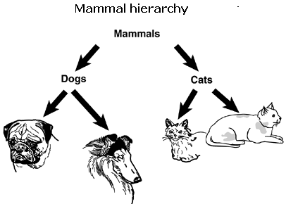
Inheritance Hierarchy
UML Lecture_01, Author: NK Jiang
<number>/34

Slide 25
Basic Terminology 2: Polymorphism
定义
  同一类族的不同对象，可以用不同的行为处理同一条消息Different receivers can interpret the message in their own way.
  Original meaning: “Having many forms”
  The sender of a stimulus doesn’t need to know the receiver’s class.
Consequence:
  different receivers can response to the same stimulus based on their interpretation.
  So we can have a variety of objects （具有相同的根节点！）who process the same piece of data in different ways.
Implemented via method overloading and overriding.
  Override,覆盖是指在子类（c++中的派生类） 中重新定义父类的函数
  重载（overload）： 在同一个类中，出现多个同名的方法的现象就是Overload
  重载事发生在同一个类中，不同方法之间的现象
UML Lecture_01, Author: NK Jiang
<number>/34

Slide 26
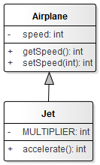
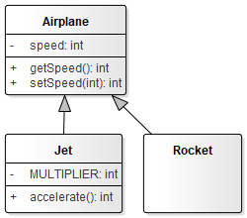
多态举例
public class Jet extends Airplane {
private static final int MULTIPLIER = 2;
public Jet() {
super();
}
public void setSpeed(int speed) {
super.setSpeed(speed * MULTIPLIER);
}
public void accelerate() {
super.setSpeed(getSpeed() * 2);
}
}
Airplane plane = new Airplane();
或者 Airplane plane = new Jet();
plane.flight();
plane = new Rocket(); //今后扩展
plane.flight();
//不同的对象接受相同的消息，产生不同的行为
UML Lecture_01, Author: NK Jiang
<number>/34
Notes:
161， +1分

Slide 27
多态举例
多态有什么用处？
  你可以编写使用父类（像Airplane）的程序代码，但实际上将使用任何类型的子类（像Jet或者Rocket），因此，代码比较灵活。
  当需要新的功能时，只要编写新的Airplane子类，程序代码的其余部分无需做任何改变，新的子类就可以运作！例如，plane.getSpeed();
所有的面向对象设计原则、设计模式（design Pattern），都是依赖多态特性的
UML Lecture_01, Author: NK Jiang
<number>/34

Slide 28
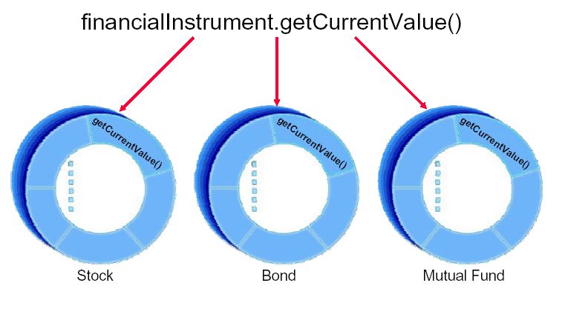
多态的例子
UML Lecture_01, Author: NK Jiang
<number>/34

Slide 29
Basic Terminology 3: Encapsulation
Encapsulation is the process of hiding the implementation details of an object.
The only access to manipulate the object data is through its interface.
It protects an object’s internal state from being corrupted by other objects.
Also, other objects are protected from changes in the object implementation.
Encapsulation allows objects to be viewed as ‘black boxes’.
Communication is achieved through an ‘interface’.
UML Lecture_01, Author: NK Jiang
<number>/34

Slide 30
Basic Terminology 3: Encapsulation
Encapsulation is the practice of including in an object everything it needs hidden from other objects. The internal state is usually not accessible by other objects.
Rule:
  An object should only reveal the interfaces needed to interact with it. Details not pertinent to the use of the object should be hidden from other objects. This is called encapsulation
UML Lecture_01, Author: NK Jiang
<number>/34
Notes:
How can I prevent other programmers from violating encapsulation by seeing the private parts of my class?
Not worth the effort — encapsulation is for code, not people.
It doesn't violate encapsulation for a programmer to see the private and/or protected parts of your class, so long as they don't write code that somehow depends on what they saw. In other words, encapsulation doesn't prevent people from knowing about the inside of a class; it prevents the code they write from becoming dependent on the insides of the class. Your company doesn't have to pay a "maintenance cost" to maintain the gray matter between your ears; but it does have to pay a maintenance cost to maintain the code that comes out of your finger tips. What you know as a person doesn't increase maintenance cost, provided the code you write depends on the interface rather than the implementation.
Besides, this is rarely if ever a problem. I don't know any programmers who have intentionally tried to access the private parts of a class. "My recommendation in such cases would be to change the programmer, not the code" [James Kanze; used with permission].

Slide 31
Basic Terminology 4: Interface p34
An interface is a collection of operations that specify a service of a class or component.
  The interface should completely describe how users of the class interact with the class
  About attributes:
    In accepted OO design, all attributes should be declared as private. Thus, attributes are not part of the interface.
    Only the public methods are part of the class interface.
    Declaring an attribute as public breaks the concept of data hiding.
Key points:
  if a user needs access to an attribute, a method is created to return the attribute (a setter).
  If a user wants the value of an attribute, a method is called that returns the value of the attribute (a getter).
UML Lecture_01, Author: NK Jiang
<number>/34

Slide 32
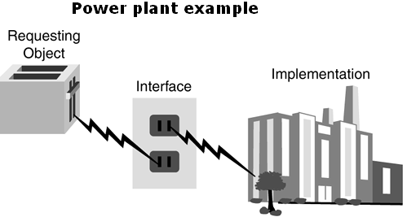
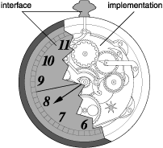
Real-World Example of the Interface/Implementation Paradigm
UML Lecture_01, Author: NK Jiang
<number>/34

Slide 33
5、 abstract 抽象
Giving the user the minimal interface possible
  For example,
    Appliance – power supplier – socket（插座）
    automobile - main concern when driving a car is that the car starts, accelerates, stops, steers etc.
      If, however, a manufacturer decided to install a joystick in place of the steering wheel …
    For using car, the engine is part of the implementation, and the steering wheel is part of the interface
UML Lecture_01, Author: NK Jiang
<number>/34

Slide 34
5、 abstract 抽象
Difference between an abstract and a concrete interface
For a taxi object
  "Take me to the airport," or
  "Turn right, then right, then left, then left, then left"?
  Which is more reusable?
    "Take me to the airport," : abstract interface is a good, reusable OO design
UML Lecture_01, Author: NK Jiang
<number>/34

Slide 35
Designing with Objects
Generally, a solid OO design process will include the following steps
  Doing the proper analysis
  Developing a statement of work that describes the system
  Gathering the requirements from this statement of work
  Developing a prototype for the user interface
  Identifying the classes
  Determining the responsibilities of each class
  Determining how the various classes interact with each other
  Creating a high-level model that describes the system to be built
UML Lecture_01, Author: NK Jiang
<number>/34

Slide 36
End
UML Lecture_01, Author: NK Jiang
<number>/34

