Slide 1
UML及形式化建模
Unified Modeling Language
Lecture02_UML引言
主讲: 姜宁康 博士
日期: 26/11/8

Slide 2

本讲内容
课后看不懂的单词、词语、句子、问题，都可以在大夏学堂课程论坛讨论
也可以微信群进行讨论
UML Lecture_UMLintroduction, Author: NK Jiang

Slide 3
“一图胜千言”
一学汉语十年的老外（名 阿呆）参加汉语考试：解释下文中每个“意思”的意思：
  题目：阿呆给领导送红包
  领导：你这什么意思？
  呆： 没什么意思，意思意思。
  领导：你这就不够意思了。
  呆： 小意思小意思。
  领导：你这人真有意思。
  呆： 其实也没别的意思。
  领导：那我就不好意思了。
  呆： 是我不好意思。
  老外泪流满面，交白卷回国 【摘自某相声节目】
  文字表达歧义太多

Slide 4

“一图胜千言”
廉政漫画：礼尚往来
在图的基础上，配一些文字，很容易清楚表达
UML采用了许多图形化的符号用于建模

Slide 5
What is the UML?
UML stands for Unified Modelling Language
  统一建模语言
  language = syntax + semantics (语法+语义)
  syntax = language elements (e.g. words) are assembled into expressions (e.g. phrases, clauses)
  semantics = the meanings of the syntactic expressions
    UML Notation Guide – defines UML’s graphic syntax
    UML Semantics – defines UML’s semantics
UML
  适用于软件开发全生命周期的各个阶段（software development life cycle ，SDLC), 无关乎具体的实现平台
  作为系统分析、设计的沟通桥梁
UML Lecture_UMLintroduction, Author: NK Jiang
Notes:
9
Core message -- second bullet
UML can be used to communicate system and software design throughout the life cycle

Slide 6
UML 历史
OO表示法的“方法之战” p18
  The problem was that if different people were using different notations, somewhere along the line somebody had to do a translation.
  A lot of times, one symbol meant one thing in one notation, and something totally different in another notation.
  In 1991, everybody started coming out with books（每个人都把自己的理解、方案通过写书表达出来）.
  E.g
    例如填充圆形（filled circle）在OMT中是多样性标志，在Booch中却是集合标志
    “类”到底是云形还是长方形的？哪个更好？
??
??
UML Lecture_UMLintroduction, Author: NK Jiang
Notes:
我有自己的方法绘制类图，不行吗？
【答】拥有自己的表示法没什么不对。但是会让其他人很难理解你的设计。通过使用像UML这样的标准，我们全都说相同的语言，确定用我们的图形讨论相同的事。
【问】类图是类的非常完整的表示吗？
【答】不是的。类图表现的类的主要特征（主要属性、主要行为）。

Slide 7
UML 历史
OO表示法的三个著名贡献者
  在九十年代很多不同的方法学和它们的符号集都被引入市场中，其中最流行的三个是：
    OMT（Rumbaugh）
    Booch方法(Grady Booch) )
    OOSE (Jacobson)。
  每种方法都有自己的价值和重点:
    OMT: 在分析方面强大，但是在设计方面比较弱
    Booch : 在设计方面强大，但是在分析方面比较弱
    OOSE : 在行为分析方面强大，但是在其它方面比较弱
UML Lecture_UMLintroduction, Author: NK Jiang
Notes:
随着时间的推移，Booch写了他的第二本书，除了别的内容以外，他还采用了大量的Rumbaugh和 Jacobson提倡的好的分析技术。
Rumbaugh出版了一系列文章，形成了我们所知道的OMT-2，它采用了Booch的大量的好的设计技术。
这三种技术开始聚合在一起，但是各自仍然有自己独特的符号。由于符号对不同的人的意味着不同的事物，所以使用不同的符号给市场带来了混乱。
例如满圆形（filled circle）在OMT中是多样性标志，在Booch中却是集合标志。
你可能听到过用术语“方法的战争”来描述这段时间——类到底是云形还是长方形的？哪个更好？

Slide 8
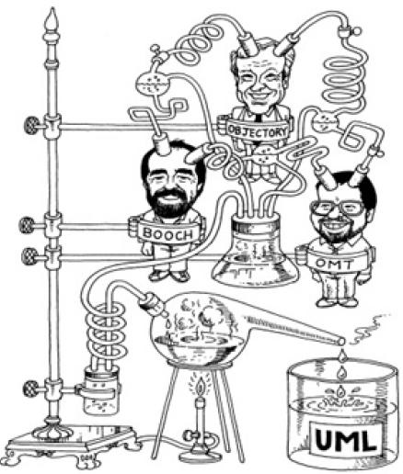
UML 历史
ML的诞生
UML规范是在 Grady Booch、Ivar Jacobson、Jim Rumbaugh这三人的领导下，由Rational Software公司开发出来的，后来交由OMG（Object Management Group）管理
UML Lecture_UMLintroduction, Author: NK Jiang

Slide 9
UML 历史
OMG（对象管理工作组），对UML的发展起了促进作用
UML试图标准化分析和设计的工作
  语义模型（semantic models）
  语法符号（syntactic notation）和
  图表（diagrams）
UML的进程
  1995年10月，第一份公共草案（0.8版本）
  1996年7月的0.9版本和1996年10月的0.91版本，包括了公众和Ivar Jacobson的反馈
  1997年7月1.0版本，提供给OMG，以供标准化
  1997年9月1.1版本，集成了一些额外的增强
在1997年11月，UML被OMG采用,作为标准的建模语言
UML目前的最高版本是UML 2.5.1
  2017年发布
  同学们可以查看OMG的Web站点www.omg.org找到更多关于UML的信息
本课程教学采用的是 UML 2.0
UML Lecture_UMLintroduction, Author: NK Jiang
Notes:
What shall we teach undergraduate computer science (CS) students? This question
has plagued our profession for decades now. Possible answers range over
several dimensions from principles (“Programming first!”) over different application
fields (“Compiler construction!”), technologies (“Java!”), and paradigms
(“OO!”). And for the last five years, another big player has entered the contest
for the students’ attention: UML . Being widely used in industry by
now, proficiency in UML is certainly a valuable asset for every CS student.
Evidence for the rapid increase in the importance of UML can be gained from
the IEEE/ACM’s computing curricula project, which mentioned UML only in
passing in 2001 (amongst CRC cards and other data modeling techniques)
and which explicitly places UML as a central component in the core course in
software engineering (SE) in 2004。

Slide 10
UML的用途
UML语言（工具）
  可视化 visualizing
  说明 specifying
  构造 constructing
  文档 and documenting the artifacts（工件，制品） of a software-intensive system（软件密集型系统）
    它可用于对软件密集型系统进行
这也是对软件系统进行建模的四个目的
  UML非常适合于软件系统的分析、建模
  同时，UML适用于很多非软件行业
UML Lecture_UMLintroduction, Author: NK Jiang

Slide 11

1. The UML is a Language for visualizing可视化
Communicating conceptual models to others is prone to error unless everyone involved speaks the same language
there are things about a software system you can't understand unless you build models
An explicit model facilitates communication
UML Lecture_UMLintroduction, Author: NK Jiang
Notes:
It makes it easier to understand and work through problem
Since it is a formal language, it enables other developers familiar with the language to more easily interpret our drawings.

Slide 12




What is Visual Modeling?
Order
“Modeling captures essential
parts of the system.”
Dr. James Rumbaugh
Item
Ship via
Business Process
Visual Modeling is modeling
using standard graphical notations
Computer System
Copyright © 1997 by Rational Software Corporation
UML Lecture_UMLintroduction, Author: NK Jiang
Notes:
3
Core Message: Modeling captures essential parts of the system
Key Point 1: Computer system basically automate business processes. However, it’s not easy to build software systems on time and within budget.
Key Point 2: Building a complex software system requires blueprint. You don’t construct a building without a blueprint. Visual modeling is the blueprint for software systems.
Conclusion: VM is a key to successful software development

Slide 13
Visual Modeling Captures Business Process
Use Case Analysis is a technique to capture business process from user’s perspective
Copyright © 1997 by Rational Software Corporation
UML Lecture_UMLintroduction, Author: NK Jiang
Notes:
4
Core Message: VM captures business process
Key Point 1: Understanding business process is hard. If an architect and developers don’t understand the business process, which is the requirement for the system, you can’t build the proper system.
Key Point 2: Use case is a technique to capture business process from user’s perspective. Use case is easy to understand because business process is defined in textual format, not in computer lingo. lingo [方言, 行话, 隐语]
Example: Use the previous slide to describe use case. The system may handle order entry, inventory, and payroll processes. This particular use case only looks at order entry process.
Conclusion: VM captures business process

Slide 14
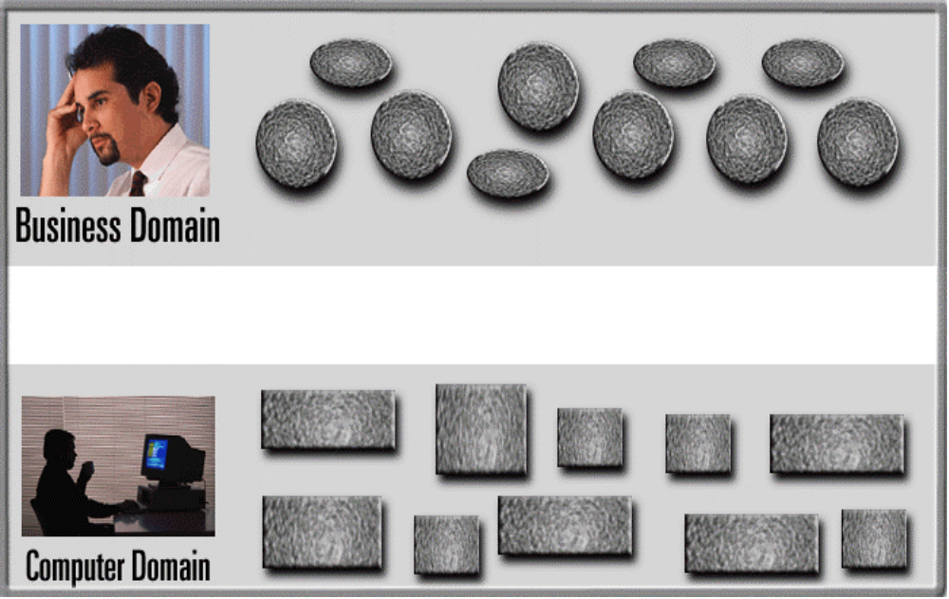
Visual Modeling is a Communication Tool
Use visual modeling to capture business objects and logic
Use visual modeling to analyze and design your application
UML Lecture_UMLintroduction, Author: NK Jiang
Notes:
5
Core Message: VM is a communication tool.
Key Point 1: Business analyst and domain experts define requirements. Software architects and developers build systems based on requirements. Typically, they have communication problems due to different use of terminology and different definition of concepts.
Key Point 2: Take a look at the Rose development team. The team is distributed in three cities around the world; Sweden, Milwaukee, and Philadelphia. There is a common language - visual modeling.
Key Point 3: With VM, there is a smooth transition between business domain and computer domain. Also, you can establish traceability from business domain to computer domain.
Conclusion: VM is a communication tool.

Slide 15
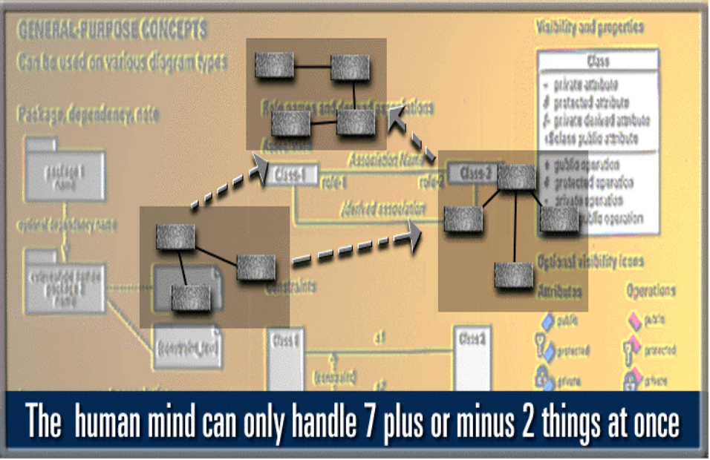
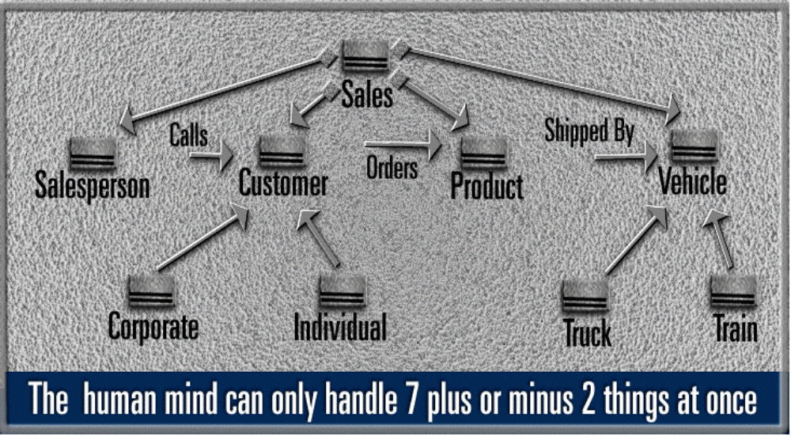
Visual Modeling Manages Complexity
UML Lecture_UMLintroduction, Author: NK Jiang
Notes:
6
Core Message: VM manages complexity
Key Point 1: This is a model of typical system. Sale has information about purchase order, sales person, and customer. In a system, you may get hundreds or thousands of these things (or objects).
Key Point 2: Human mind can only handle 7 plus or minus things at once. VM allows you to raise your level of abstraction. There are constructs to group things into more manageable number of things.
Example: One new developer joins the group. How do you describe your software system?
Conclusion: VM manages complexity

Slide 16
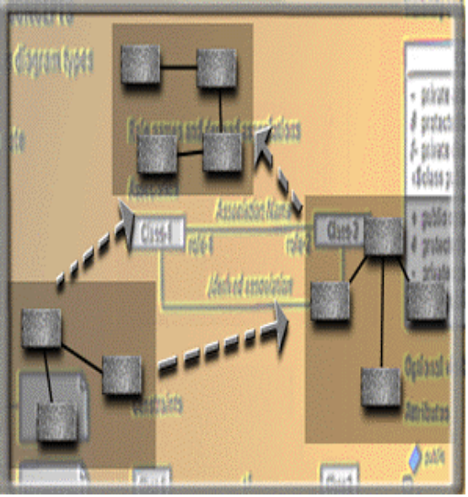
Visual Modeling Defines Software Architecture
User Interface
(Visual Basic,
Java)
Business Logic
(C++, Java)
Database Server
(C++ & SQL)
Model your system
independent of
implementation language
Copyright © 1997 by Rational Software Corporation
UML Lecture_UMLintroduction, Author: NK Jiang
Notes:
7
Core Message: VM defines software architecture
Key Point 1:Model of a system is essentially a software architecture. You can then map it to the physical architecture. For example, this is a three tier architecture - mapping logical to physical.
Key Point 2: Model your system independent of the implementation language. Technology change too much too fast. A few years ago, C++ was the language of the future but today it’s Java. How do you plan to change your system from PowerBuilder to Visual Basic? Reuse models.
Conclusion: VM defines software architecture

Slide 17
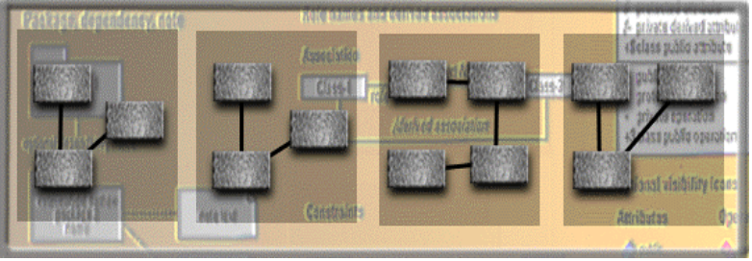
Visual Modeling Promotes Reuse
Multiple Systems
Reusable
Components
Copyright © 1997 by Rational Software Corporation
UML Lecture_UMLintroduction, Author: NK Jiang
Notes:
8
Core Message: VM promotes reuse.
Key Point 1:On previous slide, we talked about reusing a model.
Key Point 2:There is a higher leverage of reuse. Reusing parts of the system or an application. For example, a component is an application in a binary format, whether the component is made of objects or not. VM can be used as a component browser and it can also be used to model component assembly.
Conclusion: VM promotes reuse.

Slide 18
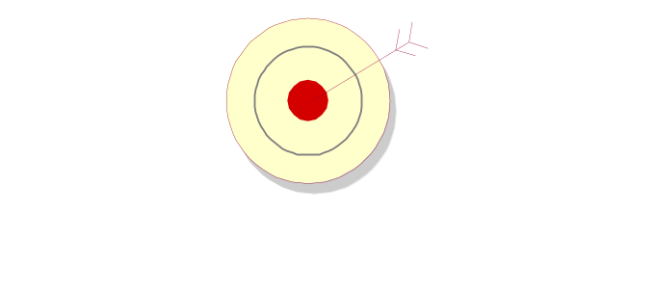
2. The UML is a Language for Specifying
Specifying
  the UML builds models that are precise, unambiguous, and complete
  “有的放矢”
We must communicate our software system using some common, precise, and unambiguous communication mechanism.
Again the formal nature （形式化的本质）of the UML facilitates this specification quite nicely.
UML Lecture_UMLintroduction, Author: NK Jiang

Slide 19
3. The UML is a Language for Constructing p30
UML models can be directly connected to a variety of programming languages
  Maps to Java, C++,Visual Basic, and so on
  Tables in a RDBMS or persistent store in an OODBMS
  Permits forward engineering
  Permits reverse engineering
UML is not a programming language
UML Lecture_UMLintroduction, Author: NK Jiang
Notes:
We know that the UML is a formal language with its own set of syntactical rules.
Because of this formality, we can create tools that interpret our models.
They can map the elements to a programming language, such as Java, C++.
Many tools such as Rational Rose, supports this forward engineering. In fact this is one of the advantages of using a formal modeling tool.

Slide 20
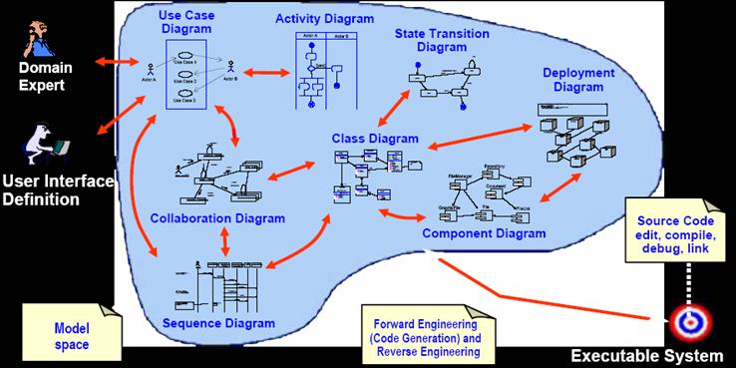
4. The UML is language for Documenting
The UML addresses documentation of system architecture, requirements, tests, project planning, and release management
UML Lecture_UMLintroduction, Author: NK Jiang
Notes:
The models we create are just one of the artifcats produced throughout the development lifecycle.
Using the UML in a consistent fashion produces a set of documentation that can serve as a blueprint of our system.

Slide 21
Where Can the UML Be Used? p31
UML主要用于软件密集型系统。在下列领域中已经有效地应用了UML：
  企业信息系统
  银行与金融服务
  电信
  运输
  国防/航天
  零售
  医疗电子
  科学
  基于Web的分布式服务
UML不限于对软件建模。
  它的表达能力对非软件系统建模也是足够的。例如，
    法律系统的工作流程、
    病人保健系统的结构和行为、
    飞机战斗系统中的软件工程以及硬件设计等。
UML Lecture_UMLintroduction, Author: NK Jiang

Slide 22
小结：UML是…
UML is a modeling language, not a method(方法/方法学)
  Most methods consist, at least in principle, of both a modeling language and a process.
  Modelling Language is the (mainly graphical) notation that methods use to express designs.
  Process is their advice on what steps to take in doing a design.
Modeling Language is the most important part of the method, which is the key part of communication.
在建模过程中，UML作为一种表达工具，可以方便地表达设计师的设计思想，并使设计思想得以快速传播和理解
建模的目的是 沟通、理解系统
UML Lecture_UMLintroduction, Author: NK Jiang

Slide 23
UML的概念模型 A Conceptual Model of the UML p33
UML的构造块
UML
事物
关系
图
结构事物
行为事物
分组事物
类图 Class D.
依赖
对象图 Object D.
类 Class
交互 Interaction
注释事物
顺序图 Sequence D
关联
接口Interface
状态机 State machine
泛化
通信图 Communication D
用例图 use case D.
包 Package
协作 Collaboration
活动 Activity
实现
构件图 Component D.
状态图 state D.
注释
Anotational thing
用例 Use case
活动图activity D.
构件Component
部署图 deployment D.
制品图 artifact D.
主动类 Active class
制品 Artifact
包图package D.
交互概览图 interaction overview D.
节点 node
注意： usecase 翻译成 “用例”！
教材翻译成“用况”
时序图 timing D.

Slide 24
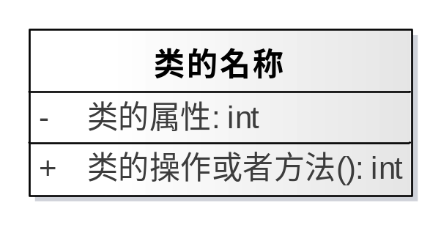

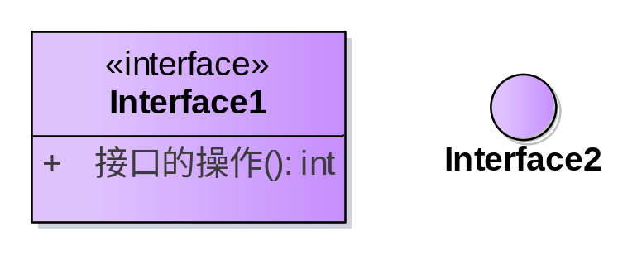
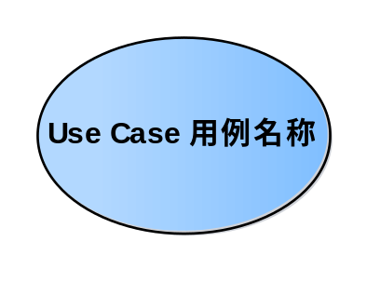
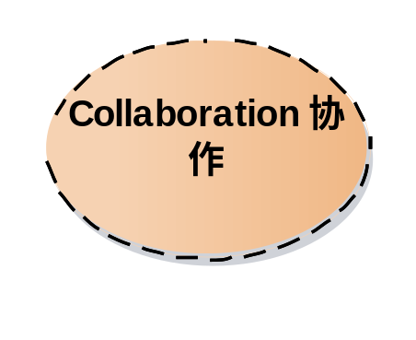
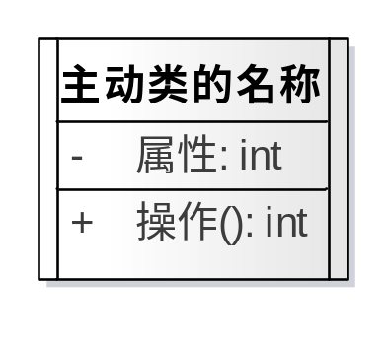
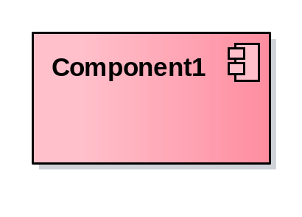
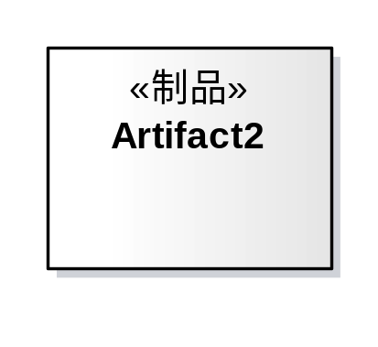

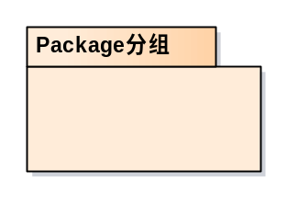
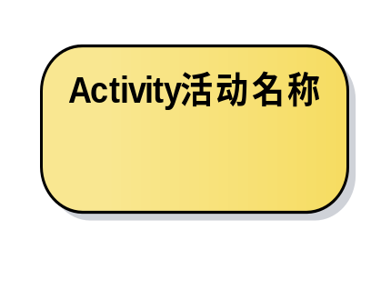
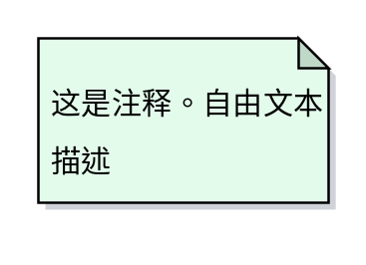
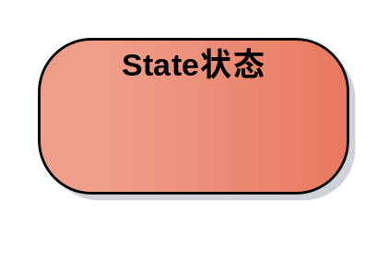
Things（事物） in the UML p33
UML Lecture_UMLintroduction, Author: NK Jiang

Slide 25


Things in the UML p40
关系 Relationships in the UML p40
  依赖关系
  关联关系(association)
  泛化关系
    一般 与 具体
  实现关系
    类与接口
Notes:
Cf., Confer,

Slide 26
Things in the UML -- 规则
UML 规则 Rules of the UML p45
  UML 有自己的语法和语义规则 ，用于：
  命名 ：为事物、关系和图起的名字
  范围 ：使名字具有特定含义的语境
  可见性 ：这些名字如何让其他成分看见和使用
  完整性 ：事物如何正确 、一致地相互联系
  执行 ：运行或模拟动态模型的含义是什么
UML Lecture_UMLintroduction, Author: NK Jiang

Slide 27
自我理解
自己能回答如下问题
  1．什么是建模？为什么要建模？
  2．模型必须是可视化的吗？
  3．缩写词UML的全称是什么？
  4．UML只适用于软件工程领域吗？
  5．UML包括哪些组成部分？
  6. UML事物有哪些？
  7．UML关系有哪些？
  8．UML图有哪些？
UML Lecture_01, Author: NK Jiang

Slide 28
End
UML Lecture_UMLintroduction, Author: NK Jiang

