Slide 1



MaskGuard
TALENTAP MEGA HACKATHON 2026 · PROBLEM B1 · SMART DATA MASKING FOR PII
Every bank employee sees what their job needs. Nothing more.
Finds
Hides
Proves
personal data by itself
it inside every query
nothing leaked
Tested on the organisers' Saffron Bank data · Dashboard + command line · SQLite · PostgreSQL · MySQL · pip install maskguard
Notes:
[0:00–0:30] One sentence, then move on: 'MaskGuard makes sure every bank employee sees what their job needs and nothing more. It finds the personal data by itself, hides it inside every query, and proves nothing leaked. We tested it on your Saffron Bank data — with your users — on all three databases.'

Slide 2




The problem: everyone sees everything
Meet Ravi, customer support
1
Nobody knows where all the personal data is
Column names lie. In the organisers' data a column called col_7 holds PAN numbers, and phone numbers hide inside support notes.
To fix a card complaint he needs the last 4 digits.
Today he can see every customer's full PAN, Aadhaar, phone and balance.
2
Hiding it on screen is not enough
If Ravi types a guessed PAN into a search, most masking tools still check it against the real value — and answer "yes, found".
₹22 crore
₹250 crore
$2.6 billion
average data breach cost in India (IBM, 2025)
maximum DPDP penalty; rules apply from May 2027
data-masking market by 2030 (12% a year)
Notes:
[0:30–2:00 · Parameter 1: problem understanding] Tell Ravi's story in 20 seconds. Then the two problems, both seen in the organisers' own data: col_7 holds PANs; phones hide inside Hinglish notes; and screen-only masking still answers a guessed PAN. Close with why now: ₹22 crore per breach (IBM 2025), DPDP penalties up to ₹250 crore, obligations from May 2027.

Slide 3







How it works: one gate between people and the data
Staff ask a question
MaskGuard
Dashboard
Command line
Bank database
Find
Label
Hide
Prove
which columns are personal
PAN, phone, money…
per role, inside the query
log every query
never copied, never changed, read-only
BI tools · API
Same question — "show me this customer's PAN" — three different answers
Admin
Support
Analyst
OFSPG0000G
OFXXXXXXXG
951adf05…1626
the real value
enough to confirm, not to copy
a code: counts and joins still work
And if Support searches for the real PAN? 0 rows. The search itself only sees the masked value.
Notes:
[2:00–3:00] Keep it to one picture. Everyone — dashboard, command line, BI tools — goes through one gate. The gate finds the personal columns, labels them, hides them per role inside the query, and logs everything. The database is never copied or changed. Then the example, with real values from Saffron Bank: admin sees the PAN, support sees OFXXXXXXXG, analyst sees a code. And the punchline: if support searches for the real PAN, they get 0 rows.

Slide 4

Architecture: simple, and built to last
Dashboard
1 Login
role from a signed token
2 Safety check
reads only
3 Rewrite the query
so the database returns masked values
Bank database (read-only)
SQLite · PostgreSQL · MySQL
Command line
REST API
BI tools (PostgreSQL wire)
PII scanner
rules + AI model
A person
approves
Policy file
who sees what
4 Audit log, tamper-evident
who asked what — never the values
Built to last, not just for the demo
Tech stack
One gate for every tool: masking is written once, so it can't differ between screens
Python
sqlglot
LightGBM
scikit-learn
Real SQL parsing, not text matching: nested and joined queries can't slip through
FastAPI
Typer + Rich
SQLite
PostgreSQL
Masks run inside the database: only 4–8 ms extra per query; no data copies
MySQL
Docker
pytest
GitHub Actions
PyPI
Safe by default: unknown columns stay hidden; unsafe settings refuse to start
Notes:
[3:00–4:30 · Parameter 2: architecture and tech stack, long term vs short-term shortcuts] Read the top row left to right: every tool goes through login, a safety check, and the query rewrite — the database only ever returns masked values to non-admins. Bottom row: the scanner suggests labels, a person approves, the policy file says who sees what, and every query is logged without values. Long-term choices: one gate, real SQL parsing (sqlglot), masks inside the database, safe by default. Shortcuts we refused: regex rewriting, screen-only masking, data copies, default passwords.

Slide 5
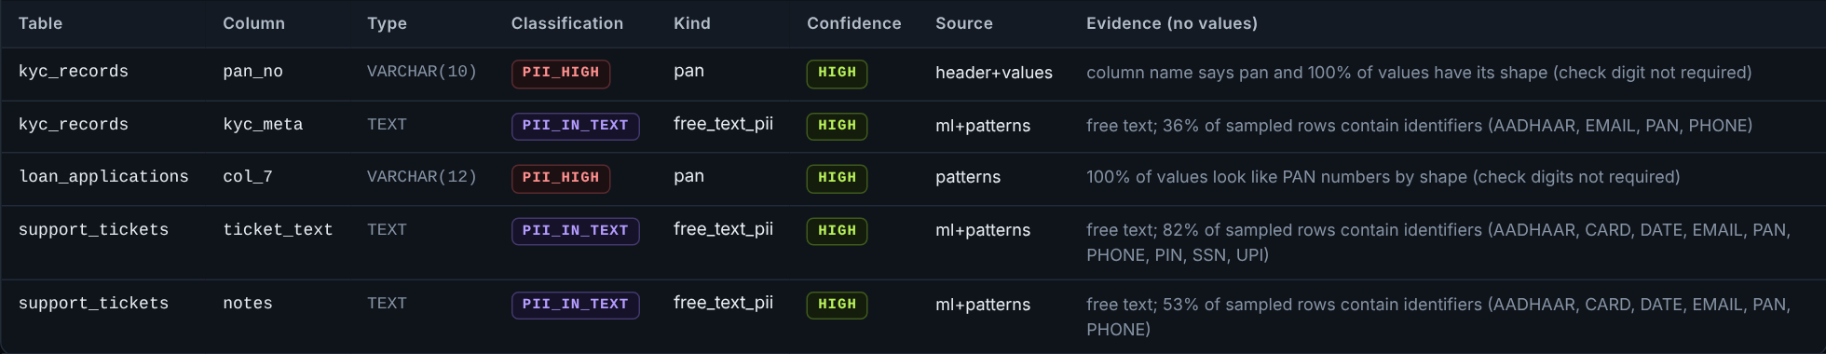



Role of AI: it finds the data — it never decides who sees it
In the dashboard: what the scanner found in the organisers' data, with its reasons (never the values)
Why AI here
0.999
accuracy (F1) with misleading column names, vs 0.844 for rules alone
1 Rules check
2 AI model reads the values
3 A person approves
Checksums prove Aadhaar, cards and IBANs for certain
Where names lie (col_7) or checks fail, LightGBM recognises the pattern
Anything unsure stays hidden until someone reviews it
Who sees what = fixed rules, explainable and testable. Never AI.
Notes:
[4:30–6:00 · Parameter 3: role of AI — deliberate, not decorative] 'We used AI exactly where rules fail.' Point at col_7 in the screenshot: the column name says nothing, the AI read the values and said PAN. Rules first (checksums are certain), then the AI model, then a person approves. Evidence: 0.999 vs 0.844 on the external bharat-pii-bench benchmark, unseen data, misleading column names. And deliberately NOT AI: the decision of who sees what is a fixed policy — explainable and testable. We also used AI coding assistants to build faster, with every change gated by 1,235 automated tests.

Slide 6
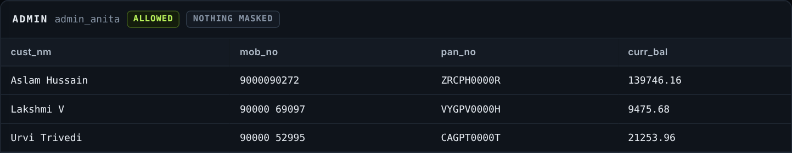

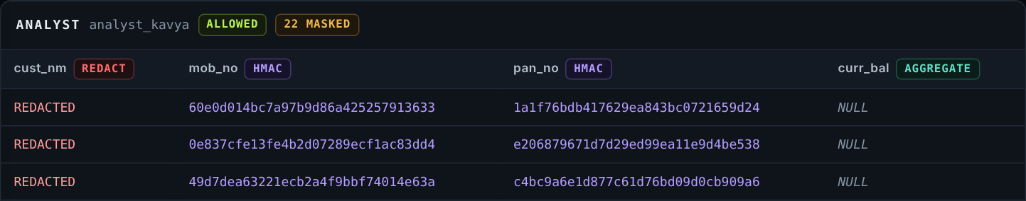
Dashboard: one query, three organiser users
admin_anita
Sees the real data.
Every query is still logged.
support_ravi
Sees only the last digits.
Balances rounded down to ₹10,000.
analyst_kavya
Sees codes, not people.
Same customer → same code, so analysis still works.
Real screenshots of the MaskGuard Control Room on the organisers' Saffron Bank data, logged in as users from their users.csv.
Notes:
[6:00–8:00 · Parameter 5: demo, part 1 — the dashboard] Live: open the Control Room, sign in as support_ravi, run the customer query in the Masking playground; show 'Why each field looks the way it does'. Sign out, sign in as analyst_kavya, run again. If the live demo stalls, this slide is the fallback — it is a real capture. Say the one-liners on the right, nothing more.

Slide 7
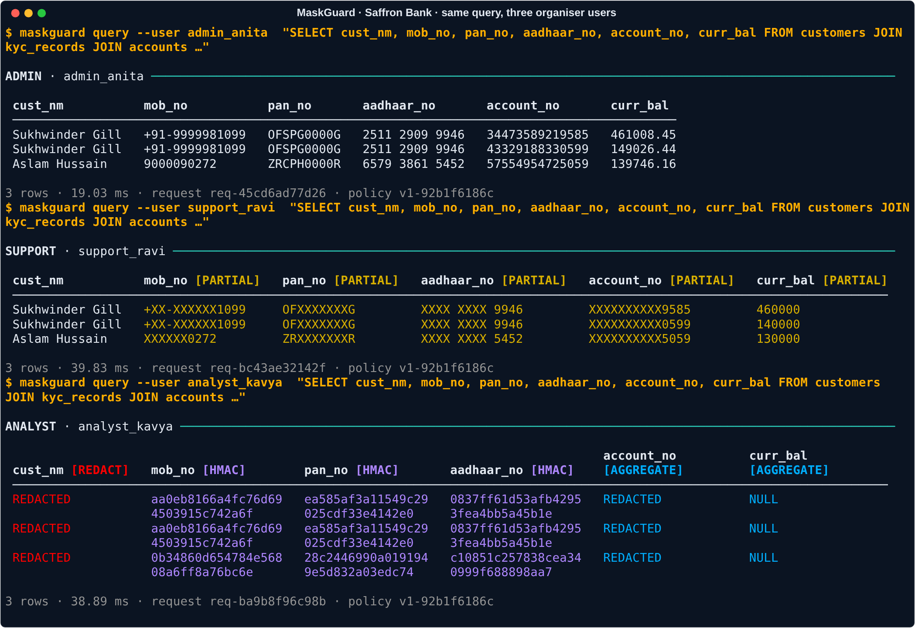
Command line: the same engine, for IT teams and automation
Five commands, start to finish
maskguard connect
connect a database; it scans it
maskguard pii approve
a person confirms the labels
maskguard compare
same query, roles side by side
maskguard attack
17 known attacks: 0 leak
maskguard integrity proof
data unchanged, audit intact
Also: writes are refused for every role (exit code 3) · JSON output for scripts and CI · pip install maskguard
Notes:
[8:00–9:30 · Parameter 5: demo, part 2 — the command line] Live: maskguard compare with the same customer query for the three users; then, as support_ravi, search for a real PAN → 0 rows; then try an UPDATE → refused; then maskguard integrity proof. The point: the dashboard and the command line are two doors to the same engine, so the answer never differs.

Slide 8
Proof on the organisers' own data — on all 3 databases
35 / 35
0
0 rows
sensitive columns found
real values leaked
for a guessed real PAN
first try 22; we fixed the general causes, not the dataset
in 13,700 masked cells, per database
Admin finds 1 row; Support and Analyst find 0
4 / 4
0 / 17
4–8 ms
data changes refused
known attacks leak
extra time per query
UPDATE, DELETE, DROP, INSERT — for every role
simple screen masking leaks 14 of the same 17
from 300 to 100,000 rows (MySQL 6–22 ms)
Same results on SQLite, PostgreSQL 16 and MySQL 8.4 · 9 organiser users · 129,260 rows checked identical across all copies · 1,235 automated tests on every change
Notes:
[9:30–11:00 · Parameter 4: completeness — functional, not a prototype] Read the two dark tiles first: 35 of 35 found, 0 leaked. Then the four light ones in one breath. Be open about the first try: 22 of 35 — nothing leaked, unfound columns stay hidden by default — and we fixed general causes (banking abbreviations, IDs that fail their checksums), then checked the external benchmark did not get worse. Full write-up: docs/SAFFRON_VALIDATION.md.

Slide 9



Why MaskGuard: what other approaches miss
MaskGuard
Encryption
(incl. quantum-safe)
Masked copy
of the database
Screen-only
masking
Finds personal data by itself
A different view for each role
Stops guessing a value through a search
Data stays in place, never copied
Encryption — even quantum-safe — keeps outsiders out. But once the bank's own app decrypts the data, every insider sees all of it. MaskGuard decides what each insider sees, so use both.
The market
Who buys first
$1.47 B → $2.6 B
May 2027
Open source
NBFCs, co-op and small finance banks, fintechs, hospitals: DPDP applies, no budget for big platforms.
data-masking market, 2025 → 2030
DPDP rules apply to every bank
vs platforms at ≈ $100k–370k a year*
* review-site estimates for Immuta / Delphix; vendors don't publish prices. Market: Knowledge Sourcing Intelligence. Other databases' built-in masking (SQL Server DDM) masks results only; Microsoft documents it doesn't stop inference.
Notes:
[11:00–12:00] Many teams in this problem use encryption or quantum-safe ideas. Be respectful: that work protects data from outsiders and it matters. But it answers a different question. Once the bank's own app decrypts the data, every employee sees everything. MaskGuard answers 'what should this employee see' — and it works alongside any encryption. Walk the grid by rows: only MaskGuard finds the data by itself, gives each role its own view, stops guess-the-value searches, and never copies the data. Then the market in one breath: $1.47B → $2.6B by 2030, DPDP from May 2027, and our first buyers are the banks that can't pay six figures.

Slide 10

Ready today. Honest about what's next.
Ready now
Limits we state
Next 90 days
Dashboard + command line + API
Tested on your data, 3 databases
Refuses to start if settings are unsafe
pip install maskguard
Names inside free text need a language model (next)
Business-rule inference between columns is out of scope for masking
BI proxy: local network only in production
Names in free text, benchmarked first
Pilot with one NBFC or co-op bank
One-click DPDP report: what is hidden, from whom, why
Finds it. Hides it. Proves it.
pip install maskguard github.com/hotaro6754/mask 12-minute video: docs/demo_full.mp4
Notes:
[12:00–12:30] Close: what works today, the limits we state ourselves, the next 90 days. Last line, slowly: 'Finds it. Hides it. Proves it.' Then: 'Happy to take questions.'

