Slide 1
ROUND 1 REVIEW
AI Frontier Challenge 2026 Round 1 Submission
MaskGuard · query-time PII masking gateway for SQLite & PostgreSQL
Team Name
Team Leader
[Enter Team Name]
[Enter Leader Name]
Track
Date
PS 1: Smart Data Masking (PII)
12 Oct 2026

Slide 2
Use Case
Problem Statement
Banks and fintechs give support, analytics and ops staff SQL access to tables full of card numbers, SSN/Aadhaar, PAN and balances, with no column-level control over what each role sees.
Masked copies go stale and multiply the data. Native dynamic masking is a display filter: WHERE, ORDER BY and aggregates still run on real values, so values can be inferred.
Who is affected: customers whose PII is exposed; the institution (breach costs, DPDP and GDPR penalties); and internal teams who still need the data to work.
Need: find PII automatically and mask it per role at query time, on any database, without changing stored data.
Market Opportunity
₹25.5 cr
average cost of a data breach in India in 2026; financial services is highest at ₹40.9 cr (IBM)
₹250 cr
max DPDP penalty for weak security safeguards; Rule 6 names masking and 1-year access logs (from 13 May 2027)
$1.1–1.5 B
global data-masking market in 2025, growing about 12–18% a year (analyst estimates)
Target users: banks, NBFCs, insurers and fintechs; their DBAs, compliance and data teams. Competitive landscape: see USP slide.
Sources: IBM Cost of a Data Breach Report 2026 (India); DPDP Rules 2025 (Rule 6) and PIB overview; The Business Research Company, Research and Markets.

Slide 3
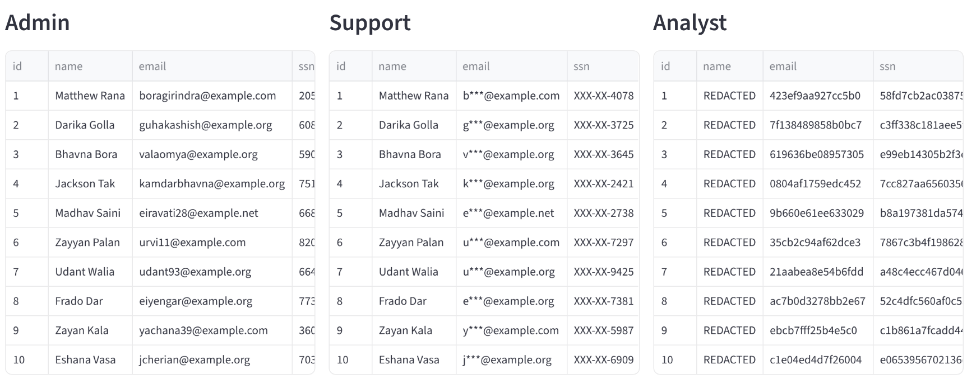
Proposed Solution
Solution Overview
What: MaskGuard, a gateway between users and the database that finds PII and masks it per role at query time. Stored data never changes.
How: every table in a query is swapped for a masked derived table, so aliases, *, CTEs, joins, WHERE, ORDER BY and aggregates only ever see masked values.
Roles: Admin sees everything · Support gets partial masks (4111-XXXX-XXXX-1111) · Analyst gets REDACTED or keyed-HMAC tokens.
Features: auto-scanner with background rescans, YAML policy, SQLite + PostgreSQL, read-only execution, statement firewall, small-group suppression, hash-chained audit log; dashboard, REST API and CLI.
Why unique: a built-in attack suite proves it: 0/17 PII leaks vs 13–15/17 for naive output masking.
Live dashboard (PostgreSQL): one query, three roles
How a query is rewritten
SELECT email AS mail FROM users
becomes
SELECT email AS mail FROM (
SELECT id, mg_email(email) AS email,
mg_partial(ssn, 0, 4) AS ssn, ...
FROM main.users) AS users LIMIT 100

Slide 4
Design Steps & Architecture
Technical Implementation
Architecture Diagram
Connect: SQLite or PostgreSQL via one backend interface; mask functions installed (Python UDFs, PL/pgSQL + pgcrypto).
Scan: headers + 200 sampled values per column through Luhn, Verhoeff, PAN, IBAN, email, phone and SSN checks; tags with evidence; background rescans.
Authenticate: PBKDF2 passwords and signed JWTs; the role only ever comes from the session.
Rewrite: sqlglot parses one SELECT, rejects anything else, swaps each table for a masked derived table, caps rows, suppresses groups under 5.
Execute: read-only (SQLite authorizer, Postgres READ ONLY transaction + timeout).
Audit: hash-chained log with literals stripped, so typed-in PII never reaches it.
Dashboard · REST API · CLI
user logs in, sends SQL
Auth
JWT session → role
Audit log
hash-chained, no literals
SQL rewriter (sqlglot)
masked derived tables · firewall · row cap · group floor
Policy YAML
PII scanner
background worker: headers + checksum validators → tags
SQLite | PostgreSQL
read-only; data never modified
Masked rows return the same way. The scanner samples the database; its tags and the policy decide each column's mask per role.

Slide 5
Challenges & Mitigation
1. Query tricks get around column masking
Problem: aliases (email AS contact), SELECT *, CTEs, subqueries, UNION and expressions rename or wrap a sensitive column, so name-based masking misses it.
Mitigation: mask at the source. Every table is replaced by a masked derived table pinned to the real schema, so any query shape only sees masked values. Attack suite: 0 leaks.
2. Inference through filters, ordering and aggregates
Problem: WHERE email = '…', LIKE prefixes, BETWEEN ranges, ORDER BY and AVG over one row reveal values without ever selecting them.
Mitigation: predicates run on masked values, so probes give no signal; aggregates over fewer than 5 rows are suppressed; writes, catalogs and unknown functions are rejected.
3. Finding PII reliably
Problem: headers lie (contact holds phone numbers, payment_ref holds cards) and plain regexes mistake 12-digit order numbers for Aadhaar.
Mitigation: checksum-validate sampled values (Luhn, Verhoeff, PAN, IBAN); low-confidence columns go to review; manual overrides; new tables are blocked until scanned.
Known limits, stated up front: HMAC tokens still allow equality joins and frequency analysis; partial masks reveal their visible digits; a column the scanner misses stays exposed until tagged; apps must not hold direct database credentials, or they can bypass the gateway.

Slide 6
Unique Selling Proposition (USP)
Leak-proof by construction
India-aware auto-scanner
Zero-touch, any database
Masks at the table source, not the output column. Our attack suite finds 0/17 PII leaks for Support and Analyst on both backends, vs 13–15/17 for naive output masking.
Checksum validators for Aadhaar (Verhoeff), PAN, cards (Luhn) and IBAN on sampled rows find PII behind misleading headers. A background worker rescans; new tables stay blocked until tagged.
No views, triggers or copies. SQLite and PostgreSQL behind one interface. Table checksums prove data is unchanged; a hash-chained audit log supports DPDP Rule 6.
0 / 17
PII leaks in our attack suite
4 / 4
unsafe statements rejected
160
automated tests, 2 backends
~7.5 ms
median added per query
Competitive Advantage Summary
vs native dynamic masking: there, filters and sorting still run on real values (inference); here they only see masked values.
vs static masked copies: no stale replicas to sync and secure; masking is applied per query, per role.
vs database-specific extensions: one policy across engines; adding MySQL is one new backend class.
Measured cost: about 7.5 ms median overhead per query (parse, rewrite, mask, audit) on our test machine.

Slide 7
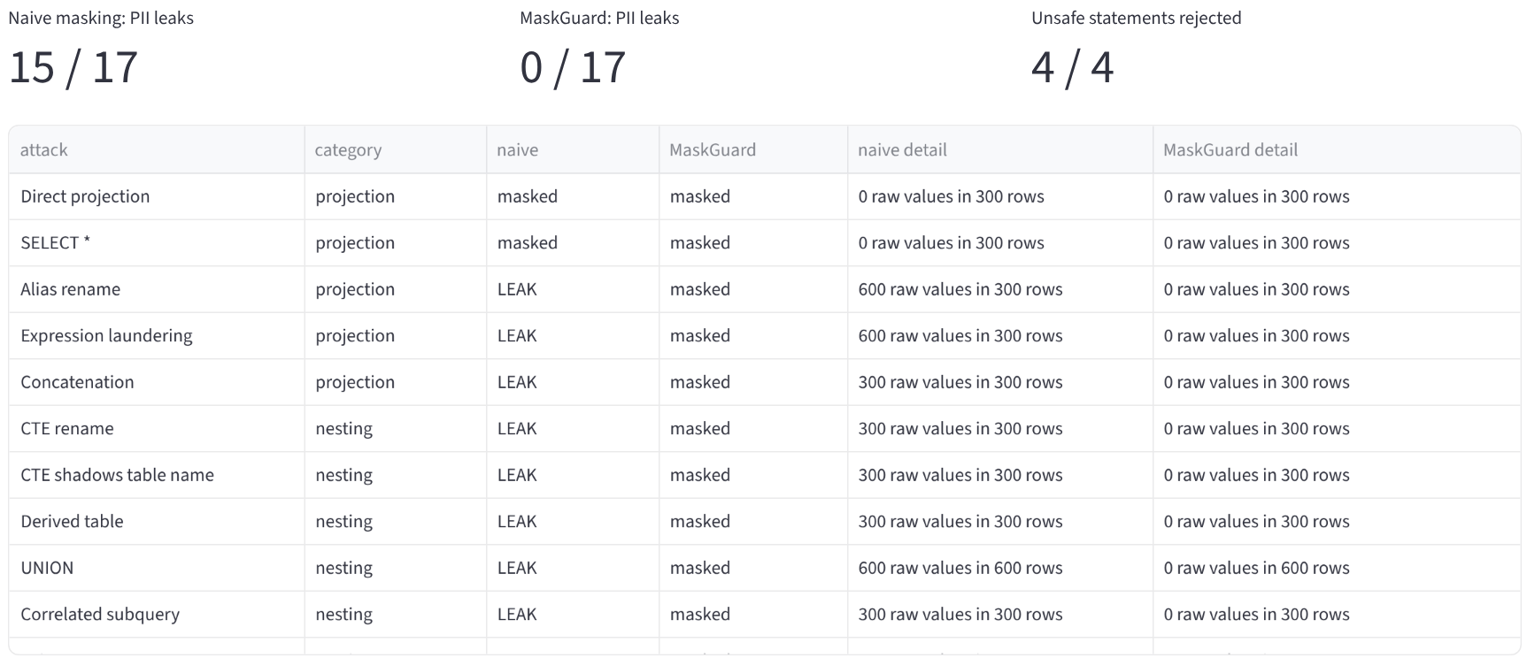
Demo & POC Video
Live Demonstration
What the demo shows
Toggle Admin / Support / Analyst; the same query side by side
PII scanner tags with evidence and confidence
Attack suite: naive masking vs MaskGuard
Table checksums unchanged after every query
Audit log with verified hash chain
p50 / p95 overhead per query
Run it: docker compose up --build
Dashboard :8501 · API :8000/docs
Demo video: docs/demo.mp4 in the repo (paste your upload link here)
Attack suite as Analyst on PostgreSQL: naive masking 15/17 leaks, MaskGuard 0/17

