Slide 1



MaskGuard
TALENTAP MEGA HACKATHON 2026 · PROBLEM B1 · SMART DATA MASKING FOR PII
Every bank employee sees what their job needs. Nothing more.
Finds
Hides
Proves
personal data by itself
it inside every query
nothing leaked
Tested on the organisers' Saffron Bank data · Dashboard + command line · SQLite · PostgreSQL · MySQL · pip install maskguard
Notes:
[0:00–0:30] One sentence, then move on: 'MaskGuard makes sure every bank employee sees what their job needs and nothing more. It finds the personal data by itself, hides it inside every query, and proves nothing leaked. We tested it on your Saffron Bank data — with your users — on all three databases.'

Slide 2




The problem: everyone sees everything
Meet Ravi, customer support
1
Nobody knows where all the personal data is
Column names lie. In the organisers' data a column called col_7 holds PAN numbers, and phone numbers hide inside support notes.
To fix a card complaint he needs the last 4 digits.
Today he can see every customer's full PAN, Aadhaar, phone and balance.
2
Hiding it on screen is not enough
If Ravi types a guessed PAN into a search, most masking tools still check it against the real value — and answer "yes, found".
₹22 crore
₹250 crore
$2.6 billion
average data breach cost in India (IBM, 2025)
maximum DPDP penalty; rules apply from May 2027
data-masking market by 2030 (12% a year)
Notes:
[0:30–2:00 · Parameter 1: problem understanding] Tell Ravi's story in 20 seconds. Then the two problems, both seen in the organisers' own data: col_7 holds PANs; phones hide inside Hinglish notes; and screen-only masking still answers a guessed PAN. Close with why now: ₹22 crore per breach (IBM 2025), DPDP penalties up to ₹250 crore, obligations from May 2027.

Slide 3







How it works: one gate between people and the data
Staff ask a question
MaskGuard
Dashboard
Command line
Bank database
Find
Label
Hide
Prove
which columns are personal
PAN, phone, money…
per role, inside the query
log every query
never copied, never changed, read-only
BI tools · API
Same question — "show me this customer's PAN" — three different answers
Admin
Support
Analyst
OFSPG0000G
OFXXXXXXXG
951adf05…1626
the real value
enough to confirm, not to copy
a code: counts and joins still work
And if Support searches for the real PAN? 0 rows. The search itself only sees the masked value.
Notes:
[2:00–3:00] Keep it to one picture. Everyone — dashboard, command line, BI tools — goes through one gate. The gate finds the personal columns, labels them, hides them per role inside the query, and logs everything. The database is never copied or changed. Then the example, with real values from Saffron Bank: admin sees the PAN, support sees OFXXXXXXXG, analyst sees a code. And the punchline: if support searches for the real PAN, they get 0 rows.

Slide 4

Architecture: simple, and built to last
Dashboard
1 Login
role from a signed token
2 Safety check
reads only
3 Rewrite the query
so the database returns masked values
Bank database (read-only)
SQLite · PostgreSQL · MySQL
Command line
REST API
BI tools (PostgreSQL wire)
PII scanner
rules + AI model
A person
approves
Policy file
who sees what
4 Audit log, tamper-evident
who asked what — never the values
Built to last, not just for the demo
Tech stack
One gate for every tool: masking is written once, so it can't differ between screens
Python
sqlglot
LightGBM
scikit-learn
Real SQL parsing, not text matching: nested and joined queries can't slip through
FastAPI
Typer + Rich
SQLite
PostgreSQL
Masks run inside the database: only 4–8 ms extra per query; no data copies
MySQL
Docker
pytest
GitHub Actions
PyPI
Safe by default: unknown columns stay hidden; unsafe settings refuse to start
Notes:
[3:00–4:30 · Parameter 2: architecture and tech stack, long term vs short-term shortcuts] Read the top row left to right: every tool goes through login, a safety check, and the query rewrite — the database only ever returns masked values to non-admins. Bottom row: the scanner suggests labels, a person approves, the policy file says who sees what, and every query is logged without values. Long-term choices: one gate, real SQL parsing (sqlglot), masks inside the database, safe by default. Shortcuts we refused: regex rewriting, screen-only masking, data copies, default passwords.

Slide 5
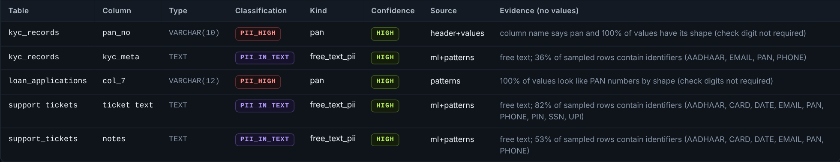



Role of AI: it finds the data — it never decides who sees it
In the dashboard: what the scanner found in the organisers' data, with its reasons (never the values)
Why AI here
0.84 → 0.97
F1 with misleading column names: rules alone vs rules + AI, 5 sample values. Real-data numbers: next slide.
1 Rules check
2 AI model reads the values
3 A person approves
Checksums prove Aadhaar, cards and IBANs for certain
Where names lie (col_7) or checks fail, LightGBM recognises the pattern
Anything unsure stays hidden until someone reviews it
Who sees what = fixed rules, explainable and testable. Never AI.
Notes:
[4:30–6:00 · Parameter 3: role of AI — deliberate, not decorative] 'We used AI exactly where rules fail.' Point at col_7 in the screenshot: the column name says nothing, the AI read the values and said PAN. Rules first (checksums are certain), then the AI model, then a person approves. Evidence: rules alone score 0.84 on the external benchmark's misleading-name test; with the AI model, 0.97 even with only 5 sample values. The honest real-data numbers are on the next slide. And deliberately NOT AI: the decision of who sees what is a fixed policy — explainable and testable. We also used AI coding assistants to build faster, with every change gated by 1,244 automated tests.

Slide 6

How accurate is the AI? Honest numbers, easy test to hard
First contact with the organisers' data
found 22 of 35 sensitive columns (precision 0.73 · recall 0.63)
6
money and credit score with short names · bal, amt, limit
3
account numbers · looked like plain ids
2
PANs with 0000 digits · failed the PAN check
2
addresses · addr_line2, us_addr
+ 8 false alarms: the bank's own branch phone, email, address and IFSC. Masked, not leaked; approved in one step.
The 13 misses leaked nothing
Grey + navy: public benchmark (bharat-pii-bench), synthetic columns with misleading names, data the model never trained on. Clean, so read it as the upper bound.
Saffron: the organisers' Saffron Bank data, 120 real-shaped columns.
Never-trained-on public datasets: 94% of 5,880 PII columns protected; 91% after damaging the data 11 ways real exports are (“NULL” text, quotes, half-masked).
Checked: 0 of 1,300 real values reached Support or Analyst. Unsure columns stay hidden until a person approves them.
One catch: 2 account-number columns were wrongly suggested as public; approving that blindly would have exposed them. Fixed.
Notes:
[~1 min · Parameter 3/4: accuracy and baselines] Pre-empt the 'too good to be true' reaction. 'The 0.999 you may have seen is on a public synthetic benchmark — clean data, so treat it as the ceiling. Here is the harder truth. On your Saffron Bank data, the first time we ran it, it found 22 of 35 sensitive columns — F1 0.68. The misses had four causes: money columns with short names like bal and amt, account numbers that looked like plain ids, PANs with 0000 digits that fail the official check, and two address columns. Nothing leaked — we checked: 0 of 1,300 real values reached Support or Analyst — because anything the AI isn't sure about stays hidden until a person approves it. One honest catch: two account-number columns were wrongly suggested as public; a reviewer who approved every suggestion blindly would have exposed them. That's fixed: a column named like a sensitive kind is never suggested public now. We fixed those general causes — not this dataset — and re-ran the benchmark to make sure nothing got worse. Now it finds 35 of 35, with 7 false alarms on the bank's own branch details: F1 0.91.' If asked 'isn't 0.90 tuned to our data?': 'Partly, yes — the fixes were made after seeing it, which is why we show the first-contact number too, and why the safety net doesn't depend on accuracy.' Numbers: docs/SAFFRON_VALIDATION.md and docs/EVALUATION.md.

Slide 7



No LLM, no quantum: classic ML that is quantum-safe
MaskGuard
LightGBM + rules
LLM-based
detection
Quantum ML
detection
0 calls
Runs inside the bank, offline, on a normal CPU
to outside services: nothing leaves the bank
≈ 3 ms
Same input, same answer, every time
per column on a normal CPU (20 values)
Milliseconds per column, no per-call cost
0.71 MB
model file; no GPU, no internet
— = partly. LLMs: only if self-hosted on the bank's own GPUs. Quantum: only as a simulation on ordinary computers (slow, and not quantum), otherwise on cloud quantum hardware with probabilistic results.
Quantum-safe? Already.
Quantum ML? Not better here, yet.
Quantum computers break RSA and elliptic-curve keys. MaskGuard's masking uses none: codes are HMAC-SHA-256 with 256-bit keys, the audit chain is SHA-256 — symmetric primitives NIST does not schedule for retirement.
Recent benchmarks find quantum classifiers do not beat tuned classical models on table data, and they run on simulators or cloud hardware. We picked what works today, on the bank's own servers.
Sources: NIST IR 8547 (draft) transition plan covers public-key algorithms; Bowles, Ahmed & Schuld 2024, "Better than classical?"; QSVM tabular benchmark, arXiv 2604.18837. Our numbers: docs/EVALUATION.md.
Notes:
[~1 min, right after Role of AI] Say it calmly, never mockingly: 'We looked at LLMs and quantum approaches and chose classic machine learning on purpose. A bank's customer data should never leave the bank to be classified, and the same column must always get the same answer. Our model is a 0.71 MB file, runs on a normal CPU in about 3 milliseconds a column, and makes no calls outside the bank. On quantum: we're already quantum-safe where it matters — our masking uses only symmetric cryptography, HMAC-SHA-256 and SHA-256, which quantum computers don't break the way they break RSA. And quantum machine learning hasn't beaten classical models on table data in recent benchmarks. We built what works in a bank today.' If asked about HTTPS: the TLS layer is the server's library; it can use post-quantum key exchange as a deployment setting.

Slide 8


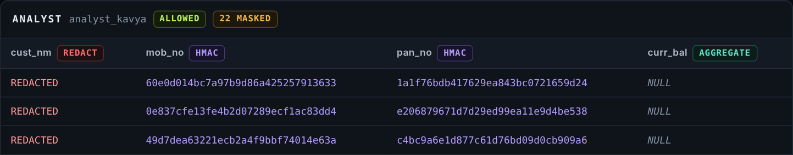
Dashboard: one query, three organiser users
admin_anita
Sees the real data.
Every query is still logged.
support_ravi
Sees only the last digits.
Balances rounded down to ₹10,000.
analyst_kavya
Sees codes, not people.
Same customer → same code, so analysis still works.
Real screenshots of the MaskGuard Control Room on the organisers' Saffron Bank data, logged in as users from their users.csv.
Notes:
[6:00–8:00 · Parameter 5: demo, part 1 — the dashboard] Live: open the Control Room, sign in as support_ravi, run the customer query in the Masking playground; show 'Why each field looks the way it does'. Sign out, sign in as analyst_kavya, run again. If the live demo stalls, this slide is the fallback — it is a real capture. Say the one-liners on the right, nothing more.

Slide 9
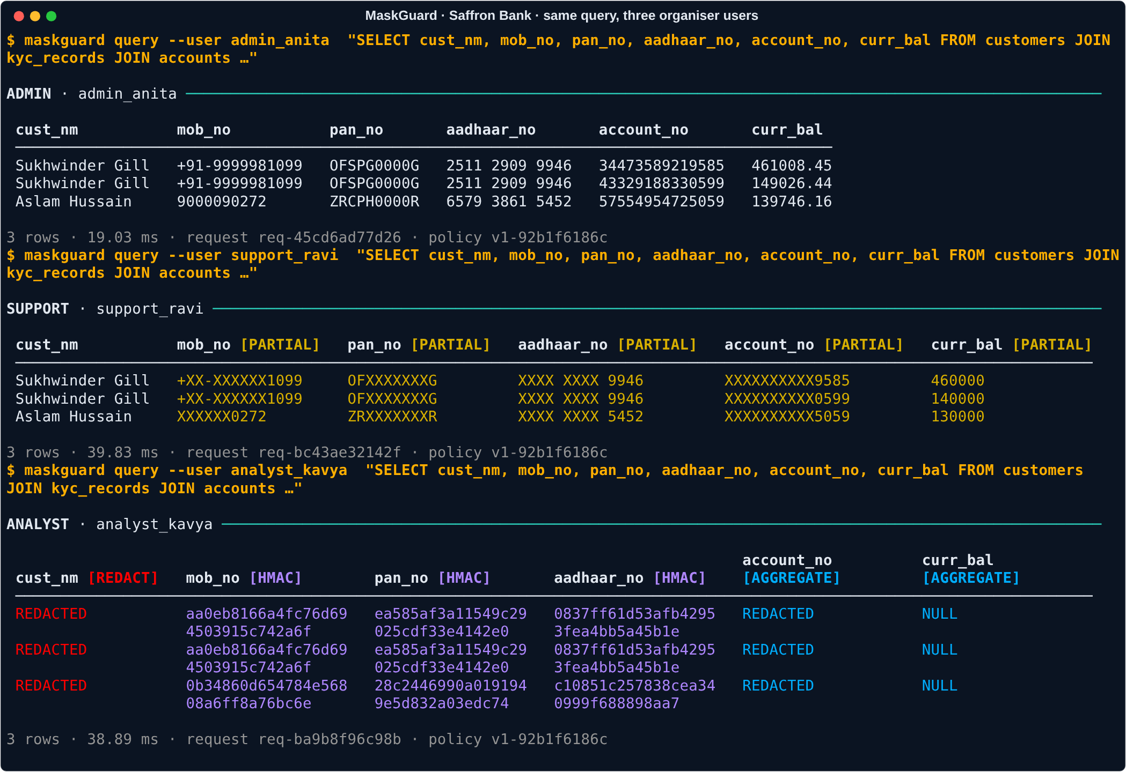
Command line: the same engine, for IT teams and automation
Five commands, start to finish
maskguard connect
connect a database; it scans it
maskguard pii approve
a person confirms the labels
maskguard compare
same query, roles side by side
maskguard attack
17 known attacks: 0 leak
maskguard integrity proof
data unchanged, audit intact
Also: writes are refused for every role (exit code 3) · JSON output for scripts and CI · pip install maskguard
Notes:
[8:00–9:30 · Parameter 5: demo, part 2 — the command line] Live: maskguard compare with the same customer query for the three users; then, as support_ravi, search for a real PAN → 0 rows; then try an UPDATE → refused; then maskguard integrity proof. The point: the dashboard and the command line are two doors to the same engine, so the answer never differs.

Slide 10
Proof on the organisers' own data — on all 3 databases
35 / 35
0
0 rows
sensitive columns found
real values leaked
for a guessed real PAN
first try 22; we fixed the general causes, not the dataset
in 13,700 masked cells, per database
Admin finds 1 row; Support and Analyst find 0
4 / 4
0 / 17
4–8 ms
data changes refused
known attacks leak
extra time per query
UPDATE, DELETE, DROP, INSERT — for every role
simple screen masking leaks 14 of the same 17
from 300 to 100,000 rows (MySQL 6–22 ms)
Same results on SQLite, PostgreSQL 16 and MySQL 8.4 · 9 organiser users · 129,260 rows checked identical across all copies · 1,244 automated tests on every change
Notes:
[9:30–11:00 · Parameter 4: completeness — functional, not a prototype] Read the two dark tiles first: 35 of 35 found, 0 leaked. Then the four light ones in one breath. Be open about the first try: 22 of 35 — nothing leaked, unfound columns stay hidden by default — and we fixed general causes (banking abbreviations, IDs that fail their checksums), then checked the external benchmark did not get worse. Full write-up: docs/SAFFRON_VALIDATION.md.

Slide 11
Why MaskGuard: what other approaches miss
MaskGuard
Encryption
(incl. quantum-safe)
Masked copy
of the database
Screen-only
masking
Finds personal data by itself
A different view for each role
Stops guessing a value through a search
Data stays in place, never copied
Encryption — even quantum-safe — keeps outsiders out. But once the bank's own app decrypts the data, every insider sees all of it. MaskGuard decides what each insider sees, so use both.
The market
Who buys first
$1.47 B → $2.6 B
May 2027
Open source
NBFCs, co-op and small finance banks, fintechs, hospitals: DPDP applies, no budget for big platforms.
data-masking market, 2025 → 2030
DPDP rules apply to every bank
vs platforms at ≈ $100k–370k a year*
* review-site estimates for Immuta / Delphix; vendors don't publish prices. Market: Knowledge Sourcing Intelligence. Other databases' built-in masking (SQL Server DDM) masks results only; Microsoft documents it doesn't stop inference.
Notes:
[11:00–12:00] Many teams in this problem use encryption or quantum-safe ideas. Be respectful: that work protects data from outsiders and it matters. But it answers a different question. Once the bank's own app decrypts the data, every employee sees everything. MaskGuard answers 'what should this employee see' — and it works alongside any encryption. Walk the grid by rows: only MaskGuard finds the data by itself, gives each role its own view, stops guess-the-value searches, and never copies the data. Then the market in one breath: $1.47B → $2.6B by 2030, DPDP from May 2027, and our first buyers are the banks that can't pay six figures.

Slide 12

Ready today. Honest about what's next.
Ready now
Limits we state
Next 90 days
Dashboard + command line + API
Tested on your data, 3 databases
Refuses to start if settings are unsafe
pip install maskguard
Names inside free text need a language model (next)
Business-rule inference between columns is out of scope for masking
BI proxy: local network only in production
Names in free text, benchmarked first
Pilot with one NBFC or co-op bank
One-click DPDP report: what is hidden, from whom, why
Finds it. Hides it. Proves it.
pip install maskguard github.com/hotaro6754/mask 12-minute video: docs/demo_full.mp4
Notes:
[12:00–12:30] Close: what works today, the limits we state ourselves, the next 90 days. Last line, slowly: 'Finds it. Hides it. Proves it.' Then: 'Happy to take questions.'

