Slide 1
ROUND 1 REVIEW
AI Frontier Challenge 2026 Round 1 Submission
MaskGuard · AI-powered PII discovery and query-time masking for any database
Team Name
Team Leader
Pirates of the Caribbean
G. Harshith
Track
Date
PS 11: Smart Data Masking
13 Oct 2026
Team members: G. Harshith (Lead) · G. Praneeth · D. Mandeep · K. Surya Srinivas

Slide 2
Use Case
Problem Statement
Banks, NBFCs and fintechs give support, analytics and ops staff SQL access to tables of card numbers, Aadhaar, PAN and balances across several databases, with no per-role control over what each person sees: a GDPR, HIPAA and DPDP compliance risk.
Sensitive columns are hard to find: headers lie (contact, ref_no) and regexes confuse order numbers with Aadhaar, so PII slips through unprotected.
Masking leaks: native masking is a display filter, so WHERE, ORDER BY and aggregates still run on real values. An IEEE Access 2025 survey names masking's weakness as “limited protection against sophisticated attacks”.
Who is affected: customers (identity theft), institutions (breach costs, DPDP penalties) and teams who need the data.
Market Opportunity
₹25.5 cr
average cost of a data breach in India in 2026; financial services is highest at ₹40.9 cr (IBM)
₹250 cr
max DPDP penalty for weak security safeguards; Rule 6 names masking and 1-year access logs (in force from May 2027)
$1.1–1.5 B
global data-masking market in 2025, growing about 12–17% a year (analyst estimates)
Target users: banks, NBFCs, insurers, fintechs and government data teams handling citizen records under DPDP.
Sources: IBM Cost of a Data Breach 2026 (India); DPDP Rules 2025 (Rule 6), PIB; The Business Research Company; Research and Markets; Prabowo et al., IEEE Access 13 (2025).

Slide 3
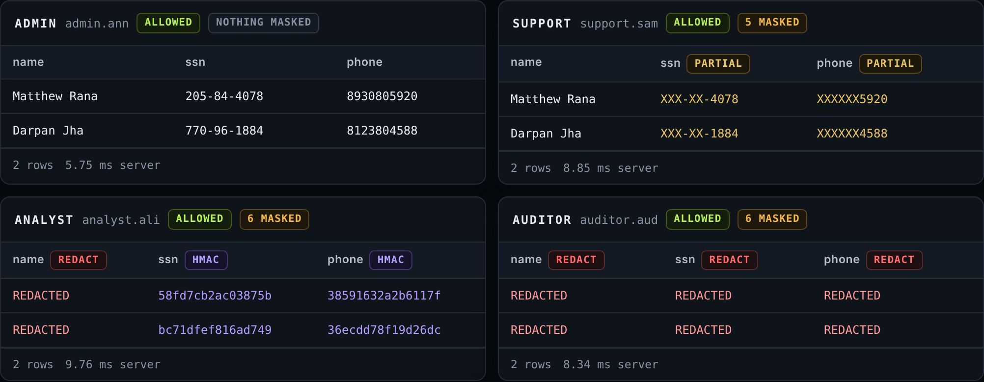
Proposed Solution
Solution Overview
MaskGuard is a privacy gateway in front of any SQL database. It finds PII with AI and masks it per role at query time; stored data never changes.
AI PII discovery: LightGBM + checksum validators find 20 PII types (Aadhaar, PAN, GSTIN, UPI, IFSC…) even behind misleading column names.
Masking at the source: each table is rewritten into a masked view inside the query. Admin sees all · Support 4111-XXXX-XXXX-1111 · Analyst keyed tokens · Auditor redacted; row filters per role.
Insider-threat engine: ML anomaly scoring on the query stream blocks enumeration and probing.
Analytics without raw PII: keyed tokens keep joins working; free-text PII redacted in place.
One engine, every interface: Control Room dashboard, security CLI, REST API + Postman suite, PostgreSQL wire proxy; audit log, integrity proof, automated PIA.
Control Room playground: one query, four roles, four real requests
How a query is rewritten
SELECT email AS mail FROM users
becomes
SELECT email AS mail FROM (
SELECT id, mg_email(email) AS email,
mg_partial(ssn, 0, 4) AS ssn, ...
FROM main.users) AS users LIMIT 100
✓ PII scanner
background worker tags PII_HIGH / FINANCIAL_CONFIDENTIAL
✓ Masking engine
works on SQLite, PostgreSQL and MySQL; the brief asks for two
✓ Demo
CLI · Postman suite · dashboard with live role toggle
✓ Raw data intact
integrity proof: table digests unchanged

Slide 4
Design Steps & Architecture
Technical Implementation
Architecture Diagram
Connect: SQLite, PostgreSQL and MySQL behind one engine, used by the Control Room, CLI, REST API, SDK and PostgreSQL wire proxy.
Discover: a background AI scanner samples each column; LightGBM (85 features) + checksums tag it with evidence. Unsure columns stay masked.
Authenticate: PBKDF2 passwords and signed JWTs; the role only comes from the session; capabilities gate audit, policy and integrity.
Assess risk: the threat engine scores each session (rules + IsolationForest) and blocks probing.
Rewrite & execute: sqlglot swaps every table for a masked view, applies row filters, rejects unsafe SQL, runs read-only.
Audit & prove: hash-chained log with request id and policy version; integrity proof shows source data unchanged; PIA for DPDP Rule 6.
Control Room · CLI · API · BI tools
REST, SDK or PostgreSQL wire proxy
Auth + threat engine
JWT role · ML risk score
Audit + integrity
hash chain · digest proof
Masking engine (sqlglot)
masked views · row filters · firewall · row caps
Versioned policy
AI PII scanner
background worker: LightGBM + checksums → tags
SQLite | PostgreSQL | MySQL
read-only; data never modified
Tech stack
Backend: Python · FastAPI · sqlglot · PostgreSQL wire proxy
AI/ML: LightGBM · scikit-learn IsolationForest · checksums
Data & security: SQLite · PostgreSQL · MySQL · JWT · HMAC-SHA256
Interfaces & QA: Typer/Rich CLI · web dashboard · pytest · Postman · Docker
Masked rows return the same way. The scanner samples the database; its tags and the policy decide each column's mask per role.

Slide 5
Challenges & Mitigation
1. Finding PII when column names lie
Measured results
Problem: headers mislead (contact, ref_no) and regexes mistake order numbers or OTPs for Aadhaar and pincodes.
Solution: ML on value statistics plus checksum validators; checksum hits can never be overridden, and uncertain columns are still masked for review.
PII discovery, misleading column names (F1)
Benchmark baseline
0.844
MaskGuard AI
0.965
2. Inference through filters and aggregates
False alarms on look-alike data
Problem: WHERE / LIKE / BETWEEN probes, ORDER BY and one-row aggregates reveal masked values without selecting them.
Solution: mask at the table source, suppress groups under 5 rows, reject unsafe SQL; the threat engine alerts within ~8 queries and blocks.
Benchmark baseline
22.2%
MaskGuard AI
6.3%
lower is better
PII leaks across 17 attacks
3. Privacy vs. usefulness for analysts
Naive masking
15
Problem: full redaction makes analytics useless; plain hashes of IDs are brute-forceable.
Solution: keyed tokens keep joins working; noisy aggregates are experimental and disabled in production until an independent privacy review.
MaskGuard
0
lower is better
bharat-pii-bench (Apache-2.0): synthetic, held-out seeds, only 5 values per column (with 20 values: 0.999 and 1.5%). Attacks on PostgreSQL.

Slide 6
Unique Selling Proposition (USP)
AI that beats the benchmark
Masked at the source
Built for India and DPDP
Our LightGBM + checksum scanner scores 0.965 F1 on an independent Indian-PII benchmark with misleading column names from just 5 sample values (baseline 0.844), and cuts false alarms from 22.2% to 6.3%.
Masks at the table source: 0 of 17 bypass and inference attacks leak (naive masking: 15). The threat engine catches 95–100% of simulated insider attacks, blocking no normal users.
Aadhaar, PAN, GSTIN, UPI, IFSC, EPIC and Devanagari names; keyed tokens; one-year tamper-evident audit and an automated PIA mapped to DPDP Rule 6.
0.965
F1 with misleading headers
0 / 17
PII leaks in attack suite
95–100%
insider attacks caught
474 + 121
tests + API checks pass, 3 DBs
Competitive Advantage Summary
vs native dynamic masking: filters and sorting there still run on real values; here they never see them.
vs text PII tools (Presidio, pii-masker): they find PII in text but do not enforce per-role access in the database at query time.
vs PostgreSQL Anonymizer: tied to one engine; MaskGuard applies one policy across databases and BI tools.
Proven, not promised: 474 automated tests and 121 Postman assertions pass on SQLite, PostgreSQL and MySQL; ~8 ms added per query.
Feasible today: one-command Docker demo, a production profile that refuses unsafe settings (read-only DB account, TLS), drop-in for PostgreSQL clients; policy is a reviewed YAML file.

Slide 7
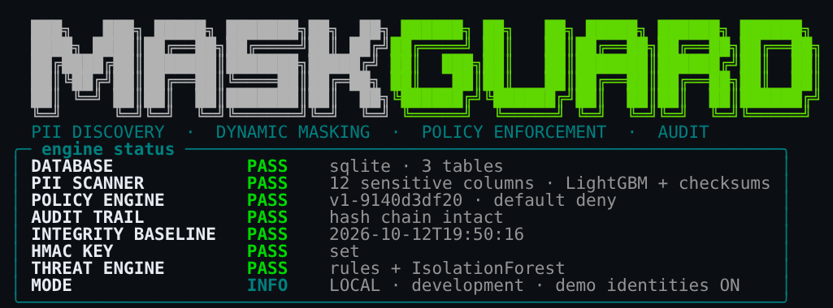
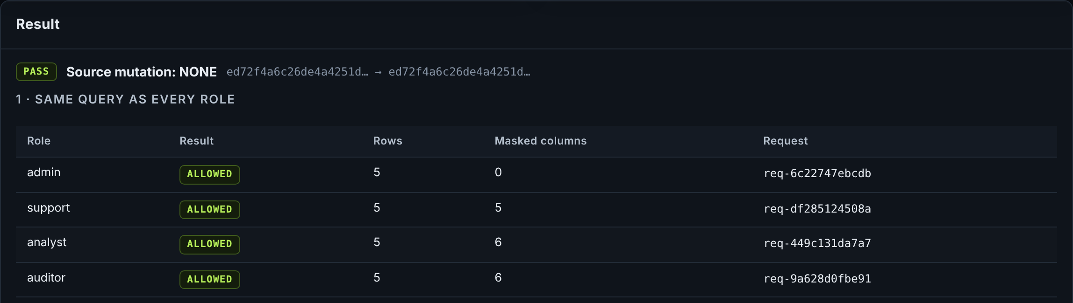
Demo & POC Video
Live Demonstration
What the demo shows
CLI: health checks, PII scan, one query as four roles
Attack suite (SQLite): naive 14/17 leaks, MaskGuard 0/17
Insider attack blocked live; source data proven unchanged
Control Room: playground, discovery, policy, audit, API
Production on PostgreSQL: unsafe setup refused, D11, 403s
Privacy review: DP gaps as tests, protocol frozen for review
Run it: uv run maskguard
Control Room :8000/ui · API :8000/docs · psql :6543
Demo video (8 min, captioned): Watch on GitHub
https://github.com/hotaro6754/mask/blob/claude/zealous-bell-me62fn/docs/demo_full.mp4
Code: github.com/hotaro6754/mask
CLI health checks (top) · integrity proof: digest unchanged after 4 roles (bottom)

