Slide 1
Autoscaling

Slide 2
Overview
Autoscaling in Kubernetes ensures that your application can handle varying loads by automatically adjusting the number of running pods or the resources allocated to them.
This dynamic adjustment is crucial for maintaining application performance, optimizing resource usage, and reducing operational costs.

Slide 3
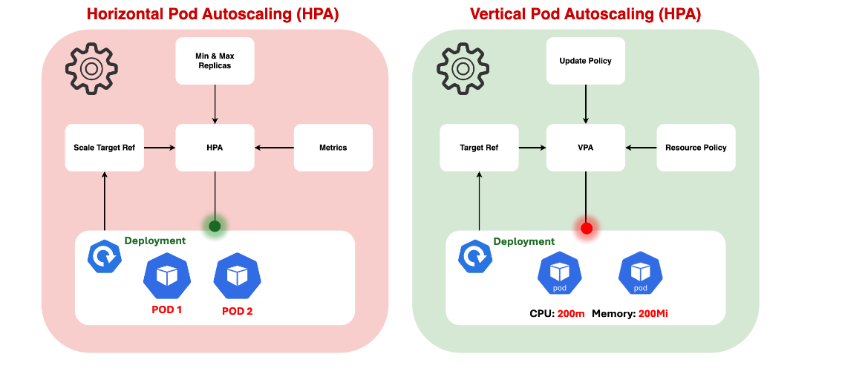
..

Slide 4
Metrics server setup
Before testing Horizontal Pod Autoscaler (HPA) and Vertical Pod Autoscaler (VPA), it’s essential to have the Metrics Server installed in your Kubernetes cluster.
The Metrics Server collects resource usage metrics from the cluster’s nodes and pods, which are necessary for autoscaling decisions.
You can install the Metrics Server using either a YAML manifest or the official Helm chart.

Slide 5
..
Confirm Metrics Collection: Once the Metrics Server is up and running, you can confirm that it’s collecting metrics by querying the API. For example, you can retrieve the CPU and memory usage metrics for nodes and pods:
kubectl top nodes
kubectl top pods --all-namespaces

Slide 6
..
If the Metrics Server is properly installed and functioning, you should see CPU and memory usage metrics for nodes and pods in your cluster.
With the Metrics Server installed and collecting metrics, you can proceed to test the Horizontal Pod Autoscaler (HPA) and Vertical Pod Autoscaler (VPA) functionalities in your Kubernetes cluster.

Slide 7
Horizontal Pod Autoscaling (HPA)
What is HPA?
Horizontal Pod Autoscaling (HPA) automatically scales the number of pods in a replication controller, deployment, or replica set based on observed CPU utilization (or other select metrics).
This allows your application to scale out (add more pods) or scale in (reduce the number of pods) in response to load changes.

Slide 8
..
HPA operates by:
Monitoring Metrics: HPA continuously monitors the specified metrics (e.g., CPU usage, memory usage, custom metrics).
Evaluating Thresholds: It compares the current metric values against predefined thresholds.
Scaling Pods: If the metric values exceed the thresholds, HPA increases the number of pods. Conversely, if the values drop below the thresholds, it decreases the number of pods.

Slide 9
What is Horizontal Pod AutoScaling
In Kubernetes, a HorizontalPodAutoscaler automatically updates a workload resource (such as a Deployment or StatefulSet), with the aim of automatically scaling the workload to match demand
Horizontal scaling means that the response to increased load is to deploy more Pods.
If the load decreases, and the number of Pods is above the configured minimum, the HorizontalPodAutoscaler instructs the workload resource (the Deployment, StatefulSet, or other similar resource) to scale back down.
Horizontal pod autoscaling does not apply to objects that can't be scaled (for example: a DaemonSet.)

Slide 10
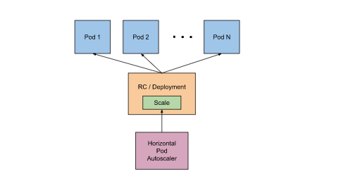
How does a HorizontalPodAutoscaler work?
HorizontalPodAutoscaler controls the scale of a Deployment and its ReplicaSet

Slide 11
..
Kubernetes implements horizontal pod autoscaling as a control loop that runs intermittently (it is not a continuous process). The interval is set by the --horizontal-pod-autoscaler-sync-period parameter to the kube-controller-manager (and the default interval is 15 seconds).
Once during each period, the controller manager queries the resource utilization against the metrics specified in each HorizontalPodAutoscaler definition. The controller manager finds the target resource defined by the scaleTargetRef, then selects the pods based on the target resource's .spec.selector labels, and obtains the metrics from either the resource metrics API (for per-pod resource metrics), or the custom metrics API (for all other metrics).

Slide 12
Vertical Pod Autoscaling (VPA)
What is VPA?
Vertical Pod Autoscaling (VPA) adjusts the CPU and memory resource requests and limits for your pods. Instead of adding more pods, VPA modifies the resources allocated to existing pods.

Slide 13
..
How Does VPA Work?
VPA operates by:
Monitoring Resource Usage: VPA continuously monitors the CPU and memory usage of the pods.
Recommending Resources: Based on the usage patterns, VPA recommends resource adjustments.
Applying Changes: The VPA can automatically apply the recommended changes to the pod specifications, typically requiring a pod restart.

Slide 14
Setup vpa
Install VPA
Before creating VPA objects first we need to install VPA in our cluster using the below steps:
Clone the VPA Source Code: Use Git to clone the VPA source code repository to your local machine. Run the following command:
git clone https://github.com/kubernetes/autoscaler.git

Slide 15
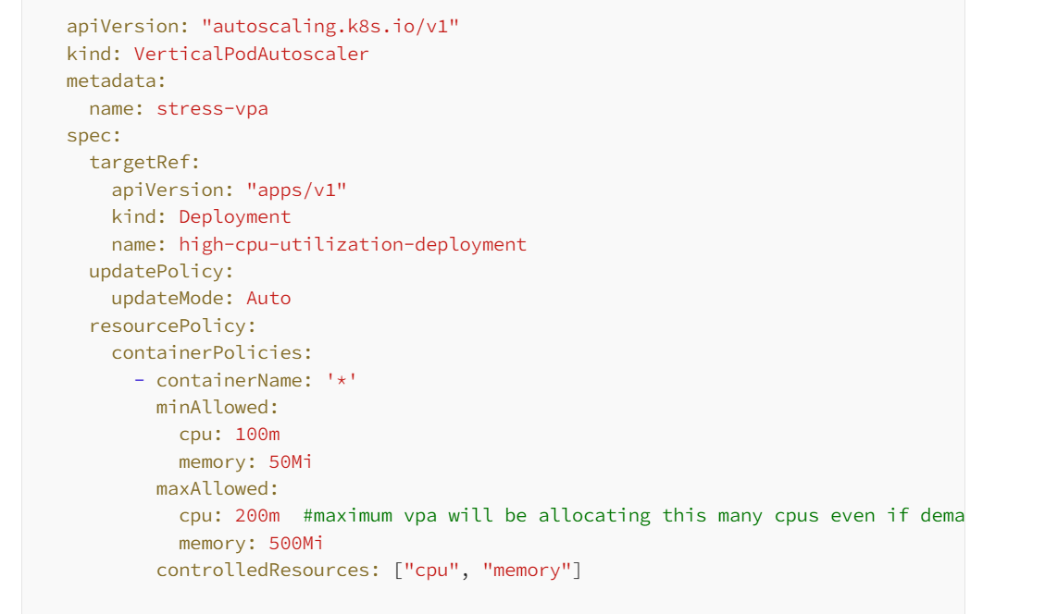
..

Slide 16
HPA vs VPA
Choosing between HPA and VPA depends on your application’s requirements:
HPA is ideal for stateless applications that can easily scale horizontally by adding more pods. It’s useful when you need to handle variable workloads and ensure high availability.
VPA is suitable for applications where scaling horizontally is not feasible or when you need to optimize resource usage for individual pods. It’s beneficial for stateful applications or those with varying resource needs.

