Slide 1
Log monitoring tools
OW

Slide 2
Prometheus
Prometheus on Kubernetes is used for metrics-based monitoring and alerting. It pulls the real-time metrics, compresses and stores them in a time-series database.
The Prometheus sends an HTTP request (pull) called Scrape, found on the configuration in the deployment. It provides a query language and a robust data model that provides detailed and actionable metrics.

Slide 3
Architecture
At its core, Prometheus has a main component called Prometheus Server, responsible for the actual monitoring work. The Prometheus server consists of:
Time Series Database that stores all the metric data like current CPU usage, memory usage etc.
Data Retrieval Worker is responsible for all the data pulling activities from applications, services, servers etc. and pushing them into the database.
HTTP Server API meant to accept queries for the stored data. The Server API is used to display the data in a dashboard or a Web UI.

Slide 4
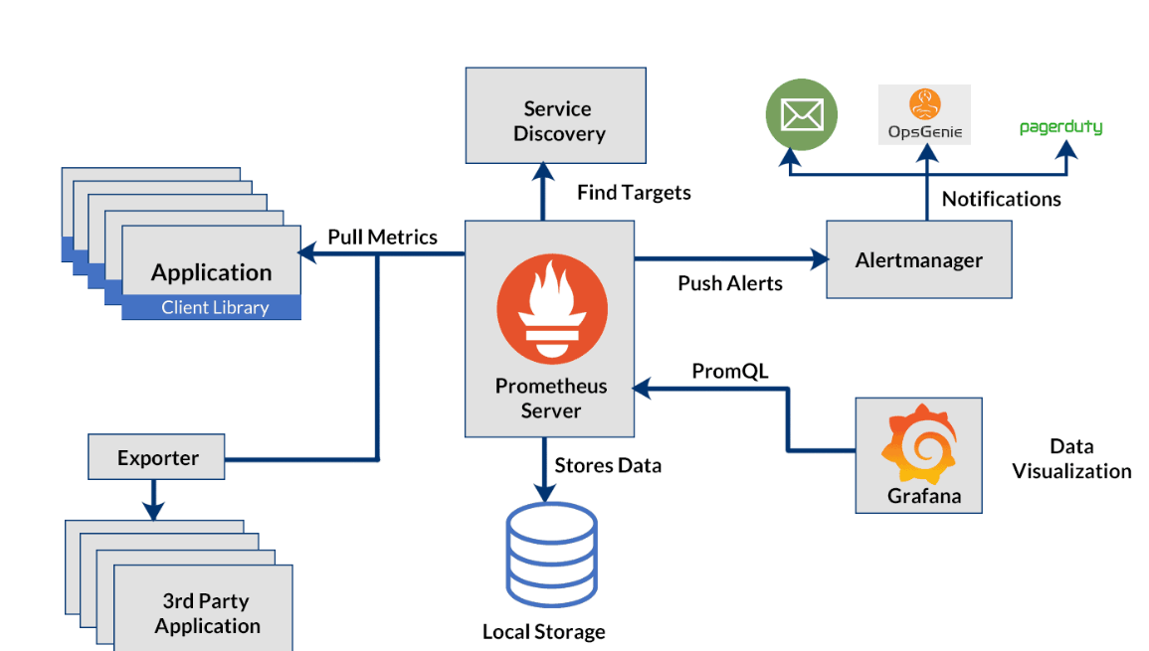
..

Slide 5
..
Containers and Kubernetes: Monitoring is not an exception to how container-based infrastructures are fundamentally altering how we perform logging, debugging, high availability, etc.
Now you have a sizable number of services, virtual network addresses, exposed metrics, and volatile software entities that can arise or disappear at any time. The use of conventional monitoring tools is not intended for this.

Slide 6
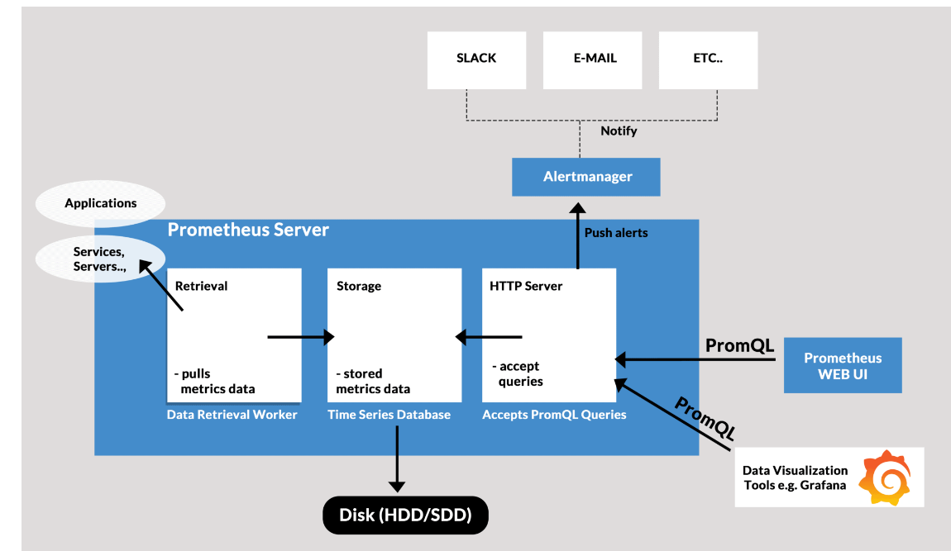
..

Slide 7
Metrics
The units monitored from these targets can be like the current CPU usage, memory usage, the number of counts of a request or an exception. These units are called Metrics.
Counter: Tells us about how many times ‘x’ happened. It can be like the number of times an exception occurred or the number of requests.
Gauge: It represents a metric that can go up and down. So, it gives us the value of ‘x’. An ‘x’ can be the current CPU usage, disk usage etc.
Histogram: This type tracks the duration or the size of requests or any required metric.

Slide 8
..
Exporter. It is a script that does help the Prometheus server retrieve the metrics by doing the following work:
Pulls the metrics from the target.
Converts it into the Prometheus readable format.
Exposes the /metrics endpoints.
So, these exporters help you scrape metrics when required and are readily available. There are many official Prometheus exporters for services like MySQL, Linux server, cloud platforms, etc. You can check it out from here 👈
Alerts Manager
The Prometheus has another component that alerts in a failure in the cluster, resource limitations etc. The Alert Manager is responsible for firing alerts via a different medium like Slack, email, etc.

Slide 9
..
Prometheus Data Storage
Prometheus on Kubernetes collects and aggregates all the data in a disk. So, it involves local storage but can also connect with remote storage. But we can’t directly store the pulled data on a relational database since it is in a custom time-series format.
Prometheus Querying
Once the data gets stored in the database, we can query the data using PromQL. The Prometheus web UI, Grafana are the tools that help us visualise data.
Most of the monitoring mechanisms like Amazon Cloud Watch pushes the data to a centralised collection platform. But, this doesn’t seem ideal for microservices because of the traffic it might cause. Hence, the Prometheus uses the pull system from which retrieves data via multiple Prometheus instances and helps better detect a status of a service. However, Prometheus offers the push mechanism for ‘short-lived jobs’.

Slide 10
What is Grafana?
Grafana is an open-source mighty visualisation and analytics software. It helps us visualise massive amounts of data with the help of an excellent customisable dashboard.
Therefore it helps us study, monitor, and analyse data over a period of time.
It connects with a lot of data source like Prometheus, Graphite, Influx DB, ElasticSearch e

Slide 11
Features
The Dashboard: It is quite an excelling feature with well equipped and continually evolving part. The dashboard helps us make sense of complex data.
Alerts: The alerts can be set up and fired whenever there is an anticipated situation.
Native Support: It has native support of around a dozen databases.
Built-in Support: It offers built-in support for Prometheus, Influx DB, CloudWatch, Graphite, ElasticSearch.

Slide 12
Log aggregation
Problem: If you are a programmer or application administrator, you surely understand how important logs are in the infrastructure. Through them, you can monitor what’s happening under the hood of your application, detect issues, and analyze system performance and behavior in real time.
However, what happens when the volume of logs increases and analysis becomes more complex?

Slide 13
Loki
This is where Loki comes in — an advanced log aggregation system developed by Grafana Labs. Loki aims to simplify effective and user-friendly collection and storage of logs.
Loki is designed to resemble Prometheus, allowing for quick and intuitive data filtering. Compared to Prometheus, the creators of Grafana decided to forego storing metrics in favor of storing logs themselves.

Slide 14
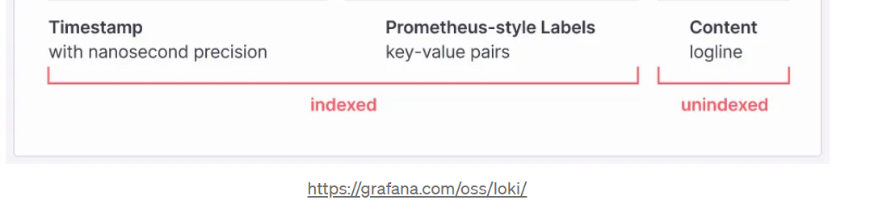
..
A key feature of Loki is that it indexes only labels and metadata for each log message. This means that the full log contents are not stored. On one hand, this improves the tool’s performance and reduces maintenance costs.
On the other hand, this approach might somewhat limit analysis. However, it’s worth keeping in mind that everything comes at a cost.

Slide 15
..
Promtail — This is an agent that operates in a “push” configuration rather than “pull.” This means its task is to acquire logs and send them to Loki, instead of waiting for queries from Loki. Multiple Promtail agents can run on a single machine, collecting and forwarding logs.
Loki — Loki is responsible for storing our logs. It indexes only the labels and metadata of each message, enabling efficient filtering and searching. Loki collects and provides log data.
Grafana (or another visualization system) — This component is used to interact with Loki. Grafana queries Loki to perform filtering and select the desired results from the logs. These data can then be visualized as charts or other graphics.

