Slide 1
Routes
OW

Slide 2
Overview
In OpenShift, routes are used to expose services to the external network, allowing external traffic to reach applications running within the cluster. Routes provide an easy way to access applications, enable load balancing, and support secure communication over HTTPS.
OpenShift routes enable access to pods (one or more containers deployed in a cluster) from external resources. In most cases, applications deployed on OpenShift expose external endpoints to the outside of the cluster through a router

Slide 3
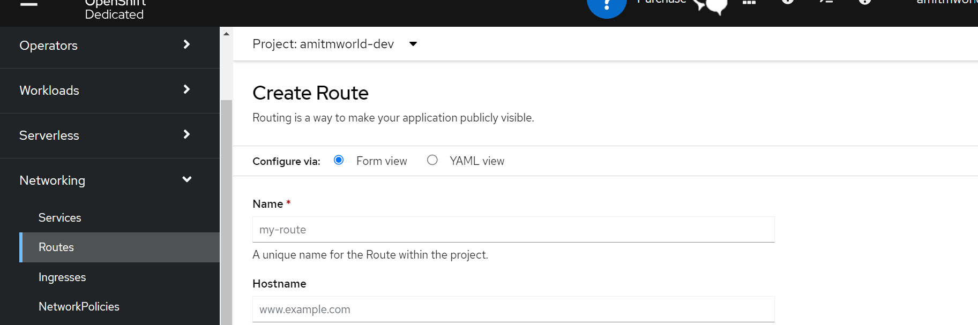
Openshift Routes

Slide 4
yaml
kind: Route
apiVersion: route.openshift.io/v1
metadata:
name: test
namespace: amitmworld-dev
labels: {}
spec:
to:
kind: Service
name: example
tls: null
port:
targetPort: 9376

Slide 5
Types of OpenShift Routes
HTTP routes (unsecured routes): Unsecured Routes in OpenShift use plaintext HTTP communication. You can create OpenShift routes through GUI/web console or CLI (command line interface)
HTTPS routes (secured routes): As the name suggests, Secured Routes are secured with TLS by providing a key and certificate. Secure routes offer various TLS terminations to serve certificates to the client. A TLS termination is the process of decrypting encrypted traffic.

Slide 6
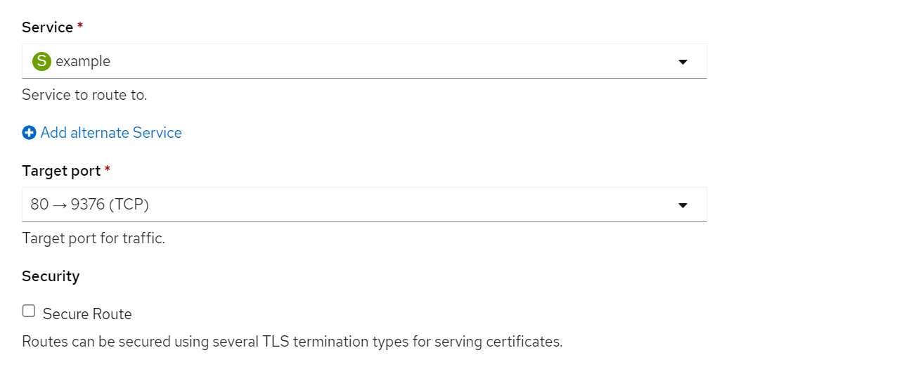
Insecure route

Slide 7
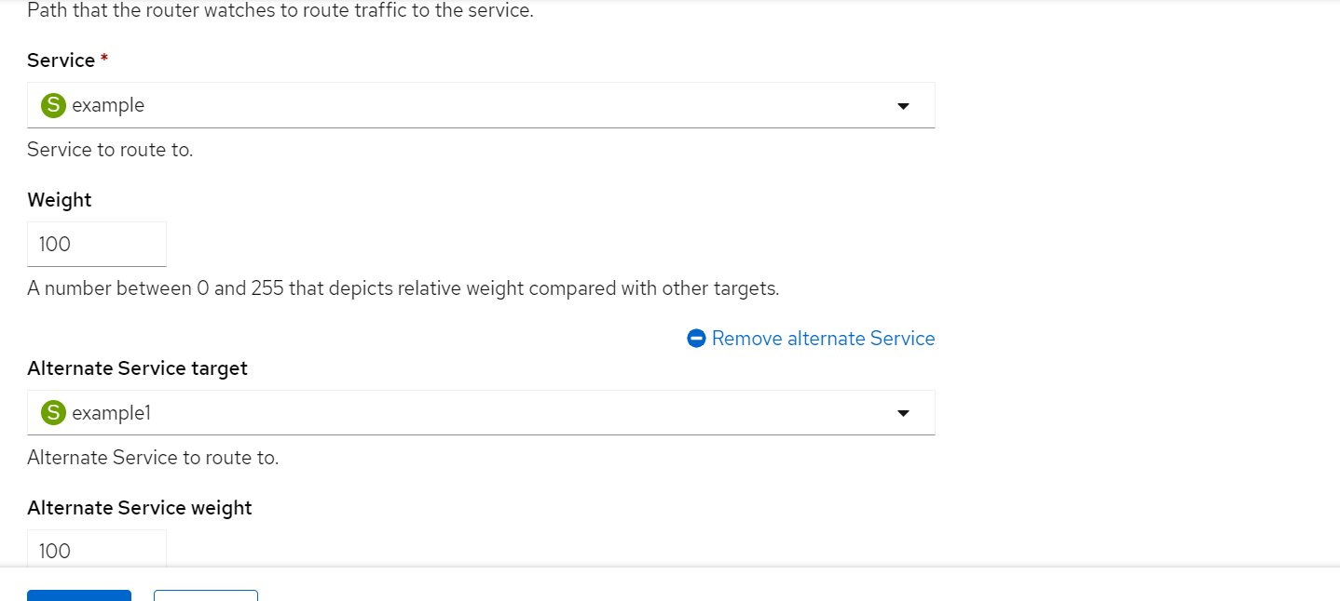
..

Slide 8
Routes components
Host: The hostname at which the application will be accessible. It can be a subdomain of the cluster's domain.
Path: The URL path that specifies the route to a specific service or resource within the application.
Service: The target service that the route forwards incoming traffic to.
Port: The port on which the target service is listening.

Slide 9
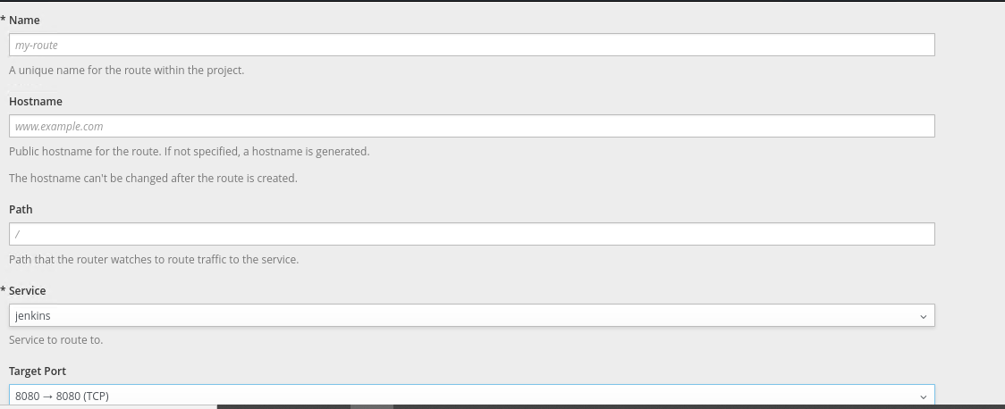
..

Slide 10
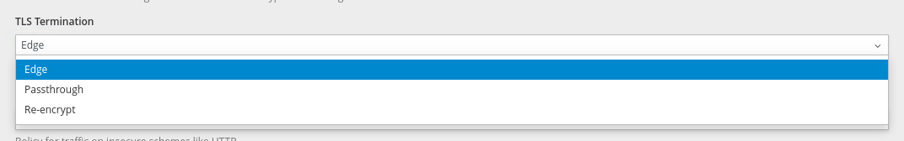
Secure routes

Slide 11
..
Edge Route: Edge termination terminates the encryption at the router. All communication till the router is secured, and any communication from the router to the endpoints is not.
Passthrough Route: In Passthrough Termination, the termination is passed on from the router straight to the pod. The pod is then responsible for providing the certificate and decrypting the traffic. Since termination is not happening on the router, certificates are not part of the route.

Slide 12
..
Re-encryption is Edge Termination with encapsulation. The termination happens at the router the same way it does in Edge Termination. However, instead of forwarding the insecure traffic to the Pod, blocking it, or redirecting it (which can be specified using insecureEdgeTerminationPolicy field), the router re-encrypts the traffic before sending it off to the destination.

Slide 13
Edge termination
Edge termination terminates the encryption at the router. All communication till the router is secured, and any communication from the router to the endpoints is not.
Since the encryption in edge termination is terminated at the router, the TLS certificate must be added to the route. If no certificate is specified, the router's default certificate is used and will likely result in an authentication error

Slide 14
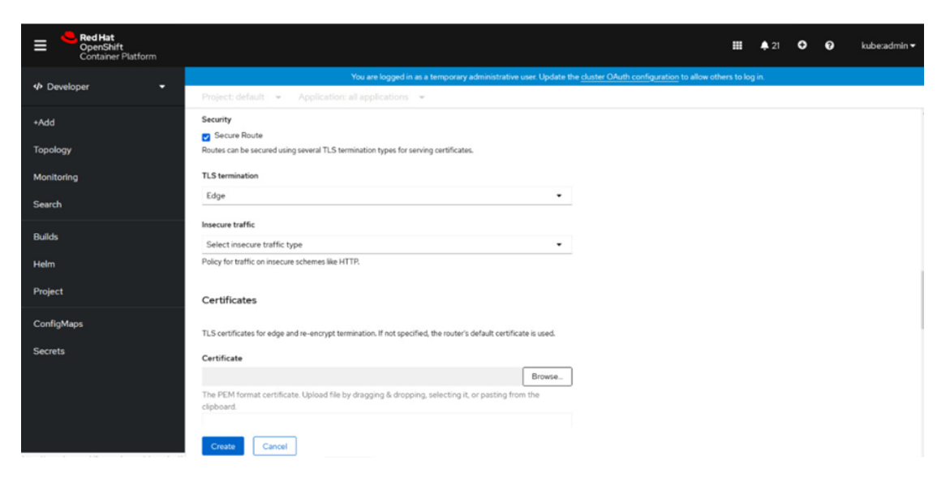
..

Slide 15
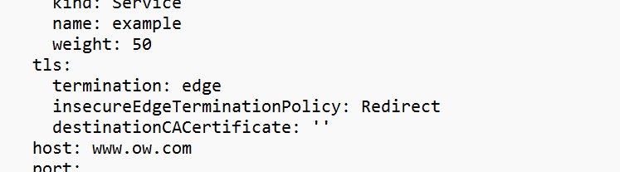
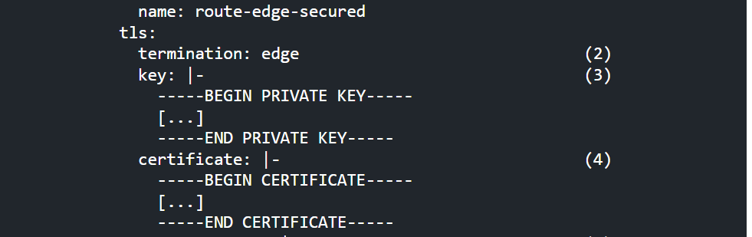
..

Slide 16
..
The termination field is edge for edge termination.
The key field is where the contents of the PEM key are entered.
The certificate field is for the contents of the certificate in PEM format.
caCertificate is optional but it may be required to enter the CA (Certificate Authority) cert for successful authentication.
insecureEdgeTerminationPolicy is the attribute used to configure what happens with this type of traffic. The three values representing the goal discussed above are None or empty, Allow or Redirect.

Slide 17
Passthrough Termination
In Passthrough Termination, the termination is passed on from the router straight to the pod.
The pod is then responsible for providing the certificate and decrypting the traffic. Since termination is not happening on the router, certificates are not part of the route.

Slide 18
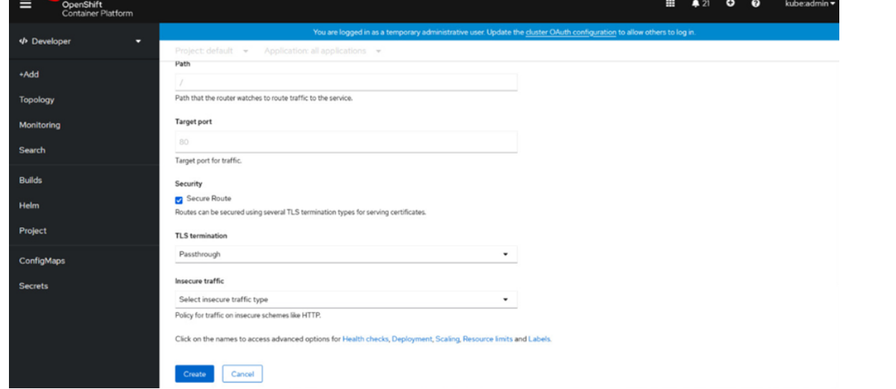
..

Slide 19
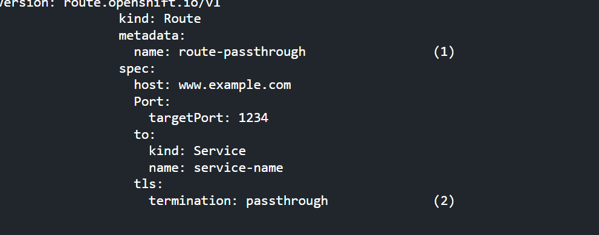
..

Slide 20
Re-encryption Termination
Re-encryption is Edge Termination with encapsulation. The termination happens at the router the same way it does in Edge Termination.
However, instead of forwarding the insecure traffic to the Pod, blocking it, or redirecting it (which can be specified using insecureEdgeTerminationPolicy field), the router re-encrypts the traffic before sending it off to the destination.

Slide 21
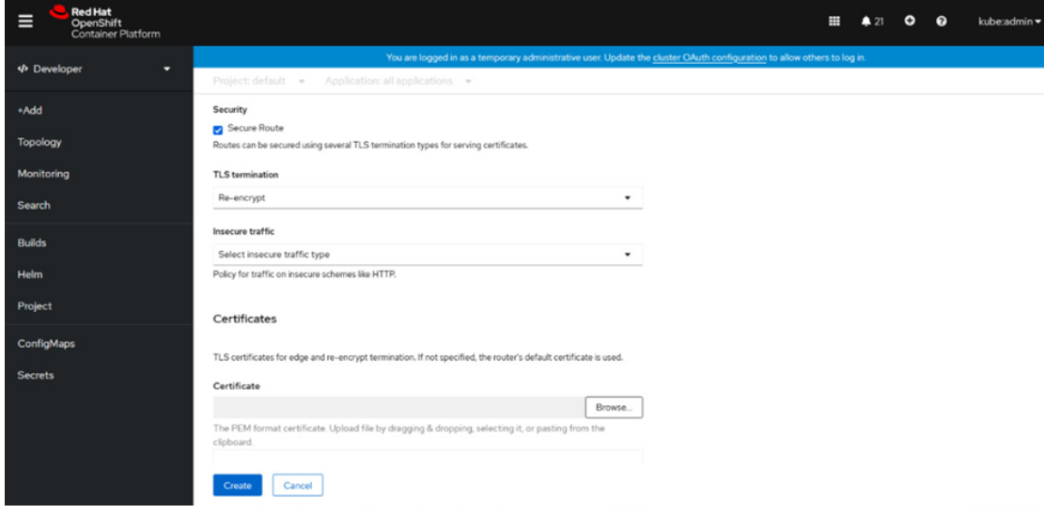
..

Slide 22
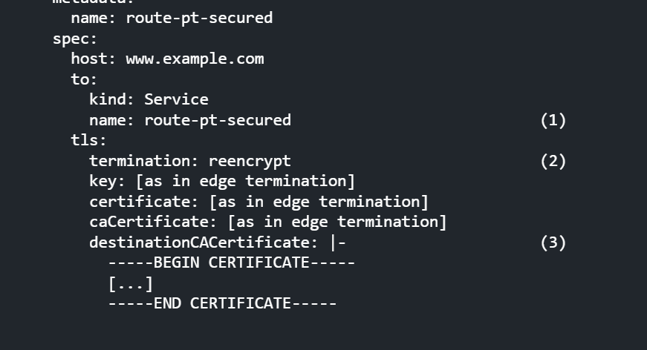
..

Slide 23
..
The name field is used for naming the object and has a limit of 63 characters.
The termination field is set to reencrypt for Re-encryption Termination.
The destinationCACertificate field specifies the certificate for re-encryption, which will encrypt the traffic leaving the router to the Pod after the initial TLS termination on the router. If this field is left empty, the router will automatically use the certificate generated by the Certificate Authority configured to provide a certificate for this service.

