Slide 1
S2I
OW

Slide 2
Overview
S2I stands for "Source-to-Image," and it is a build strategy in OpenShift that simplifies the process of building and packaging applications into container images.
S2I is designed to automate the transformation of application source code, along with any required dependencies, into a runnable container image.
This strategy abstracts away many of the complexities involved in creating Dockerfiles and build scripts.

Slide 3
Oc new-app cli
Cmds accepts an images an argument
This image will be embedded inside a Deployment, which embeds a Kubernetes Replica set and a service
Image→Deployment→ReplicaSet→Service→Application
oc new-app command can be used with –o option to crate a skeleton resource definition
This file can be customized as per the requirement. A powerful form of skeleton is template

Slide 4
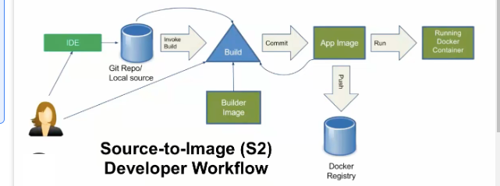
S2I Process

Slide 5
commands
# List all local templates and image streams that can be used to create an app
oc new-app –list
oc new-app centos/ruby-25-centos7~https://github.com/sclorg/ruby-ex.git

Slide 6
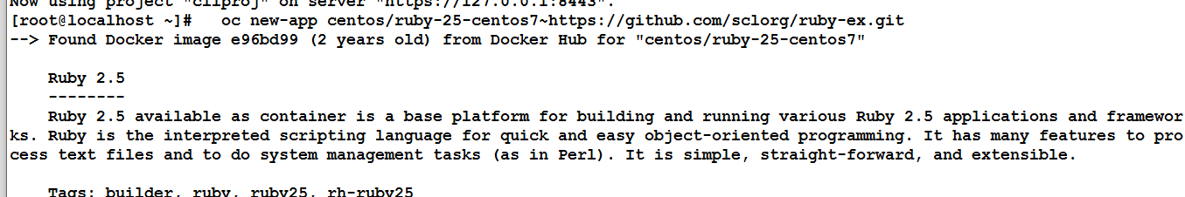
flow

Slide 7
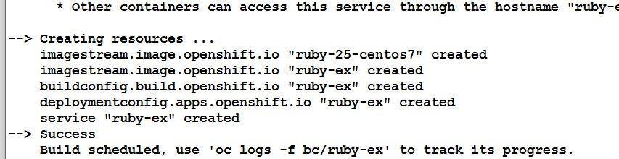
Image stream, Deployment config,serice

Slide 8
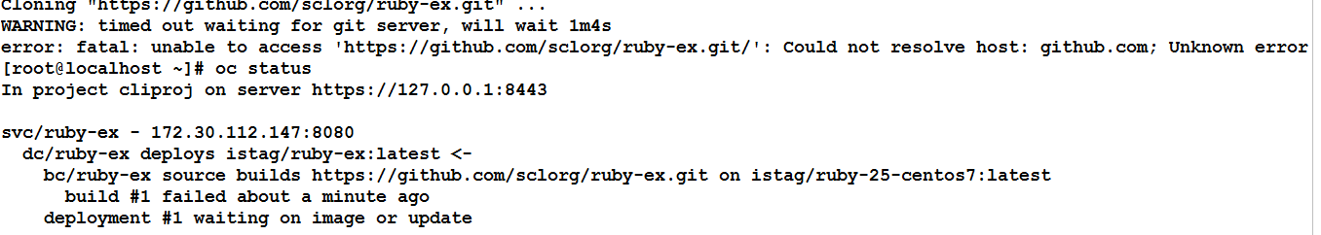
oc logs -f bc/ruby-ex

Slide 9
..check services
oc get svc –n <namespace?
oc get is
oc get dc

Slide 10
Templates
In the context of OpenShift, a template refers to a declarative blueprint that defines a set of resources and parameters for creating applications and services within an OpenShift cluster.
Templates provide a way to define and manage applications and their components in a reusable and consistent manner. They encapsulate the configuration details, such as container images, environment variables, volumes, and other settings required to deploy an application

Slide 11
..
Templates in OpenShift can include various objects like pods, services, routes, deployment configurations, and more.
They are written in YAML or JSON format and can be easily versioned and stored in source control, making them a powerful tool for defining and sharing application architectures.

Slide 12
To use a template in OpenShift:
You create a template that defines the resources and parameters for your application.
You can either import a template from a file or create it directly within the OpenShift web console.
When deploying an application, you can provide values for the template parameters, customizing the configuration.
OpenShift processes the template and creates the specified resources within the cluster based on the provided parameters.

Slide 13
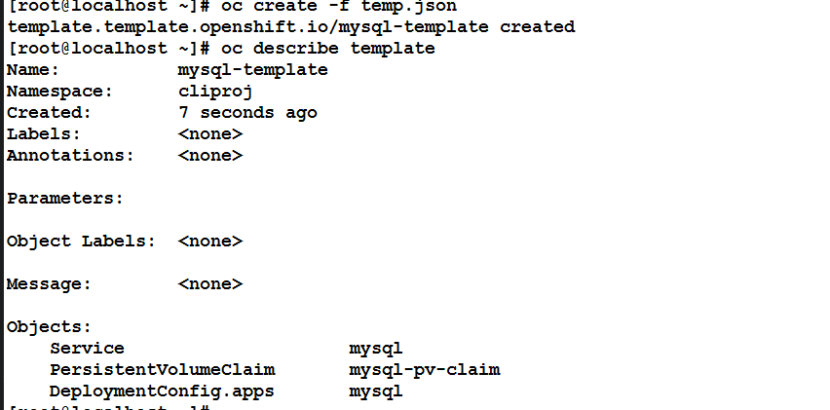
..

Slide 14
oc process
The oc process command in OpenShift is used to process a template and generate the resulting list of objects that would be created if the template were applied.
This command helps you see what resources will be created based on the template and the parameter values you provide.
oc process -f <template-file> [-p PARAMETER=VALUE]...
-f <template-file>: Specifies the path to the template file.
-p PARAMETER=VALUE: Allows you to set parameter values for the template. You can provide multiple -p flags to set multiple parameters.

Slide 15
..
let's say you have a template file named mysql-template.yaml and it contains some parameters like MYSQL_USER, MYSQL_PASSWORD, and MYSQL_DATABASE. You can process the template and see the resulting objects using the oc process command like this
oc process -f mysql-template.yaml -p MYSQL_USER=myuser -p MYSQL_PASSWORD=mypassword -p MYSQL_DATABASE=mydb

