Slide 1
Tekton

Slide 2
Definition
Tekton is a powerful and flexible open-source framework for creating CI/CD systems, allowing developers to build, test, and deploy across cloud providers and on-premise systems.
Tekton, an open source and cloud-native CI/CD tool that can be used to create different kinds of pipelines to automate, verify and deploy our applications in a Kubernetes cluster.

Slide 3
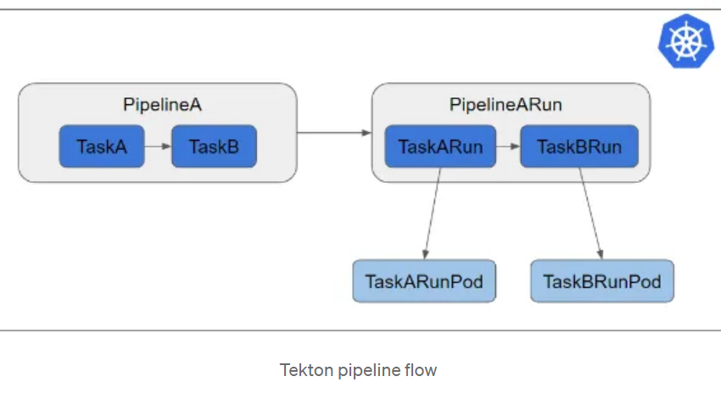
..

Slide 4
..
Pipeline-centric: The pipeline-centric nature of Tekton allows you to define and manage CI/CD pipelines with ease. Pipelines provide a clear structure for organizing and sequencing the steps involved in your software delivery process.
Kubernetes-native: Being built on Kubernetes, Tekton leverages the power and scalability of the Kubernetes ecosystem. It seamlessly integrates with Kubernetes clusters, enabling you to take advantage of container orchestration and management capabilities.

Slide 5
..
Declarative and version-controlled: Tekton’s declarative approach enables you to define pipelines and tasks using YAML files, making it easier to maintain and reproduce your CI/CD configurations. Additionally, version control support ensures that changes to your pipelines are tracked and managed effectively.
Reusable components: The ability to create and reuse tasks in Tekton greatly enhances efficiency and maintainability. By encapsulating specific actions or operations within tasks, you can build modular pipelines and promote code reuse across projects.

Slide 6
Tekton resources
These are Tekton’s custom resources:
Pipeline: Set of tasks, running sequentially and/or in parallel.
Task: A set of steps, such as cloning repo, running unit tests, building image and deploying image.
PipelineRun: The pipeline instance to run.
TaskRun: The task instance to run with specific input, output and/or execution parameters.

Slide 7
..
What is a Tekton Pipeline?
A Tekton pipeline is one of Tekton’s resources that allows us to build, test and deploy applications in a Kubernetes cluster on a cloud provider or on-premises.
Tekton uses Custom Resource Definitions (CRDs) to extend Kubernetes functionality and add additional features.

Slide 8
..
apiVersion: tekton.dev/v1beta1
kind: Task
metadata:
name: welcome
spec:
steps:
- name: echo
image: alpine
script: |
#!/bin/sh
echo "Welcome to tekton pipelines"

Slide 9
..
apiVersion: tekton.dev/v1beta1
kind: TaskRun
metadata:
name: welcome-task-run
spec:
taskRef:
name: welcome

Slide 10
pipeline
apiVersion: tekton.dev/v1beta1
kind: Pipeline
metadata:
name: demo-pipeline
spec:
params:
- name: username
type: string
tasks:
- name: welcome
taskRef:
name: welcome

Slide 11
Pipelinerun
apiVersion: tekton.dev/v1beta1
kind: PipelineRun
metadata:
name: demo-pipeline-run
spec:
pipelineRef:
name: demo-pipeline
params:
- name: username
value: "Tekton"

